Slide 1
ArgonCube Engineering Meeting
06/11/2021

Slide 2
Agenda
Module 0 Run 2
Module 0 Shipping Discussion
Round Table & AOB

Slide 3
Module 0 Shipping Discussion
Post Module 0 Run 2 we will need to package and ship Module 0 to FNAL
Focused on build & test
Determine the process for shipping
Two potential routes:
Ship fully assembled module
Disassemble and ship components

Slide 4
Pros & Cons
Fully Assembled Module
Pros:
Very little assembly work at FNAL
Single shipment to manage & track
Import/Export/Duty considerations (paperwork)
Less work required at Bern to disassemble
Opportunity to prototype transport/storage crate
Cons:
Need to design a crate with proper mitigations
Shipping options potentially more limited due to size of crate
Potential damage to module
Individual Components
Pros:
High confidence in survival
No need for crate design
Flexible shipping options
Cons:
Multiple shipments to manage & track
Import/Export/Duty consideration (paperwork)
More work at Bern to disassemble
More work at FNAL to re-assemble
Potential that some items could be lost if too many shipments

Slide 5
Fully-Assembled TPC Module – What would this look like?
Basic Shipping Requirements
Protective Crate + Pallet
Must adhere to import laws if applicable (pressure-treated wood)
Make pallet section robust, spacing of skids should accommodate pallet jacks/forklifts
Hinged window – allows US Customs to easily look inside without having to open the crate
Load Isolation
Must protect against shock loading or vibrations during shipment
Dust/Debris Mitigation
Wooden crates are not clean, must protect TPC from gathering contaminants
Humidity Mitigation
If unloaded on the US east coast during the summer it will likely be quite humid -> dessicant and some level of back-fill or purge
Shock logging
Preferably a quantity of 3 to capture XYZ accelerations during shipment -> if there is damage we can diagnose where/when it occured

Slide 6
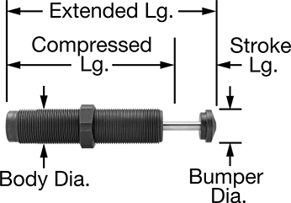
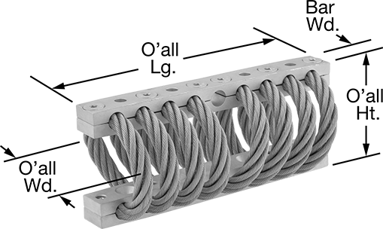
Crate Concept
External Frame (Al or SS) with Foam Padding to Cradle Module – Jay has looked a similar concept for the ND modules
Isolation Device:
Shock Absorbers
Module 0
Fasten External Frame to Aluminum or Steel Plate
Isolation Device:
Wire Ropes Isolators, Mount to Plate and to Pallet Base
Wooden Base with Skids for Pallet Jack or Forklift - make robust!!

Slide 7
Crate Concept
Crate Lid
Hinged Window
Module 0

Slide 8
Summary & Other Considerations
Robustness of internal Module 0 components is unclear → probability of damage is difficult to assess, but the consequence of damage is significant
This would dictate due diligence is required in any shipping crate design for a full module; the previous sketch should not be viewed as trivial design task…
May need a test shipment to complete the crate design
We know that components were safely shipped to Bern individually → successful assembly and testing of Module 0
What would be required to re-create this at FNAL? Does FNAL have the personnel to re-assemble a module? What would be expected of Consortium partners in terms of support?
What is the process we want for Modules 1-3?
If we intend to eventually ship fully assembled 2x2 modules we might as well start with Module 0 and discover any issues early
If we intend to ship components then we must firm-up assembly procedures, QAQC checks and coordinate potential labor needs from Consortium partners

Slide 9
AOB – CAD Integration – More details at upcoming Consortium Management Meeting
Identifying a need for ND-LAr Consortium to consolidate CAD systems and utilize *PLM as we approach PDR and subsequently Final Design
Near Site I&I is required to make “Rolling Releases” of the LBNL Windchill CAD model to Navisworks & EDMS (Windchill is a Product Lifecycle Management (*PLM) System)
Bi-Monthly release cadence
LBNL Windchill manages the official CAD model for the entire Near Site
Everything present in the cavern or surface building resides in the LBNL Windchill server, the official CAD for the ND-LAr TPC modules must also reside in the LBNL Windchill server -> these are released to EDMS via the “Rolling Releases”
Single source of truth
Other benefits
Version control & server back-up of all design iterations
Interface coordination easier with CAD PLM system
QAQC Documentation – attach QAQC documents to part/assembly files
Formal drawing check & release process watermarks and timestamps production drawings
Access to entire Near Site CAD model

