Slide 1
Tau CLFV at BESIII and SCTF
Xiaorong Zhou, Haiping Peng

Slide 2
Data Samples at BESIII
Until 2020
$N_{ττ}$ produced at BESIII is about 7$×{10}^{7}$ (including $ψ′$ decay), not enough for cLFV decays of tau
With 10Billion Jpsi at BESIII, there can be anther way for cLFV searches via with high precision:
$$J/ψ→eτ/eμ$$
About 25 fb⁻¹

Slide 3
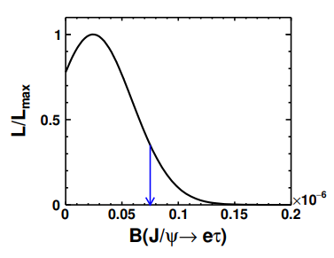
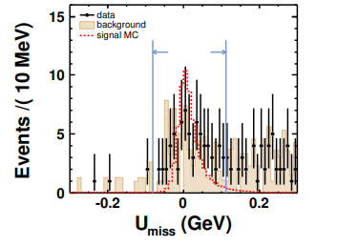
LFV decay of $J/ψ→eτ$ at BESIII
Reconstructed channel:
$J/ψ→e^{±}τ^{∓}$ with $τ^{∓}→π^{∓}π^{0}υ_{τ}$
Dominant background:
Radiative Bhabha; J/$ψ→π^{+}π^{−}π^{0}$
Observable: $U_{miss}=E_{miss}−c|{\vec{p}}_{miss}|$, select efficiency 20%
arXiv:2103.11540
${ 𝓑}_{UL}^{90}(J/ψ→eτ$) )$<{7.5×10}^{−8}$

Slide 4
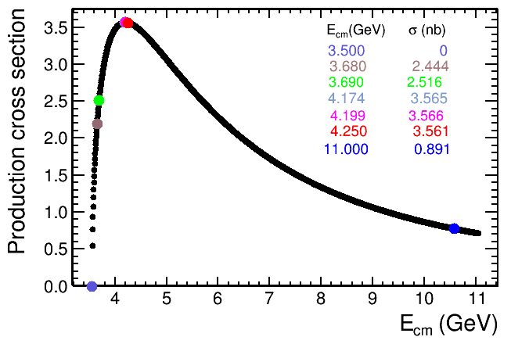
Studies of $τ$ at STCF
Proposed STCF in China
Peaking luminosity (0.5-1)$×$10³⁵ cm⁻²s⁻¹ at 4 GeV
Energy range E_{cm} = 2-7 GeV
Potential to increase luminosity and realize beam polarization
Peaking cross section locates in 4-5 GeV
At 4.26 GeV, number of tau pairs per year:
$e^{+}e^{−}→γτ^{+}τ^{−}$ is not the main background
Improved $π/μ$ misid rate at STCF
$N_{ττ}\sim$ 1.0 ab⁻¹ ×3.5 nb = 3.5$×{10}^{9}$

Slide 5
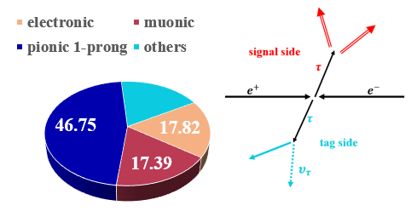
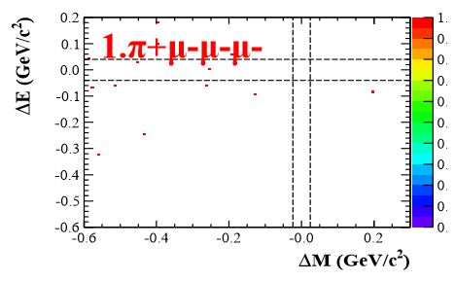
LFV decay of $τ→lll$ at STCF
Signal side: $τ→3leptons$
Tag side: $τ→eυ\overline{υ}, μυ\overline{υ} , πυ+nπ^{0}$ ($ℬr=8$2%)
Almost background free, the sensitivity :$𝓑_{UL}^{90} \left(τ→μμμ\right)\sim 1/𝓛$
Best efficiency ($τ→μμμ$ ): 22.5% (including tag branching fraction)
Background
STCF with 1ab⁻¹:
$$𝓑_{UL}^{90}\left(τ→μμμ\right)<\frac{N_{UL}^{90}}{2εN_{ττ}}\sim 1.5×{10}^{−9}$$

Slide 6
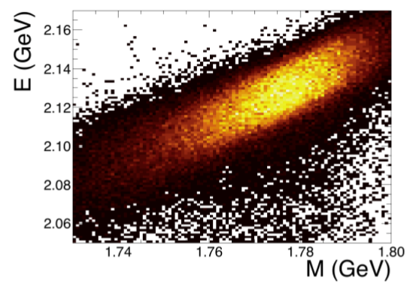
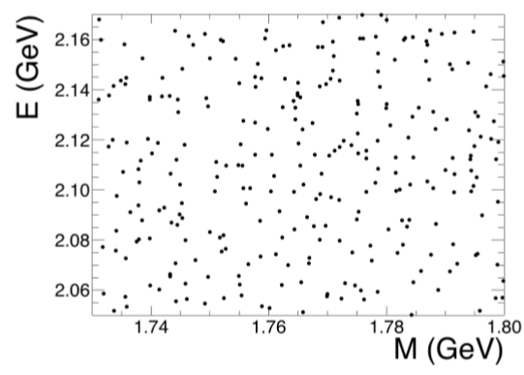
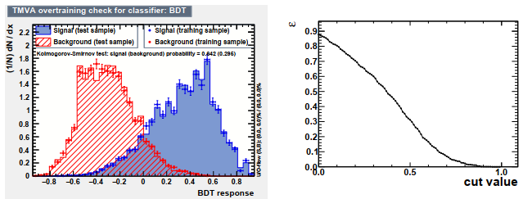
LFV decay of $τ→γμ$ at STCF
mc
Inclusive mc
$$μ eff. at 1 GeV$$
STCF with 1ab⁻¹:
$$𝓑_{UL}^{90}\left(τ→γμ\right)<\frac{N_{UL}^{90}}{2εN_{ττ}}\sim 1.2×{10}^{−8}$$

Slide 7
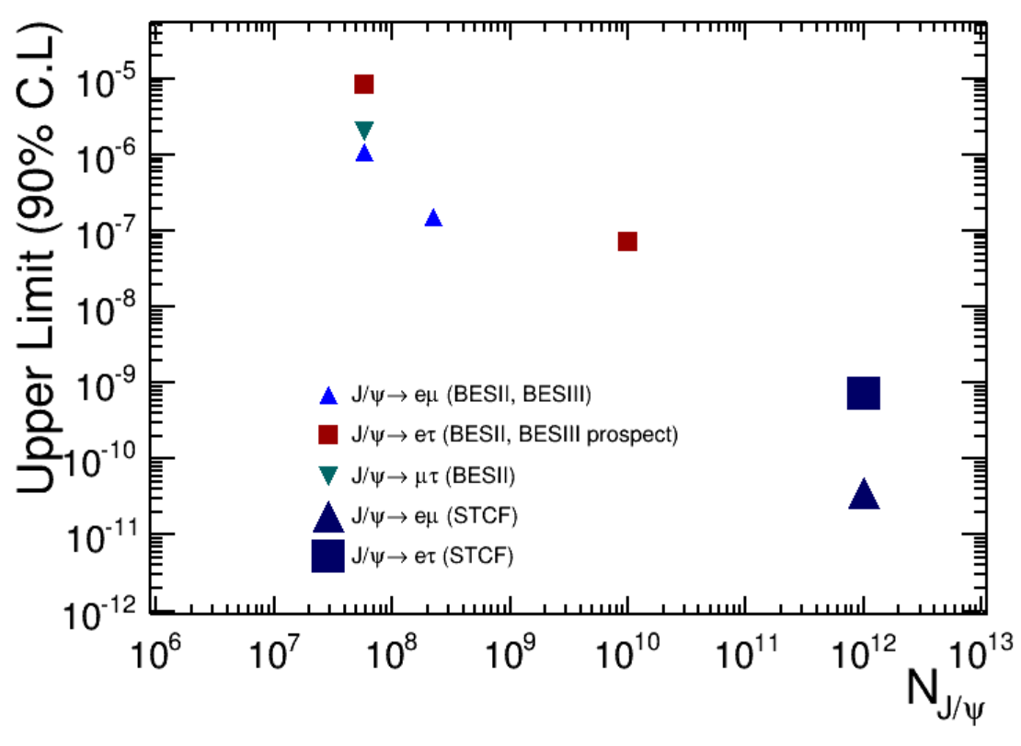
LFV decay of $J/ψ→eτ$ at STCF
The cLFV decays of vector mesons $V→l_{i}l_{j}$ are also predicted in various of extension models of SM:
${ ℬ}_{UL}^{90}(J/ψ→eμ$)$<{10}^{−13}$
${ ℬ}_{UL}^{90}(J/ψ→e(μ)τ$) )$<{10}^{−9}$
At STCF, 1 trillion $J/ψ$ can be obtained per year, taken efficiency from BESIII, the upper limit can be predicted to be:
${ ℬ}_{UL}^{90}(J/ψ→eμ$)$<{3.6×10}^{−11}$
${ ℬ}_{UL}^{90}(J/ψ→eτ$) )$<{7.1×10}^{−10}$
The ${ 𝓑}_{UL}^{90}(J/ψ→eτ$) ) can be further optimized with better PID.

