Slide 1
Superconducting Quantum Materials and Systems Center
Anna Grassellino, SQMS Center Director
Scientist Retreat @FNAL
Friday June 4th, 2021

Slide 2
Fermilab efforts in Quantum
Why Quantum research at Fermilab?
Goal: Offer Fermilab technological strengths developed for solving HEP problems to the field of QIS, and in turn utilizing QIS advancements to broaden the toolset to enable particle physics discovery
R&D in the areas of quantum computing, sensing, communications via:
  Leading and hosting one of the five National Quantum Information Science Research Centers – Superconducting Quantum Materials and Systems Center (SQMS)

Slide 3

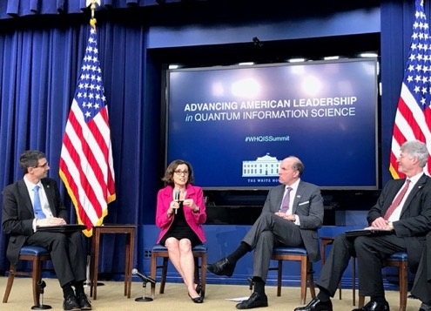

U.S. National Quantum Initiative
In 2019 Congress mandated the creation of five Dept. of Energy national quantum centers
$625M over five years to develop quantum computers, quantum sensors, and quantum communications
Goal is transformational advances in quantum science and technology
Create a quantum economy

Slide 4
August 2020: Fermilab will lead a DOE National Quantum Center
“With the Superconducting Quantum Materials and Systems Center (SQMS), we propose to bring the power of DOE laboratories, together with industry, academia and other federal entities, to “achieve transformational advances in quantum technologies for computing and sensing”
“We have the ambitious goal of building the first quantum computer at Fermilab”

Slide 5
More than 200 collaborators!

Slide 6
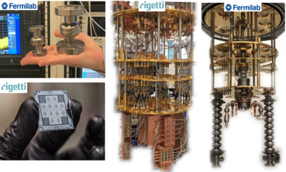
Quantum Information Science: a multidisciplinary endeavor
Industry use cases
Radio frequency superconductivity
Condensed Matter Physics
Particle Physics
Material Science
Computational Science
Cryogenics
Scale up and integration
Controls and electronics
Superconducting qubits

Slide 7
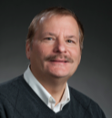
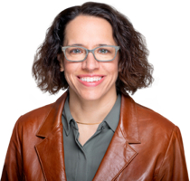
SQMS Top Leadership Team
Dr. Anna Grassellino (FNAL) Center Director
Prof. James Sauls (Northwestern University) Center Deputy Director
Dr. Matt Reagor (Rigetti)
Chief Technology Officer
Dr Eleanor Rieffel (NASA Ames)
Chief Research Scientist
Dr Matt Kramer (Ames Lab)
Chief Engineer
Rich Stanek (FNAL)
Interim COO
Dr Roni Harnik (FNAL)
Science Thrust Leader
Dr Alexander Romanenko (FNAL) Technology Thrust Leader
Mandy Birch (Rigetti)
Ecosystem Leader

Slide 8
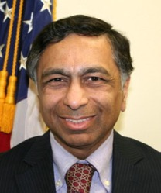
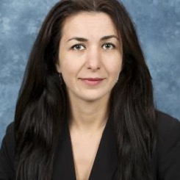
SQMS Direct DOE Program Managers
Dr. Altaf Carim (DOE HEP)
Dr. Athena Safa Sefat (DOE BES)

Slide 9
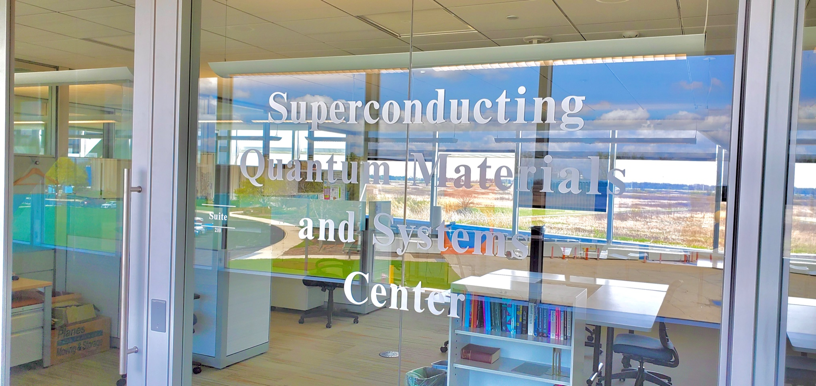
New SQMS Division at Fermilab reporting to Fermilab Director

Slide 10
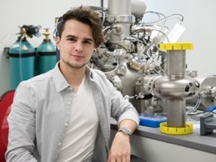
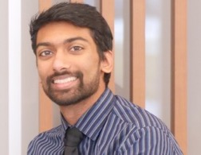
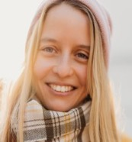
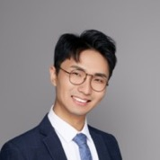
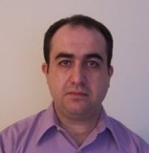
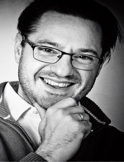
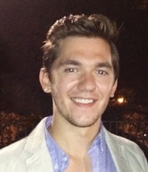
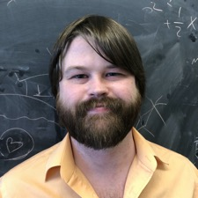
SQMS new scientific hires at Fermilab (new SQMS division, two theory div)
Experts from world top groups in quantum materials, devices, quantum computing and sensing
Daniel Bafia (from FNAL)
Postdoc
Akshay Murthy (from NU)
Postdoc
Yulia Krasnikova
(from Kapitza Institute)
Associate Scientist
Ziwen Huang (from NU)
Postdoc
Shaojiang Zhu
(from U Wisconsin Madison)
Associate Scientist
Arpita Mitra (from Penn State) Postdoc
Mustafa Bal
(from NIST)
Associate Scientist
Ivan Nekrashevich
(from Los Alamos)
Associate Scientist
(offer pending)
Changqing Wang (from Washington University St Louis)
Postdoc
Raphael Cervantes (from U of Washington)
Postdoc
Nicholas Bornman (from U of Witwatersrand, South Africa) Postdoc
Bianca Giaccone (from FNAL) Associate Scientist
David Van Zanten
(from Niels Bohr Institute, Copenhagen), Associate Scientist
Xinyuan You (from NU)
Postdoc
Asher Berlin (from NYU, SLAC)
Associate Scientist
Hank Lamm (from FNAL)
Associate Scientist
{PPD – Theory, Supported by SQMS at 50% each}

Slide 11
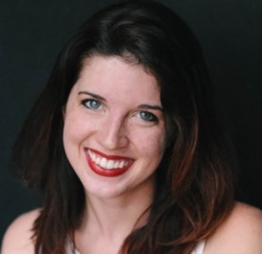
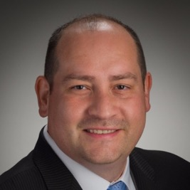
SQMS Center/Division management hires successfully completed
SQMS Center COO
Stefano Lami
Previously Science Counselor at Embassy of Italy, Washington DC
SQMS Center Communication Manager
Hannah Adams
Previously Communication Specialist at Goodyear Rubber and Tire Company
SQMS Center Senior Financial Manager
Gilbert Herrera
Previously Financial Manager at Coca Cola
SQMS Center Senior
Administrative Assistant
Laura Siarkevich
Previously Administrative Assistant for HL-LHC at FNAL
Overall, ~1/3 of the SQMS hires are women or URMs

Slide 12
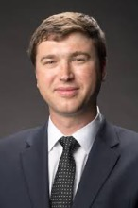
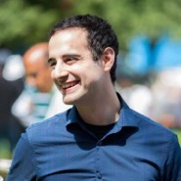
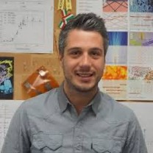
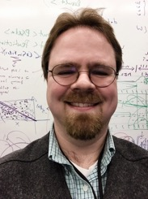
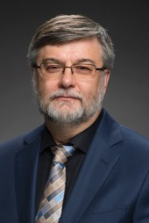
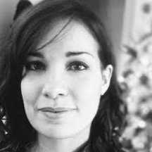
Some of the SQMS leaders@ Fermilab from across the lab
Sam Posen, SQMS Quantum Physics/Sensing Focus Area Lead and Department Head
Mattia Checchin, SQMS quantum materials and qubits department deputy head
Roni Harnik, SQMS Science Thrust Leader
Anna Grassellino
SQMS Center Director,
Division Head
Rich Stanek, SQMS Center interim COO
Alexander Romanenko,
SQMS Technology Thrust Leader
Roman Pilipenko
Quantum Testbeds, instrumentation, controls development group leader
Slava Yakovlev,
Quantum Microwave
Systems Department Head
Silvia Zorzetti
Quantum Computing Co-Design Department Deputy Head, Workforce Lead
Gabe Perdue Systems Architecture and algorithms group leader
Matt Hollister
Ultra low T cryogenics Department Head
Sergey Belomestnykh
Devices Integration
Group Leader
For Center leadership teams please visit: https://sqms.fnal.gov/people/leadership-team/

Slide 13
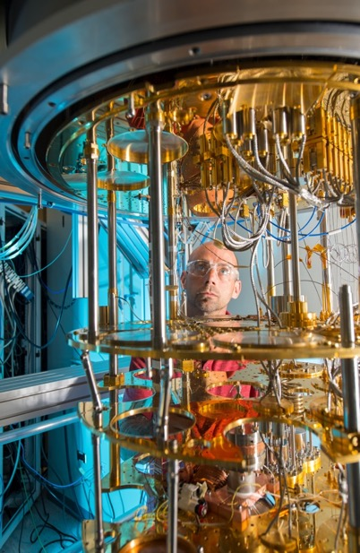
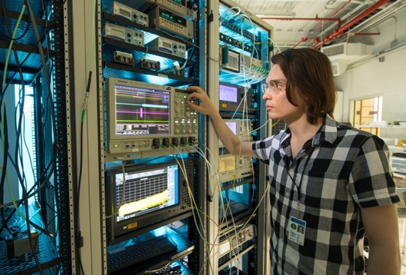
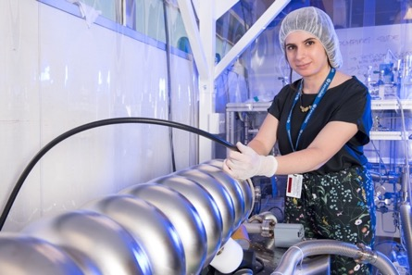
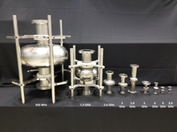
SQMS strengths at Fermilab
SQMS builds upon several Fermilab unique strengths, among which decades of investments in SRF technology and cryogenics, the newer superconducting quantum labs, and particle physics as a science driver and end user of QIS technologies

Slide 14
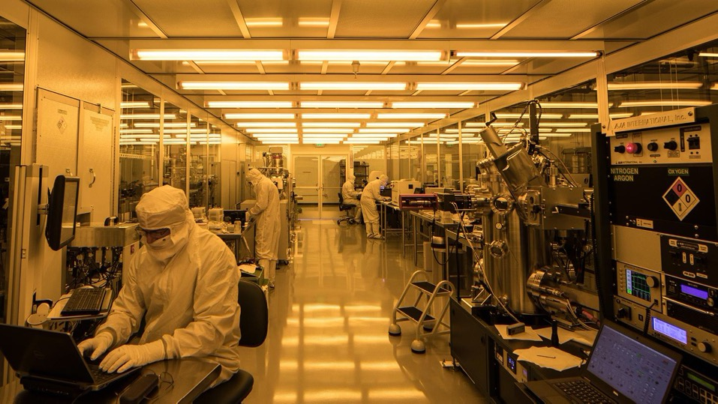
SQMS leverages unique national and international facilities
Rigetti superconducting fab facilities in Fremont, California
INFN CUORE underground cryostat at Gran Sasso, Italy
From unique superconducting 2D and 3D foundries, to material science and superconducting characterization tools, to above and underground milliKelvin testbeds, SQMS brings together the key facilities and world class experts to make transformational advances in quantum information science

Slide 15
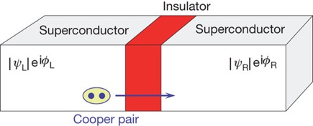
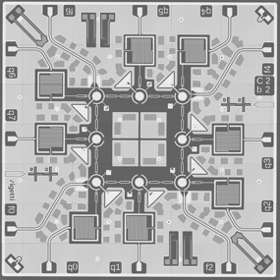
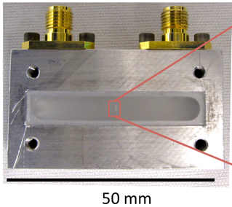
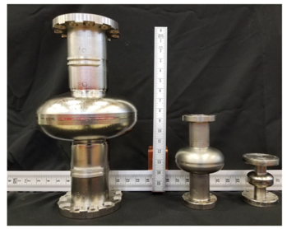
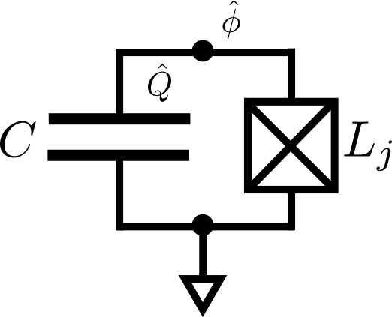
Pushing the coherence of Superconducting Qubits
+
2. Resonators (cavities)
1. LC circuit with Josephson junction
2D
3D
Rigetti 8-qubit processor
3D transmon
Fermilab SRF resonators
Q ~ 10⁵
T_{coherence}~ 0.000001 s
Q ~ 10⁸
T_{coherence}~ 0.001 s
Q > 10¹⁰
T_{coherence} > 1 s
“Transmon” qubits
J. Koch et al, Phys. Rev. A 76, 042319 (2007)
M. Reagor et al, Science Advances, Vol.4, no. 2, (2018)
H. Paik et al, Phys. Rev. Lett. 107, 240501 (2011)
A. Romanenko et al, Phys. Rev. Appl. 13, 134052 (2020)
SQMS, by improving the coherence of both key components, and of the system combined, will bring transformational advances in the fundamental QIS building blocks, leading to quantum computing scalability and quantum sensing potential for discovery

Slide 16

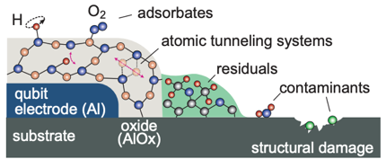
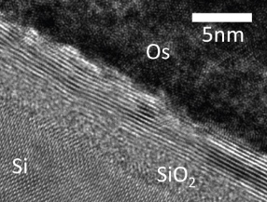
Material science studies of Rigetti’s 2D qubits at the forefront of coherence
Qubits and processors fabrication
Material Science studies to understand and mitigate qubit decoherence

Slide 17
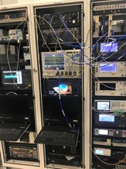


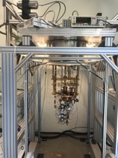


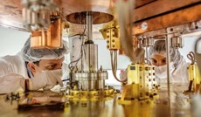
First Systematic Cross-institutional benchmarking study of qubit performance
Fermilab
Rigetti
silicon
INFN/Gran Sasso
NIST

Slide 18
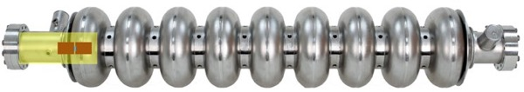

SQMS 3D approach – unique benefits of the world’s best coherence
Novel QPU architectures
Long coherence allows going from qubit to “qudit” approach
Scalability
> 100 qubits with just few input/output lines
Science
Long coherence and all-to-all connectivity offer new computation/simulation capabilities
Probing microscopic to macroscopic boundary
Searching for dark sector particles
ONE nine cell SRF cavity + ONE transmon =
SQMS 100+ qubits processor

Slide 19
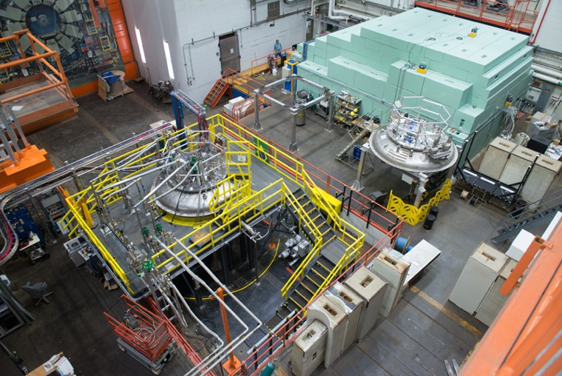
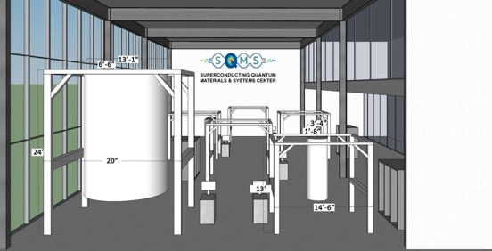
Scale up, integration capabilities and plans for the first quantum computer at Fermilab
We plan to build the largest dilution fridge ever constructed, to host hundreds of qubits, to be hosted in the IARC building

Slide 20
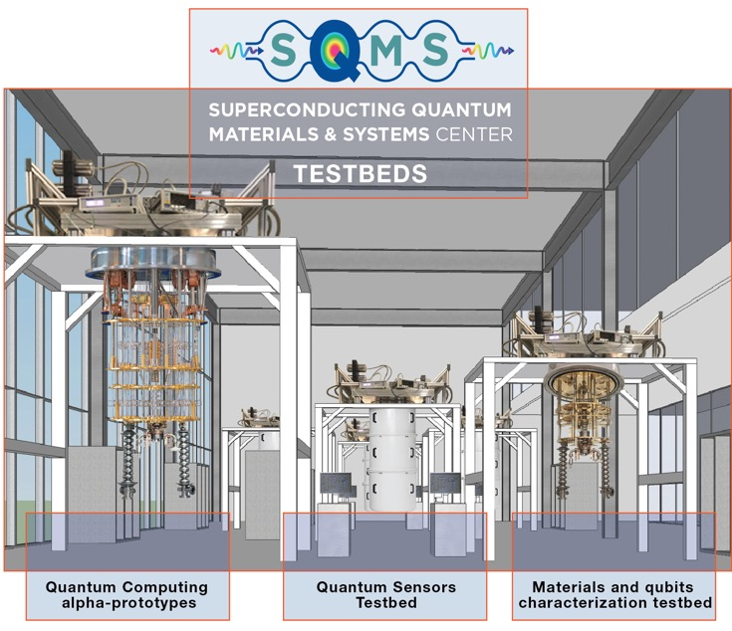
SQMS five years vision
Developing and delivering unique platforms/facilities for QIS fabrication, computing and sensing which will be available to boost the national QIS ecosystem:
Qubits measurements in the most sensitive environments
Platforms enabling new particle searches/sensing experiments
Computing/simulations on the FNAL 3D-based quantum computer

Slide 21
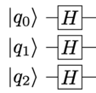

SQMS Quantum Computing Roadmap
Quantum algorithms:
Superconducting Qubits
depth (ℓ)
Classical
Classically Intractable
Quantum Advantage?
Fault Tolerant Quantum Computers
SQMS Consequences:
width (N)
10⁵
SQMS-3D
Coherence Limit (# Gates)
SQMS-2D
10⁴
3D
10x Materials
SQMS
10 yrs.
2D
Ultimate limits to depth:
SQMS
10³
Leading US testbeds:
max(ℓ) ∝ T₁ / t_{gate}
t_{gate} = [20-1000] ns
max(N*ℓ) ~ 10⁴
5 yrs.
Google Sycamore
For SC qubits, typical:
IBM Hexagonal
10²
10x Devices
Rigetti Aspen
10
10²
10³
10⁴
Yale Single-mode
System Size (# Qubits)
UChicago Multi-mode
6/24/20

Slide 22
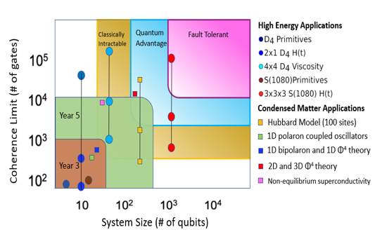
Science and Discovery with SQMS
We are excited to put SQMS quantum computer to work for science!
High connectivity is well-suited to simulate Quantum Field Theories.
Ladders of simulations (progression of toy-models) aimed towards ambitious science goals.
HEP:
QCD dynamics: least understood parts of LHC collisions and early Universe (Hadronization, viscosity of gluon plasma)
Condensed matter:
Many body states with high entanglement (aided by connectivity), many body localization. polaron system dynamics.
6/24/20
Notes:
We are very excited to put SQMS technology to work for science.
One the computing side - the SQMS 3D will provide a highly connected quit system, (you will hear more about this from Alex). This connectivity is particularly well suited to simulating quantum field theories in real time. QFT’s are the working horse, both in high energy physics and condensed matter theory.
In the bottom right we see the same plane that Matt described, now charted with benchmarks of simulation, going from simple toy models to more complex theories. The ambitious science goals, shedding light on the least understood aspects of LHC collisions, or exploring many-body localization provide science drivers into the long term.

Slide 23
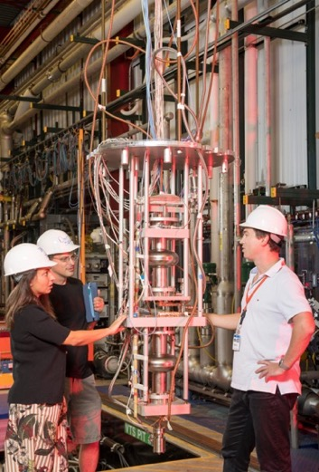
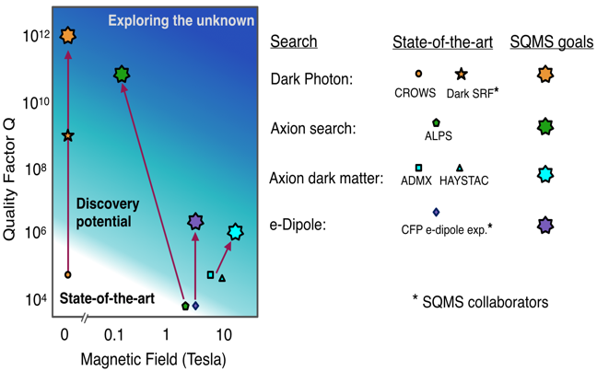
Science and Discovery with SQMS Technology - Sensing
We are excited to use SQMS technology for direct exploration:
  Are there new long range forces?
  What is the Dark Matter (DM)?
  Can we probe single electrons more precisely?
High coherence also allows to pick up fainter signals, search for elusive particles.
Orders of magnitude in sensitivity to new physics!
Axion DM
e.g. Axion DM Search -
High Q in high B field (FNAL+INFN)
Notes:
In sensing, we plan to put SQMS technology to answer some fundamental question:
Are there new long range forces in Nature?
What is the Dark matter that holds our galaxy?
We have the capability to develop new unique ways to attack these problems
In the figure on the top right we show a similar chart for the searches. The y axis is the same, quality factor, or coherence time. we replaced the x axis with the magnetic field, since several of our science goal require magnetic fields. The path on the left, at zero magnetic field is dark SRF, which Anna showed. this is low hanging fruit. The paths on the right include searches for axions and require R&D. All SQRMS goals represent orders of magnitude improvement of state of the art, enabling exploration of unknown physics.

Slide 24
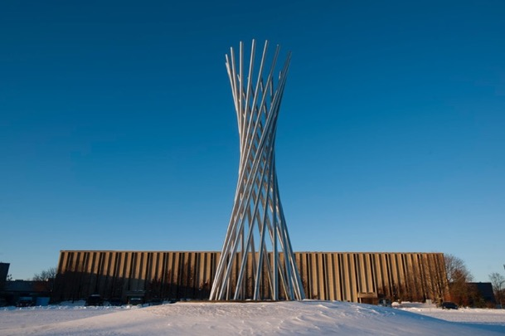
Conclusions
The new SQMS Center is a unique collaboration gathering multidisciplinary top talent and facilities towards very ambitious quantum computing and sensing goals
We will develop new tools for particle physics discovery
We will have a very focused mission: building together something revolutionary

Slide 25
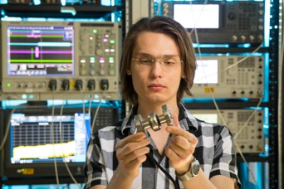
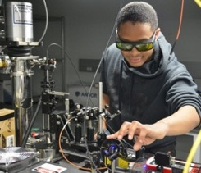

SQMS Center Spotlight on Workforce Development Progress
Progress/Achievement in QIS Ecosystem Stewardship
  The SQMS summer undergrad internship program has been launched in April 2021
Significance and Impact
  The new SQMS undergraduate summer internship is one of the key component of our workforce development program, aiming at attracting and training the new generation of diverse quantum workforce
Details
SQMS Undergraduate internship
  Applications currently open: https://internships.fnal.gov/sqms-quantum-undergraduate-internship/
  Program dates: May 31 - August 31, 2021
  10 undergraduate students with co-supervisors from two different SQMS partner institutions, to boost inter-center collaboration
  The students will spend periods of research at FNAL and other SQMS partner institutions, based on the task assignment
  Program advertised via FNAL Quantum Webinar Series to reach candidates from the National Society of Black Physicists, the National GEM Consortium, and HBCUs
Training a new generation of quantum diverse talent. Pictured students and fellows are involved in SQMS work at NU and FNAL
Notes:
Notes: Include 200 word highlight summary….

Slide 26
SQMS Center Spotlight on Workforce Development Progress
Progress/Achievement in QIS Ecosystem Stewardship
  The SQMS Parker Postdoctoral Fellowship has been launched in April 2021
Significance and Impact
  The new SQMS Parker Postdoctoral Fellowship is one of the key components of our workforce development program, aiming at attracting and training the new generation of diverse quantum workforce
Details
SQMS Parker Fellowship
  Program details available at:
  https://www.fnal.gov/pub/forphysicists/fellowships/carolyn_parker/index.html
  Prioritizes the representation and inclusion of historically and contemporarily minoritized individuals underrepresented in STEM
  One Fellowship will be awarded annually, 3 years postdoctoral appointment
  Applications will be open in May
  A center-wide committee has been established
  To enrich the research experience and enhance scientific collaboration the selected Fellow will spend periods of time conducting research with SQMS partner institutions and organizations
Caption: Carolyn Beatrice Parker is the first African-American woman known to have earned a postgraduate degree in physics.
Notes:
Notes: Include 200 word highlight summary….

Slide 27
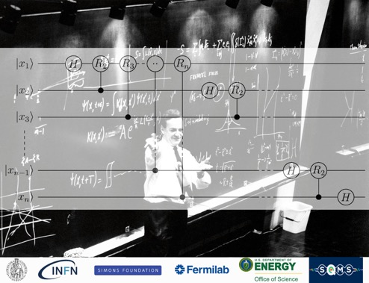
SQMS Center Spotlight on Workforce Development Progress
Progress/Achievement in QIS Ecosystem Stewardship
  The Quantum Summer School has been launched – SQMS in collaboration with the INFN Galileo Galilei Institute in Florence, Italy
Significance and Impact
  The GGI-SQMS summer school is one of the key components of our workforce development program, aiming at attracting and training the new generation of diverse quantum workforce
Details
GGI-SQMS Summer school: https://www.ggi.infn.it/showevent.pl?id=402
The program includes basic concepts in circuit quantum electrodynamics, quantum controls and metrology, along with quantum sensing at the precision frontier.
Applications currently open, program dates: Jun 21 – Jul 02, 2021
World expert in quantum as lecturers: Alexandre Blais, Caterina Braggio, Elisa Ercolessi, Peter Graham, Jens Koch, Hanhee Paik,
SQMS Cross-Center organizing committee: Caterina Braggio, Laura Cardani, Roni Harnik, Yonatan Kahn, Raffaele Tripiccione, Paola Verrucchi, Silvia Zorzetti
Webpage of the GGI summer school on quantum in collaboration with SQMS
Notes:
Notes: Include 200 word highlight summary….

