Slide 1
Updates from the Detector Working Group
J. Estrada, A. Fava, Z. Gecse, V. Rusu
All-Scientist Quarterly Meeting
June 4, 2021

Slide 2
Introduction
Activities of the Detectors for Science working group slowed down since Snowmass process was paused. No meetings in 2021.
Sensible progress in R&D in all frontiers, both on existing efforts and on new ideas. This is the main focus of this presentation.
Support mainly from LDRD’s, KA25 funds (New Initiatives) and some from Early Career Awards. Continuing this support, along with Laboratory commitment to invest in the future, is key for success!
Most of these efforts are well integrated with the Snowmass process, i.e. submitted LoI
Plan of the working group is to call for one big meeting of the detectors community in the Summer 2021, and start rebuilding momentum from there.

Slide 3
Energy frontier

Slide 4
Fermilab one of world’s largest producers of scintillator. Lab 5 extrusion past/present fabrication history
FNAL experiments:
MINOS (supervision & QC)
MINERvA
Mu2e CRV – 2018
LDMX – 2021
CMS – 2021
EGP Egypt pyramids – 2021
Large projects:
K2K (Supervision & QC)
T2K: P0D, ECal, INGRID
DoubleCHOOZ
Pierre Auger: CNEA
Pierre Auger: KIT 2015-21
ICECUBE
INO – CMVD - 2019
Small projects:
CANFRANC – Spain
INFN: Bologna, Brescia, Gran Sasso, Napoli, Padova
Inst. Phys. Globe - France
NYU – Abu Dhabi
Tel Aviv University
UIS – Colombia
Univ. Liverpool
IDEON – Canada – 2021
Chichen Itza Tomography – 2021
SNOLAB –2021
NRL – 2021
DOE complex:
ANL: STAR (Supervision & QC)
JLAB: CLAS, CDet
LANL

Slide 5
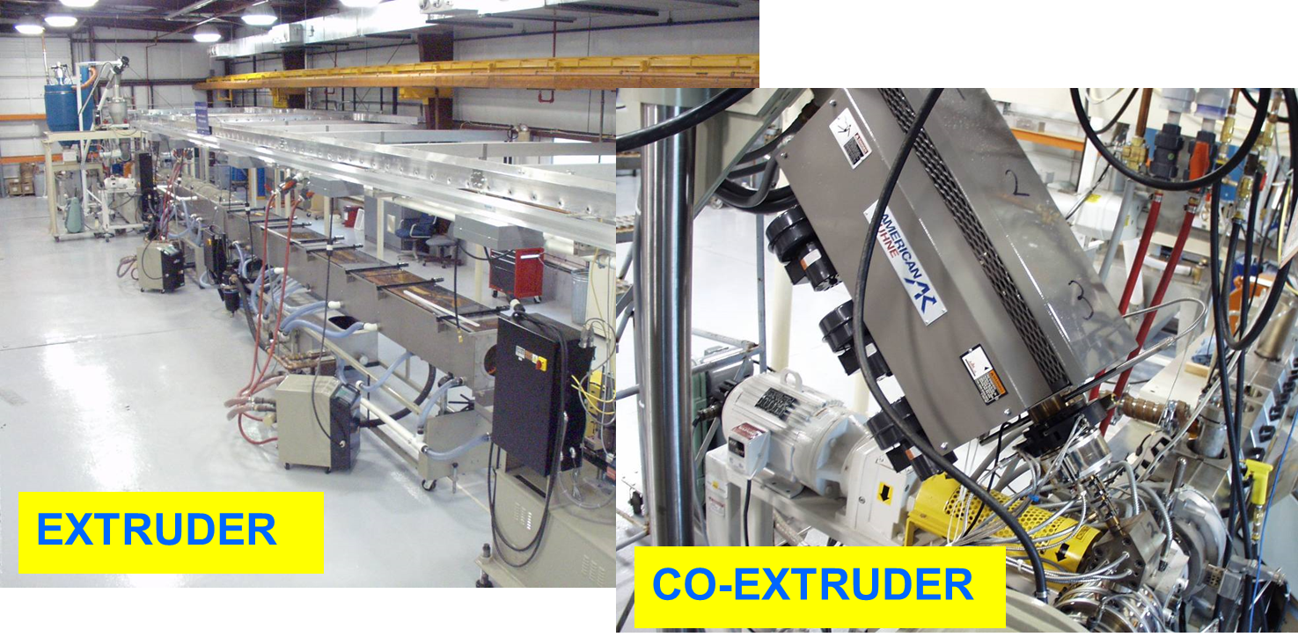
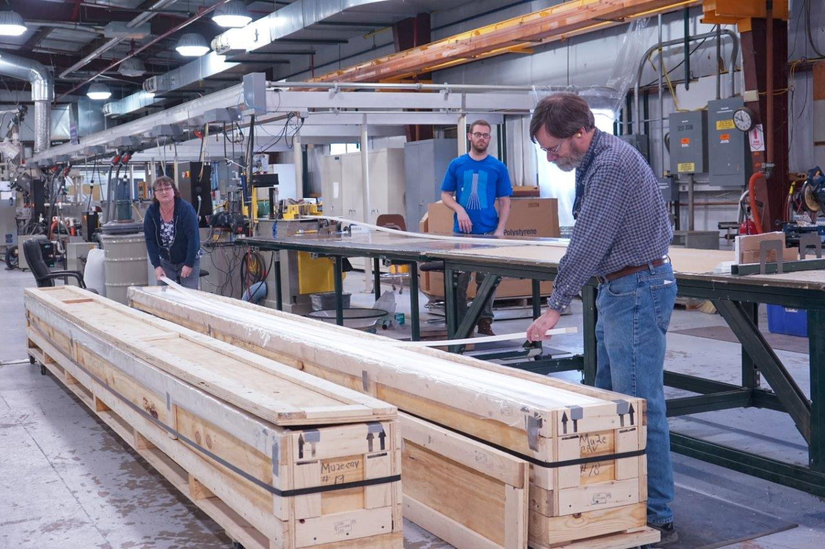
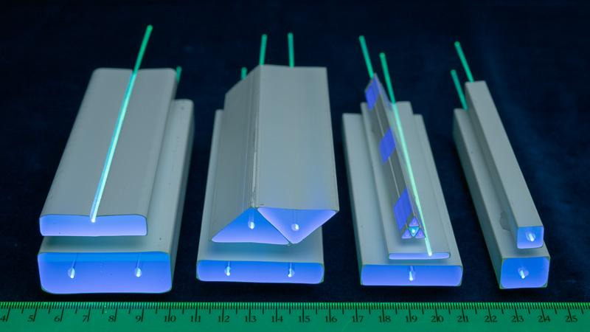
Fermilab extrusion facility NICADD at Lab 5

Slide 6
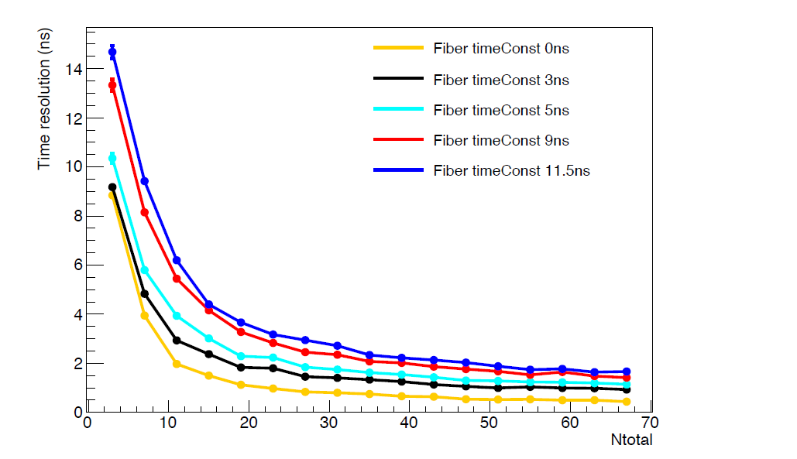
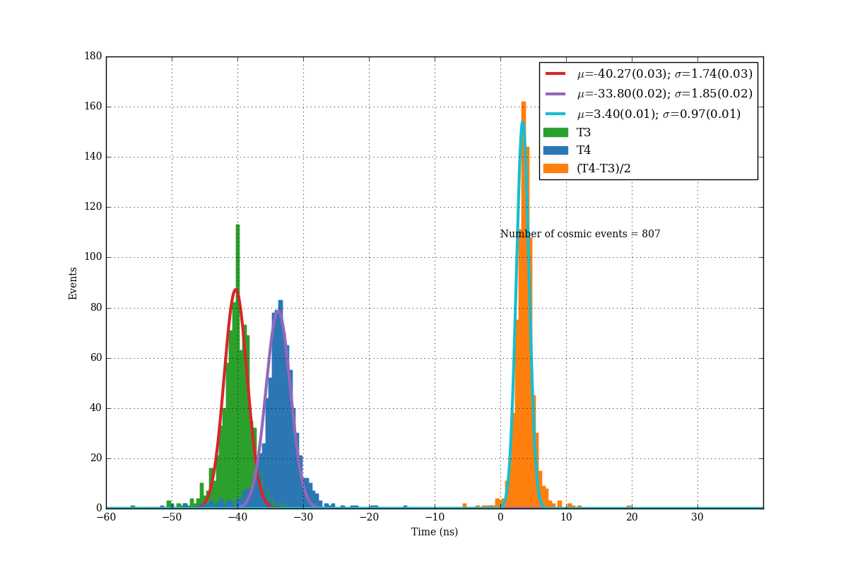
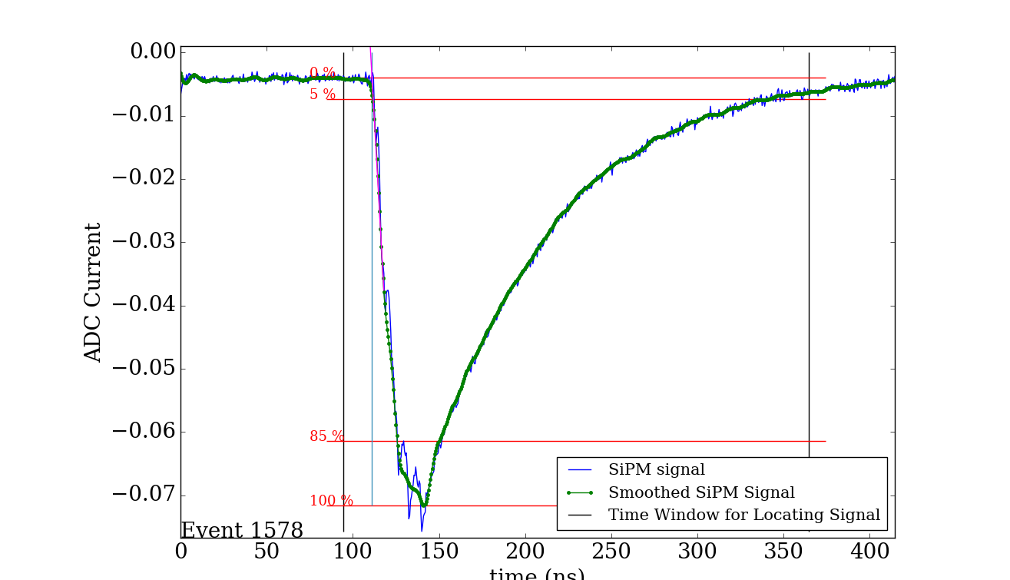
R&D to improve light yield and timing of extrusion/fiber/SIPM Application to MATHUSLA
MATHUSLA baseline design extruded scintillator.
Needs 1000 metric tons of scintillator!!
Design requirement: <1ns timing measurement for position of particle along extrusion. (T1-T2)/2
Studies to understand factors for improvement of time resolution.
Light yield
WLS decay time constant
Signal smoothing/shaping
Edge determination/discrimination
GEANT optics simulation of system. Example: Vary WLS decay time constant.
Time resolution vs total light yield
Cosmic ray studies. Have achieved <1ns rms on timing.

Slide 7
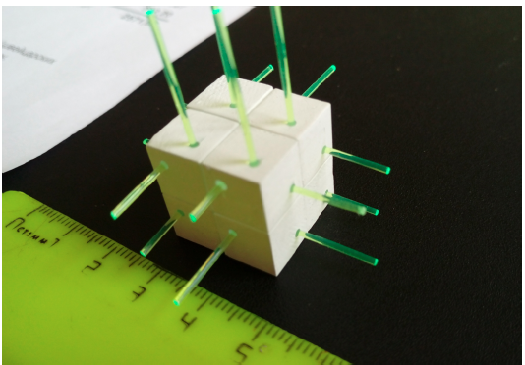
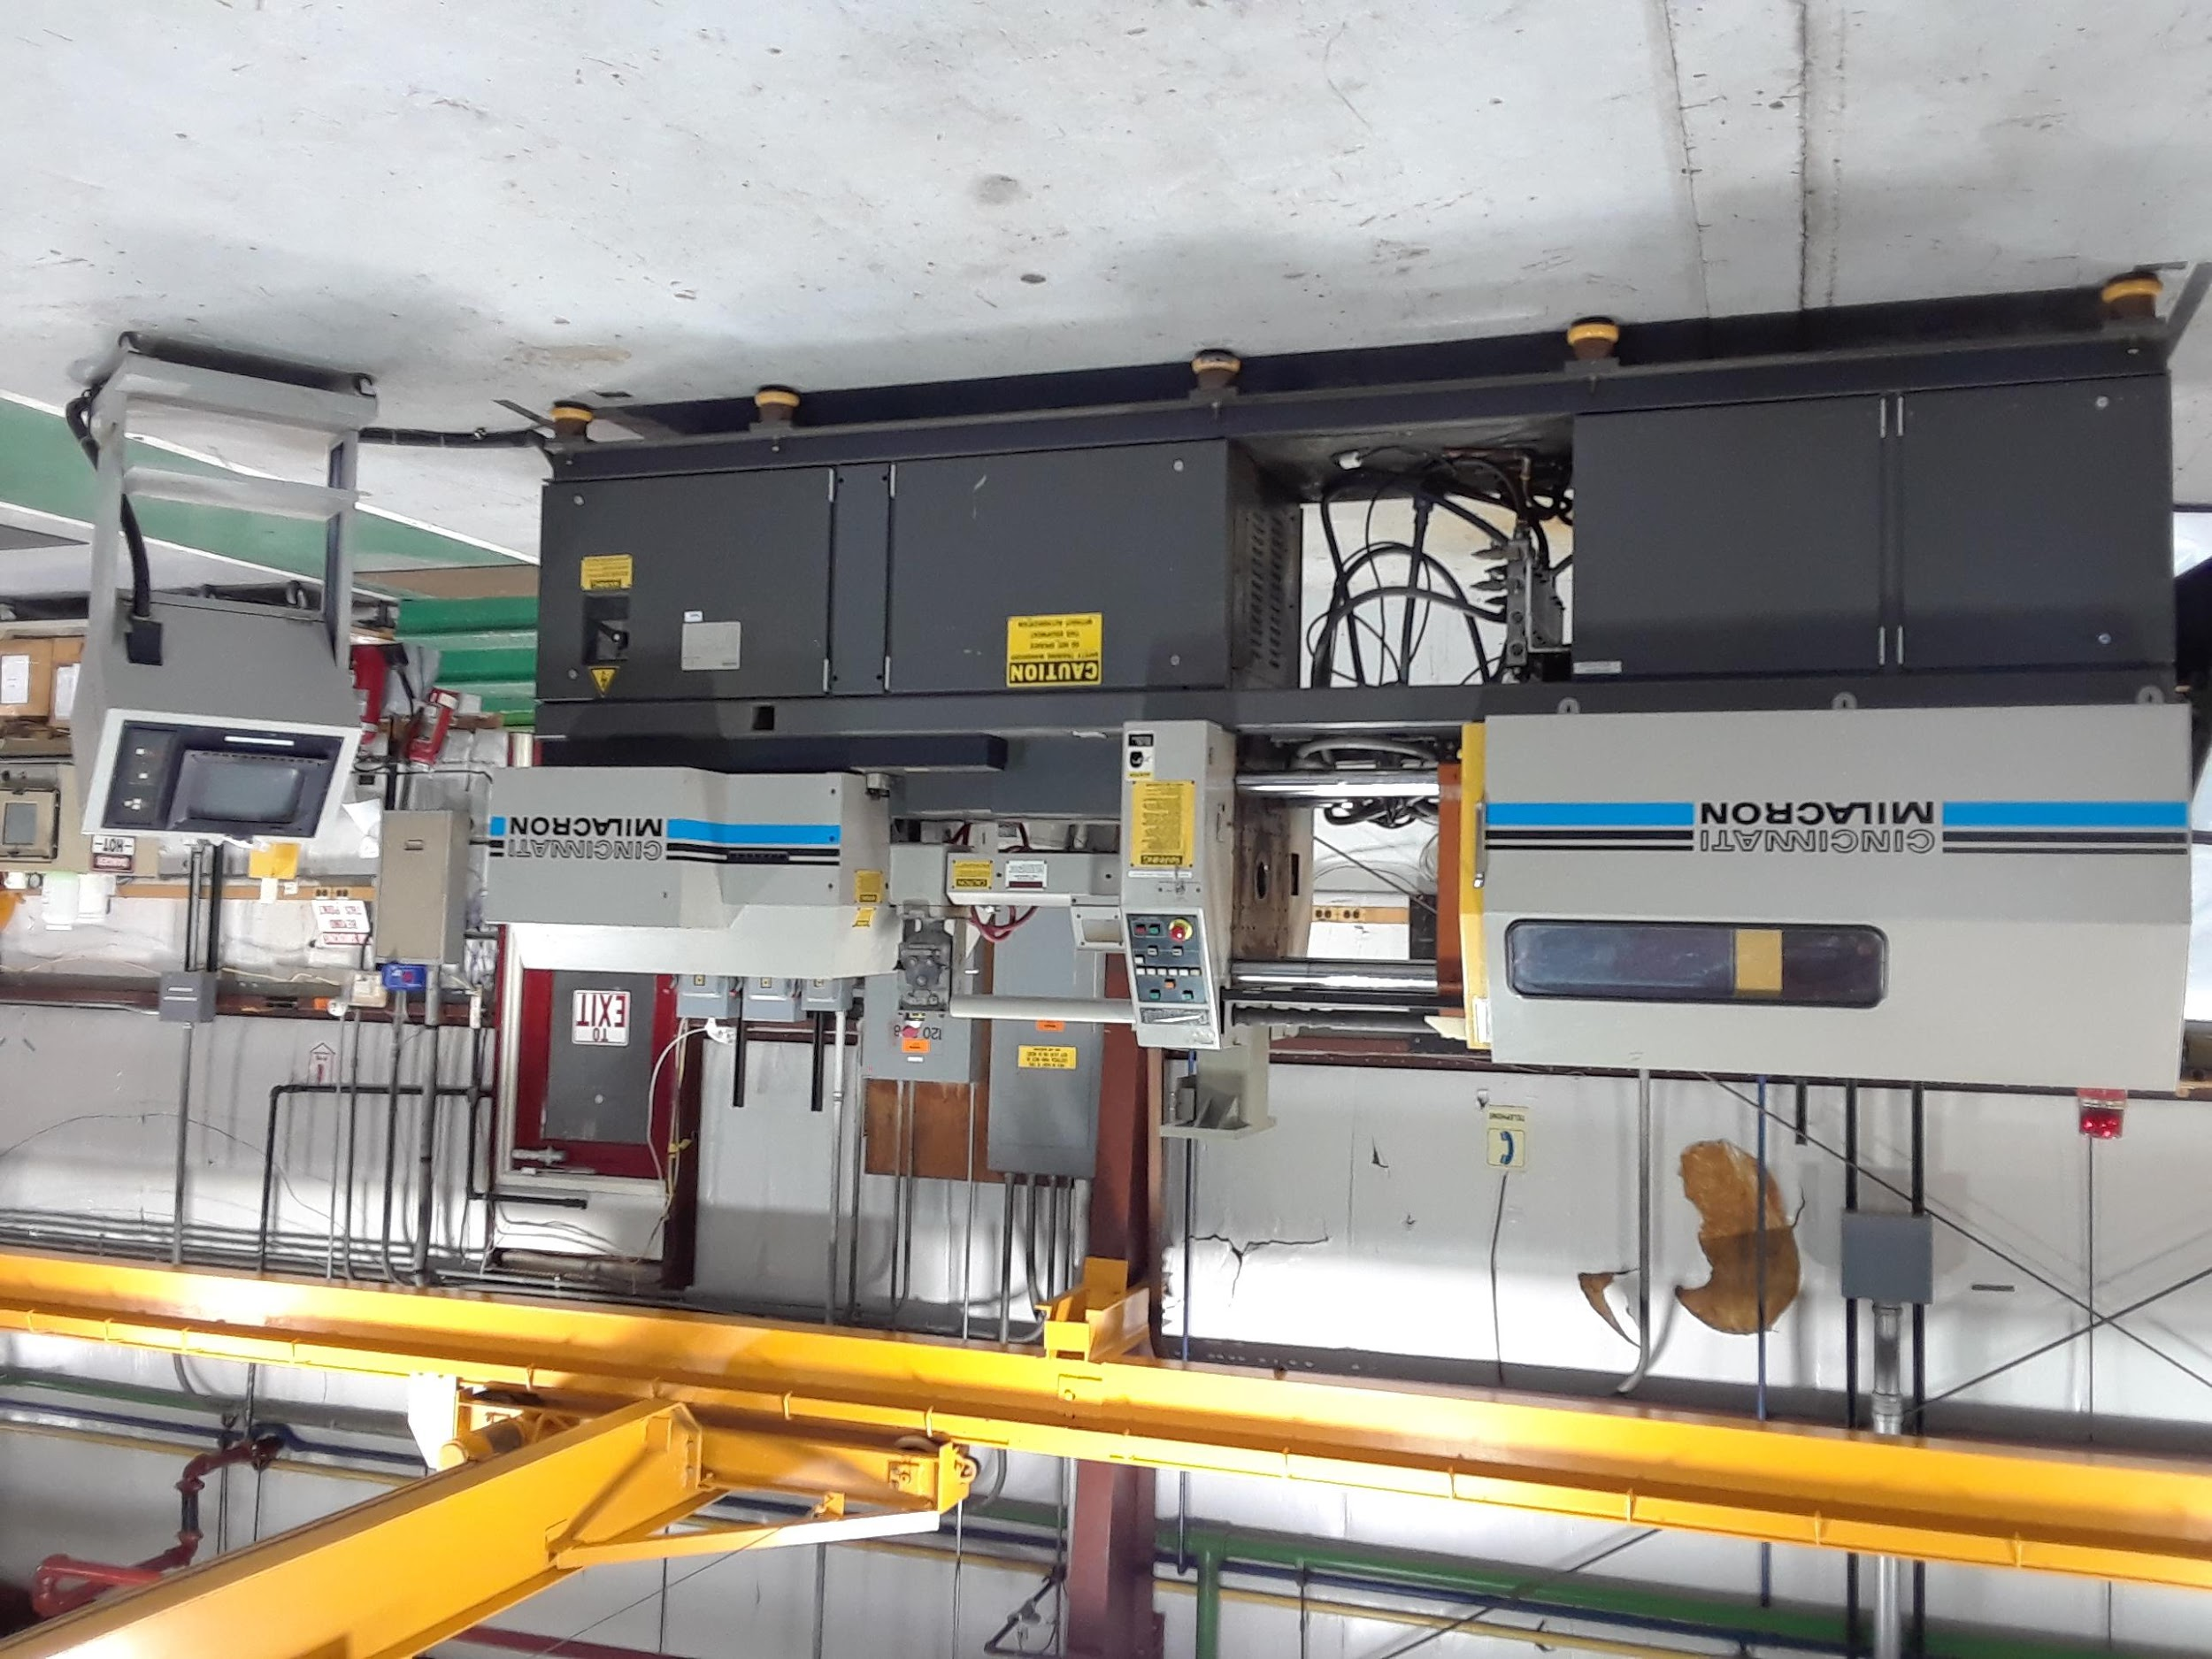
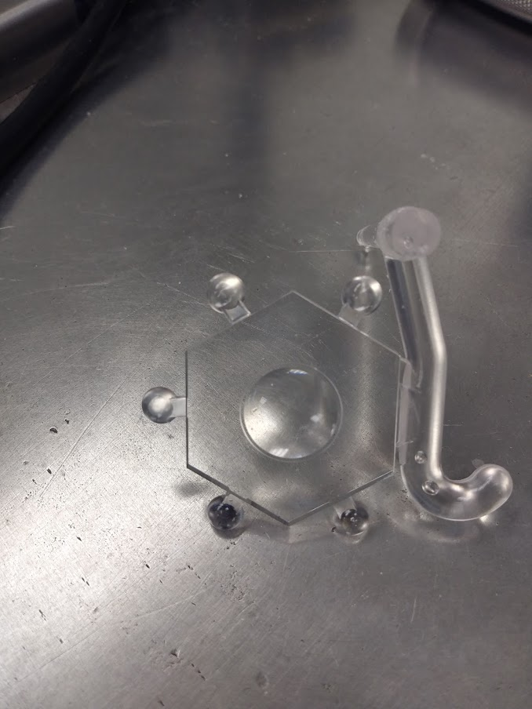
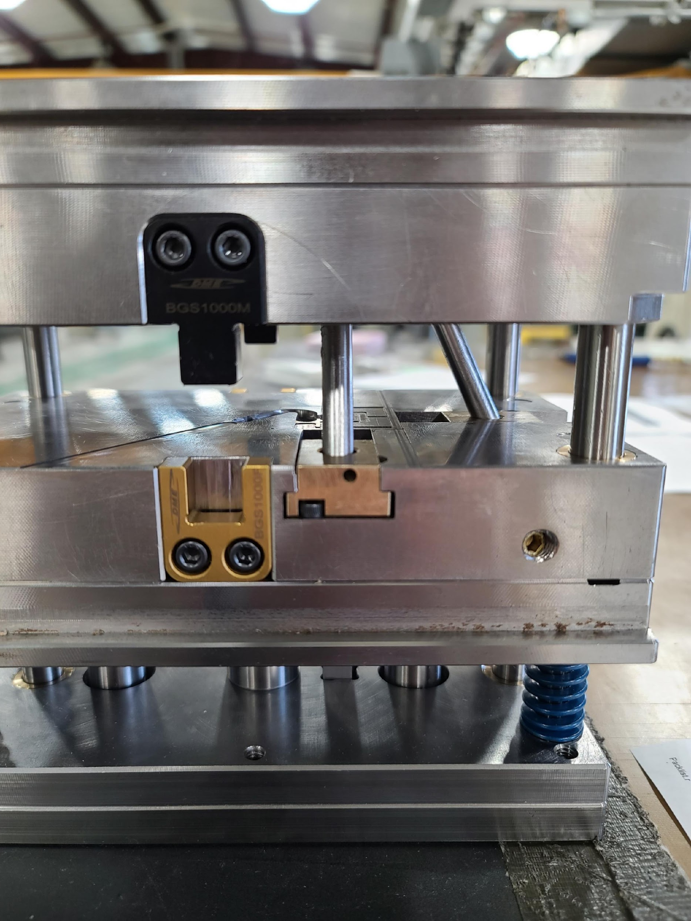
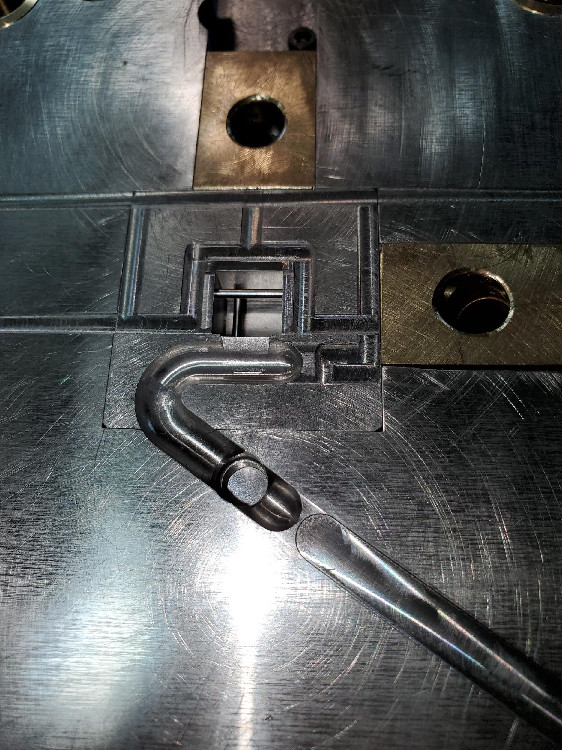
Injection Molding Scintillator for High Granularity Detectors
Injection-molded scintillator is cost-effective way to make new generation fine grained detectors. (CMS HGC Scintillator section uses ~300K tiles; DUNE 3DST 3M tiles)
Capitalizes on FNAL expertise in scintillator
Concept is to build DUNE 3DST with injection molded tiles (voxels) where all voxel processing is done during injection molding: holes, opaque white coating. Goal is to develop a small scale prototype using in-house molded voxels
Rate of progress increasing!
Voxel = 1.5X1.5X1.5 cm³, 3 orthogonal holes for WLS fiber, white cladding
New Voxel mold ready to install at Lab 5
First test pieces molded at Lab 5
April 2021
Injection molding machine at Lab 5 will be used to make the voxels.

Slide 8
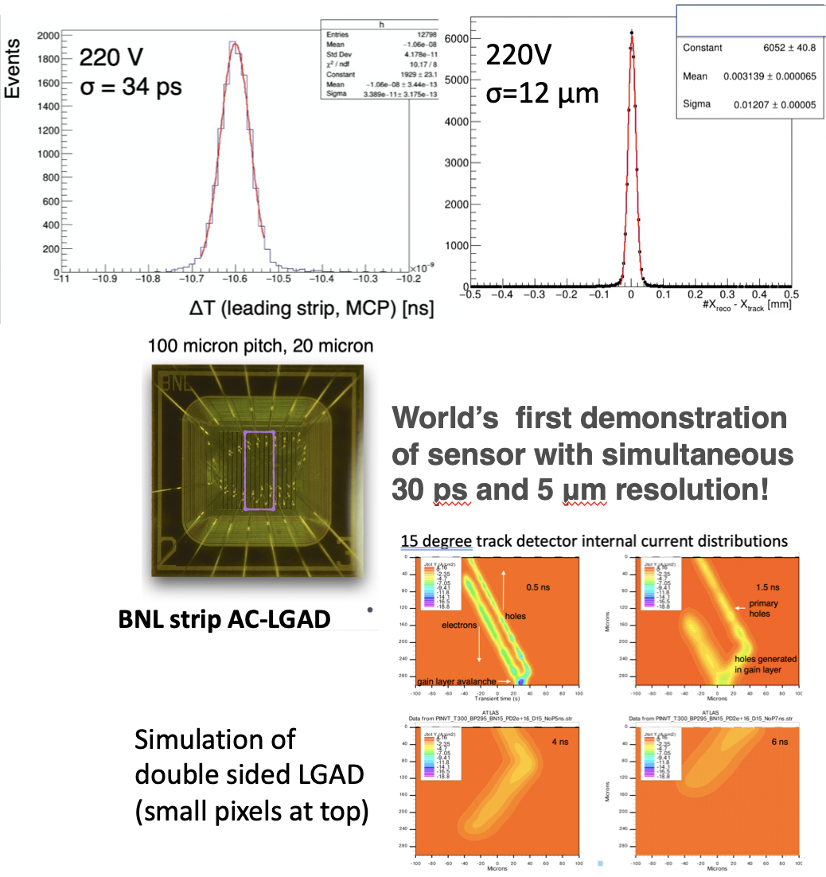
AC-LGADs
Collider Detector Tracking R&D
Overarching goals for future colliders (FCC, MuCol, …):
Fast timing – aim toward 1-20 ps timing with
Micron-level position resolution
And several degree angular resolution
Low mass and power
We address these goals using key new technologies:
Low gain avalanche diodes for improved s/n and low power
Buried layers for radiation hardness
3D integration to enable small pixels and low power
Induced current signals in low capacitance systems
AC coupling to provide position resolution
System codesign of processing and readout to process fields of pixels
Double sided processing for angular resolution
With collaborators
BNL, UIC, UCSC, many others
US Companies via SBIR
We need:
Support for personnel and equipment at SiDet (now sadly lacking)
Continued support for test and irradiation beams
A strong ASIC group
Contacts with foundries and industry
Laboratory commitment to investment in the future

Slide 9
Intensity frontier

Slide 10
Neutrino detectors
In the near future, mainstream related to DUNE detectors:
pixelated detectors, cold readout electronics (ASICs), photodetectors for instrumenting high voltage surfaces for the Vertical Drift module, high pressure GAr-TPC, 3-dimensional scintillation tracker (3DST) for Near Detector (see Energy Frontier)
Growing interest for reducing energy thresholds of LAr-TPC’s both in terms of scintillation light and drift charge, for applications in neutrino physics (recovering missing energy, Supernovae neutrino, coherent neutrino scattering CEvNS) and dark matter
Studies of scintillation light properties, proportional scintillation and charge amplification in LAr, doping of LAr with methane+Xe and with photoionizing elements, infrared light in LAr, search for directional nuclear recoil in GAr-TPC equipped with GEM’s, combined readout of light and charge with pixel detectors
Effort for magnetizing LAr-TPC’s
Activities mostly carried out at PAB: upgrades of the facility (rehaul of cryogenic and electrical infrastructures, and creation of fully equipped workspaces for physicists to do project preparation, preliminary tests or proof of concept studies) and support of Neutrino Division engineers and technicians essential!

Slide 11
DUNE FD2-VD: photon detectors on the 300 kV cathode plane

Slide 13
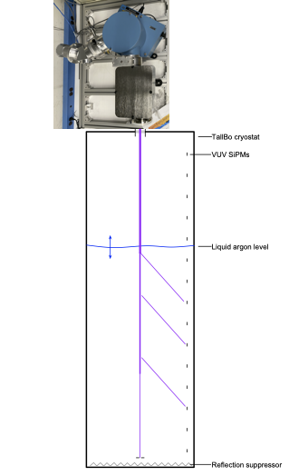
Studies of scintillation light properties
•Not R&D – supporting measurement for LAr Photon Detection.
–But, make use of Detector R&D facilities and equipment at PAB.
•Preparing measurement of attenuation and scattering in LAr vs. wavelength using a monochromator.
–May follow-up with a measurement of material reflectance.
•Receiving strong support from PAB technicians and engineers.
A. Himmel _ ECA 2017

Slide 14
Proportional scintillation light in LAr
W. Mu _ KA25 New Initiatives 2020

Slide 15
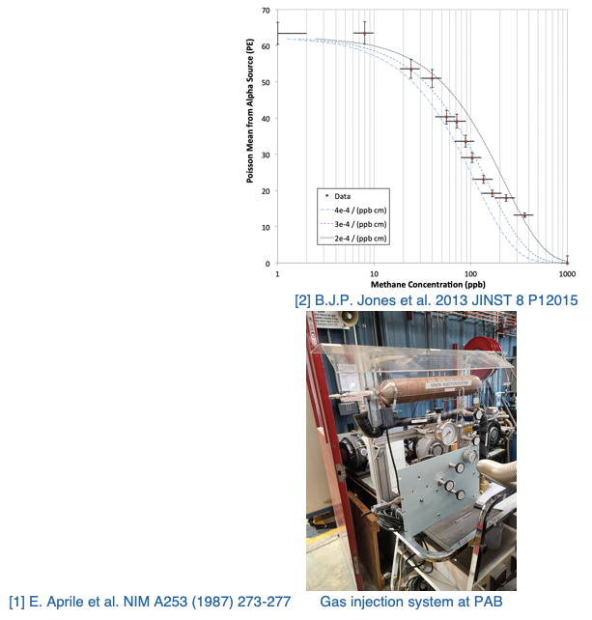
Introduction of Free Protons into LAr Detectors via Xe+CH₄ Doping
J. Zettlemoyer, M. Toups _ KA25 New Initiatives 2021

Slide 16
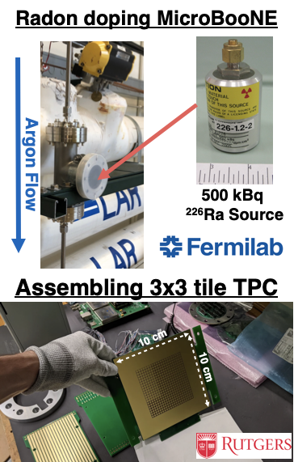
LAr-TPCs for MeV scale Physics
F. Psihas, J. Zennamo (FNAL), I. Lepetic, A. Mastbaum (Rutgers) KA25 New Initiatives 2020 and Neutrino Division

Slide 17
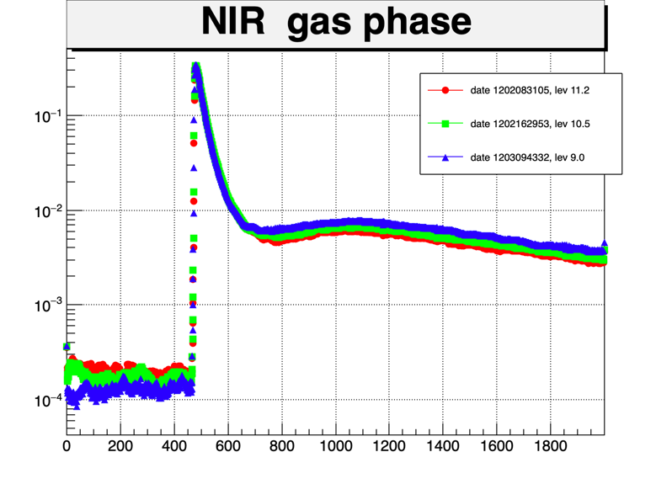
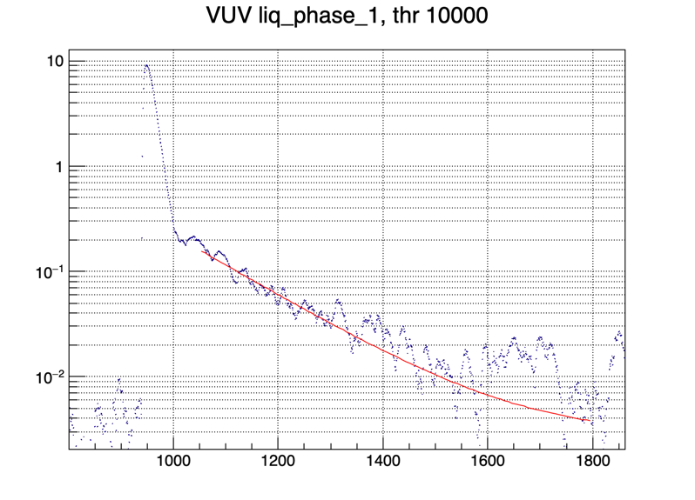
Near Infrared in liquid argon
Ran a preliminary experiment in the cryostat TallBo at the Proton Assembly Building (PAB).
Simple setup: One NIR and one VUV SiPM “looking” into an Am241 source.
Took data in both LAr and
GAr with different contents of N₂ contamination
Puzzling slow component in the gas phase seen by the NIR SiPM at 3 μs
(horizontal axis: 1 SSP tick is 6.7 ns)
Support needed for a NIR detector that could reach beyond 900 nm
Candidate detectors: InGaAs SPADs from Princeton Light Waves in the US and MPD in Italy
Also for the VUV we find a puzzling two slow components at τ ~ 300 ns and τ ~ 1170 ns. NB: we do not use WLS.
C. Escobar, A. Para, P. Rubinov

Slide 18
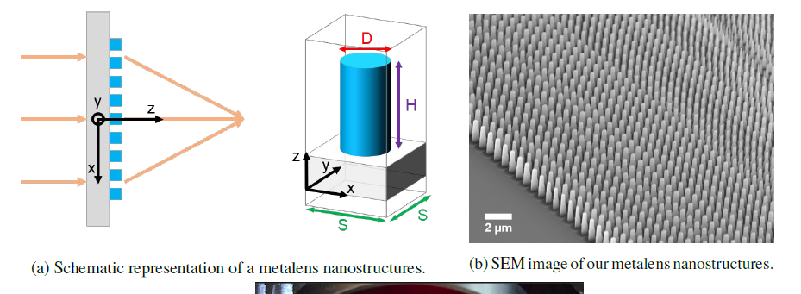
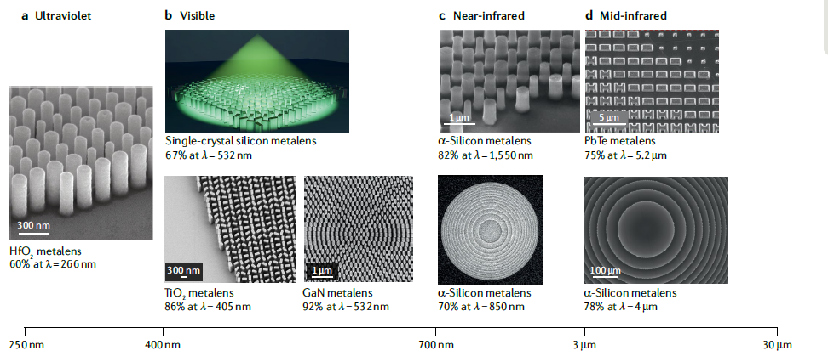
Metalenses as light concentrator in noble element detecors
Develop metalenses, flat optical elements fabricated with nanotechnology, suitable for use as light concentrators in noble element detectors, gaseous or liquid.
Concentrate scintillation light into SiPMs.
Many challenges: index of refraction mismatch between detector media and substrates; sub-wavelength fabrication scale < (λ/2NA) NA… numerical aperture (needs to go below 100 nm); wide range of angles of incidence: defeating the etendue limit!
Currently characterizing existing metalenses optimized for visible wavelengths and designing metalenses for shorter wavelengths nearing the UV.
From: Chen, Zhu and Capasso:Nature Reviews Materials volume 5, pages 604–620(2020)
C. Escobar, A. Para, M. Stancari with Harvard groups of R. Guenette and F. Campasso
LDRD + additional support needed for accessing EUV lithography (SUNY Albany/IBM)

Slide 19
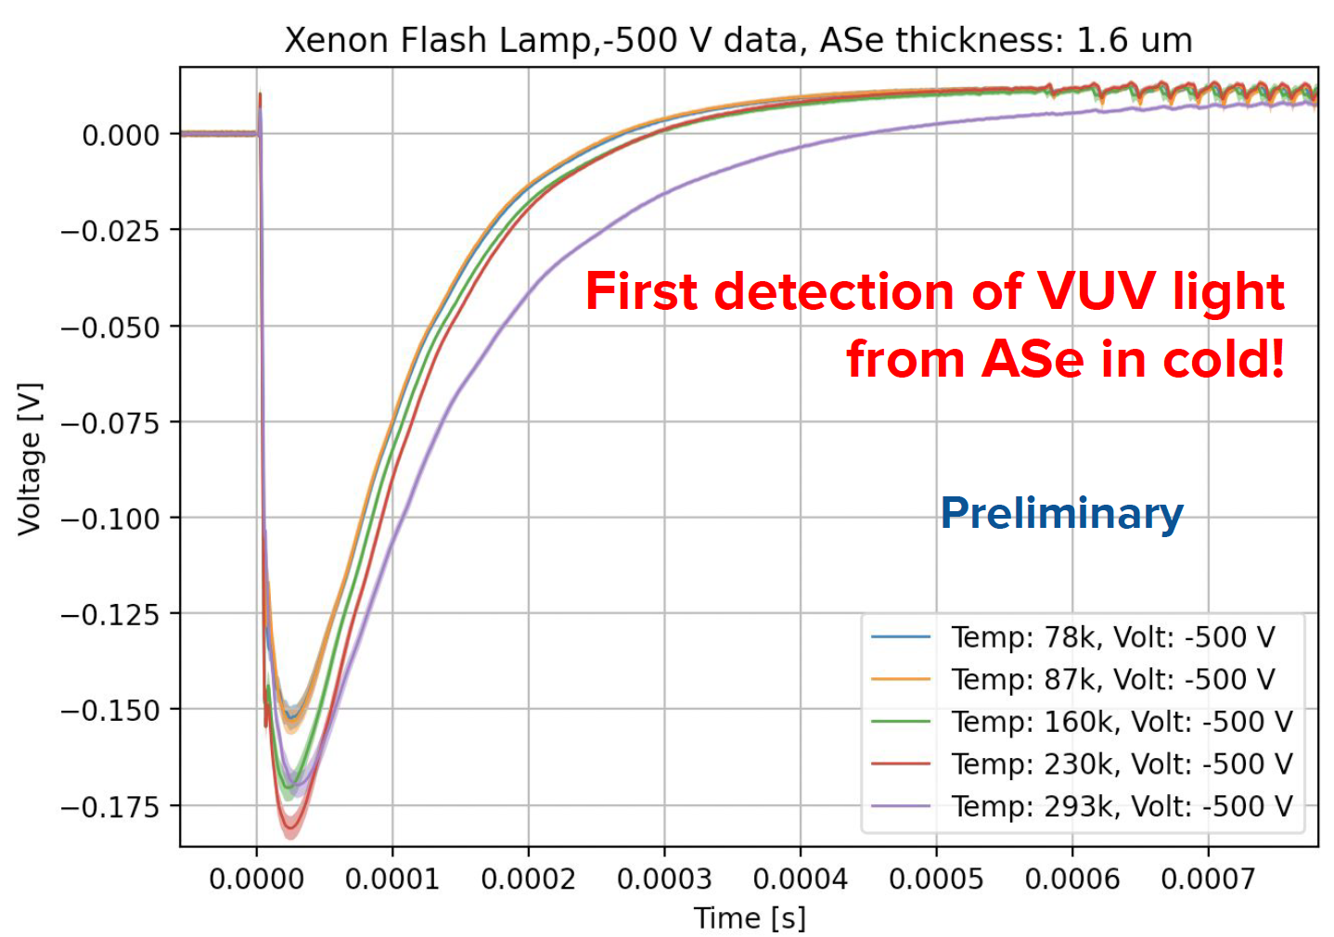
LILAr: light imaging with liquid argon
Long term goal: Develop multiple modality pixels capable of reading VUV
scintillation light and femtoCoulmb charge:
harvest the benefits of pixelated TPC and powerful light collection system.
Short term goal: The light side. Detection of scintillation light in liquid noble
elements on wide surfaces using thin films of amorphous semiconductors and
dopant cocktails for both visible and VUV light at cryogenic temperatures.
Status:
→ In collaboration with UTA theorists: Developed a first simulation based
on density functional theory for optical properties.
1st paper on the archive: 2104.14455
→ Test from 293 - 77K with VUV light on first prototypes (at ORNL): we saw signal!
→ 3rd prototype: 25 micron pitch on its way (achieve higher field)
→ Ar purity test on its way
Lab Support:
→ Availability of technicians and time at machine shops is fundamental for small “high-risk high-reward” R&D projects.
By nature, this work is seldom programmatic, but it is often limited in time. We need more flexibility in the resources
we have and more resources in general if we want to keep small R&D alive and competitive with Universities.
E. Gramellini (FNAL), J. Asaadi (UTA) _ LDRD

Slide 20
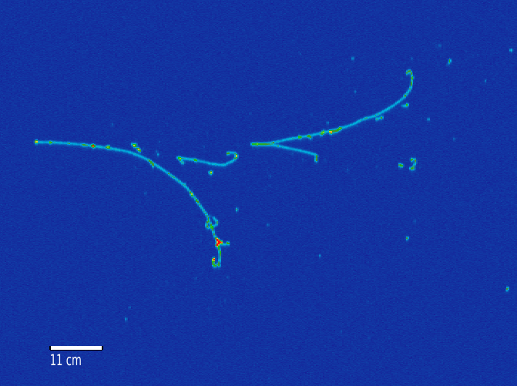
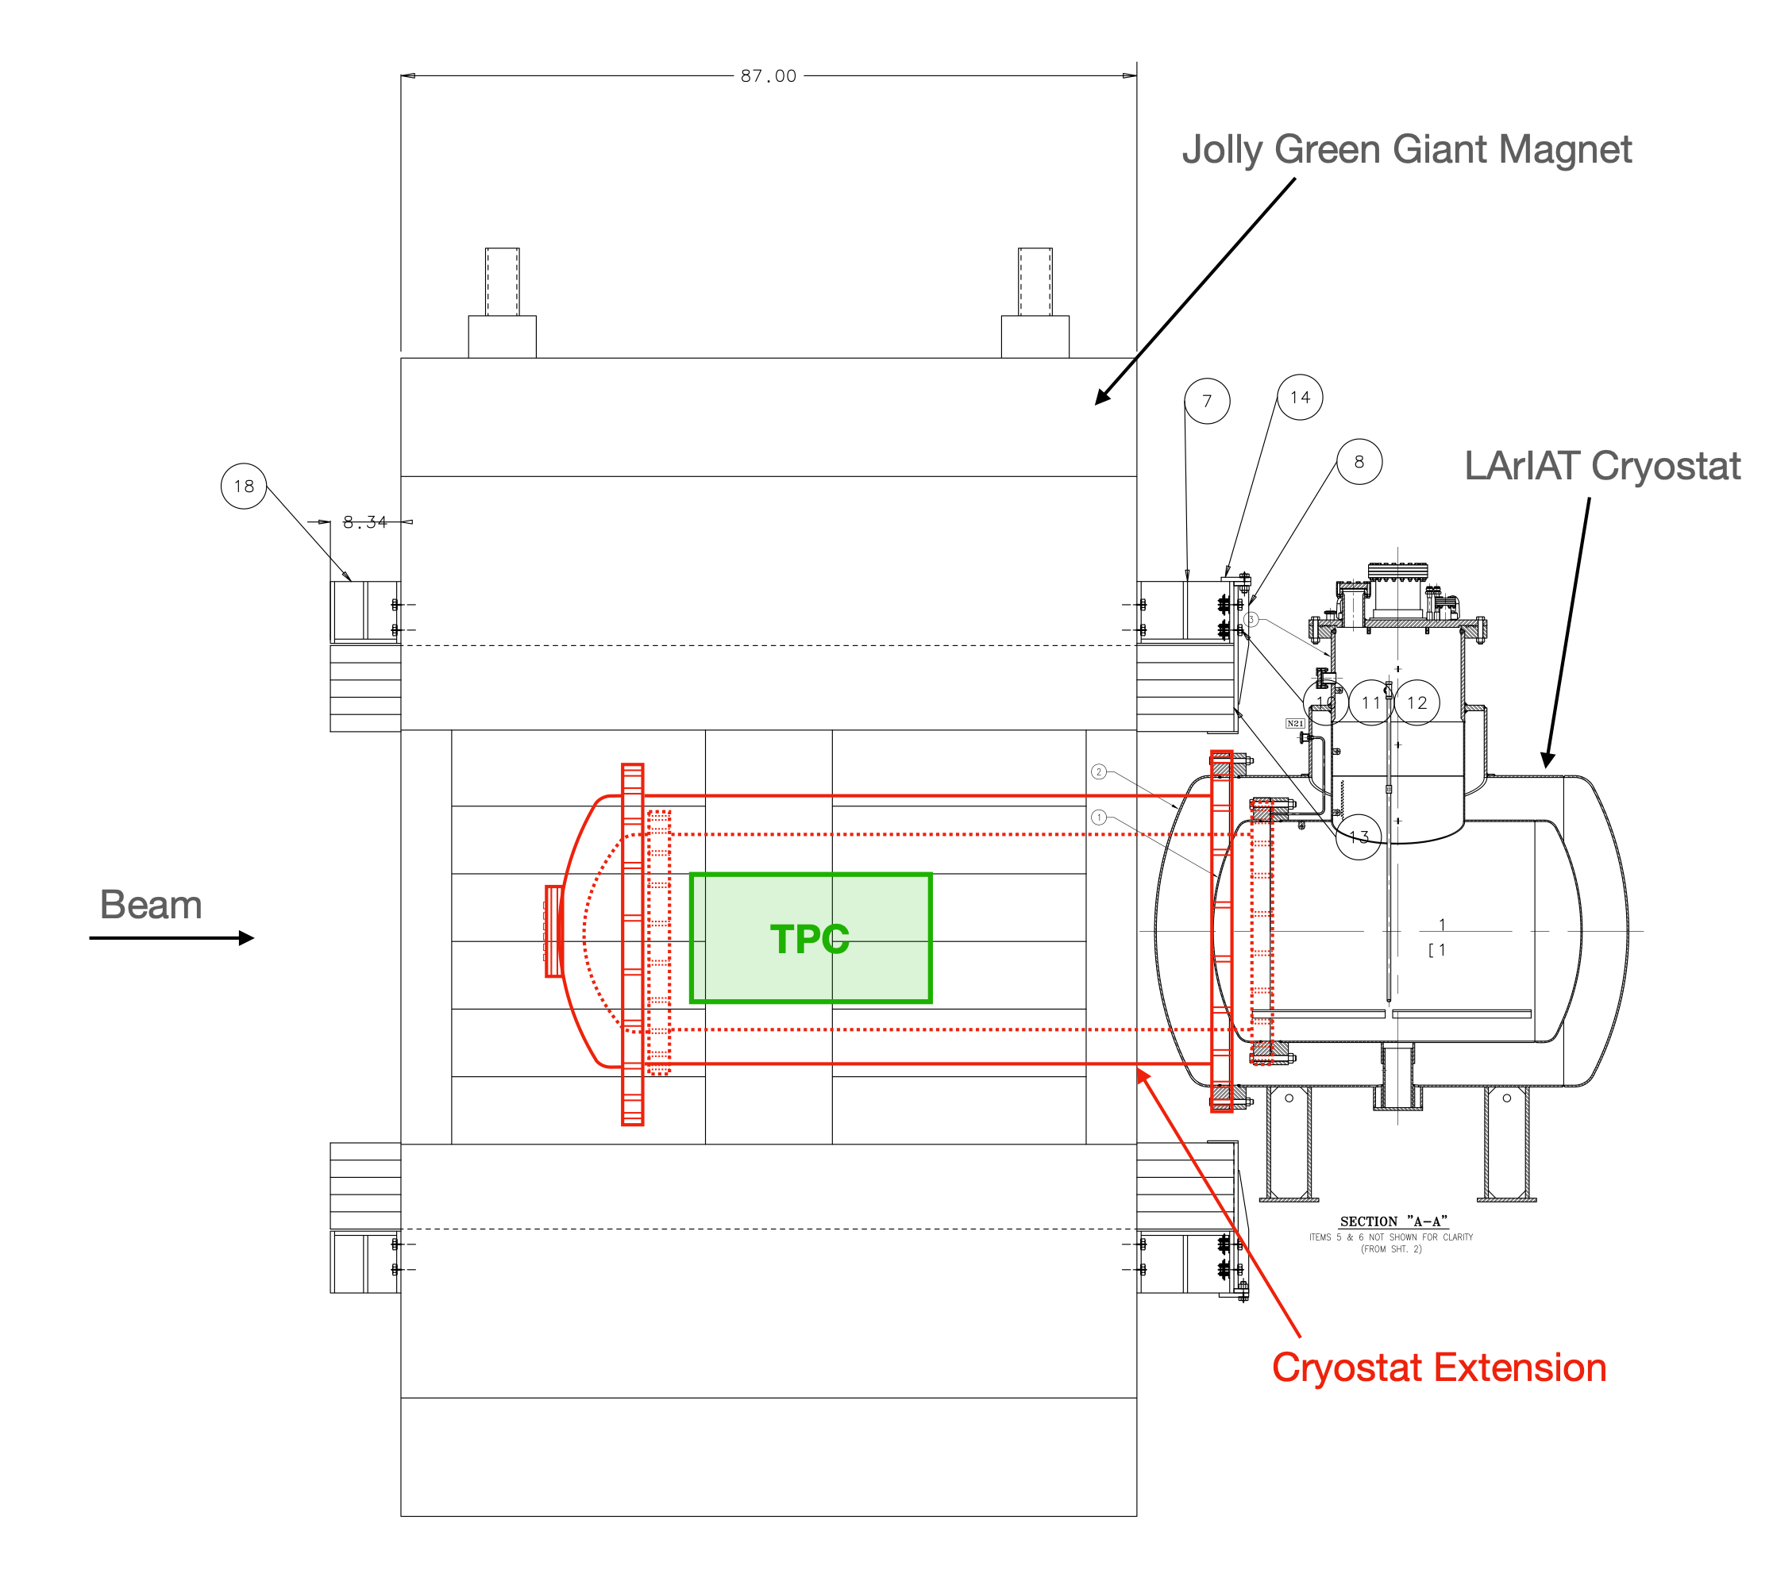
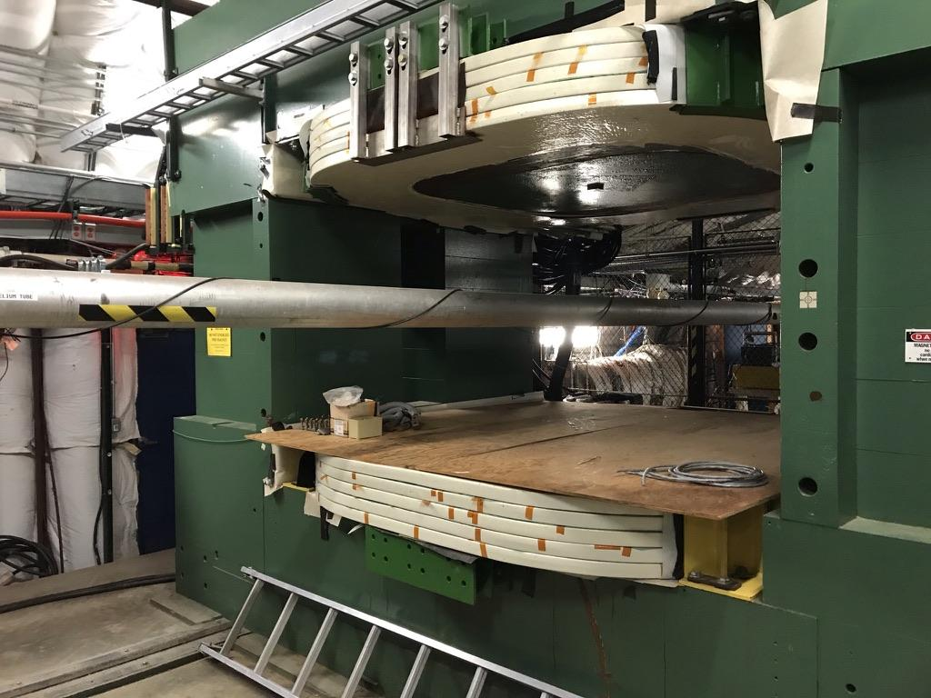
Magnetised LAr-TPC
There is a wide interest in magnetizing LArTPC detectors for neutrino physics and beyond.
The magnetization would allow us to determine the electric charge of particles (information not available in non-magnetized LArTPCs), and it would provide an additional method to measure the momentum of particles.
Proposed milestones: (i) magnetize the LArIAT detector using classical magnet; (ii) magnetize SBND with superconductors inside the cryostat; (iii) magnetize the 4th DUNE module.
Simulation of magnetized LArTPC
Jolly Green Giant Magnet at Fermilab
Proposed modification to LArIAT for using it inside the magnet
Lab support needed for test beam and magnet operation, fabricating the extension to the LArIAT cryostat, setting up LArIAt at FTBF and data taking.
M. Del Tutto, O. Palamara, C. Montanari, R. Acciarri, F. Cavanna, W. Badgett, A. Fava

Slide 21
Cosmic frontier

Slide 22
New Materials for Dark Matter Direct Detection
keV-MeV dark matter detection requires meV thresholds for particle-like dark matter, also opens windows into absorption of meV-scale bosonic DM
Requires exploring low-gap materials
Requires development of more sensitive readout electronics
Technology Development Directions
Improving the Sensitivity of Athermal Phonon Sensors for Light Mass Dark Matter - LBNL Lead
Cryogenic Carbon Detectors for Dark Matter Searches - FNAL Lead
Low-gap charge detection for fundamental physics searches - FNAL Lead
Understanding Material Response
Sub GeV DM-Nucleon Scattering via Collective Excitations: The Inelastic Regime - FNAL/UChicago Lead
Coupling Experiment and Simulation to Model Non-Equilibrium Quasiparticle Dynamics in Superconductors - FNAL Lead
Kurinsky coordinating CF-1 Low-Threshold Landscape white paper, will integrate these ideas to ensure they are prominently featured
Noah Kurinsky

Slide 23
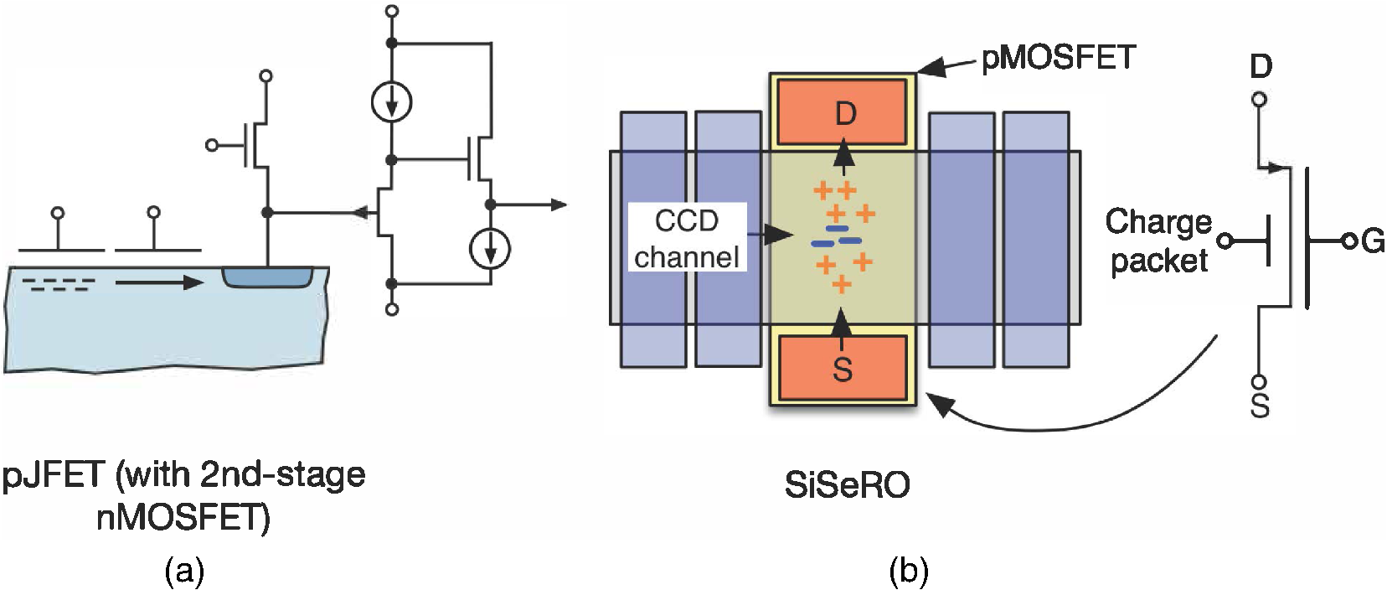
Silicon detectors with non destructive readout
Non destructive readout has demonstrated to be a very powerful tool for single charge and single photon detection. This sensor has been used for many applications: quantum imaging, dark matter searches, neutrino detection, new astronomical instruments, etc.
Lines of work:
Speed up current versions of non destructive readout.
Multiple output stages.
Multiple-amplifier output stage.
Improvements in the gain of the output stage.
SiSero amplifier.
CMOS fabrication processes. Smaller structures.
Noise reduction techniques:
Smart readout capability.
New fabrication processes.
On-chip or on-package active electronics.
Designed by Microsystems Laboratory at LBNL
https://doi.org/10.1117/1.JATIS.5.2.021015
Guillermo Fernandez-Moroni

Slide 24
Axion Direct Detection Experiments
Fermilab scientists were active in preparation of many Snowmass LOIs related to future axion searches:
Extension of ADMX to 2-4 GHz (Dak Matter New Initiatives Project)
Axion haloscopes from 4-10 GHz
Axion detection beyond the quantum limit
Frequency multiplexed axion dark matter searches
ADMX high resolution search
Broadband high frequency detectors
US participation in MADMAX
Qubit-based detectors
UP-conversion Loop Oscillator Axion Detector
High field magnets for next generation searches
Non-equilibrium quasiparticle dynamics in superconductors
Now starting up work on two white papers:
Resonant cavity experiments. Expected to be comprehensive summary of US and international efforts.
“Discovering GHz-THz axion dark matter” to be led by Fermilab postdoc Stefan Knirck will capture ideas for axion discovery with broadband detectors.
Andrew Sonnenschein

Slide 25
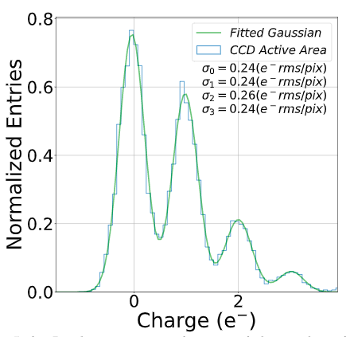
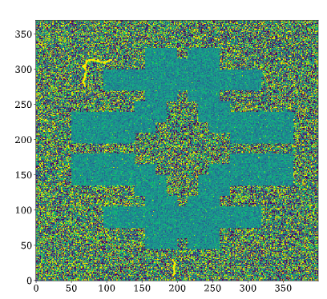
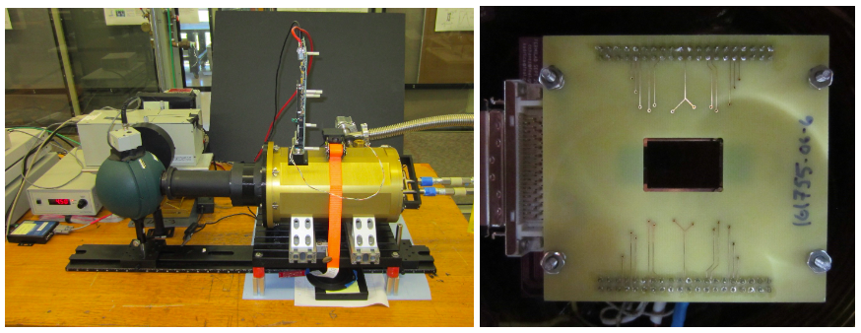
Skipper CCDs for Cosmic Surveys
Reducing noise to ~0.5e- rms/pix can lead to a ~50% increase in survey speed for some applications
Selecting regions of the detector can further improve survey speed and efficiency
Target a future spectroscopic survey (there are ~4 facility concepts being proposed to Snowmass)
Alex Drilica-Wagner

Slide 26
R&D for CMB instruments
Topic | Primary | Secondary
CMB Spectral Distortions: A new window to fundamental physics | Jens Chulba, Suvodip Mukherjee | ++, Benson
CMB-HD: An Ultra-Deep, High-Resolution Millimeter-Wave Survey Over Half the Sky | Neelima Sehgal | ++, Benson
Primordial Non-Gaussianity with Millimeter-Wave Line Intensity Mapping | Kirit Karkare | ++, Anderson, Benson, Simon
Millimeter-Wave Line Intensity Mapping Facilities | Kirit Karkare | ++, Anderson, Benson, Simon
Cosmology with Millimeter-Wave Line Intensity Mapping | Kirit Karkare | ++, Anderson, Benson, Simon
Brad Benson

Slide 27
Instrumentation for Future Cosmic Surveys
Write a white paper that brings together roughly a dozen cosmic survey instrumentation LOIs:
Detector technology: fully depleted CCDs, skipper CCDs, germanium CCDs, non-destructive CMOS, MKIDS
“Photon Systems”: fiber positioners, photonics, ultra-high-resolution interferometers, multi-photon interferometers
Development and Testing Facilities: detector fabrication facilities, calibration facilities, astronomical testing facilities
Fermilab involvement: Cancelo, Diehl, Drlica-Wagner, Estrada, Kurinsky, Moroni, Sofo-Haro, Tiffenberg, and many more
Alex Drilica-Wagner

Slide 28
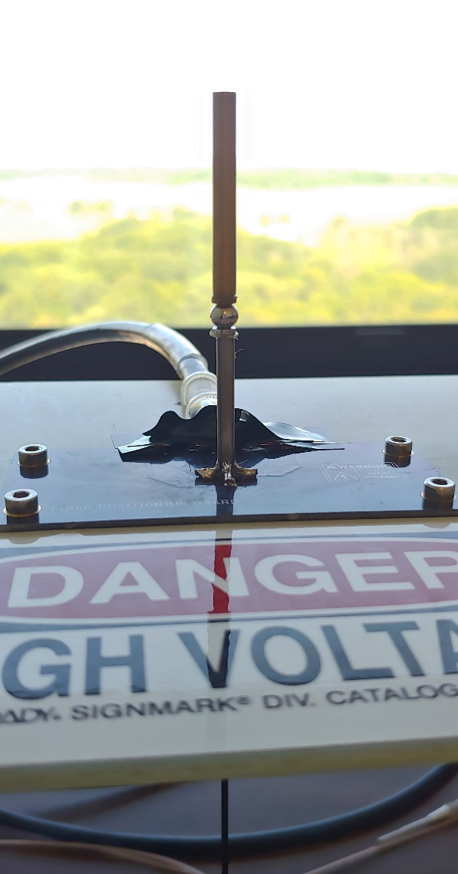
Developing Small-Pitch Optical Fiber Positioners for Massively Parallel Spectroscopy
Prototype Tilting Spine @ FNAL
DES/LSST will need new telescopes and instruments to attain sufficient amounts of spectroscopic follow-up.
A limitation on the number of spectra that can be simultaneously acquired is the size of the Fiber Positioner. Currently used technologies permit ~ 1 cm distance between them.
Our LDRD Goal is to build 5 to 6 mm pitch optical fiber positions for massively parallel spectroscopy.
Tom Diehl

Slide 29
Precision frontier

Slide 30
Precision frontier R&D challenges
Radiation hard electronics
Component qualifications is needed
Fast rad hard calorimeter
<10% energy resolution and 500ps timing
~1MRad and 10¹³n_1MeV/cm²
Ultra low mass tracker
<0.1% X₀ with <100ps TOF tracking for PID
High efficiency cosmic ray veto system
>99.99% efficiency, neutron fluency issue on SiPM/scintillator
High power, rad hard POL delivery
Radiation and B-field hard DC/DC converters
Sub-ns electronics/trigger
Series of workshops on mu2e-II

Slide 31
mu2e-II tracker - R&D towards low mass tracker
8 micron wall thickness, spirally wound, Mylar straws → tested for mechanical properties
Thin straws, new handling and construction techniques will be tested → constructing a small 8 straw prototype panel which may then be further tested.
Test stand to test permeation and resistance of mylar with different amounts and types of metal deposit.
Simulations in parallel to understand different geometries

Slide 32
mu2e-II calorimeter
BaF₂ → excellent candidate for a fast, high rate, rad hard crystal for calorimetry
R&D on SiPM for readout
Other possible techniques include different crystals (LYSO), nanoparticle wavelength shifters, LAAPDs, etc.

