Slide 1
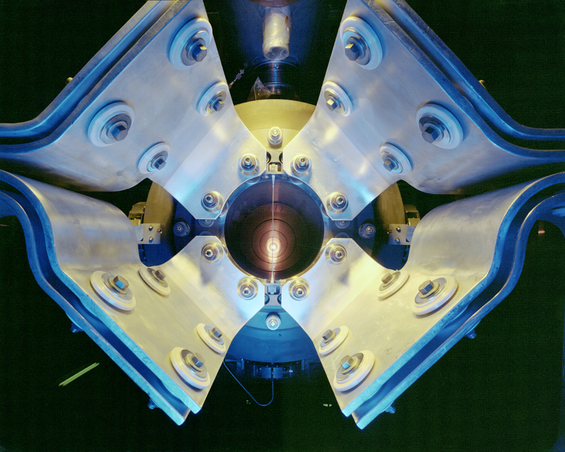
US Program and Goals
Proton Accelerator for Science and Innovation Workshop
January 11 – 13, 2012

Slide 2
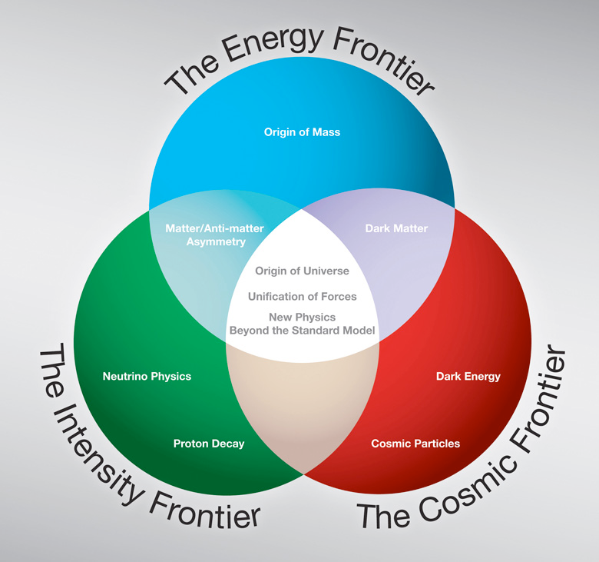
Program planned along three frontiers

Slide 3
The cosmic frontier
Principal goals are the study of dark energy and the study of dark matter
Dark energy:
  DES being installed in the Blanco (4m) telescope, Cerro Tololo, Chile; supported by DOE and NSF
  LSST (8m) in process of approval. First priority of the Decadal Survey for ground telescopes. Supported by DOE and NSF
  BigBOSS proposed for the Mayall (4m) telescope to carry out a spectrographic survey. Going through review process as well as NSF Portfolio Review.

Slide 4
The cosmic frontier
Dark energy:
  CMB: relevant to dark energy, dark matter and inflation; large number of approaches supported mostly by NSF: Atacama Cosmic Telescope, South Pole Telescope, QUIET, POLARBEAR……
  WFIRST, a wide field IR survey, is the first priority of Decadal Survey for space; delayed due to NASA’s budget restrictions while building the James Webb Telescope

Slide 5
The cosmic frontier: dark matter
Direct detection: many efforts trying to achieve “zero background”, i.e. discriminating against electromagnetic backgrounds, alpha particles and shielding against neutrons. Examples:
  CDMS in various versions (Ge bolometers)
  LUX (liquid Xenon)
  MAX (depleted liquid Argon)
  COUPP (bubble chamber)……
Indirect detection: look for annihilation products such as in Fermi-GLAST and AMS

Slide 6
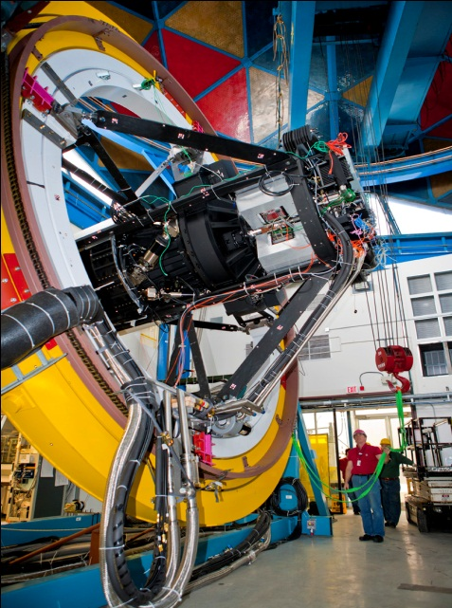
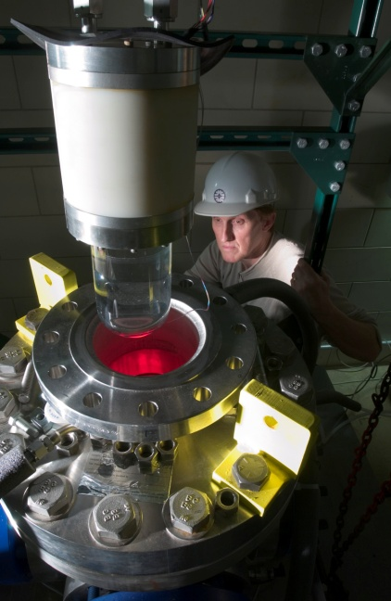
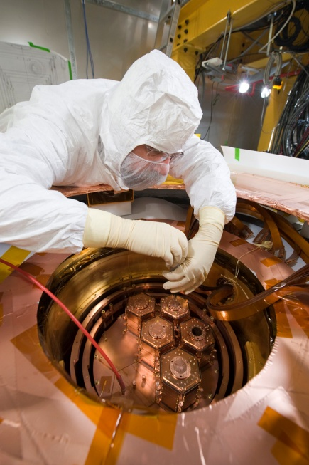
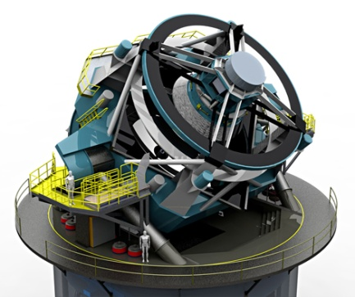
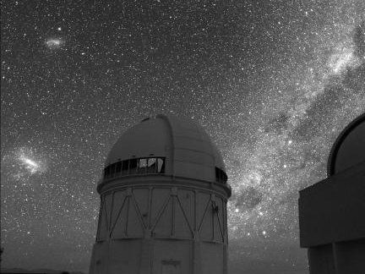
Cosmic Frontier
DDM: ~10 kg
IDM: Fermi, AMS
DE: BOSS, CMB
P. Auger
DDM: ~100 kg
IDM: Fermi, AMS
DE: DES, CMB
P. Auger
DDM: 1+ ton
DE: LSST
DE: BigBOSS??
DDM: 1+ ton
DE: LSST
DE: WFIRST??

Slide 7
The US at the energy frontier
Continued analysis of Tevatron data for the next few years
The principal activity for the foreseeable future is exploitation of the LHC.
The next steps will be to contribute to the High Luminosity LHC with both detector and accelerator upgrades.
The biggest unknown is what follows the LHC?
  ILC ?
  CLIC ?
  Muon Collider ?
  Energy doubler ?

Slide 8
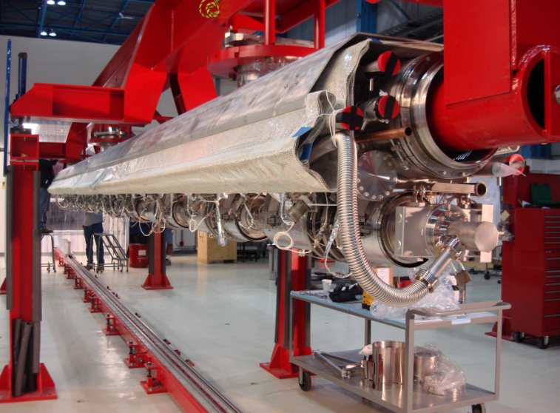
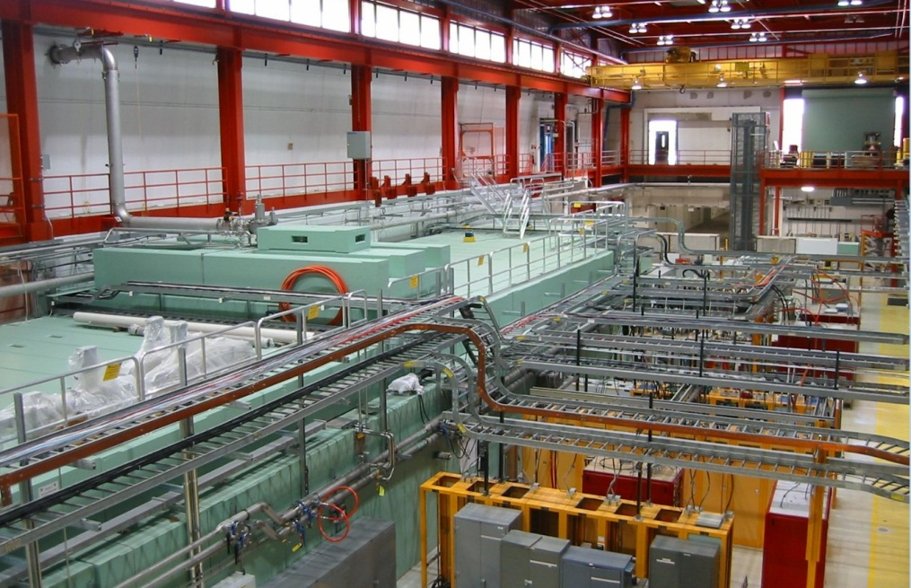
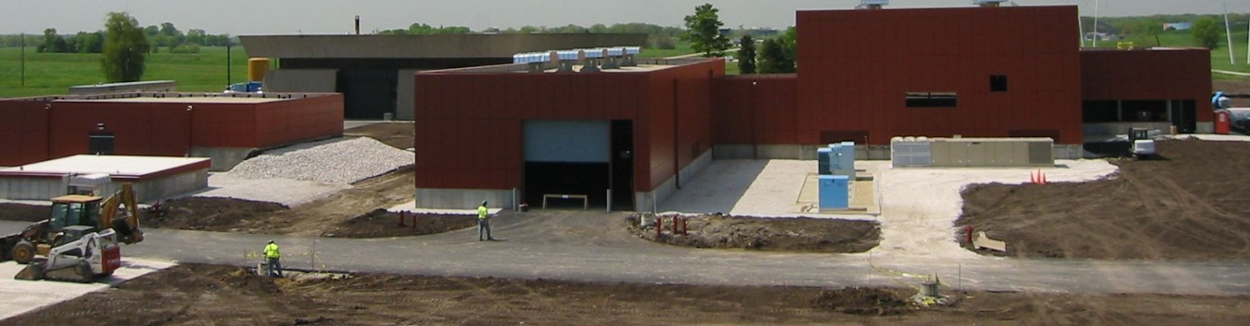
Fermilab HE program: ILC R&D

Slide 9
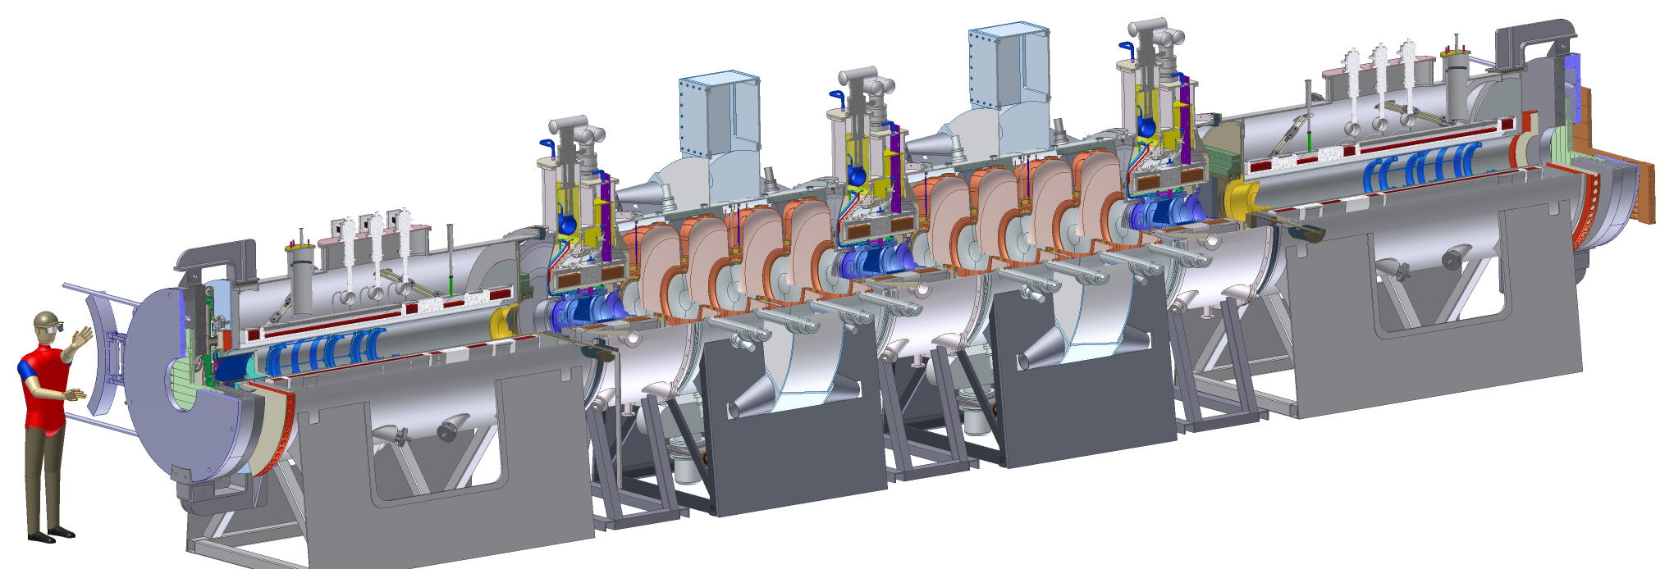
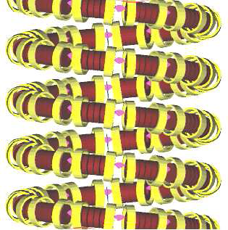
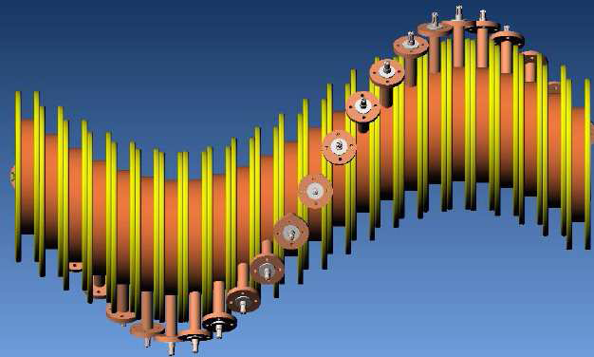
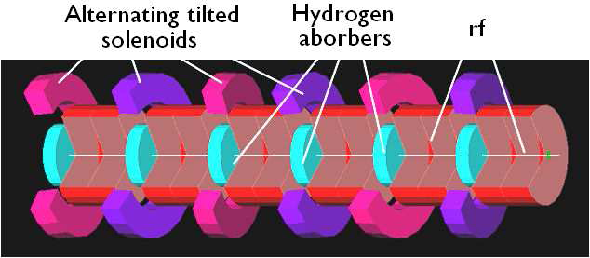
Fermilab HE program: muon collider
MICE
“Guggenheim”
Helical cooling
The “snake”

Slide 10
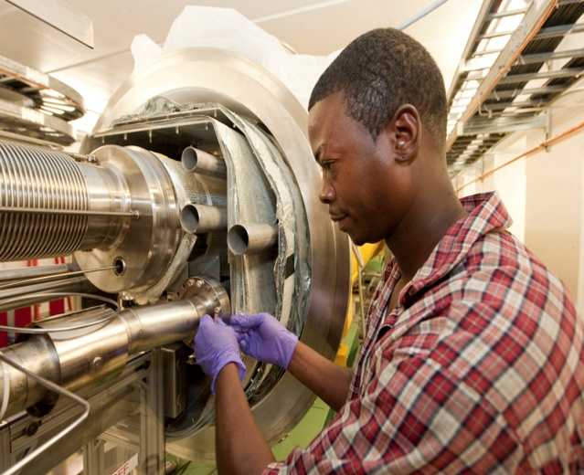
The US at the energy frontier
Tevatron
LHC
LHC
LHC Upgrades
ILC??
LHC
HE-LHC
ILC, CLIC or
Muon Collider

Slide 11
Fermilab facilities → intensity frontier Neutrinos
ν SM: Pattern of neutrino masses and mixings
  Long baseline experiments: MINOS → NOvA → (LBNE)
Beyond ν SM: Explore cracks in our understanding: sterile neutrinos? Anomalous interactions?
  Short baseline experiments: MiniBooNE → MicroBooNE
  Long baseline experiments: MINOS → MINOS+
Neutrino physics measurements as a probe of nuclear structure and support of oscillation experiments
  Dedicated experiment: MINERvA

Slide 12
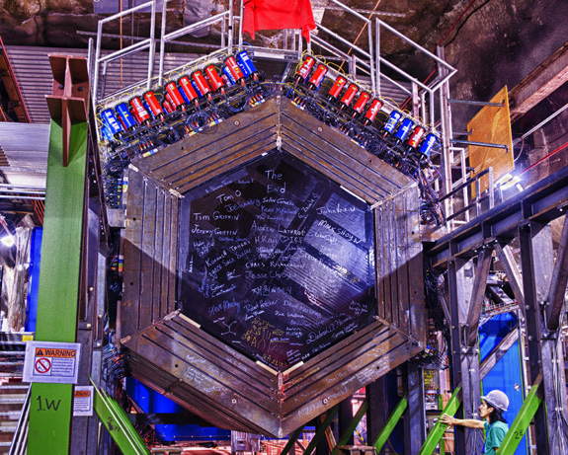
MINERvA

Slide 13
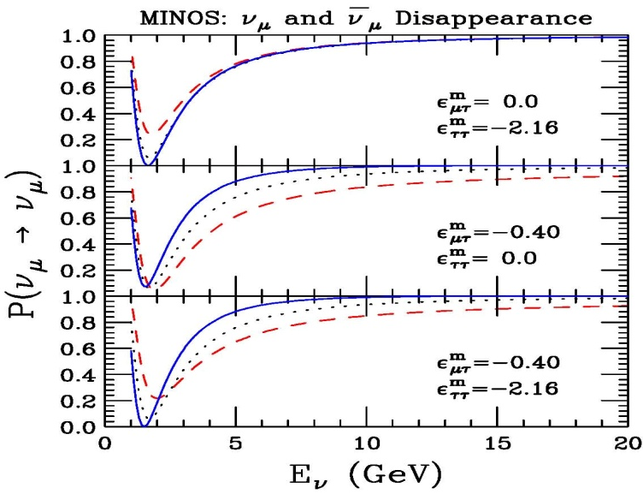
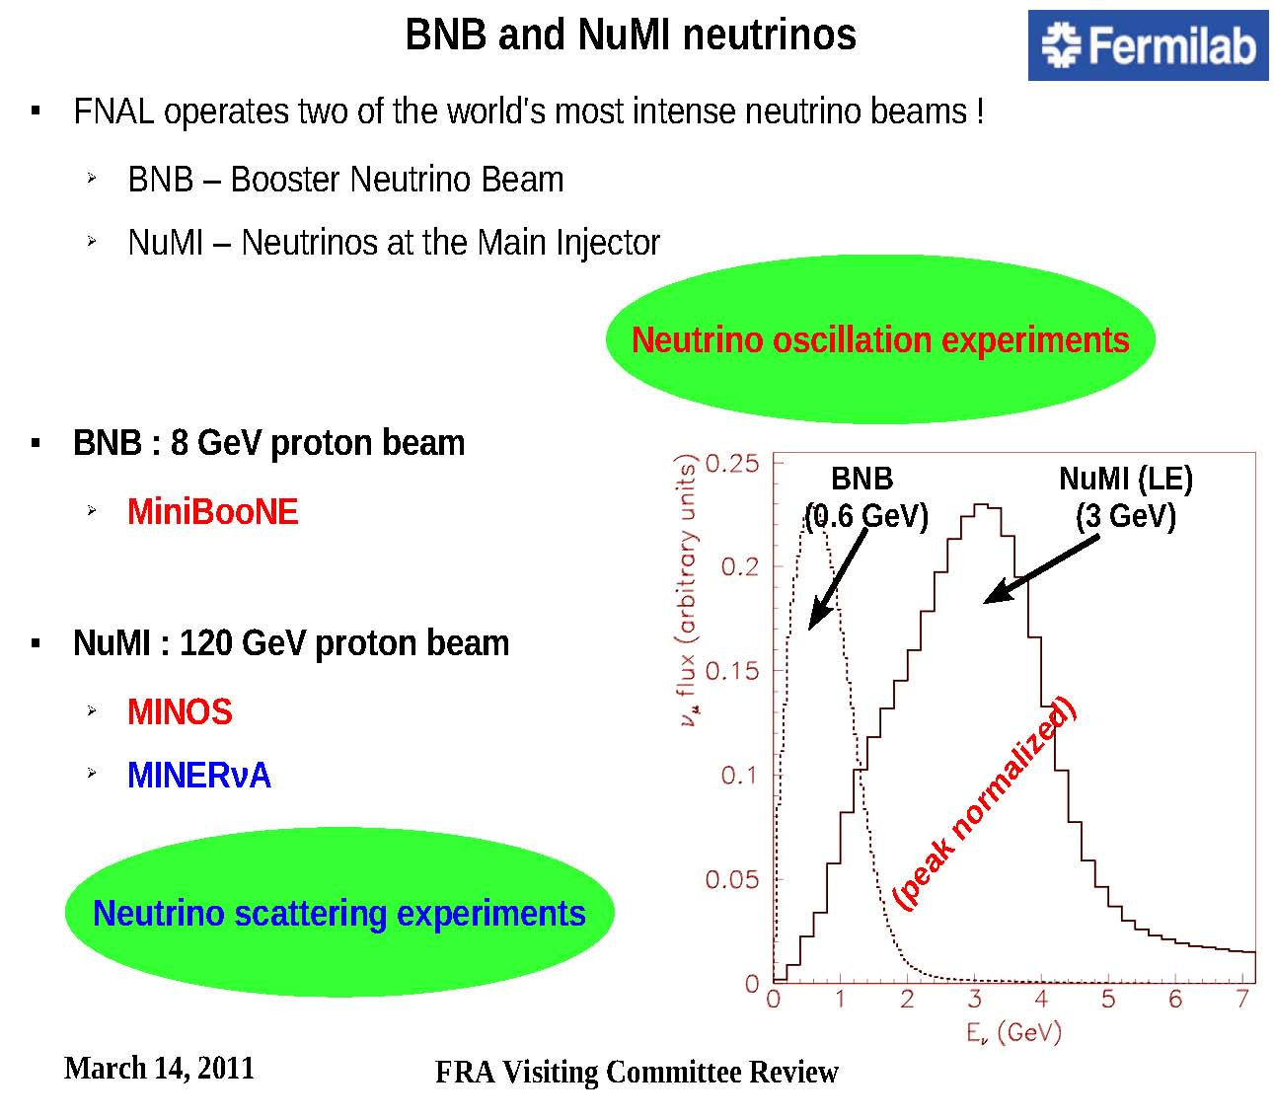
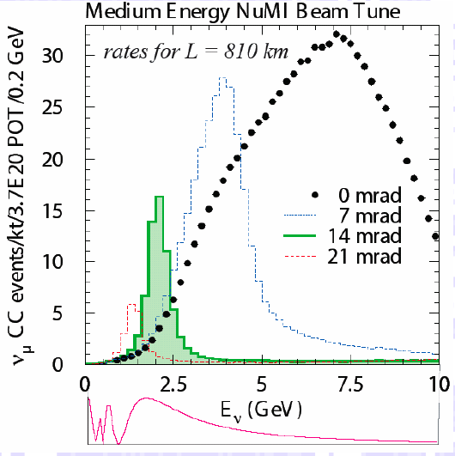
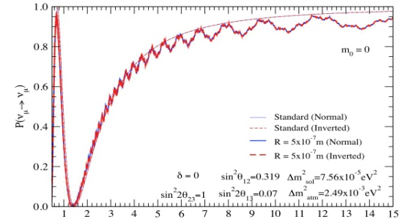
MINOS + (FY13-14)
Sensitivities to new physics
Kopp, Machado, Parke
MINOS now
MINOS @NOvA time
Machado, Nunokawa, Funchal
NOvA
0 2.5 5 7.5 10
Neutrino Energy (GeV)
0 5 10 15
E_{ν} (GeV)

Slide 14
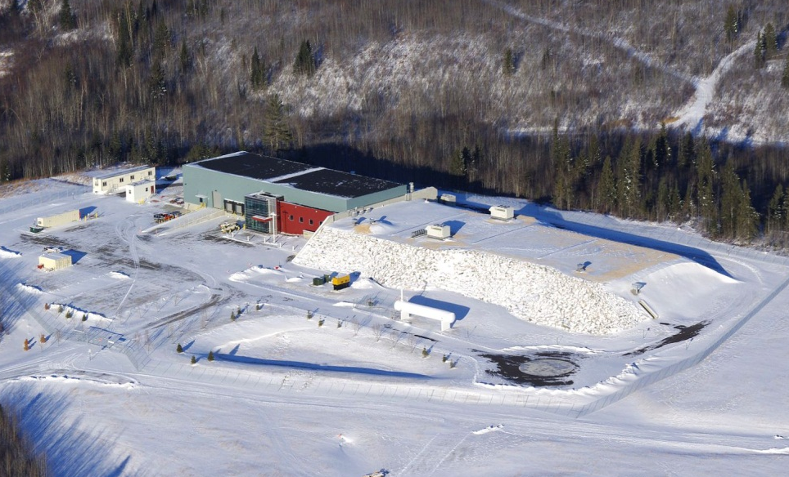
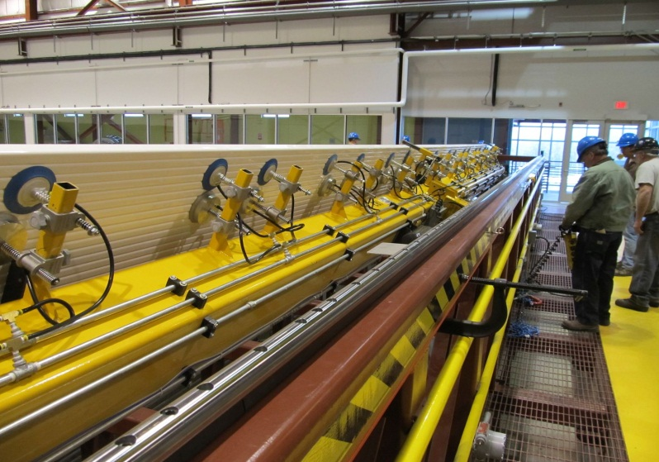
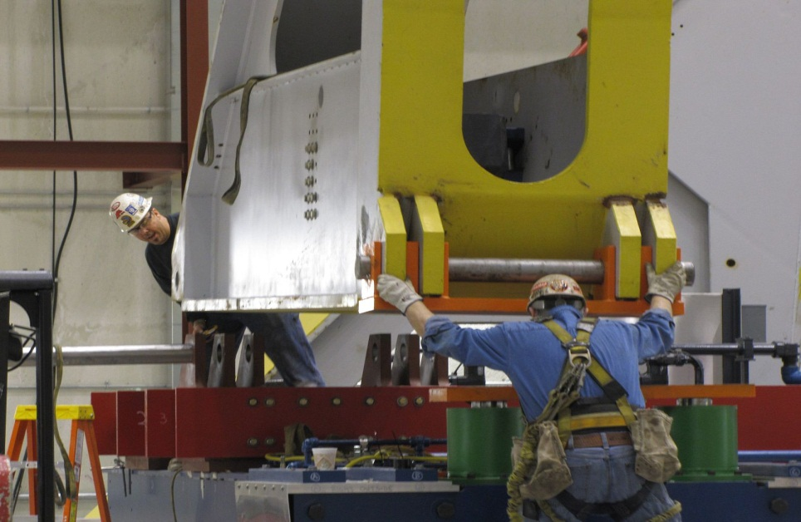
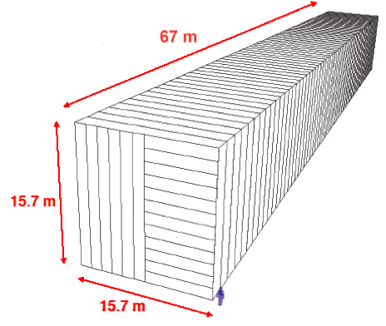
NOvA: electron appearance

Slide 15
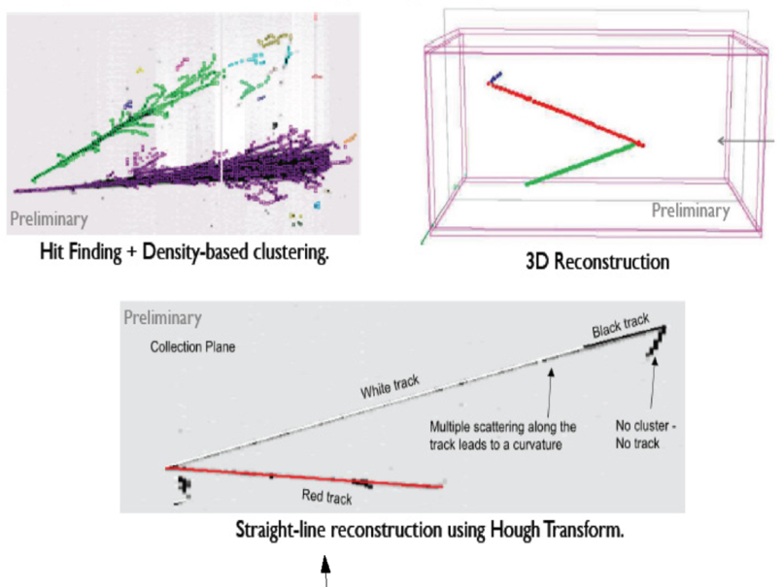
MicroBooNE
Follow excess in MicroBooNE data. Critical to determine is it electrons or photons?
Use Liquid Argon TPC: physics + further development of the technology

Slide 16

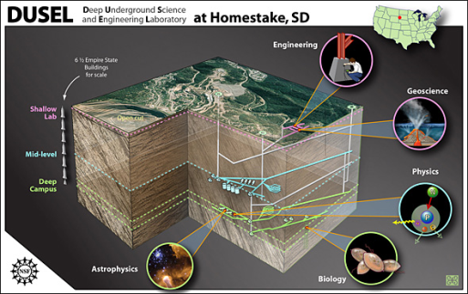
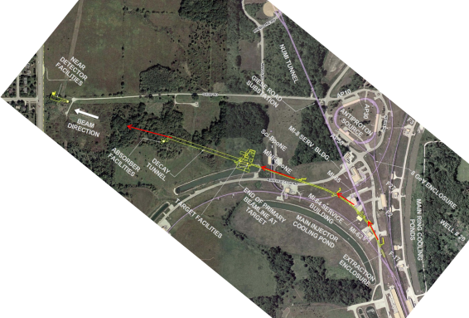
Long Baseline Neutrino Experiment
CD 0: January 2010
1300 km
Collaboration: 306 members
58 institutions (6 US labs) and 5 countries (India, Italy, Japan, UK, US)
Continue to grow!

Slide 17
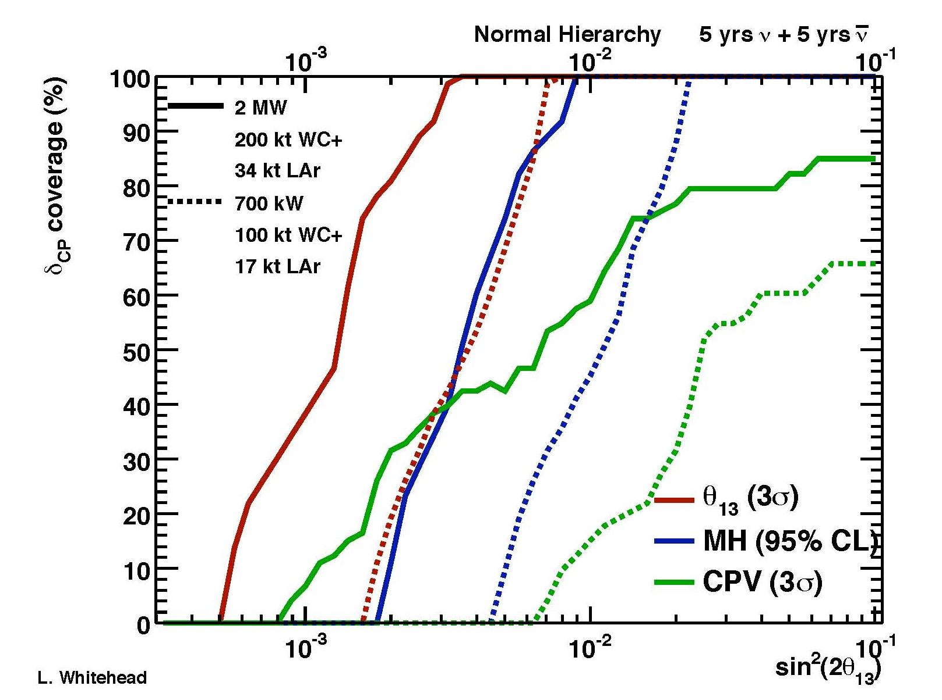
Evolution of Neutrino Sensitivities
LBNE NOvA MINOS >2 ← 0.7MW 0.7MW 0.3MW

Slide 18
Technology recommendation: LAr
Needs DOE concurrence: expected very soon
The proposal is to build 33 kton TPC in two modules at the 4850’ level
DOE would assume full control of the facility with NSF contributing to scientific instruments
Goals: neutrino mass hierarchy and CP violation. Proton decay into the k-mode, supernova explosion

Slide 19
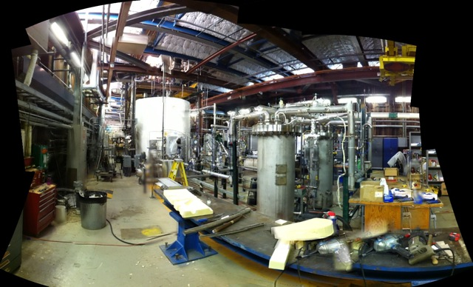
LAr Purity Demonstrator
LAPD has now run its liquid through the filters and continues to take data
Now measuring lifetimes > 5 ms after 8 volume exchanges, and still rising
(1.4 ms is needed for the LBNE drift)
Next goal: Maintain 5ms purity for several weeks

Slide 20
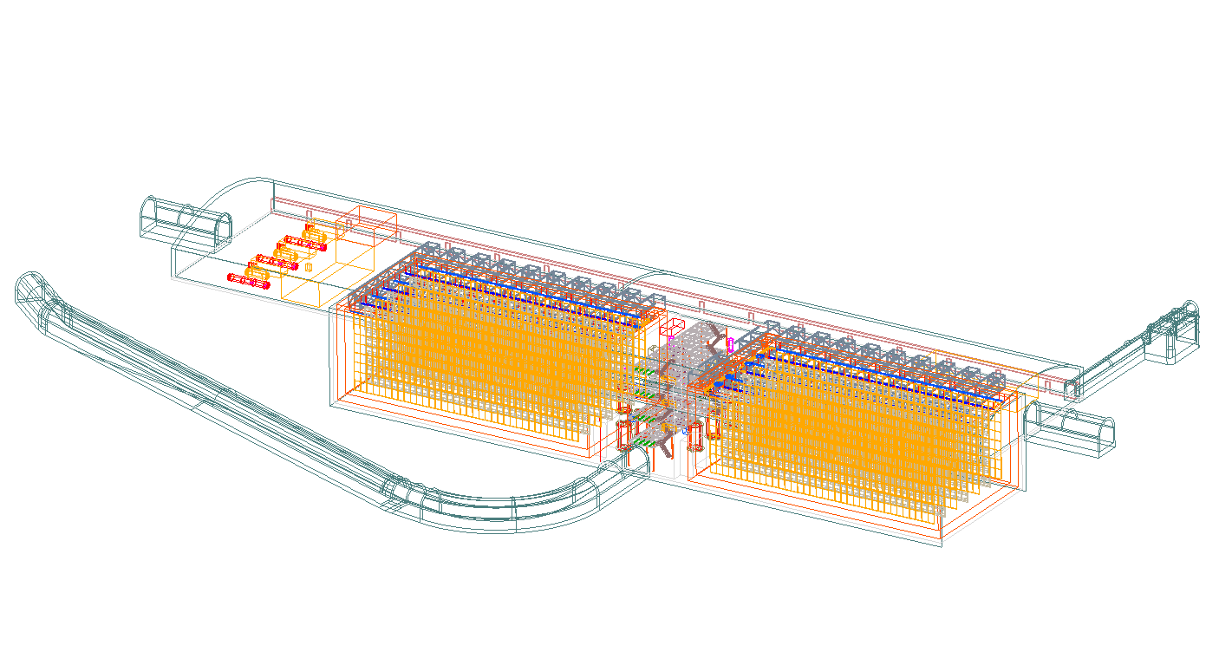
Underground LAr TPC

Slide 21
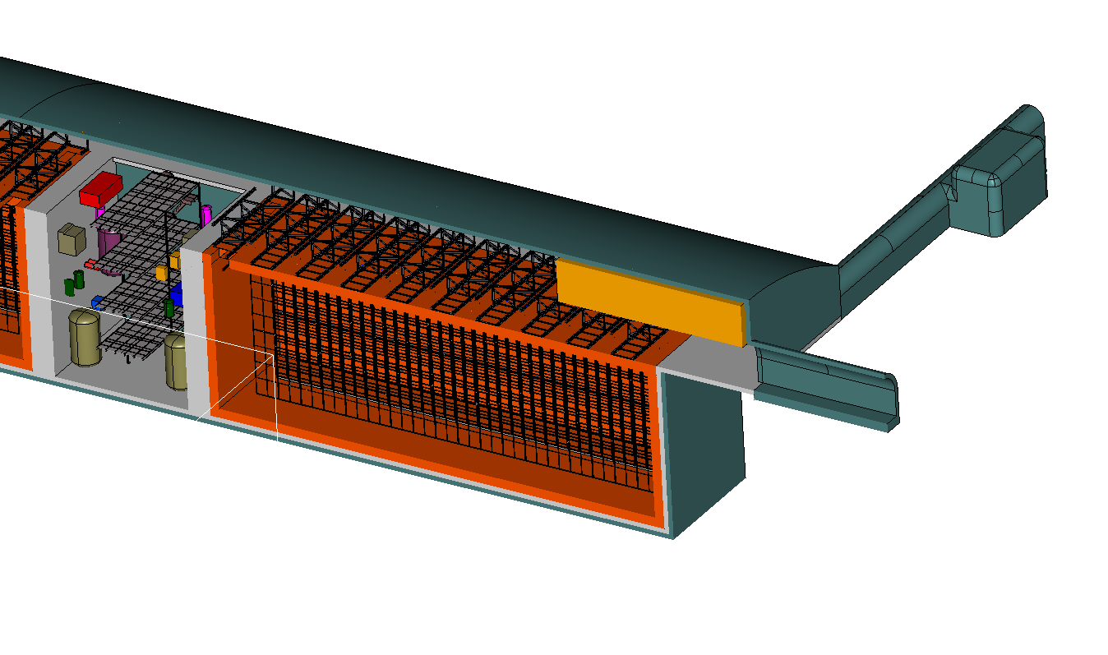
Underground LAr TPC

Slide 22
Fermilab facilities → intensity frontier
Rare Decays
Also in the intermediate term, a series of world-class experiments exploiting the present beams:
  g-2: anomalous magnetic moment of the muon x20 statistics
  Mu2e: direct muon to electron conversion - huge sensitivity to NP
  SeaQuest: nuclear physics Drell-Yan process to study the structure of the nucleon in the nuclear environment
nothing
Only handle on the
next energy scale
Intensity Frontier
LHC
Determine/verify
structure
Lots

Slide 23
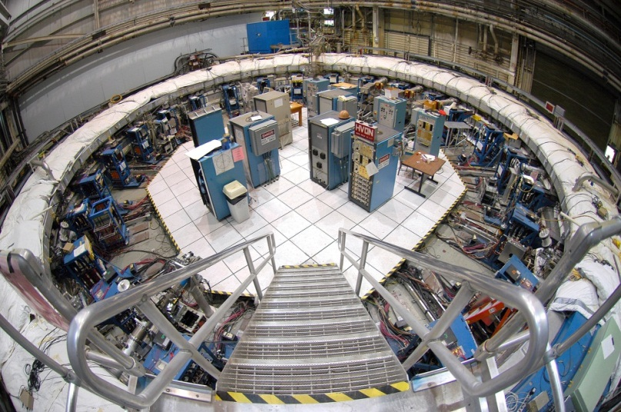
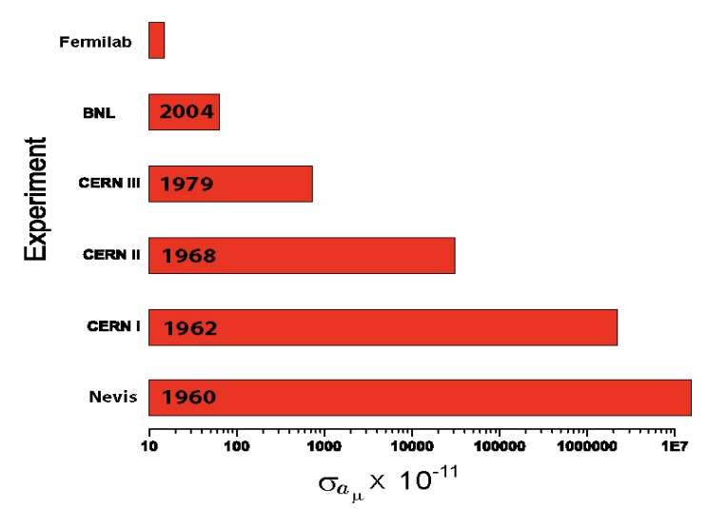
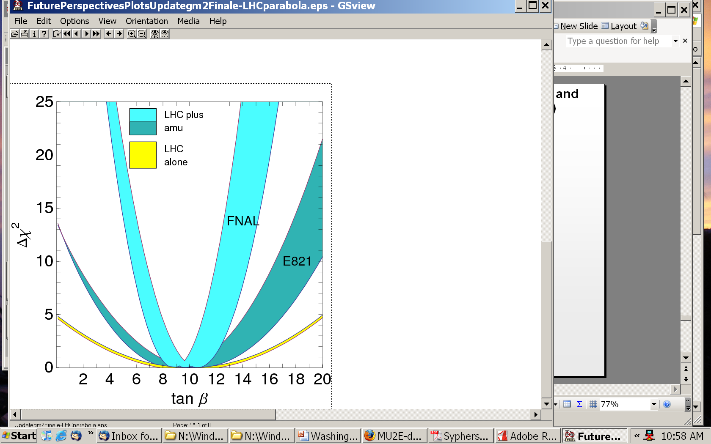
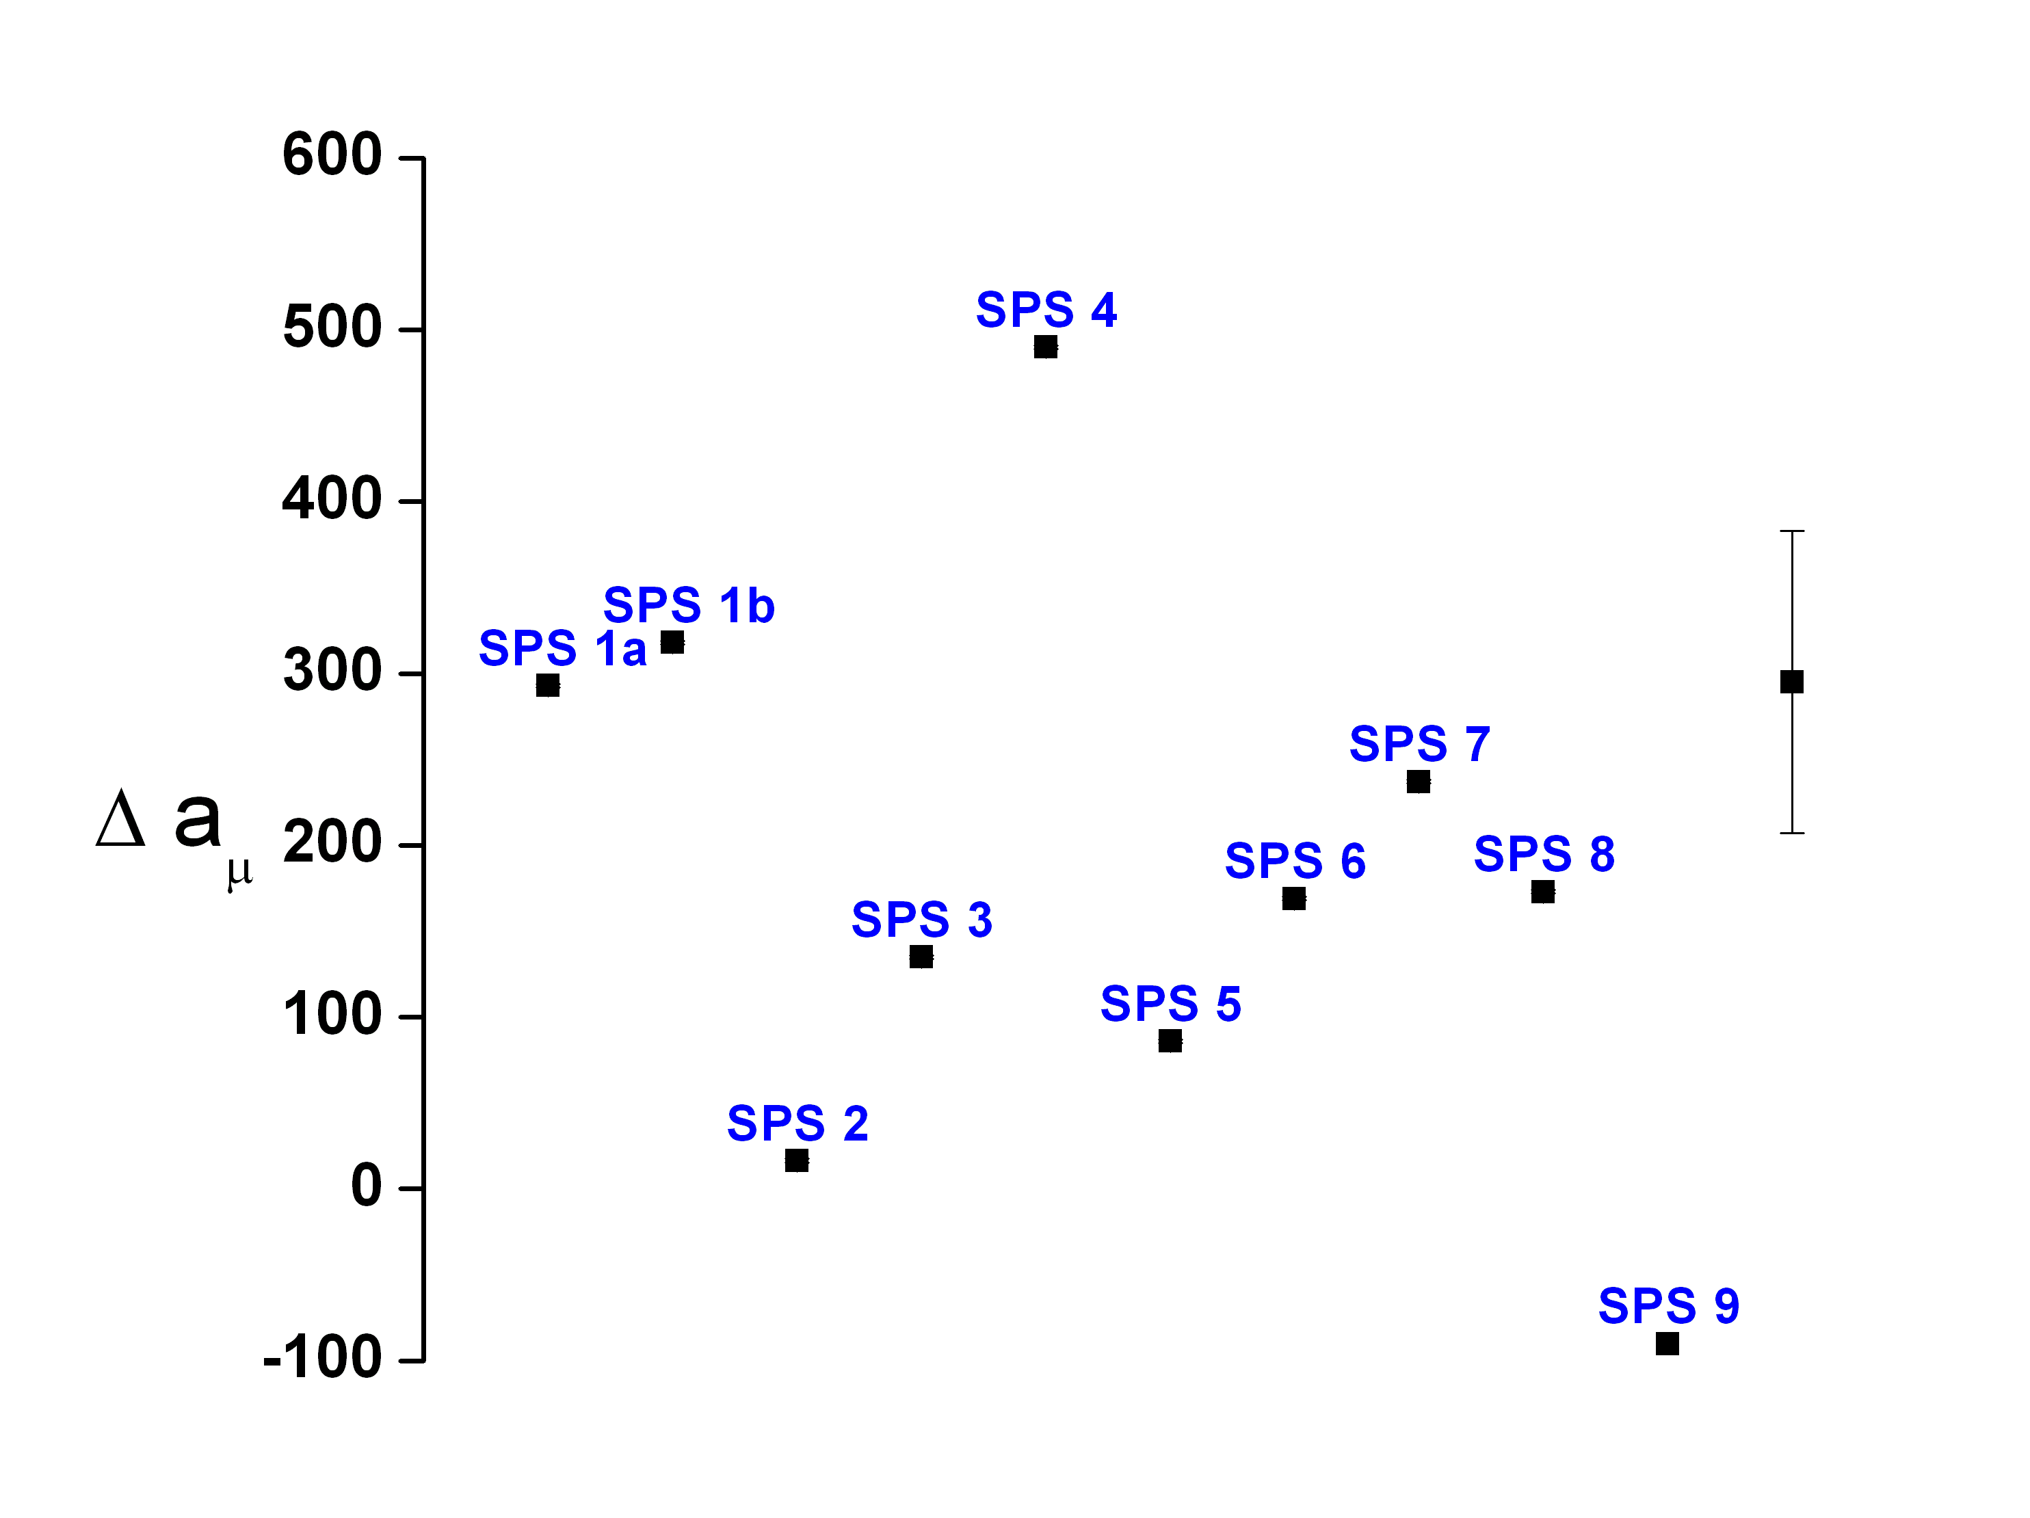
A new (g-2) to uncertainty 0.14*10⁻¹¹
Model
LHC
UED

Slide 24
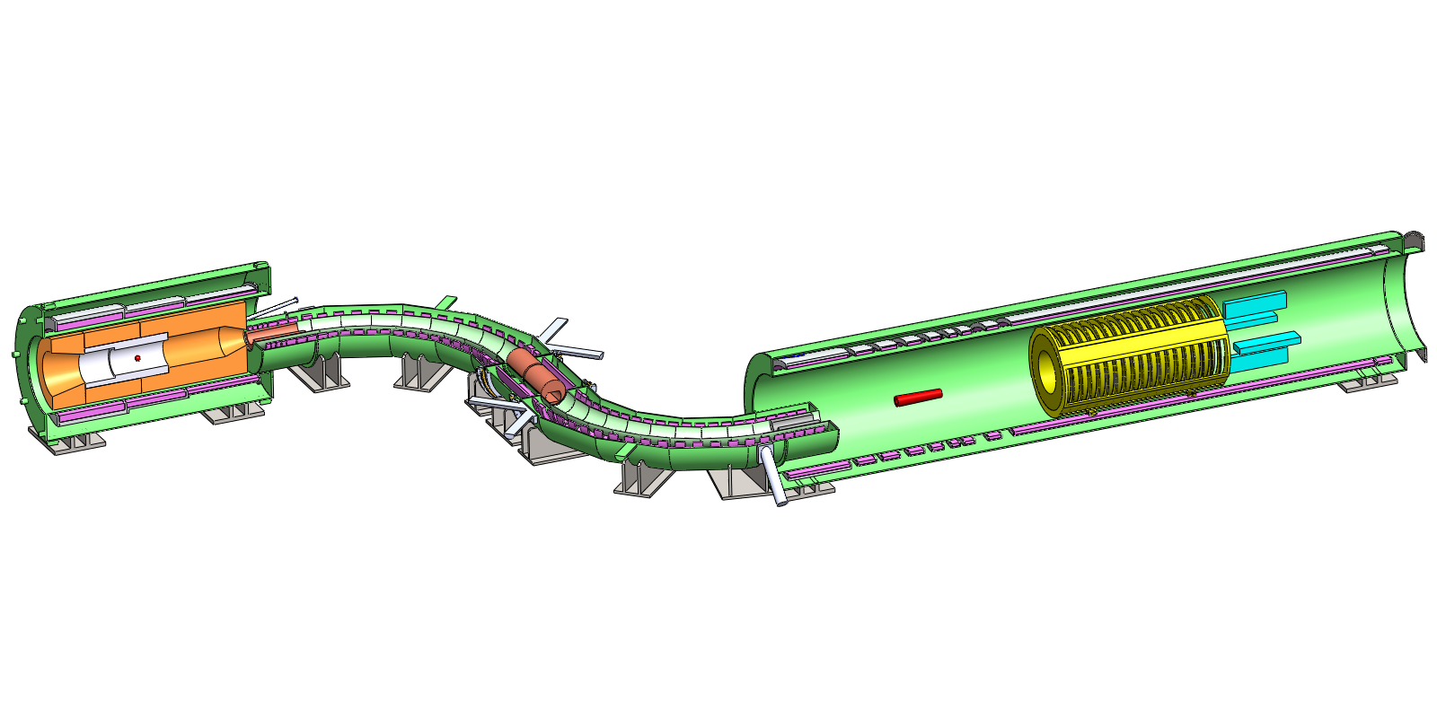
Some examples: Mu2e….
Production Solenoid
Detector Solenoid
Transport Solenoid
Production Target
Calorimeter
Tracker
Conversion of a muon into an electron in the field of a nucleus: negligible rate in the SM and measurable in almost any extension of the SM

Slide 25
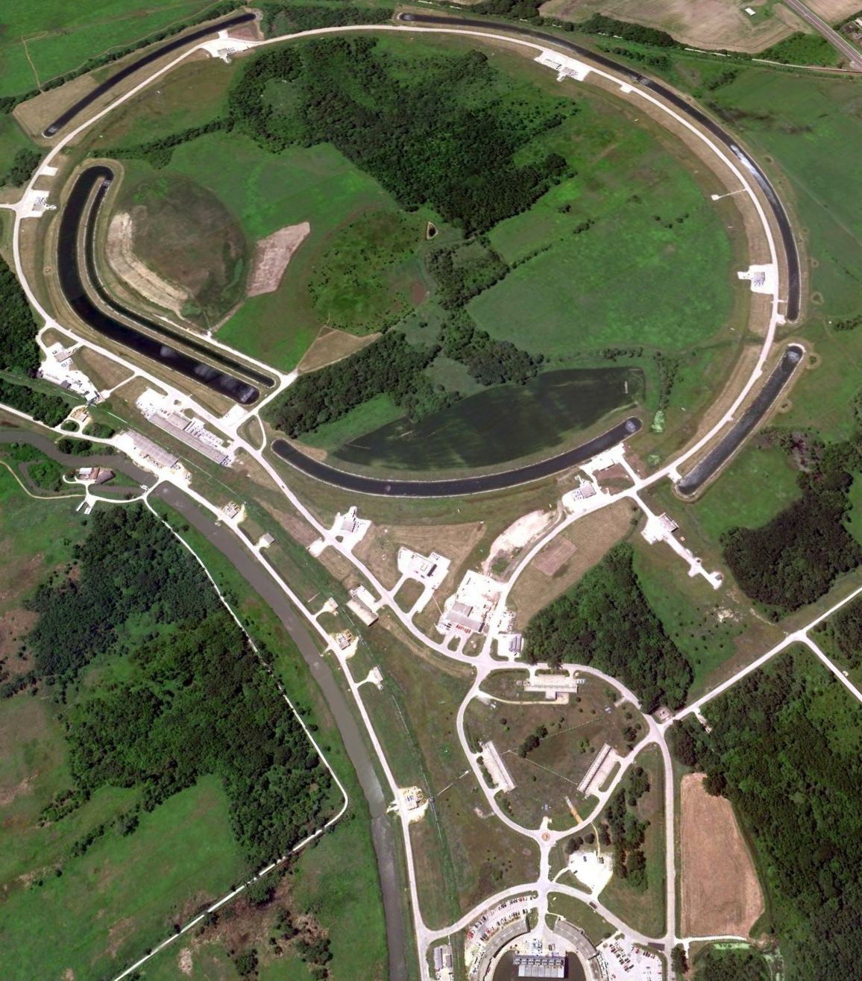


Mu2e and Muon (g-2) Programs
Proton delivery
Beam Transfer
Muon Campus

Slide 26
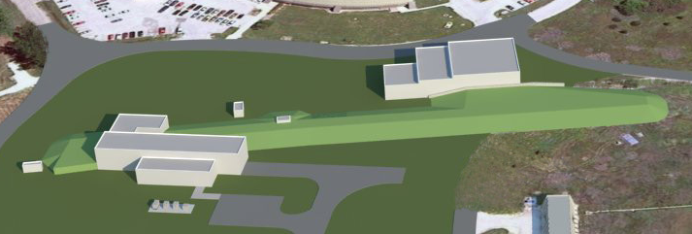
Muon Campus
Muon (g-2)
Building
Common Beam Line Enclosure
Mu2e Building
Mu2e and Muon (g-2) will use common beam line enclosure and infrastructure

Slide 27
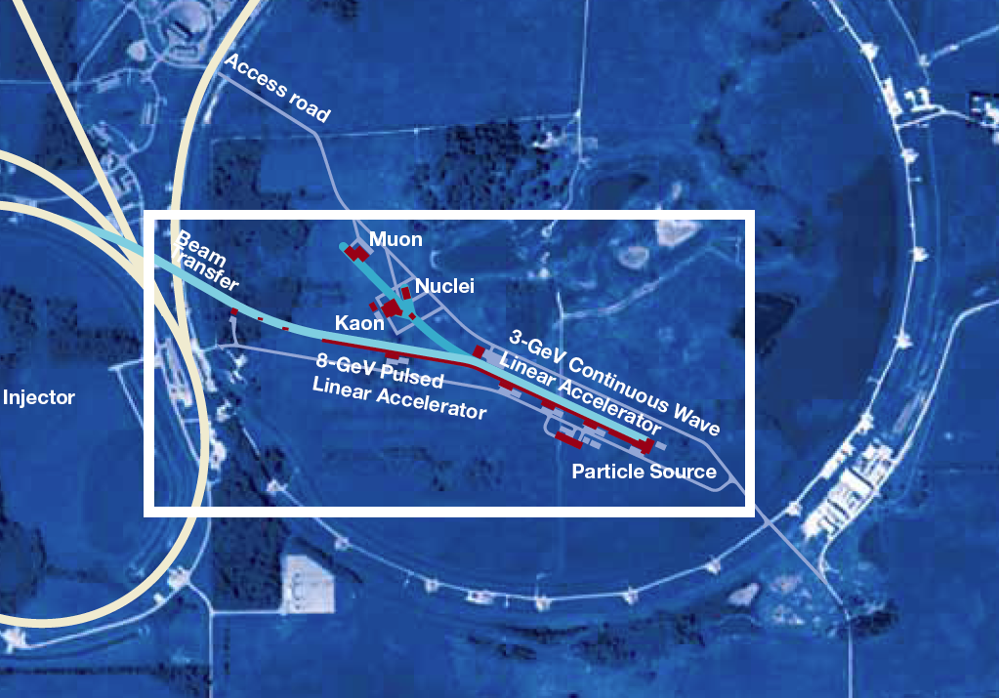
Mu2e and (g-2) with Project X ( First day: 3 GeV or 8 GeV)
3 GeV Transfer Line

Slide 28
Program next decade
LBNE (2+ MW): the long-base line experiment
  Neutrino mass spectrum (mass hierarchy)
  Matter-antimatter symmetry
  Neutrino/antineutrino differences
  Anomalous interactions
Project X: a broad program with megawatts of continuous beam, ideal to lead at the intensity frontier
  Neutrino, long/short base-lines, more than 2 MW to LBNE
  Kaons where the Standard Model backgrounds are minimal and we are sensitive to many models
  Rare muon decay with sensitivity to masses 10000 TeV
  Symmetry violations through electric dipole moments in nuclei
  Applications to transmutation, spallation targets, ADS

Slide 29
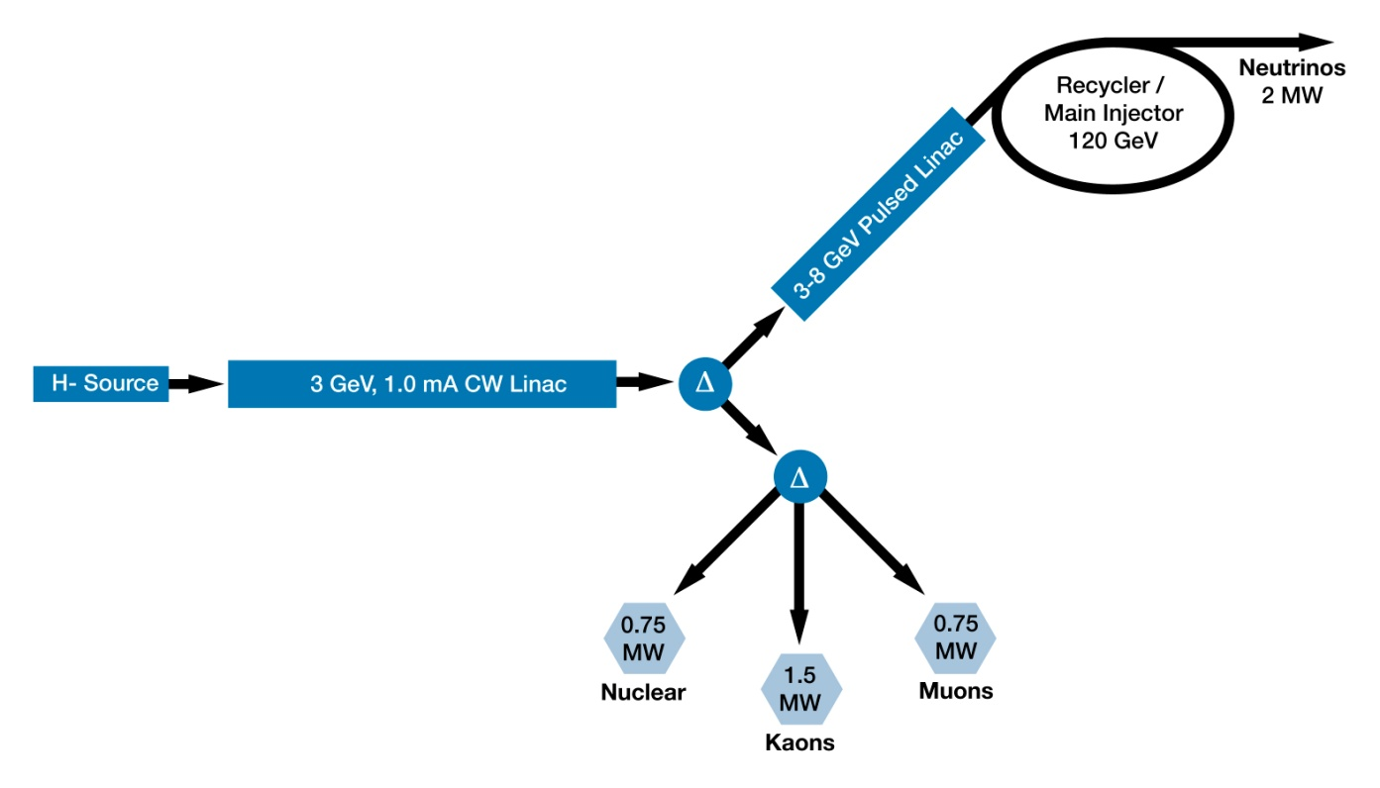
Project X Reference Design

Slide 30
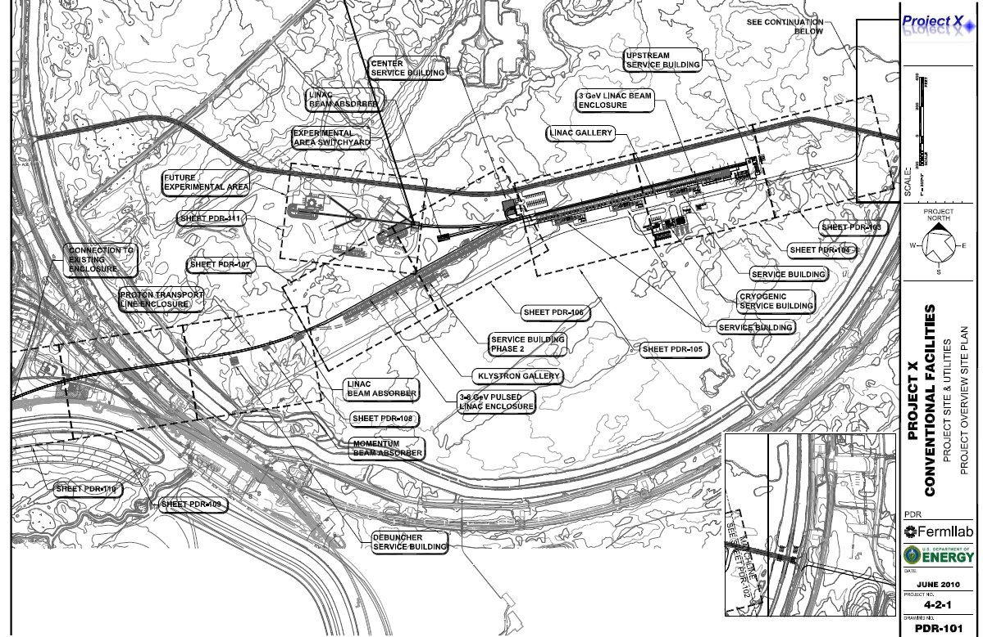
Project X Siting

Slide 31
Project X
Unique facility with 3 MW, continuous wave (CW) linac. Multiplies low energy flux of protons at Fermilab by 100 with flexible timing patterns, ideal for rare decays
Solves “proton economics”. Experiments run simultaneously at 3 GeV, 8 Gev and 60-120 GeV at high power
Delivers 2+ MW to LBNE
To be developed consistently to serve as front end of neutrino factory or muon collider

Slide 32
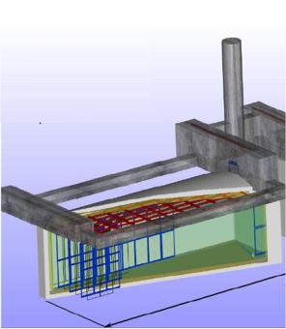
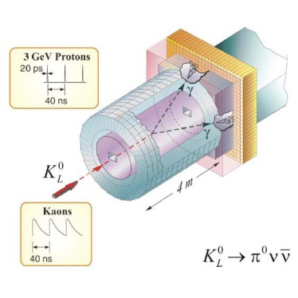
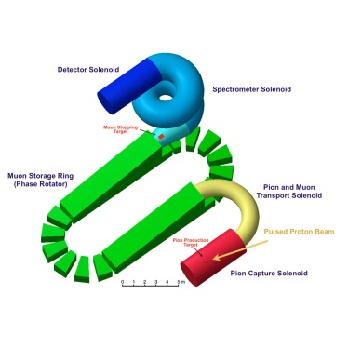
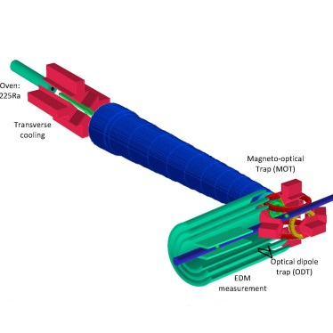
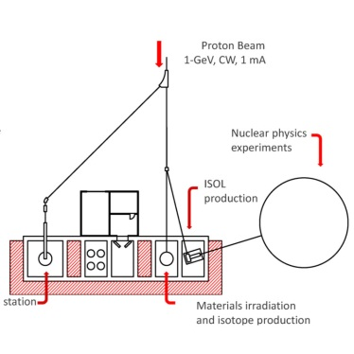
Project X: new experiments
Neutrinos
  Matter-antimatter asymmetry
  Neutrino mass spectrum
  Neutrino- antineutrino differences
  Anomalous interactions
  Proton decay
  SuperNova bursts
Kaons
  Physics beyond the Standard Model
  Elucidation of LHC discoveries
  Two to three orders of magnitude increase in sensitivity
Muons
  Oscillation in charged leptons
  Physics beyond the Standard Model
  Elucidation of LHC physics
  Sensitive to energy/mass scales three orders of magnitude beyond LHC
Nuclei
  New generation of symmetry-test experiments
  Electric Dipole Moments
  Three or more orders of magnitude increase in Francium, Radium, Actinium isotopes
Energy Applications
  Transmutation experiments with nuclear waste
  Spallation target configurations
  Materials test under high irradiation
  Neutron fluxes under various configurations relevant to ADS

Slide 33
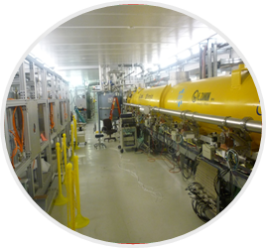
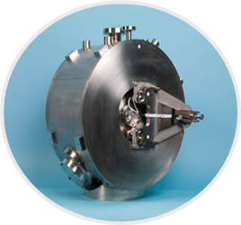
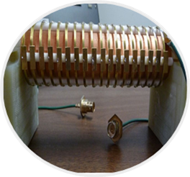
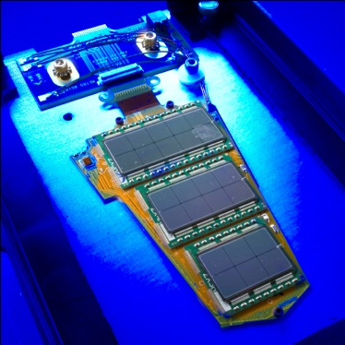

Project X: technology innovation
CW Linac Design
  Multi-MW/high duty factor (continuous wave) proton linac
  First of a kind, all superconductingRF design
  Low beam loss/high reliability
SRF Accelerating Modules
  State-of-the-art performance
  High Q₀/high gradient
  Low-β spoke resonators
  Medium-β elliptical resonators
  U.S. industrial development
Fast Chopper
  Revolutionary concept
  Programmable bunch patterns at 162 MHz
  Applications beyond HEP
Detector Development
  High speed electronics & triggering
  Rad hard detectors
  Large Liquid Argon Time Projection Chambers
  Cryo-electronics
  High power targeting
Transmutation
  MW-class CW beams at 1 GeV
  Technology demonstration
  Benchmarking experiments to validate concepts

Slide 34



Project X and the big questions
Where does mass come from?
Why is matter dominant?
What are the neutrino masses and what do they say?
  Where are the heavy neutrino partners?
  Why are there three families of quarks and leptons?
  Do the forces unify?
  Does nature use supersymmetry or other new symmetries?
  Are there extra dimensions of space?
  What is dark matter?
  What is dark energy?
neutrinos
muons
kaons
Nuclei
(EDMs..)

Slide 35






Fermilab and the intensity frontier
NOvA
MicroBooNE
g-2
MINERvA
MINOS+
SeaQuest
MINOS
MiniBooNE
MINERvA
SeaQuest
NOvA
g-2
LBNE
Mu2e
Project X+LBNE
μ, K, nuclear, …
ν Factory ??

Slide 36

Muon collider layout
From Project X to Neutrino Factory and Muon Collider
4 TeV
ILC/Project X
technology
Project X upgrade

