Slide 1


Magnets and RF Working Group Plans
Jim Clarke
ASTeC and The Cockcroft Institute,
Daresbury Science and Innovation Campus
On behalf of Peter McIntyre, Giorgio Apollinari, and Vladimir Shiltsev
Proton Accelerators for Science and Innovation Workshop, 12th January 2012

Slide 2
Magnets and RF
Magnets and RF are (of course) key technologies for accelerators
R&D in both these areas is vital for the success of future projects
Prototyping is expensive and takes time but is (usually) essential – especially in the most demanding of applications
It seems likely that there are opportunities for working more closely together to pool resources and expertise

Slide 3
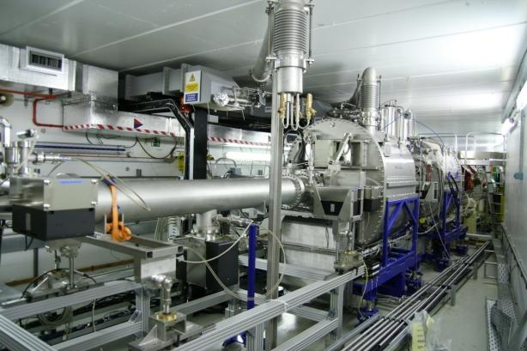
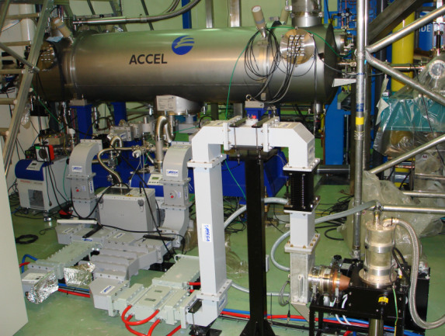
UK Context: SRF
The UK now has many years experience of operating superconducting RF cryomodules
  supplied by industry
  electron accelerators
Diamond Light Source, 500MHz
ALICE ERL, 1300MHz

Slide 4
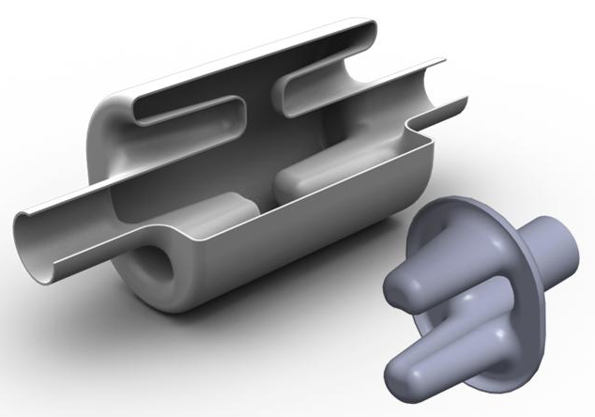
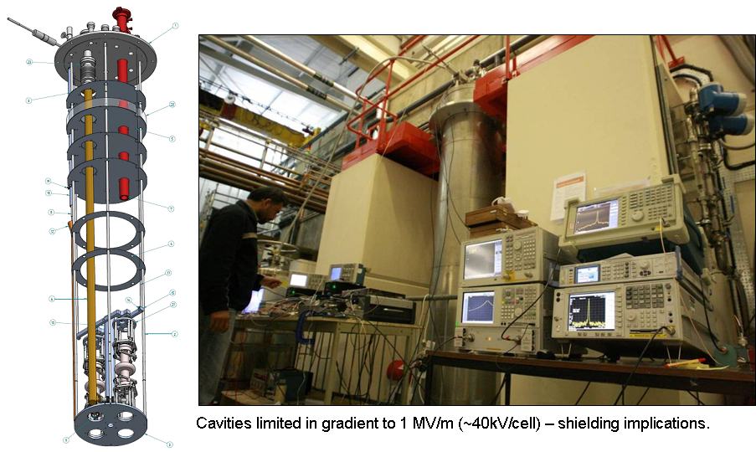
UK Context: SRF
The UK has led the design of the ILC crab cavities (with FNAL!) and is now focussed on crab cavities for LHC
LHC Crab Cavity
ILC Crab Cavity under test at Daresbury

Slide 5
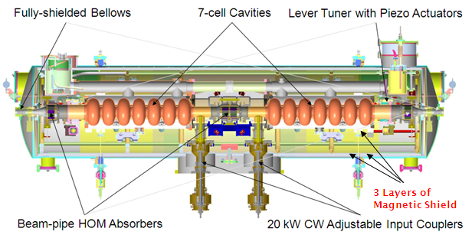
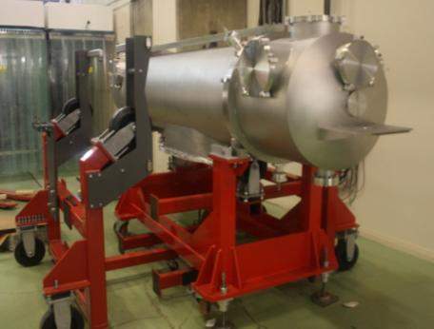
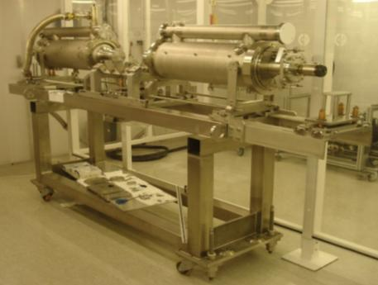
UK Context: SRF
The first ever SRF cryomodule (DICC) to be assembled in the UK is about to be installed and tested on ALICE
International collaboration:
  ASTeC (STFC)
  Cornell University
  DESY
  FZD-Rossendorf
  LBNL
  Stanford University
  TRIUMF

Slide 6
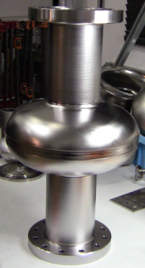
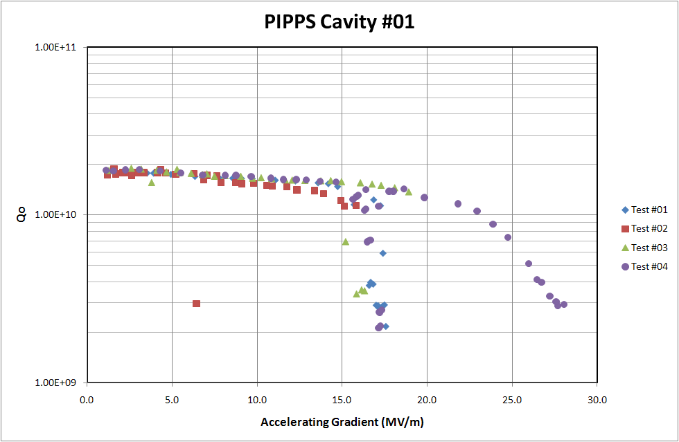
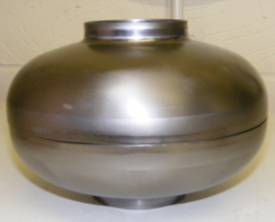

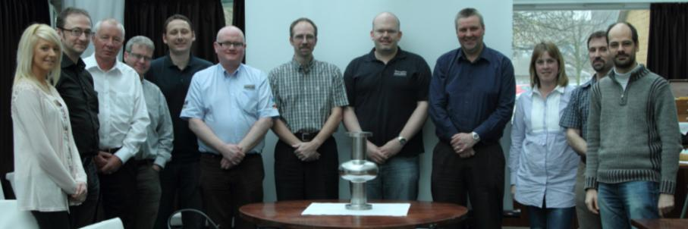
UK Context: SRF
The first ever SRF cavity to be built by UK industry was achieved and successfully tested in 2010
Courtesy: P Kniesel (J-Lab) – 31/1/2011
Multipacting
(15 – 17 MV/m)

Slide 7
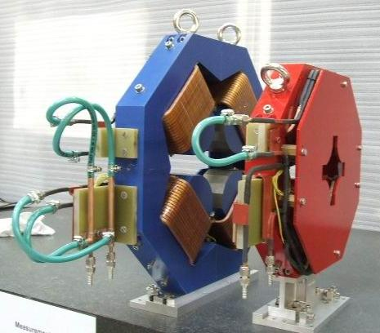
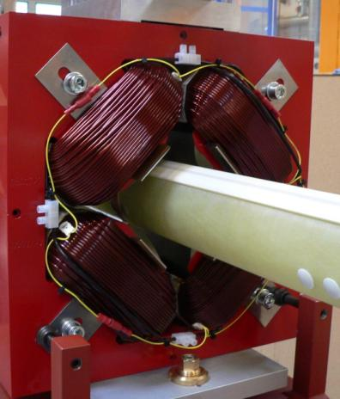
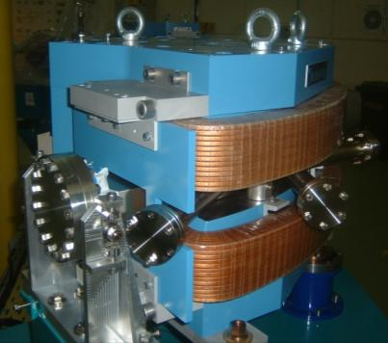
UK Context: Magnets
An active (though small!) skill base exists in the UK in the area of resistive accelerator magnets
ALICE Dipole
Prototype Quadrupoles for EMMA
ALICE Quadrupole

Slide 8
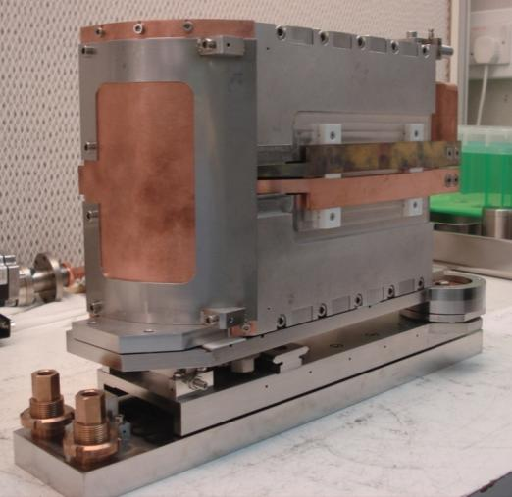
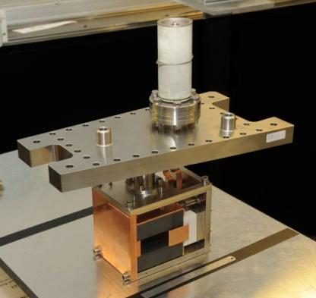
UK Context: Magnets
The UK also has expertise in fast pulsed magnets ...
EMMA Kicker (50ns rise/fall time)
EMMA Septum (0.8T, ~8cm long)

Slide 9
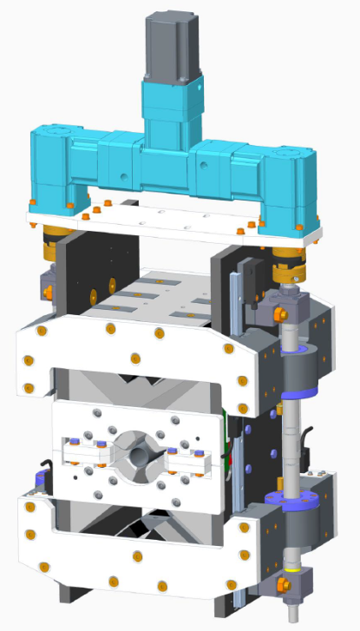
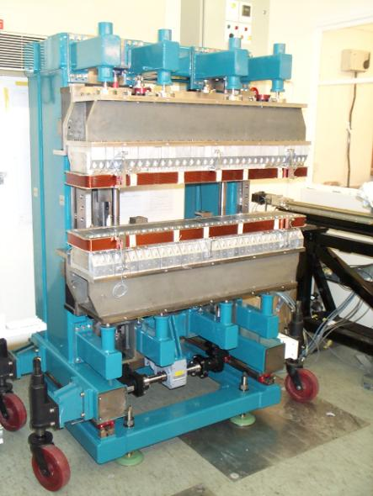
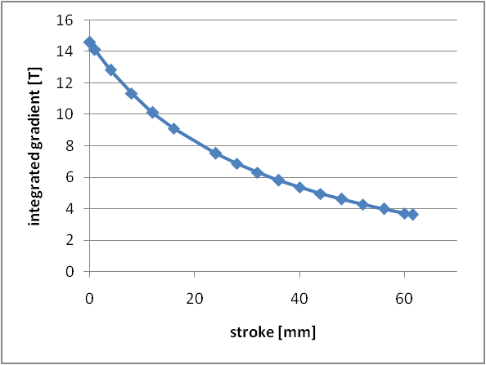
UK Context: Magnets
And permanent magnet systems ...
CLIC Tuneable PM Quadrupole
SRS Wiggler (2.4T)

Slide 10
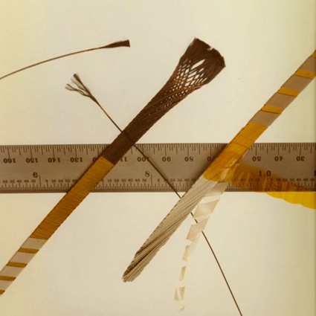
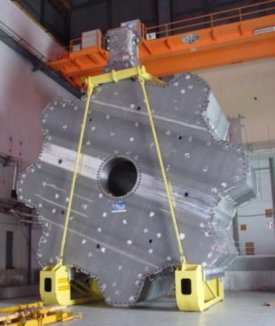
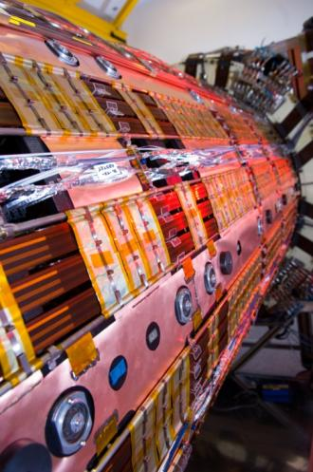
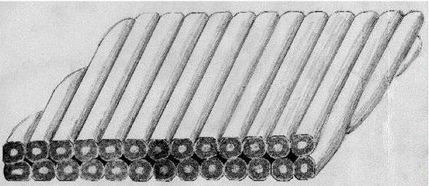
UK Context: Magnets
The UK has (historically) played a key role in the development of superconducting magnets for accelerators and detectors
Rutherford cable
ATLAS End Caps

Slide 11
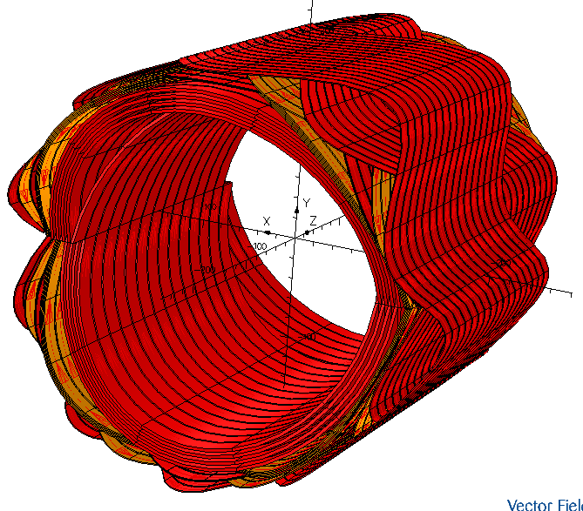
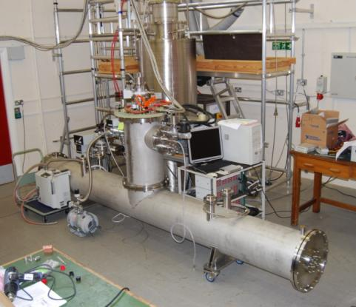
UK Context: Magnets
Recent superconducting magnet work has mainly focussed upon undulators and novel FFAG designs
FFAG combined function magnets (Holger Witte)
Helical Undulator for ILC

Slide 12
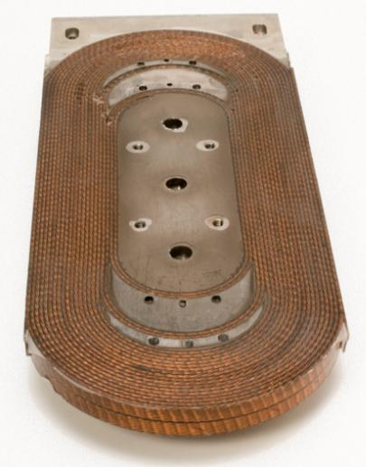
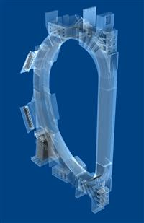
UK Context: Magnets
Recent superconducting magnet work also includes studies of insulating materials and coatings with superior mechanical and electrical properties
  Part of EuCARD study on High Field Accelerator Magnets
Resin development for ITER
Short model Nb₃Sn coil

Slide 13
Working Group Timetable
Friday - Theory West (WH2NW)
9.00 Superconducting RF for linear hadron accelerators – Slava Yakovlev
9.40 Superconducting RF operational experience at FNAL – Elvin Harms
10.20 Coffee Break
10.50 Advances in proton linac design & simulation – Peter Ostroumov
11.30 Superconducting materials for SRF & high field magnets – Lance Cooley
12.10 Prospects for induction acceleration in FFAGs – Neil Marks
12.50 Lunch
14.00 High field dipole studies at FNAL – Alexander Zlobin
14.40 Helical solenoids for muon colliders – Michael Tartaglia
15.20 Coffee Break
15.50 The use of HTS in HEP magnets – Emanuela Barzi
16.30 The PAMELA FFAG magnet designs – Holger Witte
17.10 Discussion & Planning
17.30 End of day
Saturday - Theory West (WH2NW)
9.00 800 MeV Strong-Focusing Cyclotron – Peter McIntyre
9.40 Identification of potential synergies
10.30 Coffee Break
11.00 Summary writing and documenting of collaborative opportunities
12.30 Lunch

