Slide 1
Accelerator Driven Systems: Outlook
Stuart Henderson
Fermilab
With thanks to Shekhar Mishra, Yousry Gohar, Jerry Nolen

Slide 2
Very Recent History (National and International Context)
Oct, 2009: DOE/OHEP sponsors Workshop on Accelerators for America’s Future; applications in energy and environment were a central component
March 2009: Belgian government approved funding for MYRRHA, a 50-100 MWth accelerator-driven research reactor
May 2009: Office of Science phone conference on ADS – “Has anything changed in the last 15 years that would motivate looking at this stuff again?”
Spring 2009: Dr. S. Banerjee, India DAE meets with Off. Sci.
June 2009: DOE/OHEP asked to organize a working group to write a White Paper on accelerator/target technology
July: ADS working group (E. Pitcher/S. Henderson chairs) met and drafted the White Paper; attended by Office of Science

Slide 3
Very Recent History (National and International Context)
September: ADS White Paper issued
http://www.science.doe.gov/hep/files/pdfs/ADSWhitePaperFinal.pdf
November: Announcement at ADS workshop in China of the Chinese vision for ADS
November: E. Pitcher/S. Henderson briefing of Secretary Chu on ADS prior to China visit
December: Study launched at ORNL to assess potential of SNS 2nd target station as an accelerator-driven reactor with focus on irradiation capability

Slide 4
Very Recent History: Fermilab Context
Oct. 2009: Workshop on Applications of High-Intensity Proton Accelerators (Mishra, Raja)
Summer 2010: Working Group formed to explore nuclear energy applications with Project-X (Mishra, Gohar, Johnson, Johnson)
Oct. 2010: Indian Institutes and Fermilab Collaboration meeting in India
Nov. 2010: Mini-workshop on Nuclear Energy Applications with Project X held at Fermilab
Nov/Dec: Project X briefings to OHEP, Off. Sci.

Slide 5
Fermilab Perspective on ADS
A Multi-Megawatt proton beam is
a national resource,
providing capabilities unparalleled in the world,
with potential application far beyond high-energy physics
Project X can help to meet the national need in two research thrusts:
Development of advanced fuel cycles through an experimental program aimed at transmutation technology demonstration (ADS)
Providing irradiation capabilities needed for the development of materials for advanced energy systems
If the US decides to develop and demonstrate accelerator-driven nuclear technology, Project-X provides an ideal beam and serves as an ideal testbed

Slide 6
Project-X Can Help Meet National Needs in Development of Advanced Nuclear Technology
A MW-class proton beam in the GeV energy range coupled to a flexible, dedicated target facility can support a research and development program focused on transmutation experiments and technology
Objective of the R&D Program:
Perform spallation neutron target and transuranic transmutation experiments to verify and confirm the technical approach and the proposed technologies for disposing of spent nuclear fuels using accelerator driven systems.

Slide 7
R&D Priorities for Nuclear Energy
Demonstrate and verify the following aspects of the neutron spallation target systems:
Neutron yield, spectra, and spatial distribution.
Control and recovery of the spallation products.
Chemistry control of the liquid metal
Thermal hydraulics parameters of the target design
Demonstrate and verify the following aspects for the subcritical assembly:
The thermal hydraulics parameters including the velocity and the temperature distributions, and the pressure drop
The chemistry control of the fuel carrier to protect the structure material
The removal of the short lived fission products from the mobile fuel carrier
The online measurements of the mobile fuel composition
The operation of the continuous feed of the transuranic materials to control the composition of the mobile fuel carrier

Slide 8
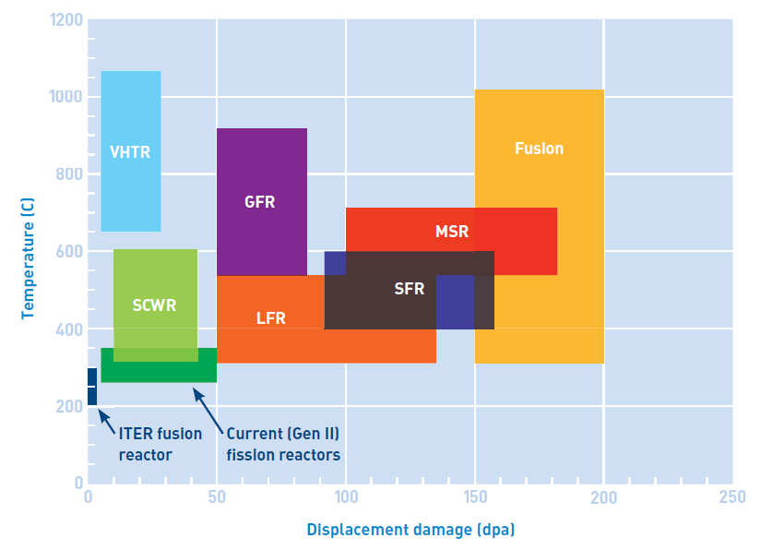
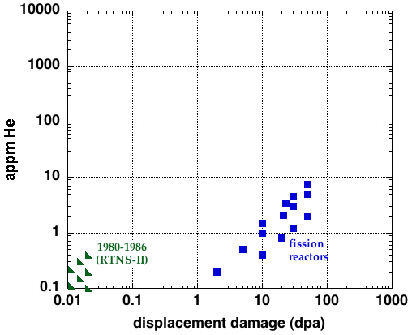
Materials Irradiation
Next generation materials must be engineered to withstand high radiation damage, temperature and He concentration
A suitable irradiation source is a critical need for future fission/fusion materials development
A MW-class proton beam driving a target designed for high neutron flux can meet this need
Steels
Spallation
neutrons
Fusion
reactor
IFMIF
ITER

Slide 9
Functional Layout of the Joint Facility at Project X
1 MW at 1 GeV or 3 GeV
incident beam
Selection dipole
Standard Model
Experiments
Support Services
Energy applications
Isotope Production
Material irradiation

Slide 10
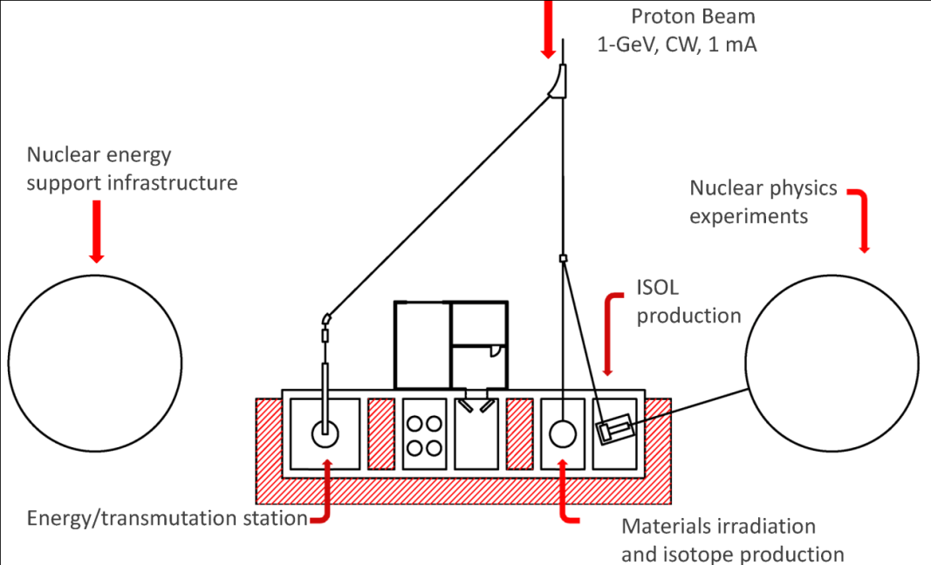
Schematic Layout: NE/NP Area

Slide 11
Conclusion
MW-class proton beams have wide-ranging application beyond High Energy Physics
Project X can provide MW-class proton beams for essential target and materials developments in support of high priority national programs for future energy sources

Slide 12
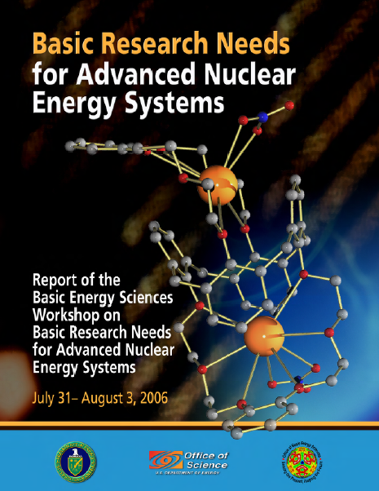
National Needs in Advanced Energy Systems are Articulated in Numerous Recent Reports
DOE/BES Report: Basic Research Needs for Advanced Nuclear Energy Systems
“The fundamental challenge is to understand and control chemical and physical phenomena…from femto-seconds to millennia, at temperatures to 1000 C, and for radiation doses to hundreds of displacements per atom. This is a scientific challenge of enormous proportions, with broad implications in the materials science and chemistry of complex systems”

Slide 13
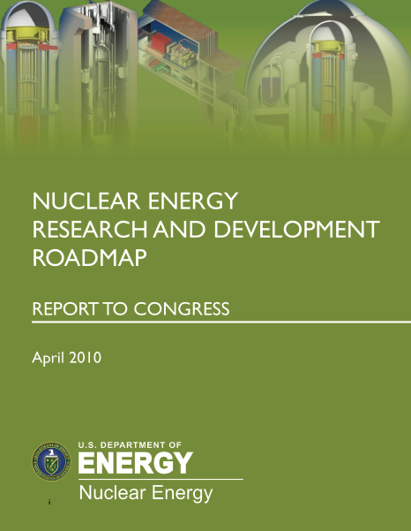
National Needs in Advanced Energy Systems are Articulated in Numerous Recent Reports
DOE/NE Report: Nuclear Energy Research and Development Roadmap
R&D on Transmutation Systems for Sustainable Fuel Cycle Options
R&D to develop fast-spectrum reactor technology
DOE/HEP Report: Accelerators for America’s Future
R&D on Accelerator-Driven Systems technology focusing on high-reliability linear accelerator and liquid-metal target technology

Slide 14
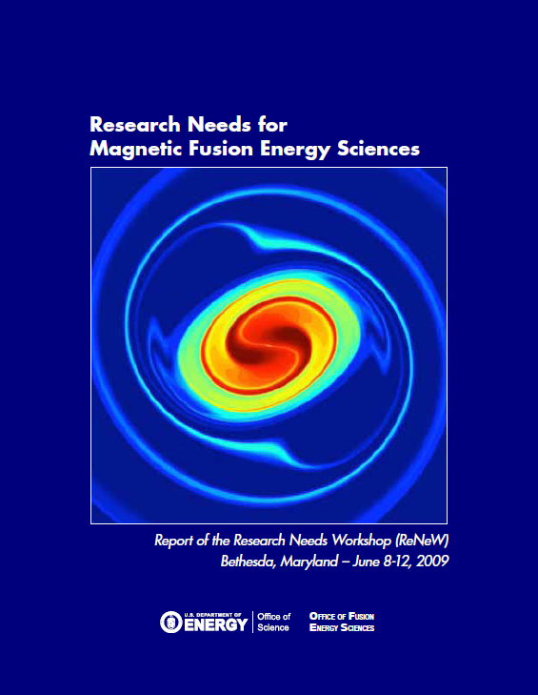
National Needs in Advanced Energy Systems are Articulated in Numerous Recent Reports
DOE/FES Report: Research Needs for Magnetic Fusion Energy Sciences
Thrust: Develop the material science and technology needed to harness fusion power
“Establish a fusion-relevant neutron source to enable accelerated evaluations of the effects of radiation-induced damage to materials”

