Slide 1
UK Plans and Goals
John Womersley
Chief Executive, Science and Technology Facilities Council
January 2012

Slide 2
Outline
Introduction to STFC
Our accelerator R&D Programme
Looking forward
John Womersley

Slide 3
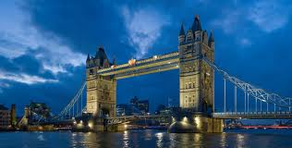
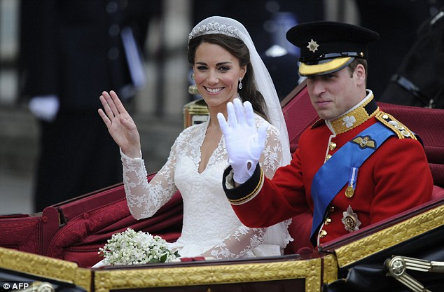

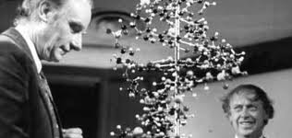

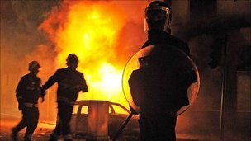


Slide 4
UK Share of Global Science
Royal Society - “The Scientific Century”

Slide 5










HM Government &
Notes:
The Science and Technology Facilities Council is an independent, non-departmental public body of the Department for Business, Innovation and Skills (DBIS).
The majority of our funding is public money from DBIS, allocated through the Comprehensive Spending Review.
STFC also receives a capital allocation from government for investment in infrastructure or assets.
STFC receives additional funding from a variety of other sources, including the other Research Councils, the European Space Agency, the European Commission and industry.

Slide 6
Underpinning Technology National Laboratories Science and Innovation Campuses
UK National Facilities
ISIS, Diamond, Central Laser Facility
Research in nuclear and particle physics and astronomy
International Science Facilities
CERN, ESO,
ESRF, ILL
Notes:
The Science and Technology Facilities Council is an independent, non-departmental public body of the Department for Business, Innovation and Skills (DBIS).
The majority of our funding is public money from DBIS, allocated through the Comprehensive Spending Review.
STFC also receives a capital allocation from government for investment in infrastructure or assets.
STFC receives additional funding from a variety of other sources, including the other Research Councils, the European Space Agency, the European Commission and industry.

Slide 7
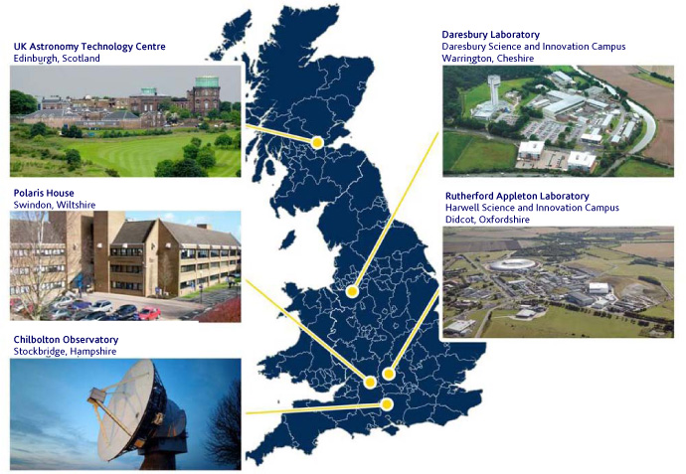
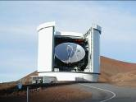
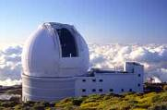
STFC is responsible for “big science” in the UK: particle and nuclear physics, astronomy, x-ray light sources, neutron sources and high power lasers
Joint Astronomy Centre Hawaii
Isaac Newton Group of Telescopes
La Palma
+ grants to UK universities and research at CERN, ESO, ESRF and ILL
Notes:
STFC employs over 2,200 staff over seven locations
Swindon, Head Quarters
Rutherford Appleton Laboratory in Oxfordshire, which is part of the Harwell Science and Innovation Campus
Daresbury Laboratory in Cheshire, which is part of the Daresbury Science and Innovation Campus
the UK Astronomy Technology Centre in Edinburgh
the Chilbolton Observatory in Hampshire
the Isaac Newton Group of Telescopes on La Palma in the Canary Islands
the Joint Astronomy Centre in Hawaii.

Slide 8
STFC's Science Programme
During 2009 we re-prioritized our entire programme
Started with community consultation
Based on advice from our advisory committees, we constructed a science programme with a 10 year planning horizon assuming flat cash budgets
Required tough decisions and some unpalatable choices, but ensures our forward planning is on a firm footing
The 2010 Comprehensive Spending Review provided sufficient funding to allow us to take this program forward over the next 4 years
John Womersley

Slide 9
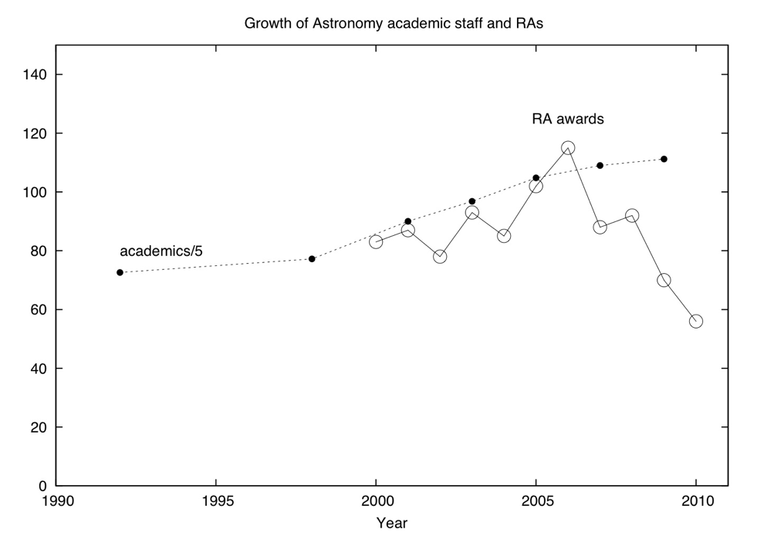
Tough choices…
Number of postdoctoral research associates in astronomy awarded each year
1990
1995
2000
2005
2010
By focusing support on our highest priorities we have delivered a sustainable and affordable program…
that will make significant scientific advances
… and will allow us to make the case for budget increases in due course

Slide 10
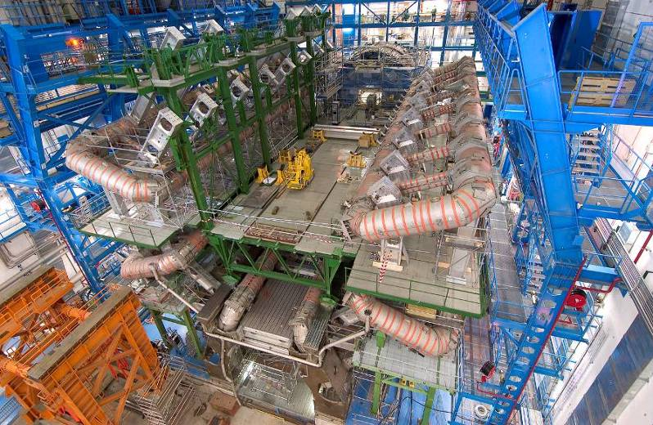
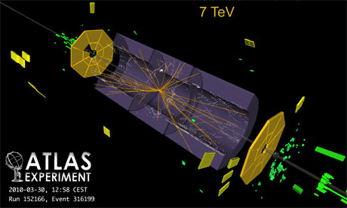
Particle Physics Priorities
Our highest priority in particle physics is the exploitation of the Large Hadron Collider at CERN. The LHC will reveal how nature operates at energy scales where the standard model of particle physics breaks down and will transform our understanding of the fundamental rules of the universe.
John Womersley

Slide 11
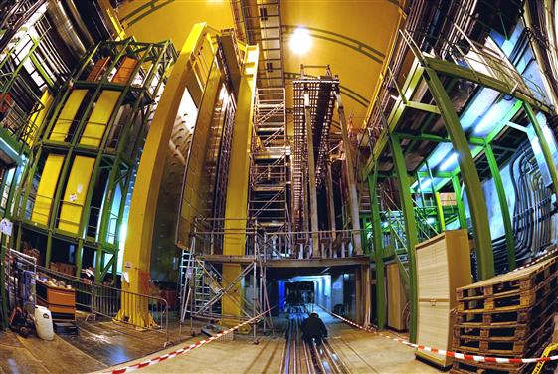
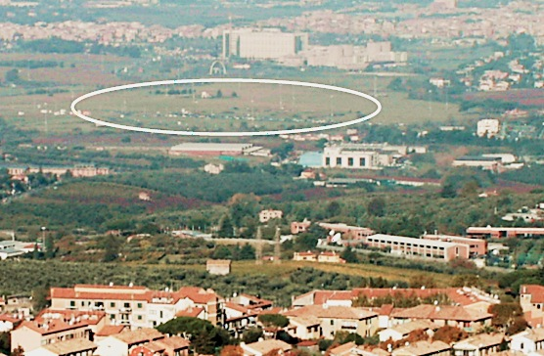
Flavour physics
Major focus is LHCb
Very modest involvement in CERN NA62 (rare K decays)
Some community interest in INFN Super-B factory
  Level of involvement will depend on science interest and affordability

Slide 12
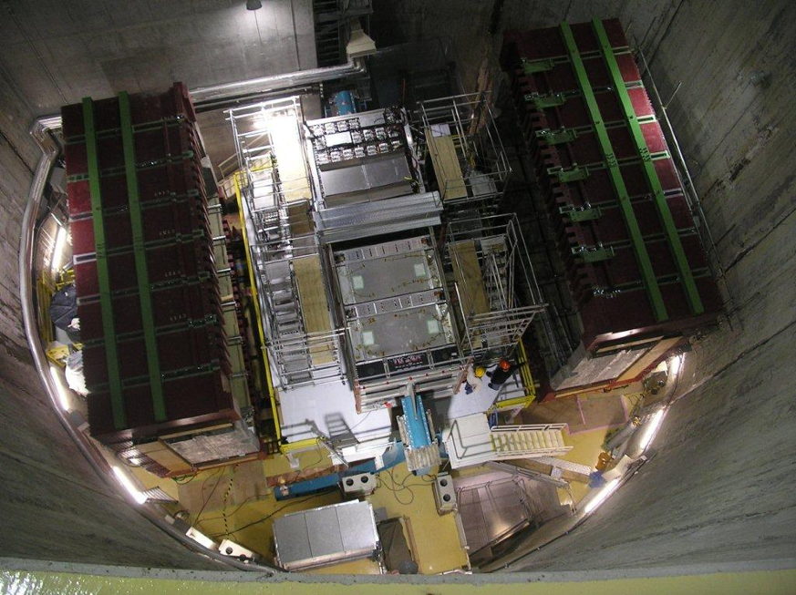
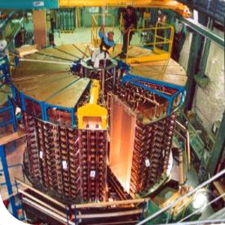
Neutrino physics
Neutrino mixing at MINOS and T2K
  first evidence for electron-neutrino appearance?
Neutrinoless double beta decay in NEMO and SuperNEMO

Slide 13
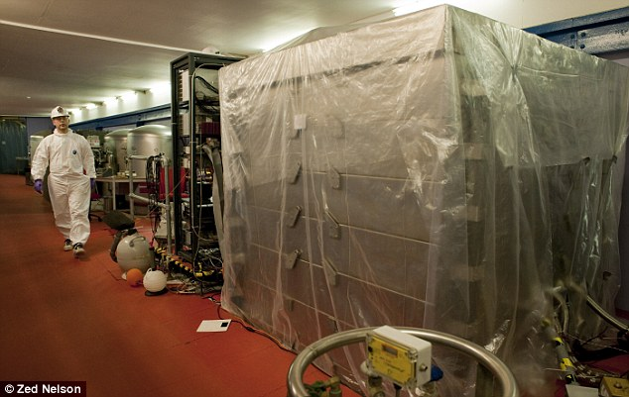

Breadth of programme
Focus on highest priorities has given us an excellent program but a rather narrow one
Our advisory committees have emphasized the need to build back some breadth with (modest) initiatives in
  Direct detection of dark matter
  High energy gamma ray astronomy (CTA)

Slide 14
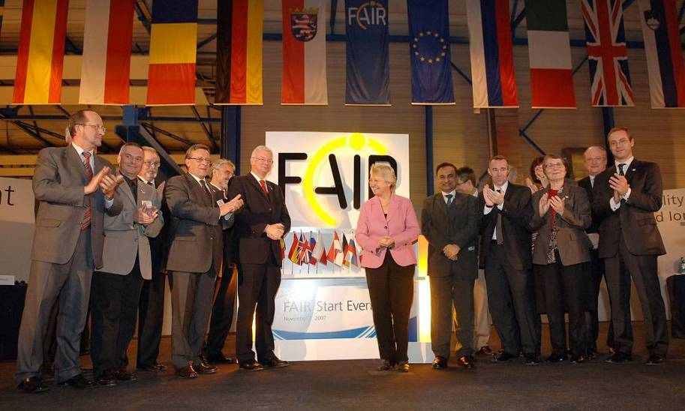
Nuclear Physics
A new generation of facilities offering beams of highly unstable ions promises breakthroughs in understanding the behaviour and origin of hadrons and nuclei
Our highest priority in nuclear physics is to participate in the NuSTAR experiment at the Facility for Antiproton and Ion Research, the new European laboratory being constructed at GSI in Darmstadt

Slide 15
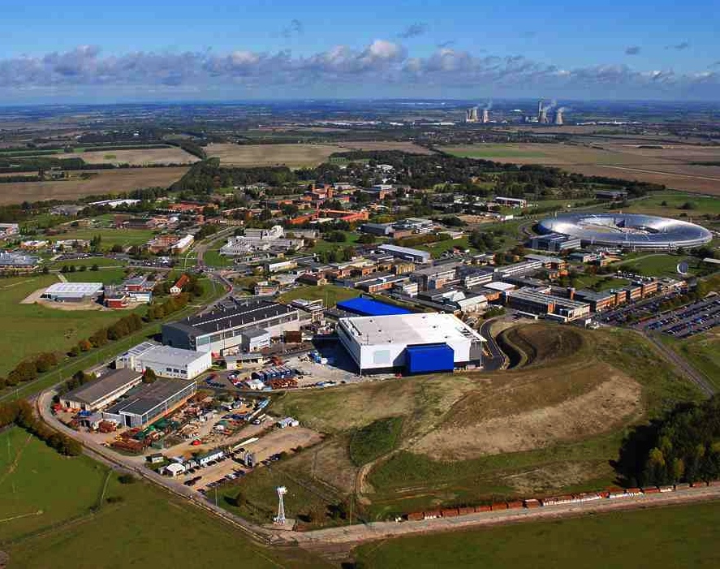
Interdisciplinary research facilities
John Womersley

Slide 16
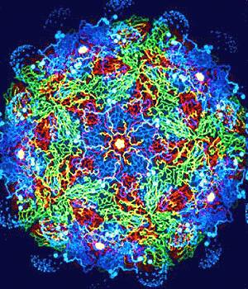
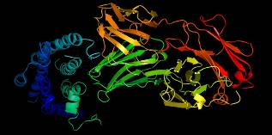
Many of the breakthroughs and developments of 21st century science and technology will be linked to our ability to manipulate and image matter at the scales from single atoms (10⁻¹⁰ m) to living cells (10⁻⁶ m).

Slide 17
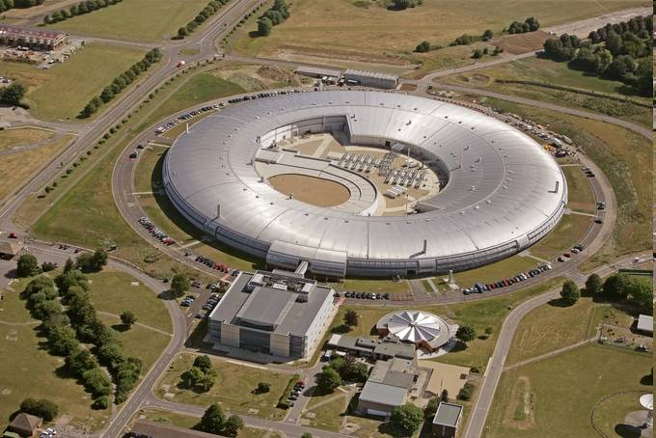
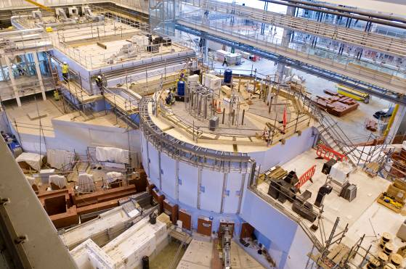
This research requires large scale research infrastructures that are beyond the capability of any single university or research group, sometimes any single nation. STFC’s role is to plan, develop and operate these facilities for the UK.
Diamond Light Source ISIS Spallation Neutron Source

Slide 18
Introduction to STFC
Our accelerator R&D Programme
Looking forward
John Womersley

Slide 19
Accelerator R&D
We have invested in accelerator science by setting up the John Adams Institute and the Cockcroft Institute and by establishing test facilities at RAL (MICE and FETS) and Daresbury (ALICE and EMMA)
Goals of the program are
  Support future science facilities
  Develop applications of technology in areas like healthcare, security, energy…

Slide 20

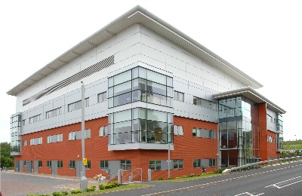
Cockcroft Institute
Liverpool, Manchester, Lancaster and ASTeC (STFC)

Slide 21


John Adams Institute
Oxford and Royal Holloway,
plus (since 2011) Imperial College

Slide 22
Accelerator R&D Funding
Total = £14.2M (2011/12)
                Capital £3.5M
Resource £10.7M + £2.5M in 2011

Slide 23
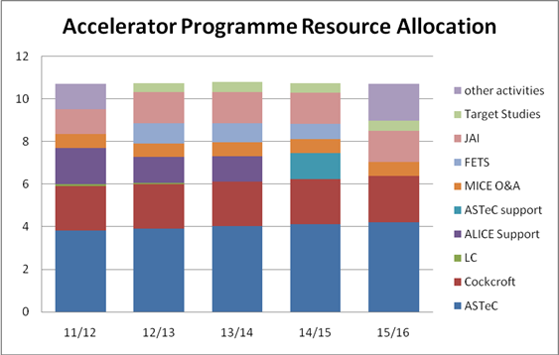

Slide 24
Developing an Accelerator Strategy
STFC Accelerator Strategy Board brings together academics, international experts, accelerator institutes, our national laboratory departments, and Diamond
Start with STFC corporate strategy and vision
Need to take account of the science roadmap, technology strategy, ESFRI and RCUK Large Facilities roadmap
Meeting | Development Stage
September 2010 | Initial discussions and ideas
March 2011 | Draft Strategic Framework discussed
September 2011 | Strategic Framework agreed Draft Strategic Roadmap discussed.
January 2012 | Further development of Strategic Roadmap

Slide 25
Strategic Framework
As agreed by ASB:
“Accelerators underpin a large part of STFC’s responsibilities. STFC has responsibility for working with the key stakeholders to nurture and develop accelerator science, technology, knowledge and expertise within the UK.”

Slide 26
Strategic Framework - 2
The prime driver for our accelerator science and technology:
“To support and develop the facilities and experiments needed to meet the UK’s present and future science goals as set out in STFC’s and RCUK’s science roadmaps and to support and develop the UK and international facilities needed to meet STFC’s commitment to other UK science disciplines”

Slide 27
Strategic Framework - 3
Impact of Accelerators:
We will seek to “exploit accelerator technology in novel ways that have economic impact and/or address the global challenges in the energy, environment, medical and security fields.”
Underpinning Capabilities Required:
Vibrant community of accelerator experts
Access to appropriate accelerator test facilities

Slide 28
Managing the programme
We aim to take a strategic approach:
Focus on core areas
Develop core capability
Strengthen collaborations
Takes account of current financial constraints
Funded from a single central source
Managed, tensioned programme, regularly reviewed

Slide 29
Managing the programme - 2
Ensure that the limited resource available for the accelerator programme is used in the most appropriate way to ensure that the impact is maximised.
Ensure that capability and expertise is maintained in core areas to allow the UK to participate in current and future programmes where it can make a difference.
Identify generic R&D programmes that can benefit different areas of accelerator science and technology.
Ensure that the accelerator programme retains sufficient breadth and depth without becoming overstretched.

Slide 30
Towards a roadmap
The Roadmap will highlight:
the present context and the existing capability
the overall goals,
the possible programmes/projects
We have split into electron/photon, proton and laser categories. This is not scientifically driven but it is practically helpful.

Slide 31
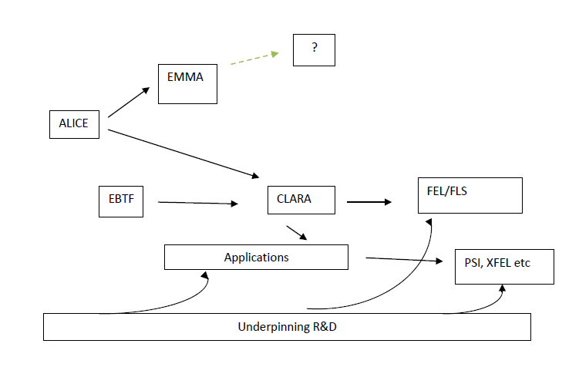
Electron/Photon

Slide 32
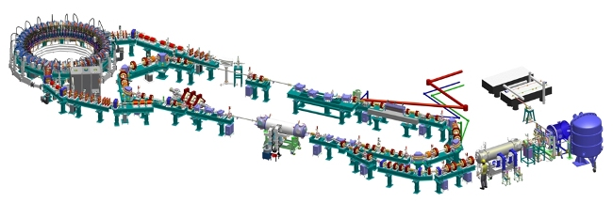
ALICE and EMMA
Energy Recovery Linac and Non-Scaling FFAG at Daresbury Laboratory

Slide 33
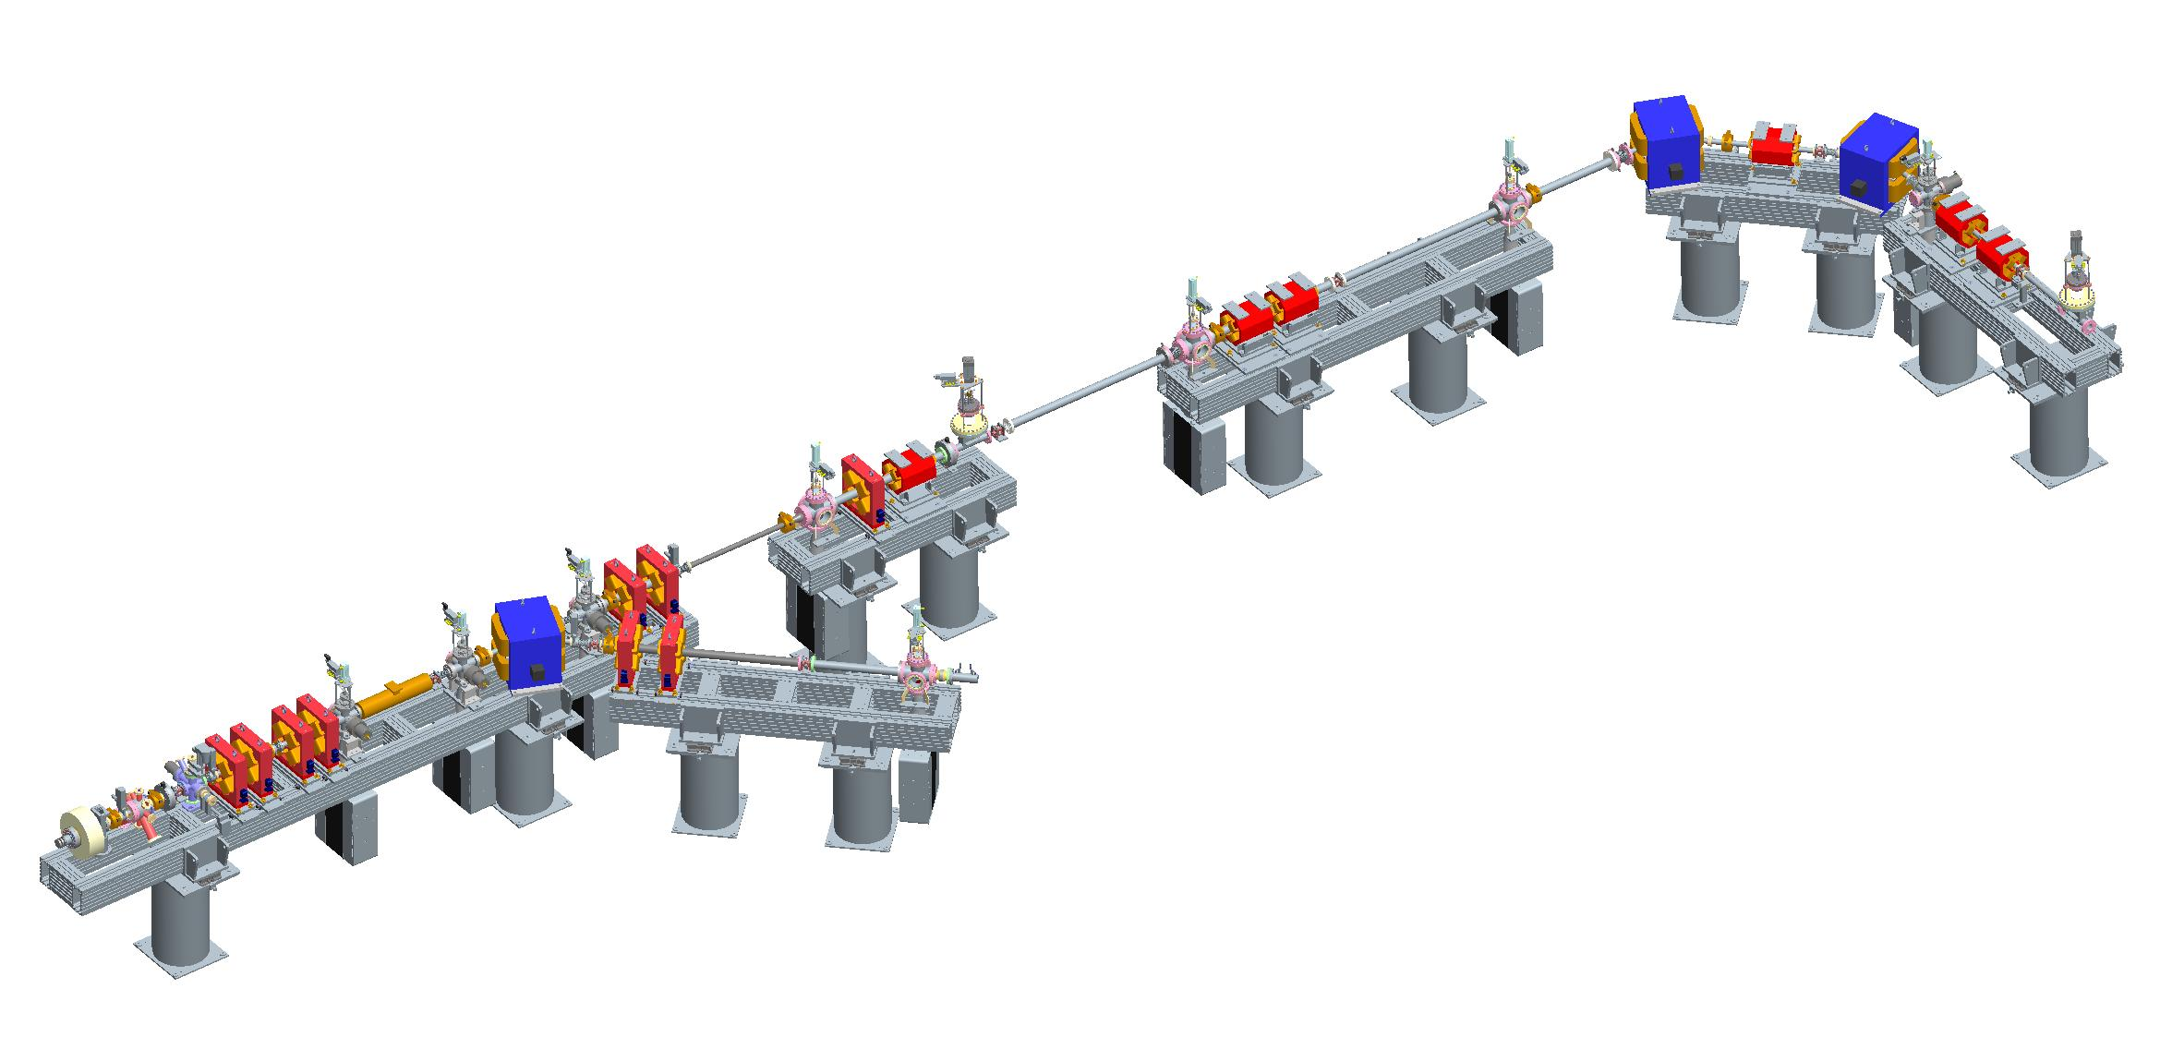
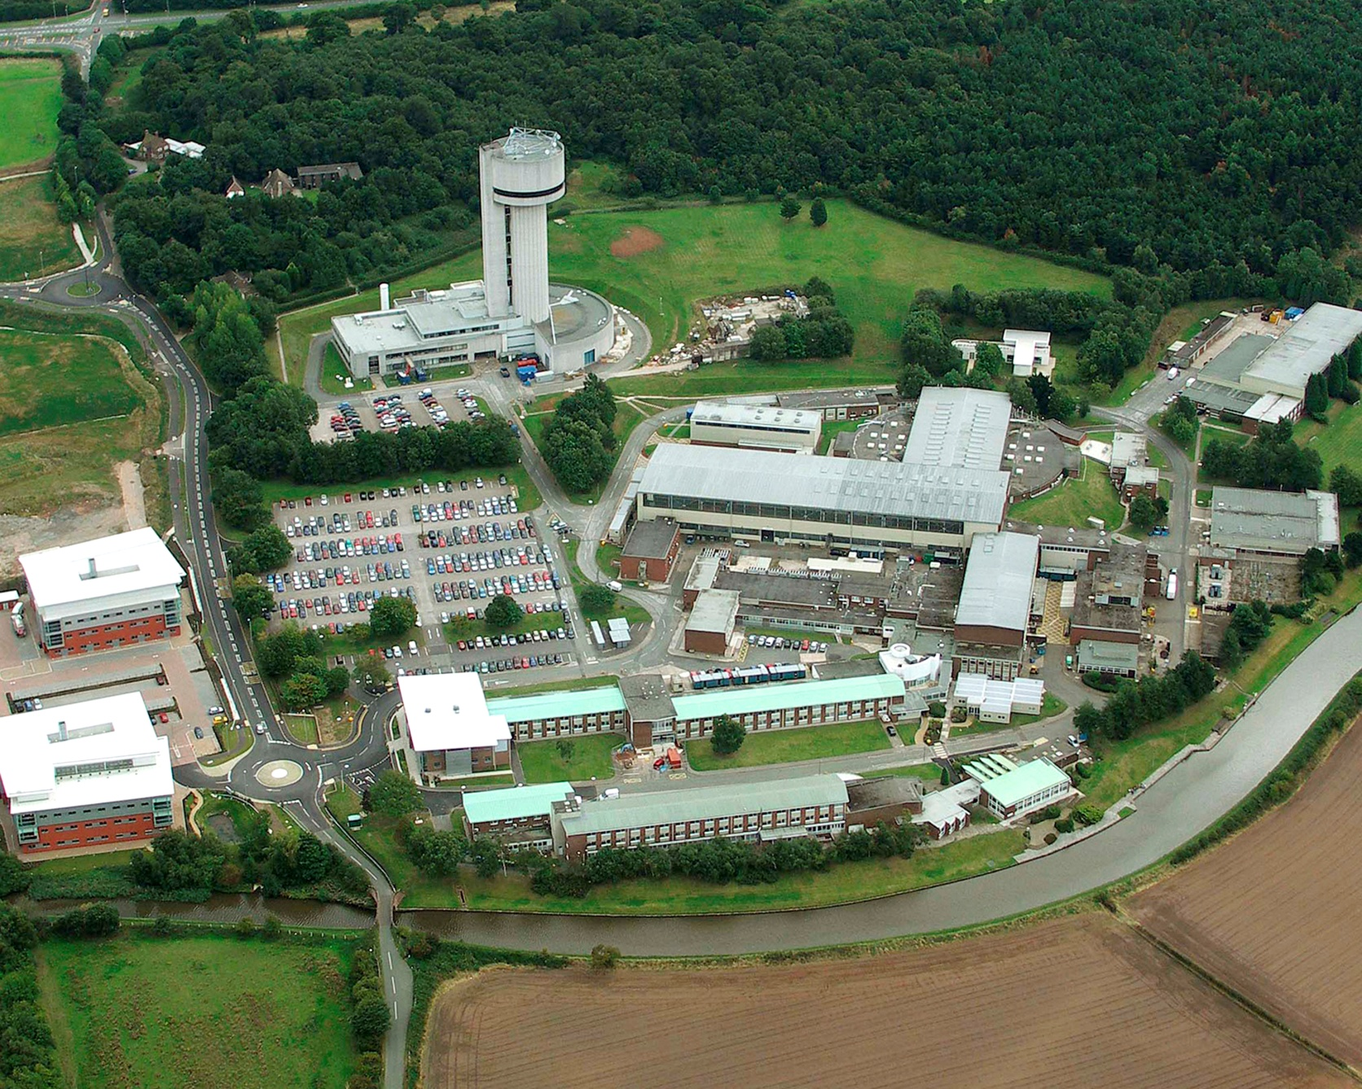
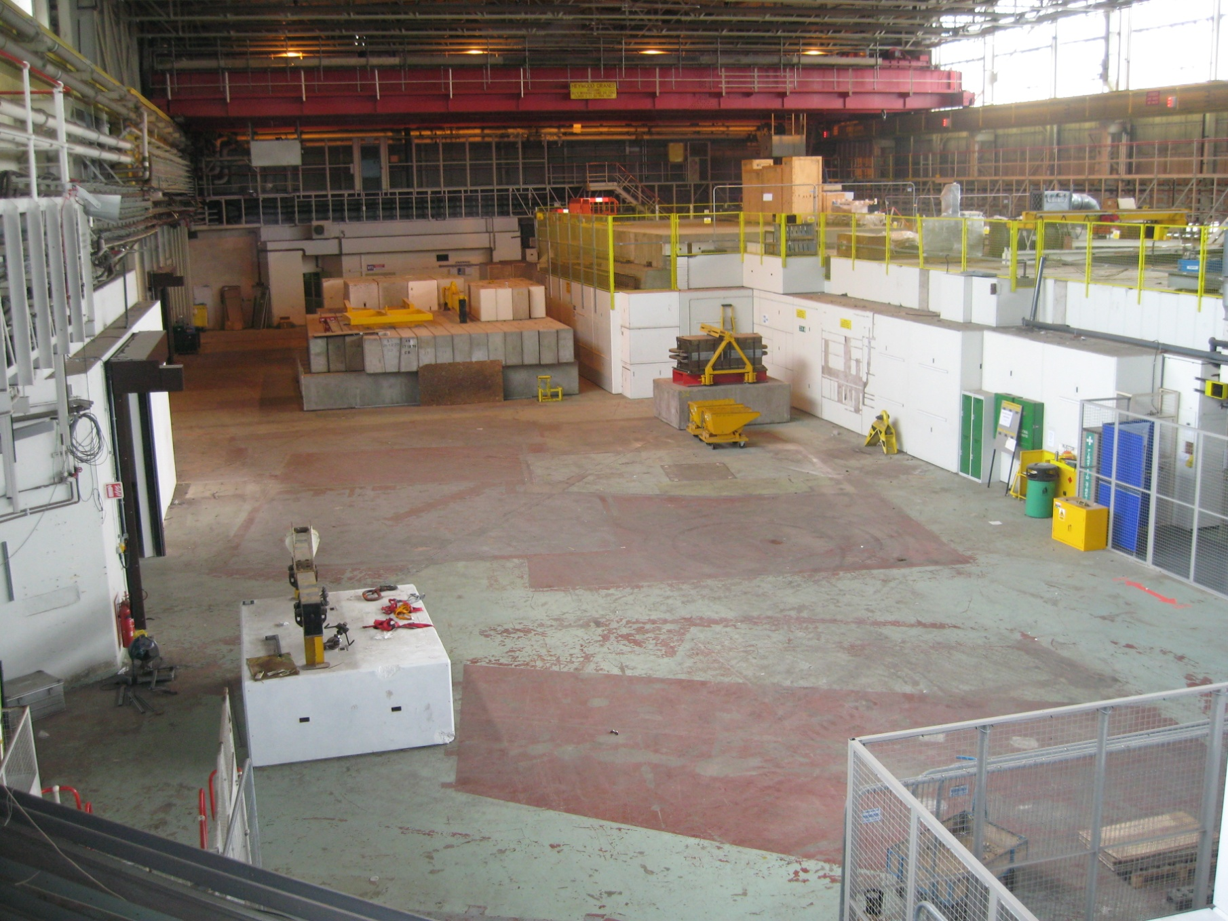
Electron Beam Test Facility

Slide 34
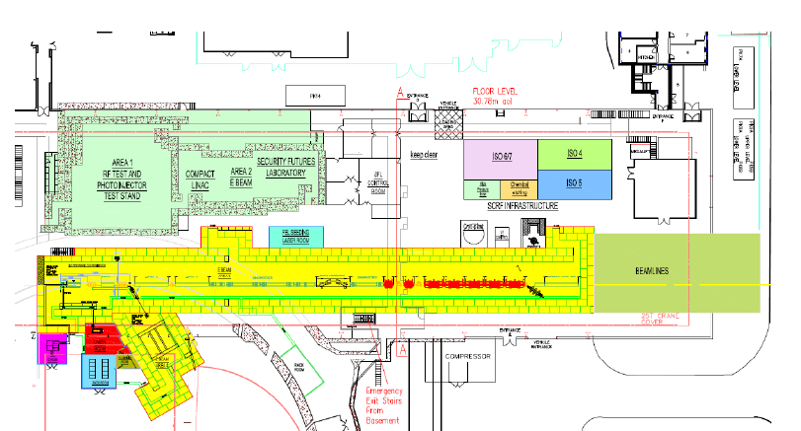
Layout in the SRS Outer Hall
EBTF
CLARA

Slide 35
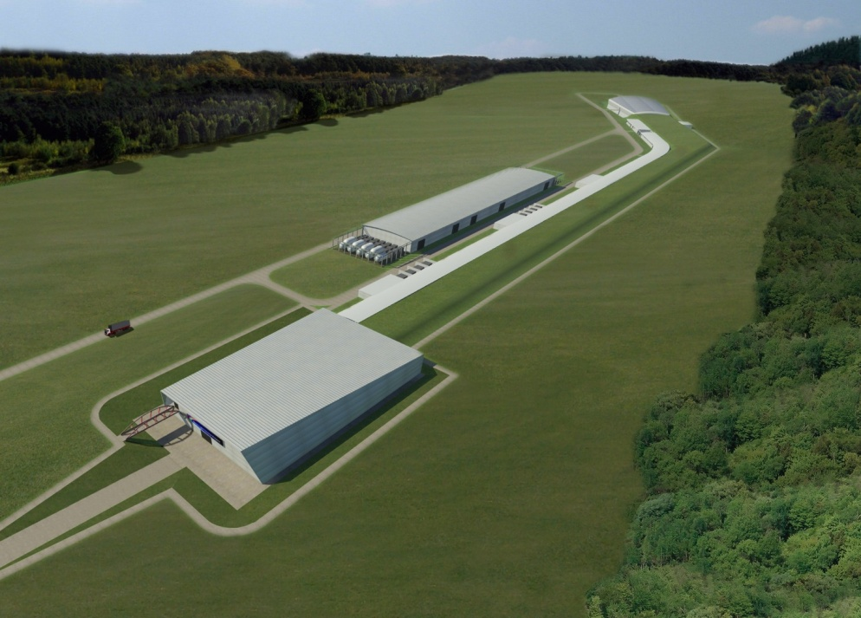
Free electron light source

Slide 36
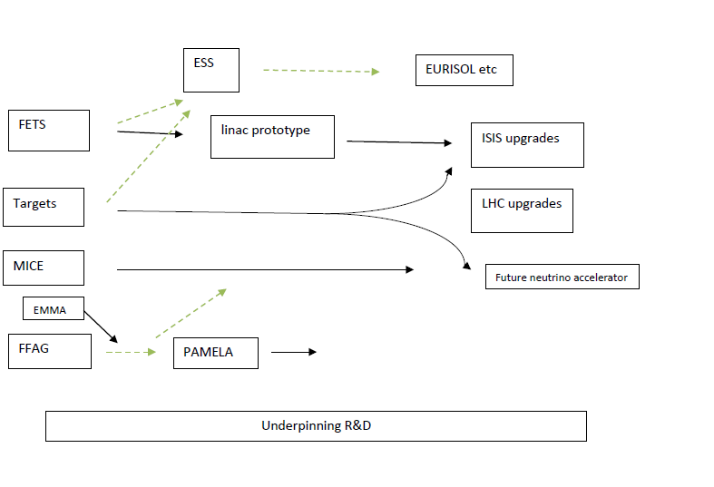
Proton

Slide 37
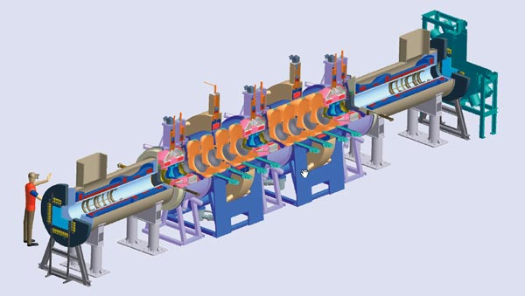
MICE
Demonstration of Muon Cooling at RAL

Slide 38
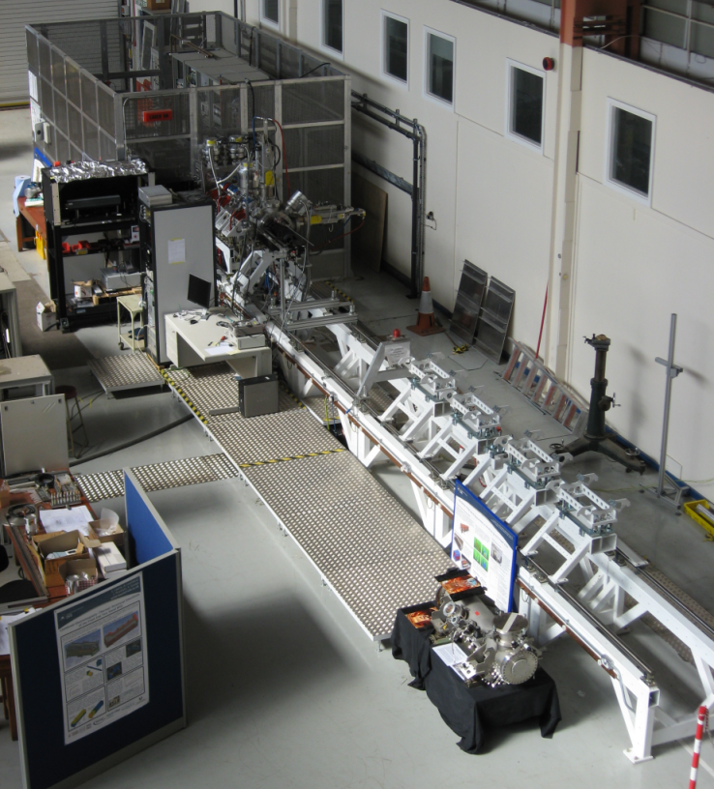
Front End Test Stand
What are we doing now?
Front End Test Stand development with Spain
Working on High Power Proton Accelerator (HPPA) options and target technologies
Evaluating synergies with other high power proton requirements

Slide 39
ISIS upgrades
A phased series of upgrades could deliver an order of magnitude gain over current capabilities - while continuing to operate a world-class user facility
Ongoing evolution of the instruments suite £7-10M ea.
Optimisation of the present target-moderator £7-10M
Obsolescence programmes for major components
  Linac Tank 4 replacement £7-10M
  Linac beam chopping £20-30M
  Linac energy increase to 120 MeV £50-70M
Beam power upgrades to 0.5 MeV; 1 MeV; 5 MeV £700-1000M

Slide 40
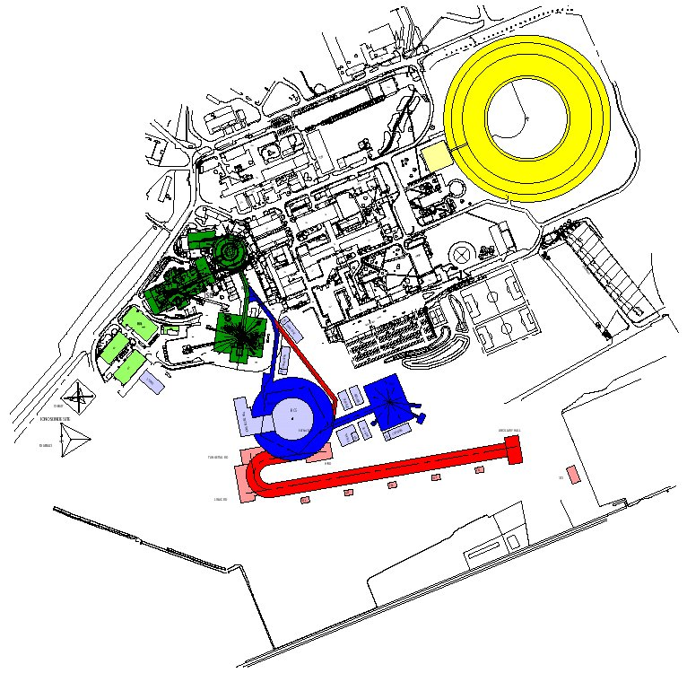

Slide 41
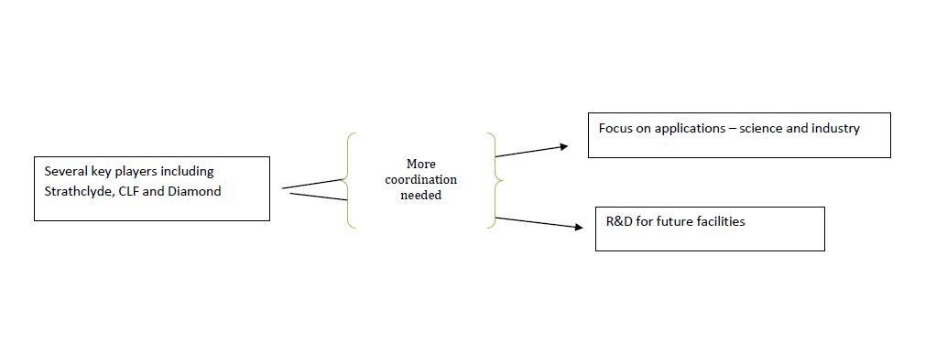
Lasers
Still work to do here

Slide 42
Introduction to STFC
Our accelerator R&D Programme
Looking forward
John Womersley

Slide 43
The next 3-4 years
We have a reasonably well-defined (and sustainable) science program and priorities for 2011-15
  We should look for imaginative and affordable ways to broaden it where we can
  Additional capital opportunities
Very high level of government support for science
  Based on pragmatism, what it can do for the economy, not on a love of learning
We need to deliver on our commitments to government from CSR 2010

Slide 44
Future initiatives
STFC’s mission means that we need to look 15-20 years into the future
Challenging to do this at a time when many find it hard to look more than 3-5 years ahead – but essential
Timescale for any significant funding is almost certain to be post-2015
  but not too soon to start thinking, or doing the necessary R&D

Slide 45
Future initiatives
In describing future science opportunities in STFC’s areas, I can talk about
  High Performance Computing
  Future UK Free Electron Light Source
  ISIS MW upgrades
  Vulcan 10PW Laser and Laser Fusion
  Square Kilometre Array
  European ELT
  … but what for particle physics?

Slide 46
Why does government support science?
£
Government
Science
Technological innovation, skills
Understanding of the Universe
For Particle Physics:
detectors, accelerators, computing,
attracting students into science…

Slide 47
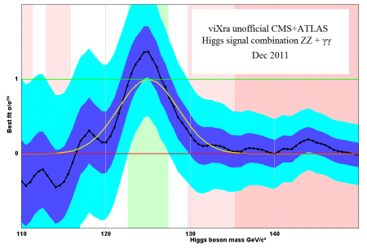
Particle Physics in 2012
The best of times
Significant results from the Large Hadron Collider soon
  Confirm or refute a picture of how the universe works at the TeV scale that has held for almost 30 years

Slide 48
Particle Physics in 2012
The best of times
Dark matter and dark energy – the universe is stranger than we ever thought
Neutrino results from OPERA (faster than light?) have generated significant interest
£15M STFC investment in particle physics/astronomy HPC
Applications for physics courses at university in 2010/11 up by more than 17% (and still holding up in 2012 despite big fees increases)

Slide 49
UK research quality is extremely high
Astronomy
Year No of pubs (world ranking) Citation impact (world ranking)
2008 2075 (2nd) 10.06 (2nd)
2009 2256 (2nd) 11.37 (1st)
2010 2411 (2nd) 11.79 (1st)
Particle physics
Year No of pubs (world ranking) Citation impact (world ranking)
2008 1127 (4th) 8.35 (1st)
2009 1047 (3rd) 8.99 (1st)
2010 1030 (4th) 9.23 (1st)
Nuclear physics
Year No of pubs (world ranking) Citation impact (world ranking)
2008 372 (7th) 6.47 (2nd)
2009 347 (7th) 6.99 (2nd)
2010 347 (7th) 6.74 (2nd)
Notes:
the citation impact gives you a quality measure and the no of publications gives you a quantity measure. The description that goes with the numbers (from the RPEIR) is -
In 2010/11 STFC funded-activities in astronomy, particle physics and nuclear physics produced over 3500 research papers. In terms of research quality, the UK was 1st in the world in citation impact^{[i]} in astronomy and particle physics and 2nd in nuclear physics in 2010, sustaining this performance from previous years. This demonstrates the world class quality of the UK’s research and is even more impressive given that we are 2nd, 4th and 7th respectively in terms of research volume in these subjects. This backs up the recent finding that the UK research base is most productive in the world^{[ii]}.
^{[i]} STFC Annual Bibliometric Study 2010, Evidence Ltd, publication available on request
^{[ii]} ‘International Comparative Performance of the UK Research Base 2011’, compiled by Elsevier for Department for Business, Innovation and Skills (2011) - http://www.bis.gov.uk/policies/science/science-innovation-analysis/uk-research-base

Slide 51
Particle Physics in 2012
Or the worst of times?
Particle Physics in the US is in a state of malaise (if not crisis)
CERN subscription is about at its upper limit (at least as far as the UK is concerned)
What is the vision and strategy for the future global particle physics programme?
  Solid base of LHC + upgrades at CERN: to 2030 (DG)
  – plus…
  Neutrino mass/mixing
  Astroparticle physics
  } where?

Slide 52
Why are we here?
Potential US-UK collaboration in proton accelerators (both for science and applications) is an interesting opportunity
  we are both working in a constrained financial environment where collaboration is important
  we have complementary expertise
  there is a strong foundation of existing work together MINOS, MICE...)
  together we can influence an emerging global particle physics strategy and deliver the broader impact from accelerator technology that we need

Slide 53
Discussion

