Slide 1
Accelerator Challenges & ADSR Work in the US
(with a focus on accelerator technology)
Stuart Henderson
Fermilab
January 13, 2012

Slide 2
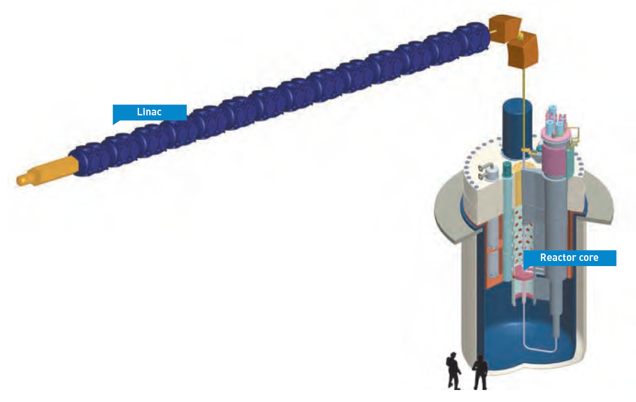
Accelerator Driven Systems
High-power, highly reliable proton accelerator
~1 GeV beam energy
~1 MW of beam power for demonstration
Tens of MW beam power for Industrial-Scale System
Spallation neutron target system
Provides external source of neutrons through spallation reaction on heavy metal target
Subcritical reactor
Chain reaction sustained by external neutron source
Can use fuel with large minor actinide content
Notes:
Comment on bullet under “subcritical reactor”:
Deterministic nuclear safety is assured in all conditions
Depending on the design, loss-of-flow or loss-of-coolant accidents could lead to fuel melt which may form a critical mass that would not be “nuclear” safe. I tried the bullet
Reactivity insertions do not produce exponential power excursions
but did not like it (to hard to explain). Settled on the bullet
Can use fuel with large minor actinide content
The bullet
Utilizes fuel form required by advanced nuclear fuel cycles
could be applied to certain fast reactors as well, depending on exact fuel content.

Slide 3
Accelerator Challenges: Requirements
Accelerators for ADS applications require
Proton beam energy in the ~GeV range
  Efficient production of spallation neutrons
  Energy well-matched to subcritical core design
  Minimize capital cost (lower energy increases source requirements)
Continuous-wave beam in the > 10 MW regime
  High power is required for industrial scale systems to justify large capital expense
Low beamloss fractions to allow hands-on maintenance of accelerator components
Reliability ranging from very high to extremely high
Availability typical of modern nuclear plants

Slide 4
Range of Missions for Accelerator Driven Systems
Transmutation Demonstration and Experimentation
Industrial-Scale Power Generation w/ Energy Storage
Industrial-Scale Power Generation w/o Energy Storage
Industrial-Scale Transmutation
Accelerator sub-critical reactor coupling
ADS technology and components
M.A./Th fuel studies
Transmutation of M.A. or Am fuel
Convert process heat to another form of energy
Deliver power to the grid
Burn MA (or Th) fuel
Incorporate energy storage to mitigate long interruptions
Deliver power to the grid
Burn MA (or Th) fuel
Time, Beam-Trip Requirements, Accelerator Complexity, Cost

Slide 5
Range of Parameters for ADS
 | Transmutation Demonstration | Industrial Scale Transmutation | Industrial Scale Power Generation with Energy Storage | Industrial Scale Power Generation without Energy Storage
Beam Power | 1-2 MW | 10-75 MW | 10-75 MW | 10-75 MW
Beam Energy | 0.5-3 GeV | 1-2 GeV | 1-2 GeV | 1-2 GeV
Beam Time Structure | CW/pulsed (?) | CW | CW | CW
Beam trips (t < 1 sec) | N/A | < 25000/year | <25000/year | <25000/year
Beam trips (1 < t < 10 sec) | < 2500/year | < 2500/year | <2500/year | <2500/year
Beam trips (10 s < t < 5 min) | < 2500/year | < 2500/year | < 2500/year | < 250/year
Beam trips (t > 5 min) | < 50/year | < 50/year | < 50/year | < 3/year
Availability | > 50% | > 70% | > 80% | > 85%

Slide 6
Accelerator Technology – Existing Parameter Sets
 | Transmutation Demonstration (MYRRHA [5]) | Industrial Scale Facility driving single subcritical core (EFIT [10]) | Industrial Scale Facility driving multiple subcritical cores (ATW [11])
Beam Energy [GeV] | 0.6 | 0.8 | 1.0
Beam Power [MW] | 1.5 | 16 | 45
Beam current [mA] | 2.5 | 20 | 45
Uncontrolled Beamloss | < 1 W/m | < 1 W/m | < 1 W/m
Fractional beamloss at full energy (ppm/m) | < 0.7 | < 0.06 | < 0.02

Slide 7
ADS Activities: Recent Past and Ongoing
There is no ADS program in the United States
However, there are a number of developments over the last decade that are highly relevant to the topic
  High-power CW front-end system development (LANL LEDA)
  Construction, Commissioning and Operation of the world’s highest power pulsed accelerator and liquid metal target system (Spallation Neutron Source)
These developments bring ADS feasibility forward
Intense interest in ~GeV energy MW proton linear accelerators is driving interest in ADS

Slide 8
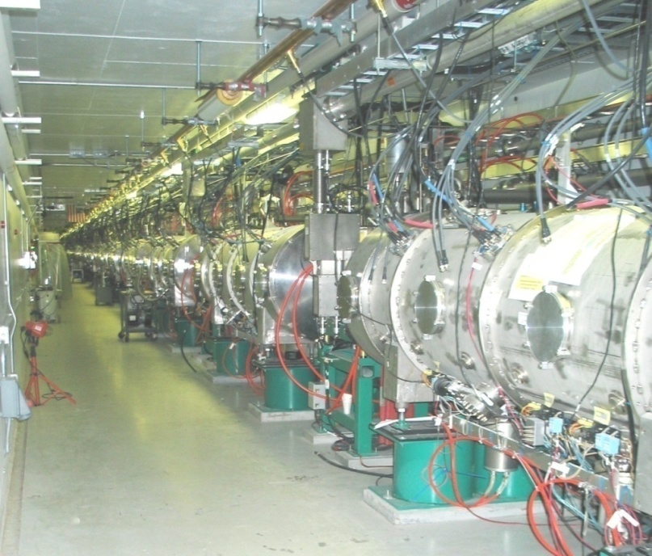
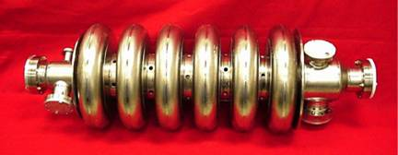
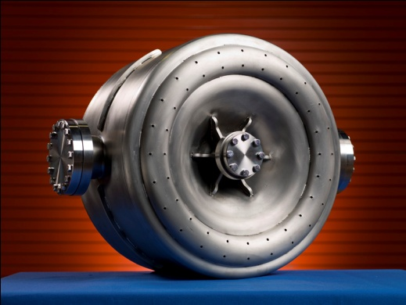
ADS-Relevant Technology Development of the Last 10-15 Years
Spallation Neutron Source: Modern, MW-class high power proton accelerators based on superconducting technology exist and operate with acceptable beam loss rates
Superconducting radiofrequency structures have been built to cover a broad range of particle velocities (from v/c=0.04 to 1). Use of SRF offers potential for achieving high reliability
SNS Superconducting Linac

Slide 9
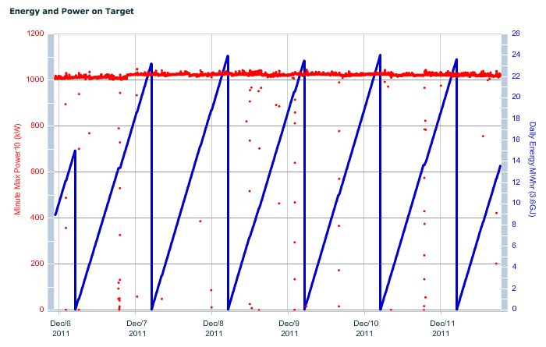
Performance of SNS, a MW-class Proton Linear Accelerator

Slide 10
Trip Rates at SNS
Courtesy J. Galambos
We are working on reducing the long outages
SNS is focusing on reducing long outages – which affect our customer
  Short trips are not a driver of downtime, and have received relatively little attention
SNS was not designed for very low trip rates

Slide 11
Proton Beam Loss is much lower than H⁻
Courtesy J. Galambos
H⁻, strong focusing
Beam Loss (Rad/C)
A. Shishlo et al.
H⁻, weak focusing
Proton, strong + weak focusing
Source Current (mA)
Measured beam loss in the SNS linac is much lower for protons than for H⁻
  Trends are consistent with “Intra-beam stripping”
  Good news for ADS !

Slide 12
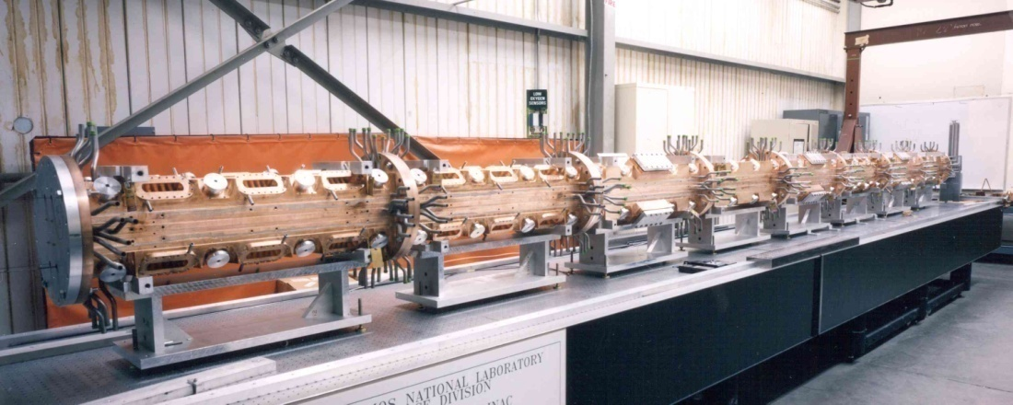
Front-End System Technology: Low-Energy Demonstration Accelerator (LEDA)
Full power performance demonstrated for a limited operating period.
  20 hours at 100 mA CW
  110 hours at > 90 mA CW
RMS beam emittances measured; reasonable agreement with simulation
No long-term operations for reliability/availability evaluation.
HPRF system performed well, but no long-term window tests.

Slide 13
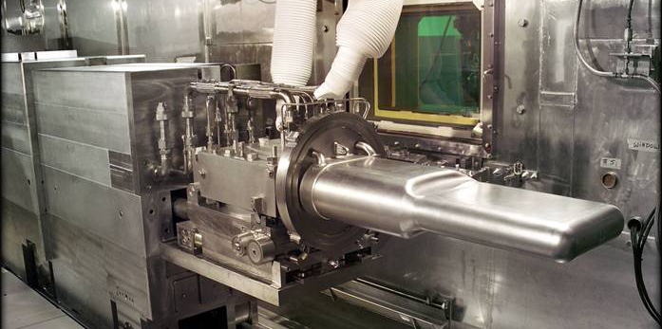
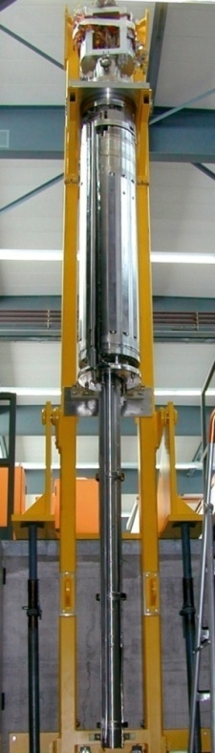
State of the Art: Operating MW-class Target Systems
Solid-target
  SINQ at PSI (~1.2 MW “DC” beam)
Liquid Hg
  Spallation Neutron Source (1.1 MW pulsed)
  Japan Proton Accelerator Research Complex (0.3 MW pulsed)
Pb-Bi Eutectic target
  MEGAPIE at PSI (0.8 MW)
Spallation targets for ADS application well above 1 MW will likely use heavy liquid metal cooling to achieve compact designs.
  The only example of lead or LBE cooling for high power is the Russian LBE submarine reactors which were designed for approximately 150 MW.

Slide 14
The “DOE ADS Whitepaper”

Slide 15
The White Paper
In June 2010 DOE Office of Science tasked a Working Group with producing a White Paper assessing accelerator and target technology for Accelerator-Driven Systems (ADS)
The White Paper was intended to make a hard-nosed assessment, addressing
  the technical requirements for ADS
  the current status and readiness of accelerator and spallation target technology
  the R&D necessary to meet the requirements
…and to answer two underlying questions:
  Do the advances that have been made in Accelerator Technology in the last 10-15 years change the practicality of ADS for processing waste and generating electricity?
  Is the technology to the point where a demonstration program is warranted?

Slide 16
The White Paper
“Accelerator and Target Technology for Accelerator Driven Transmutation and Energy Production”
http://www.science.doe.gov/hep/files/pdfs/ADSWhitePaperFinal.pdf
Hamid Aït Abderrahim, SCK-CEN
John Galambos, ORNL
Yousry Gohar, ANL
Stuart Henderson*, FNAL
George Lawrence, LANL, retired
Tom McManamy, ORNL
Alex Mueller, CNRS-IN2P3
*Co-chairs
Sergei Nagaitsev, FNAL
Jerry Nolen, ANL
Eric Pitcher*, LANL
Bob Rimmer, TJNAF
Richard Sheffield, LANL
Mike Todosow, BNL

Slide 17
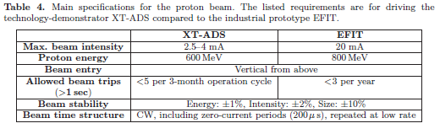
Accelerator Reliability
More than any other requirement, the maximum allowable beam trip frequency has been the most problematic, and in many ways has been perceived as a “show-stopper”
Conventional wisdom held that beam trips had to be limited to a few per year to avoid thermal stress and fatigue on the reactor structures, the target and fuel elements

Slide 18
Recent Developments Re: Beam Trip Requirements
Three analyses based on transient response of reactor components using modern FEA methods are in good agreement: JAEA, MYRRHA and Argonne National Laboratory
These new analyses result in ~2 order of magnitude relaxation of requirements for “short” trips and ~1 order of magnitude relaxation for “long” trips
Updated Beam-Trip Rate requirements, while still very challenging, appear manageable with i) modern linac architecture, ii) appropriate redundancy and iii) utilization of reliability engineering principles
More work is required to bring these components together with high reliability at > 10 times the beam power of today’s accelerators, but “getting from here to there” is achievable

Slide 19
ADS Technology Readiness Assessment
 |  | Transmutation Demonstration | Industrial-Scale Transmutation | Power Generation
Front-End System | Performance
 | Reliability
Accelerating System | RF Structure Development and Performance
 | Linac Cost Optimization
 | Reliability
RF Plant | Performance
 | Cost Optimization
 | Reliability
Beam Delivery | Performance
Target Systems | Performance
 | Reliability
Instrumentation and Control | Performance
Beam Dynamics | Emittance/halo growth/beamloss
 | Lattice design
Reliability | Rapid SCL Fault Recovery
 | System Reliability Engineering Analysis
Green: “ready”, Yellow: “may be ready, but demonstration or further analysis is required”, Red: “more development is required”.

Slide 20
Key Findings from the White Paper Working Group Report
There are active programs in many countries, although not in the U.S., to develop, demonstrate and exploit accelerator-driven systems technology for nuclear waste transmutation and power generation.
Accelerator-driven sub-critical systems offer the potential for safely burning fuels which are difficult to incorporate in critical systems, for example fuel without uranium or thorium.
Accelerator driven subcritical systems can be utilized to efficiently burn minor actinide waste.
Accelerator driven subcritical systems can be utilized to generate power from thorium-based fuels
The missions for ADS technology lend themselves to a technology development, demonstration and deployment strategy in which successively complex missions build upon technical developments of the preceding mission.

Slide 21
Key Findings from the White Paper Working Group Report
Recent detailed analyses of thermal transients in the subcritical core lead to beam trip requirements that are much less stringent than previously thought; while allowed trip rates for commercial power production remain at a few long interruptions per year, relevant permissible trip rates for the transmutation mission lie in the range of many thousands of trips per year with duration greater than one second.
For the tens of MW beam power required for most industrial-scale ADS concepts, superconducting linear accelerator technology has the greatest potential to deliver the required performance.
One of the most challenging technical aspects of any ADS accelerator system, the Front-End Injector, has demonstrated performance levels that meet the requirements for industrial-scale systems, although reliability at these levels has not yet been proven.

Slide 22
Key Findings from the White Paper Working Group Report
Superconducting radio-frequency accelerating structures appropriate for the acceleration of tens of MW of beam power have been designed, built and tested; some structure types are in routinely operating accelerator facilities.
Ten to one-hundred fold improvement in long-duration beam trip rates relative to those achieved in routine operation of existing high power proton accelerators is necessary to meet industrial-scale ADS application requirements.
The technology available to accelerator designers and builders of today is substantially different from, and superior to, that which was utilized in early ADS studies, in particular in the design which was considered in the 1996 National Research Council report.
Spallation target technology has been demonstrated at the 1-MW level, sufficient to meet the “Transmutation Demonstration” mission.

Slide 23
Key Findings from the White Paper Working Group Report
With appropriate scaling at each step along a technology demonstration path, there are no obstacles foreseen that would preclude the deployment of spallation targets at a power level (10 to 30 MW) needed to meet the application of ADS at an industrial scale.
Technology is sufficiently well developed to meet the requirements of an ADS demonstration facility; some development is required for demonstrating and increasing overall system reliability.
For Industrial-Scale Transmutation requiring tens of MW of beam power many of the key technologies have been demonstrated, including front-end systems and accelerating systems, but demonstration of other components, improved beam quality and halo control, and demonstration of highly-reliable sub-systems is required.

Slide 24
Activities in the US with connections to ADS (there is no US ADS Program)

Slide 25
Project X and potential for ADS
A demonstration facility that couples a subcritical assembly to a high-power accelerator requires 1-2 MW beam power in the GeV range
The 3 GeV Project X CW Linac has many of the elements of a prototypical ADS Linac
  Beam power will range from 3 to 12 MW
  Energy in the 1-2 GeV range is considered optimal, so provision is retained for delivering a beam energy less than 3 GeV
The Project X CW Linac is ideally suited to power a demonstration facility with focus on:
  Target system and subcritical assembly technology development and demonstration
  Demonstration of transmutation technologies and support for fuel studies
  Materials irradiation
  High reliability component development, fault tolerant linac and rapid fault recovery development
In Collaboration with Argonne have begun to formulate an experimental program on Pb-Bi spallation target characteristics and transmutation experiments

Slide 26
US Activities (Stuart’s Summary)
Argonne activities (more from Y. Gohar)
  Experimental neutron source based one electron linac
  Study physics and develop control meth for future ADS using Zero power systems
  Three-year study to develop ADS concept for disposal of SNF from US light water reactor fleet
JLAB/Virginia activities:
  CLEAN Proposal for CEBAF to rebuild a section of linac to demonstrate very high reliability
  A consortium of Virginia Universities, Industrial partners, and JLab has been established to develop US leadership in ADS R&D while preparing to host an ADS facility in Virginia
    Goal - pursue funding for an electron accelerator coupled to a small, non-critical reactor core to study cross-sections and reaction rates

Slide 27
US Activities
ORNL activities:
  Evaluation of second target station as an irradiation facility
LANL activities:
  Materials Test Station proposal to serve the irradiation community
BNL activities:
  Interest but no activities yet
Texas A&M University (P. McIntyre)
  Subcritical Fission Technology Center
  Developing a concept for a multi-beam flux-coupled cyclotron providing multi-MW beams

Slide 28
Finally
There is a growing grass-roots effort to put ADS back on the radar screen in this country
Many people are working at the lab level to generate interest
What is lacking now is interest from the funding agency to restart a healthy program
Nevertheless, there are many activities that bear directly on ADS technology and readiness for deployment
A strengthened effort between UK-US on these important topics is welcomed and could be very helpful in making the case for ADS

Slide 29
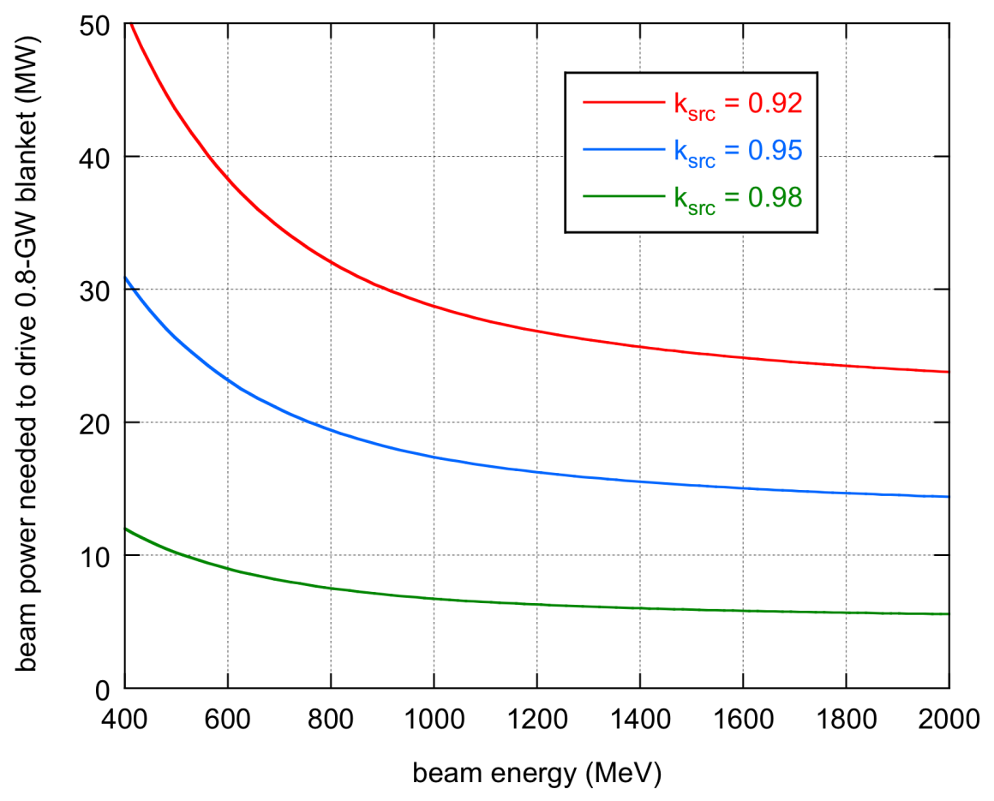
ADS System Level Requirements
Accelerator and Target requirements are challenging
High proton beam power
Low beam loss to allow hands-on maintenance of the accelerator
High wall-plug to beam power efficiency
Accommodate high deposited power density (~1 MW/liter) in the target.
Beam Trip Frequency: thermal stress and fatigue in reactor structural elements and fuel assembly sets stringent requirements on accelerator reliability
High System Availability is required for a commercial system

Slide 31
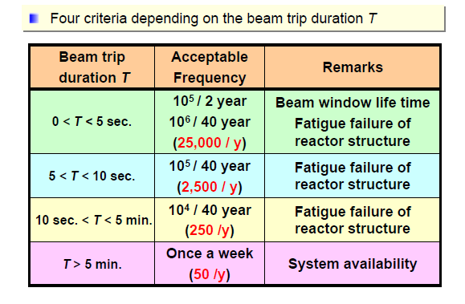
Recent Beam Trip Duration Analyses
There are three analyses based on transient response of reactor components using modern FEA methods: JAEA, MYRRHA and Argonne
These analyses show relatively good agreement
JAEA Analysis: H. Takei et. al., Proc. 5th OECD/NEA HPPA

Slide 32
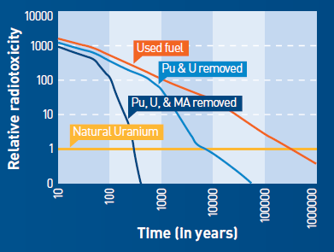
Applications of Accelerator Driven Systems Technology
Accelerator Driven Systems may be employed to address several missions, including:
  Transmuting selected isotopes present in nuclear waste (e.g., actinides, fission products) to reduce the burden these isotopes place on geologic repositories.
  Generating electricity and/or process heat.
  Producing fissile materials for subsequent use in critical or sub-critical systems by irradiating fertile elements.

Slide 33
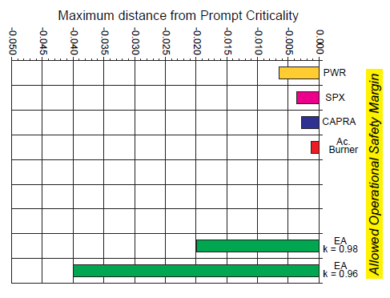
Advantages of ADS
Greater flexibility with respect to Fuel Composition:
  ADS are ideally suited to burning fuels which are problematic from the standpoint of critical reactor operation, namely, fuels that would degrade neutronic characteristics of the critical core to unacceptable levels due to small delayed neutron fractions and short neutron lifetimes, such as minor actinide fuel.
  Additionally, ADS allows the use of non-fissile fuels (e.g. Th) without the incorporation of U or Pu into fresh fuel.
Potentially enhanced safety:
  External neutron source is eliminated when the beam is terminated
Standard light/heavy water uranium fueled
Superphenix fast reactor
Minor actinide + MOX fuel burner
Minor actinide burner

Slide 34
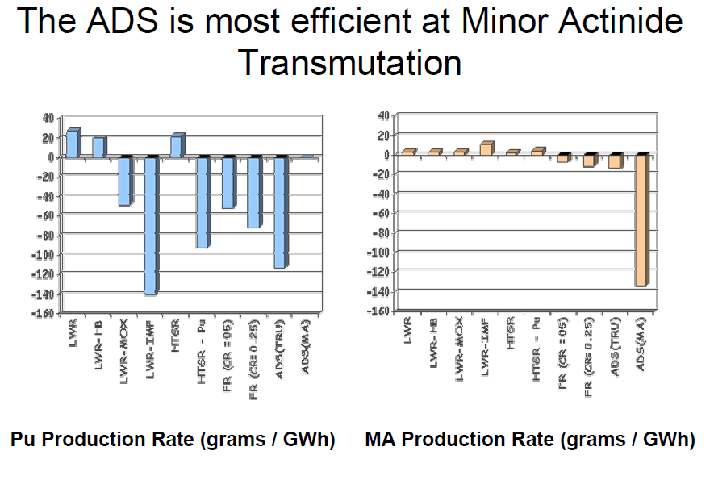
M. Cappiello, “The Potential Role of ADS in the U.S.”

Slide 35
Project X as a National Resource with Application Beyond HEP

Slide 36
Project-X Beyond HEP
We recognize that a multi-MW high energy proton accelerator is a national resource, with potential application that goes beyond particle physics
Such facilities are sufficiently expensive that the U.S. will not invest in multiple facilities with duplicative capabilities
We are engaging the potential user communities for utilization of high power proton beams beyond HEP
We would like to explore your interests and ideas for potential uses of such a facility

Slide 37
Applications of High Power Proton Accelerators
Materials Science
Neutron Sources
Muon Sources
Particle Physics
Proton Drivers for HEP
Nuclear Physics
High-power ISOL
Neutron, nuclear EDMs
Energy & Environment
Materials Irradiation
Accelerator Driven Systems
Medicine
Isotope production
National Security
Proton Radiography

Slide 38
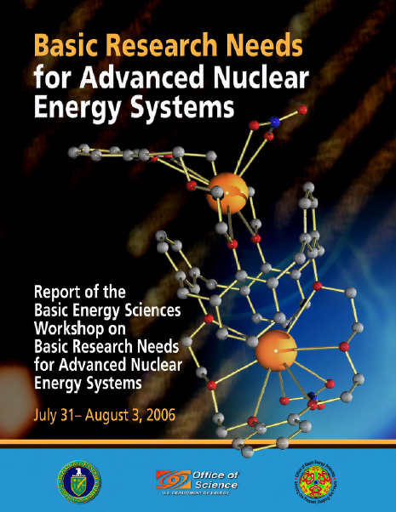
National Needs in Advanced Energy Systems are Articulated in Numerous Recent Reports
DOE/BES Report: Basic Research Needs for Advanced Nuclear Energy Systems
  “The fundamental challenge is to understand and control chemical and physical phenomena…from femto-seconds to millennia, at temperatures to 1000 C, and for radiation doses to hundreds of displacements per atom. This is a scientific challenge of enormous proportions, with broad implications in the materials science and chemistry of complex systems”

Slide 39
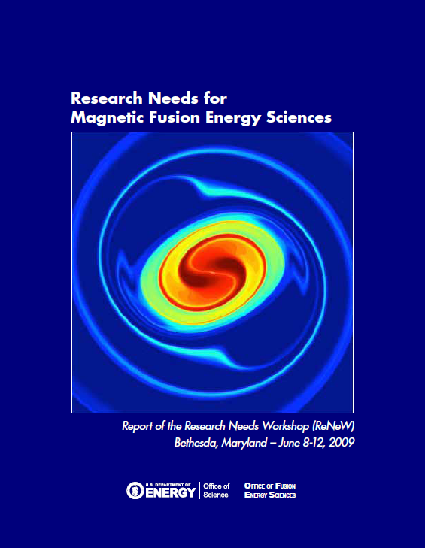
National Needs in Advanced Energy Systems are Articulated in Numerous Recent Reports
DOE/FES Report: Research Needs for Magnetic Fusion Energy Sciences
  Thrust: Develop the material science and technology needed to harness fusion power
  “Establish a fusion-relevant neutron source to enable accelerated evaluations of the effects of radiation-induced damage to materials”

Slide 40
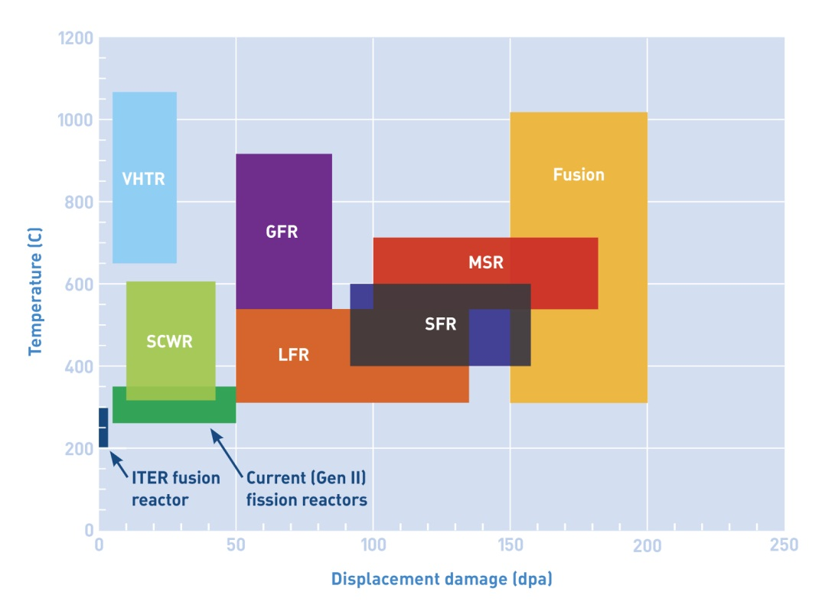
Applications of Accelerators: Materials Irradiation
Materials for next generation fission reactors or fusion devices need an order of magnitude greater radiation resistance than those in use today
Zinkle and Busby, Materials Today 12 (2009) 12.
Fission reactors include very-high-temperature
reactors (VHTR), supercritical water-cooled reactors (SCWR), gas-cooled fast reactors
(GFR), lead-cooled fast reactors (LFR), sodium-cooled fast reactors (SFR), and molten-salt
reactors (MSR).

Slide 41
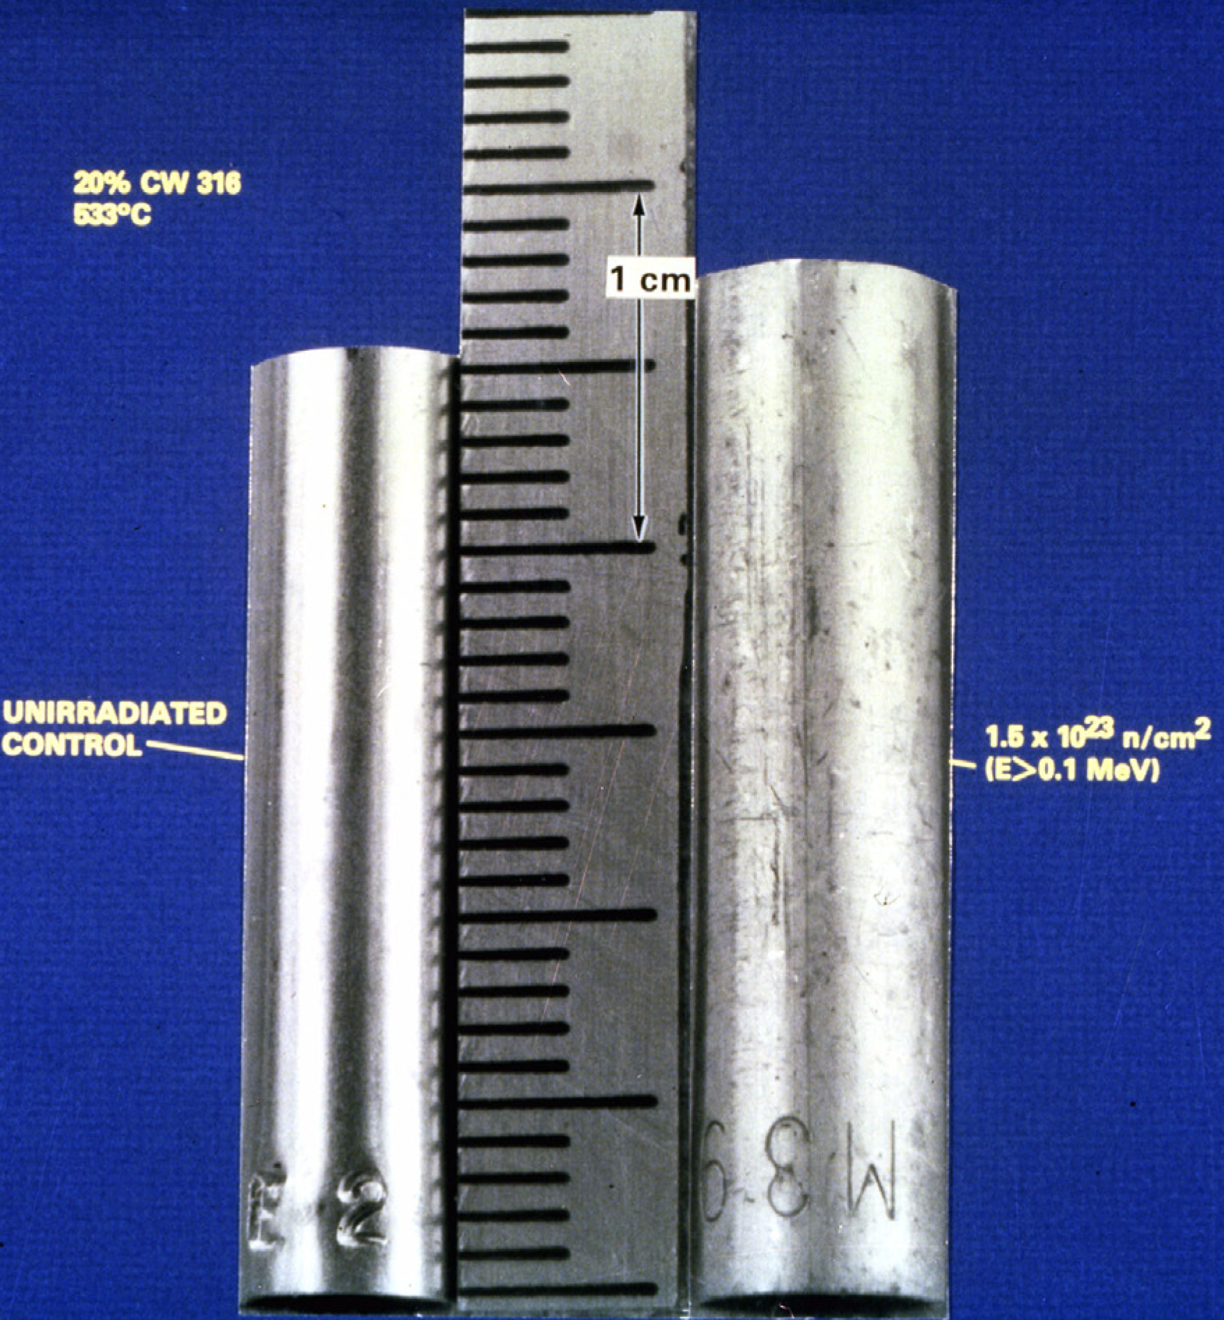
Applications of Accelerators: Materials Irradiation
Irradiation with energetic particles leads to atomic displacements
  Atomic displacements leads to microstructural evolution, which results in substantial mechanical and physical property changes.
Damage regime can be reached by accelerator-driven sources
Very aggressive accelerator parameters are required to reach 20-40 dpa/yr
  IFMIF: 250 mA x 40 MeV deuteron accelerator (10 MW beam power) using d-Li stripping
  MW-class spallation neutron source
316 SS
Courtesy R. Kurtz, PNNL

Slide 42
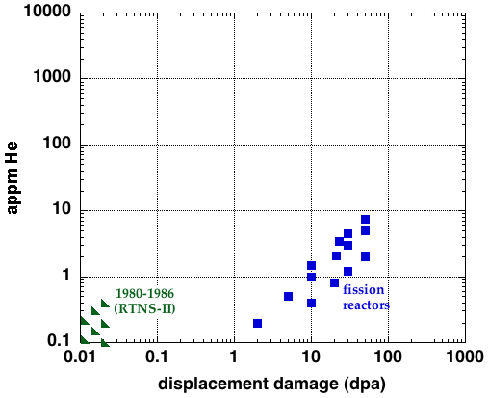
Materials Irradiation
Suitable irradiation sources are a critical need for future fission/fusion materials development
A MW-class proton beam driving a target designed for high neutron flux can meet this need
Steels
Spallation
neutrons
Fusion
reactor
IFMIF
ITER

Slide 43

Recent Developments
DOE Symposium and Workshop on Accelerators for America’s Future
DOE/Office of Science recently commissioned an assessment of “Accelerator and Target Technology for Accelerator Driven Transmutation and Energy Production”
  http://www.science.doe.gov/hep/files/pdfs/ADSWhitePaperFinal.pdf
Summary: Substantial technology developments of the last 10-15 years make an ADS demonstration facility feasible, and go a long way toward demonstrating the technology required for an industrial-scale system.
Briefing to Secretary Chu on ADS

