Slide 1




Proton/Ion Beam Therapy & Medical Accelerators
Research in the UK
Dr. Suzie Sheehy
ASTeC, RAL
On behalf of Prof. Ken Peach
PTCRi, Oxford
Proton Accelerators for Science & Innovation Workshop, Fermilab, Friday 13th January

Slide 2
Medical Applications of Accelerators
Radiopharmaceuticals
Radiobiology
Charged Particle Therapy in the UK
The PAMELA project
The LIBRA project

Slide 3
Radiopharmaceuticals

Slide 4
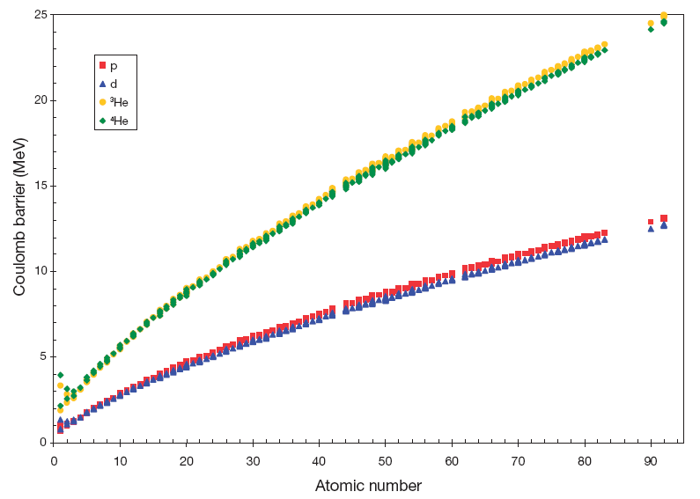
Coulomb Barrier for p, d, ³He, ⁴He
From IAEA Technical report 468 (2009)

Slide 5
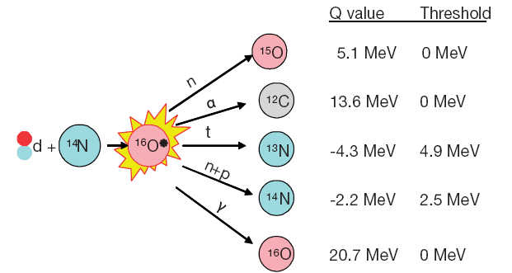
An example
“Accelerator has the advantage that target & product are different chemical elements”
From IAEA Technical report 468 (2009)
Notes:
Accelerators have the advantage that the target & product are different chemical elements – can easily separate, obtain high activity preparations & produce fewer impurities by selecting target, particle & energy window for irradiation.

Slide 6
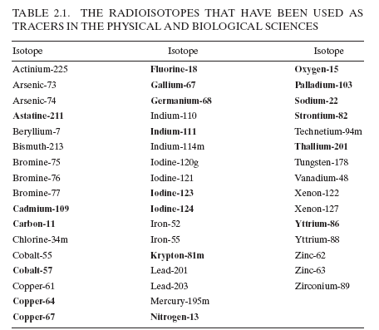
A list of 49 “useful” radionuclides
From IAEA Technical report 468 (2009)

Slide 7
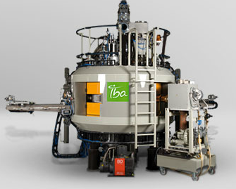
IBA Cyclone 30
Need sufficient energy to overcome Coulomb Barrier
Need sufficient current to give practical yields
Notes:
To main characteristics – beams must have sufficient energy to overcome coulomb barrier & sufficient current to give practical yields.
Mainly positive & negative ion cyclotrons but also superconducting cyclotrons, low energy linacs, tandem cascade accelerators.
Some accelerator systems designed to only produce one radionuclide

Slide 8
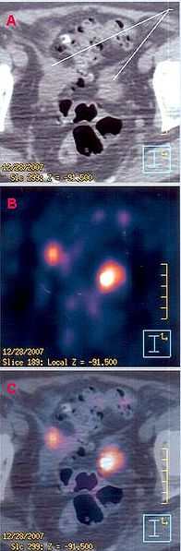
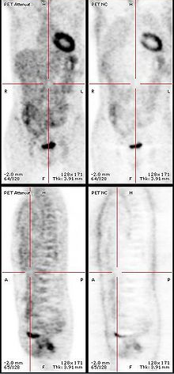
PET Scanning
Positron Emission Tomography
Excerpt of PET-CT clinical images from a 69-yrs old female with metastases in the pelvic area, evidenced by hypermetabolic spots, one near the sigmoid colon (at right), another in a lymphatic node (at left).
Notes:
Use Oxygen-15 for PET studies
Also used for SPECT – (single photon emission computed tomography)

Slide 9
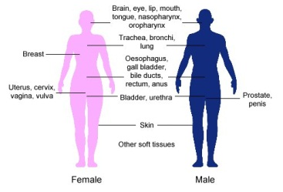
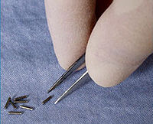
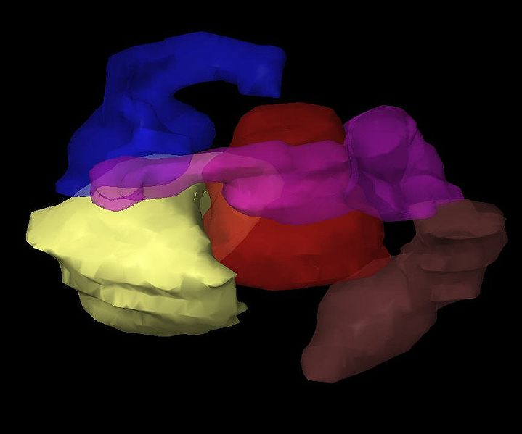
Brachytherapy
Little radioactive needles

Slide 10
In the UK?
Not aware of any sustained work
⁹⁹Mo
  Highly used to make Tc-99m
  Dependent upon nuclear reactors
  Can be made with accelerators
    MW power
  High risk
    Market price for ⁹⁹Mo is very low
  Not very interesting accelerator physics
    If 1MW is needed, buy 10 100kW cyclotrons

Slide 11
Radiobiology

Slide 12
In vitro & in vivo studies
Shortage of suitable beams
  Up to a few 100 MeV
  H→~Ne
  Variable rate
    Nano-beams to few Gy/minute
  Needs a biology lab nearby
    Animal facilities?
In the UK
  Working with CERN to see if LEIR can be used for radiobiology
    Also heavier ions for space radiobiology study

Slide 13
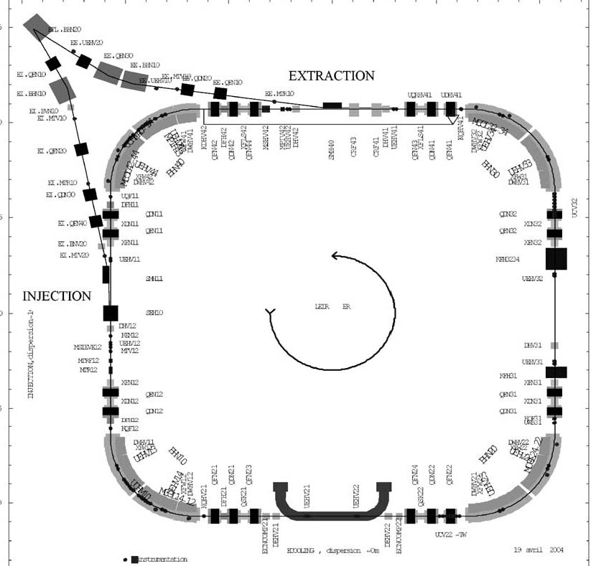
LEIR

Slide 14
Proton & Light Ion Therapy
… in the UK

Slide 15
Status
Clatterbridge (since 1989)
  62 MeV Cyclotron; eye tumours (~100/year)
National Health Service (call: 08/2009)
  2 or 3 centres, ~2000 patients/y, 25% Paed
  UCH, Manchester Christie (Birmingham)
    No ground breaking yet
Private plans
  “Pro-Tom” system for London “funded”
Other options
  Oxford would like a small (2-3 room) centre
    For research

Slide 16
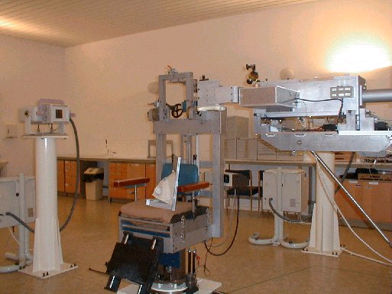
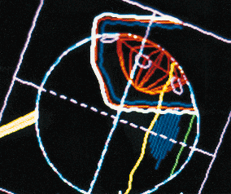
The Clatterbridge Centre for Oncology
Established 1989
  Douglas 62 MeV cyclotron
  First hospital based proton therapy
  >1700 patients with ocular melanoma
  First example of 3D computer treatment planning in UK;
    eye gaze direction used to obtain best approach angle to eye.
After Bleddyn Jones
Courtesy Clatterbridge

Slide 17
Proton & light ion therapy
The PAMELA project

Slide 18
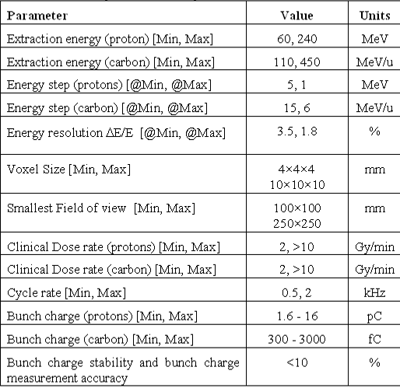
Main Clinical Requirements
Treatment
Plan
should be
determined
by
clinical
need
not
limited
by
Accelerator
Technology

Slide 19
Accelerator Technology?
Cyclotrons
  Fixed energy extraction, difficult for Carbon at full energy (equivalent to 1.2 GeV/c protons)
Synchrotrons
  Flexible, but too slow?
FFAG
  Flexible, rapid cycling (fixed field), variable energy … but … new technology
    Scaling (Mori) & non-Scaling (Johnstone, PAMELA)
(Compact) Linear Accelerators
  e.g. Dielectric Wall Accelerators
…
Laser-Plasma Ion accelerators
  Future …

Slide 20
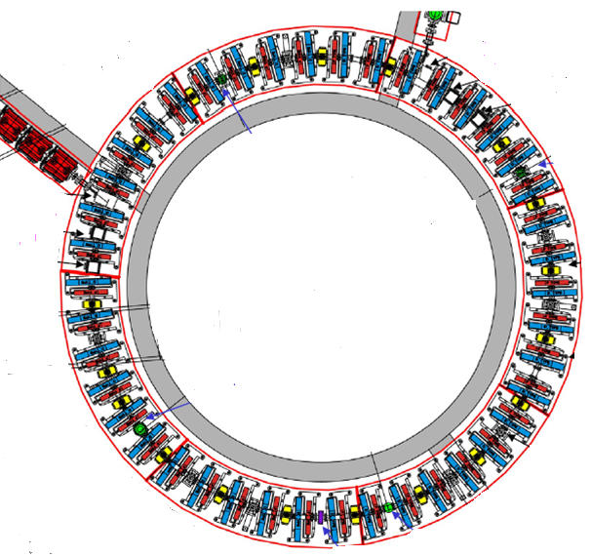
EMMA works!
Can an EMMA-like ring work for protons?
S. Machida et al., “Acceleration in the linear non-scaling fixed-field alternating-gradient accelerator EMMA”, Nature Physics, 2012 (DOI: 10.1038/NPHYS2179)

Slide 21
Challenges
The non-scaling Fixed-Field Alternating Gradient Accelerator is a new type of accelerator
  Lattice?
  Magnets, injection/extraction
  Challenging RF
  Resonance crossing?
  Stability
EMMA is a relativistic ns-FFAG
PAMELA is a non-relativistic ns-FFAG

Slide 22
Solutions
(Johnstone & Koscielniak)
  Use wedge-shaped magnets
    Stabilize betatron tune
    Longer straight sections
(Machida)
  Introduce higher multipoles
    Stabilize betatron tune
    Longer straight sections
See Johnstone and Koscielniak,
“Tune-Stabilized Linear-Field FFAG for Carbon Therapy”, EPAC Edinburgh (2006), 2290.
Johnstone: “Non-Scaling FFAG Accelerator Variants for HEP and Medical Applications”,
PAC Vancouver (2009)
S. Machida, “FFAGs for proton acceleration”, FFAG'08 workshop, Manchester, 2008
S. L Sheehy et al., “FFAG with small orbit shift and tune excursion”, PRSTAB 13, 040101, 2010.

Slide 23
PAMELA
STATUS
The PAMELA Design Team:
John Cobb, Suzanne Sheehy, Holger Witte, Takeichiro Yokoi (JAI, Oxford)
Richard Fenning, Akram Khan (Brunel University, UK)
Rebecca Seviour (Cockcroft Institute, Lancaster, UK)
Carol Johnstone (Fermilab, USA)
Mark Hill, Bleddyn Jones*, Borivoj Vojnovic
(Gray Institute for Radiation Oncology and Biology, Oxford, UK)
Morteza Aslaninejad, Matt Easton (Imperial College, UK)
Jaroslaw Pasternak , Jürgen Pozimski
(Imperial College and STFC/RAL, UK)
Neil Bliss, Carl Beard, Peter McIntosh, Susan Smith,
Stephan Tzenov (STFC/DL, UK)
Rob Edgecock, David Kelliher, Shinji Machida,
James Rochford (STFC/RAL, UK)
Hywel Owen, Sam Tygier (University of Manchester, UK)
Roger Barlow (University of Huddersfield)

Slide 24
How does PAMELA work?
From EMMA to PAMELA
The EMMA lattice
Doublet structure
  Focus and Defocus
Dense lattice
  Little space between magnets
Lots of RF Acceleration
  Almost every other cell
The PAMELA lattice
Triplet structure
  Focus, Defocus, Focus
Less Dense lattice
  Long straight sections
Less of RF Acceleration
  Larger cavities
  Lower frequencies
Larger radius
F
D
D
F
F

Slide 25
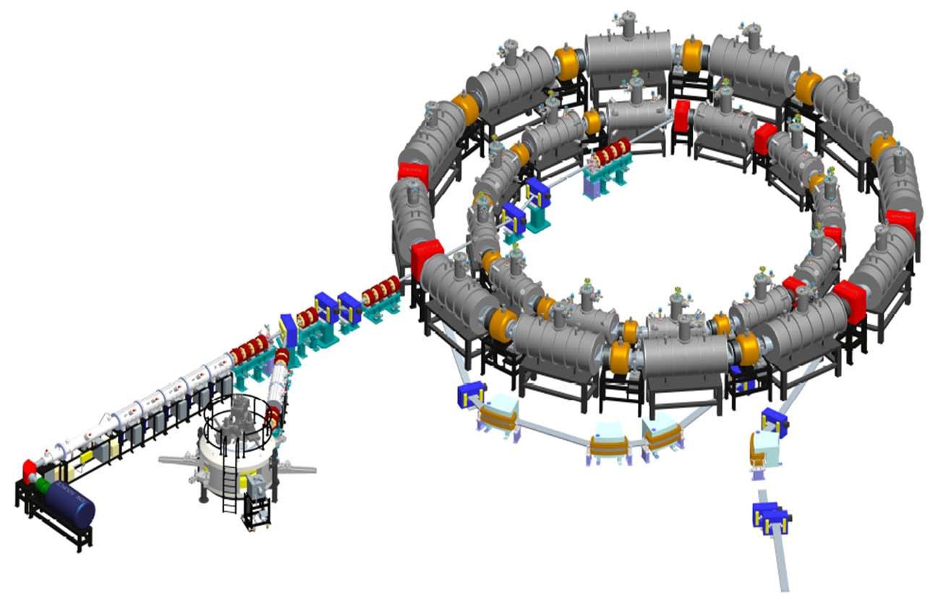
PAMELA Layout
Carbon ring
~12m
Proton ring
Carbon source & injection
Proton source & injection
Extraction
Transfer line

Slide 26
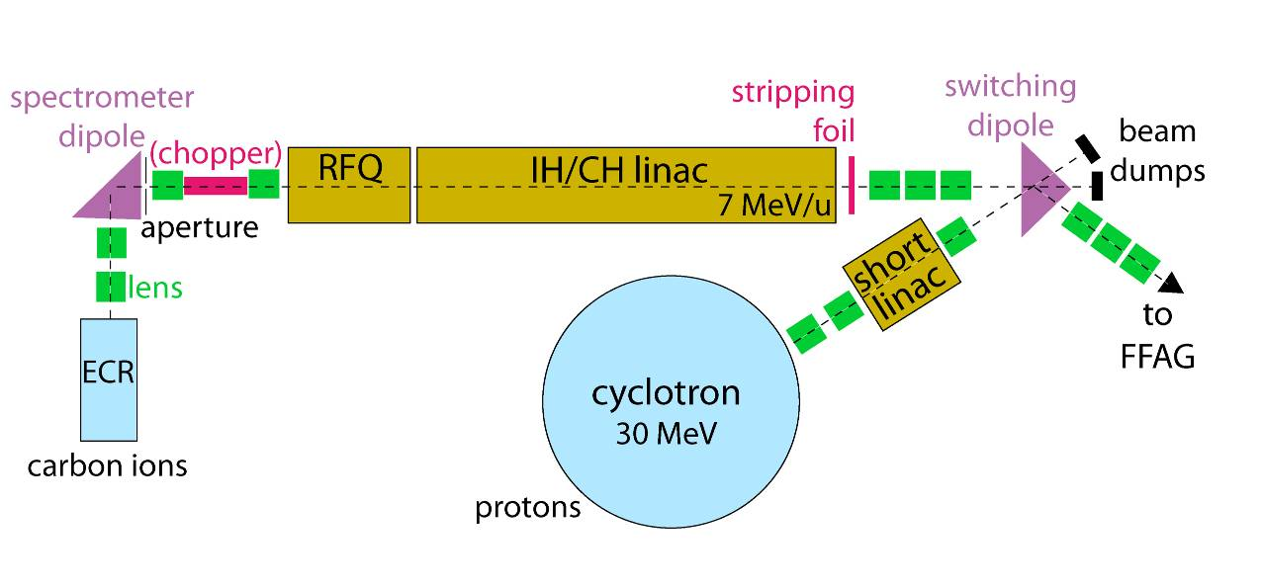
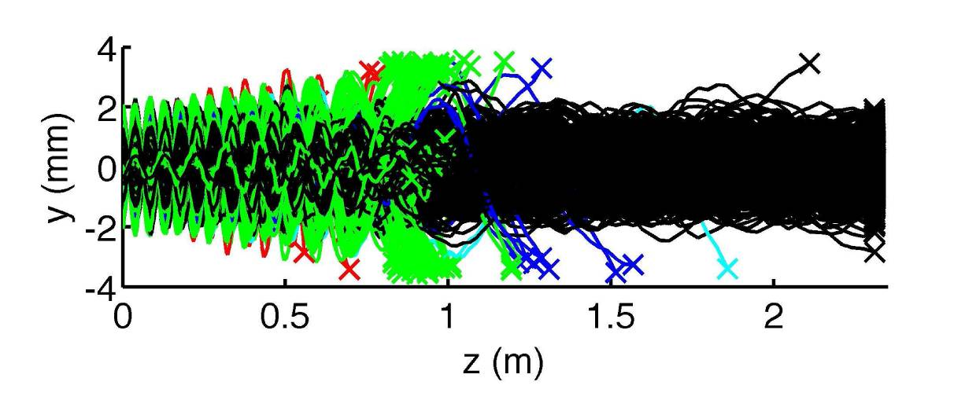
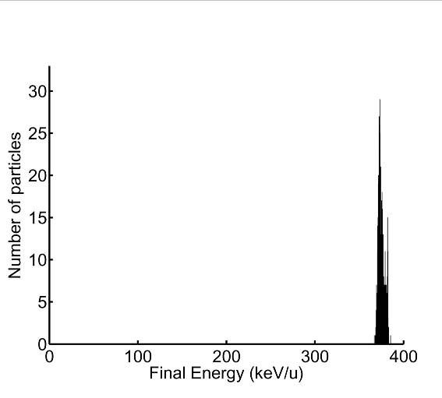
Ion sources
Carbon RFQ Parameters
E-field frequency 200MHz
E_{I} 8 keV/u
E_{f} 382 keV/u
Transmission 75%
RFQ length 2.4m
Electrode potential 80 kV
C⁴⁺ trajectories through the RFQ
C⁴⁺ final energy

Slide 27
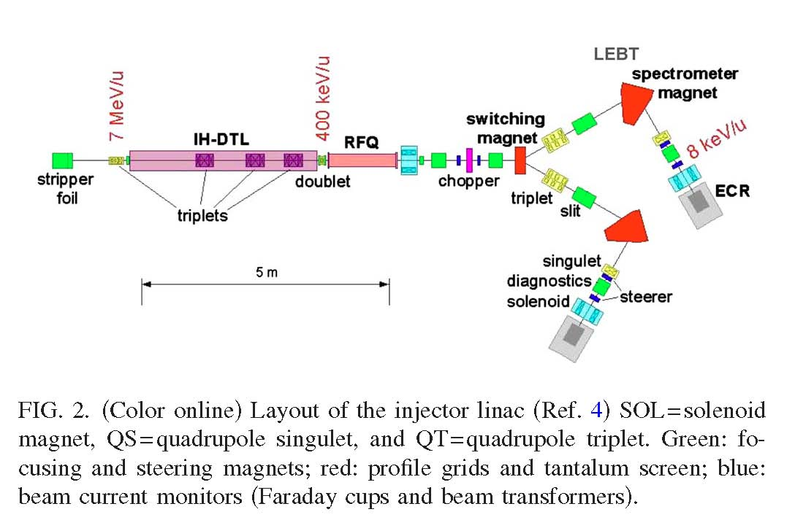
Ion Sources: another option
The Heidelberg C⁴⁺/H₃⁺ ECRIS Source for HIT
Winkelmann et al. Rev. Sci. Instrum. 79, 02A331 2008

Slide 28
Present Lattice – Proton Ring
Proton ring (30 to 250 MeV)
  Carbon requires second ring
non-scaling, non-linear lattice
  Tune-stabilisation
Principle idea:
  Start with scaling FFAG
  Relax scaling law
    Rectangular CF magnets
    Aligned on straight line
    Multipoles up to octupole
  Results in FFAG with...
    Small orbit excursion (<172 mm)
    Compact magnets
    No/little tune shift
12 cells, FDF-triplet
  Straights: 1.7 m
  Sufficient space
    Injection/extraction
    RF
Packing Factor | No. cells | Radius | Orbit Excursion | Straight Section
0.48 | 12 | 6.251 m | 0.176 m | 1.702 m
Notes:
28

Slide 29
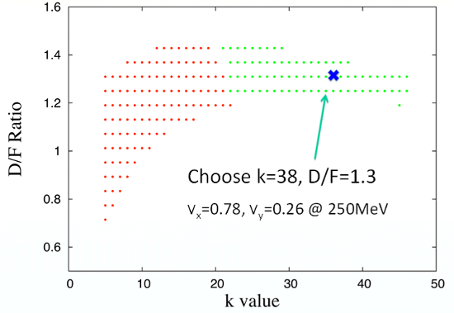
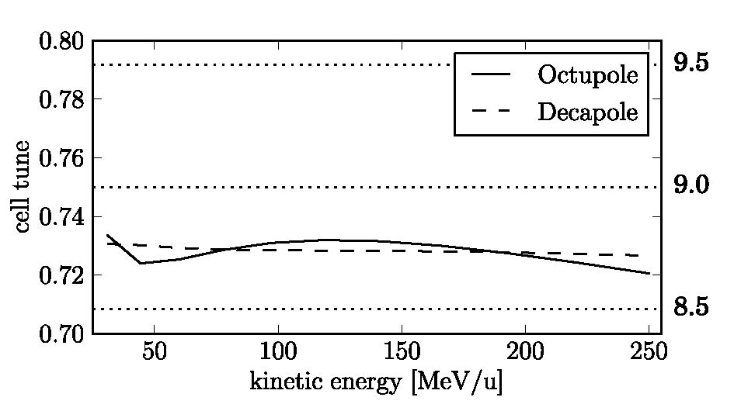
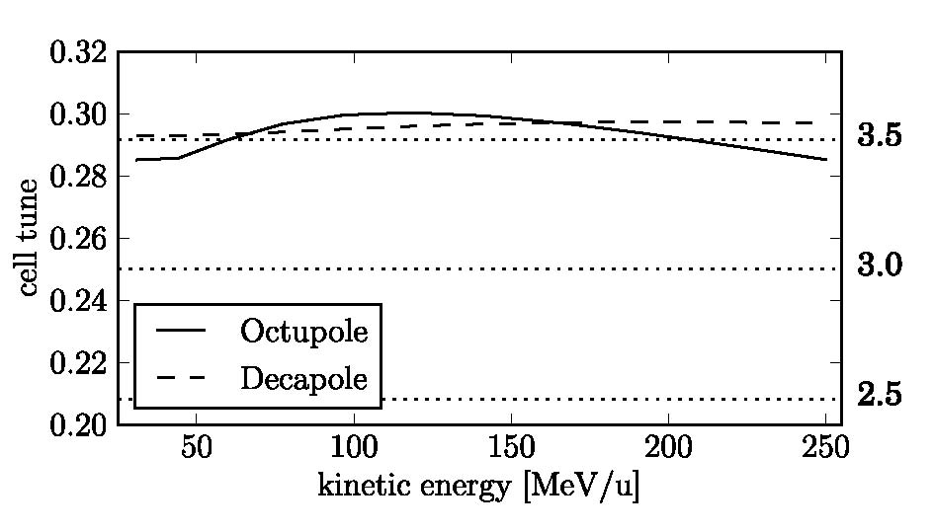
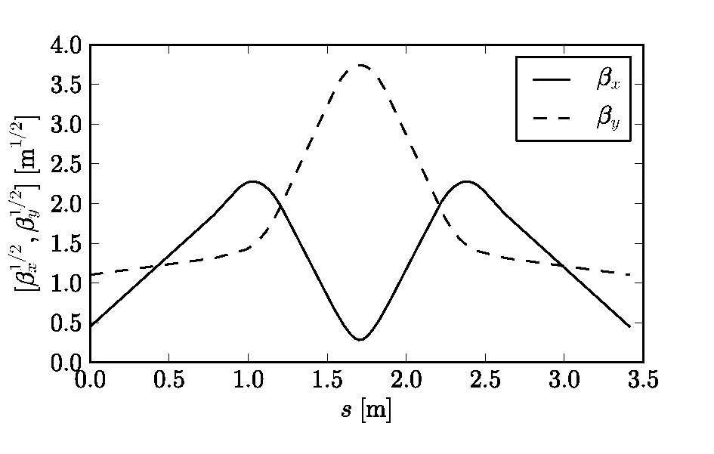
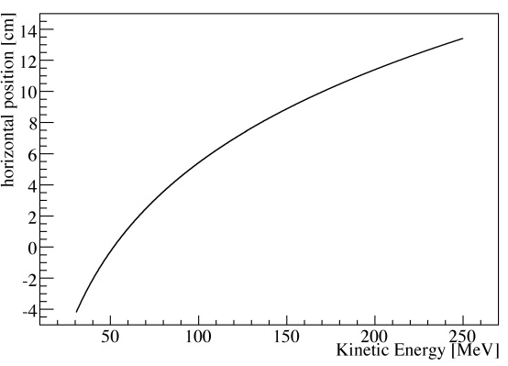
Working Point and Tunes
Working point
  High k (38)
    minimize orbit excursion
Machine tune variation (cell tune variation*12): [decapole]
  ν_{x} within 0.0476
  ν_{y} within 0.0528
  Well within an integer!
Beam sensitivity
  Amplification factor 5.8 (h)
  9.5 (v)
  (A = orbit distortion [mm] /
  1σ alignment error [mm])
horizontal
vertical
Proton Ring
Notes:
29

Slide 30
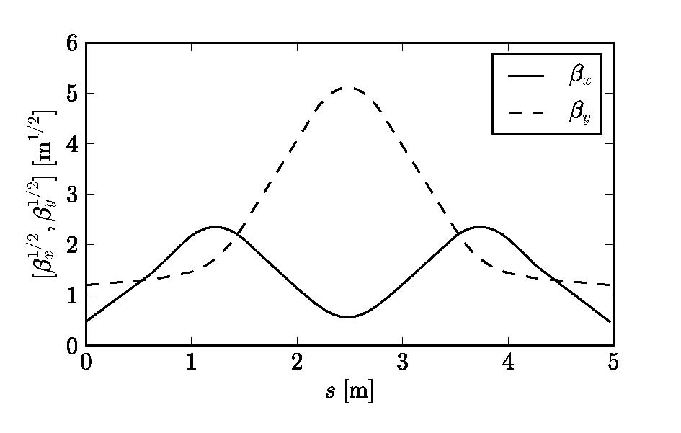
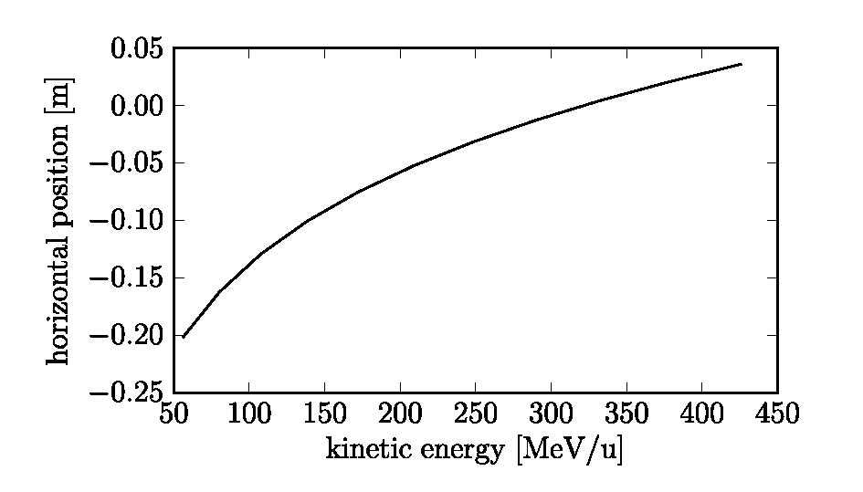
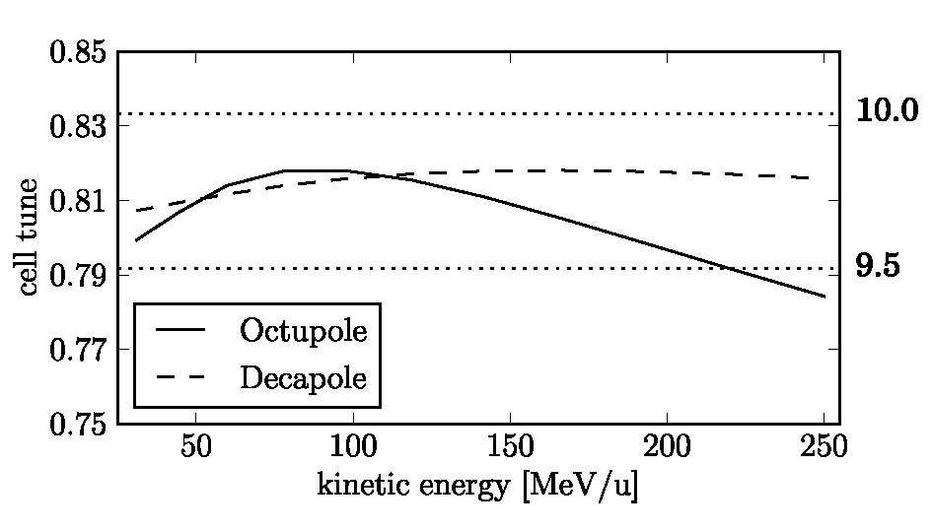
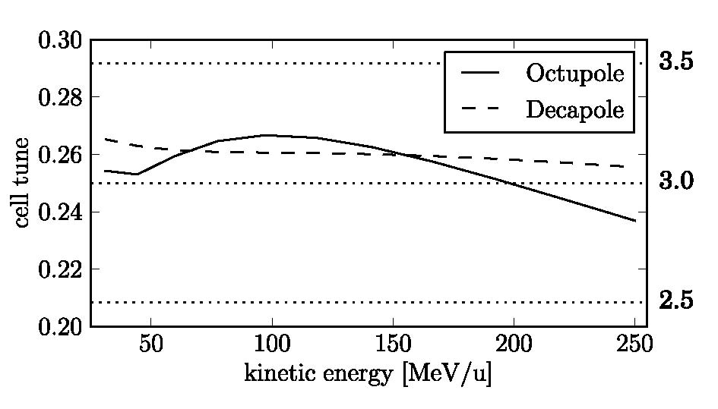
Working Point and Tunes Carbon Ring
Working point
  Radius 9.3m
  Packing factor 0.63
  High k 42
  orbit excursion 0.217m
Machine tune variation (cell tune variation*12): [decapole]
  ν_{x} within 0.130
  ν_{y} within 0.117
horizontal
vertical
Notes:
30

Slide 31
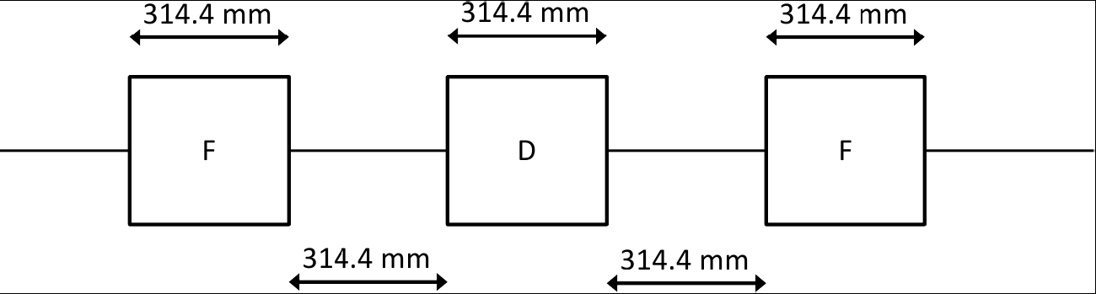
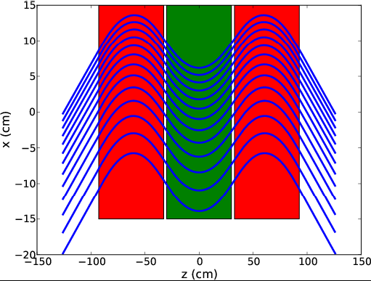
Magnetic Lattice

Slide 32
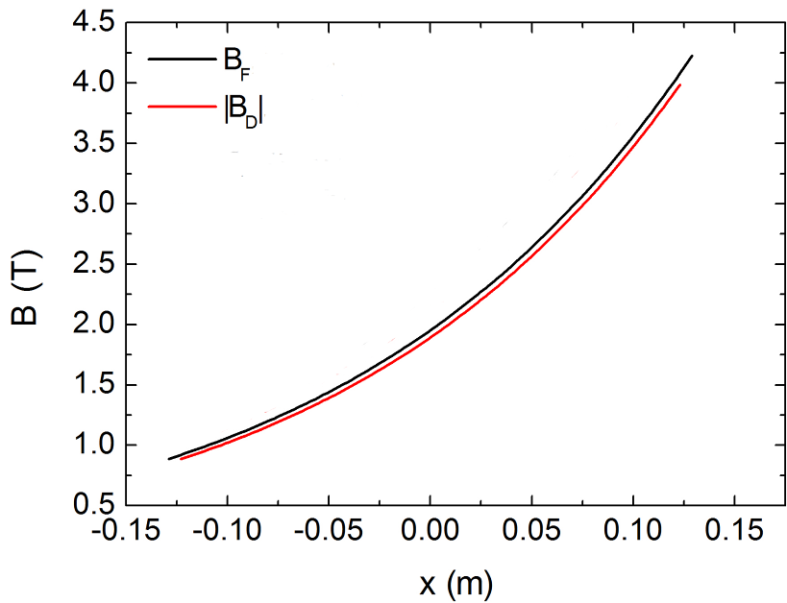
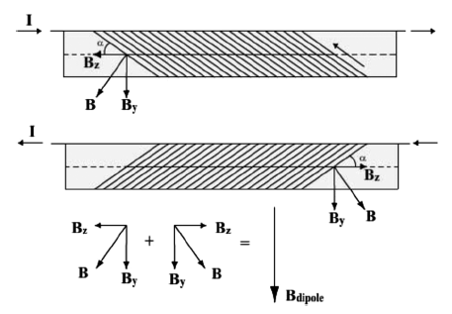
Magnet Requirements
Non-scaling, non-linear FFAG
  Multipoles up to decapole
Challenges
  Maximum field (4.25T)
  Length restriction (314 mm)
  Required bore (>250 mm)
Magnet options
  n/c Iron cored magnets
  Superferric coils
  S/C cos(θ) magnets
  S/C Double-helix coils
Choose: Double-helix coils
Notes:
32

Slide 33
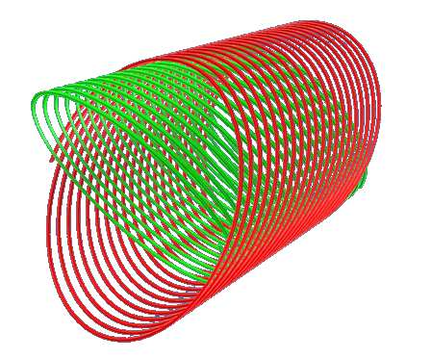
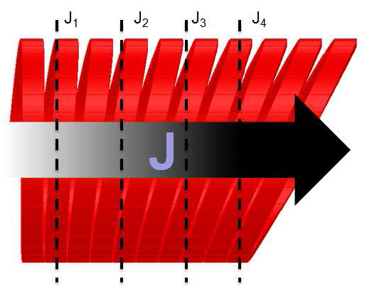
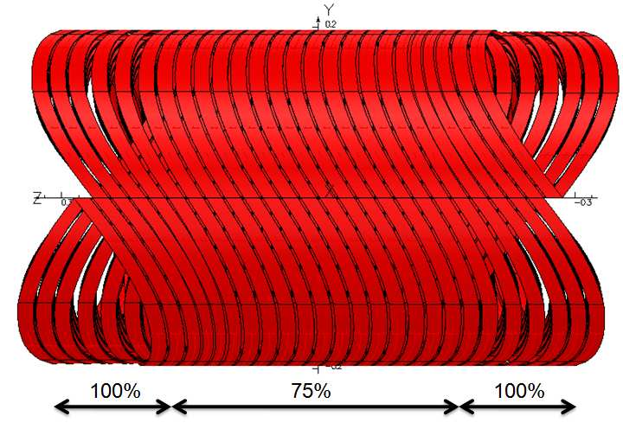
Double-Helix Principle
Current density:
Helix 1
Helix 2
Double-Helix
+
Double-helix coil:
Smart way of creating a cosine-theta magnet
Main advantage for PAMELA: No coil end problem
Notes:
33

Slide 34
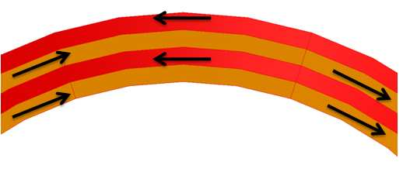
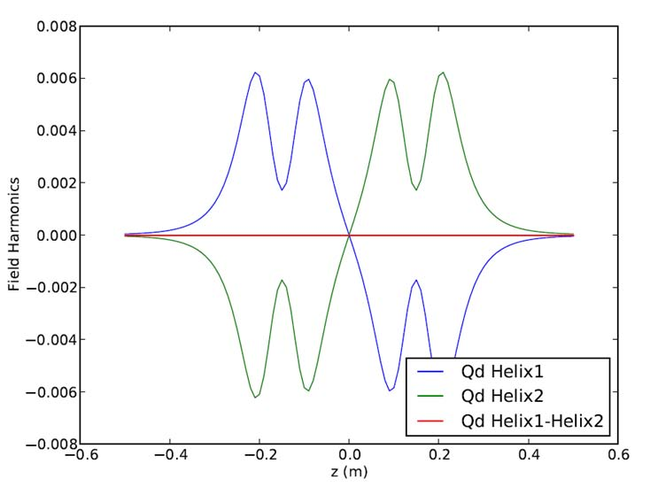
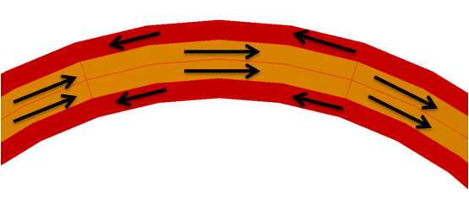
High field quality
Patent Application GB 0920299.5

Slide 35
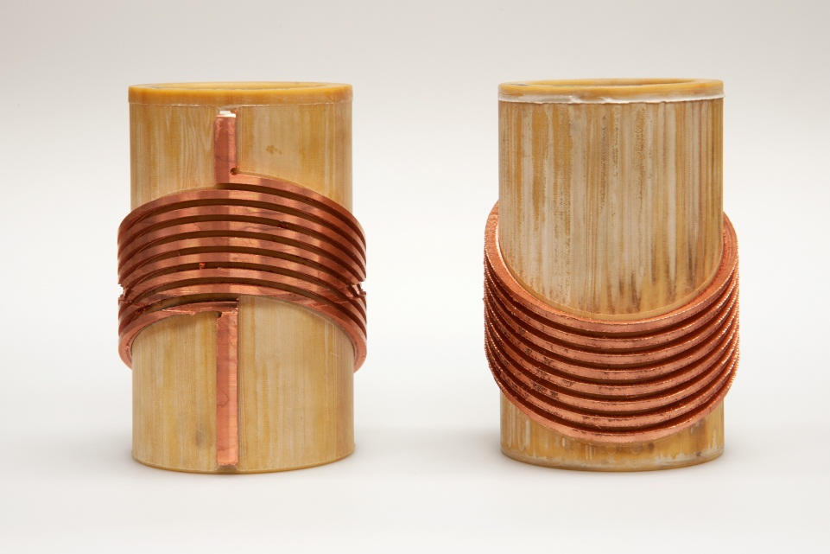
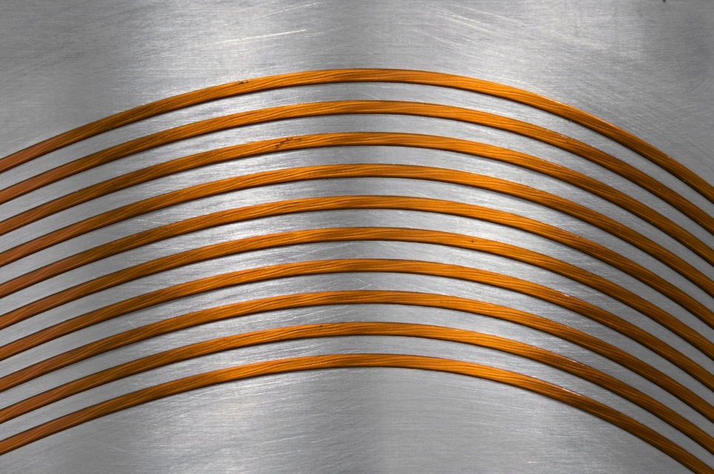
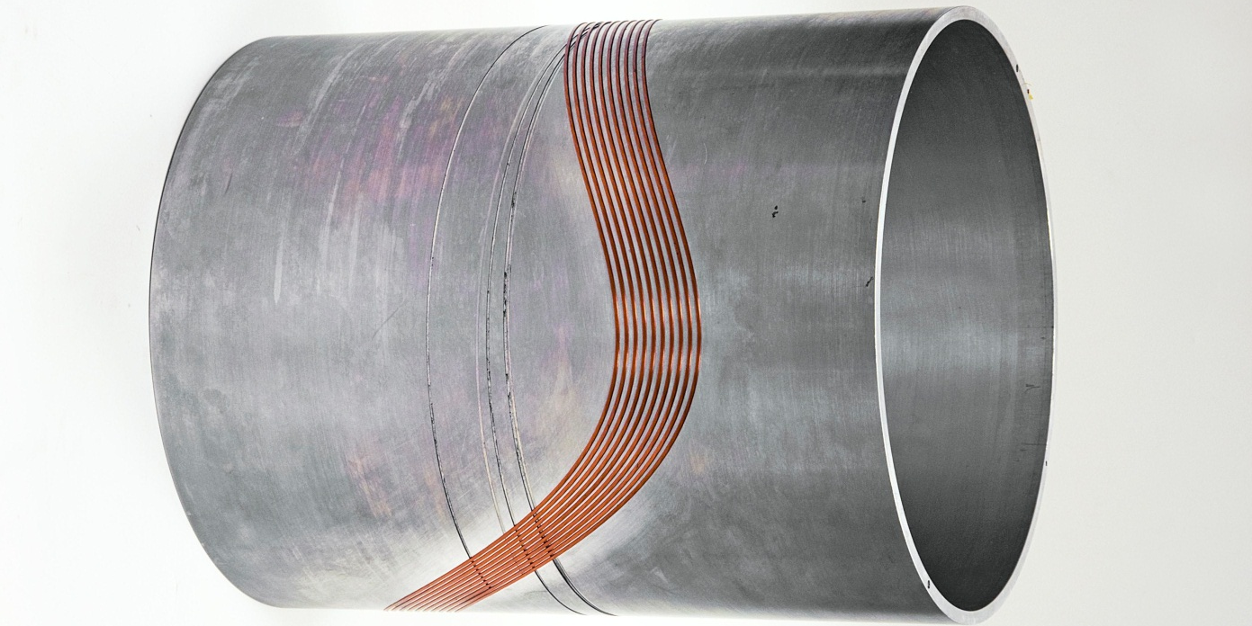
Some test windings

Slide 36
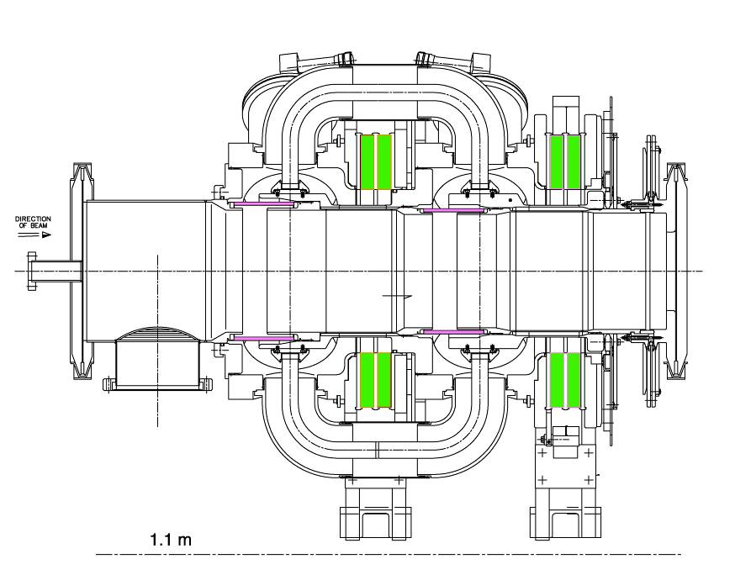
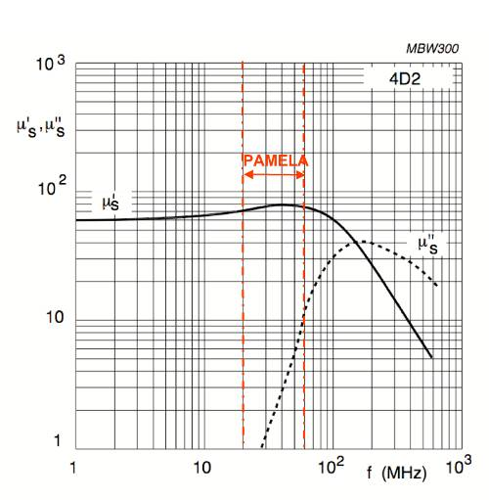
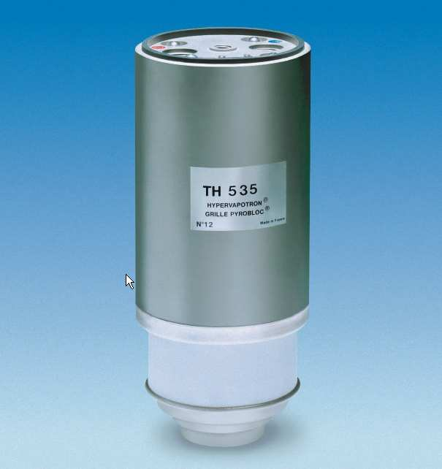
RF System
1kHz repetition rate ~ 100kV/turn
Drift space ~1.7m
Target energy gain:
  ~16kV/turn/cavity
Challenges:
  duty cycle, Modulation, gradient
Ferrite loaded cavity
  baseline: ISIS 2nd harm. cavity
    Relatively high Q (~100)
    sufficient accelerating field
    h=10 ?
    heat load @ 1kHz ~100kW/cavity
Development started
  Ferrite property measurement
    Q-value, FM rate dependence
1.1m
Notes:
36

Slide 37
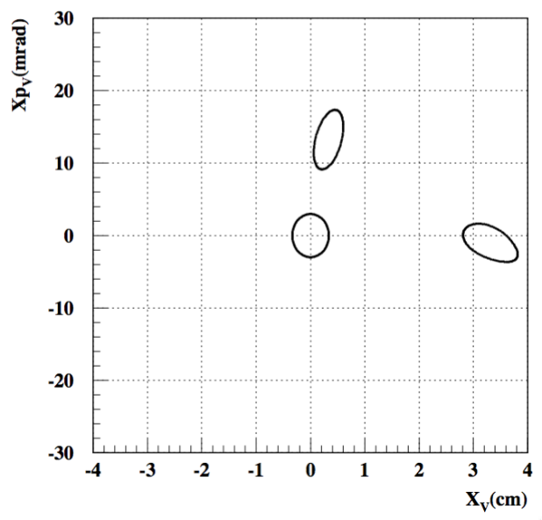
PAMELA: Beam extraction
Kicker system
Vertical extraction
Advantages over horizontal extraction
  weaker field
    <0.06T~1m (hor: 2.9 kG)
  Peak voltage:
    30kV (hor: 446 kV for movable C-type)
R&D issues
  Large aspect ratio kicker (185x26 mm²)
    kicker inductance?
  Kicker reliability
    @1 kHz, 10h/day, 5d/week ~10^{B} pulses/y
  Scaling to carbon ring
    0.16T, 78kV
Kicker#1
Septum
FDF
FDF
230MeV (B_{kicker}:0.6kgauss)
@kicker
septum
CO
@septum
Notes:
37

Slide 38
Kicker specification
Kicker specification at injection
Emittance of circulating beam at injection | 10π mm mrad (unnormalized)
Vertical beta function at injection | 1m
Orbit separation at septum | 30mm
Fall-off time | 250ns (traveling wave)
Acceptable total field error (ΔB/B) | 0.1
Kicker specification at extraction
Emittance of circulating beam at extraction | 10π mm mrad (unnormalized)
Vertical beta function at injection | 1m
Orbit separation at septum | 30mm
Fall-off time | 100ns (traveling wave)
Acceptable total field error (ΔB/B) | 0.02
Kicker length <1m

Slide 39
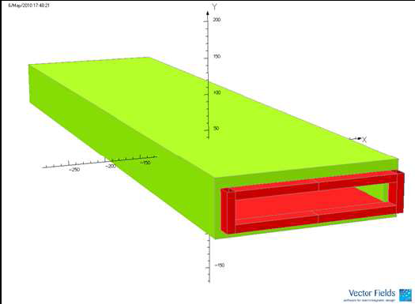
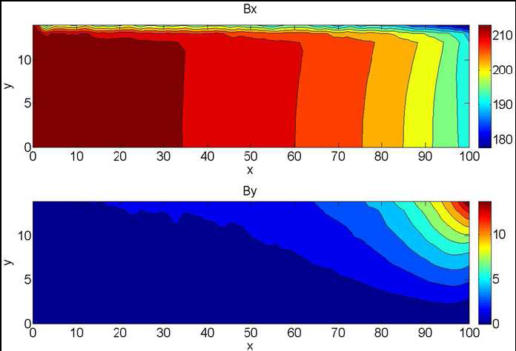
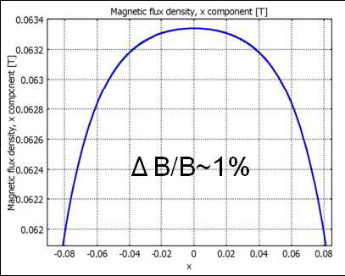
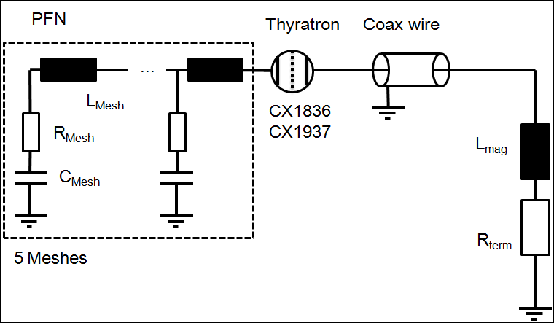
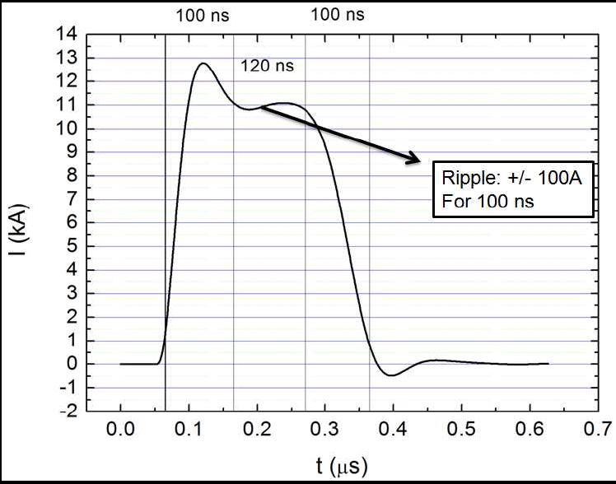
Kicker Performance (proton ring)

Slide 40





Septum

Slide 41

Beam Transport
Need an FFAG beam transport
0.2m
0.2m
3.6m
5m

Slide 42



Gantry & Beam Transport Design
FFAG-like achromatic beam transport & gantry

Slide 43
Next steps
Seek component prototype funding
  Main ring magnets
  RF
  Kickers
  Carbon RFQ
Seek machine funding
  Demonstrator for CPT

Slide 44
PAMELA Summary
Conceptual design presented
  A realistic lattice design
  Feasible magnets & RF
  Ion source, injection, extraction
  Beam transport & gantry
Next steps require prototyping
Meanwhile, need to gain experience in UK

Slide 45
Accelerator Technology?
Cyclotrons
  Fixed energy extraction, difficult for Carbon at full energy (equivalent to 1.2 GeV/c protons)
Synchrotrons
  Flexible, but too slow?
FFAG
  Flexible, rapid cycling (fixed field), variable energy … but … new technology
    Scaling (Mori) & non-Scaling (Johnstone, PAMELA)
(Compact) Linear Accelerators
  e.g. Dielectric Wall Accelerators
…
Laser-Plasma Ion accelerators
  Future …

Slide 46

Laser-plasma accelerators
Compact, bright sources of:
High energy electrons
Gamma rays
XUV and x-ray radiation
Ions

Slide 47
Applications
E_{p} > ~ 100 MeV
Ion beam cancer therapy
Proton probing (field measurements)
Radiography (density measurements)
Injection into conventional accelerators
Production of isotopes
Fast ignition fusion
Proton heating
Industrial (lithography)
The ‘bright’ approach:
multiple accelerator stations driven by a single laser system
E_{p} ~ 10 MeV

Slide 48


Laser Induced Beams of Radiation
and their Applications
Project aims to develop target, detector and interaction technology required for high repetition, high energy operation of laser-driven particle and radiation sources.
LIBRA
Notes:
Laser impinging on solid or liquid target

Slide 49
Acceleration mechanism (1)
Extreme laminarity and ultra-low emittance: < 4 µm.mrad
Short duration source: ~ 1 ps (Et < 10⁻⁶ eV-s)
High brightness: 10¹¹ –10¹³ protons/ions in a single shot (> 5 MeV)
High current (if stripped of electrons): kA range
Relativistically intense laser pulse
> 10¹⁸ W/cm²
Broad energy spectrum (thermal Maxwellian) at present
TV/m accelerating fields extending microns from surface

Slide 50

Setup for cell irradiation
D ~ 27 cm
Vacuum chamber Wall
Focusing Parabola
1 cm
S
N
50 um Mylar window
Laser Beam
1 cm
0.9 T
magnet
Target
Slit (500 µm)
Mylar window : 50 µm
Dispersion: in 20mm from 3MeV to 10MeV
Energy Res.: ~ 2.6MeV energy overlapping (500um slit)
Delivered dose @ 5MeV: ~ few Gy/shot

Slide 51
Single shot survival curve
Preliminary data
Notes:
Can give huge doses in a single shot

Slide 52
Consistent with other V79 proton data ?
Consistent with other V79 proton data ?
laser accelerated
conventional source
LET:10-12 KeV/µm
M. FOLKARD et al., INT. J. RADIAT. BIOL 1996, 69, 729 - 738
+ M. BELLI et al., INT. J. RADIAT. BIOL 1993,
63, 331 - 337

Slide 53

Acceleration mechanism (2)
Z⁺
e-
Acceleration by Radiation Pressure of laser pulse (RPA):
In ultrathin foils the laser push on electrons may lead to the detachment of a portion of the foil (light sail)
Narrow-band spectrum (whole-foil acceleration)
Energy transfer more efficient as ions approach relativistic regime
Dominant mechanism at laser intensity ~ 10²³ W/cm²
GeV acceleration in a single laser pulse!!
In the very early stages of achieving RPA experimentally
Experimental campaign using RAL’s GEMINI and Vulcan laser systems starting Feb 2012 for investigation into RPA technique
Simulated RPA ion spectra

Slide 54
Scope as a future source for radiotherapy?
Flexibility:
Possibility of varying output energy
(e.g. varying laser intensity, …)
Possibility of varying accelerated species
    (changing target: C, He, B, Li…)
Reduced cost/shielding/size:
possibility to avoid/reduce size of gantry
laser transport rather than ion transport
Novel therapeutic/diagnostic options
(x-ray + ions , multiple beams?)
Shaped spectrum
(no need to degrade monochromatic beams)
High quality/energy injector
Compared to conventional accelerators what do we need to improve?
  Narrow angular distribution
  Narrow energy distribution (not simply slicing)
  Beam purity
  High repetition, stability
  Higher maximum ion energies

Slide 55
  Developed set-up for ultra-high dose rate (10⁹ Gy/s) irradiation on single exposure
  Demonstrated dose-dependent cell damage
  No clear difference due to dose-rate identified
  Max proton energy of ~ 100 MeV & large energy spread needs to be improved
  Novel RPA technique may be appropriate source for ion beams for medical applications
  Rep. rate limited by that of the laser; currently aiming for 10 Hz for high power laser systems

Slide 56
Summary
Proton & Ion beams are used widely in medical applications
UK work mostly focused on cancer therapy
Not much happening on radioisotopes?
Scope for radiobiology experimental facilities
Conventional but novel (PAMELA) & laser-based (LIBRA) acceleration techniques
Thanks to Ken Peach for the original presentation
& to Ceri Brenner (CLF/STFC) for slides on laser-plasma work

