Slide 1
High Power Proton Accelerators Working Group Report
J. Thomason & S. Holmes
U.K.-U.S. Proton Accelerators for Science and Innovation Workshop
January 12-14, 2012

Slide 2
Operating Facilities ISIS/SNS
John Thomason
Mike Plum
Major Discussion Points

Slide 3
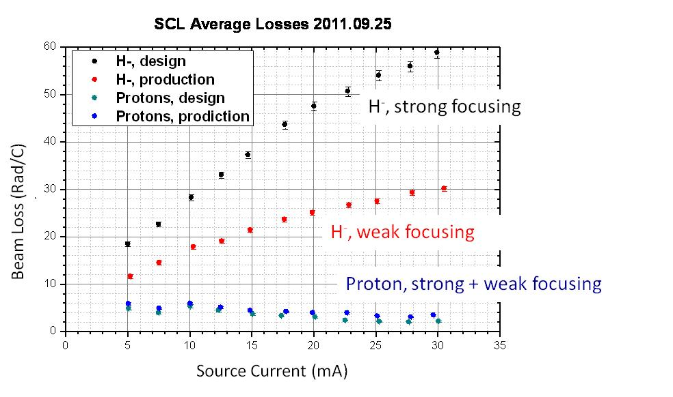
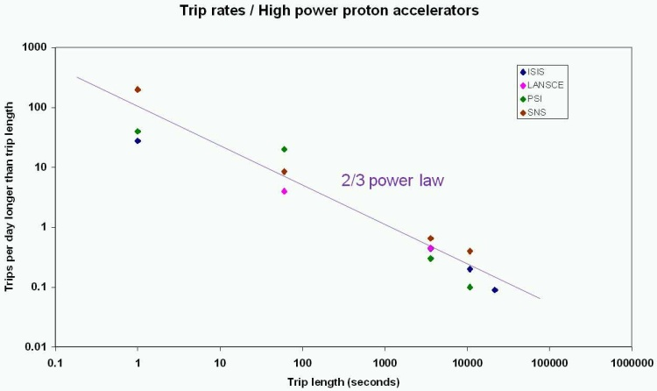
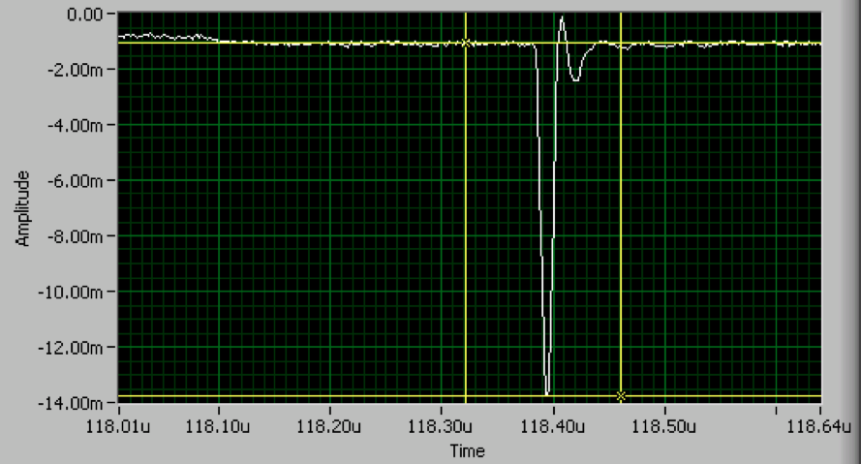
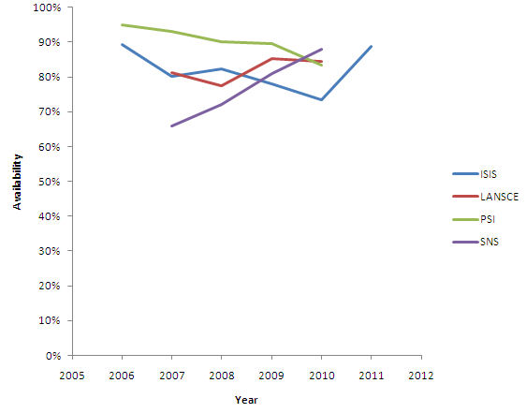
ISIS overall aims – accelerators
Run ISIS sustainably
Prepare for ISIS upgrades
Act as centre/host for proton accelerator R&D in UK
Collaborate nationally and internationally
SNS is a operational MW class superconducting linac proton accelerator
High reliability
Well instrumented (longitudinal, transverse, laser-based)
Good test bed for H⁺ vs. H⁻ beam dynamics
Interesting beam instabilities at high intensities
Opportunities to conduct experiments
We welcome collaborators from other facilities

Slide 4
Operating Facilities ISIS/SNS
Common Interests/Opportunities
Reliability modeling
Participation in machine experiments
Follow-up
Next year
SNS/PX/ISIS to share reliability model input information as required
Establish points of contact at each lab (reliability and information on when machine experiments are happening)
Longer term
What was Missing from the Discussions?
There are other high-power proton labs in the US

Slide 5
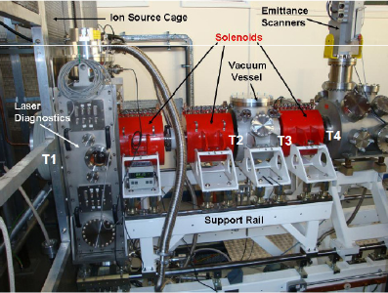
Test Facilities FETS/PXIE – Major Discussion Points
Alan Letchford
Sergei Nagaitsev
LEBT
RFQ
MEBT
HWR
SSR1
Dump
3 MeV beam energy
60 mA x 2 msec x 50 Hz
(6 mA average)
MEBT/Chopper
2 nsec rise/falltime, few MHz chopping
Disposed beam power ~10 kW
Under construction
15-30 MeV beam energy
1 mA CW
MEBT/Chopper
2 nsec rise/falltime, 30 MHz chopping rate
Disposed beam power ~10 kW
In planning

Slide 6
Test Facilities FETS/PXIE
Common Interests/Opportunities
MEBT/Chopper
Deflector design
Absorber
Diagnostics
See Diagnostics discussion
RF sources for MEBT bunchers
RF distribution with vector modulators
Space-charge neutralization in LEBT
Follow-up
Next year
Retain communication on deflector, absorber designs
FNAL (perhaps SNS?) participation in neutralization measurements at FETS
Longer term
What was Missing from the Discussions?
Opportunities at HINS

Slide 7
Ion Sources FETS/PXIE
Dan Faircloth
Dan Bollinger
Major Discussion Points

Slide 8
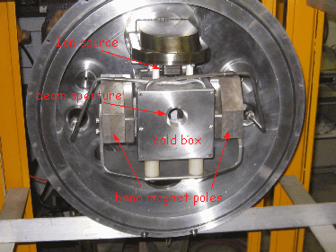
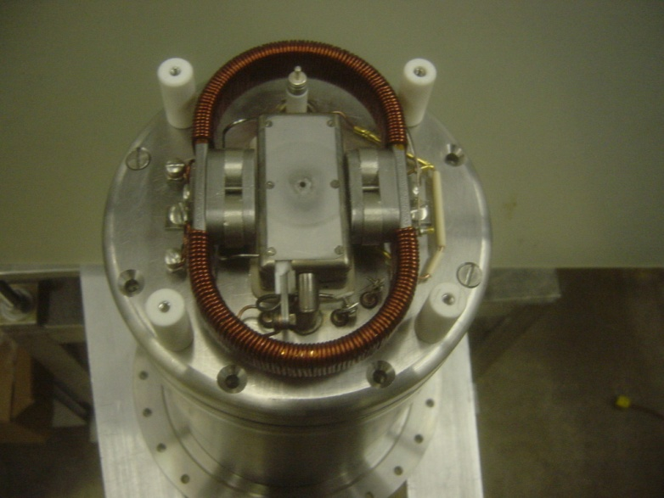
Fermilab Ion Source Parameters
Parameter | Current FNAL | HINS | New FNAL
Arc I | 50 A | 20 A | 15 A
Arc V | 140 V | 152 V | 145 V
H- current | 50 mA | 10 mA | 94 mA
Extraction V | 16 kV | 10 kV | 35 kV
Power eff. | 7 mA/kW | 3.3 mA/kW | 40 mA/kW
Duty factor | 0.12 % | 0.012 % | 0.2 %
Rep Rate | 15 Hz | 1 Hz | 15 Hz
Pulse Width | 80 μs | 120 μs | 150 μs
Cs consumption | 0.5mg/hr | - | -
Beam Energy | 16 kV | 10 kV | 35 kV
Current FNAL
HINS

Slide 9
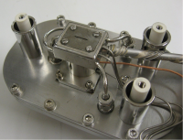
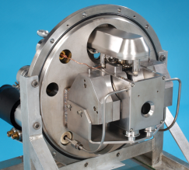
RAL Ion Source Parameters
Parameter | Current ISIS | FETS
Arc I | 55 A | 70 A
Arc V | 60 V | 50 V
H- current | 35 mA | 70 mA
Extraction V | 17 kV | 19 kV
Power eff. | 10 mA/kW | 20 mA/kW
Duty factor | 1.25 % | 10 %
Rep Rate | 50 Hz | 50 Hz
Pulse Width | 250 μs | 2000 μs
Cs consumption | 4 mg/hr | -
Beam Energy | 35 keV | 65 keV

Slide 10
Ion Sources FETS/PXIE
Common Interests/Opportunities
Cs handling
Beam extraction
Optical spectroscopy (not currently of interest at FNAL)
Follow-up
Next year
ISIS to provide information of Cs handling
FNAL to inform on experience of HINS source with no Cs trapping
Longer term
Sharing results of modeling of extraction
Looking at novel materials for longer lifetime
Possibility of NF₃ purging for longer lifetime
What was Missing from the Discussions?
Direct BNL magnetron input to this meeting

Slide 11
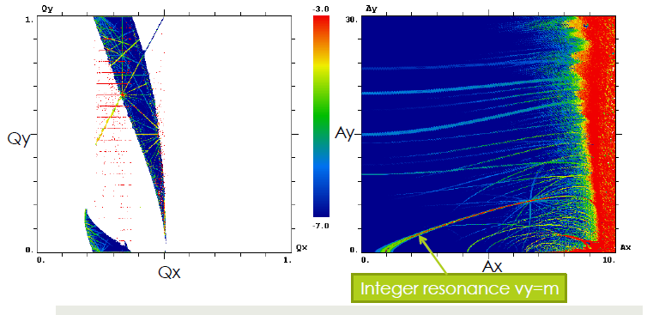
New Acceleration Concepts IOTA/FFAG – Major Discussion Points
Alexander Valishev
Shinji Machida
IOTA
(Highly) non-linear element(s) introduced into lattice
Hamiltonian remains integrable (2 constants of motion)
Resonance don’t matter anymore ⇒ high intensity without instabilities(?)
Test accelerator in planning stage

Slide 12
New Acceleration Concepts IOTA/FFAG – Major Discussion Points
Linear, non-scaling FFAG
Very rapid acceleration with few turns
E_{out}/E_{in} ~3
Tunes not constant ⇒ high intensity without instabilities(?)
EMMA test accelerator in operation at Daresbury
Electron acceleration 10-20 MeV
cyclotron
synchrotron
FFAG
orbit
excursion
orbit
excursion
Black shape: lattice magnet
Red curve: orbit

Slide 13
New Acceleration Concepts IOTA/FFAG
Common Interests/Opportunities
FFAG applications for high energy protons?
Refer to Applications WG
IOTA
Current link is to JAI/BNL (magnet design)
Follow-up
Next year
JAI to consider if want to expand involvement in IOTA
Longer term
What was Missing from the Discussions?
FFAG discussion spread over three WGs

Slide 14
Diagnostics
Juergen Pozimski
Major Discussion Points

Slide 15
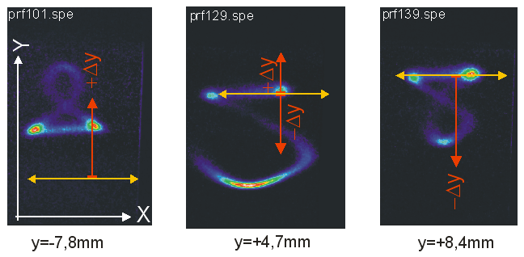
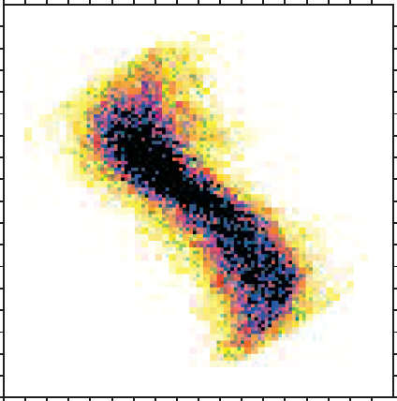
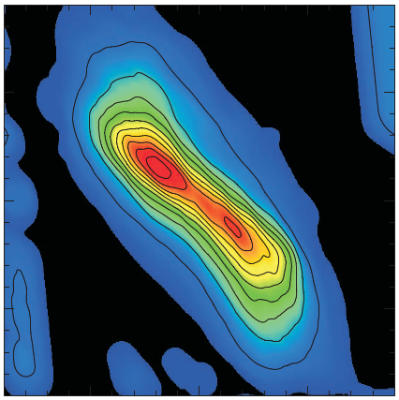
To ensure hands on maintenance of MW class accelerators uncontrolled
beam losses must be kept below 1W/m, requiring non interceptive beam
diagnostic with a highly challenging sensitivity range of better than 10⁻⁶
Laser wire profile and emittance measurements
Secondary particle
(RG) profile scanner
Channeltrons
Beam
Electric field
Emittance reconstruction
from multiple profiles (5)
Detection
Photo detachment
Particle separation
I(t,y)-> profile, long. ε (TOF)
-
-
−
-
−
−
−
−
-
−
−
−
−
-
−
−
“no” momentum transfer
magnetic dipole
I(t,y,x)-> 2 D profile, 4 D transv. ε

Slide 16
Diagnostics
Common Interests/Opportunities
Extending dynamic range to halo sensitivity
Diagnostics development at HINS
Instrumentation development with protons and H⁻
6-d phase space in the front end (feeds into simulation codes)
Electron beam based profile monitors
Longitudinal bunch shape
Laser based diagnostics
e-cloud diagnostics?
Not an issue at the moment in ISIS or SNS; projected to be issue in MI/Project X era.
ISIS/SNS ring diagnostics
Follow-up
Next year
FNAL to determine operational future of HINS: keep SNS and ISIS engaged in plans
ISIS diagnostics visit to SNS in April to be extended to include other diagnostics (including laser wire?)
Longer term
Joint (FNAL/SNS/FETS) plan to develop longitudinal bunch shape monitor
What was Missing from the Discussions?
Diagnostics experts to inform discussion

Slide 17
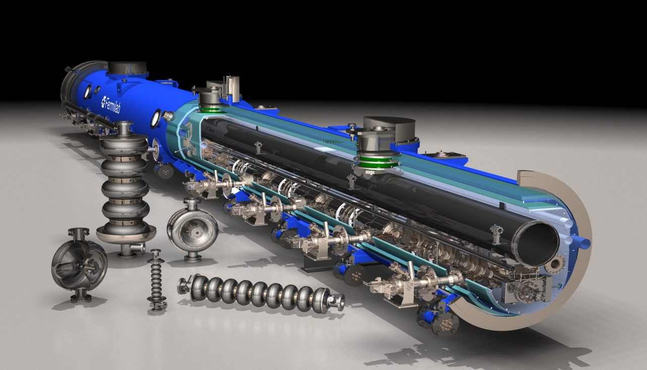
SRF – Major Discussion Points
Bob Kephart
Modest experience and infrastructure in UK (ALICE)
β=1; 1300 MHz
Major investment at Fermilab
β=0.1 - 1.0; 162.5 – 1300 MHz

Slide 18
SRF
Common Interests/Opportunities
Low beta acceleration (ISIS upgrades, Project X)
Opportunity is to increase UK knowledge base in this area
Opportunity to consolidate on 325/650 MHz
Follow-up
Next year
Identify mechanism(s) for assignment of UK personnel within SRF effort at Fermilab and SNS
Longer term
UK personnel assignments into SRF programs at Fermilab and SNS
Common frequencies and component designs?
UK utilization of Fermilab SRF test/development/production infrastructure?
What was Missing from the Discussions?

Slide 19
Future Facilities ISIS Upgrades/Project X
John Thomason
Steve Holmes
Major Discussion Points

Slide 20
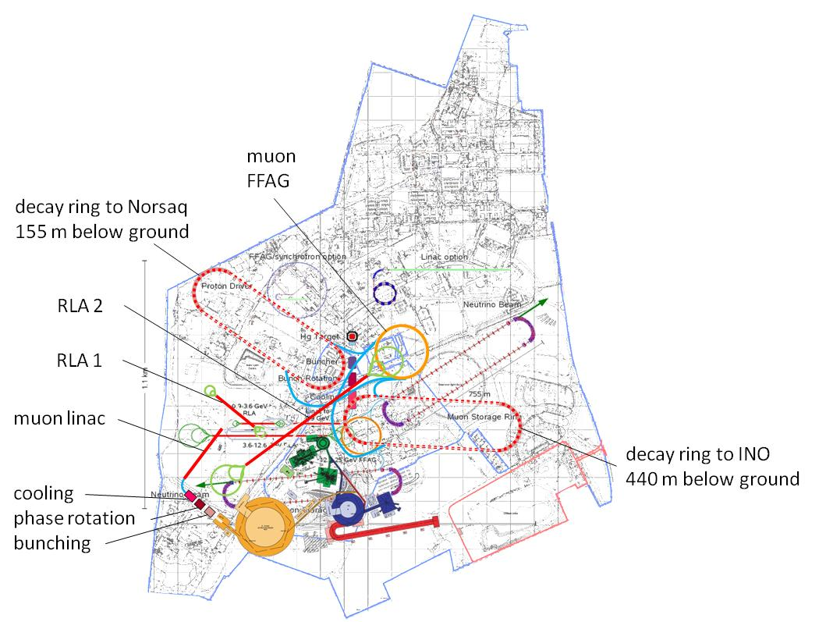
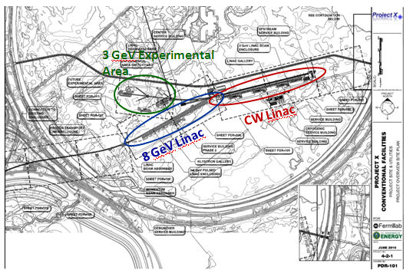
Multi MW class facilities that could
have future possibilities for neutrino
factory or muon collider
Both based on SC high power linacs

Slide 21
Future Facilities ISIS Upgrades/Project X
Common Interests/Opportunities
Mostly covered under secondary topics
Have close connections with other high power proton facilities worldwide
Reviewer exchanges
Participation in Project X Collaboration meetings
Follow-up
Next year
PX collaboration meeting April 10 – 12 in LBNL, identify ≈2 UK attendees
UK PX contact with RAL NF representative
Longer term
More of the same
What was Missing from the Discussions?
In depth beam dynamics presentation from PX and ISIS upgrade

Slide 22
Simulations and Modeling Major Discussion Points
Shinji Machida
Vladimir Shiltsev
Many common efforts with some overlap
Longitudinal (2D) and transverse (4D) tracking with space-charge + fully integrated (6D)
Multi-turn injection, foil heating
Energy deposition, collimation, shielding, activation
Require good characterization of input beam characteristics
Benchmarking
Generally good to very good agreement
Benchmarking is most effective in well characterized machines
SNS, MI, J-PARC
Need some benchmarking of foil heating simulations

Slide 23
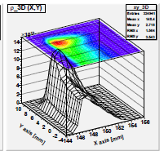
Simulations and Modeling Major Discussion Points
Single harmonic only, 0 ms
Single harmonic only , 0.5 ms
Dual harmonic , 0 ms
Dual harmonic , 0.5 ms

Slide 24
Simulations and Modeling
Common Interests/Opportunities
Benchmarking of codes: at SNS and perhaps MI
Thermal modeling of injection foils and comparison with experience
Follow-up
Next year
Benchmark ISIS and Project X foil codes against each other.
Make a plan for measuring foil temperature distributions and compare to simulations
Retain contact/communications with UK-US (all topics)
Longer term
Strategy for determination of 6-D input distribution for simulations
What was Missing from the Discussions?
Opportunities for utilization of high performance computing
Beam dynamics modeling

