Slide 1

Applications of Proton Accelerators
Hywel Owen
(standing in for Yousry Gohar and Ken Peach!)

Slide 2
Interests and Activities
Conventional accelerator: FNAL, DL, RAL, Man, Hudd, ICL (other WG)
FFAGs: FNAL, DL, RAL, Man, Hudd, ICL
High Power Targets: see other WGs!
Spallation Physics: RAL, Hudd
Low Energy Targets: Man, Hudd
ADS Neutronics: Man, Hudd, ANL, Cam
ADS Core Design: Man, Cam, ANL
Conventional Reactor Design: Man, ICL, ANL
Compact sources: FNAL, Man, Hudd, RAL
Medical isotopes: Man, Hudd, RAL
Security applications: Man, Hudd

Slide 3
A Tale of Two Activities
FFAG Opportunities
Developments to satisfy needs in
  ADS
  Medical accelerators
  Low energy commercial applications
Non-Target ADS
1. ADS tech, fuel studies, coupling
2. Transmutation
3. Power plus transmutation, with energy storage
4. Power plus transmutation, without energy storage
No explicit US or UK ADS activity yet
Relationship to European activities
  EU programmes on MYRRHA, GUINEVERE
  Kharkov
  Aker/Jacos ADTR
IAEA project on subcrticial systems

Slide 4
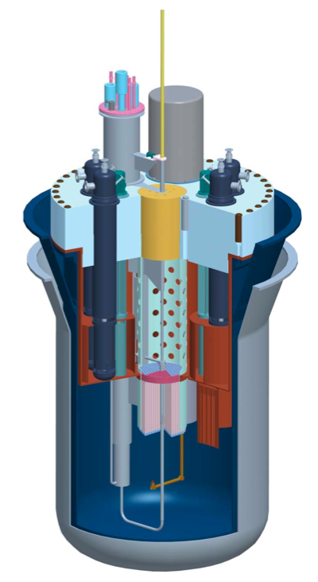

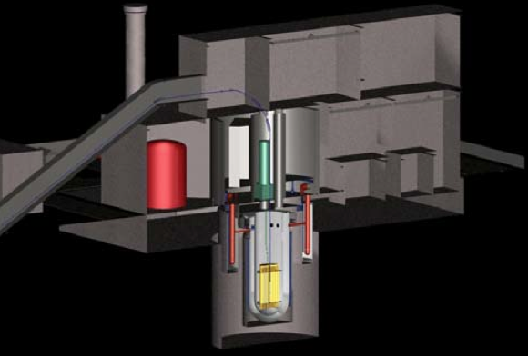
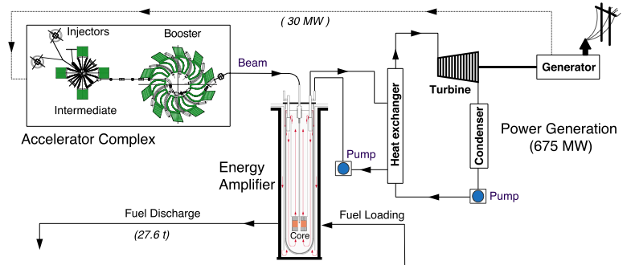
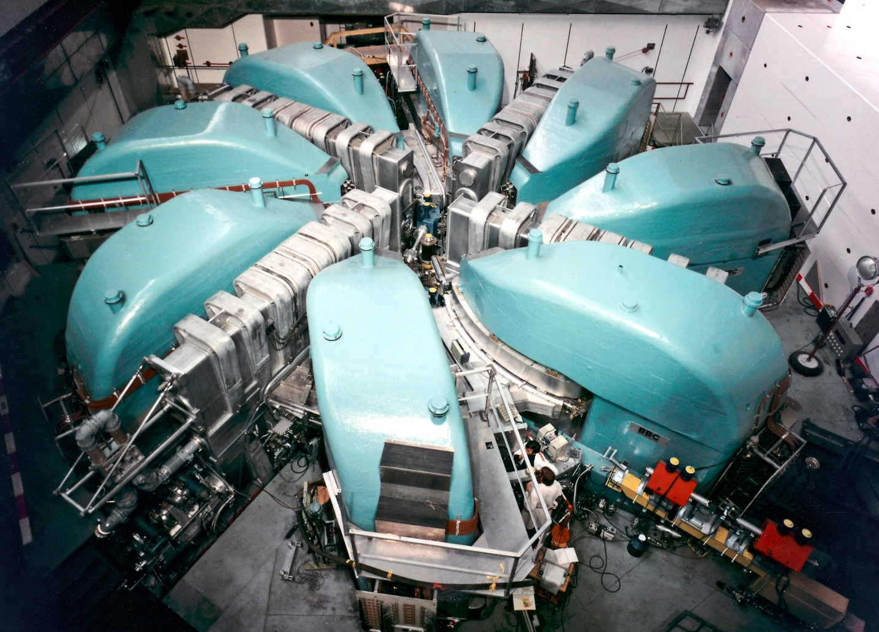
ADS Needs
Abderrahim et al., Nuclear Physics News, Vol. 20, No. 1, 2010
ADTR (600 MWe)
Lead-Cooled: Rubbia et al., CERN/AT/94-47 & CERN/AT/95-44
Phys Rev C73, 054610 (2006)

Slide 5
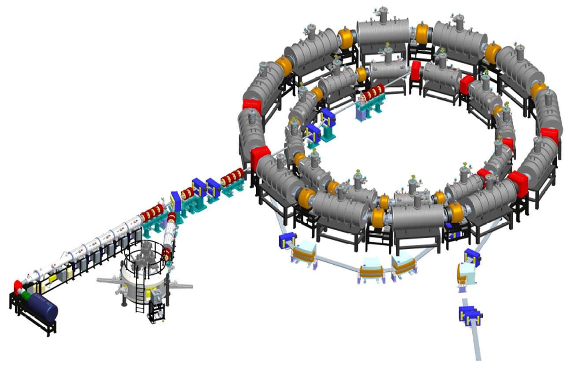
After PAMELA
Carbon ring
~12m
Proton ring
Carbon source & injection
Proton source & injection
Extraction
Transfer line

Slide 7
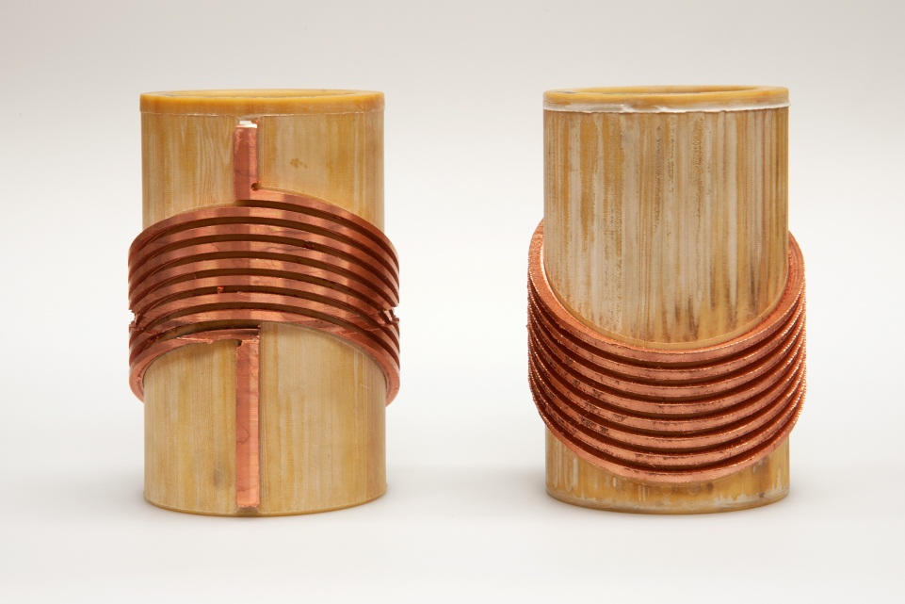
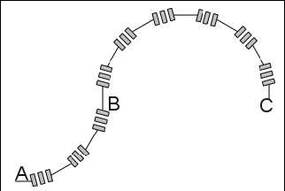
Another Medical FFAG?
330 MeV commercialisable FFAG, that can deliver proton CT, SC dipoles to make it small
Particular requirement in UK for NHS proton programme
Variable energy/switchable extraction (250/330 MeV)
Small degrader to allow rapid small energy variation over small range
Gaussian transverse profile from a thin degrader (better transverse uniformity)
30 MeV cyclotron for injection
Gantry design for 330 MeV
  Reduction in size. 'De-elephantisation’
  Permanent magnets?
  Proton CT/treatment gantry
  Superconducting gantry magnets?

Slide 8
1 GeV nsFFAG
Parameter | 250 MeV |  | 1000 MeV
Avg. Radius [m] | 3.419 |  | 5.030
Cell tune (x/y) | 0.380 | 0.237 | 0.383 | 0.242
Ring tune (x/y) | 1.520 | 0.948 | 1.532 | 0.968
Field F [T] | 1.62 |  | 2.35
Field D [T] | -0.14 |  | -0.42
Magnet Length F [m] | 1.17 |  | 1.94
Magnet Length D [m] | 0.38 |  | 1.14

Slide 9
A 1 GeV FFAG
250 MeV injection to fit magnets and RF
Can't be H-, must be H+
4 cells
Optimise the lattice to make it isochronous
Make it bigger to make the field normal conducting, 1.5 T peak field anywhere, 0.5 m between each magnet for edge field and coil overhang.
Beam parameters
Outline design of magnet, normal conducting
Engineering layout
Make 1st iteration of design to fit in RF cavities and other components
2-4 MeV per turn, 2 straights for acceleration, 2 cavities in each straight
450 MeV, 5 mA, ~0.8 T max field machine could serve as a prototype, but also be useful as a surface muon source.

Slide 10
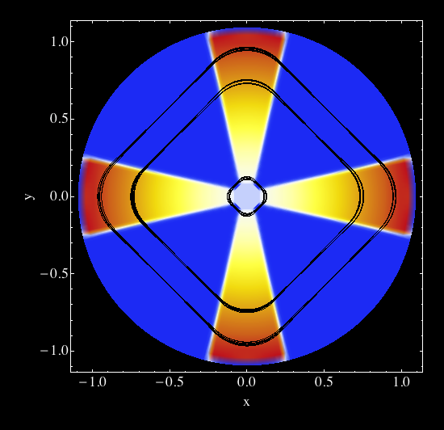
Compact proton sources
Security, low-energy isotopes, carbon dating?
Possible demonstration of non-scaling proton FFAG
For commercial use, must be cheap
Ion source injection
Matching of output to commercial needs
Comparison with existing technologies (DT, DC, RFQ, Linac, Cyclotron, Oniac)
Non-scaling FFAG
4 MeV, p.

Slide 11
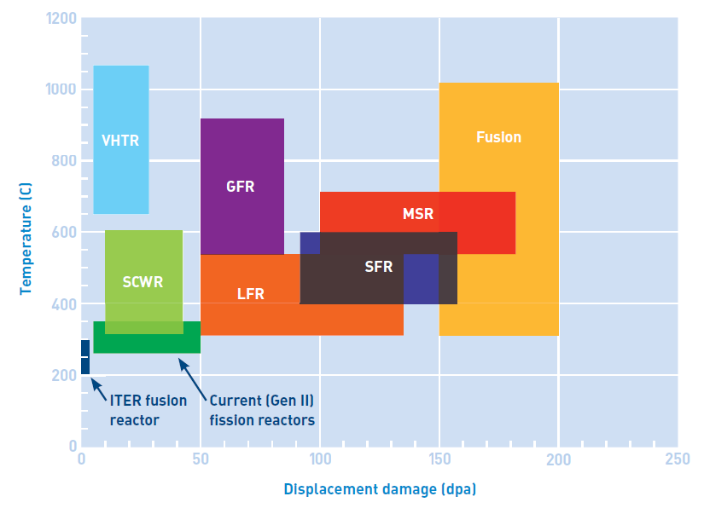
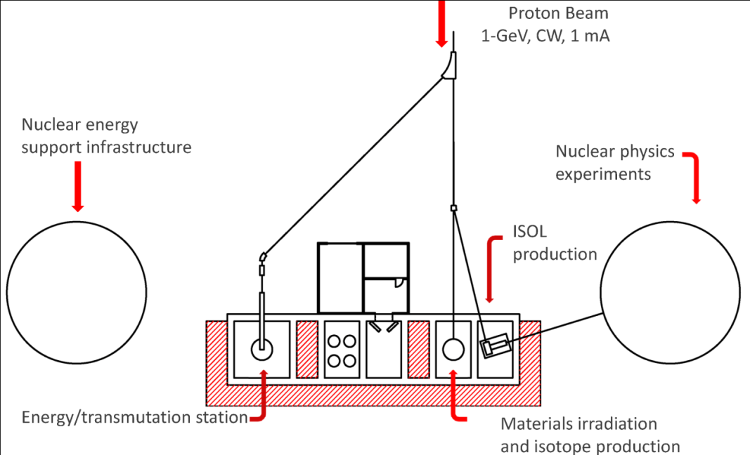
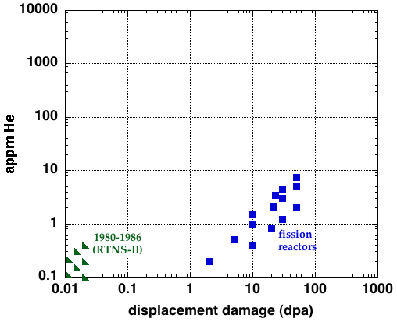
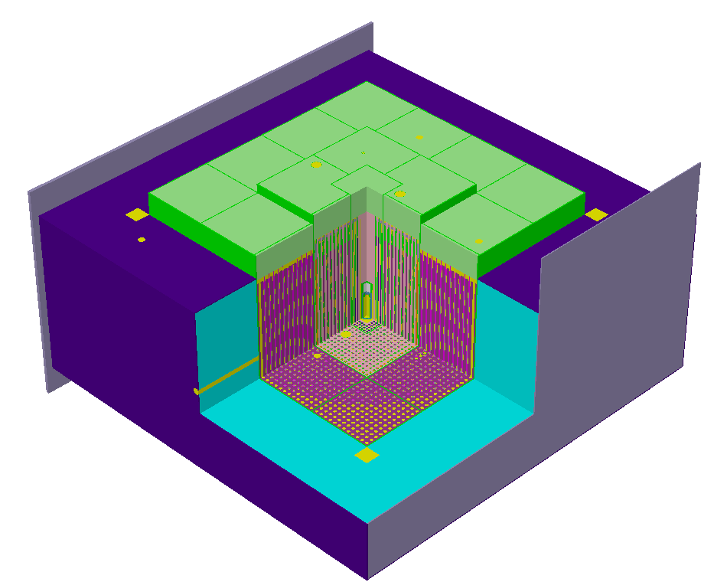
Project X Target Area
Steels
Spallation
neutrons
Fusion
reactor
IFMIF
ITER

Slide 12
Non-target Project X target area studies
Project X, 3 GeV first opportunity to use high power beam on a facility
Intend to develop high power target facility
LBE loops
Liquid metal as a fuel carrier
high power spallation target with partial cores, fuel irradiation tests (solid fuel, liquid fuel)
fusion irradiation
subcriticality measurement using assembly
Capacity, flexibility, spectrum
Beam 1/3 GeV
Higher flux at close-in points than fast reactor flux?
Horizontal vs vertical layout is important!
Stages
Roadmap requirements and research needs Accelerator requirements (what we're getting)
Proposal for programme of studies to meet ADS requirements in US and overseas
Contribute to technical report on conceptual design of target area
Also collaboration on concept developments for UNF/transmutation, accelerator-reactor coupling

Slide 13
Topics not discussed, but which might have been…
Radiobiology (use of PXIE?)
Use of surface muons for condensed matter
Use of Project X for materials irradiation tasks?
Isotope production, and relation of Project X to isotope shortage
Items from ESFRI roadmap?

