Slide 1
H- ion source development at FNAL
Dan Bollinger

Slide 2

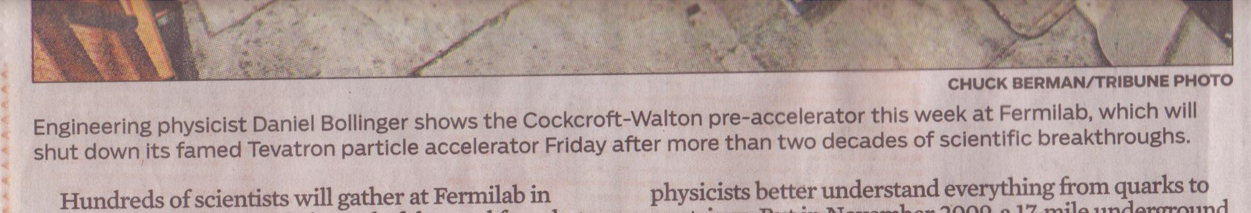
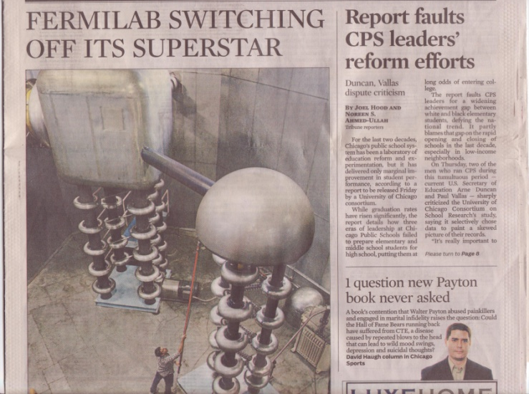
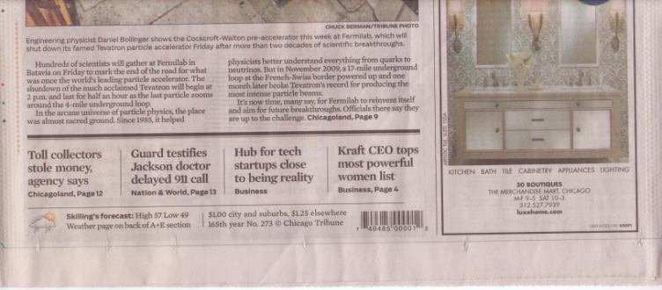
The coolest thing about working on sources is: You don’t have to commit a crime to be on the cover of the Chicago Tribune !

Slide 3
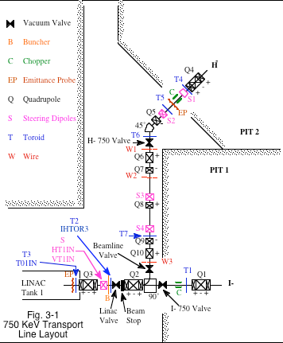
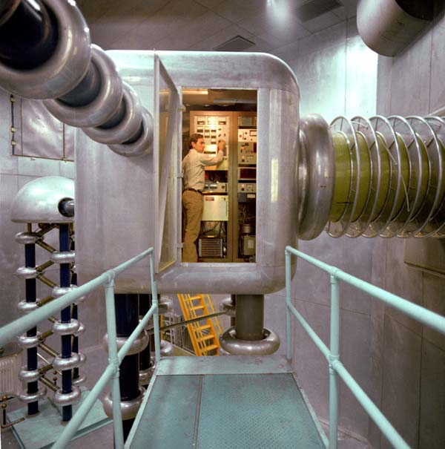
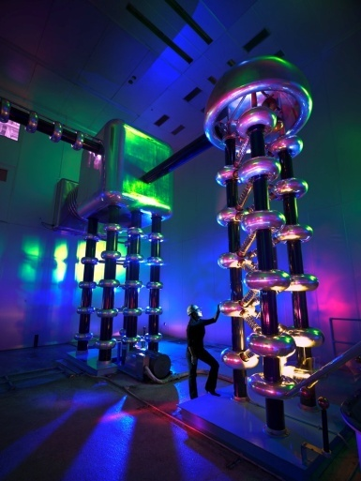
Current operational sources
There are two Cockcroft-Walton pre-accelerators H- and I-. The need for two is redundancy.
At the end of each accelerating column is a chopper that sets the accelerated beam pulse width.
Since a ribbon of beam is coming out of the accelerating column, there is a buncher prior to the entrance to tank one.

Slide 4
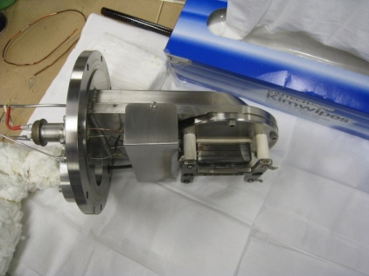
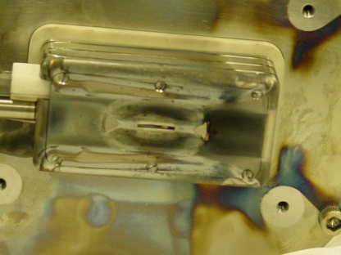
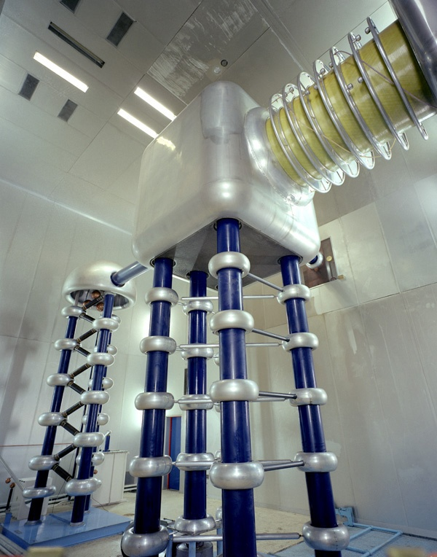
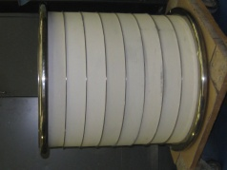
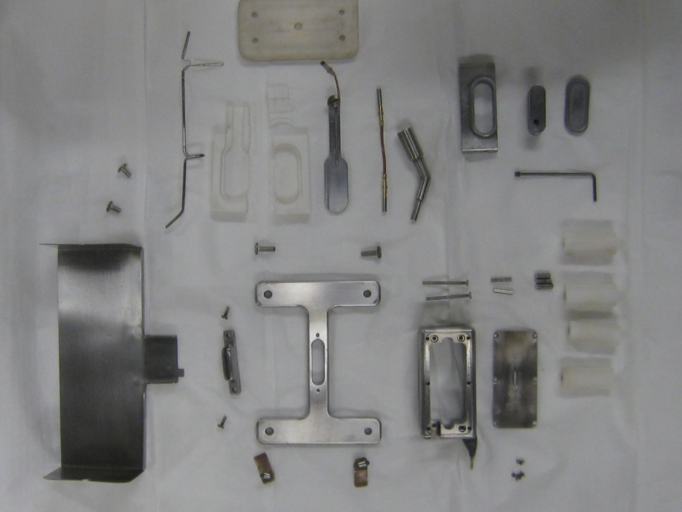
Current operational sources
Accelerating column
Slit aperture H- ion source
Source fits together like a 3-D puzzle
The accelerating column typically runs at 745kV. Each accelerating gap (other than the 1st one) has to hold off at least 100kV.

Slide 5
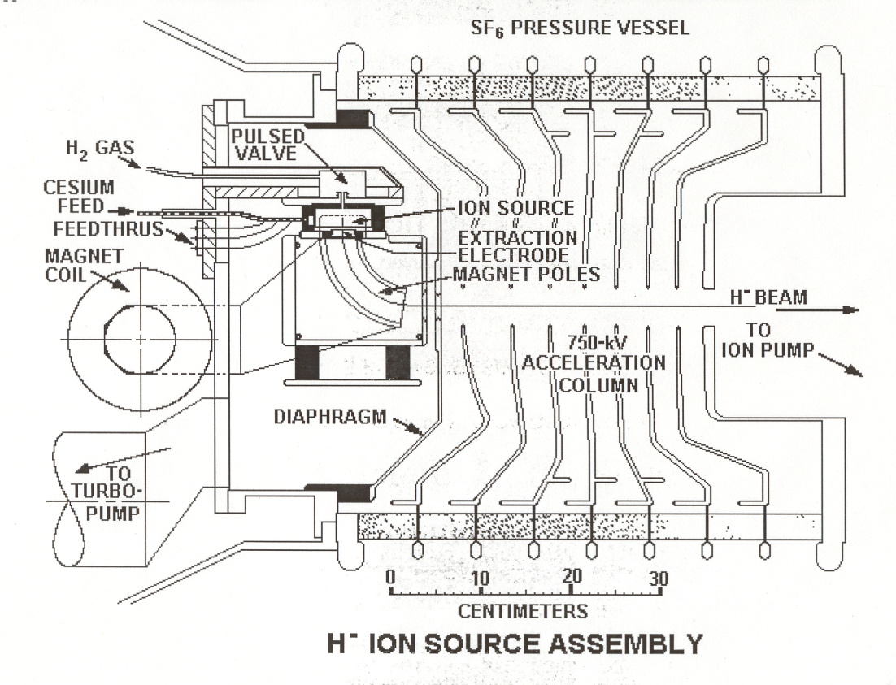
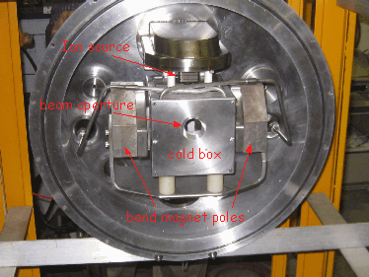
Current operational sources
Source is mounted pointing down inside the accelerating column. The extracted beam goes through a 90deg bend magnet which sweeps away co-extracted electrons an helps shape the beam.
It then passes through a cold box which acts as a Cs trap to help prevent the accelerating column from being contaminated

Slide 6
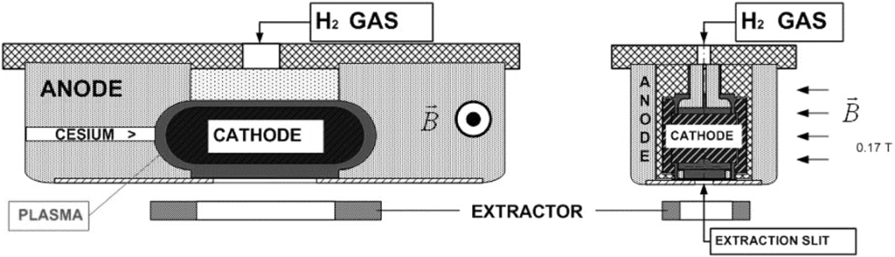
Current ion sources used at Fermilab
magnetron
Magnetron H- sources are used
In Cockcroft-Walton
Soon in HINS
New source for Preinjector upgrade (RFQ project)
N
cathode
H-
6cm
S
Plasma is generated by ExB motion of electrons
H- are produced at the cathode surface then extracted. That’s why these sources are called Surface Plasma Sources (SPS)

Slide 7
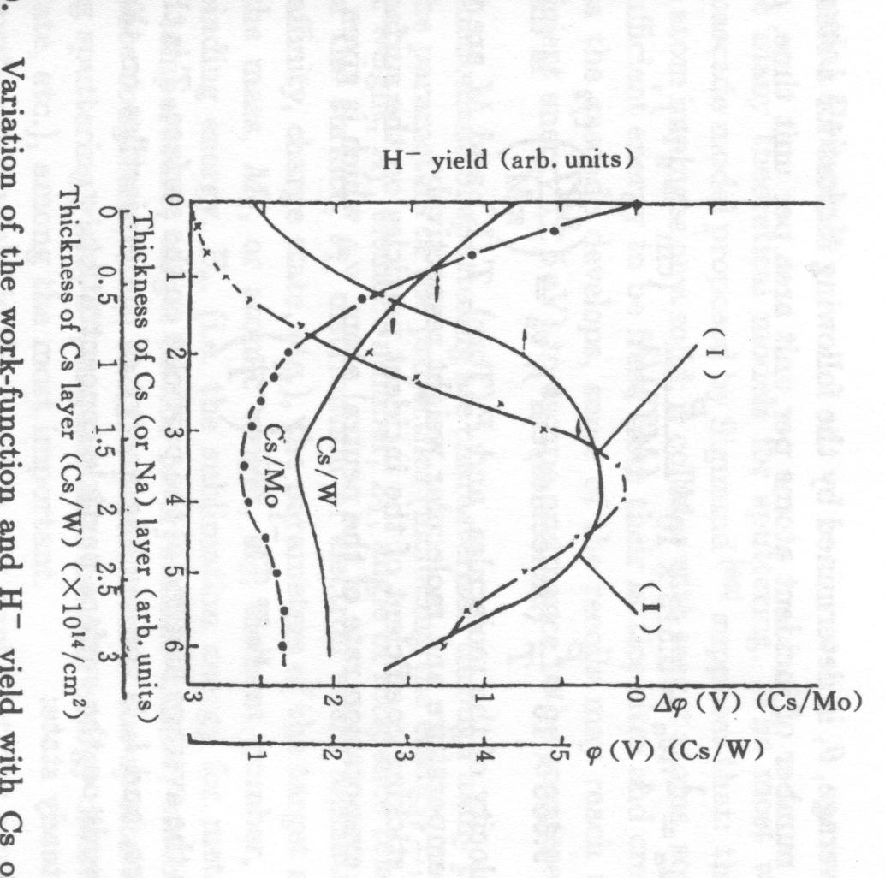
Surface production of H- ions
Mo
Cs
Cathode (-)
e⁻
~1 mm
H⁺
H₂⁺
e⁻
Anode (+)
B
Cs
H⁻
Figure from Stockli USPAS June 2007
e⁻
Cs
Mo has a host of loosely bound e- that take about 4.6eV to remove
Cs lowers the surface work function to about 1.8eV with 0.6 mono-layer thickness
Hydrogen affinity is about 0.75eV so most of the hydrogen particle leave the surface as neutrals, however a few leave the surface as H- ions
This is why we use cesiated sources
Cs
P
H
H
Figure from ZHANG Ion Sources
Figure from Stockli USPAS June 2007

Slide 8
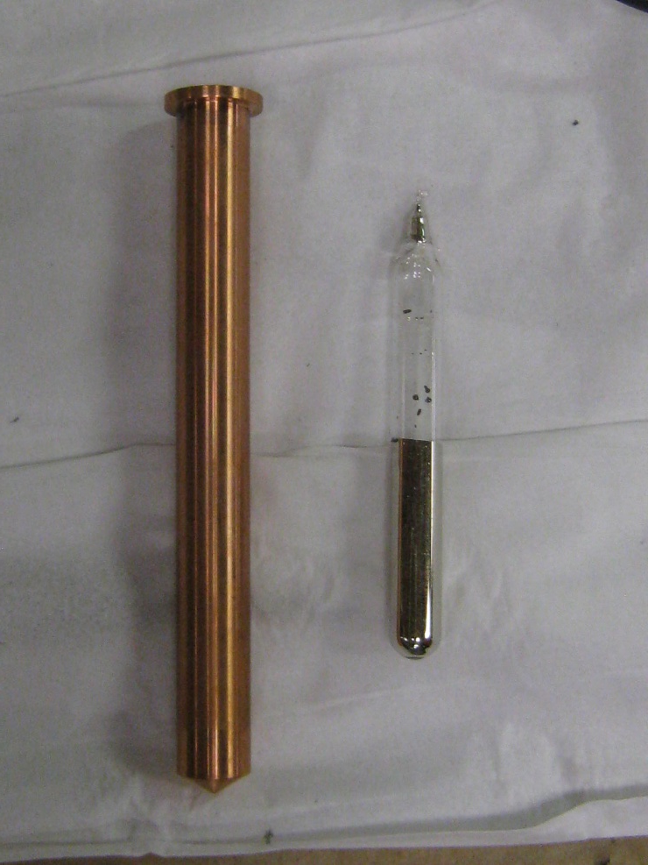
Cesium your friend……. or NOT
All of our sources use 5g ampoules of metallic cesium. They are installed in a copper tube “boiler” and then the glass is cracked. The supply typically last about 400days.
In the past we have had to bang on the cesium boiler to apparently release cesium that was trapped by the glass. There may be a better way of handling the cesium supply

Slide 9
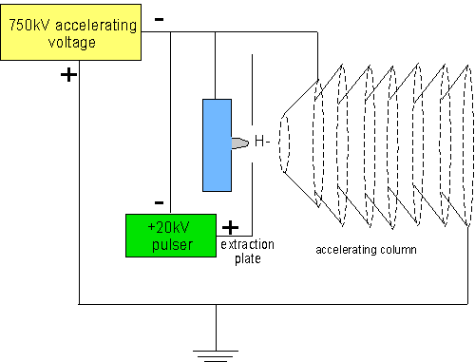
Cockcroft-Walton accelerators extraction scheme
The current operational sources extractors are limited by sparking to about 17kV with accelerating column pressures of around 1.5 X 10^-5 Torr
In order to get 50+ mA out of the source we need to run with high arc currents ~50A which leads to cathode erosion and relatively short lifetimes (3.5 months on average)

Slide 10
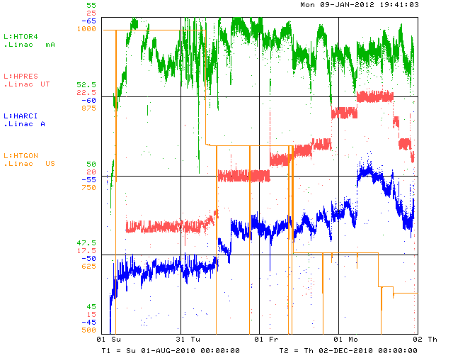
Typical source aging
beam current
Hydrogen pressure needs to keep increasing due to the Cs inlet getting blocked with cathode material
However, near the end of life, the hydrogen pressure needs to decrease due to H- stripping causing the beam current to decrease
Arc current keeps increasing with the hydrogen pressure, decreasing the power efficiency (mA/kW)
The gas valve on time needs to be moved earlier as the hydrogen inlet becomes clogged
It may be possible that other types of cathode materials such as tungsten would have less erosion and slow down this type of source aging.

Slide 11
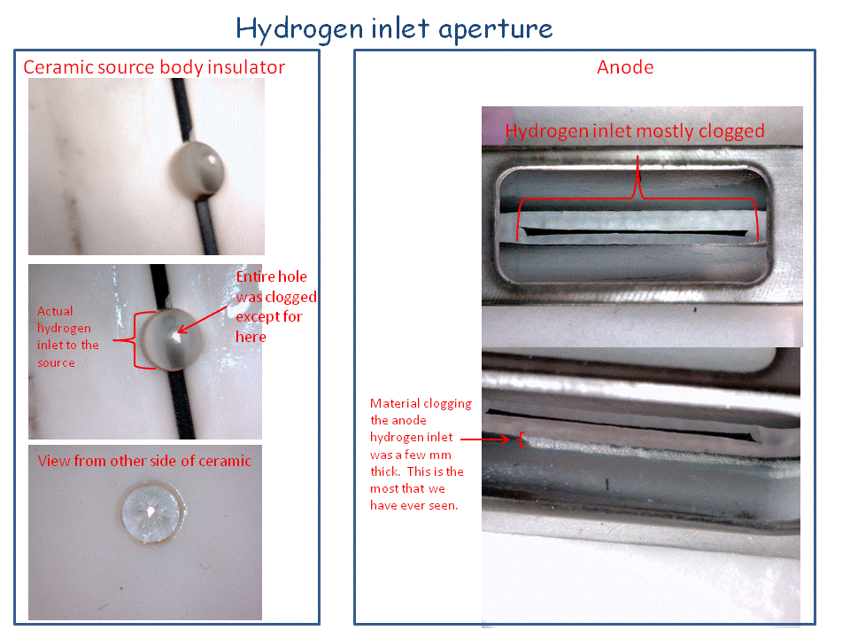
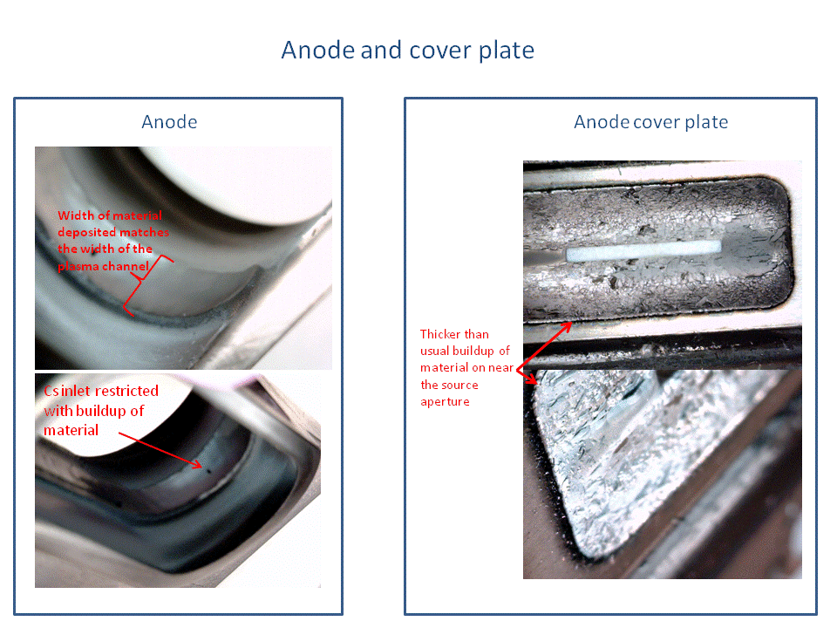
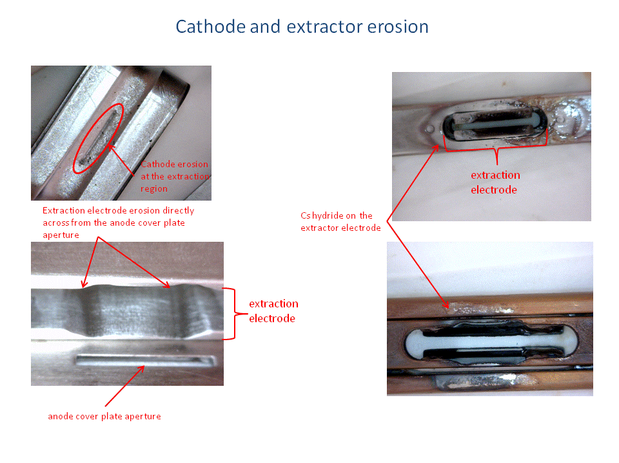
Typical source aging
These are the typical signs of source aging:
Hydrogen inlet
  Cesium hydride blocking aperture
  Sputtered cathode material blocking anode inlet
Cesium inlet
  sputtered cathode material clogging inlet
Cathode erosion at extraction region
extractor electrode eroded by coextracted e-

Slide 12
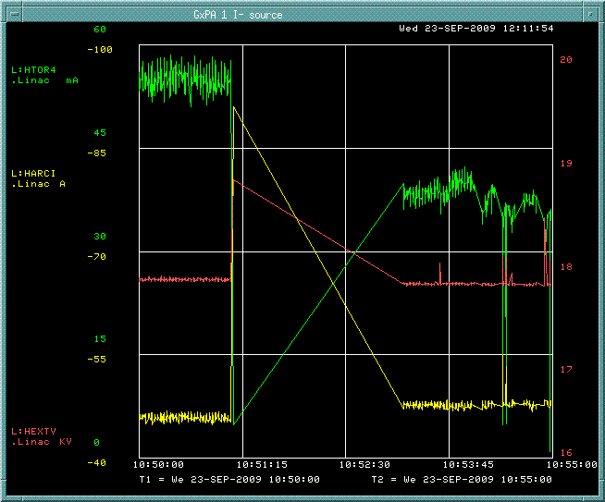
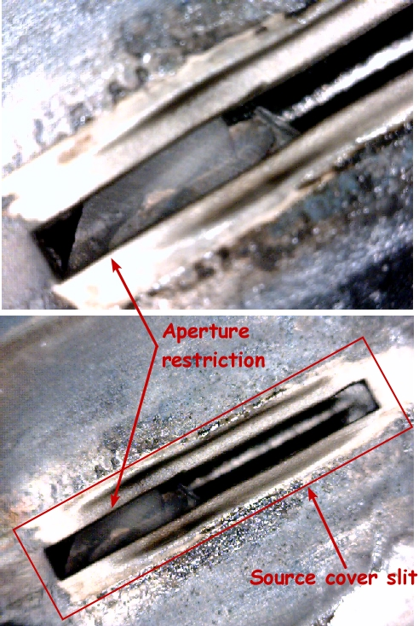
Typical source failures
Cathode material flakes blocking source extraction aperture
beam current
arc current
Cathode material flakes off and causes cathode/anode shorts

Slide 13
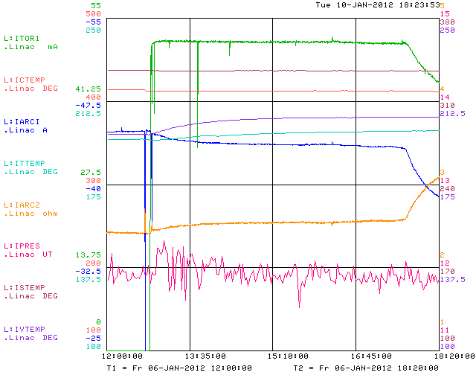
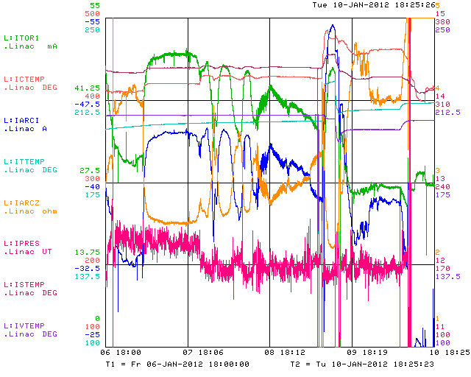
“Typical” source instability
Source instabilities are usually a good way to feel bad about yourself !
Recent startup of the I- source (last Friday). Things were fine for about 5hrs after the HV was turned on (there was an arc several hrs prior to this).
arc current
Things have not been stable since !
beam current
source impedance
Instabilities are the largest “behind the scenes” battles that we wage

Slide 14
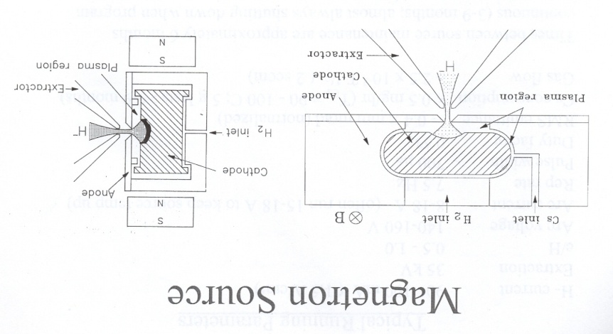
BNL source
BNL uses a round aperture magnetron that has a spherical dimple cathode that helps focus the H- at the extraction region.
Figures from Jim Alessi BNL

Slide 15
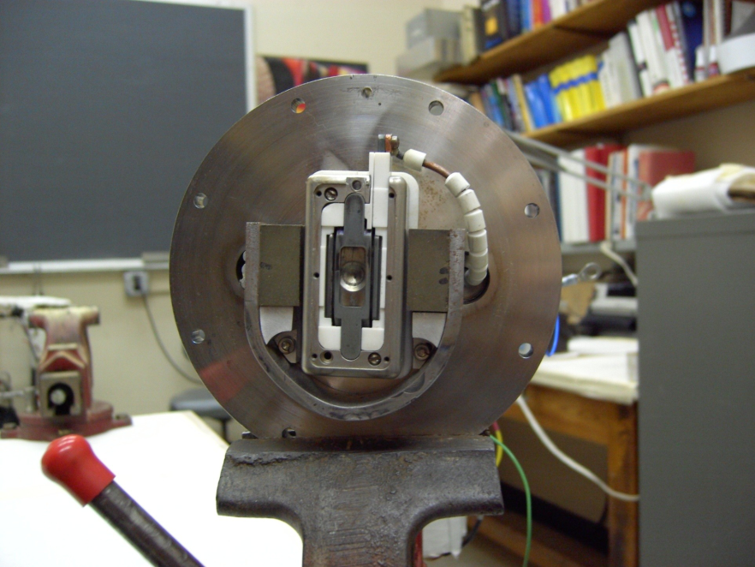
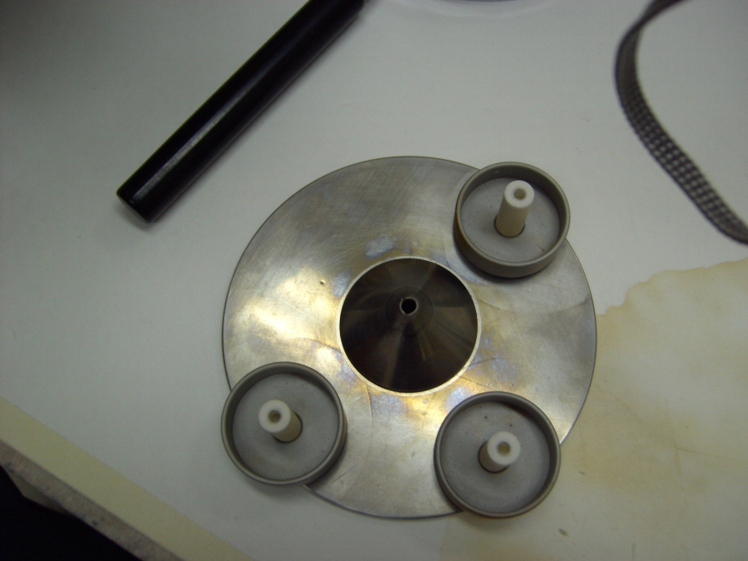
BNL style magnetron
Extraction cone:
45deg angle
0.125in aperture
Spherical dimple

Slide 16
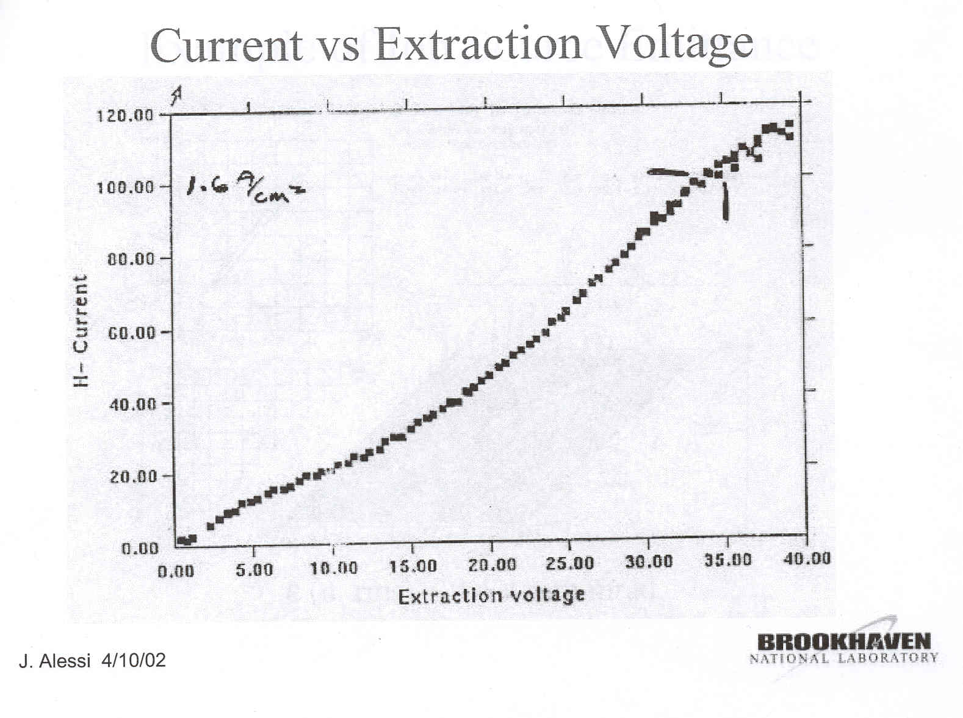
BNL style magnetron
The source has greatly improved lifetime, typically 9 months !
Very good power efficiency ~ 67mA/kW
High beam currents ~ 100mA
In use since 1989
H- current | 90-100mA
Extraction Voltage | 35kV
Arc Voltage | 140-160V
Arc Current | 8-18A
Rep Rate | 7.5Hz
Pulse width | 700ms
Duty Factor | 0.5%
Cs consumption | 0.5mg/hr
Gas Flow | 3sccm
RMS emittance | 0.4 p mm mr (normalized)

Slide 17
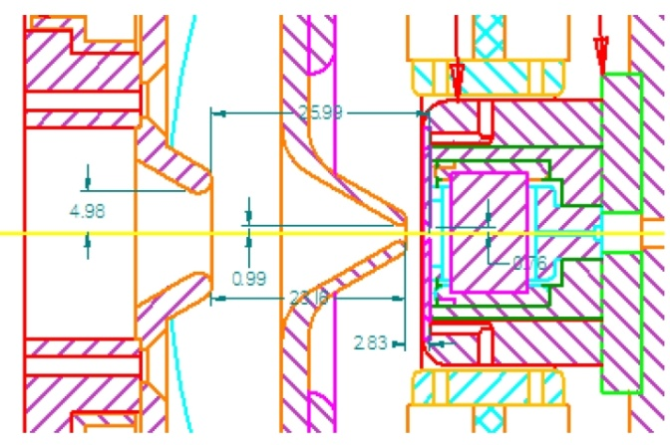
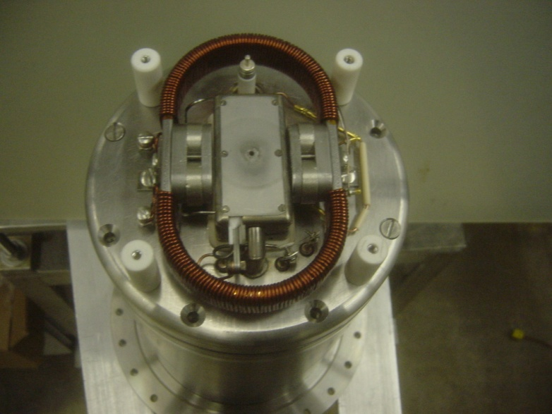
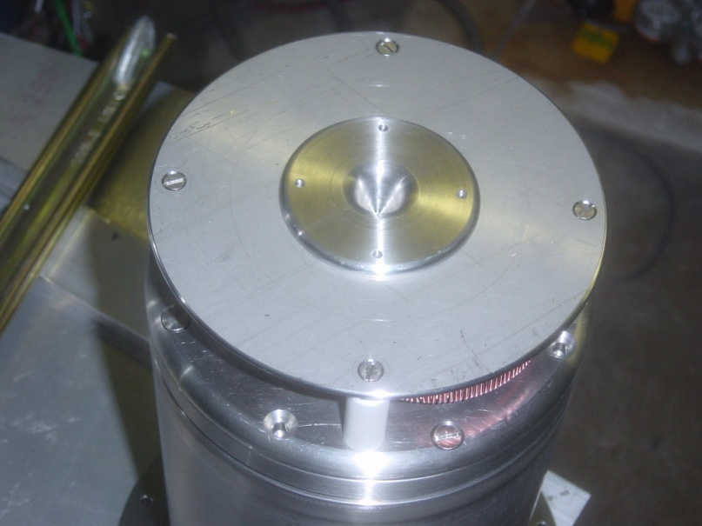
HINS source
Extraction gap ~ 0.08in
HINS source similar to BNL:
round aperture
cone shaped extractor
however, separate extraction/acceleration electrodes similar to current FNAL design
acceleration gap

Slide 18
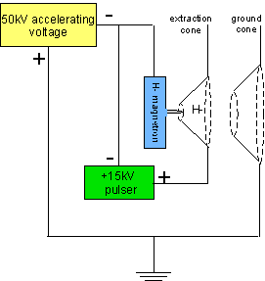
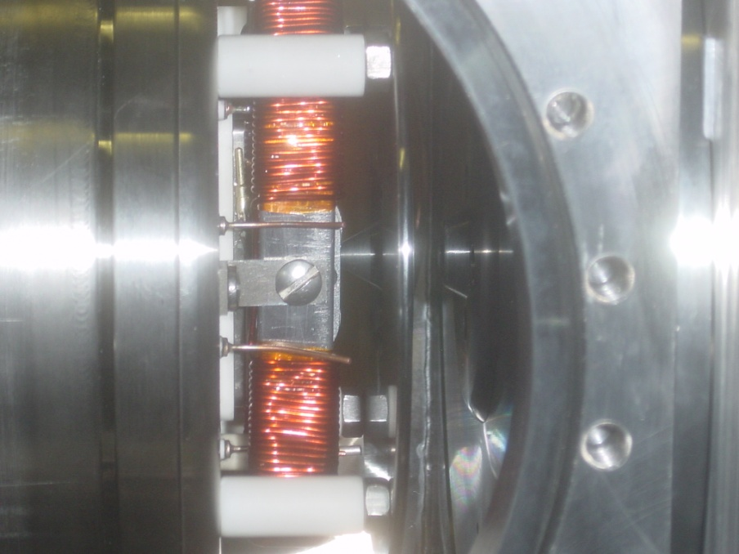
HINS source extraction scheme
Source operates similar to the Cockcroft-Walton accelerators.
50kV acceleration voltage for RFQ injection
2 cones, one for extraction, one at ground potential (for vacuum break)
~ 10kV
50kV

Slide 19
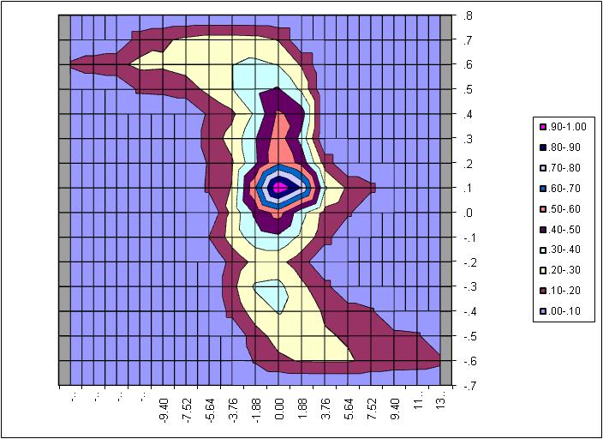
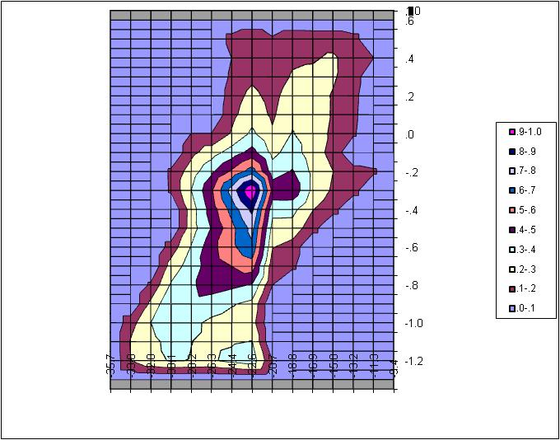
Typical HINS source emittance
Horizontal en rms = 0.12 mm mr
Vertical en rms = 0.18 mm mr
C. Schmidt
C. Schmidt

Slide 20
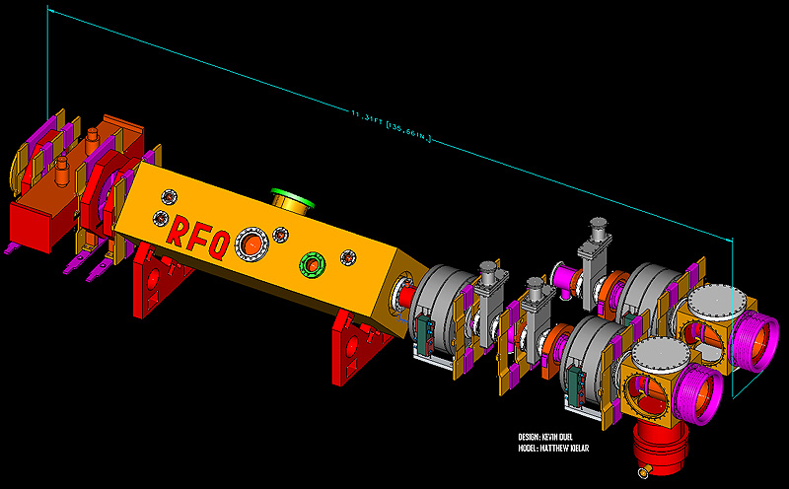
We currently have a plan to replace the Cockcroft-Walton accelerators with a 750keV RFQ and magnetron ion source similar to BNL. There will be 2 ion sources mounted on a slide for redundancy.

Slide 21
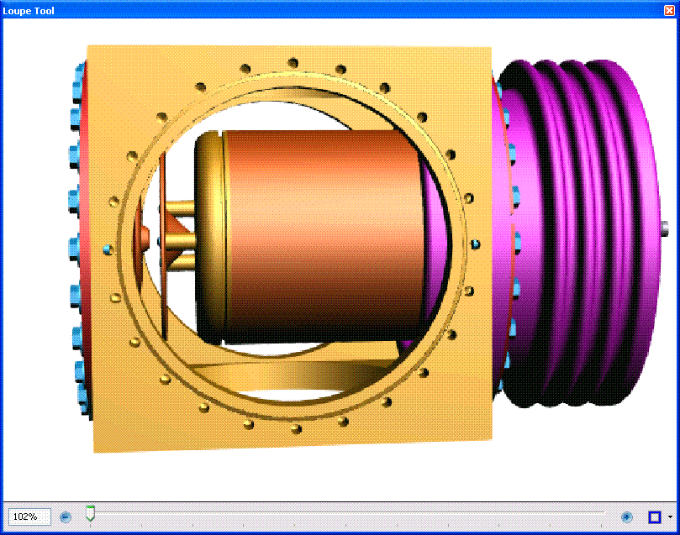
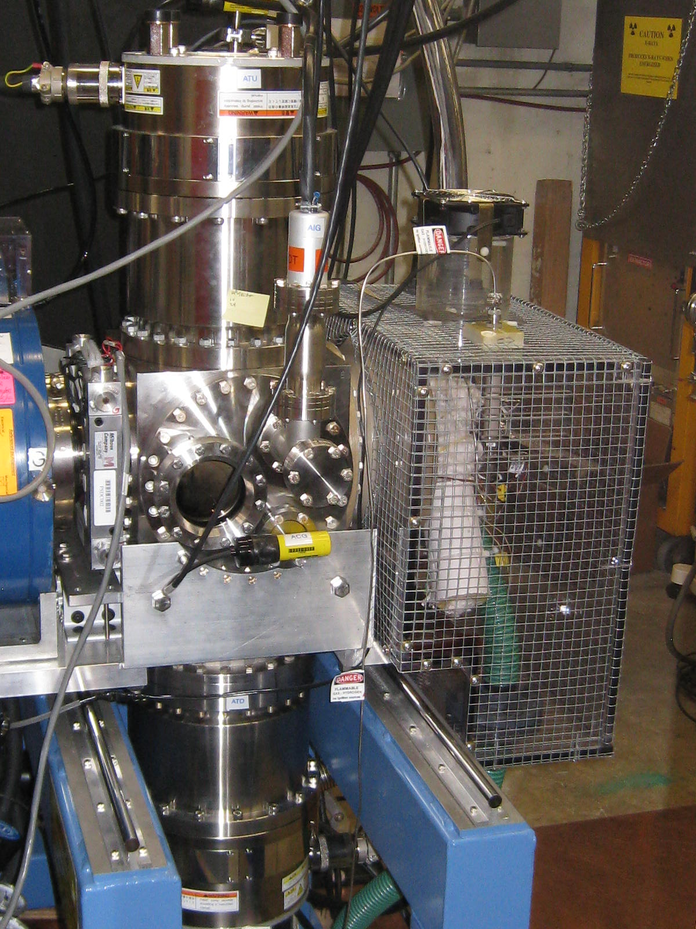
New source design
Source cube
New source similar to BNL and HINS
Extraction gap 0.090in
Anode aperture 0.125in

Slide 22
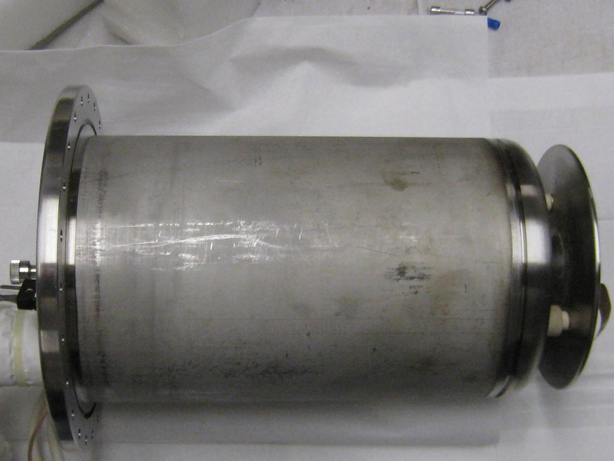
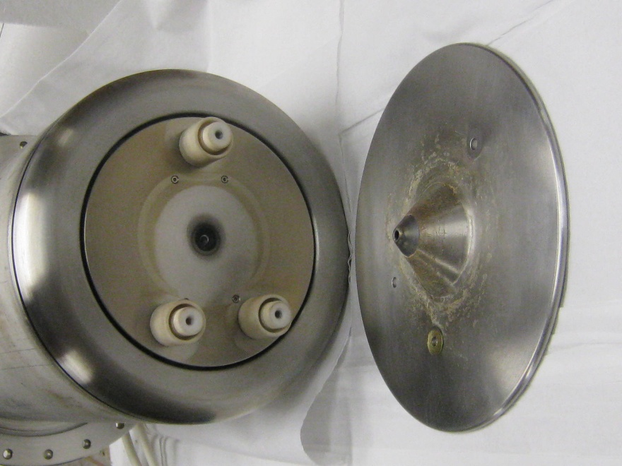
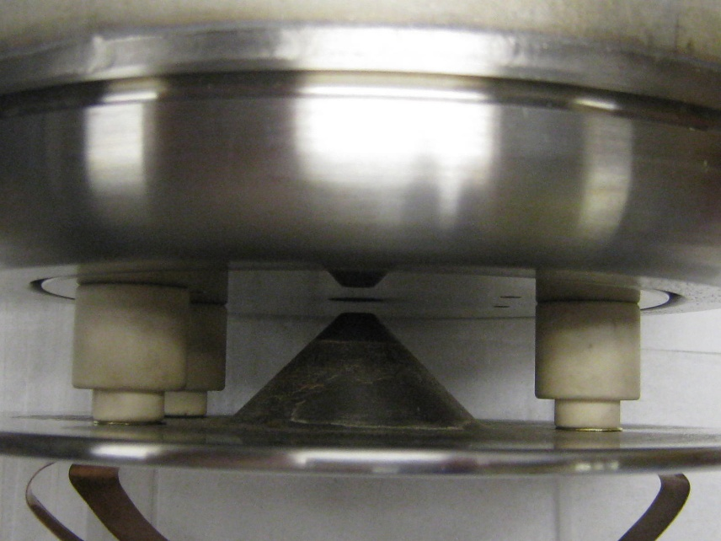
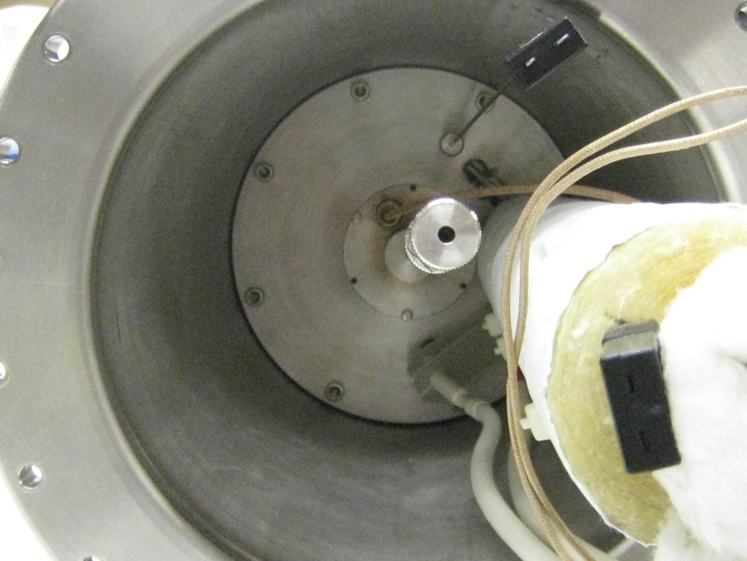
New FNAL source design
anode cover plate
~11in
ceramic extractor standoffs
extraction cone
gas valve
extraction gap .090in
Cs tube
cathode connections

Slide 23
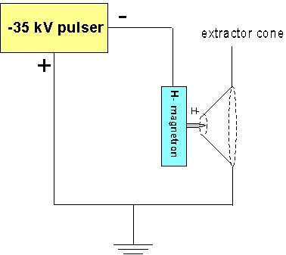
New source extraction scheme
With this type of extraction, where the extraction voltage=acceleration voltage, the beam current is much higher for a given arc current. This really helps the power efficiency by pulling as much H- out of the source as possible.
Similar to BNL extraction
One problem with this scheme is the loss of the extractor as a beam intensity “knob”

Slide 24
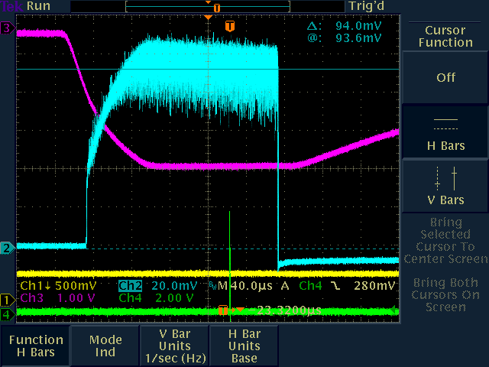
Beam current about 94mA at 35kV extraction
In the test stand we saw ~94mA at the exit of the source cube at 35kV extraction

Slide 25
Summary of source parameters
Parameter | Current FNAL | HINS | BNL | New FNAL
Arc I | 50A | 20A | 10A | 15A
Arc V | 140V | 152V | 150V | 145V
H- current | 50mA | 10mA | 100mA | 94mA
Extraction V | 16kV | 10kV * | 35kV | 35kV
Power eff. | 7mA/kW | 3.3mA/kW * | 60mA/kW | 40mA/kW
Duty factor | 0.12% | 0.012% | 0.5% | 0.2%
Rep Rate | 15Hz | 1 Hz ** | 6.7Hz | 15Hz
Pulse Width | 80μs | 120μs | 700μs | 150μs
Cs consumption | 0.5mg/hr | - | 0.5mg/hr | -
*Currently HINS is using DC extraction, with the low duty factor the arc current needs to be higher to keep the cathode warm. With pulsed extraction the arc current could be reduced helping with power efficiency.
** HINS requirements have changed of the years, it is currently 0.5Hz, but we are operating the source in the test stand at 1Hz.

Slide 26
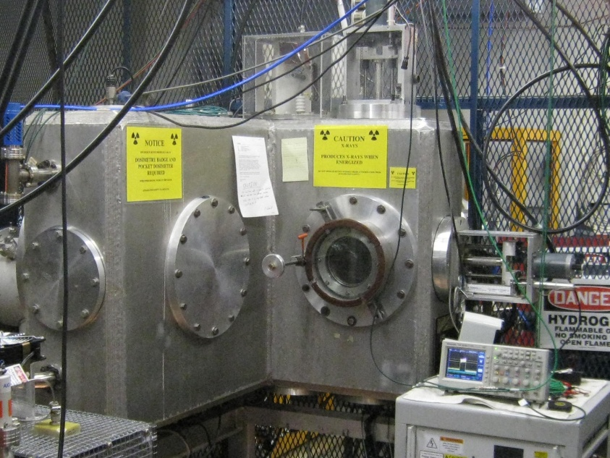
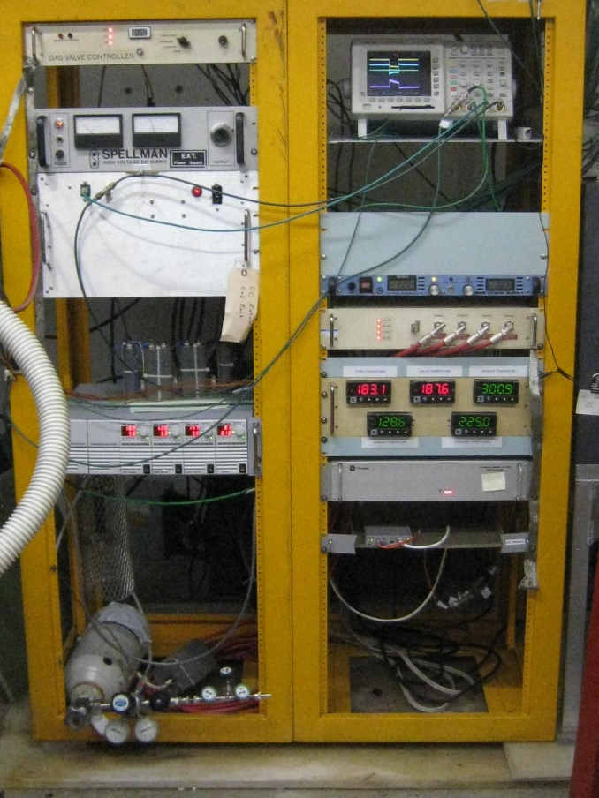
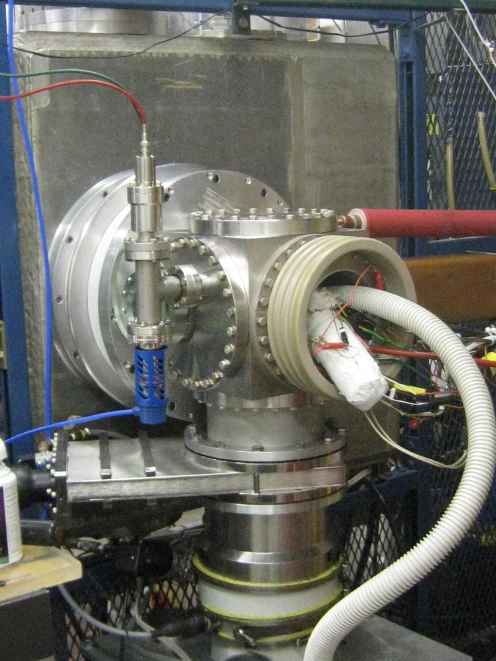
FNAL ion source test stand

Slide 27
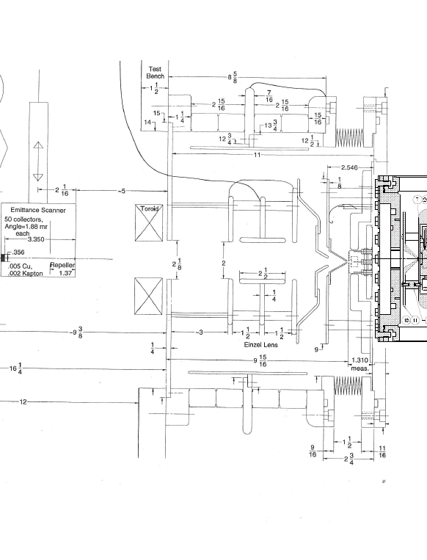
Test stand schematic
Emittance probes with 1.88mr angular resolution
Einzel lens focusing
The test stand uses an Einzel lens for focusing
Toroid
Faraday Cup
Emittance probes

Slide 28
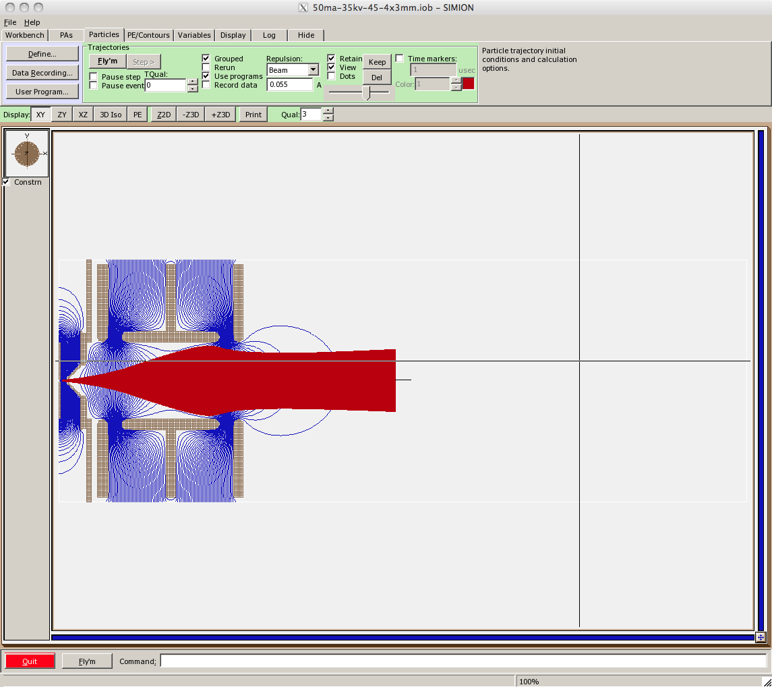

Einzel lens scraping
Simulations of the source in the test stand showed that the beam would scrape the lens with a little more than 50mA of beam current at 30kV. We were not able to focus the 90+mA beam coming out of the new source, so I was not able to get a good measure of the emittance. Since the source is similar to both HINS and BNL the emittance should be similar.
55mA at 30kV
90mA at 30kV

Slide 29

Test area layout with new LEBT

Slide 30


1st beam through the RFQ !
source
beam current
1st toroid 80mA
1st toroid
toroid after
RFQ ~ 40mA
RFQ
solenoids

Slide 31
Possible areas of collaboration
Operational experience
  source stability
  optimizing tuning
  quicker startups
  cesium balance
Source lifetime
  better materials (tungsten cathodes & extractor, etc..)
  reducing erosion with better tuning
  improving power efficiency
Extraction
  more efficient extraction geometry (simulations and experiment)
  minimize emittance
  reduce sparking
Improved cesium delivery
  boiler: better methods than cracking ampoule
  less interactive heating of boiler, valve, tube
  better methods of cleaning boilers
Gas valves
  better calibration methods
  find substitute for piezeoelectric valves (fuel injectors ?)

