Slide 1
High Power Targets and Machine/Detector Interface Working Group
PASI 2012 Workshop

Slide 2
2 for the price of 1!
High Power Targets Working Group
Chris Densham (RAL)
Patrick Hurh (FNAL)
Machine/Detector Interface Working Group
Jenny Thomas (UCL)
Bob Tschirhart (FNAL)
Now Combined into the Creatively Named: High Power Targets and Machine/Detector Interface Working Group!

Slide 3
Targetry is the Common Ground
Machine
Target
Detector

Slide 4
Next Generation Science & Technology Requires Next Generation Targetry
Neutrinos: All next-generation concepts have graduated to the Mega-Watt class.
Rare Processes: Current round is low-power (~50kW) and/or small beam acceptance. Holy grail is high power (MW) and large beam acceptance.
Spallation Targetry: Next generation science demands higher complexity (e.g. cryogenic targets for UCNs). Next generation technology demands high reliability (e.g. Accelerator Driven Systems).

Slide 5
Targets at the Heart
Almost all future high intensity (1-4 MW)accelerators will require target facilities that are:
Reliable
Functional
Safe
Affordable
Recent experiences indicate:
Serious safety, technical and scientific challenges exist (even at 400 kW)
Challenges can be overcome with coordinated R&D

Slide 6
 |  |  | Beam Pulse |  | Energy (GeV) | Ave. Beam Power(MW) Design | Ave. Beam Power(MW) Operation | Max Power Density (MW/m³) | Peak Energy Density (MJ/m³/pulse)
Facility | Status | Target Material | Length (us) | Rep Rate (Hz)
ESS - long pulse | Design | W | 2,900 | 20 | 2.5 | 5 | - | 75 | 3.8
EURISOL | ?? | Hg | 3 | 50 | 2.2 | 4 | - | 100,000 | 2,000
IFMIF | ?? | Li | CW |  | 0.04 (D₂) | 10 | - | 100,000 | NA
JPARC - Hadron | Existing | Ni | 7E+05 | 0.3 | 50 | 0.75 | 0.1? | 7,600 | 5,300
JPARC - T2K | Existing | C | 4 | 0.47 | 30 | 0.75 | 0.1? | 126 | 266
JPARC - T2K Upgrade | Study | C | 5 | 0.3 | 50 | 1.66 | - | ?? | ??
Project X - Kaon | Study | C | CW |  | 3 | 1+ | - | TBD | NA
Project X - Muon | Study | C | CW |  | 3 | 1+ | - | TBD | NA
Project X - Nuclear | Study | High-Z | CW |  | 1.5-3.0 | 1+ | - | TBD | NA
Project X - ADS Demo | Study | LBE? | CW |  | 1.5-3.0 | 1+ | - | TBD | NA
MiniBoone | Existing | Be | 1.6 | 5 | 8 | 0.032 | 0.032 | 120 | 24
NuMI | Existing | C | 8.6 | 0.53 | 120 | 0.4 | 0.4 | 265 | 500
ANU/NOvA | Construct | C | 10 | 0.75 | 120 | 0.7 | - | 232 | 309
LBNE | Design | C | 10 | 0.7 | 120 | 0.7 | - | 178 | 254
LBNE - Upgrade | Study | C | 10 | 0.7 | 120 | 2.3 | - | 592 | 846
Pbar | Complete | Inconel | 1.6 | 0.5 | 120 | 0.052 | 0.052 | 7,650 | 15,300
ISIS TS1 | Existing | Ta clad W | 2x0.1 | 40/50 | 0.8 | 0.2 | 0.16 | 250 | 6
ISIS TS2 | Existing | Ta clad W | 2x0.1 | 10 | 0.8 | 0.05 | 0.04 | 1000 | 100
FRIB | Design | C | CW |  | 1-48 (p to U) | 0.4 | 0.4 | 60,000,000 | NA
PSI SINQ/Solid Target | Existing | Pb, | CW |  | 0.59 | 0.72 | 0.72 | 720 | NA
PSI SINQ/MEGAPIE | Complete | LBE | CW |  | 0.59 | 1 | 1 | 1,000 | NA
PSI UCN | Starting | Pb | CW |  | 0.59 | 1 | ?? | ?? | NA
SNS | Existing | Hg | 0.7 | 60 | 1 | 2 | 1 | 750 | 13
SNS - STS | Design | W/Ta or Hg | 1000 | 20 | 1.3 | 1.5 | - | 39 | 57
NuFact/Muon Collider | Study | Hg | 0.002 | 50 | 8 | 4 | - | 75,000 | 1,500

Slide 7
Coordinated HPT R&D Required
Past and current HPT R&D efforts have been initiated and funded by individual experiments
Narrow focus
Inadequate funding
Little to no coordination with other efforts
Most of the underlying challenges are very similar.
Coordinate the HPT R&D efforts and fund as separate program
Build the HPT expertise as a core competency
Broaden focus of R&D efforts
More efficient use of funds
All HPT applications will benefit

Slide 8
Both Sides of the Pond
This call for HPT R&D program is coming from both the US and the UK
As demonstration of this:
US - HPT strategy talk at Fermilab Accelerator Sector meeting
UK – HPT “generic” studies proposal to STFC

Slide 9
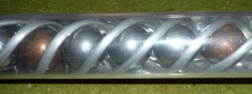
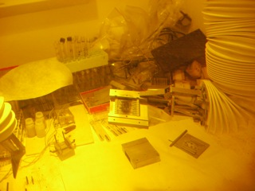
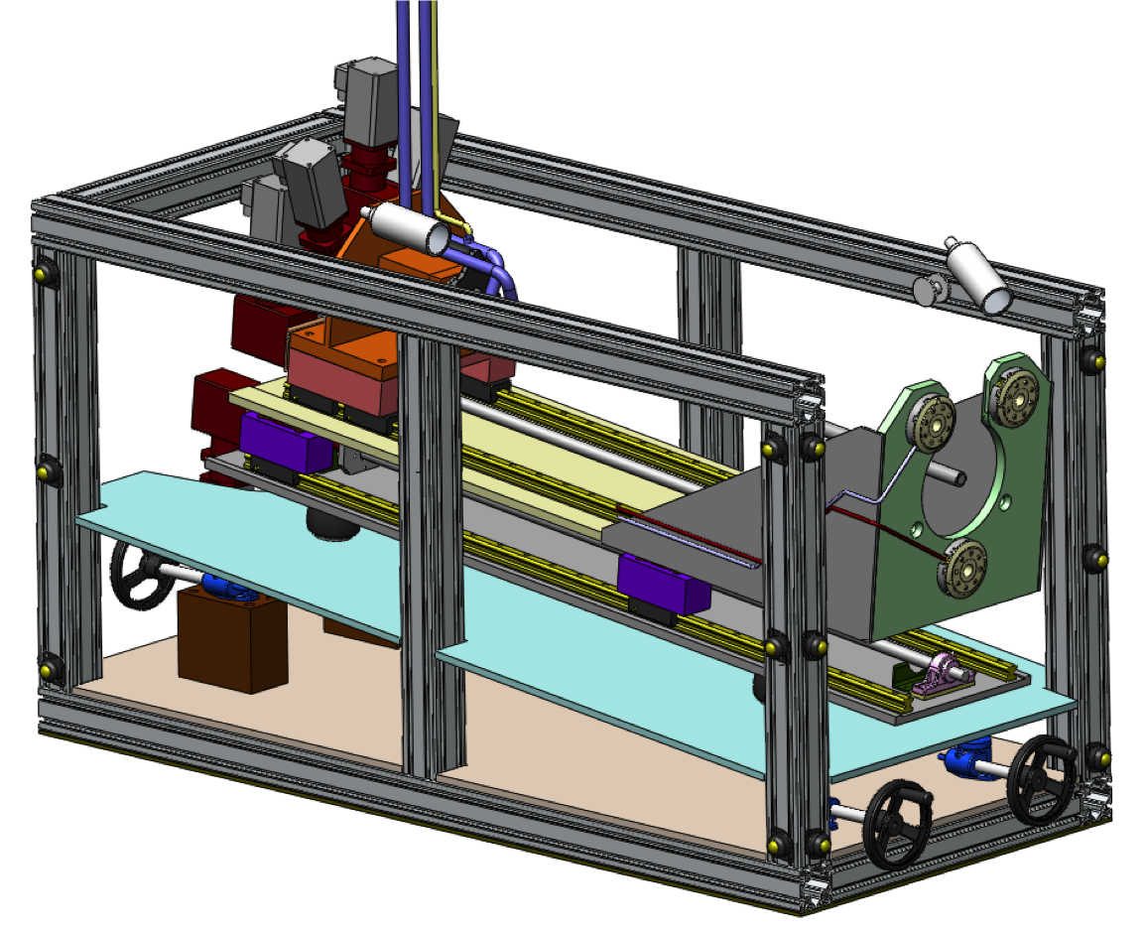
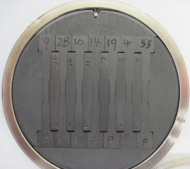
High Power Target Development at Fermilab
Accelerator Sector Planning and Strategy Workshop P. Hurh

Slide 10
Introduction – Current Issues
From AD Sector Strategy Planning Meeting:
Design Challenges
Heat removal
Thermal Shock (Stress Waves)
Radiation Damage
Radiation Accelerated Corrosion
Spatial Constraints
Residual Radiation
Manufacturing techniques
Physics Optimization
Not just targets, but entire target systems (beam windows, collection optics, absorber, decay pipe, etc.)

Slide 11
From AD Sector Strategy Planning Meeting:
Scope
Operational Support
NuMI/NOvA (700 kW)
LBNE (700 kW)
Mu2e
G-2
MiniBooNE
Future Target Facility R&D
LBNE (2.3 MW)
Project X era facilities (Kaon, Muon, Nuclear)
Muon Collider/NuFact
LHC Collimators

Slide 12
Strategy - Barriers
From AD Sector Strategy Planning Meeting:
Budget
Not enough to fund from projects alone
People
Need more in specific areas
Can’t do this alone: Need to extend/expand current collaborative activities
R&D/Remote Handling gets pushed “off-project”
Fine, in theory, but rarely gets addressed appropriately once off the radar

Slide 13
From UKHPT Proposal to STFC:
Proposal for continuation of generic high power target studies
Rob Edgecock
(Huddersfield & STFC)
on behalf of the UK High Power Target Group (UKHPT)

Slide 14
From UKHPT Proposal to STFC:
High Power Targets
WP1: Generic tools for high power target development and operation
WP2: ISIS upgrades
WP3: Thorium energy amplifiers (ADSR)
WP4: Neutrino Factory solid target
WP5: Low energy thermal neutron production
WP6: Conventional neutrino and super-beams
WP7: Muon to electron conversion experiments
WP8: Generic fluidised powder target research
Note: Many of the HP target problems are common (generic).
Broad range of skills are required to solve them.
This proposal makes them available for each target.
Not possible with individual proposals.

Slide 15
From UKHPT Proposal to STFC:
High Power Target Issues
Modelling of beam energy deposition
Modelling of secondary particle production
Modelling of target material response using FEA codes
Target cooling or replacement
Activation and radiation damage everywhere
Thermal shock
Target lifetime
Particle capture, moderation and delivery
Beam windows
Target station design, inc. shielding, RH, licensing, etc
Diagnostics in high radiation environments
Demanding environmental and safety requirements

Slide 16
Working Group Plan
Hear testimony on science and technology requirements.
Hear testimony on challenges in state-of-the-art technology.
Identify critical R&D, and opportunities for collaboration using the “Matrix”….

Slide 17
The Matrix | Target Technology Issue/Challenge
Potential Facility | High Heat Flux Cooling | Thermal "shock” (solid) | Thermal "shock” (liquid) | High Magnetic Field | Novel Target/Window Design | Liquid Metals | Radiation Damage and Corrosion | Radiation Protection & Facility Design | ??? |  | "Score" (Avg)
Nu (SBL & LBL) | 6 | 8 | 5 | 2 | 8 | 0 | 8 | 6 |  |  | 5.38
Kaon (LE stopping) |  |  |  |  |  |  |  |  |  |  | 0.00
Muon (LE stopping) |  |  |  |  |  |  |  |  |  |  | 0.00
Spallation (ISOL) |  |  |  |  |  |  |  |  |  |  | 0.00
Spallation (M&LS, UCN) |  |  |  |  |  |  |  |  |  |  | 0.00
ADS |  |  |  |  |  |  |  |  |  |  | 0.00
NuFact/MuCollider | 9 | 9 | 9 | 9 | 10 | 10 | 3 | 10 |  |  | 8.63
Medical Apps |  |  |  |  |  |  |  |  |  |  | 0.00
Security Apps |  |  |  |  |  |  |  |  |  |  | 0.00
??? |  |  |  |  |  |  |  |  |  |  | 0.00
??? |  |  |  |  |  |  |  |  |  |  | 0.00
??? |  |  |  |  |  |  |  |  |  |  | 0.00
"Score" (Avg) | 7.50 | 8.50 | 7.00 | 5.50 | 9.00 | 5.00 | 5.50 | 8.00 | 0.00
Identify the most common challenges that are rich for HPT R&D collaborative activities

Slide 18
 | Friday, 1/13/12
9:00 | Introduction - Bob Tschirhart/Pat Hurh/Jenny Thomas/C. Densham
 | Review of High Power Proton Target Challenges
9:05 | Thermo-mechanical Response (simulation and failure criteria) |  | T. Davenne
9:30 | Flowing Targets |  | B. Riemer/T. Davenne
9:50 | Radiation Damage and Radiochemistry Issues |  | N. Simos
10:20 | Break
10:30 | Facility Design |  | M. Fletcher
11:00 | Radiation Protection and Licensing |  | K. Vaziri
 | Review of Requirements from the Experimental Programs
11:30 | Overview |  | R. Tschirhart/ J. Thomas
11:35 | Neutrino (conventional) |  | P. Adamson
12:00 | PX - Kaon, Spallation, Muon |  | M. Lancaster
12:30 | Lunch
13:30 | ISIS Upgrades |  | D. Findlay/M. Fletcher
14:00 | Nu Factory and Muon Collider |  | K. McDonald
14:30 | ADS |  | Stuart Henderson
15:00 | Other Application (medical/security) |  | K. Peach
15:30 | Break
 | Discussion of Intersection of Target Challenges and Program Requirements ("Matrix")
15:45 | Overview of Matrix | P. Hurh/R. Tschirhart
16:00 | Low Z Solid Targets (Neutrino, Kaon (?), Muon) | Guided Discussion
16:30 | High Z Solid Targets (Spallation, NuFact(?)) | Guided Discussion
17:00 | Flowing Targets (NuFact, Muon Collider, ADS) | Guided Discussion
 | Discussion of Collaborative Opportunities
17:30 | Identification of Collaborative Opportunities* | Guided Discussion
 | Saturday, 1/14/12
9:00 | Identification of Collaborative Opportunities* (con't) | Guided Discussion
 | Summary Writing
11:00 | Writing Assignments

Slide 19
Working Group Goals
Develop long term path for high power target R&D program
Identify near term, “shovel ready” HPT R&D activities for collaboration

Slide 20
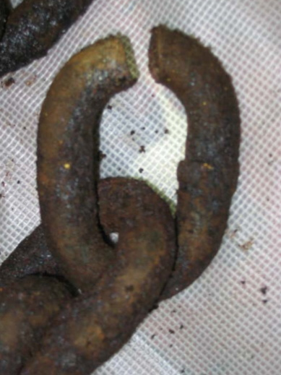
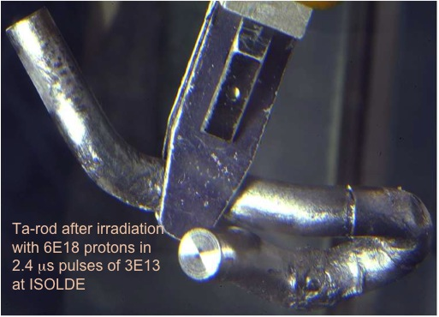
Motivation!

