Slide 1
Fermilab’s collaboration with ANL and University of Chicago on Detector Development
Erik Ramberg ANL/FNAL/UC Collaboration Meeting December 12, 2011

Slide 2
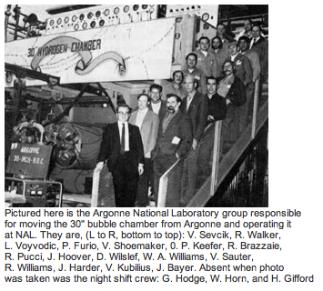
40 years of detector collaboration:
From the archaic technology of bubble chambers …
(30” ANL Hydrogen neutrino chamber – 1972)

Slide 3
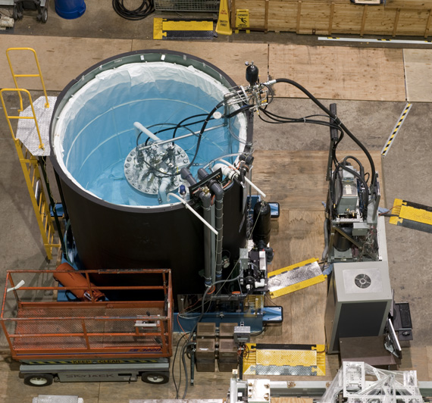
40 years of detector collaboration:
To the sophisticated technology of…
bubble chambers.
(60 kg COUPP dark matter chamber – 2012)

Slide 4
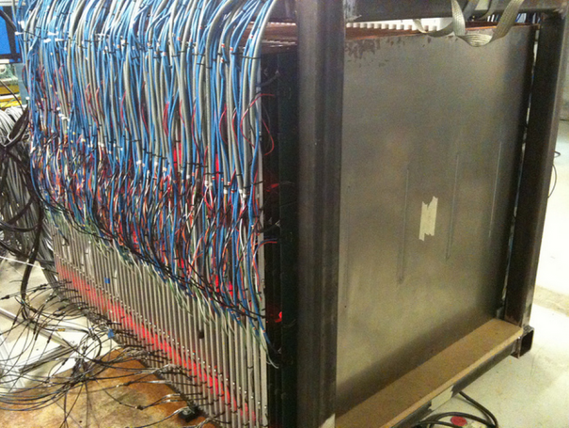
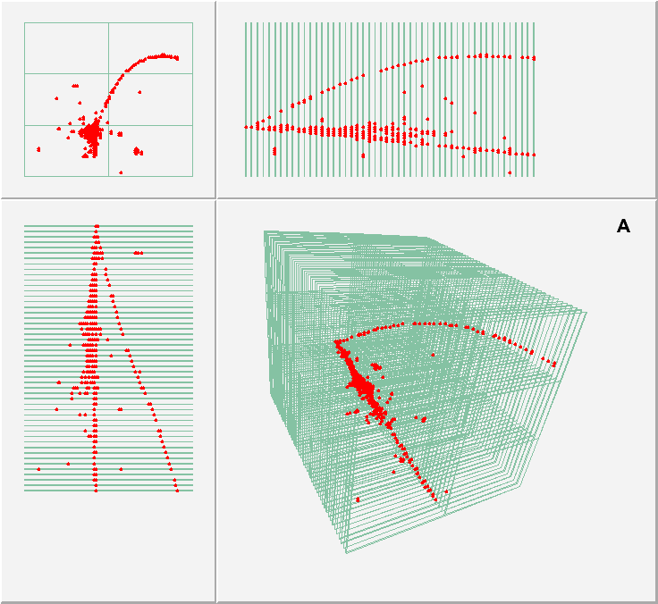
We continue a history of close collaboration:
The first U.C. Seed Grant was given to a collaboration between U.C. & FNAL and ANL to study extreme time-of-flight detectors. We are still reaping dividends from this effort and it has expanded into a very advanced photodetector project at ANL (LAPPD). It has implications for industrial and medical research. (Henry)
ANL and FNAL are working together to explore multiple wavelength, high bandwidth optical data acquisition – including free-space, through-silicon transmission. (Marcel)
FNAL developed read-out circuits and trigger boards for one of the most advanced calorimeters in the world: ANL’s Digital Hadron Caorimeter. And ANL has brought it to Fermilab’s test beam facility for its inauguration. (Marcel)
UC/ANL/FNAL collaborating on fast tracking trigger techniques for ATLAS. (Mel)
FNAL is working with U.Chicago to develop the first interferometer dedicated to search for holographic space-time noise. (Erik)
U.Chicago and Fermilab are working together on the field’s most promising dark matter technology: a long-livetime bubble chamber. We have proven that the acoustic signature from each bubble carries information about the event. (Erik)

Slide 5
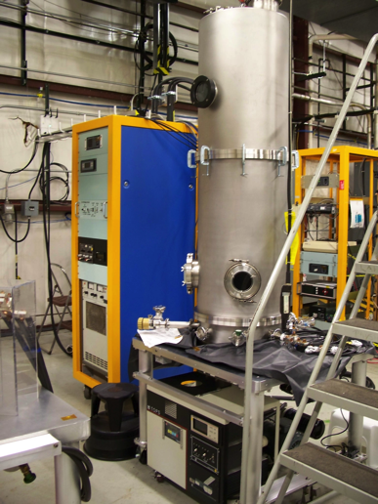
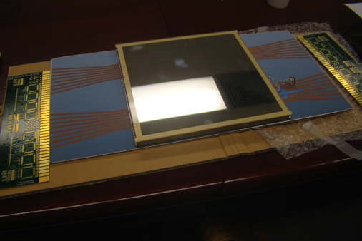
Fermilab is supporting the LAPPD project - “Large Area Picosecond level Photo Detectors” - Managed by ANL - FNAL provides technical and scientific help on the project - Created new electrode coating chamber
A mockup of the 8” MCP/PMT:
Readout on both ends gives 1 mm positional resolution
Transmission line readout retains superb timing resolution
U.C. is developing high speed digitizers (10-20 GHz)
Micro Channel Plate has been developed with new process
(ALD coating of drawn glass channels)
New coating facility in lab 7

Slide 6
Are the Mysteries of Space-Time Accessible by Humans?

Slide 7
λ_{Planck} ≈ 10⁻³³ cm²

Slide 8
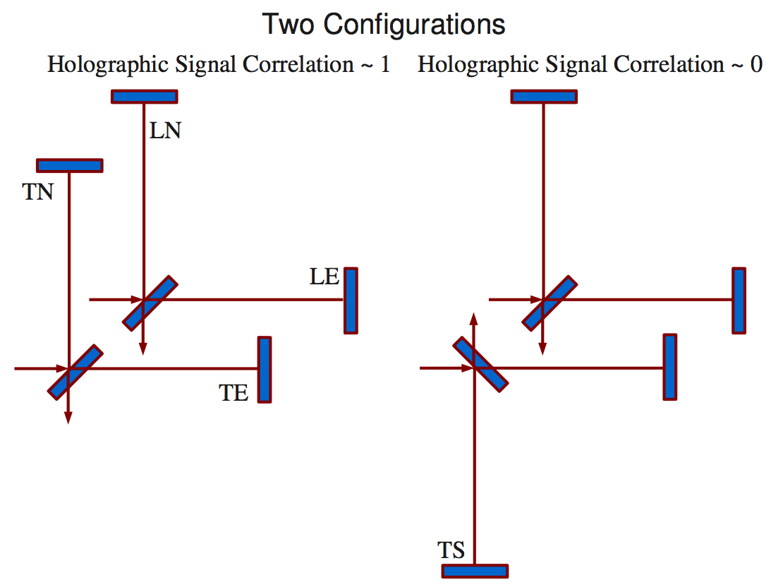
Craig Hogan (joint U.C./FNAL) proposes an experimental test of holographic space-time noise

Slide 9
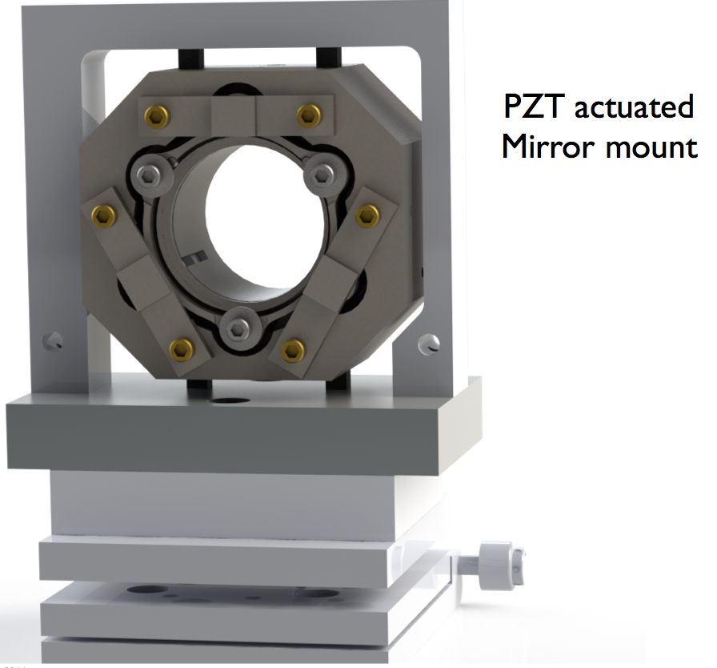
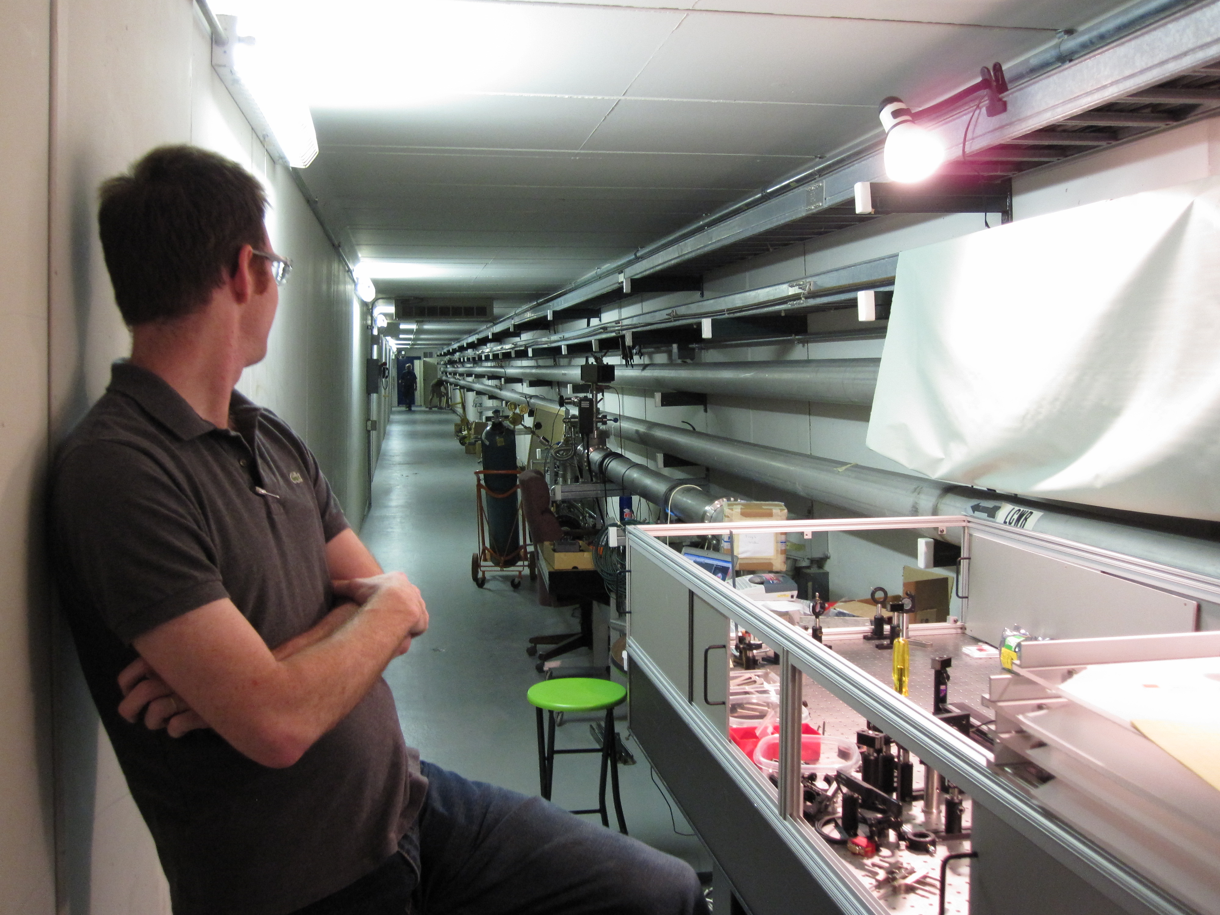
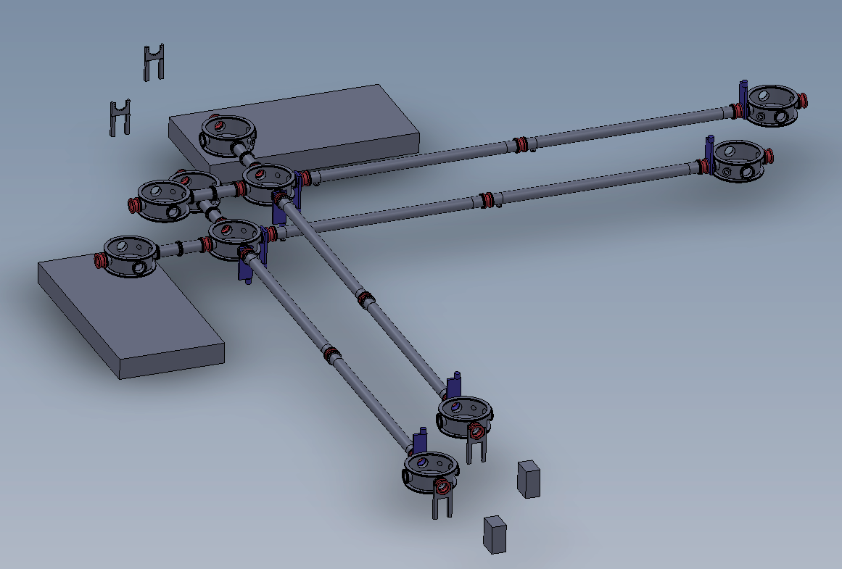
Chicago and FNAL in a New Laser Lab
Developed a brand new high power laser lab in an empty Fermilab beamline (Meast)
Collaboration with U.C./MIT/Michigan
Contains a 2 watt laser with planned for cavity finesse of 1000 (2 kW stored power!)
A baseline of 40 meters, with two correlated interferometers looking in the MHz range.
Sam Waldman, MIT, contemplates space and time in the new laser lab.
Collaboration is fabricating new type of mirror mount using PZT actuators.

Slide 10
What is the Vast Majority of Matter in the Universe Made of?

Slide 11
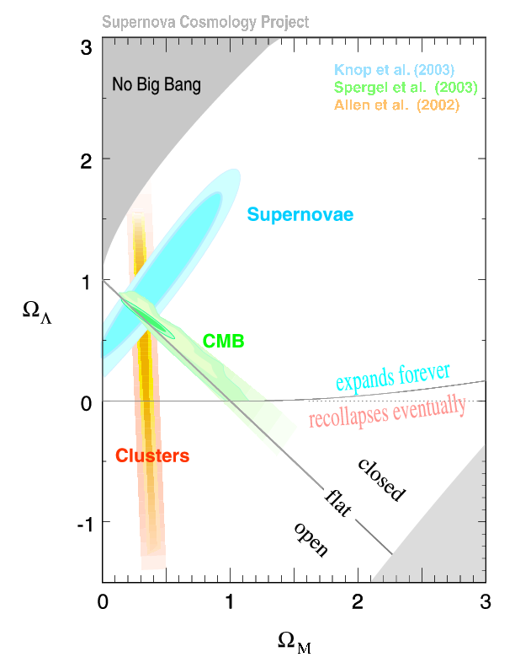
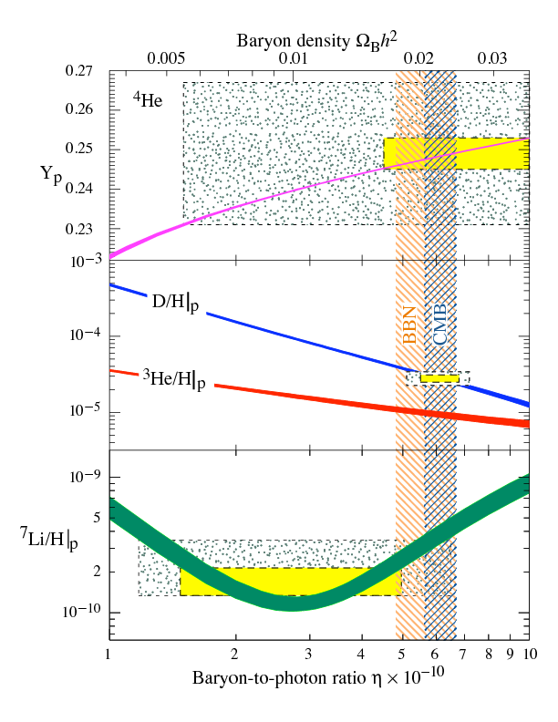
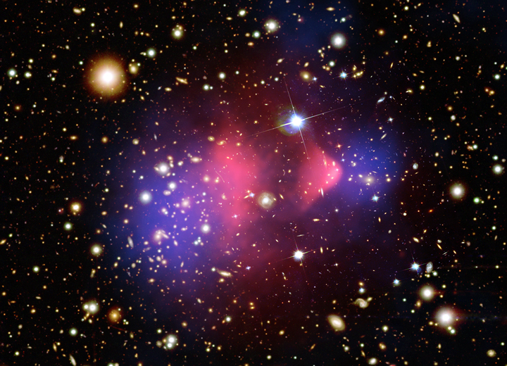
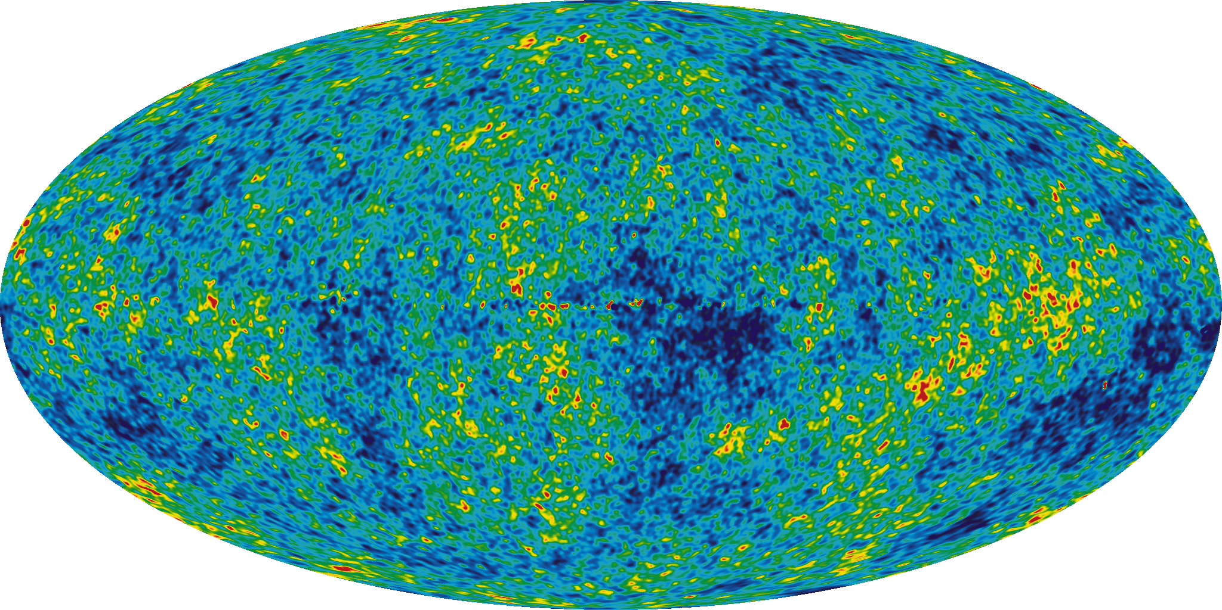
Evidence for Dark Matter

Slide 12
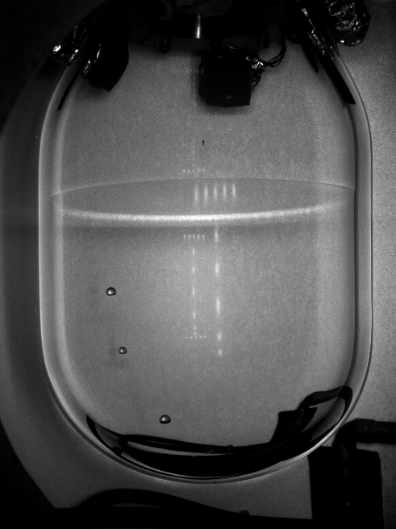
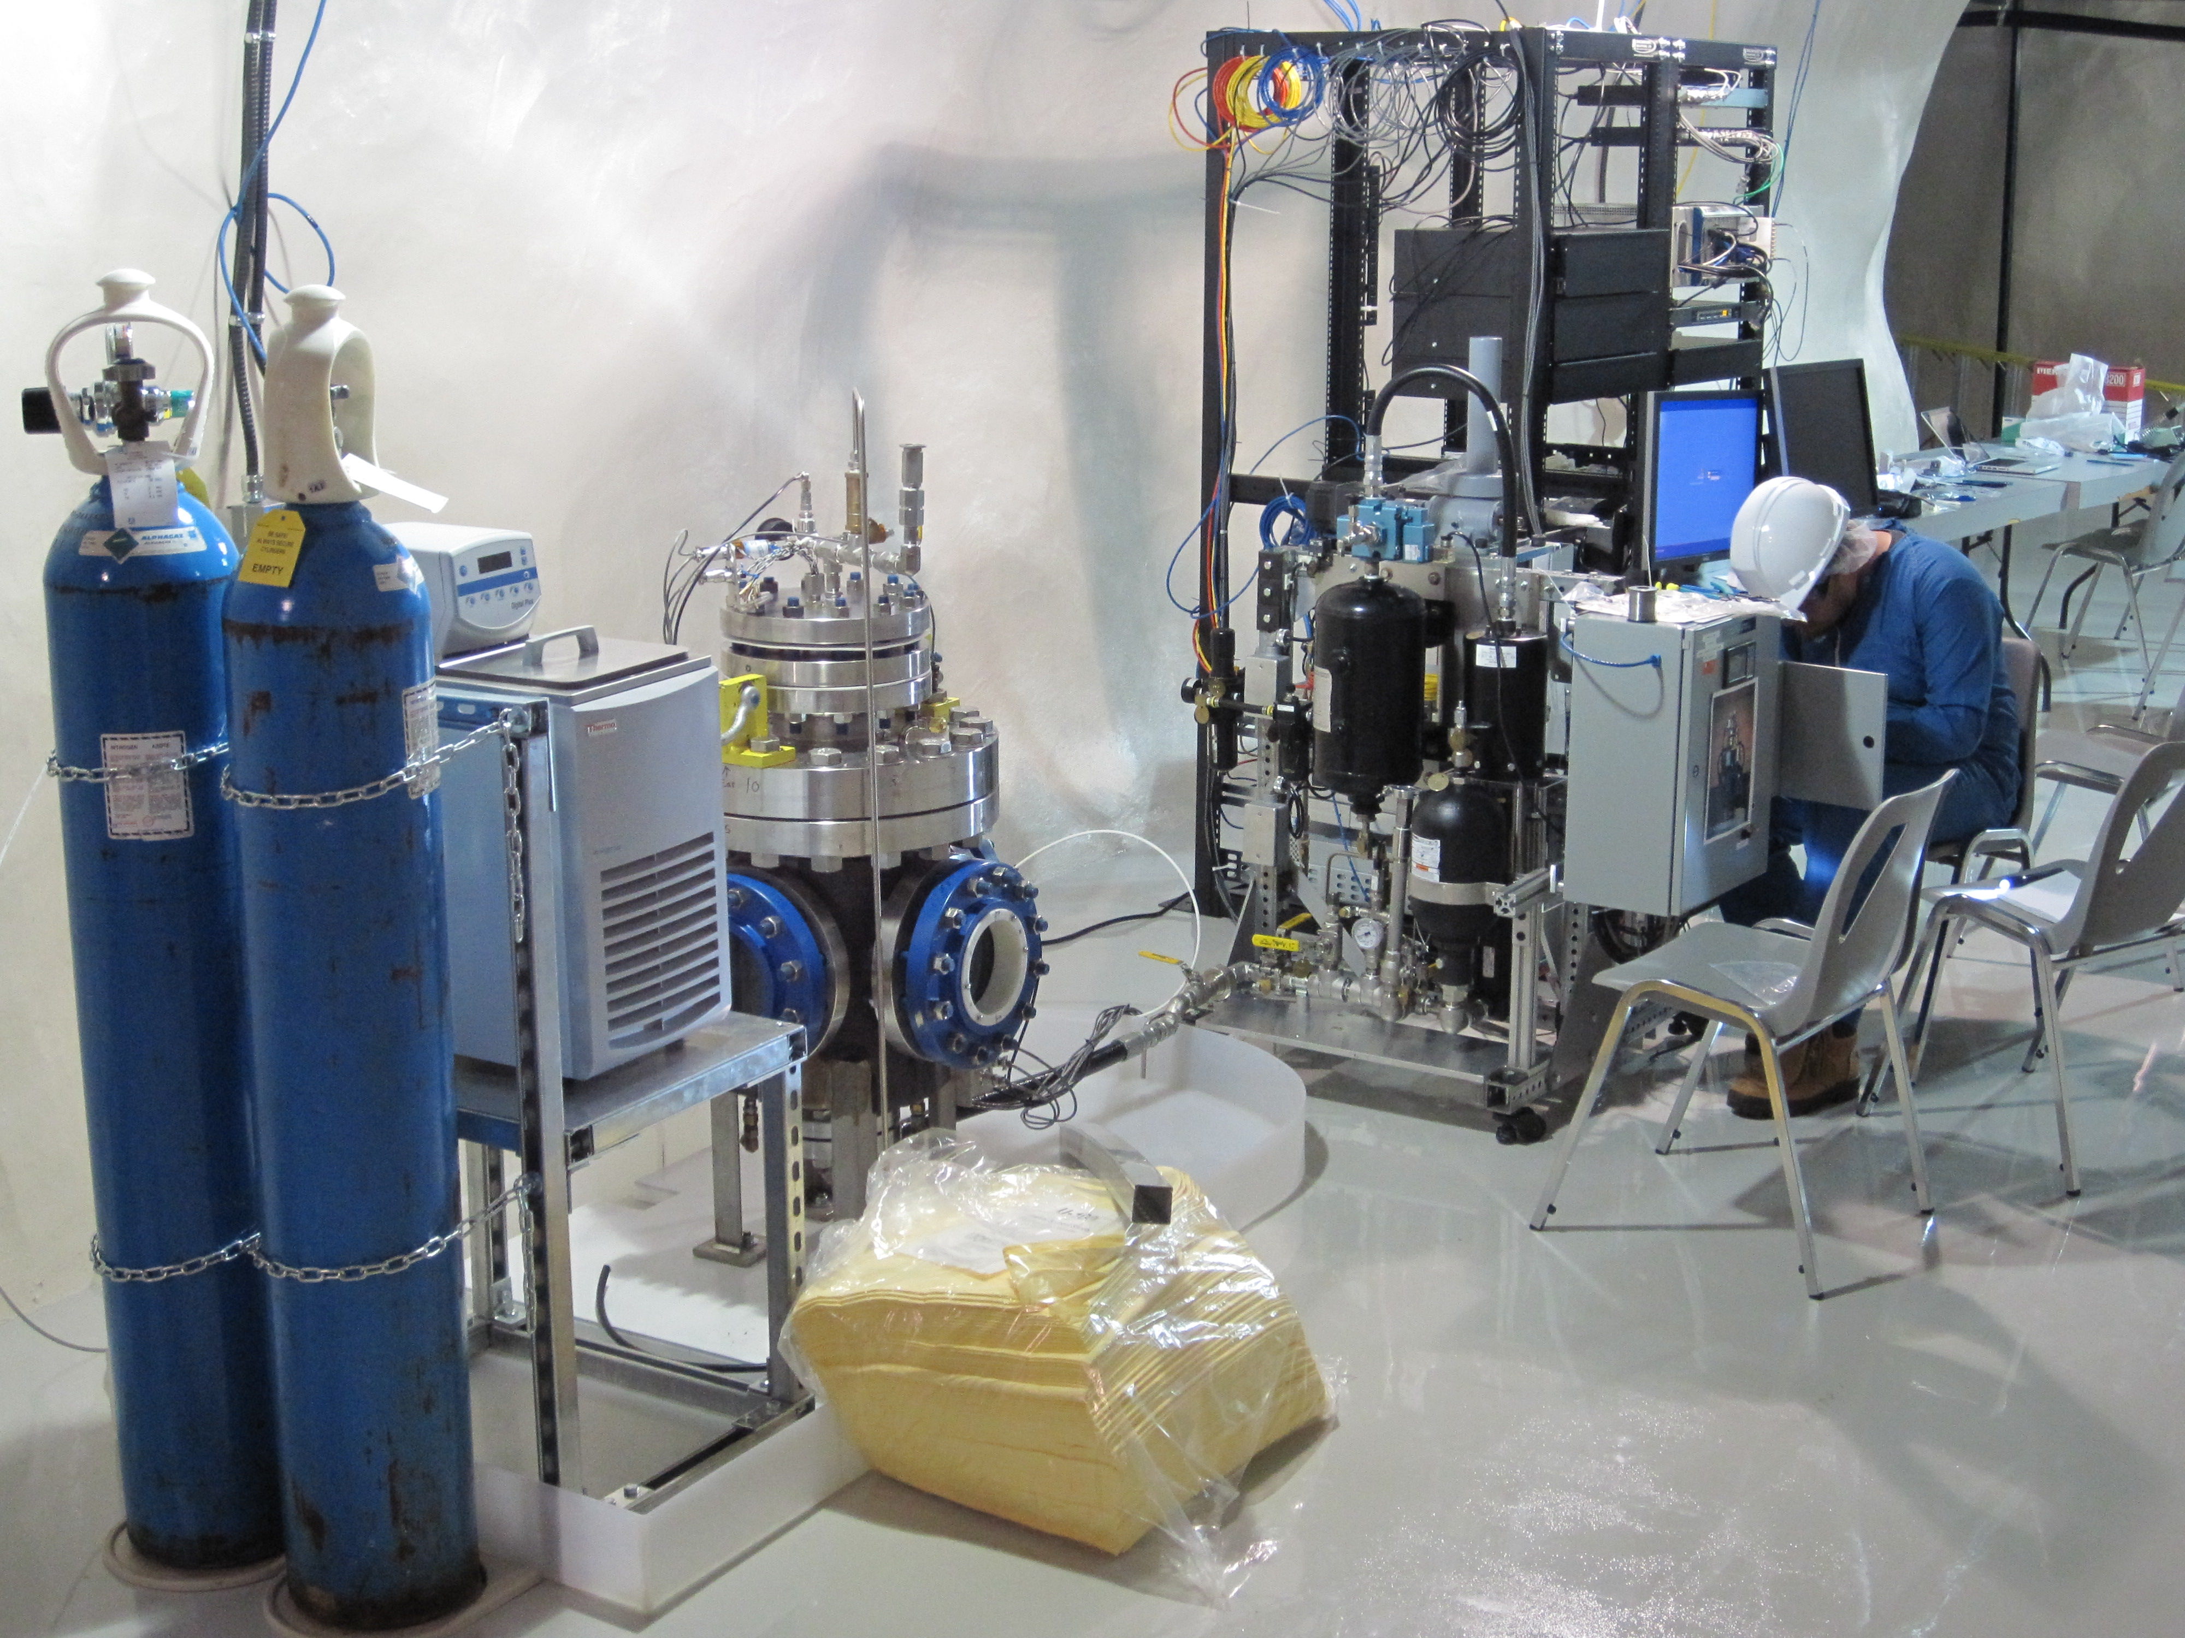
COUPP Bubble Chamber for Dark Matter Detection
Propylene Glycol (hydraulic fluid)
‘COUPP’ = Chicagoland Observatory for Underground Particle Physics
Superheated CF₃I target near room temperature and pressure
Can tune chamber so it is sensitive ONLY to nuclear and not electron recoils
Started out as an R&D test beam experiment from U.Chicago (Juan Collar)
Program of detector research with UC/FNAL/U.I.S.B. collaboration solved the DAQ, mechanical and background issues.
Now it is a full-fledged dark matter experiment; the 60 kg detector is moving soon to SNOLAB
Water (buffer)
CF₃I (target)
COUPP-4 at SNOLAB

Slide 13
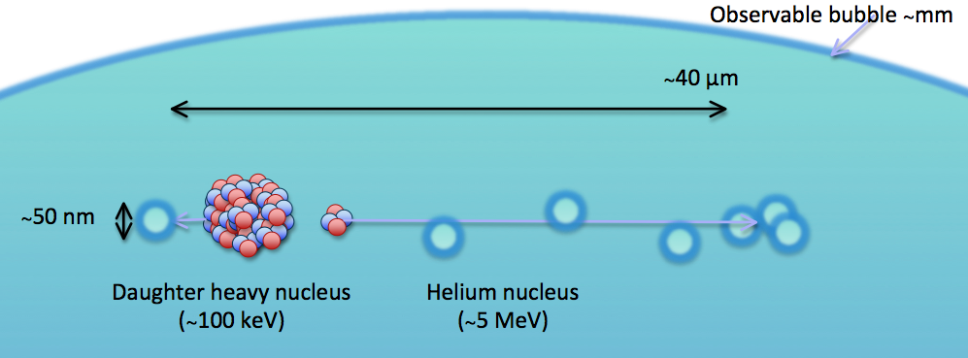
A Heuristic Picture of Acoustics in a Bubble Chamber
Alpha’s, with their longer path, presumably form a set of small proto-bubbles
Alpha decays are thus louder when probing length scales <40 μm
PICASSO experiment indicated this could lead to alpha decay identification

Slide 14
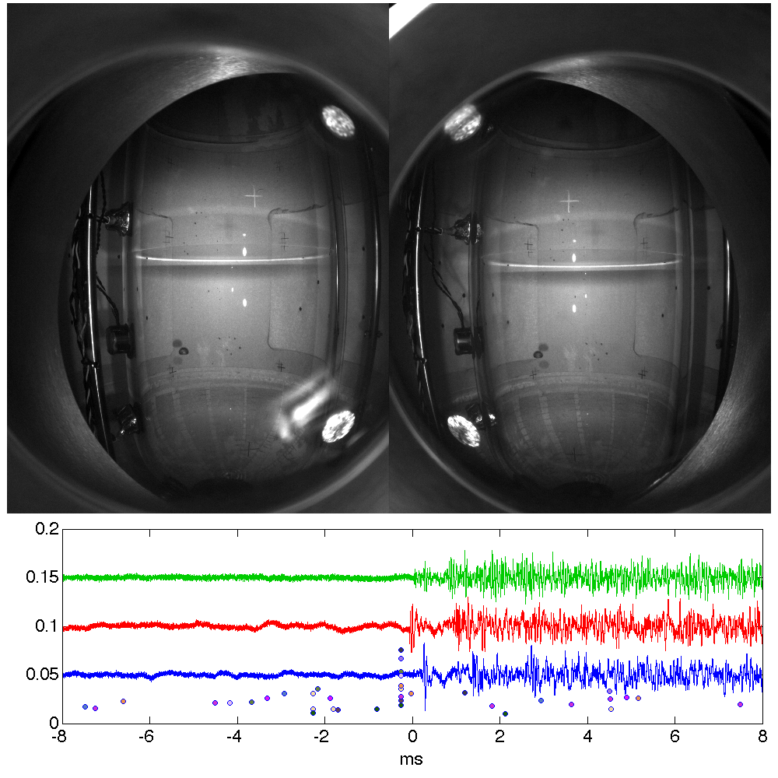
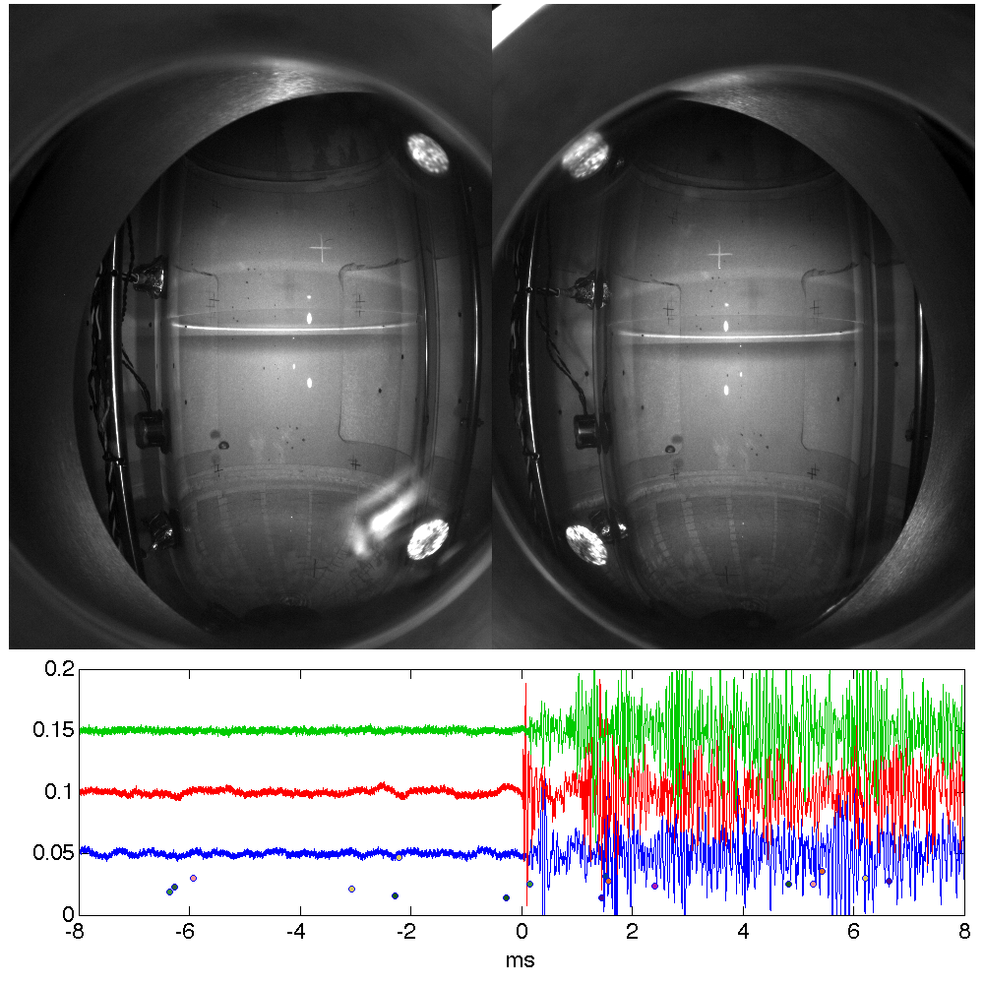
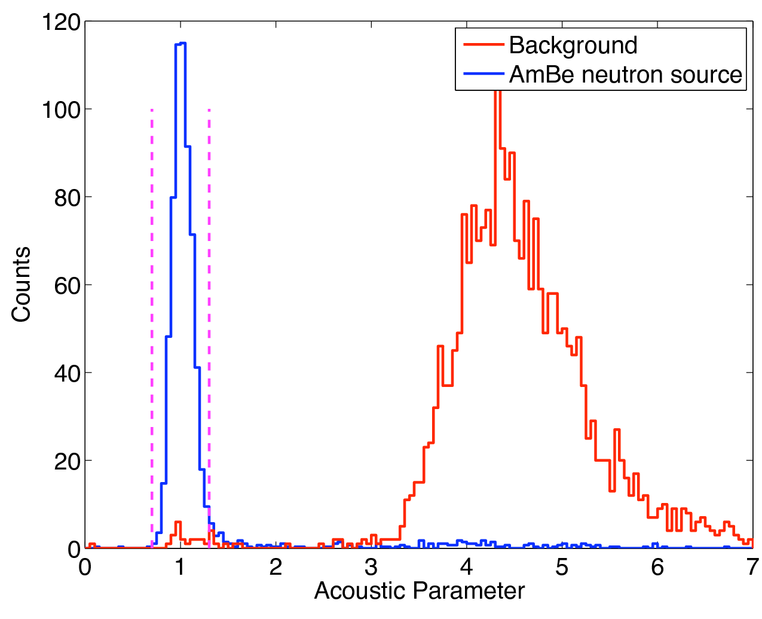
Particle Identification by Sound !
Cosmic-induced neutron
Alpha decay
Confirmed and significantly extended preliminary indication from PICASSO experiment
This gets rid of one of the major backgrounds in this dark matter experiment.

Slide 15
HEP Community Efforts

Slide 16
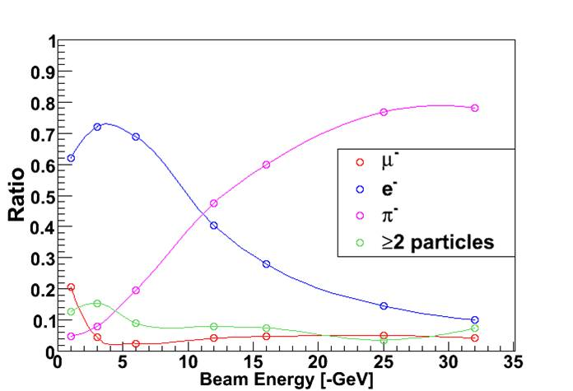
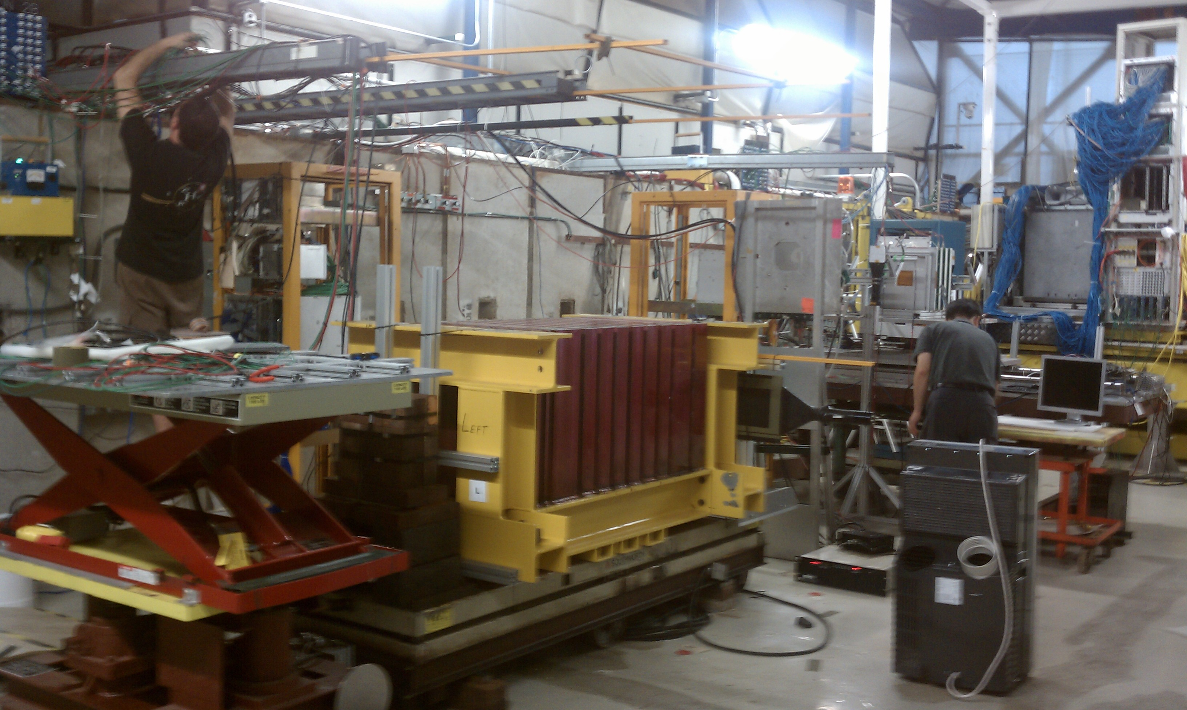
Fermilab Test Beam Facility is a very important asset to the local and U.S. community. Need to update this facility continuously.
This facility is now typically booked 6 months in advance

Slide 17
Options for the future
Expand the U.C. Seed Grant program. As far as I’m concerned, it has been a great success in forming collaborations.
Create a resource program at Fermilab, open to the university community, where institutions can access some of our unique facilities, without needing a project affiliation.
Form a cohesive detector center at Argonne, encouraging a collaborative approach between nuclear, particle and other divisions
Consider a significant detector training program between the three institutions.

Slide 18
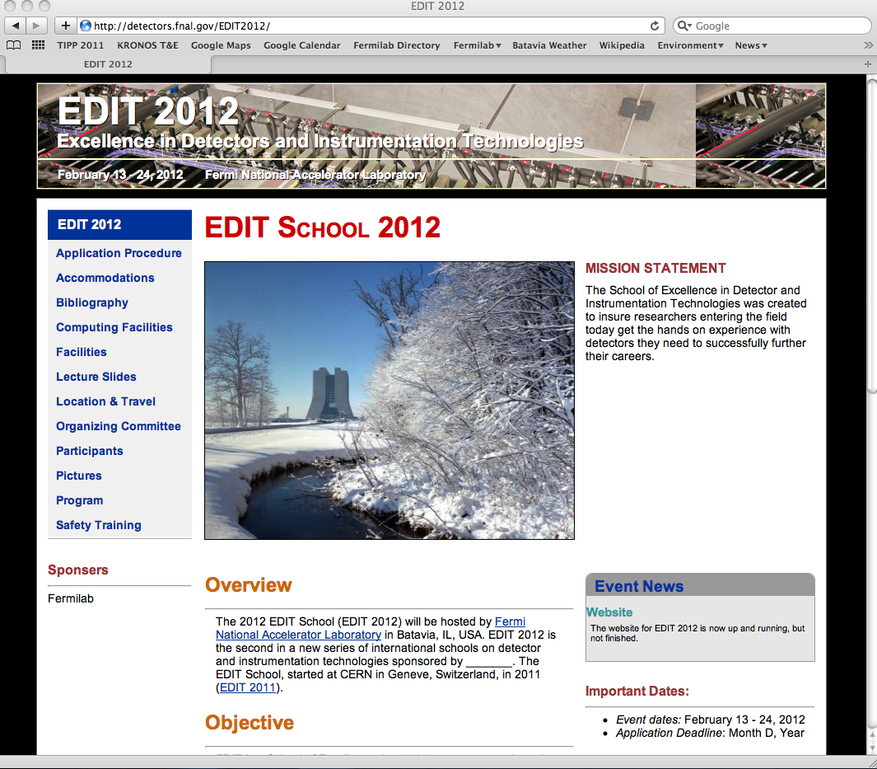
EDIT-2012 Detector School at Fermilab
“Excellence in Detector and Instrumentation Technology” detector school at CERN was a response to a strong need as shown in ICFA survey.
Fermilab has committed to having the next one in February 13-24, 2012
Will be 8 days of hands-on experience, including two days in the test beam!
205 applications for 64 slots, with most applicants having minimal detector experience.
(We envision this school rotating between a few large international labs)

Slide 19
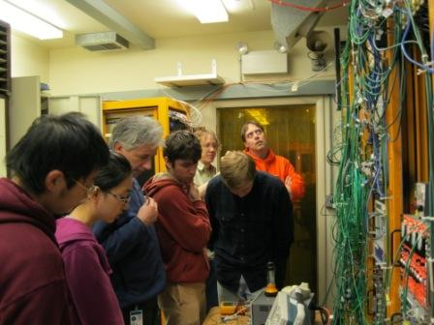
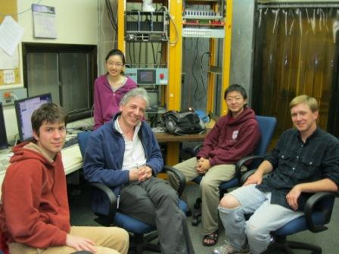
Something we should encourage:
Training the next generation of students in real nuclear and particle physics detector techniques
In May of 2010 Paolo Privitera of University of Chicago brought 4 Undergraduate students to the Fermilab Test Beam Facility, to expose them to life in High Energy Physics. The students collected calibration data with a Pb glass calorimeter for two days. Their data was later used by the T-1005 collaboration in their studies.

