Slide 1
News 6/3/21
Julie and Brendan

Slide 2
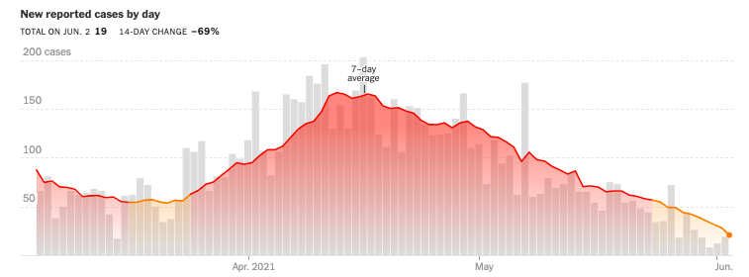
Covid
Kane County
Covid is still here
This has affected many of us and some of us have lost people very close to us
Please continue to follow the guidelines and be extra mindful of the mental health of our colleagues and collaborators
Many are going through many other stressful things besides Covid
None of the lab’s policies have changed since the last meeting. But they have clarified that we do not expect to have a separate set of rules for people who have been vaccinated
See May 21 email from Amber
Expect an update soon
If you are attending virtual meetings not hosted by Fermilab, fill in a TA
Please take vacation. We all need a break.

Slide 3
From Katie:
1045 employees, users, subcontractors vaccinated

Slide 4
From me:
We are no longer in a situation where we are waiting to see what the lab will do next
We now all have two things to do
Get vaccinated
Report to the health office that you have been vaccinated
Please get vaccinated and encourage your colleagues and collaborators to do the same
My prediction is restrictions will go nowhere fast if we have << half the people we expect working on-site to be vaccinated.

Slide 5
Mu2e Applications Physicist position
Please help us spread the word about this position. It is open until June 13.
We have 7 applications so far in AJO
6 out of 7 are people I personally contacted and asked to apply.
It would be nice to see more interest, particularly from Mu2e
We’ve reached out to all candidates who appear eligible in the GEM consortium database
We’ve asked all current APs at the lab to reach out to people they know who they think would make good APs
We already received the feedback that we did not include enough info in the ad and a lot of people have questions
Please direct people with questions to me
I’ve been contacted by g-2, neutrino, Belle-II, and LHC people
It’s a lot of work to get these jobs approved, we have to make the best of them once we actually do get them approved
Perceived interest in the community is important for future positions
We want a large, talented, and diverse candidate pool
I can’t get that alone

Slide 6
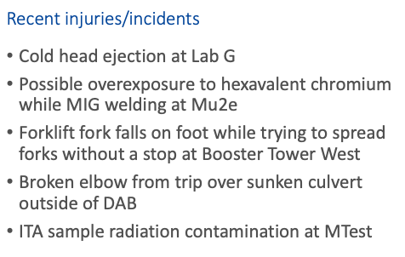
Saftey
As we ramp up work on-site, its also important to get back into good safety practices.
PPD incidents in the last month (from Katie):

Slide 7
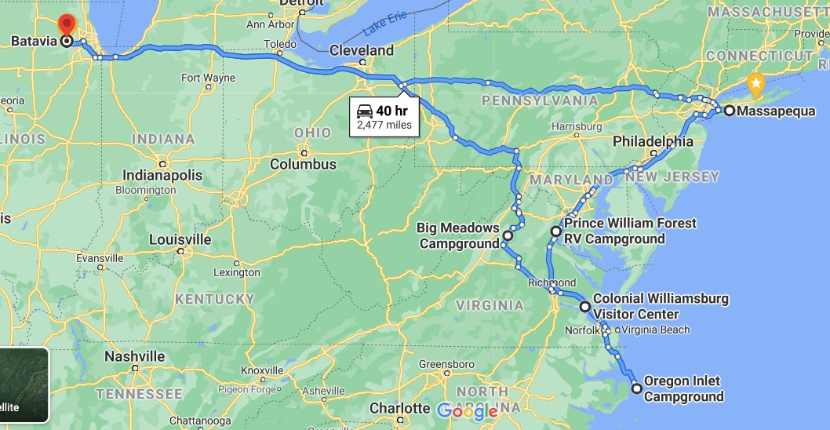
Vacation
This is the best thing I know of to improve mental health, safety, and overall productivity
Please take vacation
My dates:
June 14 – 16, June 21 - July 9, August 16 – 20
Get vaccinated and get out there

