Slide 1
Particle Accelerator Applications
Thomas Kroc, PhD
SIST – Summer Lecture Series
29 June 2021

Slide 2
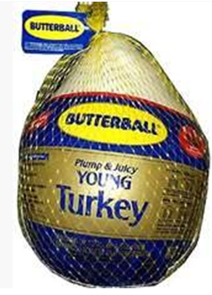
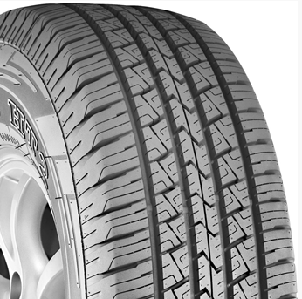
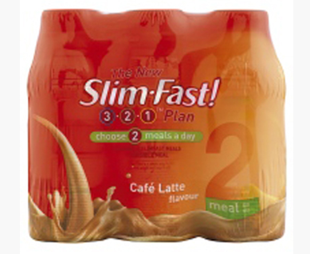
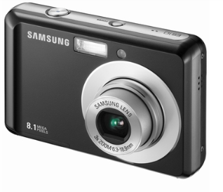
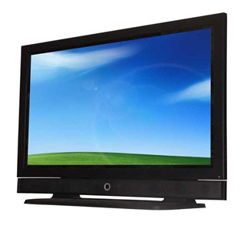
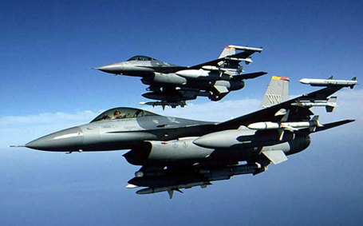

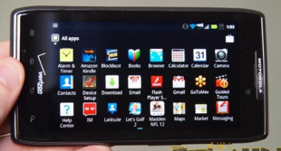
Accelerators built in the pursuit of science now have major impact on the economy… but many more opportunities
About 30,000 accelerators are in use world wide
  Sales of accelerators > $ 2 B /yr and growing at 10% per year
  Accelerators touch over $ 500B/yr in products
  Major Impact on our economy, health, and well being
Some Products:
Shrink wrapped food
Radial Tires
Aircraft
Digital Electronics

Slide 3
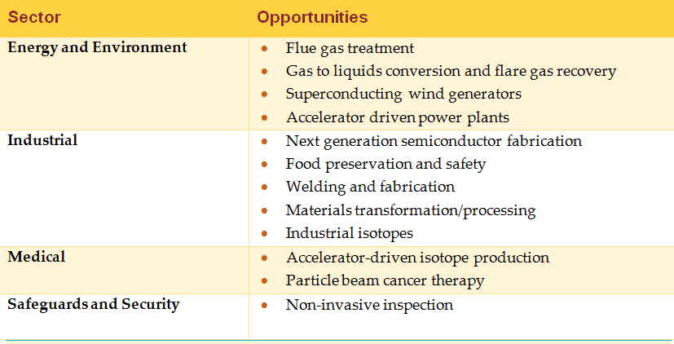
Opportunities
We also imagine other transformational uses of accelerators like:
  Medical Device Sterilization
  highway lifetime extension
  hard rock tunneling

Slide 4
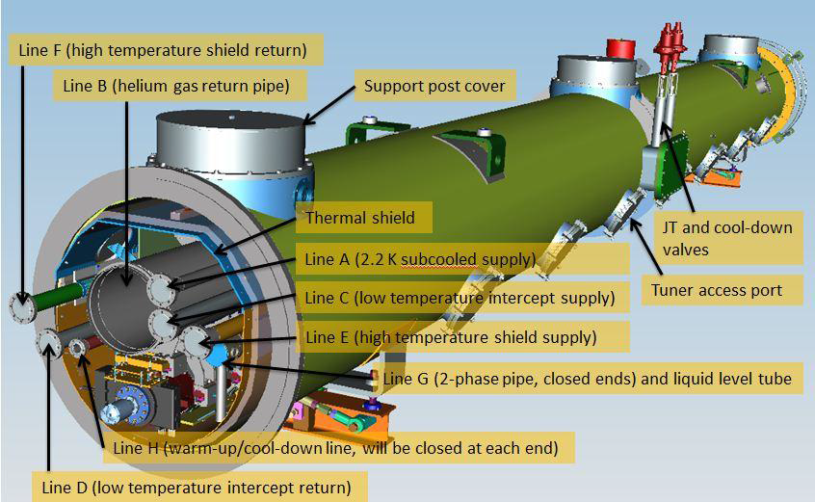
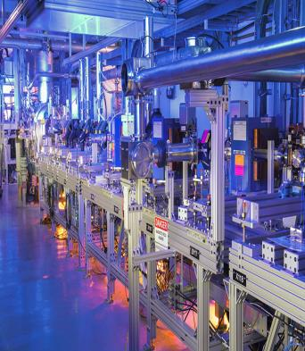
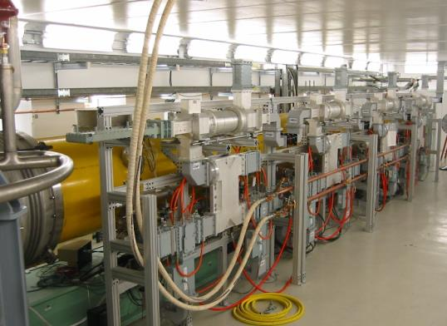
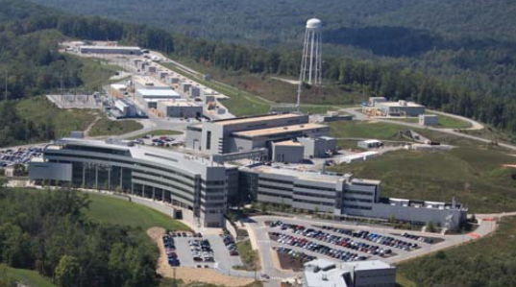
What’s New?
All new accelerators for discovery science are superconducting.
But current SRF “science” accelerators are large and complex
Why SRF?
  Higher gradient, more energy per unit length
  More efficient, less wasted energy
LCLS-II Cryomodule
FNAL FAST 50 MeV injector and ILC cryomodule
CBEAF CW electron linac
2 K cryoplant
SRF Proton Linac
Spallation Neutron Source at ORNL

Slide 5
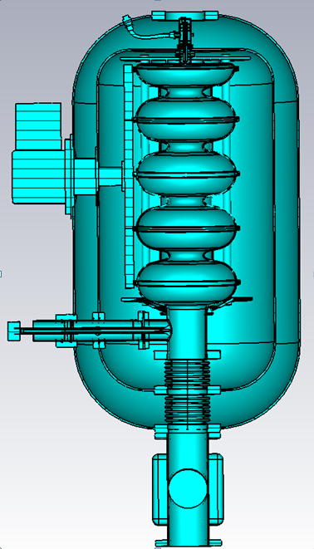
What we are doing
We are combining a number of state-of-the-art technological advances into a simple to operate, compact, superconducting RF accelerator.
Inexpensive (relatively)
Efficient
  > 80%,mains to e-beam
Turn key operation
High reliability
≤ 10 MeV
≤ 250 kW
∼ 0.7m ∅ x 1.5 m long

Slide 6
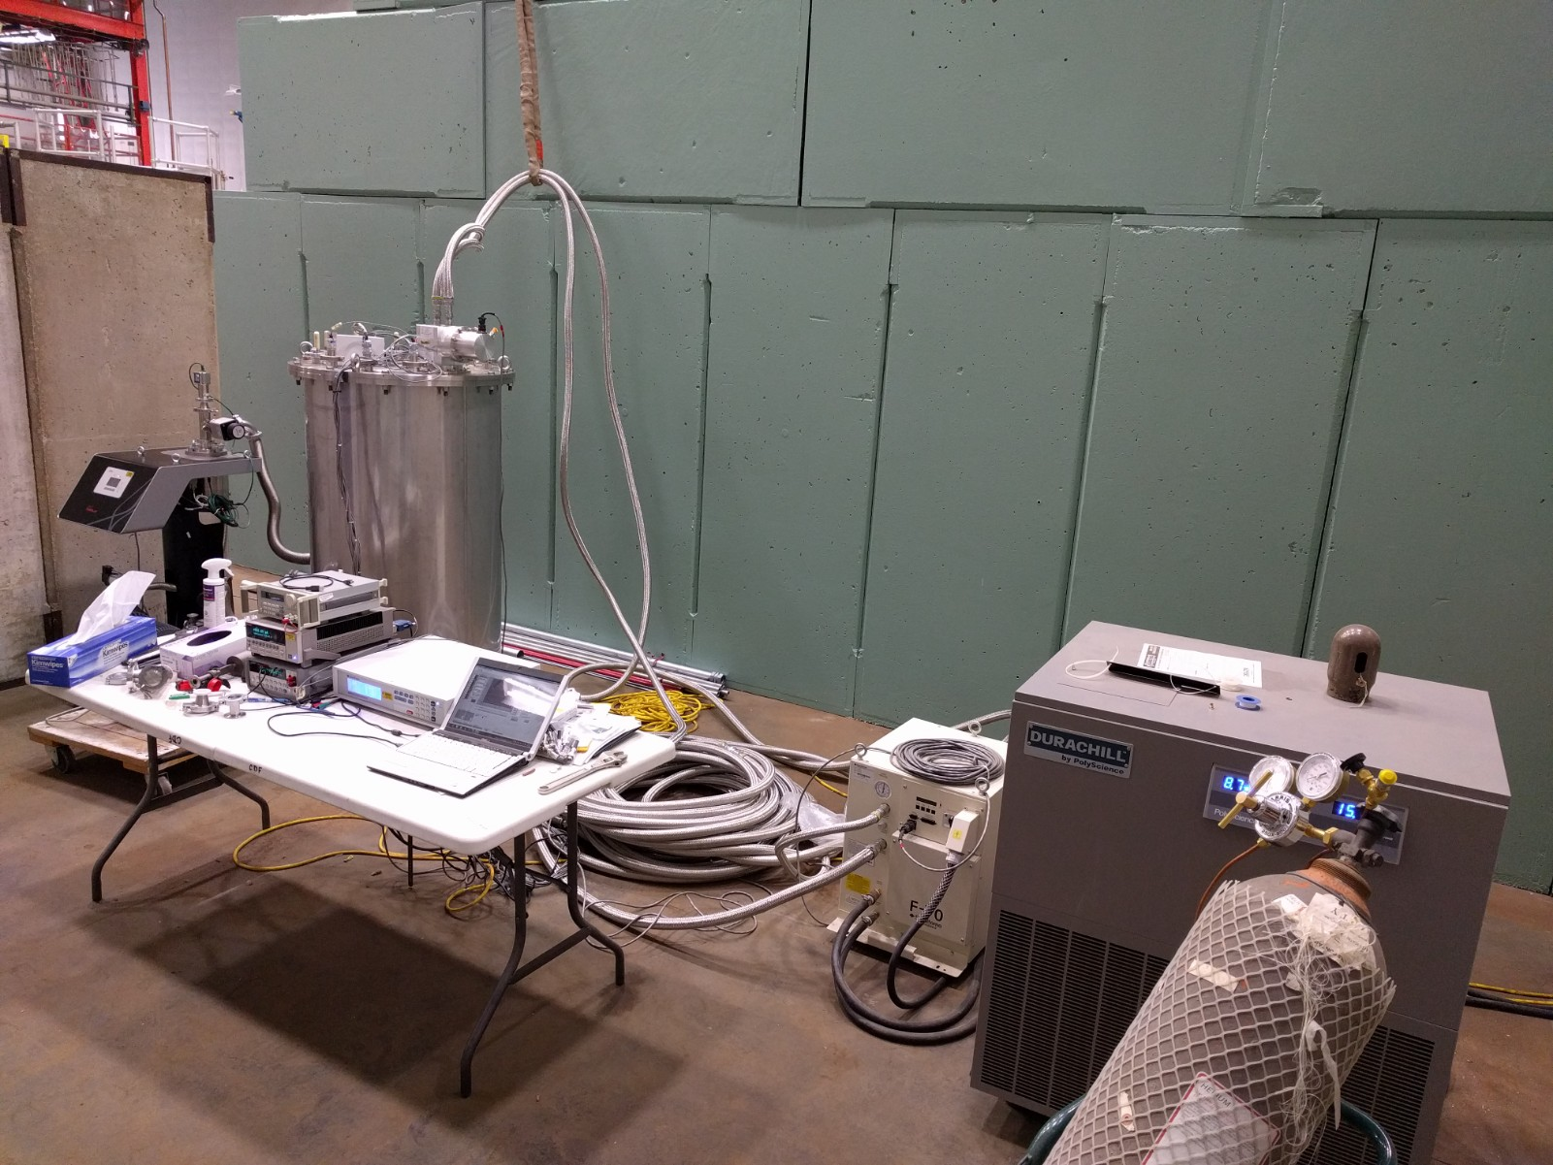
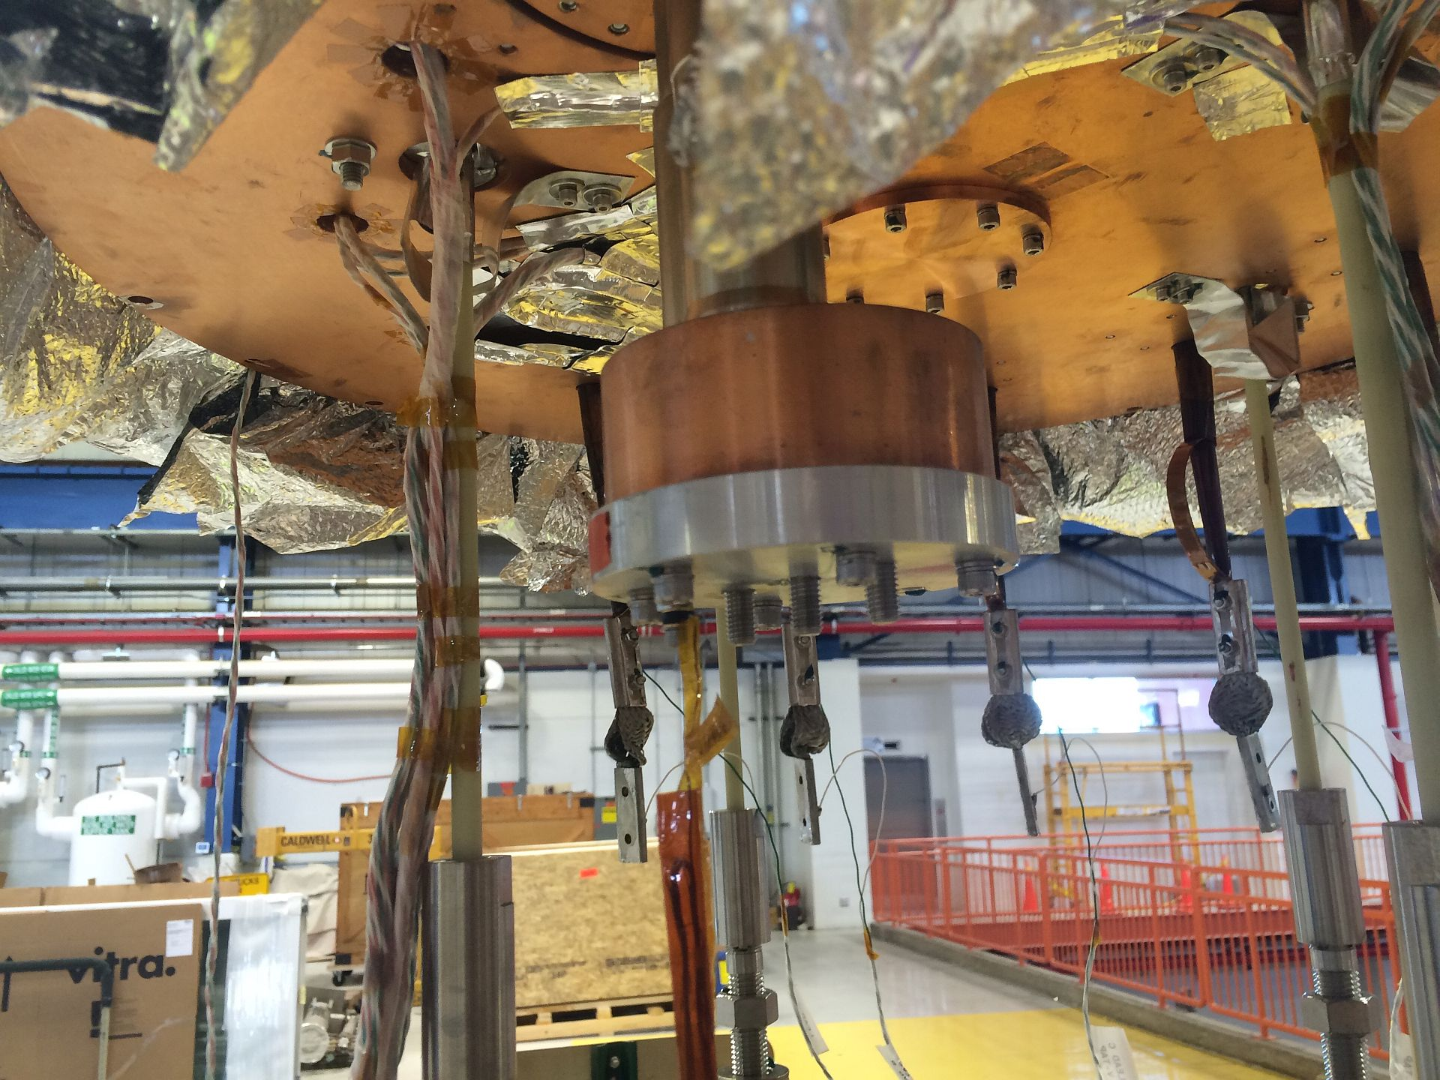
Heat
Eliminate liquid cryogens
Conduction cooling
  No LHe
Commercial cryocoolers
  2W each @ 4 K

Slide 7
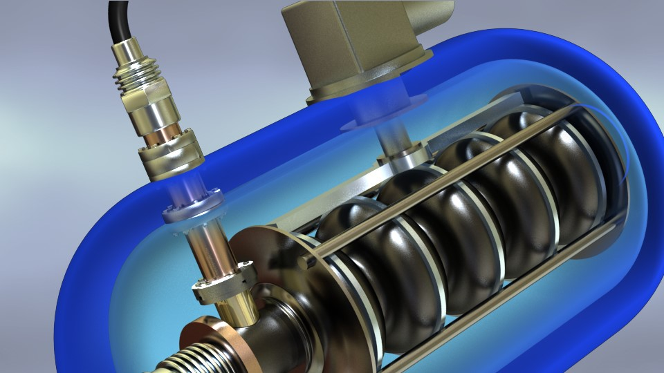
Conduction Cooling
Cold head(s) of the cryocooler(s) connected to cavities by high purity aluminum
300K
60K
Thermal
anchoring
block
Heat Budget
4 – 6 W
US patent applications
#15/280,107
#14/689,695
4K
Copper wires
Connection
80
X7
X8
Phosphor-bronze wires
X78440 (C5)
42266 (D4)
X6
X78441 (C2)
80
X42268(D3)
X63112 (C4)
X78443 (D2)
Heater
40 Ohm,10W
X4
X2
X1
X5
15
46
10
162
20
X78442 (D5)
X3
X63115 (C3)
Notes:
This novel and proprietary configuration (Patent application #62/234,475) results in dramatic reductions in complexity, size, weight, and cost.

Slide 8
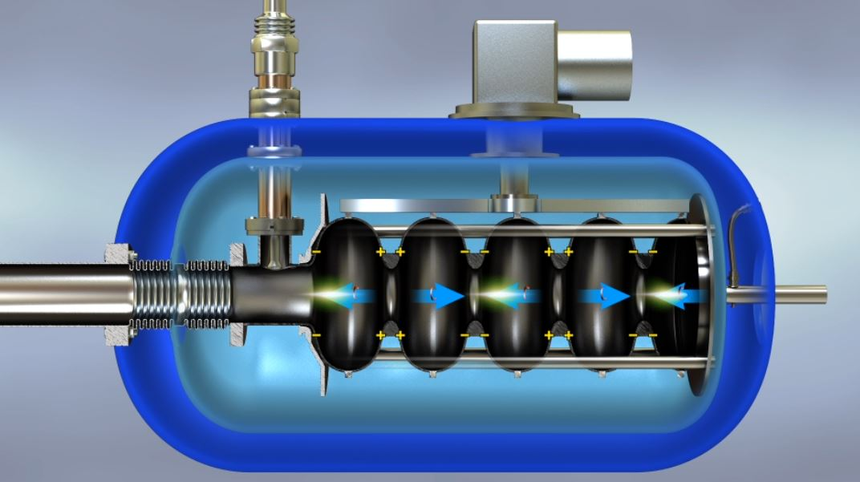
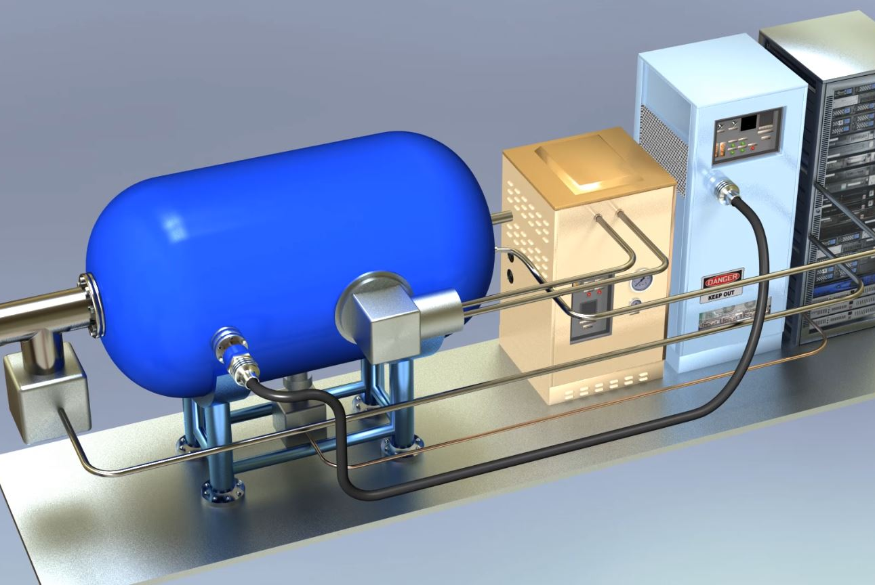
The Compact SRF Accelerator
Low
Heat-loss
RF Coupler
Solid state or
Magnetron
Power Supply
Cryo-cooler
Compressor
Cryo-cooler
Cold Head
Integrated
Electron
Gun
Nb₃Sn
Coated Cavities
No LHe

Slide 9
Comparison of Gammas, X-rays, and e-beam

Slide 10
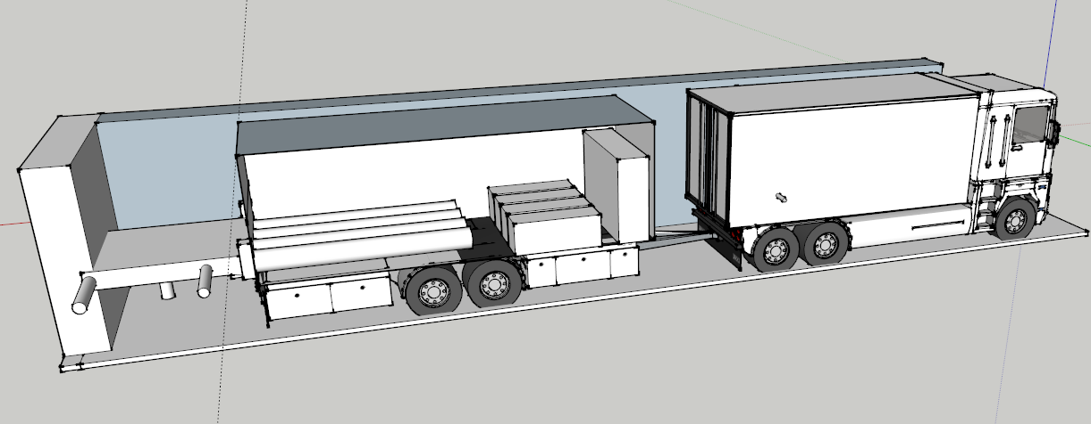
Accelerators for the Environment: Flare Gas
Trailer mounted high power electron accelerators
Natural gas turbines provide the local electrical power
Liquid hydrocarbons created can be mixed and collected with crude oil produced by the well
High revenue can fund accel design
1 well flares ~ $ 5 M/yr for 1-2 yrs
Accelerator and RF Power
Gas turbine generator
Unconverted Nat Gas + Hydrogen drives gas turbine for power
e.g. nCH₄ → C_{n}H_{2n} + H₂
Details are Proprietary
Nat Gas
Liquid hydrocarbons

Slide 11
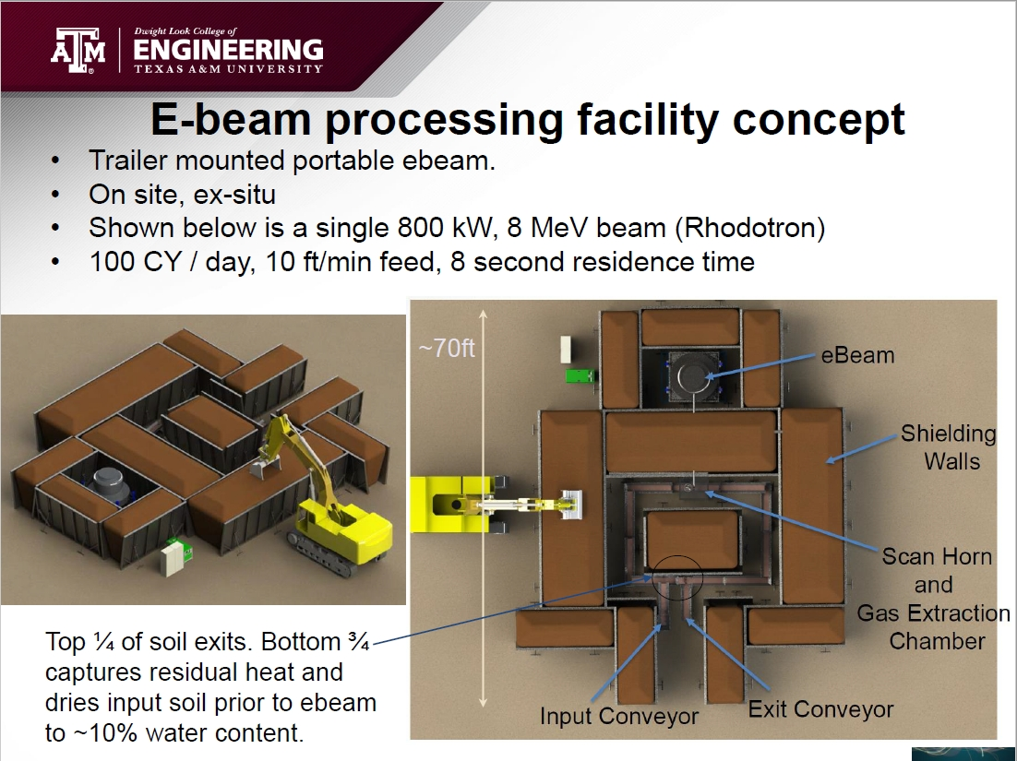
Contaminated Soils

Slide 12
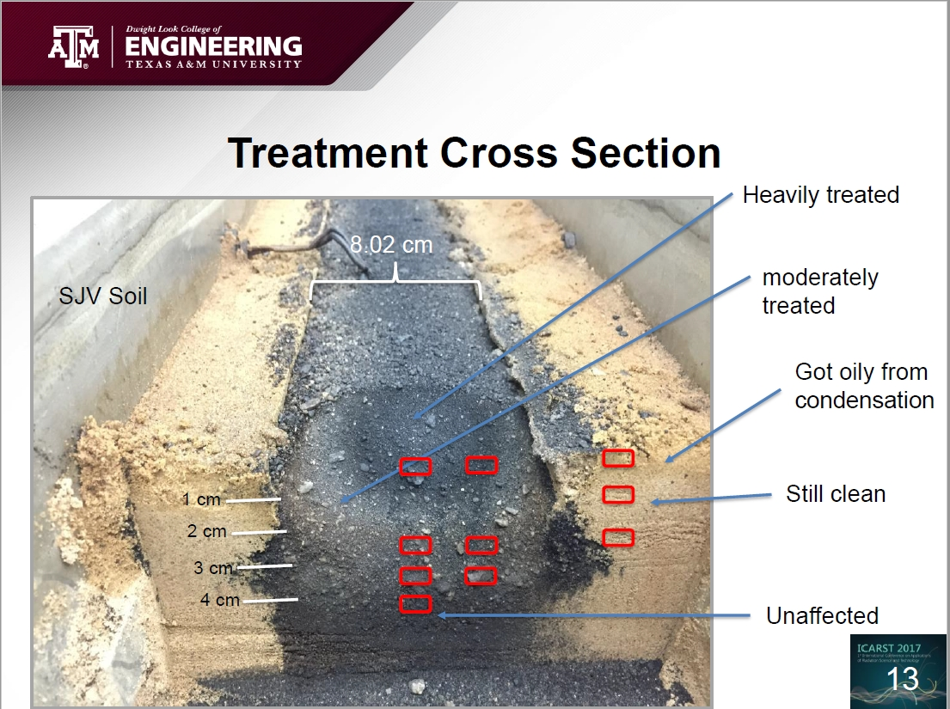
Contaminated Soils

Slide 13
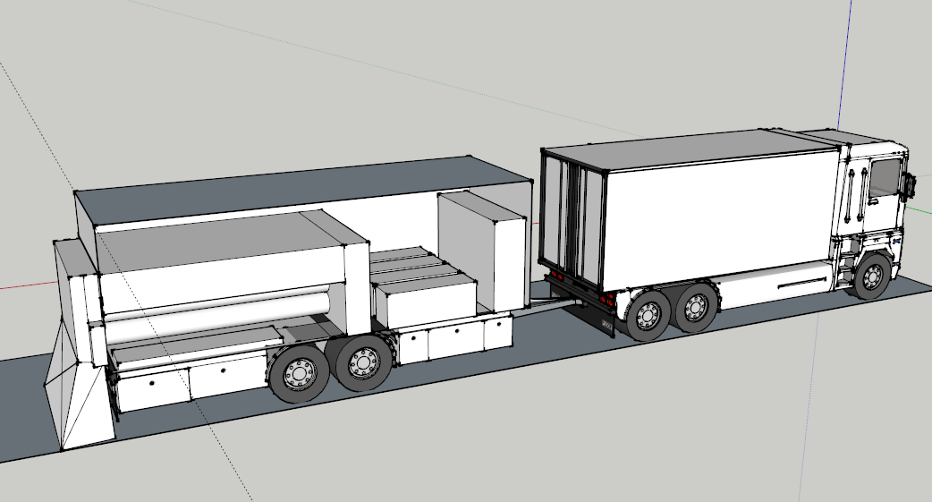
Mobile EB to extend lifetime of highways
1400 KW ➔ 2 lane-miles per 8 hr shift
Cost of 1 lane-mile interstate highway = $ 2.4 - 6.9 M
Huge value added ~ $ 500 K- $1.4 M per shift (1 yr extension)
$ 5-8 M capital cost ➔ very short payback period!

Slide 14
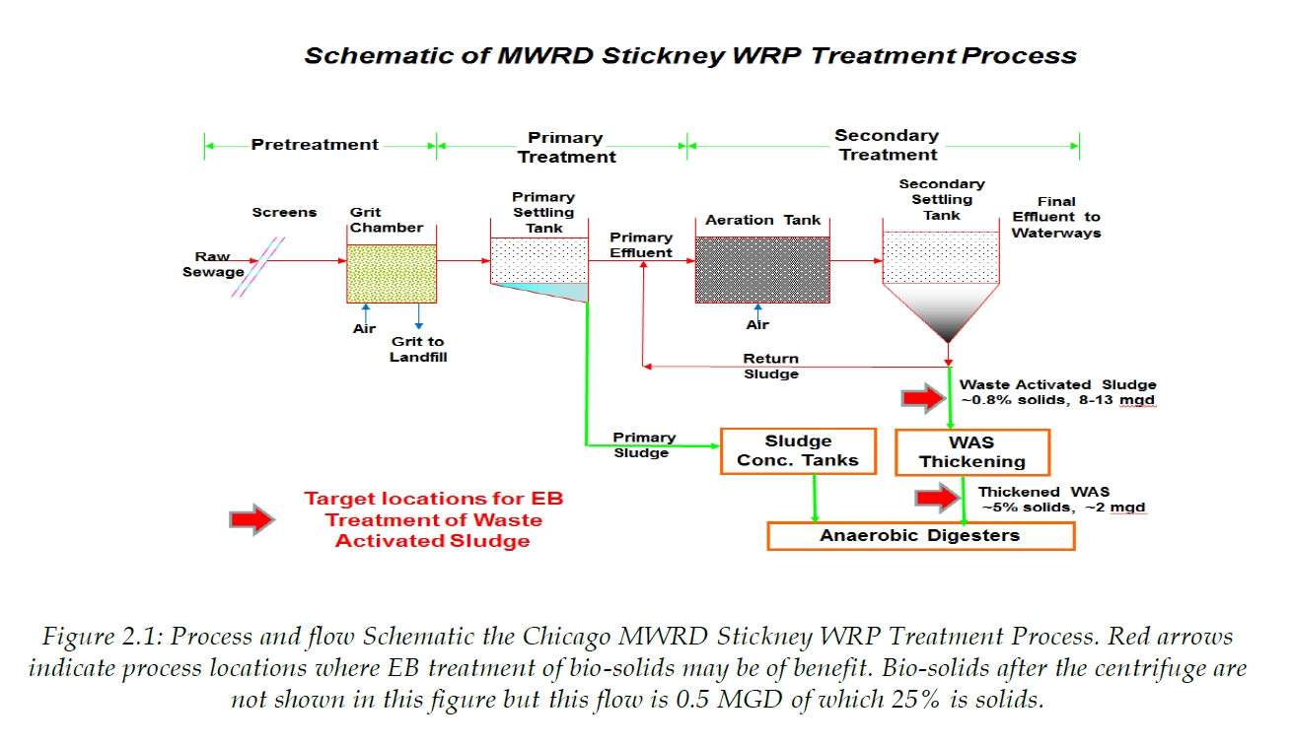
Sewage & Sludge Treatment

Slide 15
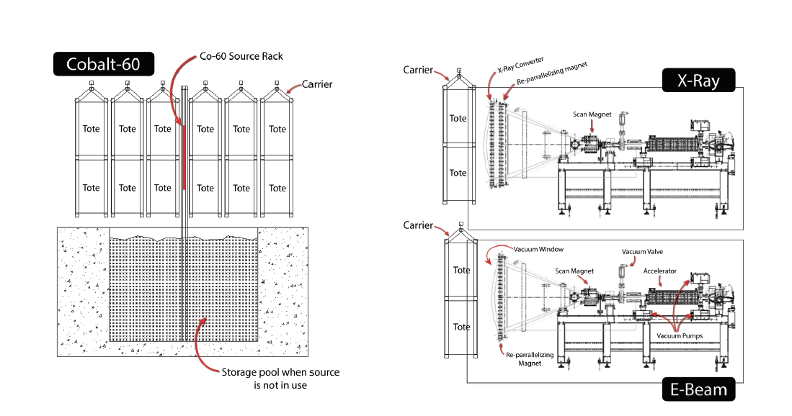
Medical Device Sterilization

Slide 16
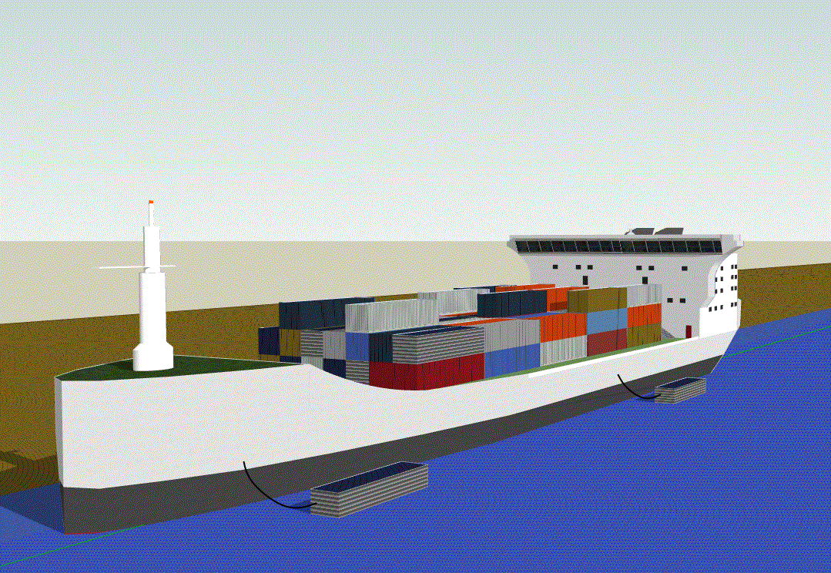
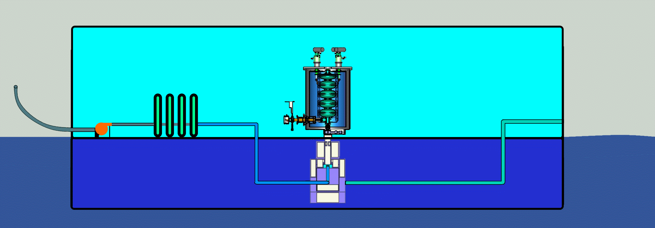
Ballast Water

Slide 17
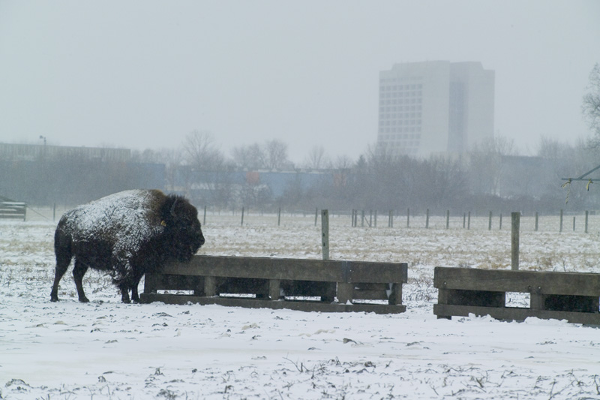
Thank you

