Slide 1
Introduction to Accelerator Physics
Jeremiah Holzbauer, Ph.D.
FNAL Undergraduate Lecture Series
June 2021

Slide 2
Disclaimer
I’ve tuned this talk so that the complex math isn’t required to understand the topic, but sometimes it’s there to give context to some things
The math is there, and it can be as high-speed as you want it to be, but the concepts should be approachable
Sometimes this means losing a little precision for clarity, but the core message is right
If you have questions, raise your hand! A lecture without questions is boring, no matter how much I wave my hands. If you have a question, it’s almost certain you’re not alone and I’m not explaining something clearly.
Some images and slides are taken from the outstanding US Particle Accelerator School class: Fundamentals of Accelerator Physics and Technology (http://nicadd.niu.edu/~syphers/uspas/2018w) by Mike Syphers (anytime you see MJS on an image/slide)
jeremiah@fnal.gov

Slide 3
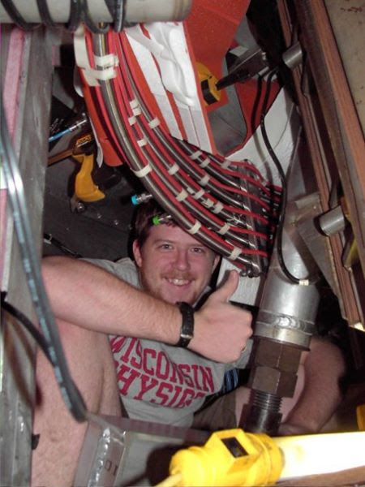
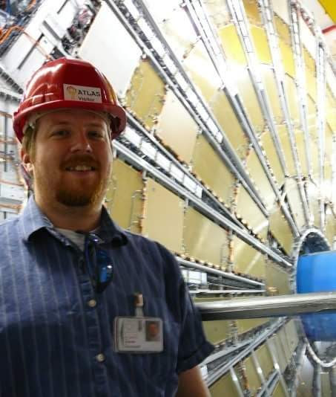
About Me
University of Wisconsin
Applied Math, Engineering, and Physics B.S. (2006)
Nuclear Engineering
Plasma Physics (Madison Symmetric Torus)
Michigan State University
Physics Ph.D. (2011)
Worked at the NSCL
Designed accelerator components for the Facility for Rare Isotope Beams

Slide 4
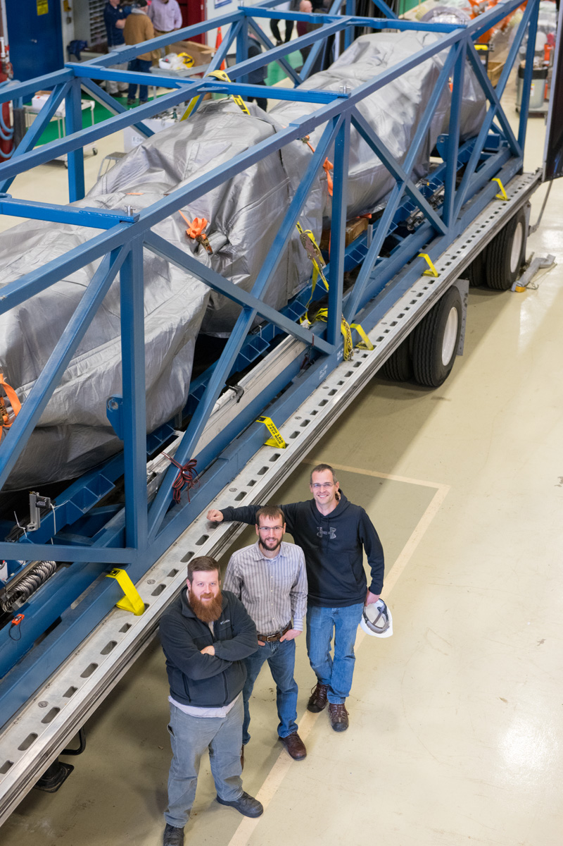
About Me (2)
Postdoc at Argonne National Laboratory
Advanced Photon Source Upgrade
Fermilab
Guest/Associate/Full Scientist
Accelerator component design, integration, and testing
Algorithm development (noise cancelling for accelerators)
High level troubleshooting (diagnose, fix complex technical issues)
Transportation failures
Integrated system stability
SRF Coordinator for PIP-II Project Technical Integration Team
Planning and Implementation of complex systems

Slide 5
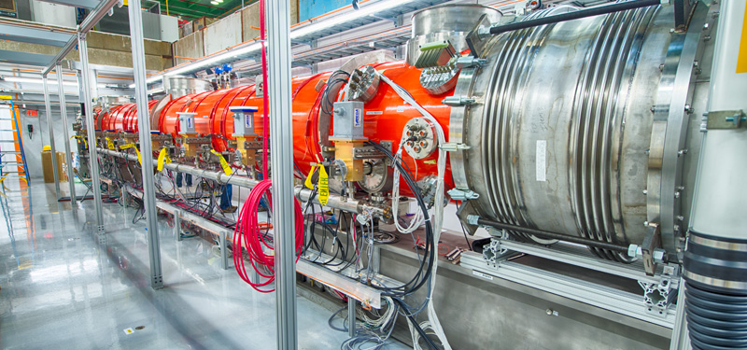
What Appeals to Me about Accelerator Physics
I’ve always loved learning about new technologies, working on complex problems, and making technologies practical
Accelerator Physics lives at the boundary between theoretical physics and practical engineering, conceiving, designing, building, and operating extreme and complex machines
Always pushing the technological boundaries, always something new

Slide 6
Why Accelerator Physics?

Slide 7
Studying Different Sizes
Scientists want to study everything, but are limited by their tools
Eyes are great, but only visible light, and only from ~millimeter to ~mile size
Telescopes push the size and distance up, microscopes push the scale down
Although with astronomy, it’s giant things VERY far away, so also detecting fainter and smaller things
When the eye is what actually detects the light, both are limited
The last 150 years has been a continuous effort to find and develop new tools
More sensitive cameras that detect more things
Better sources of light, brighter, etc.
https://en.wikipedia.org/wiki/Orders_of_magnitude_(length)

Slide 8
Atoms to Study Atoms
With a microscope, you can see germs (10s of μm), parts of germs, etc, but we knew they were made of smaller bits (atoms)
It was known that radioactive material gave off these atoms
Famous experiment shot atoms at atoms to investigate their structure
https://en.wikipedia.org/wiki/Geiger-Marsden_experiments

Slide 9
Rutherford’s Desire
Ernest Rutherford’s discovery of the structure of the nucleus in 1909 opened new fields of experimentation
Nuclear Physics
Eventually, High Energy Physics, Light Sources, etc.
These fields (and eventually others) require particle “accelerators”
Rutherford expressed a long-standing
“ambition to have available for study a copious
supply of atoms and electrons which have
individual energy far transcending that of the
alpha and beta particles” available from natural
sources.
This desire has led to a century of accelerator physics research

Slide 10
Why High Energy Particles?
What does the science want?
More Energy!
Different science available
Controllable/Tunable Energy!
Dynamic behavior studies
Fine structure investigations like resonances
More Intensity!
Take data faster
Study rare processes
Rare isotopes
Neutrinos
Rare particle decays
Variety of Particle Beams!
The ability to create and use beams of any element/isotopes
What do they REALLY want?
Wall power
Desired Beam

Slide 11
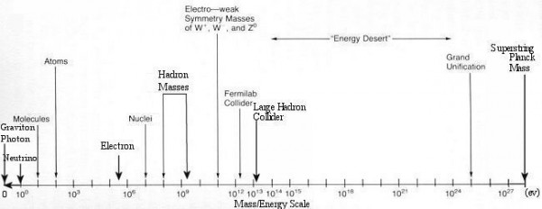
Energy Scales
1 eV = 1 electron Volt = the energy 1 electron gains going down 1 Volt potential difference (9 V battery gets us 9 eV)
Energy for an experiment is determined by what they want to do (even if the energy gets turned into X-rays or other particles first!)
Also, $E=\frac{hc}{λ}=mc^{2}$, where $λ$ is the wavelength, higher energy lets you look at smaller things (visible light goes down to 400$μm$)
http://sten.astronomycafe.net/the-particle-desert/

Slide 12
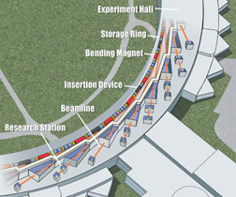
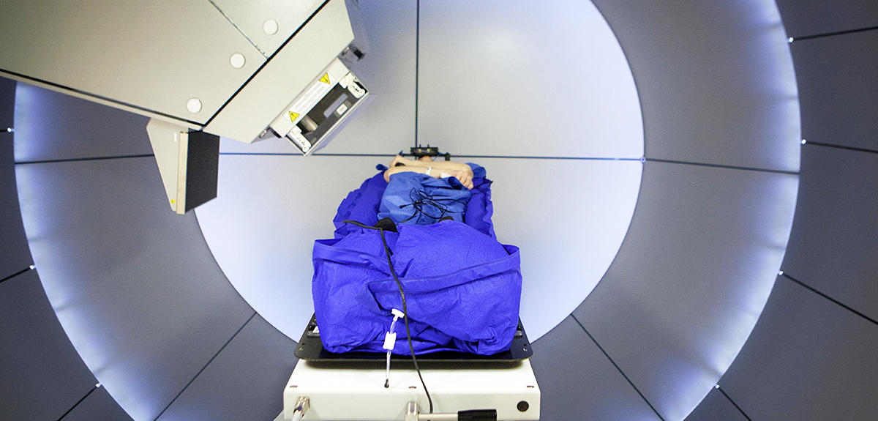
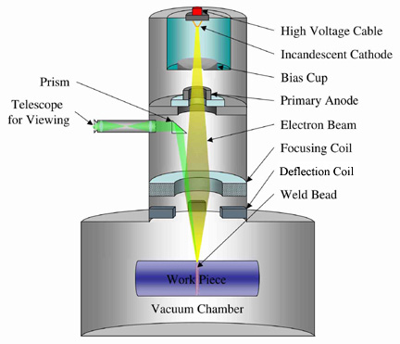
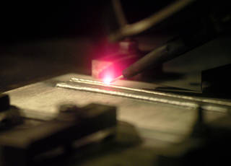
Accelerators in Society
Accelerators can be used to make powerful light sources
High energy X-rays, very powerful microscope for proteins/materials research, etc.
Medical therapy for cancers and imaging
Tons of industrial applications
Clean welding, cutting, 3D printing
Material hardening and processing
Treatment of wastes/sterilization
http://www.accelerators-for-society.org/

Slide 13
Accelerators at Fermilab

Slide 14
Building a Particle Accelerator

Slide 15
Fundamental Parts of a Particle Accelerator
Source of particles
Right type, large enough number, organized in a way we can use
Way to confine and manipulate
Get them going in the same direction, keep them contained, focus them where we want them to go, make sure they aren’t wasted
Get them all this energy we want them to have
Generally, they don’t ‘start’ with a lot of energy, and we need to give them a controllable amount of energy
A detector/camera designed to get the data we need
What kind of energy/wave/precision do we need?

Slide 16
Important Parts that don’t get much love
Particles don’t like air! Everywhere they go must be very good vacuum
An accelerator is 10,000’s of parts, they all need to be controlled, integrated, monitored, recorded
All the main components need to be powered, usually with lots of energy (high current, high power microwaves, etc.)
Timing and stability is critical! Everything is going very fast and must be synchronized
Error tolerance is low, everything must be very carefully positioned and aligned
Particles are weird! Measuring them is also hard, but critical
Everything must be SAFE, people getting hurt or major damage to the machine are intolerable
You need people that know all these things, can design them, maintain them, and operate them on a daily basis, which is a ton of people and specialties!

Slide 17
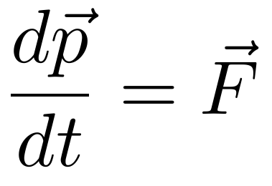
Take a step back: What force to use?
Strong
Weak
Electromagnetic
Gravity
Radioactive decay
Limited Natural Sources (some artificial sources, not much better)
Limited Intensity
Very specific energies
Limited set of available beams
Extremely weak
Using the Sun’s gravity well, you could get a proton up to ~22 MeV (about the same as Rutherford used, ~5.5 MeV)
No comments on the practicality
Electric Fields!
Strong
Easy(ish) to control and modify
Only limitation is that particles must be charged… sort of

Slide 18
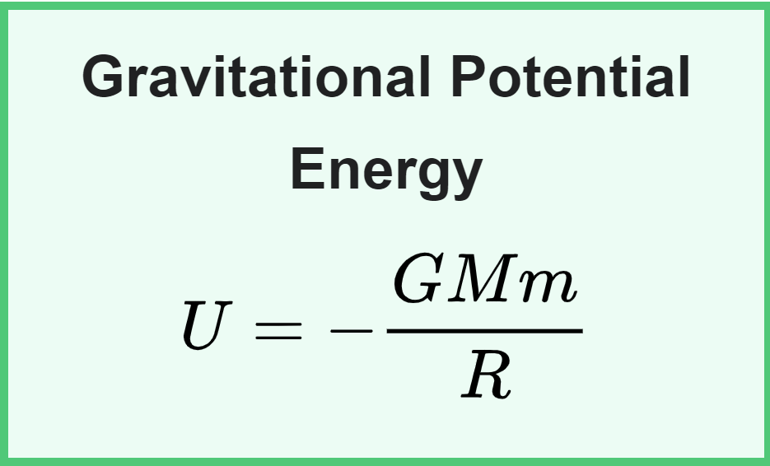
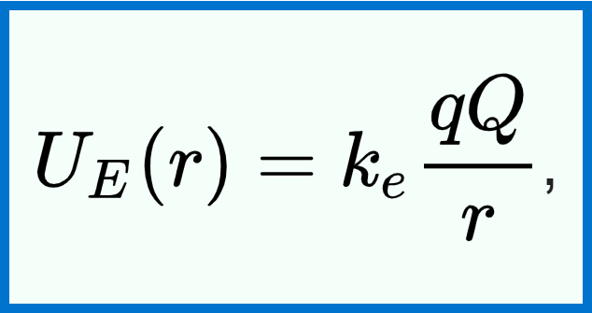
Let’s dig a little more into Gravity vs E&M
Very similar in form (for pretty deep reasons, actually)
Let’s compare the relative stored energy in gravity and charge between two protons at 1 cm:
$\frac{U_{e}}{U_{G}}=\frac{k_{e}q^{2}}{Gm_{e}^{2}}≈{\frac{9×{10}^{9}∗{\left(1.6×{10}^{−19}\right)}^{2}}{6.6×{10}^{−11}∗{\left(1.6×{10}^{−27}\right)}^{2}}}^{}≈ {10}^{36}$ (!!!!!!!!)

Slide 19
What you NEED to know about Electromagnetism
Two charges (positive and negative)
Opposites attract, like charges repel
Charges flow easily on/in metals, but not ceramics/insulators
Electric fields are created by all charges, from positive to negative charges, more charge, stronger fields
Same for magnetic fields, except only MOVING charges create magnetic fields, move charge, moving faster, more magnetic fields
Charged particles in EM fields feel force, gaining energy from electric fields and being deflected by magnetic fields
Magnetic fields can’t do work (dig deeper on the next slide)

Slide 20
Little Deeper Dig into EM fields and charged particles
${\vec{F}}_{E}=q⋅\vec{E}$ for electric fields
Particle with charge $q$ feels a force proportional to the electric field strength, in the same direction of the field
Can be effective at very low energy, but not much at high energy
${\vec{F}}_{B}=q\left(\vec{v}×\vec{B}\right)$ for magnetic fields
Particle with charge $q$ feels forces proportional to the magnetic field strength and the particle’s velocity, but always at right angles to the particle’s velocity
It all comes down to work (change in energy):
$ΔE=F⋅Δx=\left(q\vec{v}×\vec{B}\right)⋅\vec{v}Δt=0$ (magnetic fields defect, but don’t change energy)

Slide 21
1) Particle Sources
Some particles are easy!
Electrons just pop off metals with some encouragement, either get it hot, or hit it with a laser of sufficiently high frequency
Work function (energy needed to liberate electrons) is ~ few eV for most metals $\frac{1.24 eVμm}{4 eV}≈300 nm$, so a standard UV laser will do it!
Protons are slightly harder, but all you have to do is strip an electron from a hydrogen atom (13.6 eV), and hydrogen gas is cheap
Some particles are harder…
Heavy ions need lots of electrons stripped, harder to vaporize
Radioactive particles need radioactive sources
Exotic particles (muons, neutrons, etc.) need lots of energy, and the source just becomes another particle accelerator

Slide 22
Most Simple Accelerator
We don’t need Magnetic Fields, just a particle source and some electric fields
Take two plates, one with lots of positive charge, the other with lots of negative charge, lots of E-field
We only get static electric fields, no moving charges
We shape the plates to tune the electric fields, strong in the desired direction and focusing
Fire a laser at one wall to make electrons that are accelerated by the fields
-
+
-
-
+
-
-
-
+
+
+
+
+
+
+
-
-
+
-
-
-
-
+
+
Annotate particles

Slide 23
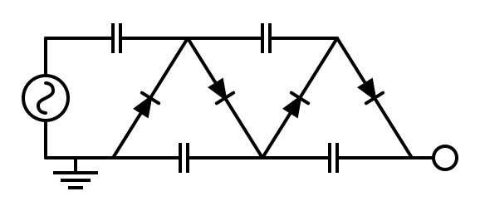
Actual Particle Sources
Electrostatic Accelerators
Limited energy gain (60 MeV/q)
Can accelerate DC beams (used often for particle sources)
Tandem Accelerators
By changing the particle charge from negative to positive, twice the energy can be achieved (limited current)

Slide 24
2) Confining and Manipulating
There are two major goals here:
Bend particles: change their average direction, bend in a circle, point them at things
Gather particles: like particles repel, and no particle stream starts all pointing in the exact same direction, so as they drift apart, they must be herded back together

Slide 25
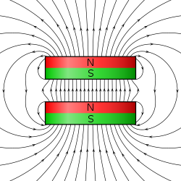
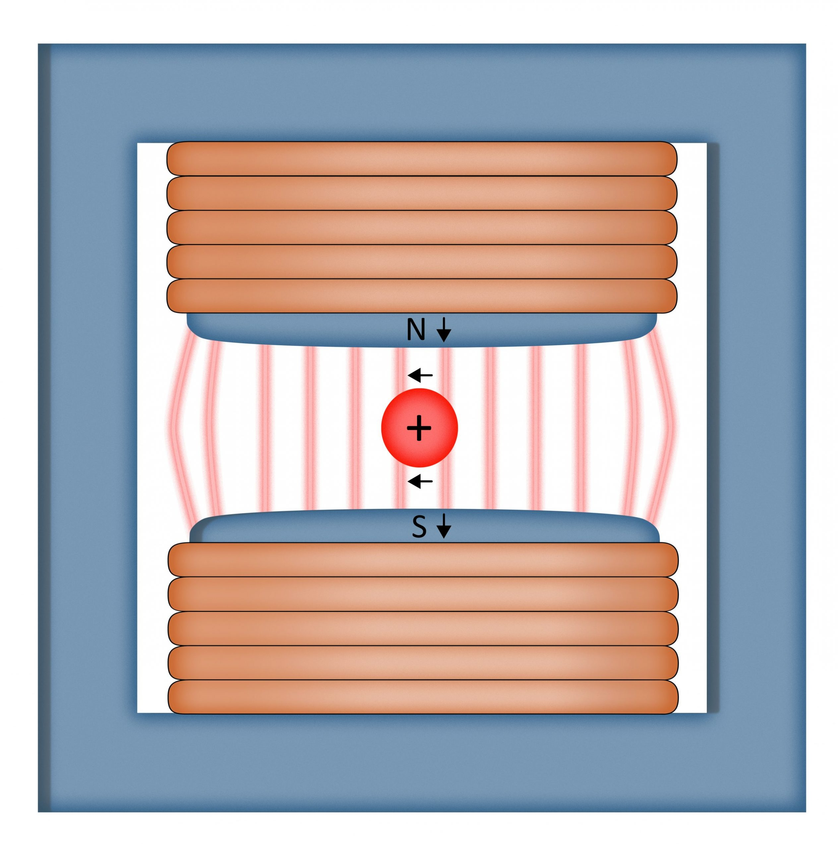
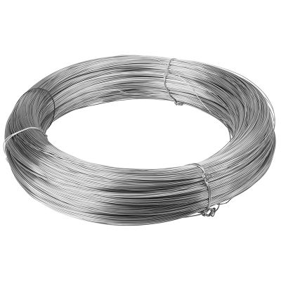
Magnets that Bend/Deflect
You want all particles deflected the same amount:
Strong fields, uniform distribution: “Dipole Magnet”
Magnetic materials are sometimes used, but that’s not very strong
Current in wire makes magnetic fields, so if we carefully shape the wires and guide the fields, we can make great dipoles
Wikipedia

Slide 26
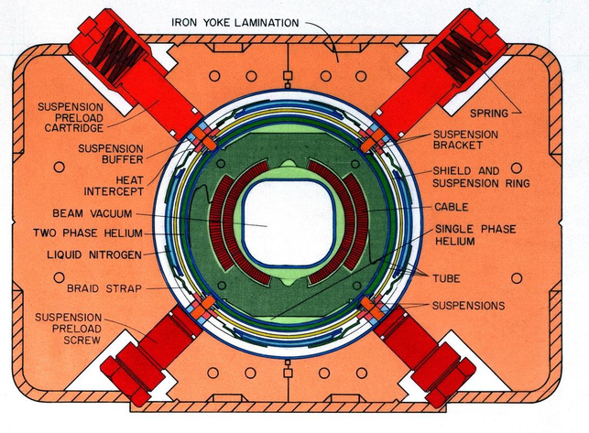
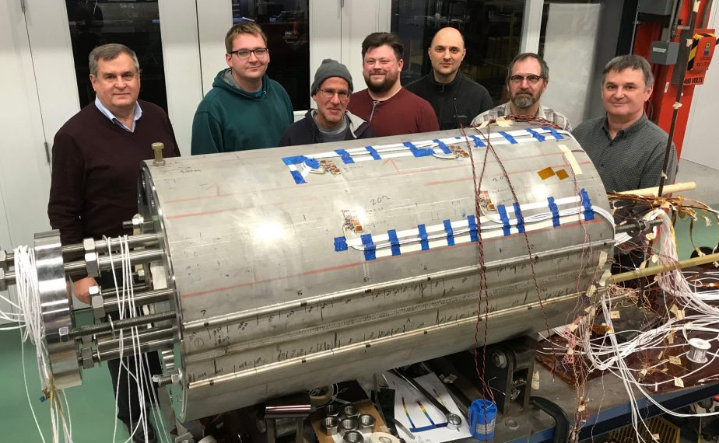
Really Strong Dipoles for High Energy Particles
$$F_{c}=\frac{mv^{2}}{ρ}=F_{B}=qvB$$
$$Bρ=\frac{p}{q}$$
This is true at relativistic speed ($p=γm_{0}βc$)
Fridge magnet ~10 mT
Next generation accelerator dipoles ~15 T
Field needs to be stable, ‘clean’, repeatable
Very high current power supplies, also not easy!
https://news.fnal.gov/2019/09/fermilab-achieves-world-record-field-strength-for-accelerator-magnet/

Slide 27
What about focusing?
Now that we can manipulate the average, bend it around, etc., what about focusing the particles back towards the ideal particle?
Needs a strong enough magnetic field to bend errant particles back on track
Stronger as it goes away from the center, but zero in the center
Change sign going from one side to the other
Some sort of magnetic device

Slide 28
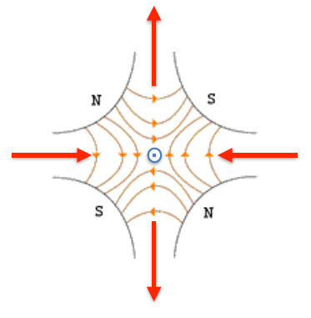
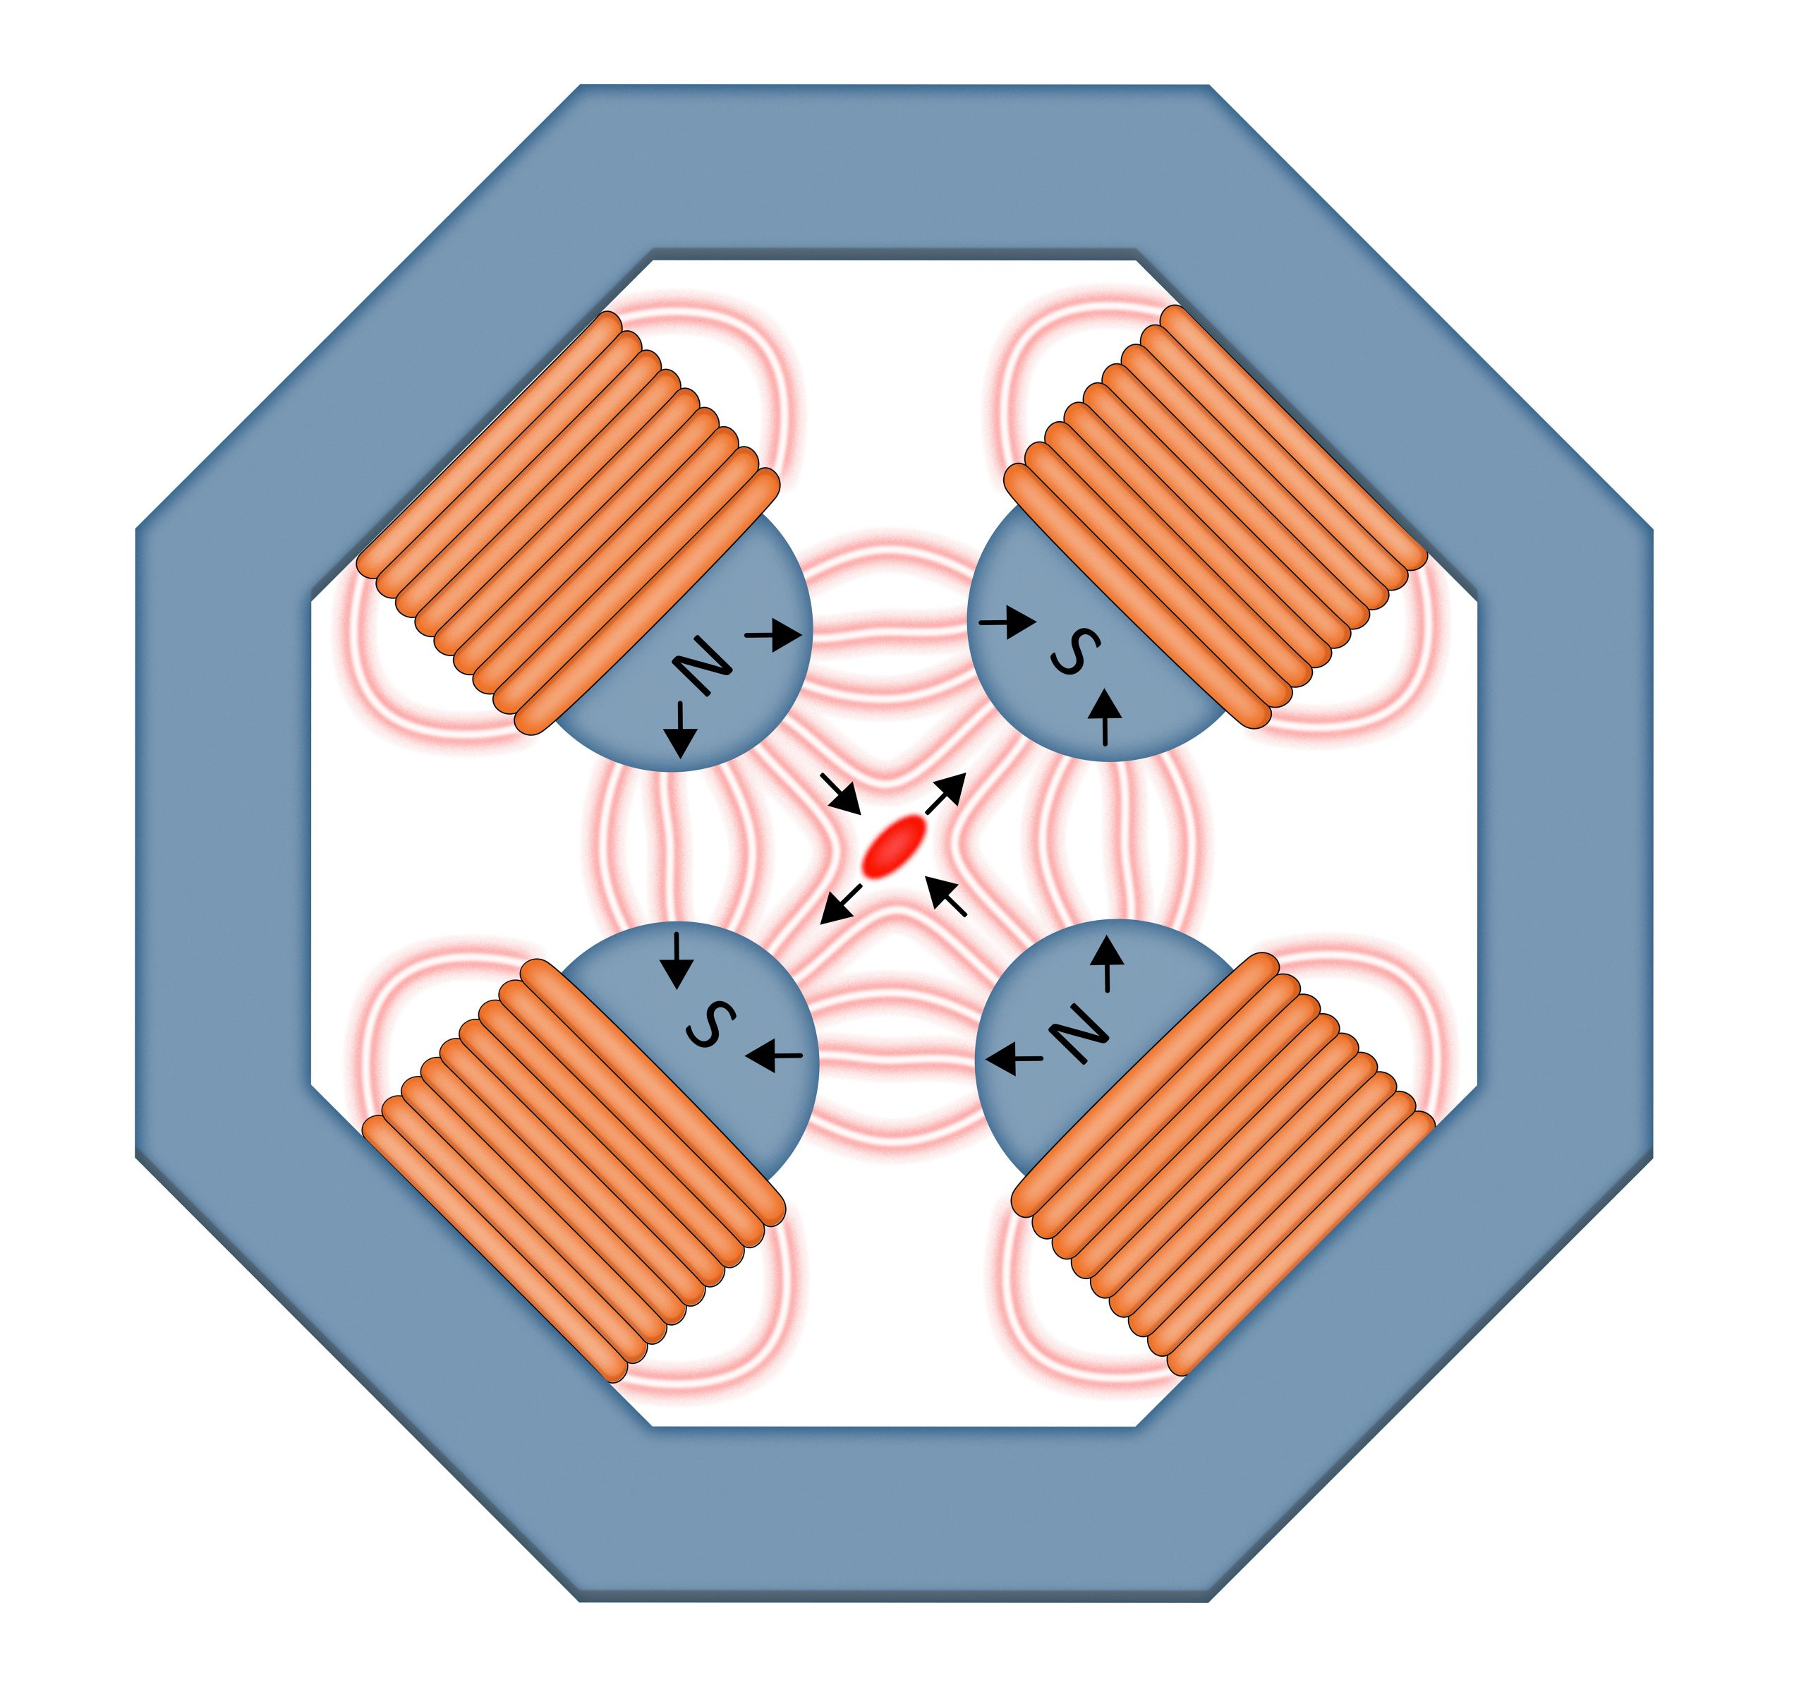
(Not quite) Ideal Focusing Element
Unfortunately, we must obey Maxwell’s Equations, and the best we can do it make N-pole magnets (dipole = 2 pole, one N, one S)
Next option is Quadrupole magnets (4 pole)
Gives us what we want… in one plane
Focusing in one plane, defocusing in the other
Fortunately, we can alternate them, and get a stable solution
https://news.fnal.gov/2020/03/the-power-of-attraction-the-use-of-magnets-in-particle-accelerators/
http://nicadd.niu.edu/~syphers/uspas/2018w

Slide 29
Little bit deeper dive into focusing magnets
If we assume the quads aren’t very long, and they don’t bend the particles too much, we can treat them like thin optical lenses
$B^{′}≡\frac{∂B}{∂x};\frac{B^{′}L}{Bρ}=\frac{1}{F} for F≫L$
We can relatively simply build a model of a full machine, treating each magnet as a thin lens, using linear algebra to solve for all the parameters
CAVEAT: Errors, end effects, and higher-order effects are a huge deal. Ideal magnets don’t exist.

Slide 30
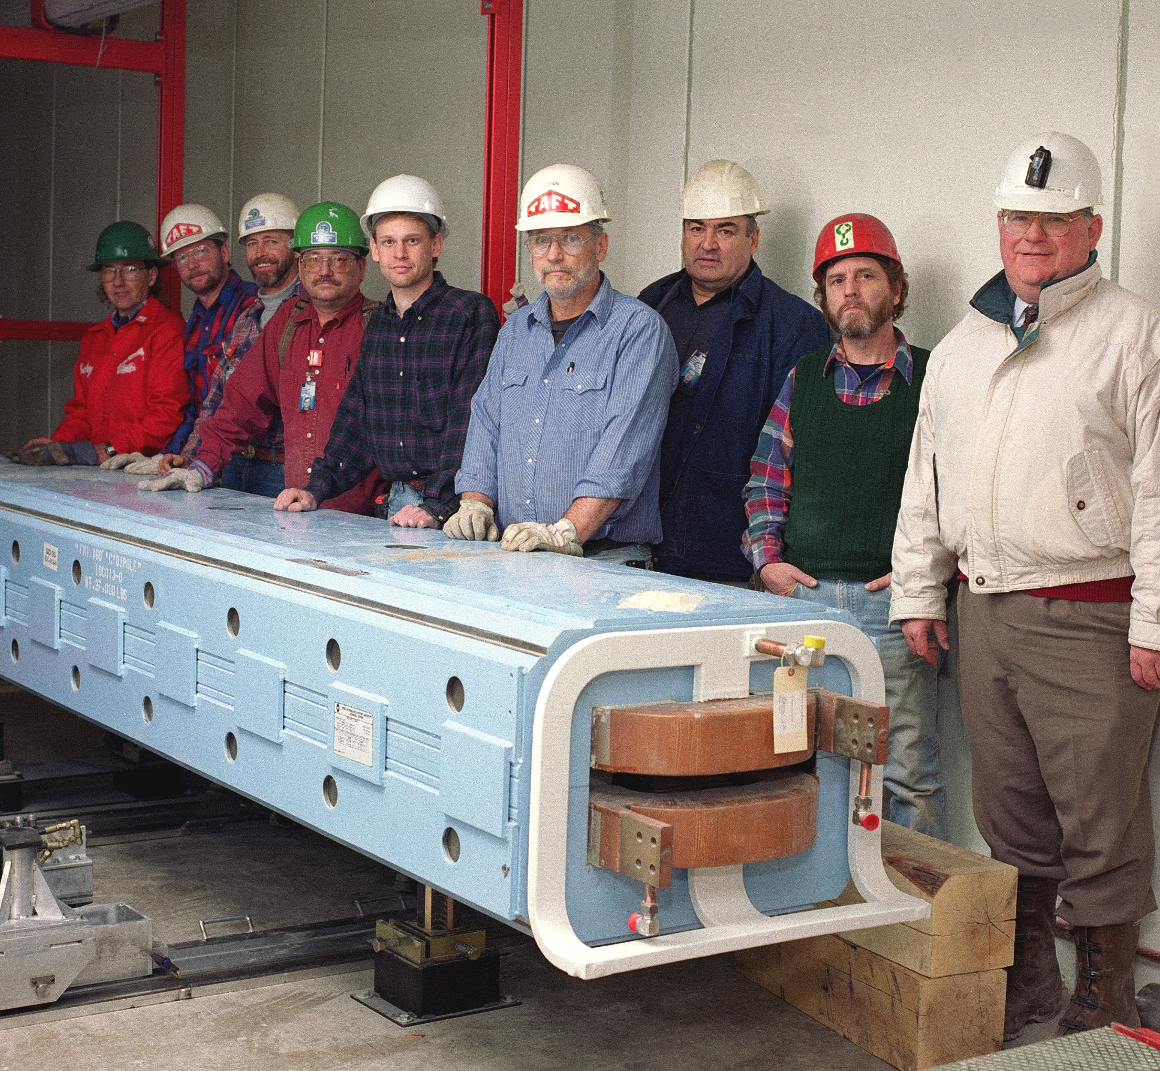
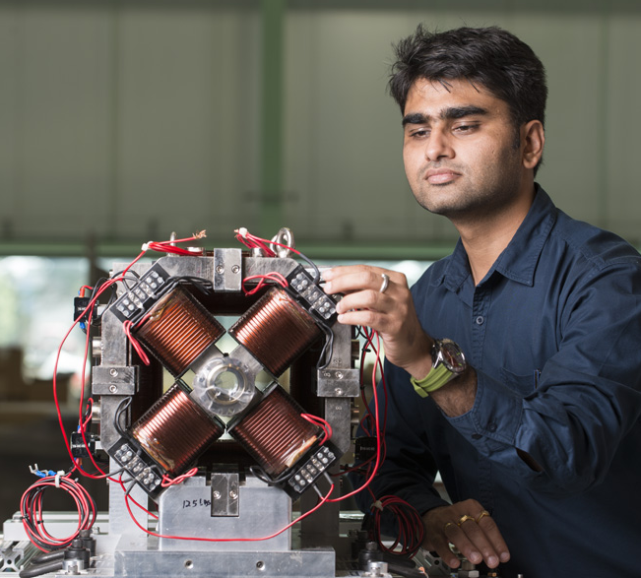
Fermilab Magnet Examples, big and small
https://news.fnal.gov/2020/03/fermilab-presents-march-magnets/

Slide 31
One more thing…
When the energy isn’t uniform (i.e. all the time), you need a sextupole magnet to correct it, for instance.
Here, red is too low energy, purple is too high (green is ideal)
The sextupole field distribution corrects the focusing error due to off energy particles
https://news.fnal.gov/2020/03/the-power-of-attraction-the-use-of-magnets-in-particle-accelerators/

Slide 32
3) Always More Energy!
Electrostatic is limited, like trying to just use a big hill to speed up, the hill can only get so tall (and you can only use it once!)
If we use waves (time varying forces) we can ride the wave as long as we want, limited by other practical concerns

Slide 33
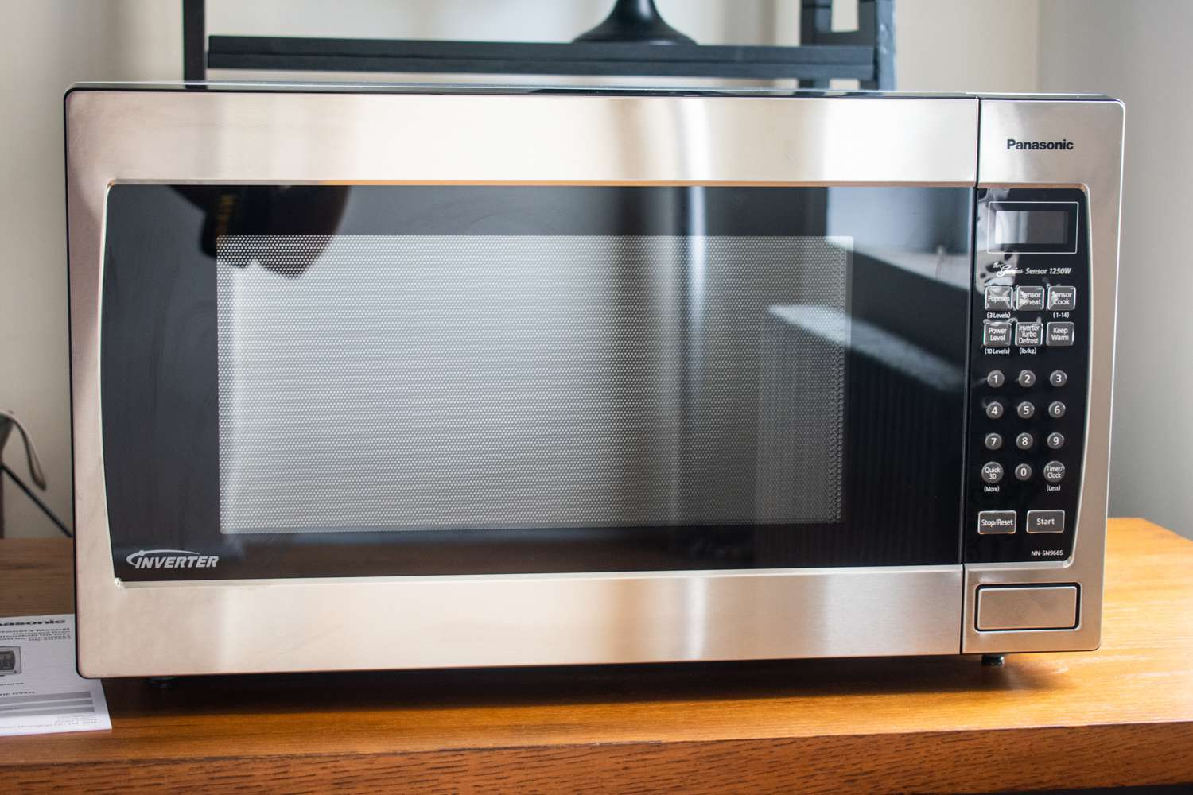
We need fancy microwaves!
Takes power from the wall, makes high energy waves (microwaves, RF)
Directs that power to the ‘box’ of the microwave
Accelerates (heats) up the particles in the food
Control system, timer, power setting, interlocks, etc.
Only problem: Food isn’t moving, our particles are flying by at a giant speed, so we must synchronize with them

Slide 34
The Benefits of Radio Frequency Fields

Slide 35
Wideroe Drift Tube Linac
First RF accelerator conceived and demonstrated by Wideroe in 1927 in Aachen, Germany
RF voltage of 25 kV from 1 MHz oscillator was applied to single electrode between two ground planes
Accelerated potassium ions to 50 keV, two gaps for twice the voltage
Sloan and Lawrence built one of these style linacs with 30 electrodes, applying 42 kV to get mercury ions up to 1.36 MeV
Wideroe’s Device (from his thesis)

Slide 36
A Digression – Radio Frequency Resonators
Useful to remember:
$\vec{F}=q\vec{E}+q\vec{v}×\vec{B}$
Magnetic Fields do no work
Opposites Attract
Diagram courtesy of LEPP

Slide 37
RF Cavity Resonance – Test Charges
-
+
-
+
-
+
-
+
-
+
-
+
Equivalent to Compressing/Stretching Spring

Slide 38
Resulting Electric Fields
Excellent! We have the fields we want.
Note: No currents means no magnetic fields
What happens when we stop holding the charges in place?

Slide 39
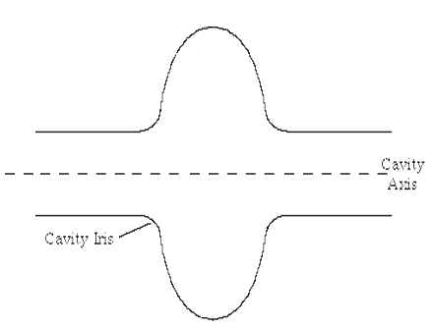
Releasing the Spring
Important Assumption:
-Material charges move through is a perfect conductor.
This means no energy is lost.
Time = 0
Time = ?
Let’s call it τ/2
-
+
-
+
-
+
-
+
-
+
-
+
Equivalent of a spring moving from compression to tension

Slide 40
Resonant Behavior
In τ/2 time, the electric fields reversed themselves
Symmetry says that in another τ/2, the fields will return to their original position
Do the Math:
$\vec{E}\left(\vec{r},t\right)=\vec{E}(\vec{r},0)\cos\left(ωt\right)$
Where $ω=\frac{2π}{τ}$
Monopole Mode:
One strong electric field region centered on the beam axis
Electric field in the direction the beam is traveling

Slide 41
Magnetic Fields
At t = τ/4, all electric fields are gone, replaced by magnetic fields
The moving charges act as currents, creating the magnetic fields around the cavity equator
Remember Maxwell:
$∇×\vec{B}=\frac{1}{c^{2}}\frac{∂\vec{E}}{∂t}$ (in vacuum)
Flowing Charge = Currents

Slide 42
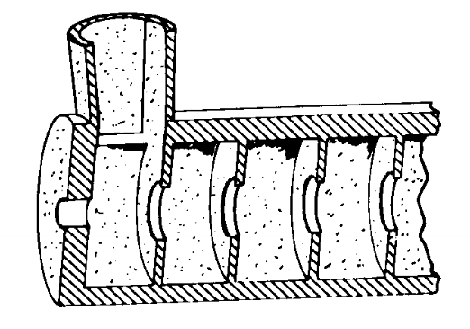
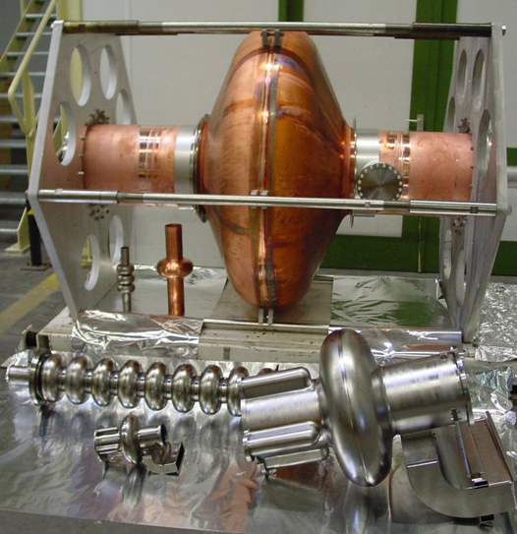
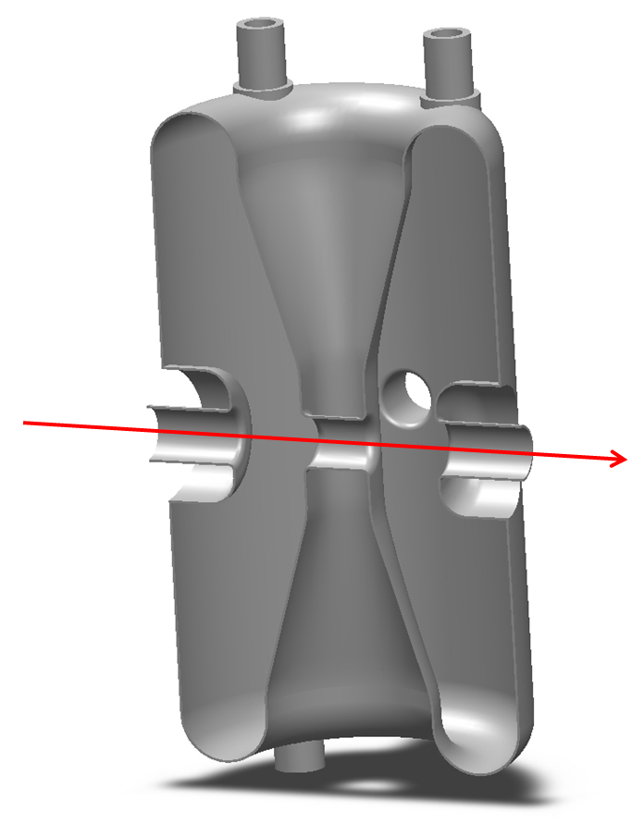
How do we create V(t)?
What do we need?
Correct Frequency
Accelerating fields that are easy to access
“Clean” accelerating field distribution
Reasonable mechanical properties
Efficiency energy storage

Slide 43
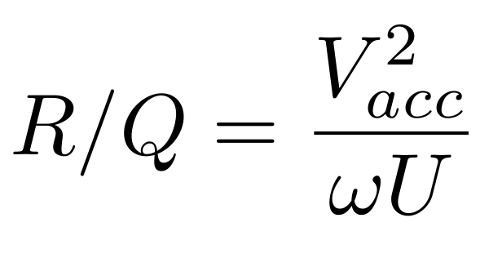
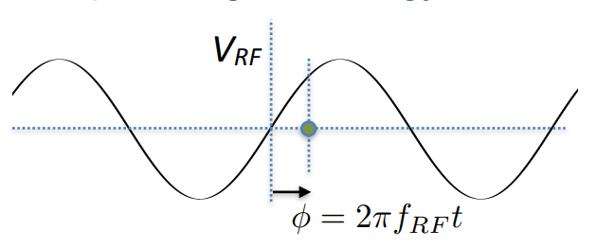
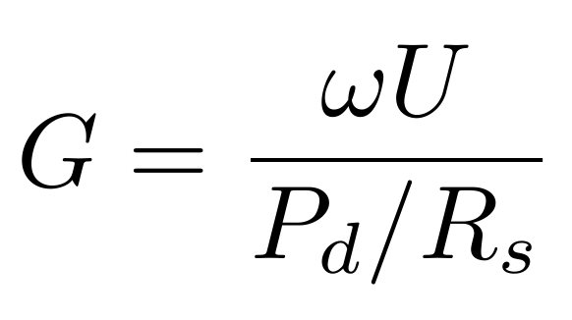
How are these cavities judged?
Maximum Accelerating Voltage
Transit Time Factor
Longitudinal Focusing Term
Charge
R/Q
Measure efficiency of transferring energy to the beam
Geometry Factor
Measure of efficiency of energy storage in the cavity

Slide 44
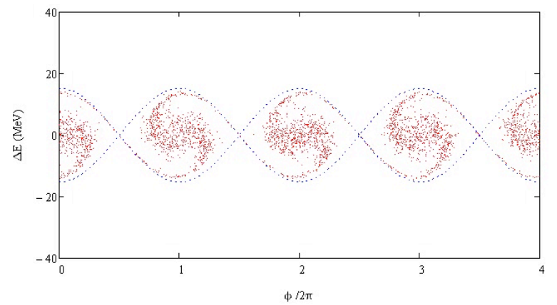
One last piece… longitudinal focusing
Quads etc. focus the transverse directions, but what about the direction of travel? Any energy spread means that particles will drift apart from each other.
Sort of glossed over it, but if you use RF, you can’t have a continuous beam of particles, you have to bunch them into packets
Faster particles get less energy, slower ones get more

Slide 46
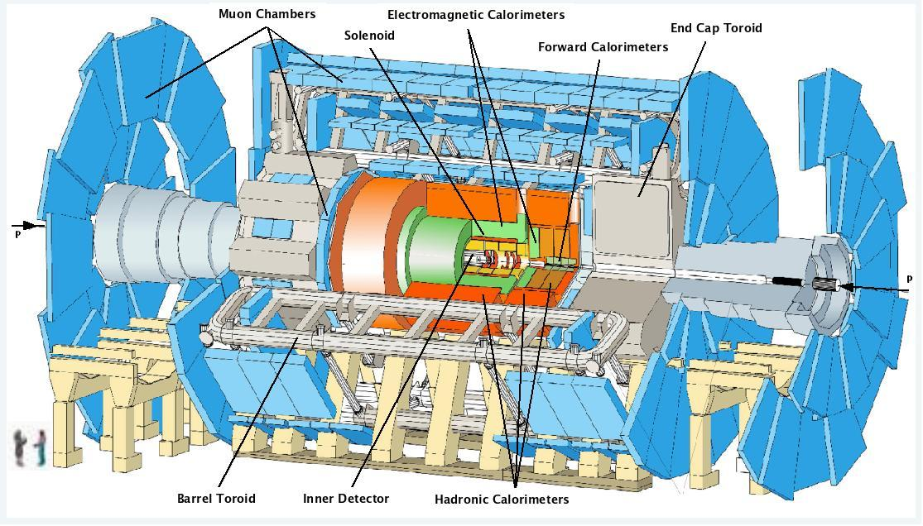
4) Detectors and Cameras
GIGANTIC topic I can’t do justice to (next week’s topic)
The highest energy targets need massive detectors
Particles collide in the middle, generating lots of things the detector records

Slide 47
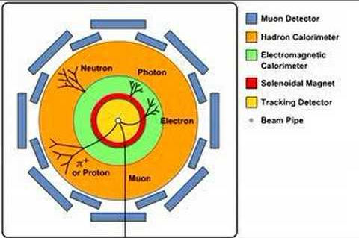
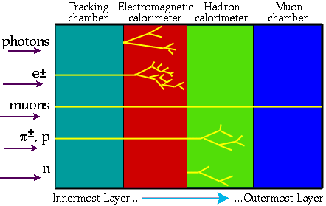
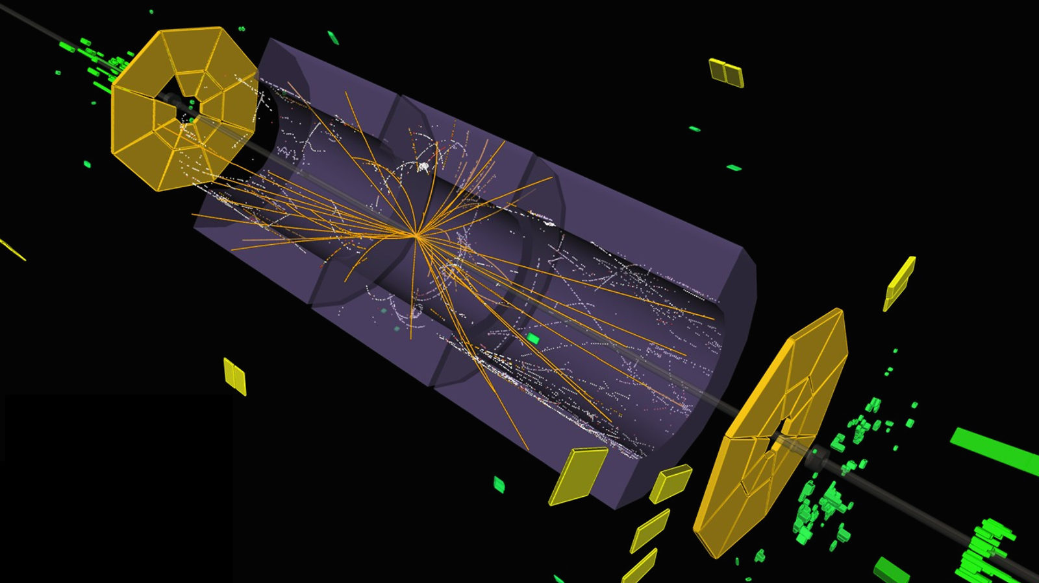
HEP Detector Analysis is a HUGE deal

Slide 48
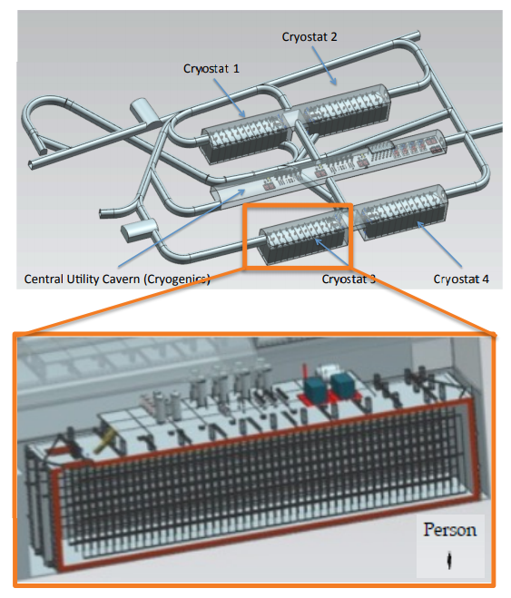
Precision Physics Detectors
Sometimes you just need LOTS of data, which means huge detectors
LBNF is a big expansion to the FNAL complex to generate massive number of neutrinos
DUNE is a detector complex in South Dakota to see them

Slide 49
Long story short
All topics covered today are things you could spend your whole career on
Engineering of all kinds
Scientists of most kinds (Physics, materials, etc.)
Technical specialists
Drafters, machinists, etc.
Operations experts
Lots of variety in education level, experience, and interests
uspas.fnal.gov <- US Particle Accelerator School
Generate, confine, direct, and accelerate particles, delivering them to the experiment as needed
Always need of new particle beams

Slide 50
Thanks! Questions?

Slide 51
Backup Slides

Slide 52
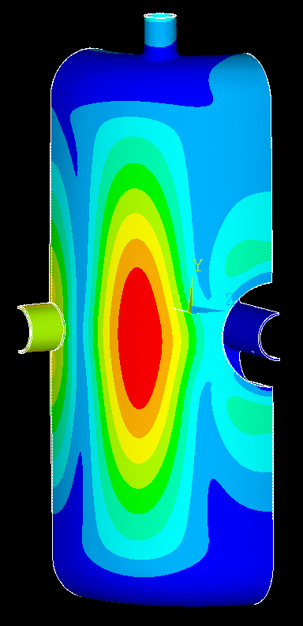
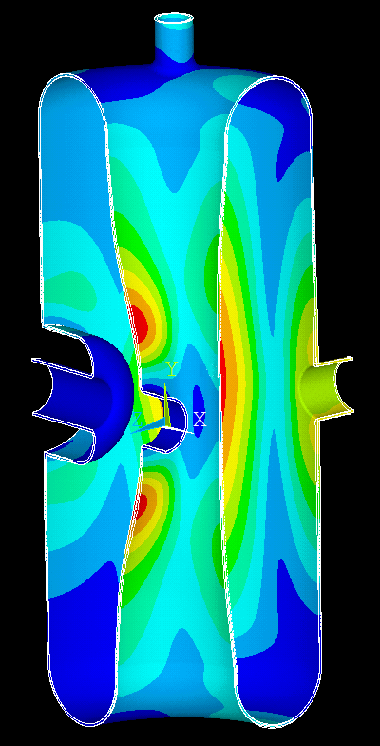
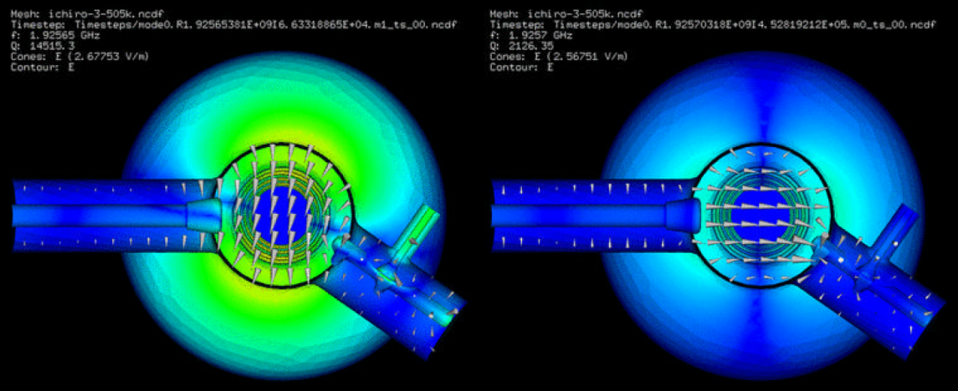
Other Design Considerations
Mechanical Issues
In operation, a cavity is exposed to many different pressures that deform their shape
How this deformation changes the cavity frequency and performance must be well understood
Higher Order Modes
As the beam passes through the cavity, it can excite ALL cavity modes
Strong beam asymmetry or offset increases the strength of this coupling
These modes must be strongly damped or they can cause emittance growth or beam breakup… in some cases

Slide 53
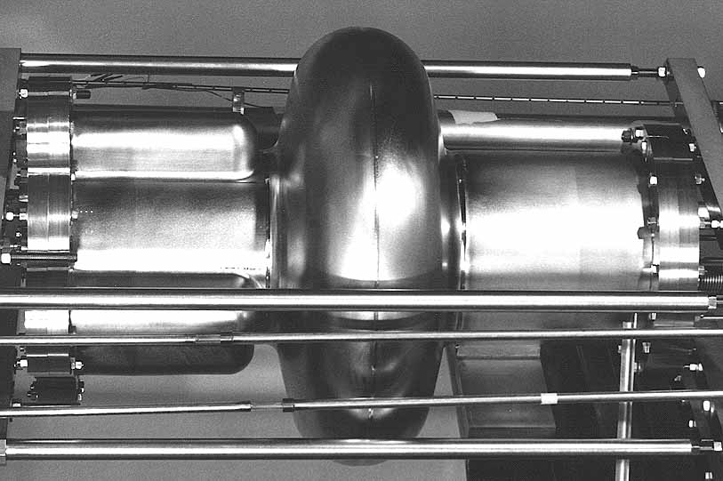
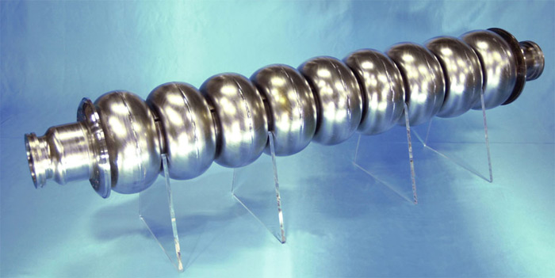
Cavity Design for Different Accelerators
Synchrotrons (Ring Machines)
The beam sees the cavity MANY times, low gradient is typical
Field must be very clean and stable
Very heavy higher order mode damping
Very large aperture
Acceleration and bunching
Linacs (Linear Accelerators)
Single (or low #) pass machine
High Gradient is KEY (reduces # of cavities needed, therefore $$$)
Reliability and ease of fabrication is very important (many cavities)
Efficiency of operation also important

Slide 54
Basic Equations
Maxwell’s Equations are very general, govern all classical electromagnetic interactions
Lorentz Force
Stored Energy density in EM fields
Poynting Vector is useful conceptual tool (direction of energy flow in EM fields)
$\vec{∇}⋅\vec{D}=ρ$
$\vec{∇}×\vec{E}=−\frac{∂\vec{B}}{∂t}$
$\vec{∇}⋅\vec{B}=0$
$\vec{∇}×\vec{H}=\vec{J}+\frac{∂\vec{D}}{∂t}$
Where $\vec{D}=ε_{0}\vec{E}$ and $\vec{B}=μ_{0}\vec{H}$
$\vec{F}=q\left(\vec{E}+\vec{v}×\vec{B}\right)$
$u= \frac{1}{2}\left({ε_{0}\vec{E}}^{2}+{\frac{1}{μ_{0}}\vec{B}}^{2}\right)$ in vacuum
$\vec{S}= \frac{1}{μ_{0}}\vec{E}×\vec{B}$ in vacuum

