Slide 1
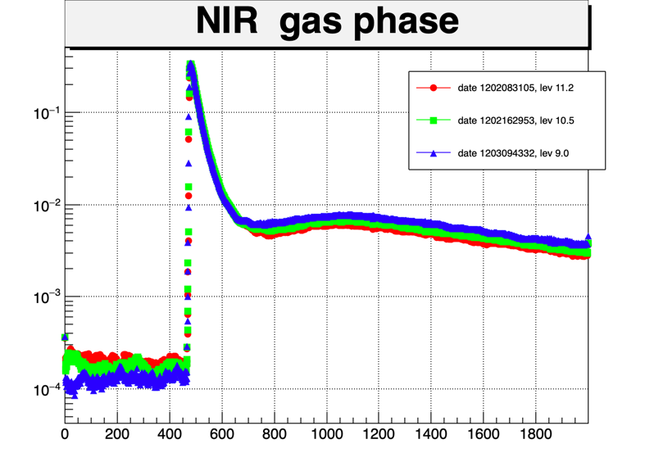
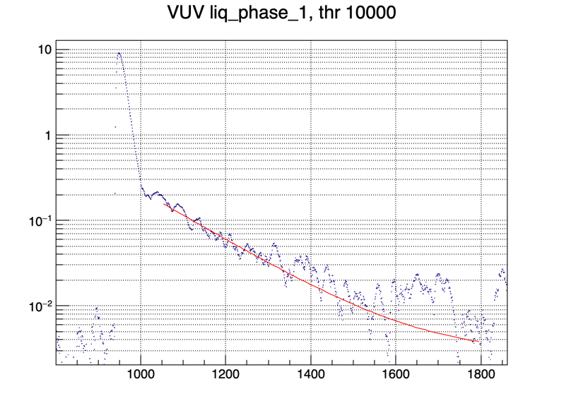
NIR in LAR
Carlos O. Escobar Adam Para and Paul Rubinov
Support needed for a NIR detector that could reach beyond 900 nm
There are candidate detectors:
InGaAs SPADs from Princeton Light Waves in the US and MPD in Italy
Ran a preliminary experiment in the cryostat named TallBo at the Proton Assembly Building (PAB) at Fermilab.
Simple setup: One NIR and one VUV SiPM “looking” into an Am241 source.
Took data in both LAr and
GAr with different contents of N2 contamination
Puzzling slow component in the gas phase seen by the NIR SiPM at 3 μs
(horizontal axis: 1 SSP tick is 6.7 ns)
Also for the VUV we find a puzzling two slow components at τ ~ 300 ns and τ ~ 1170 ns. NB: we do not use WLS.
FERMILAB SAC strategic planning working group: Detectors 6/2021

Slide 2
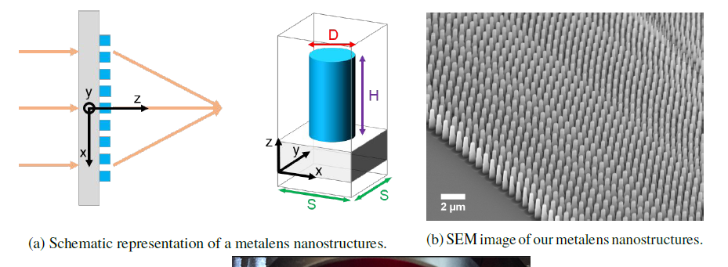
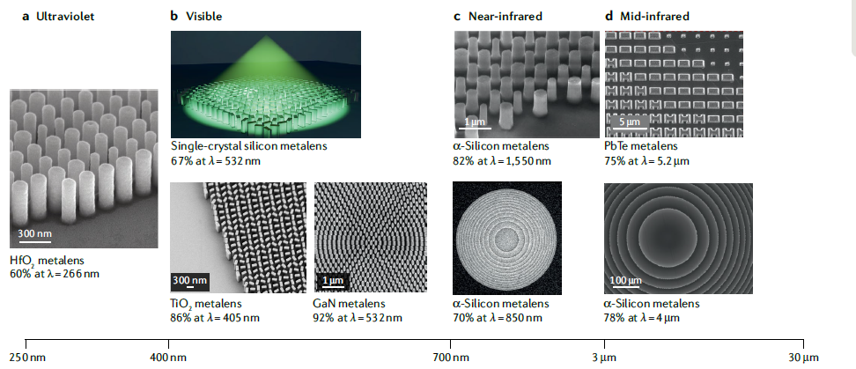
Metalenses as light concentrators in noble element detectors
Carlos O. Escobar, Adam Para, Michelle Stancari with the Harvard groups of Roxanne Guenette and Federico Capasso
Supported by LDRD
Support beyond LDRD is needed for accessing EUV litography (SUNY-Albany/IBM)
Develop metalenses, flat optical elements fabricated with nanotechnology, suitable for use as light concentrators in noble element detectors, gaseous or liquid.
Concentrate scintillation light into SiPMs.
Many challenges: index of refraction mismatch between detector media and substrates; sub-wavelength fabrication scale < (λ/2NA) NA… numerical aperture (needs to go below 100 nm); wide range of angles of incidence: defeating the etendue limit!
Currently characterizing existing metalenses optimized for visible wavelengths and designing metalenses for shorter wavelengths nearing the UV.
From: Chen, Zhu and Capasso:Nature Reviews Materials volume 5, pages 604–620(2020)
FERMILAB SAC strategic planning working group: Detectors 6/2021

