Slide 1
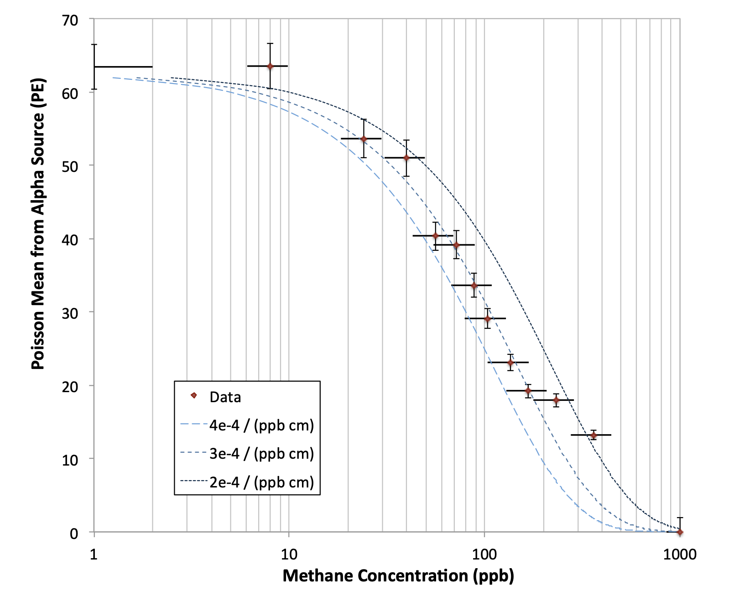
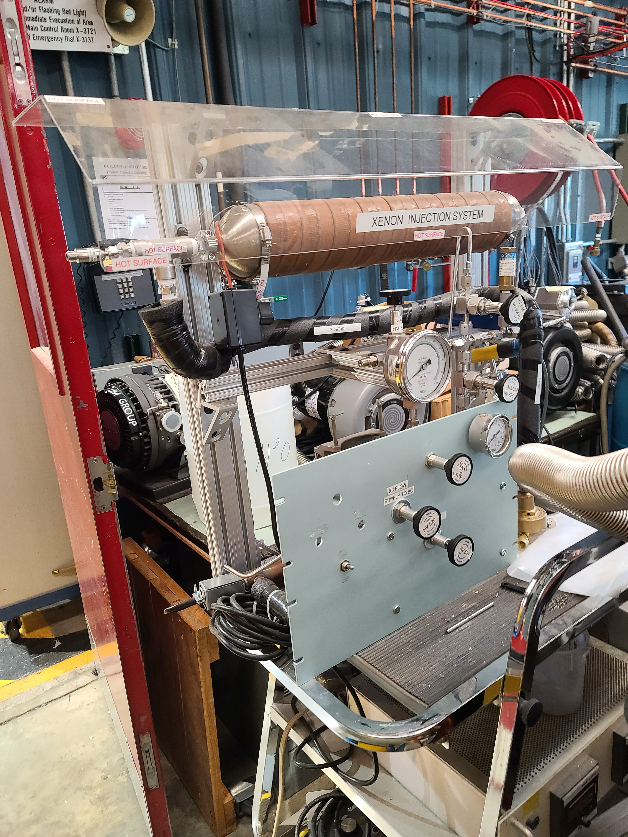
Introduction of Free Protons into LAr Detectors via Xe+CH4 Doping
Two main physics motivations
Sensitivity to low-energy anti-electron neutrinos via inverse beta-decay
Additional channel to detect supernova burst neutrinos and diffuse supernova neutrino background (DSNB)
Anti-electron neutrino appearance at pion decay-at-rest neutrino sources
Neutron tagging via neutron capture on Hydrogen
Improved modeling and reconstruction of high-energy neutrino-Ar interactions
Background rejection in rare searches, e.g. proton decay, coherent-elastic v-nucleus scattering (CEvNS), DSNB
LAr doped with high concentrations of Methane (CH4) works well as a TPC [1], although the LAr scintillation light was shown to be strongly absorbed [2]
LAr doped with Xe shifts scintillation wavelength away from strong CH4 absorption region
Project goal is an unambiguous demonstration of the ability to detect scintillation light after Xe+CH4 doping
Effort largely uses readily available equipment at PAB through Neutrino Division
Engineering/technical support provided from Neutrino Division
TallBo LAr cryostat
[2] B.J.P. Jones et al. 2013 JINST 8 P12015
[1] E. Aprile et al. NIM A253 (1987) 273-277
Gas injection system at PAB

