Slide 1
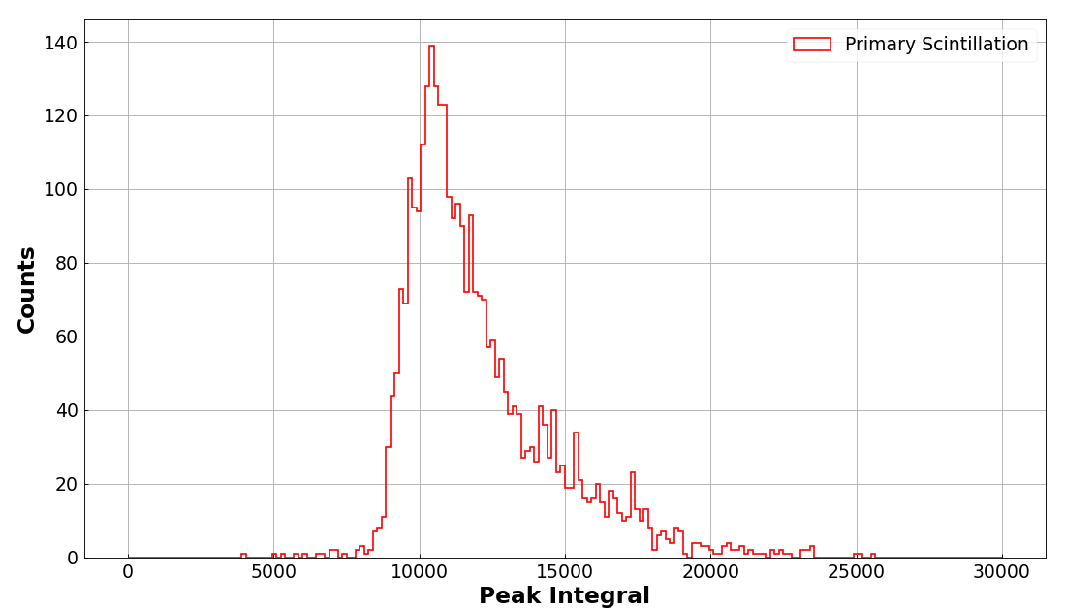
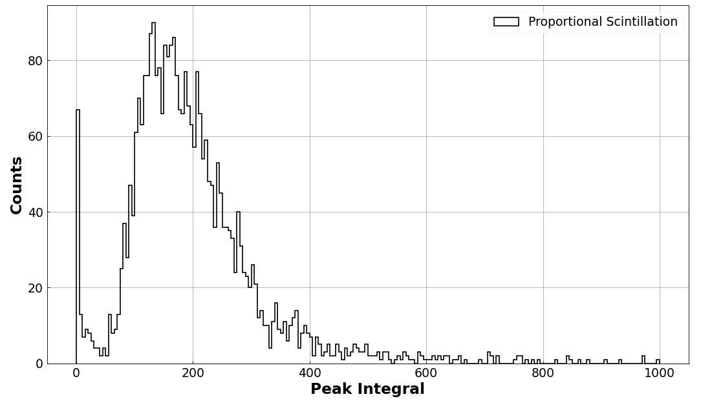
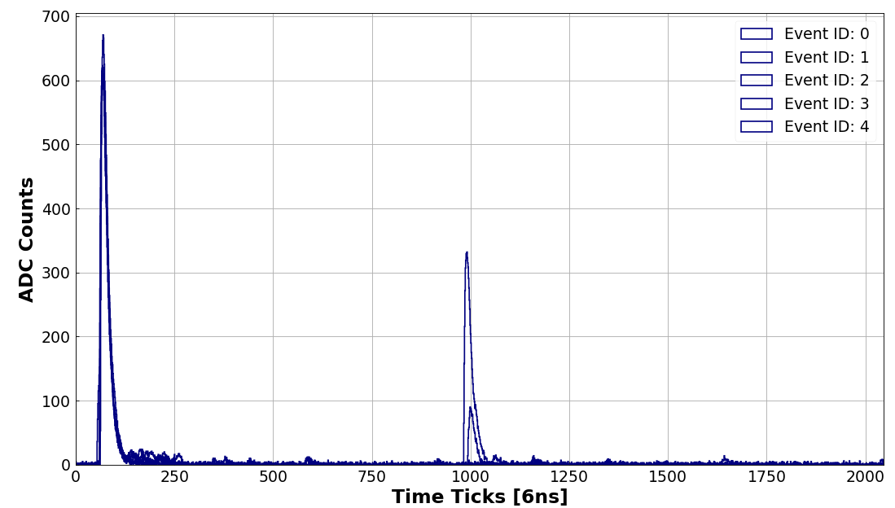
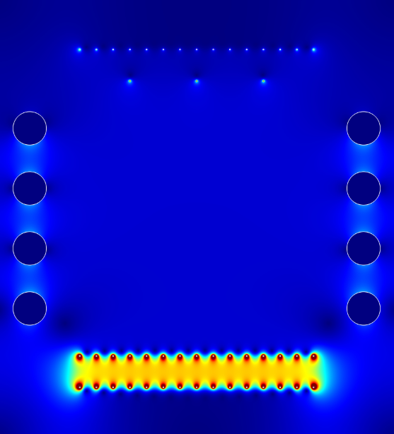
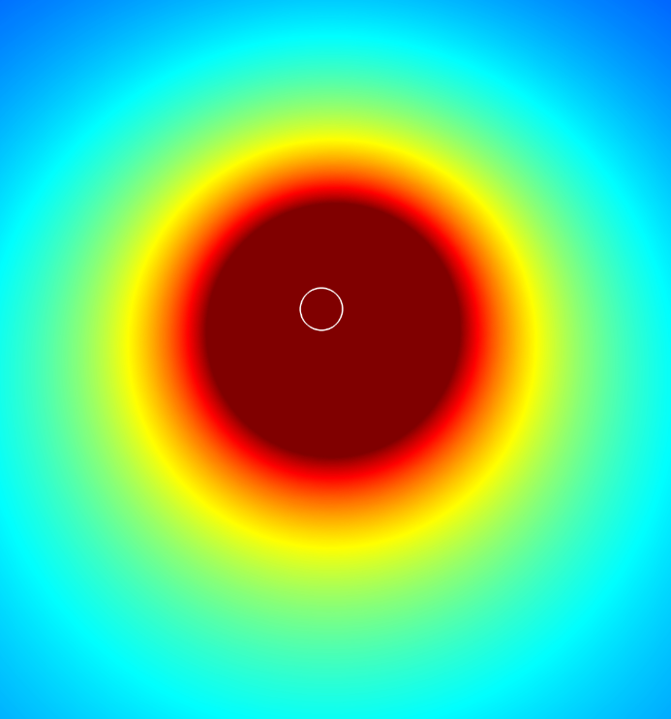
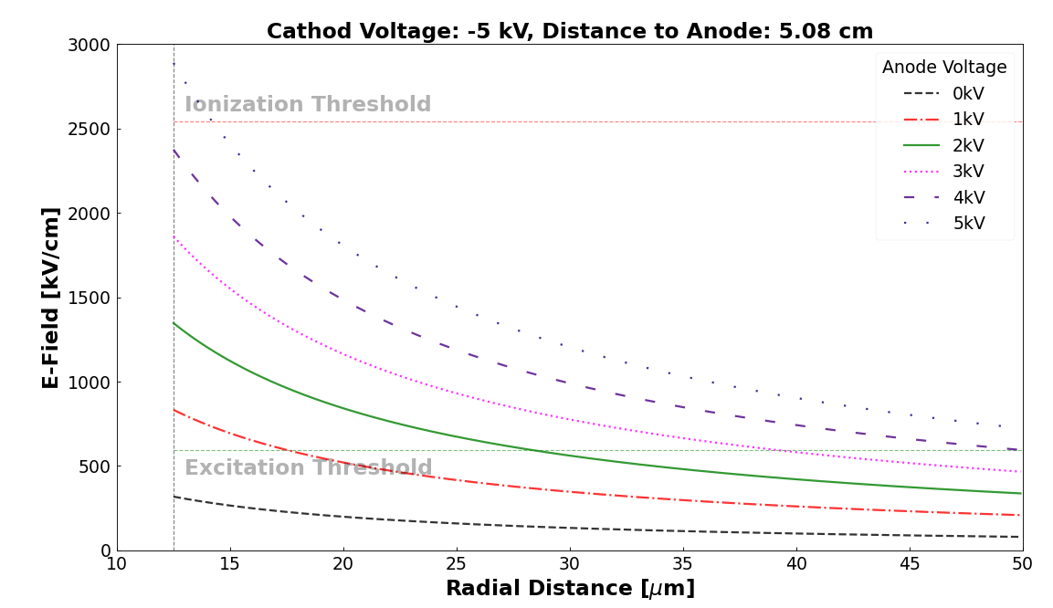
Proportional Light in Liquid Argon
S1
S2
Goal
Measure the proportional light in Liquid argon
Challenge
Create high field above the threshold for the proportional light
Method
Use the strong field (~MV/cm) around the thin wire (12.5um) to produce the proportional light
Status
First cryogenic run shows very promising
Plan
Scan anode voltages from 0 to 5kV
Understand the threshold and gain for the proportional light
S1
S2
t_{d}
Sample Signals
in Liquid Argon
GND
0 - +5kV
-
-
-
-
-
-
-
-
-
Proportional light
S2 ($t_{d}$)
-
-
-
-
-
-
Primary light
S1 ($t_{0}$)
-
α-source
-5kV
GND

