Slide 1
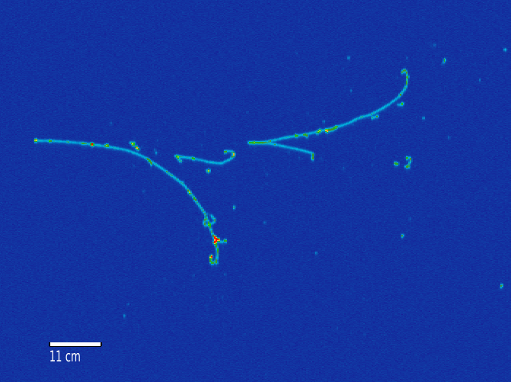
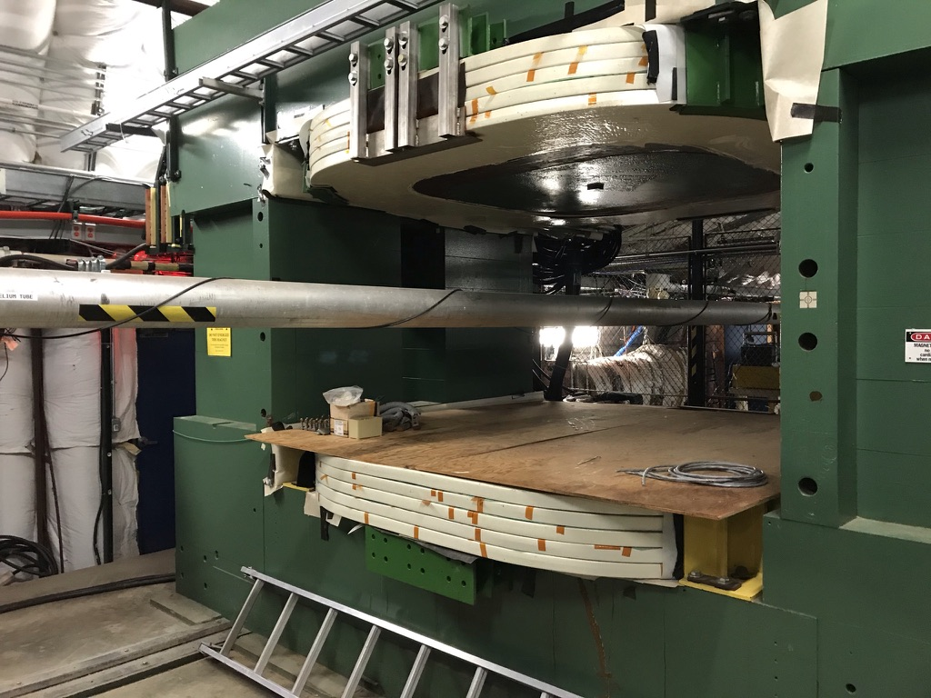
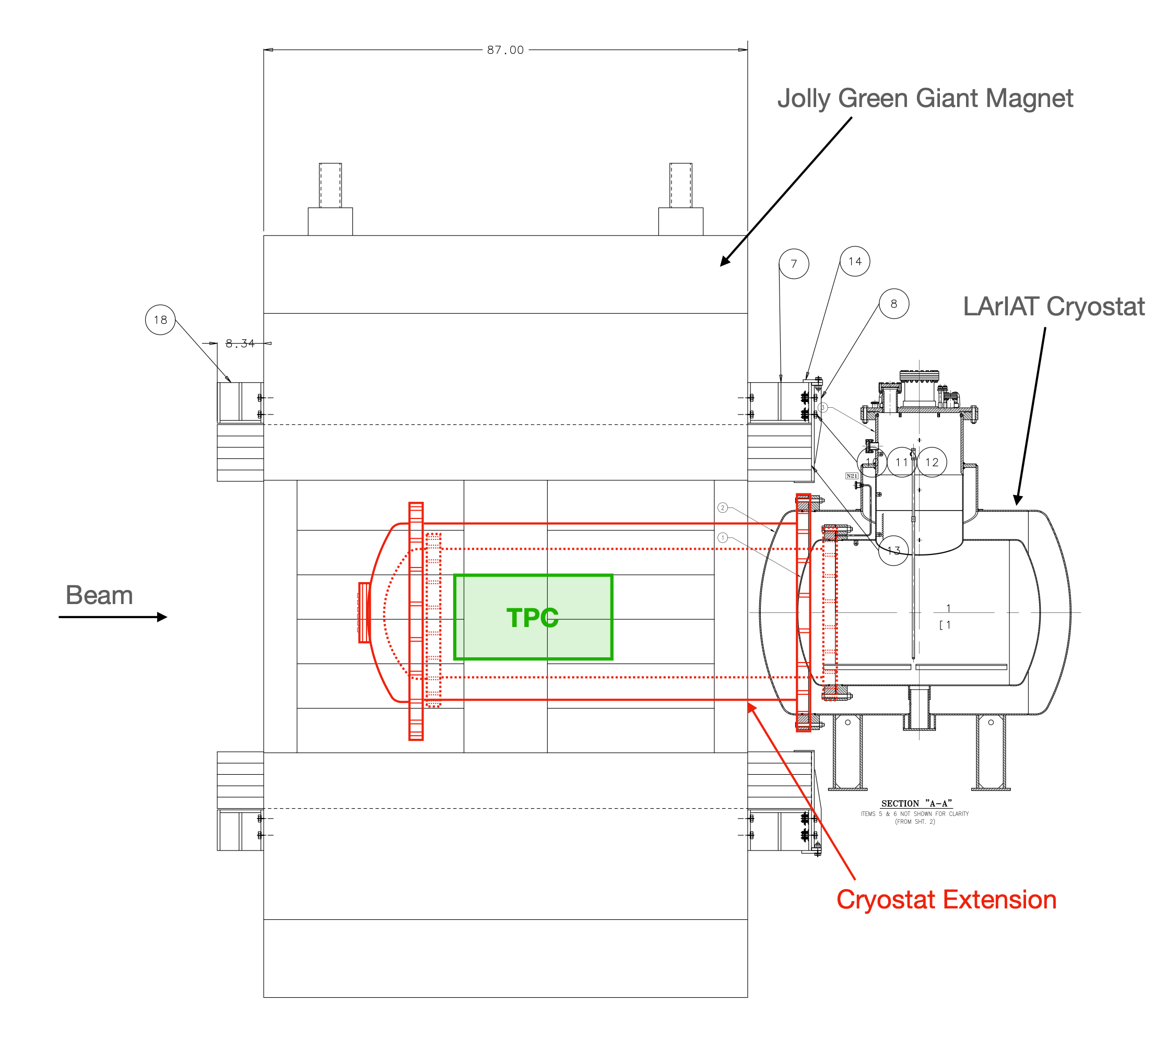
Magnetized LArTPC
Marco Del Tutto, Ornella Palamara, Claudio Montanari, Roberto Acciarri, Flavio Cavanna, William Badgett, Angela Fava
There is a wide interest in magnetizing LArTPC detectors for neutrino physics and beyond.
The magnetization would allow us to determine the electric charge of particles (information not available in non-magnetized LArTPCs), and it would provide an additional method to measure the momentum of particles.
Proposed milestones: (i) magnetize the LArIAT detector using classical magnet; (ii) magnetize SBND with superconductors inside the cryostat; (iii) magnetize the 4th DUNE module.
Positron
p = (0, 0, 0.5) GeV
⊙
B = (0, 0.7, 0) T
Simulation of magnetized LArTPC
Jolly Green Giant Magnet at Fermilab
Lab support needed here for test beam and magnet operation, fabricating the extension to the LArIAT cryostat, setting up LArIAt at FTBF and for LArIAT data taking.
Proposed modification to LArIAT for using it inside the magnet

