Slide 1
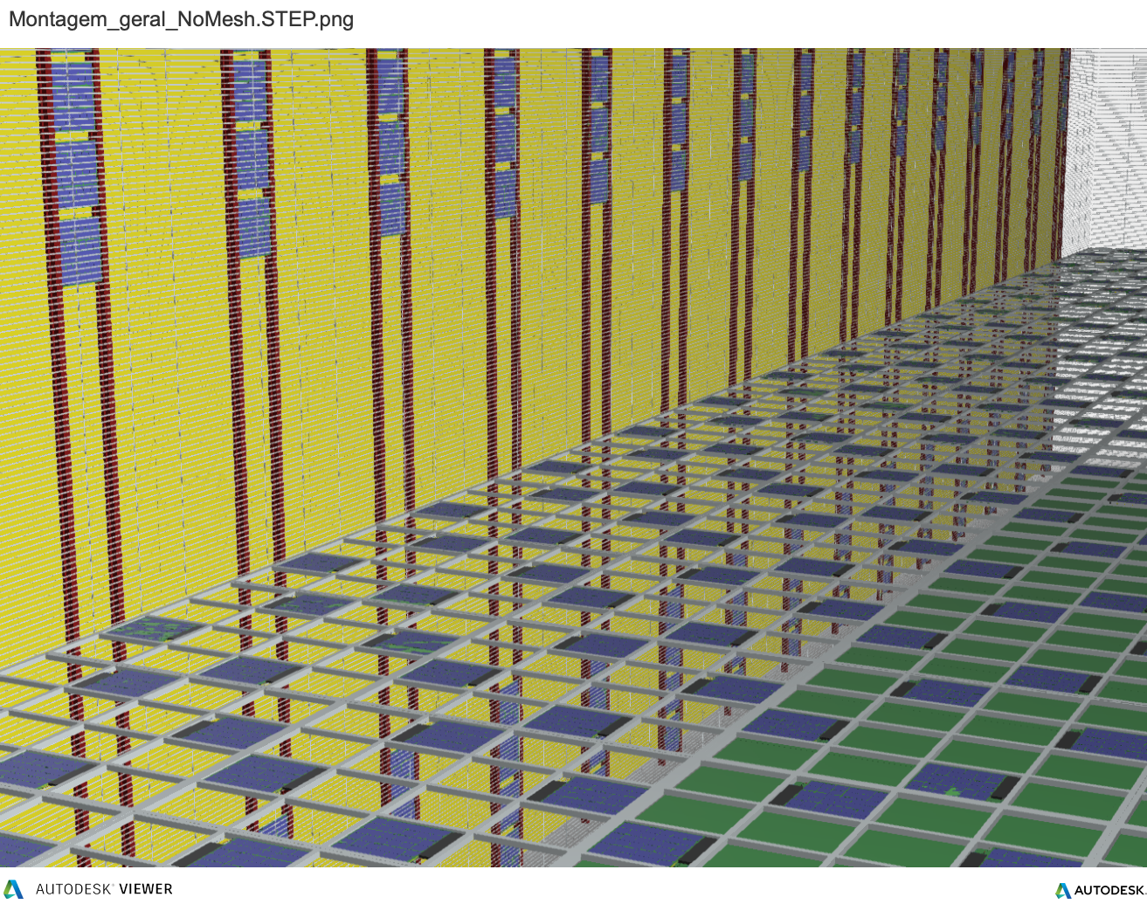
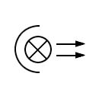
DUNE FD2-VD: Operating photon detectors on the 300 kV LArTPC Cathode Plane
Require electrically floating Photo-sensors and r/o Electronics
⇒ Power (IN) and Signal (OUT) transmitted via non-conductive cables (i.e. optical fibers)
!! none of the commercially available technologies (PoF and Optolinks) are rated to operate in Cold (LAr T)
A highly specialized R&D - launched at FNAL (ND, SCD, AD, PPD EE-dept.s) in collaboration with groups in US and International -
is currently ongoing
to develop Cold custom Technology for this application
View from inside the Upper Volume of the FD2-VD LArTPC
with PhDet-instrumented Cathode plane (xARAPUCA tile)

Slide 2
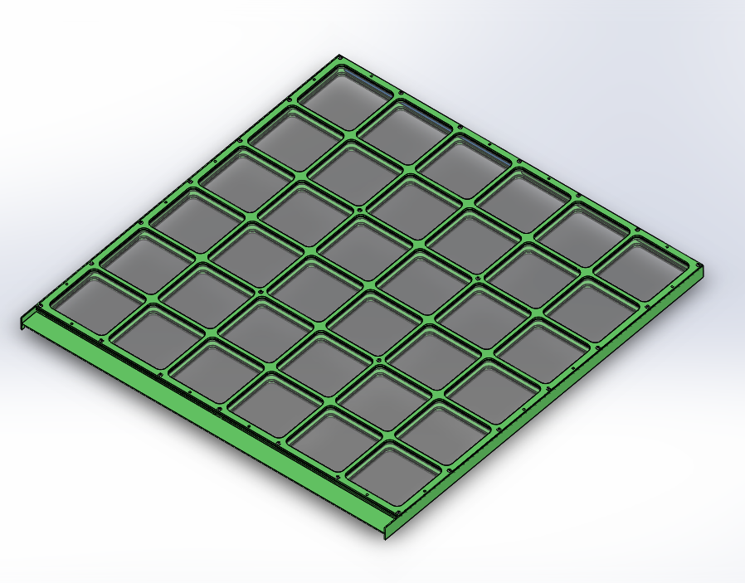
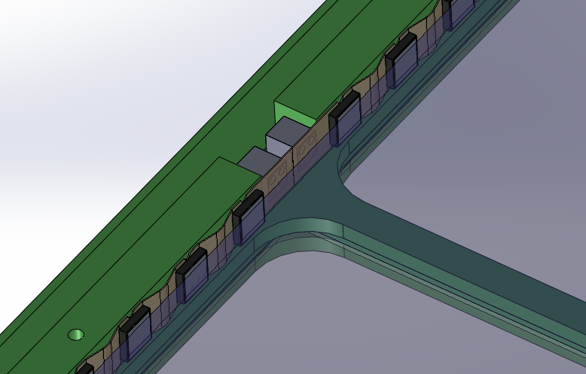
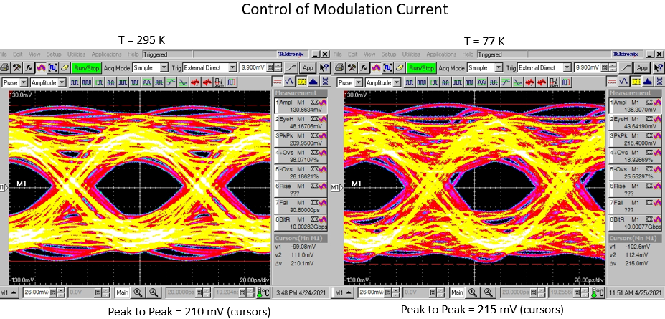
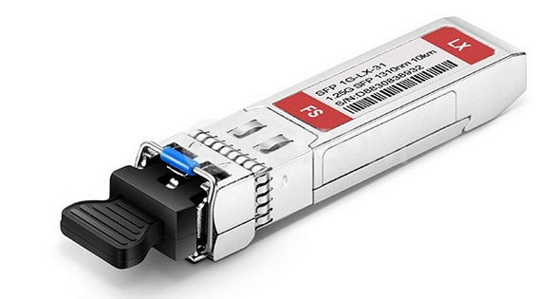
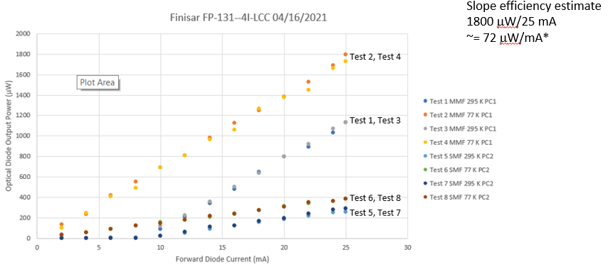
160 SiPMs (40 per side)
Glued to WLS Bar for improved optical contact
SiPMs mounted on Kapton flexi-PCB
Addresses relative thermal contraction of elements
Power-to-Glass FB-118 HQE WLS plate (Milano)
PoF - Power over Fiber
Relatively new technology rapidly developing
used for systems requiring isolation – eg. PhotoVoltaic Cell Towers, and
Low Noise Experimental Systems
Low Volt/High Current Receiver (CE)
Lasers Transmitter+Fiber
High Volt/Low Current Receiver SiPM
FD2-VD PhDet:
X-large
HV/LC - PoF: COTS Si-based Receivers fully validated in cold
LV/HC PoF: high efficiency GaAs-based Receivers better suited for low temperatures
Custom units with building voltage specification under development
xARAPUCA Tile
(new generation)
SoF - Signal over Fiber
eye diagrams
Largest SiPM array $→$ One Channel (new solution):
20 hybrid Passive ganging X 8 OpAmp Active ganging
Test Program at 295 K and 77 K
Binary “1”
Validation in Cold
Selection
Laser Driver
Binary “0"
Driver
Testing
Laser Diode
Diode
Testing
COTS Transceivers
FD2-VD PhDet:
Prototype Board
Bring Together Custom Gbps Transmitter

