Slide 1
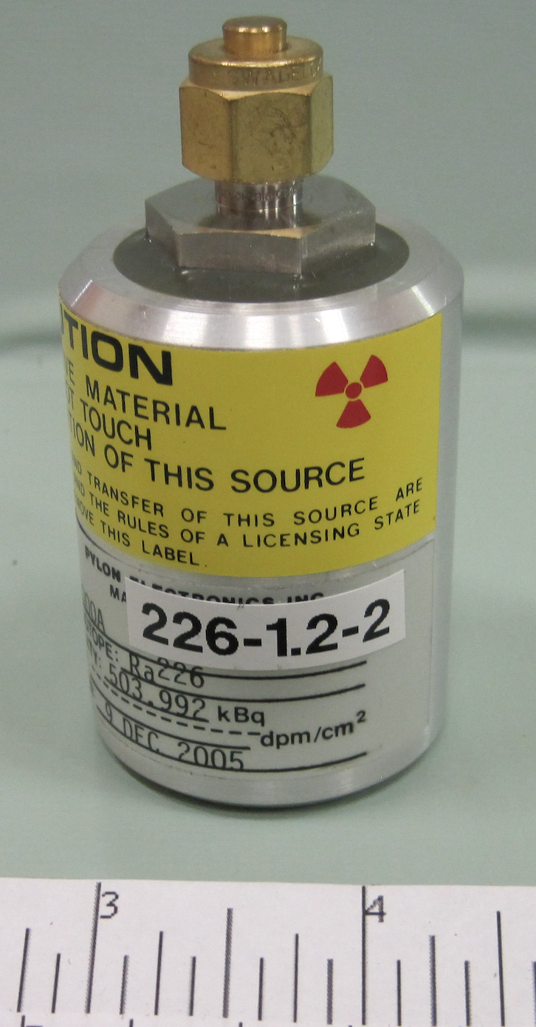
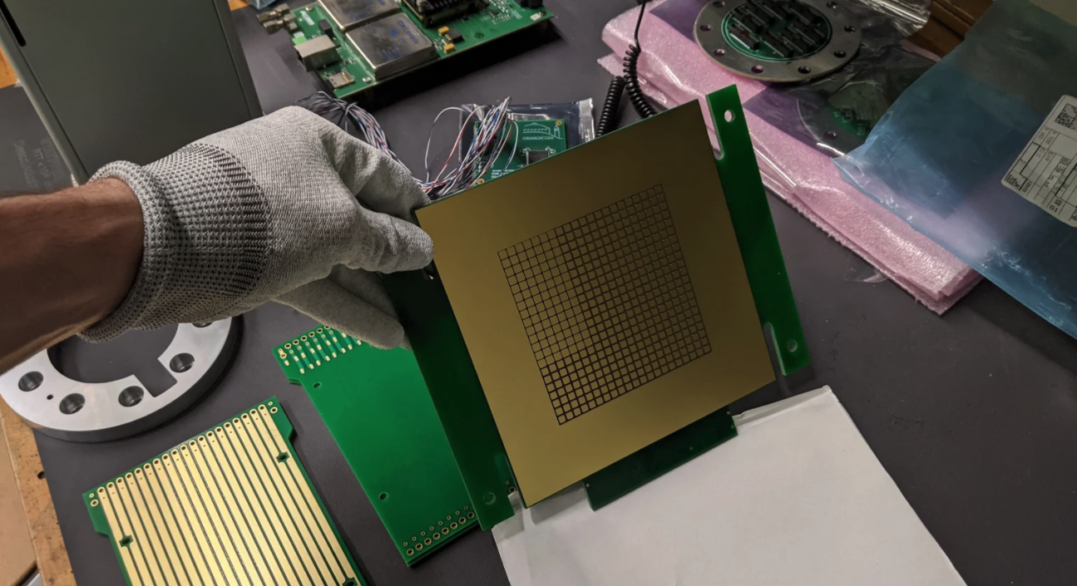
LArTPCs for MeV-scale Physics
I. Lepetic, A. Mastbaum (Rutgers University)
F. Psihas, J. Zennamo
(Fermilab)
Radon doping MicroBooNE
Goal: Use radioactive sources to measure LArTPC MeV-scale performance and explore improvements through addition of photosensitive dopants
@MicroBooNE: Add radon source to study MeV-scale energy resolution
Status: Source holder installed and will add source soon, data analysis will begin immediately
@PAB: Deploy a pixelated LArTPC to study gamma-sources into the Blanche cryostat with photosensitive dopants
Status: All components delivered to Rutgers from LBNL & CalTech, assembly will begin soon
Argon Flow
500 kBq ²²⁶Ra Source
Assembling 3x3 tile TPC
10 cm
10 cm
This work is supported by a New Initiatives Grant and the Neutrino Division, and additional tech and engineering support from the Neutrino Division

