Slide 1
A PIP-II Mu2e Experiment
Mary Anne Cummings
Muons, Inc.

Slide 2
What is Muons, Inc.?
  Founded 2002, subsidiaries - MuPlus, MuSTAR - by Scientists from US National Labs – original mission to design a Muon Collider
  Mu*STAR accelerator-driven molten-salt nuclear reactors
    Major focus of our companies
  NEW tools and technology for particle accelerators
  Funded by DOE (and DOD) contracts and SBIR-STTR grants total of ~$32M
  9 US university and 11 national lab research partners
    Broad, diverse and cutting edge scientific network
    We are embedded in both worlds
  Supported 18 post-docs and 6 Ph.D. students
  Software products:
    G4beamline - interface to GEANT4, optics and tracking
    MuSim - interface to several codes, optics and tracking

Slide 3
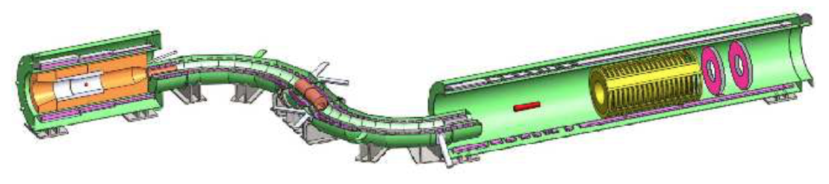
G4Beamline
Simulation of the Mu2e beam channel and detector as an example of use of the G4beamline interface to Geant4. Simulations of complex magnet channels, acceleration fields and tracking of particles through these fields.
Both through matter and vacuum - can be done without knowledge of C++ ! !

Slide 4
PIP II: FNAL Intensity Upgrade for Mu2e
The current Mu2e design is optimized for 8 kW of protons at 8 GeV.
The proposed PIP-II upgrade project is a 250-meter-long CW linac capable of accelerating a 2 mA proton beam to a kinetic energy of 800 MeV (total power 1.6 MW)
In 2015-2016, Muons, Inc. looked at finding an accommodation to the future Fermilab program with as little change to the current Mu2e experimental setup and beamlines as possible. Considerations included:
  Appropriate proton beam time structures,
  Proton beam transport,
  Production of mu-,
  Transport of mu- into the detector and stopping target,
  Heating and irradiation of magnet coils,
  Veto rates,
  Acceptable live times,
  Stopping rates, and
  Backgrounds.

Slide 5
Muons, Inc. Previous Mu2e-II Study
First observation: 800 MeV protons have 1/10 the kinetic energy of 8 GeV protons, they have 1/6 the momentum. Scaling all magnet currents by 1/6:
PIP-II beam follow the same trajectory through the production solenoid, missing the heat and radiation shield (HRS), and hitting the beam absorber.
But this would give the transport solenoid too small a field to transport most of the muons, and would give the detector too small a field for the detector to work at all.
So the simple and obvious approach does not work.
Muons, Inc. did initial studies of Mu2e in the PIP-II era, looking at three scenarios:
      No changes (except magnet currents and re-alignments)
      Minimal changes (leave all coils alone)
      Modifying the HRS with a new beam hole
      3. “Modest” changes
Remove one TS coil
Modest changes to HRS, target, and beam absorber

Slide 6
Backward Production #1 and #2
The first scenario attempted to put 800 MeV protons onto the Mu2e production target, using the same hole in the HRS as the 8 GeV beam. We found that while it is possible to hit the target, it is not possible for the beam to miss the HRS. The HRS (obviously) cannot handle the full 100 kW beam. The production solenoid field was varied from 3 T to 5 T (baseline, 4.5 T), but it is not possible to use 800 MeV protons with the current HRS, production solenoid, and target.
The second scenario considered drilling a new beam hole into the HRS, and moving the beamline ahead of the HRS to match. By moving the incoming proton beam closer to the production solenoid axis, it is possible to hit the target and miss the HRS. But this was found unacceptable for three reasons:
The brass HRS was found to be inadequate to protect the production solenoid coils from 100 kW of beam.
It is unlikely that holes could be drilled, as the HRS will be highly radioactive after Mu2e operation. (Mu2e design and fabrication were too advanced to consider doing this before operation starts.)
One or more transport solenoid coils were always in the way.

Slide 7
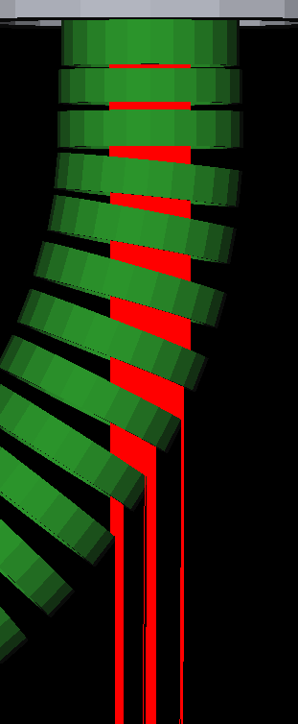
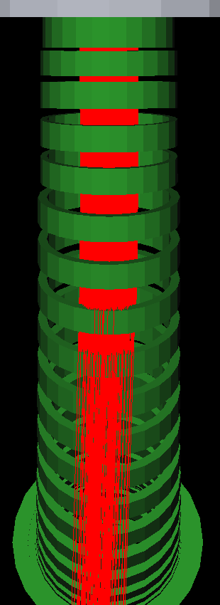
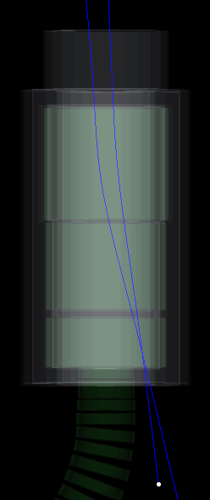
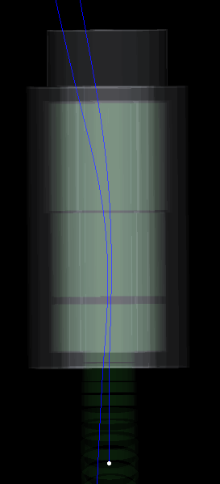
Backward production #3
So the “modest change” approach would require:
  Removing one TS coil and drilling a hole for the beam in its cryostat.
  Replace the HRS with one made of tungsten.
  Move the beamline ~100 mm closer to the TS, slight angle.
  Move the target, add active cooling.
  Move the beam dump.
This is not really a “modest change”.
Side and top views of coils in the transport solenoid, with 800 MeV protons from the target tracked backwards (headed downward) to show where they intersect the transport solenoid. The yellow arrow points to the TS coil that would be removed (left). This moves the beam in the production solenoid (right).

Slide 8
Forward Production Mu2e-II
The conclusion of this earlier work was that for Mu2e in the PIP-II era, using the 800 MeV beam requires a redesign of the beamline, target, HRS, production solenoid, and beam absorber. Or perhaps a complete change of concept
Muon-collider front ends generate significantly more muons per proton than Mu2e’s target and production solenoid. ( .06 μ/p vs .0016 μ/p)
Mu2e rejected such forward production due to the muon background it generates.
Mu2e-II need not reject this: 2 meters of concrete will range out 800 MeV muons.
Mu2e-II 800 MeV beam will not produce anti-protons!
The Muons, Inc. ionization cooling technology has been successfully demonstrated! (elements of the Helical Cooling Channel).

Slide 9
Forward Production Features
A small amount of longitudinal cooling can significantly increase the fraction of muons that stop.
The absorber used for cooling can significantly clean up the hadron flash. This might permit a shorter dead time and allow the use of higher-Z stopping targets.
Muon collider front ends considered much higher beam power and ignored backgrounds; this needs to be looked at from a Mu2e-II perspective… part of Muons, Inc. proposal
Muons, Inc. had two SBIR projects that are directly related:
  Stopping Muon Beams
  Isochronous Muon Beams
Neuffer, Bao, and Hansen did a related study.
There is potentially a lot to be gained here; the challenge is to keep it affordable and re-use as much of Mu2e as possible.

Slide 10
Muons Inc. Proposed Study (not funded)
At present (2019, 2021?), PIP-II has not been fully defined, but its basic structure as an 800 MeV H⁻ linac is not expected to change:
  Intensity studies: PIP-II linac will be capable of accelerating a continuous beam, initially it will have fewer power supplies and only accelerate a pulsed beam with ~ 10% duty factor could have a significant impact on the time structure and overall intensity available for the Mu2e-II beam.
  Beam stripping: As PIP-II will accelerate an H- beam, it might be possible to use the stripping of H- to protons to improve the extinction of the proton beam between desired pulses on the production target. or using laser stripping with the laser off between desired bunches or H0 (Dr. Roberts)
Forward production: In previous grants Muons, Inc. applied new six-dimensional beam cooling inventions for muons colliders, improved capture techniques, and our new simulation tools to develop designs for low-energy beam lines to stop many muons in small volumes.
  STTR DE-FG02-07ER84824 “Stopping Muon Beams” (2007-2009)
  STTR DE-SC0002739 “Quasi-Isochronous Muon Collection” (2009-2011)

Slide 11
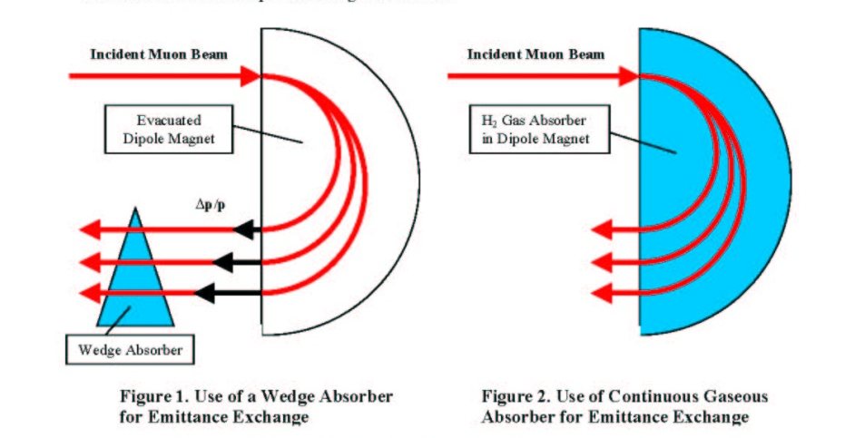
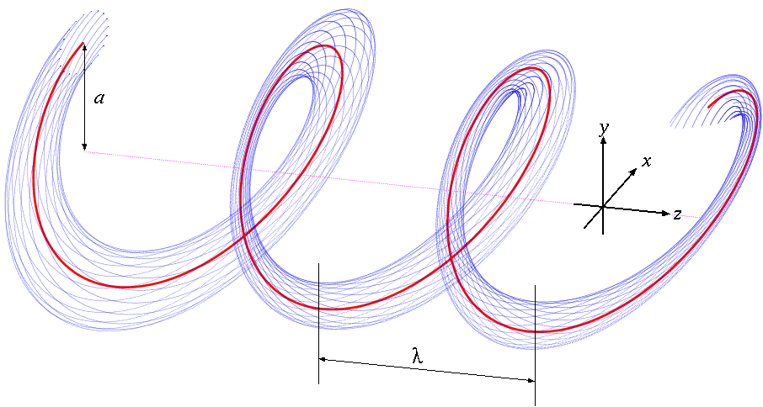
Particle Motion in a Helical Magnet
Dipole ➔ Dipole + Solenoid (+Quad for stability)
}
Transforming to the frame of the rotating helical dipole leads to a time and z –independent Hamiltonian, can form relation:
Positive dispersion
Red: Reference orbit
Blue: Beam envelope
Dispersive component makes longer path length for higher momentum particles and shorter path length for lower momentum particles.
Manipulate values of parameters to change performance

Slide 12
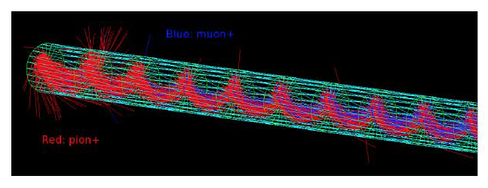
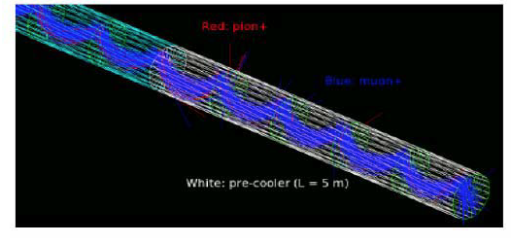
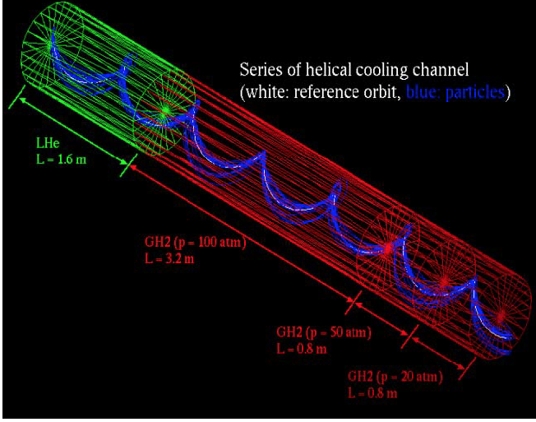
HCC Elements for muon production
G4Beamline simulation of muon (blue) and pion (red) orbits in a HCC-type magnet that is adapted as a decay channel (right).
Helical Cooling Channel
(HCC)
Higher-momentum particles lose more energy because they have longer path lengths in the gaseous absorber, thereby reducing the beam energy spread and hence the longitudinal emittance.

Slide 13
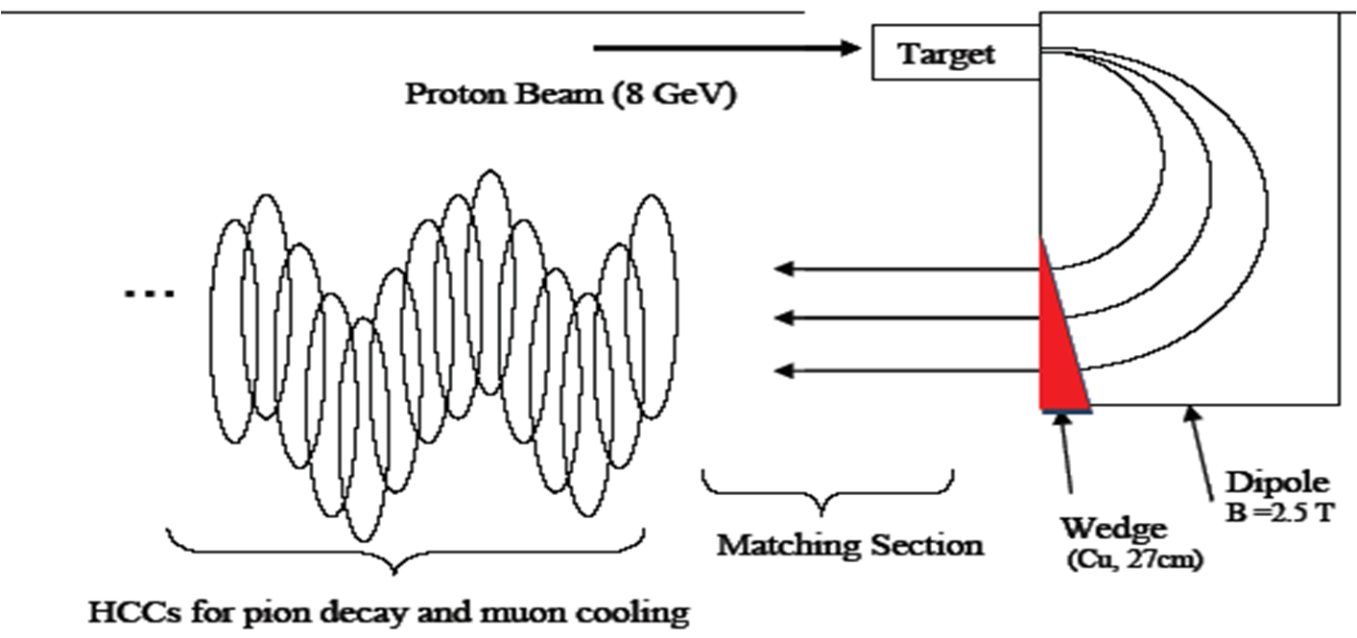
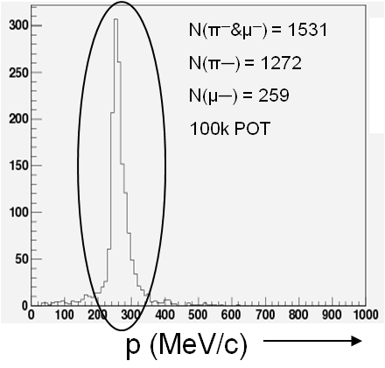
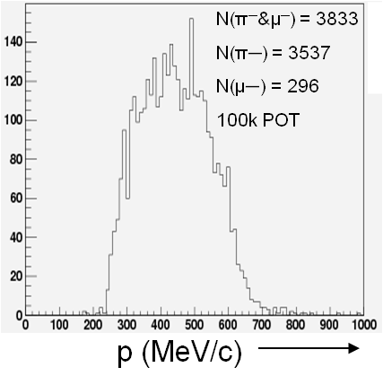
Intense Stopping Muon Beams
Dipole and Wedge
Into HCC
Matching into the HCC which degrades muons to stop in target
180° dipole bend removes large neutral backgrounds.
Muons with a narrow time and momentum spreads will enable the use of higher Z target, and maintain the necessary “extinction” factor.
Wedge narrows P distribution

Slide 14
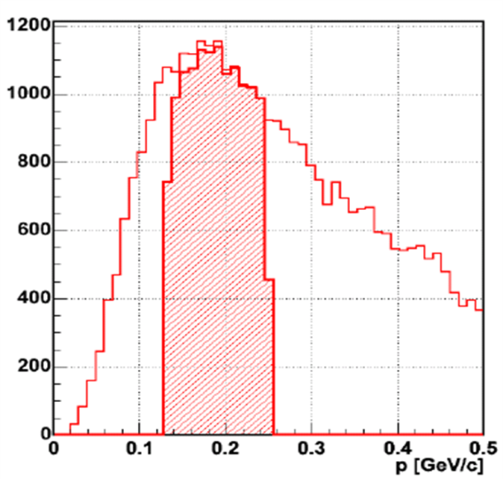
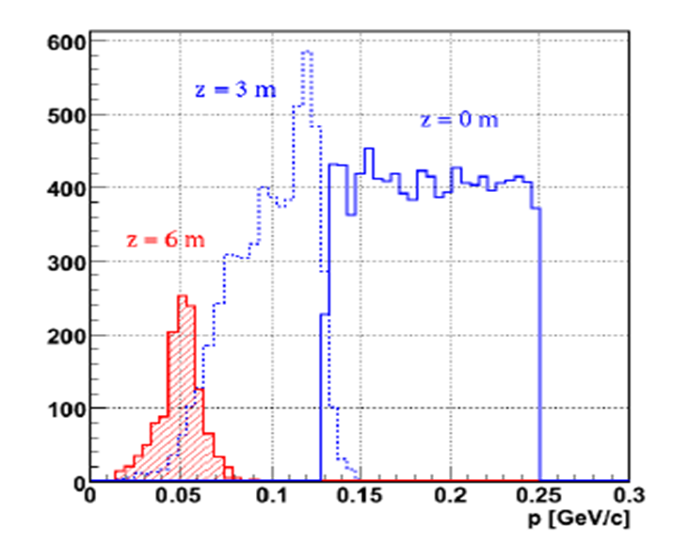
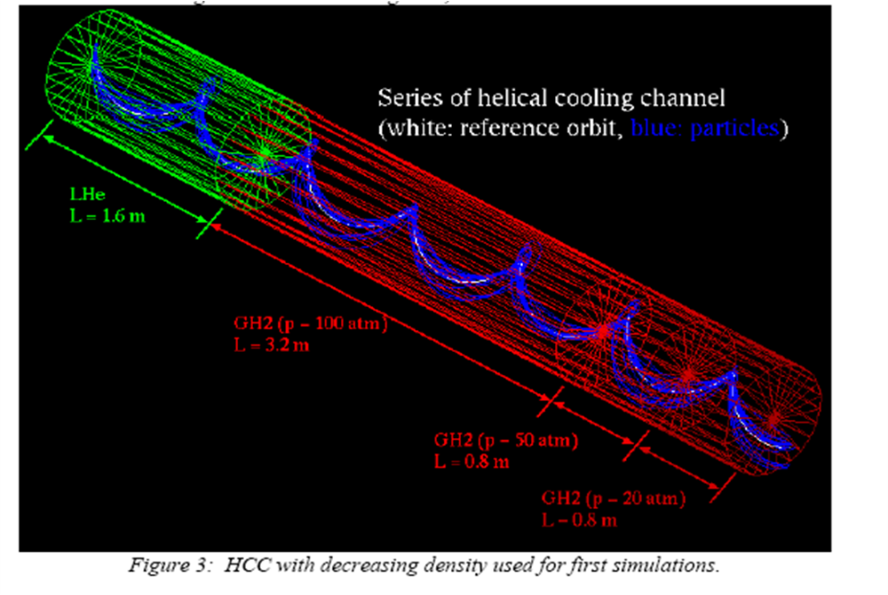
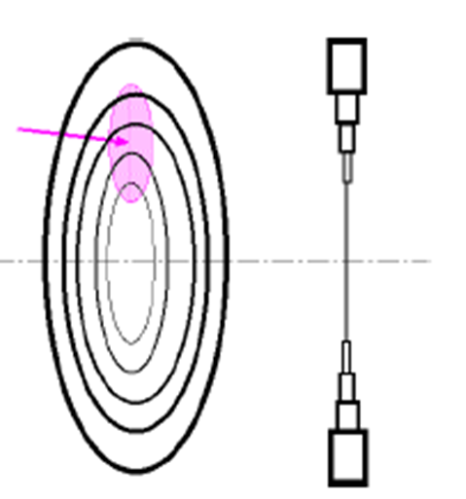
Stopping Muon Beams for Mu2e
Using an HCC to reduce the energy spread of the secondary pion beam which produces the muons, decrease backgrounds and increase mu/p production.
μ/p production can be optimised by capturing pions at the production peak. Cooling brings down the mean momentum low enough to stop in the detector target.
“Tapered-density” absorber HCC channel: “concept” study (1), and a element of a realistic absorber (2), a thin radial LiH wedge. Density is decreased by increased wedge spacing.
Notes:
13

Slide 15
Quasi-Isochronous Helical Channel
A related idea conceived for the collection and cooling of muon beams, namely, a Quasi-Isochronous Helical Channel (QIHC) to facilitate capture of muons into RF buckets, has been developed further. The resulting distribution could be cooled quickly and coalesced into a single bunch to optimize the luminosity of a muon collider. It also can be optimized for Mu2e
A helical magnetic field that creates helical particle trajectories near a reference orbit of a selected muon momentum
RF cavities that capture particles in stable buckets, an
An absorber that reduces the energy of particles that would otherwise be too energetic to be captured.

Slide 16
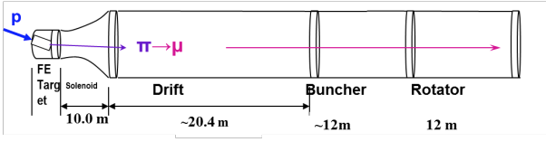
Low Energy Production of Bright Muon Beams
The Muons, Inc. inventions were based on 8 GeV proton sources. This will have to be studied for the 800 MeV proton source. The efficiencies at lower momenta will have to be studied and other or additional schemes will be examined. Starting here:
  The collection π => μ at ~70—200 MeV/c
  The efficiency of energy-loss absorption could be improved by introducing dispersion and adding a wedge component so that higher-energy muons pass through more material.
  Deceleration can be considered
  Dave Neuffer et al have developed a low energy capture model that feed into a decelerator: (~0.04 μ/p)

Slide 17
Muons, Inc. DOE Mu2e-II Proposal
Task 1. The general relationship between PIP-II and Mu2e-II
1a. H- beam energy and time structure
1b. Stripping H⁻ to protons
1c. Overall intensity
1d. Extinction of beam between desired pulses
1e. Accommodating PIP-II design revisions as they happen
Task 2. Backward Muon Production (as in current Mu2e)
2a. Preliminary design of a new production solenoid, target, and heat and radiation shield (HRS)
2b. Considerations of target and HRS cooling
2c. Preliminary design of proton beam transport into the target, and to the beam absorber
2d. Evaluation of changes required to the transport solenoid
2e. Optimization and evaluation of the overall stopping muon rate
2f. Consider stripping to H⁰ immediately before the production solenoid
Task 3. Forward Muon Production (muon collider / neutrino factory)
3a. Develop several forward-production concepts
3b. Analyze concepts, optimizing stopping mu- rate, cost, and overall size and layout
3c. Select one concept for presentation
3d. Consider how to place components in the Fermilab muon campus
3e. Optimization and evaluation of the overall stopping muon rate

Slide 18
Closing Thoughts
Adapting to the PIP-II era will require substantial changes to the current Mu2e experiment – a forward production scheme is not unreasonable as a viable alternative, and can
Direct mu => e conversion would be the “golden channel” of charged lepton flavor violation (CLFV). CLFV would probe a complementary area of New Physics from that of the rest of the High Energy Physics Program, definitely worth a serious PIP-II era effort.
An enhanced Mu2e experiment using muon collider front end techniques could provide the best sensitivity for discovering CLFV. A forward muon production scheme could be optimal:
  The ability to change stopping targets
  Maintain high background suppression

Slide 19
Some Important HCC Relationships
Hamiltonian Solution
Equal cooling decrements
Longitudinal cooling only
~Momentum slip factor
~

