Slide 1
proton Economics: PIP-II and BEYOND
Eric Prebys
mu2e-ii-accelerator@fnal.gov

Slide 2
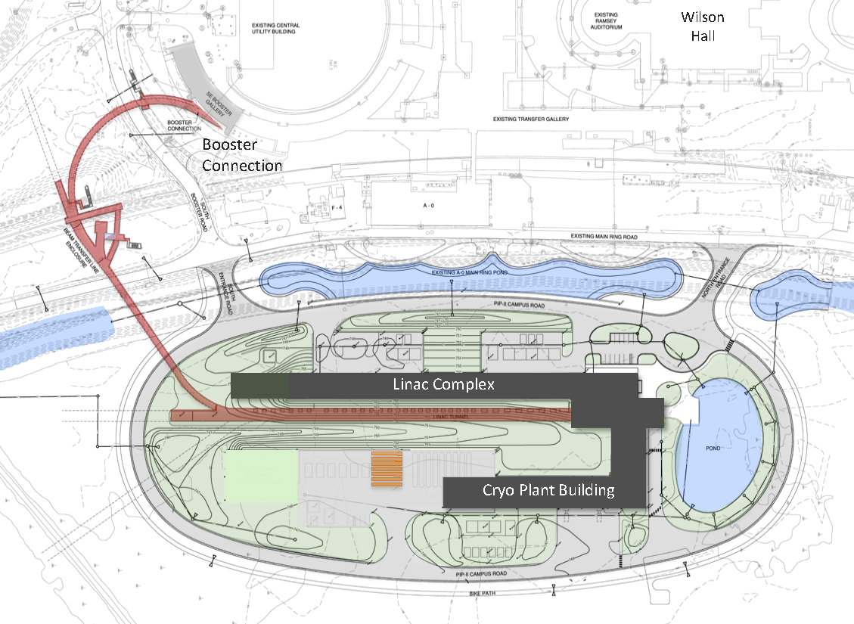
PIP-II Scope Overview
800 MeV H− linac
  Up to 165 MHz bunches
  Up to 2 mA CW
  Up 1.6 MW
Upgraded Booster
  20 Hz, 800 MeV injection
  New injection area
Upgraded Recycler & Main Injector
  RF in both rings
Protons for the High Energy Program
  .55 ms injection into Booster at 20 Hz
  ~1% of available beam!
Additional beam
  All the beam?
  3-way beam split?
To mu2e
The PIP-II scope enables the accelerator complex to reach 1.2 MW proton beam on LBNF target.

Slide 3
PIP-II and Next Generation Mu2e
PIP-II Features
  800 MeV beam will a selectable, arbitrary beam pattern up to 162.5 MHz
    Peak current up 5 mA (2.0x10⁸/bunch)
    CW average up to 2 mA (0.8x10⁸/bunch)
  High Energy (≧8 GeV) limited to ~1% of available beam
Mu2e-II
  Use PIP-II (800 MeV) as beam source
  Reuse as much as possible of the baseline Mu2e experiment
    Follow similar experimental scenario
    Improve if possible
Need strong Snowmass Letter of Intent & white paper(s)
    This is a real opportunity for Snowmass to make a difference

Slide 4
Bunch Switching
The full bunch rate out of the PIP-II linac is 162.5 MHz
  Arbitrary pattern selectable on a bunch-by-bunch basis
The high energy (≧8GeV) program will use about 1% of the potentially available beam
  Limited by the 20 Hz rep. rate of the upgraded Booster
I’m assuming beam headed for the Booster will be switched by a 20 Hz switching magnet (not challenging)
If we’re the only other user, then we would access to the full 162.5 MHz; however
If we’re not the only user, our ~600 kHz bunch rate is certainly too fast for a pulsed kicker.
If there are multiple 800 MeV users, then the most likely solution is an RF beam separator.

Slide 5
RF Beam Splitting
The Beam will go through an RF deflector running at 162.5/4=40.625 MHz
Individual beam lines are selected by choosing which bunches to populate.

Slide 6
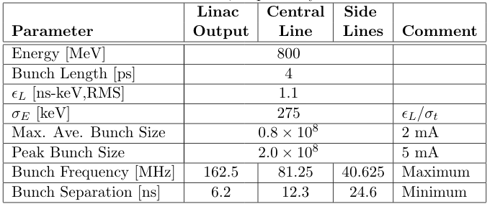
PIP-II Linac Beam Parameters
Up to ~100 μs or so
Assume this limit for short bursts.
Cannot be changed quickly (we’ll be tied to this number during NOvA/LBNF operation!)

Slide 7
Cheat Sheet: Calculating Beam Rate and Power
Assume we have n_{b} bunches with N protons in each bunch every T seconds
Reminder: Limits
  N_{b,max}: 2x10⁸ (5 mA peak)
  Max. I_{ave}: 2 mA
0.8x10⁸ @ 162.5 MHz = 1.6MW
1.6x10⁸ @ 81.25 MHz = 1.6MW
2.0x10⁸ @ 40.625 MHz = 1.0MW
2.0x10⁸ @ 20.312 MHz = 0.5MW
This will be very important

Slide 8
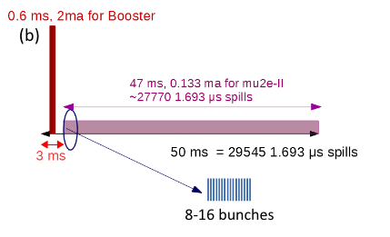
Mu2e-II Beam formation*
Possible beam structure (100 kW):
  8 bunch burst @ 600 kHz
  2.0x10⁸ protons/bunch
  600 kHz repetition rate
  = 118 kW
  3% duty factor
  0.15 mA
  These numbers are
  independent from the
  instantaneous bunch rate!
    ie, which line we’re in
The bunch rate only affects the pulse width
  162.5 MHz = 50 ns
  81.25 MHz = 100 ns
  40.625 MHz = 200 ns
All of these numbers would double for 200 kW
~275 162.5 MHz buckets
That’s all that would be needed from the accelerator end!
*https://www.snowmass21.org/docs/files/summaries/AF/SNOWMASS21-AF5_AF0-RF5_RF0_Prebys-204.pdf

Slide 9
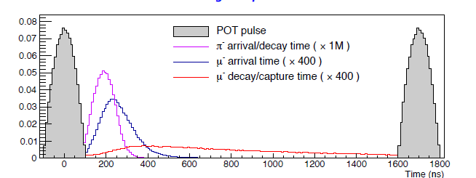
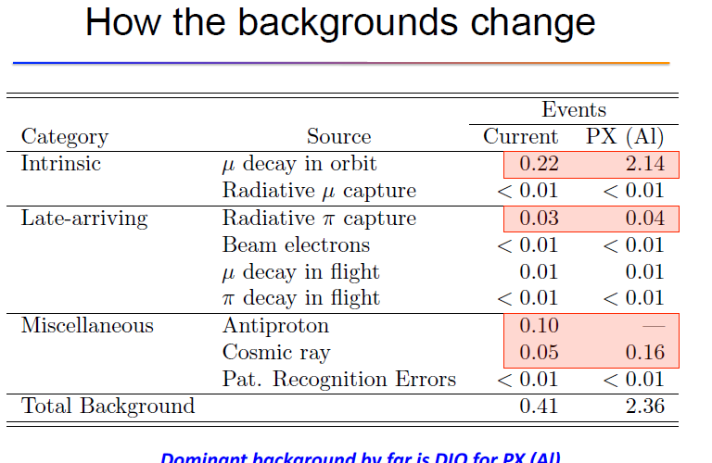
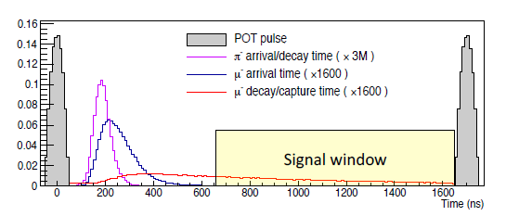
mu2e→mu2e-II
mu2e →mu2e-II
  shorter pulses @
  100 kW
Timing comparison
  K. Knoepfel et al.
Still dominated by
beam straggling

Slide 10
Beyond PIP-II
At some point they will finally replace the Fermilab Booster
The amount of beam you can put into a synchrotron is limited by the space charge tune shift at injection.
This is the whole motivation for PIP-II
  Get a factor of 2 going from 400 to 800
The Booster tune shift is already pretty large (>.2), so won’t get too much out of a new RCS without also increasing the beam energy.
  Nominal plan to increase energy to 2 GeV -> additional factor of three
  Add better painting -> 35x10¹² protons per batch
    Factor of 9 over current limit
    Factor of 5 over PIP-II goal
Limited by Main Injector aperture

Slide 11
What this would mean to Mu2e-II
To first order, the beam power would just scale with the energy
  100 kW -> 250 kW
BUT, at ~ms injection times, the 2 mA total current limit cuts in
  Maximum bunch size goes from 2x10⁸ to 0.8x10⁸
  Cannot change this quickly, so we’re stuck with it while LBNF running
As luck would have it, this exactly cancels out the effect of the increasing energy for a given power and bunch length!
The increased energy beam would be easier to inject into the PS, but by then we will have modified it for the 800 MeV beam.
Could the bunch size be increased with improved cryo-cooling?

Slide 12
Compressor Ring(s) and Such
It takes about 2 ms to inject 35x101² protons into the RCS
  Compared to 30 μs now
This is too long compared to a 20 Hz sine wave
Options
  Modify the waveform to flatten it out at the low end
  Add energy vernier control to the LINAC to match Booster field
  Add a compressor ring to preload the beam
    The way the Recycler is used to preload beam for NuMI

Slide 13
Layout
Luciano Ristori has been discussing this
As far as I know, it has not proceeded beyond a cartoon
Compressor
800 MeV
PIP-II Linac
Extension
E=2 GeV?
New Rapid Cycling Synchrotron

Slide 14
Can Mu2e-II Benefit from a Compressor Ring
Short answer: Not in our current configuration
  Maximum rate for injection and extraction from the compressor ring would be something like 100 Hz maximum
    Big pulses separated by 10 ms are not matched to our needs
  Better to simply use the higher energy LINAC in the same way we plan to use the 800 MeV LINAC
However, a compressor ring is necessary to implement a PRISM/PRIME type FFGA later.
  LINAC beam structure completely incompatible with the fast loading required by the FFGA
  We’ve already discussed this in the context of an 800 MeV compressor ring
    https://www.snowmass21.org/docs/files/summaries/AF/SNOWMASS21-AF5_AF0-RF5_RF0_Prebys2-203.pdf
    https://www.snowmass21.org/docs/files/summaries/RF/SNOWMASS21-RF6_RF0_pellico-029.pdf

Slide 15
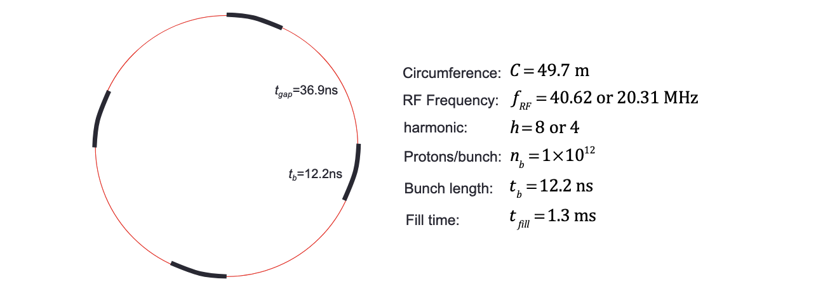
Comparison of Proposals
Prebys et al
  Green field ring, ~ 1T magnets
Pellico et al (Booster storage ring)
  Permanent magnet ring in Booster tunnel

Slide 16
Ring Size and Space Charge Considerations
Once we’ve fixed the injection energy, the space charge tune shift limit is given by
  Maximize → longitudinal painting
  Minimize put a pin in that
  Maximize → transverse painting
    No longer limited by MI aperture, but not without consequences
Bunch size
Bunch length
Number of bunches
~limit
Peak Current/Average Current
Normalized emittance
period

Slide 17
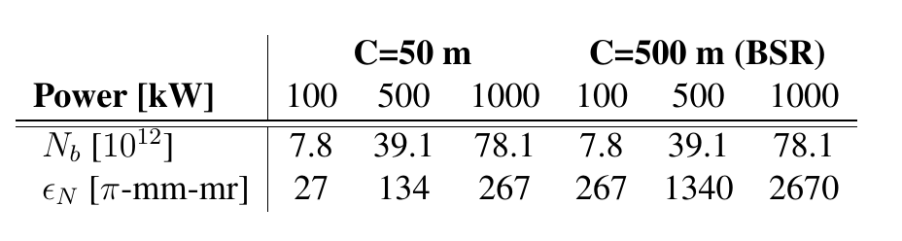
Comparing Small Ring to BSR
Assume f_{ext} = 100Hz, Δ_{ν}=.2 For 800 MeV beam
Effect of going to 2 GeV
  Energy increase -> improve by a factor of 2.5
  βγ² -> improve by a factor of 3
  Increase momentum -> increase period -> degrade by factor 2
  Overall improvement: 3.75 (71 π-mm-mr for 1 MW)
Main Injector only needs ~15-20!
>>SNS

Slide 18
Summary
Mu2e-II would not benefit in terms of power from the 800 MeV to 2 GeV energy upgrade
We would not benefit from a compressor ring, unless we added a PRISM/PRIME style FFGA, in which case it would be vital
Because our needs our different from LBNF, we would want to have input on the design of the compressor ring.

