Slide 1
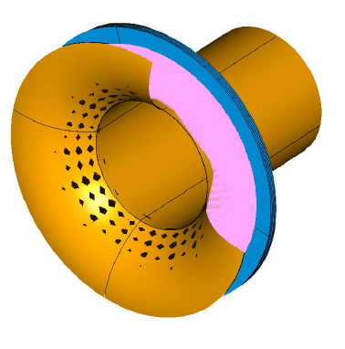
Mu2e-II Tracker Workgroup Report
Dan Ambrose
University of Minnesota
Jul 21st, 2021

Slide 2
Mu2e-II Tracker Workgroup:
  Join the list-serve : MU2EII-TRACKER@fnal.gov
  Meeting Schedule : Bi-weekly Tuesdays 12:00 PM CST. Next one is Aug 3rd.
  Zoom link sent through list-serv
  or online on the calendar of
  https://mu2eii-internal-wiki.fnal.gov/wiki/Main_Page
  Workshop Scheduling : Doodle poll has been sent out to the list-serv.
  Expected to be in the middle of August
  We would gladly welcome more interested people.
  Please contact Gianfranco(giovanni.tassielli@le.infn.it ), me(ambr0028@umn.edu), or come to the workgroup meeting though the list-serve

Slide 3
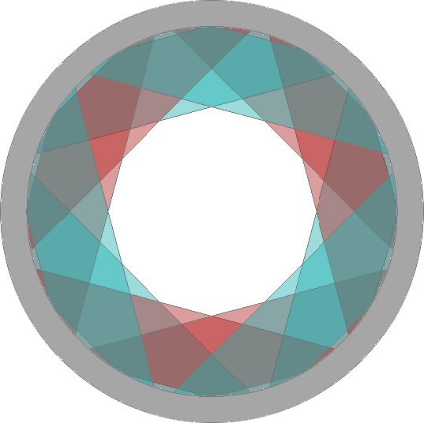
Mu2e Tracker Requirements
Electron momentum resolution: < 180 keV/c at 105 MeV/c
Efficiency for acceptance and reconstruction of 105 MeV/c electron tracks: >20%
Work in vacuum: operation limits for outgassing rate : < 6 sccm
Hit rate: > 5MHz/channel, 500 ns after proton bunch hits production target
Access : < once per year
Operation time: > 10 yrs
Beam direction
Tracker Design: Straw drift tubes measure track curvature through a 1 T magnetic field.
Segmentation to minimize occupancy
Thin walls minimize multiple scattering
No support structure in tracking region
High radiation survival (structure & electronics)
beam’s-eye view of the tracker

Slide 4
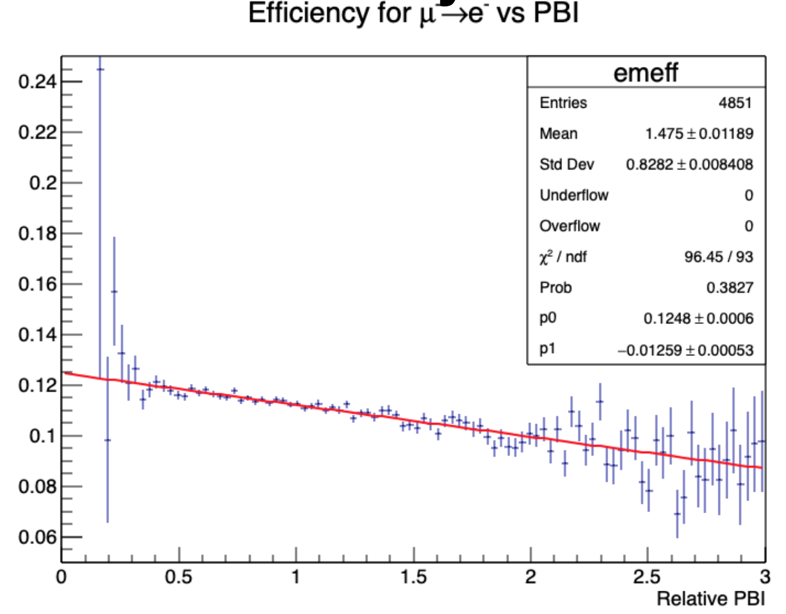
Mu2e-II Tracker Requirements
Lower mass
  To meet Mu2e-II momentum resolution/background separation goals
  Looking into :
    Thinner straws
    Different Geometry
    Lower mass gas or sense wires
    Pursuing alternative new technologies
Survive the increased charge deposition and beam flash radiation :
  Develop radiation-resistant front-end electronics
    ASICS
    DC-DC converter
    Optical components
Increased hit occupancy and timing window
  4x increase in Proton bunch intensity reduces reconstruction efficiency by 30% (extrapolated)
MDC2018, Dave Brown
Docdb# 28281

Slide 5
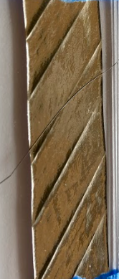
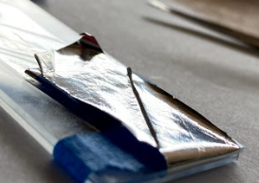
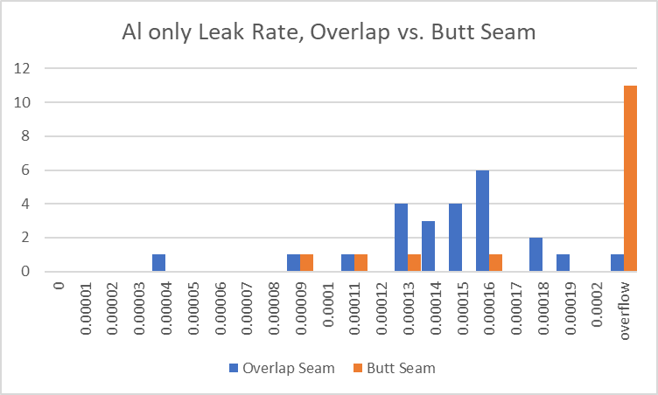
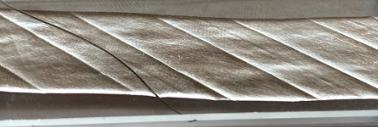
Straws Studies
Difficulty finding vendors for aluminum only 3 µm Mylar for Straw tests and a possible small prototype
Designed and constructing a permeation test stand to try and understand what the minimum thickness of coating we can get away with and also study gap/overlap/butt seams.
Looking into different metal deposits
Communicate with COMET and NA-62 about
other straw production options
Overlap Seams stick out!
This is probably a dead end unless we can redesign the winding process/where the adhesive is applied.
Overlap Seams Butt Seam
Overlap Seam removes holes created in paper removal

Slide 6
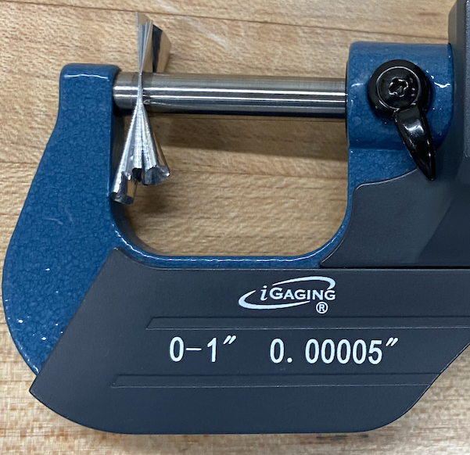
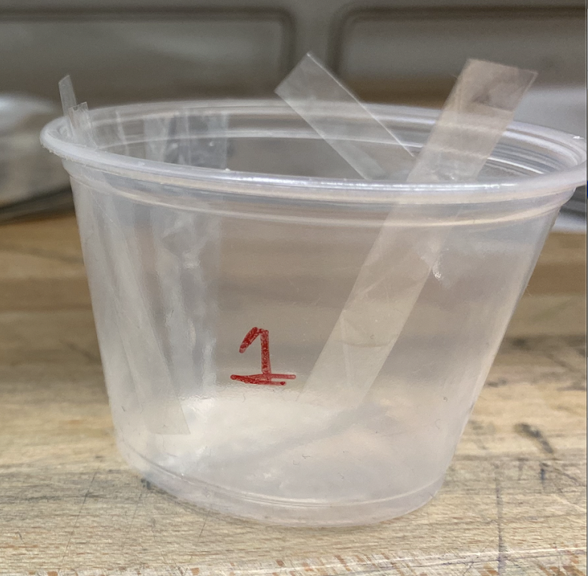
8 𝜇m thin-walled straw’s material studies
We have been examining material properties of straws.
REU Student Anjali Dziarski (Indiana University) has been instrumental in designing experiments and gathering data on the straws.
Multi-layered
Thickness Measurement
Density measurement
 | Metallization | Wall Thickness (𝝻m) | Linear Density (g/m) | Max Internal Pressure (atm) | Noticeable inelastic deformation tension (g)
Mu2e Straws | 0.02 𝝻m Au 0.10 𝝻m Al | 18 ± 1 *Batch Dependent | 0.35 ± 0.01 | 5 | 1500
Mu2e-II Prototype Straws | *None Investigating Al only option | 8.2 ± 0.1 | 0.15 ± 0.01 | 3 | 500
To Do:
Sag vs. Tension
Long Term Creep Test
*Leak Rate Measurement
*Charge Deposition Study
*Need metalized Mu2e-II straws

Slide 7
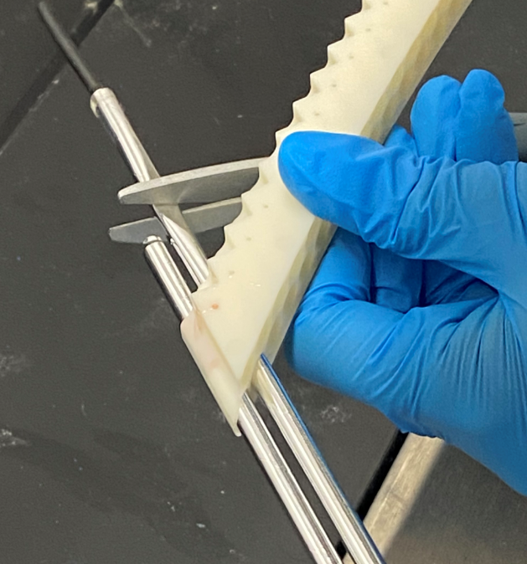
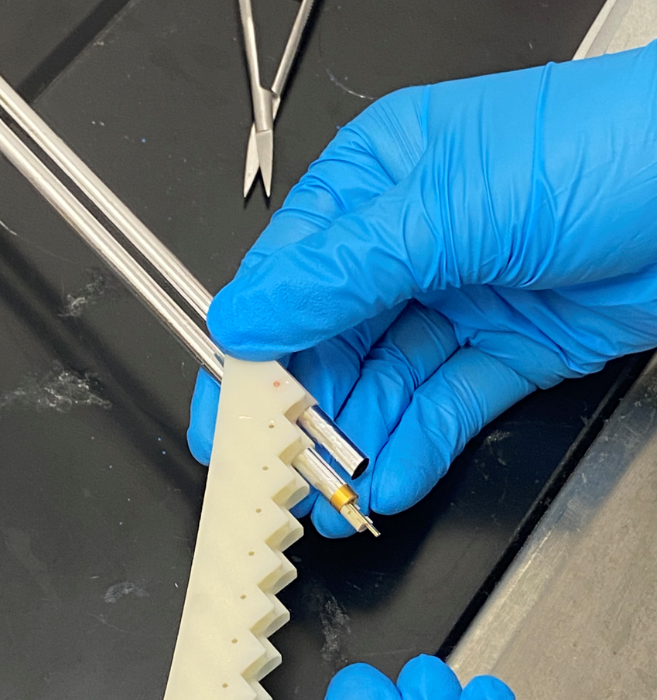
Tracker Construction Techniques
We’re testing proof of concept for ideas for handling these thinner straws :
Installing inflated straws
Cutting straws to length in Panel
Installing endpieces in Panel
Observations :
Modified Sealing endpiece fits through inner ring and seals straw
Cutting jig needed
Installing terminations is very doable, cleaning up silver epoxy is difficult

Slide 8
Tracker Simulation Update
Goal is to have a simulation to estimate tracker requirements and test different options including different technologies.
  Mu2e configuration with reduced straw material
  Drift chamber alternative
  Radial TPC based on u-well technologies
  A tracker based on light Si sensors (Mu3e like)
Geant-4 Simulation being used to explore different geometries and detector options.
Building a toy MC to study momentum resolution (Conversion / DIO separation power).
Start with radiative spectra of e⁻ from muons stopped on Al
  Czarnecki and Szafron calculations
The toy will scale, shift and smear those distributions
  Scaled by muon stopping rate
    depends on target mass
  Shifted and smeared by energy loss and straggling
    Target, IPA, and Straws separately
  Smeared by momentum reconstruction resolution
    Straw multiple scattering
    Intrinsic straw resolution
    Tails due to background rates
  Scaled by acceptance X efficiency
    Geometry affects acceptance
    Background hit rate effects efficiency
Simulation help welcome!

Slide 9
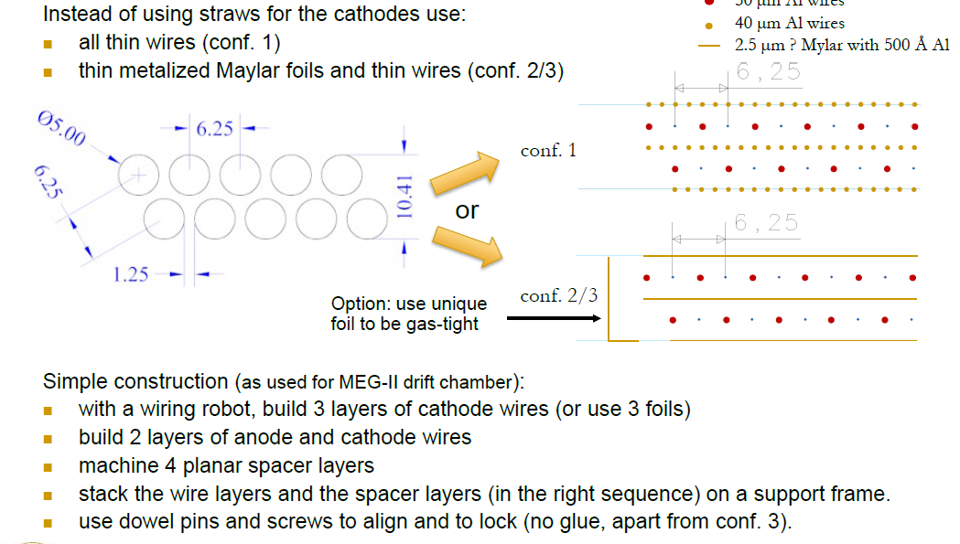
A possible alternative to Straws
Assumption:
20 µm W wires
50 µm Al wires
40 µm Al wires
2.5 µm Mylar with 500 Å Al
G.F. Tassielli DPF2021

Slide 10
Summary
Planning on hosting an online workshop in middle of August
Simulations to study the expected performance and to evaluate different options in ongoing:
    Using Geant-4 simulation looking into different tracker geometries
    Toy MC being developed to estimate electron energy resolution based on parameters of the tracker, stopping target, and proton absorber.
    Tracker designs being tested by simulation and building prototypes:
Initial batch of 8 𝜇m thin straws have passed multiple material requirements.
    Purchase of metalized prototype batch has run into significant delays in material procurement.
    Designed test stand for determining amount and type of metallization required of the straws
    Material tests on the initial batch continue.
Developing techniques in Tracker construction
    Building a small prototype with inflated straws
    Material testing on overlapped seam straws

