Slide 1
CC* Campus Engagement Update
Lauren Michael, Research Facilitation Lead opensciencegrid.org OSG Council Meeting, June 24, 2021

Slide 2
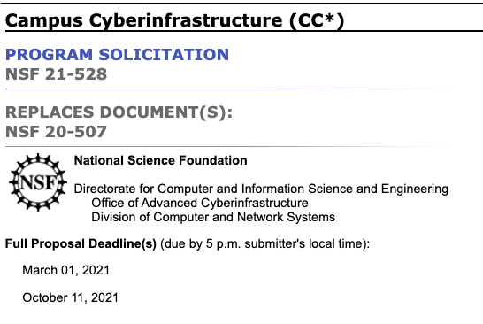
Support for CC* Awards
Notes:
Reminder of OSG’s noted role in CC* solicitation.

Slide 3
Support for CC* Awards
Consulting for Your Proposal
Science drivers
OSG integration
Support Letters
>60 letters provided since 2019
cc-star-proposals@opensciencegrid.org
https://opensciencegrid.org/campus-cyberinfrastructure
Notes:
Reminder of proposal services.

Slide 4
CC* Awards, Letters, CEs
 | 2019 | 2020 | 2021
‘Compute’ Letters Provided | ~20 (1) | 24 (4) | 9 (5)
New OSG Engagement⁺ due to CC* | 6 (1) | 10 (4) | 7 (4)
Compute’ ‘Awards w/OSG Letters | 11 (1) | 18 (?) | TBD
‘Compute’ Awards w/o OSG Letters | 1 | 1 | TBD
Awards w/ CE (today) | 9 (1) | 8[2] | TBD
⁺ To Lauren’s best knowledge () refer to non-’Compute’ categories, e.g. Networking, Regional, Integration, Planning, Cyberteam, etc.
[In progress]
Notes:
We didn’t yet track which non-Compute proposals were awarded (that we provided letters for), but can review NSF records to determine those.

Slide 5
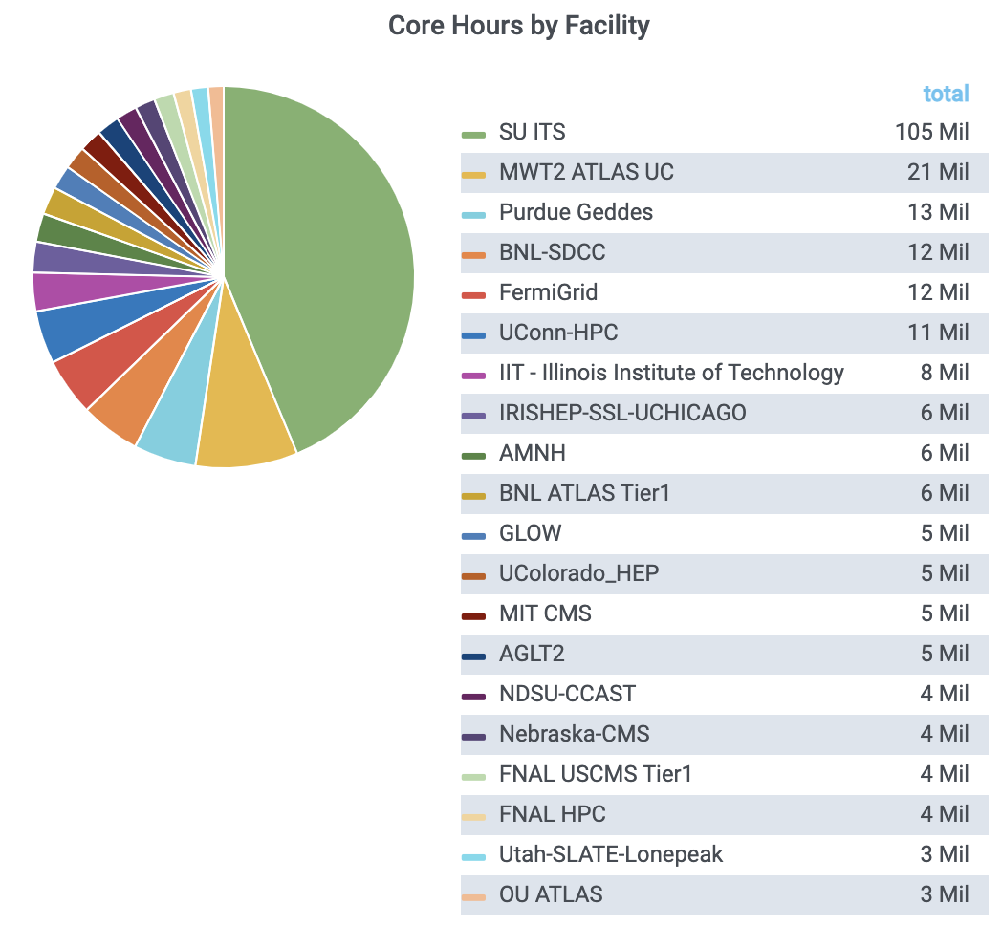
Institutions Supporting the OSPool in the Last Year!
58 Campuses in the last year (5 new since OSG AHM)
18+ of 29 committed 2019 & 2020 CC* awardees are already sharing
https://opensciencegrid.org/campus-cyberinfrastructure
https://gracc.opensciencegrid.org/d/000000077/open-science-pool-all-usage?orgId=1
Notes:
5 new campuses contributing since AHM, 3 of which are CC*. Lauren is intentionally not naming committed campuses who are not yet sharing (some delayed by pandemic-related staffing or infrastructure issues) in these slides, so as not to draw negative attention in ‘public’ slides, but we’ve been in touch with them.

Slide 6
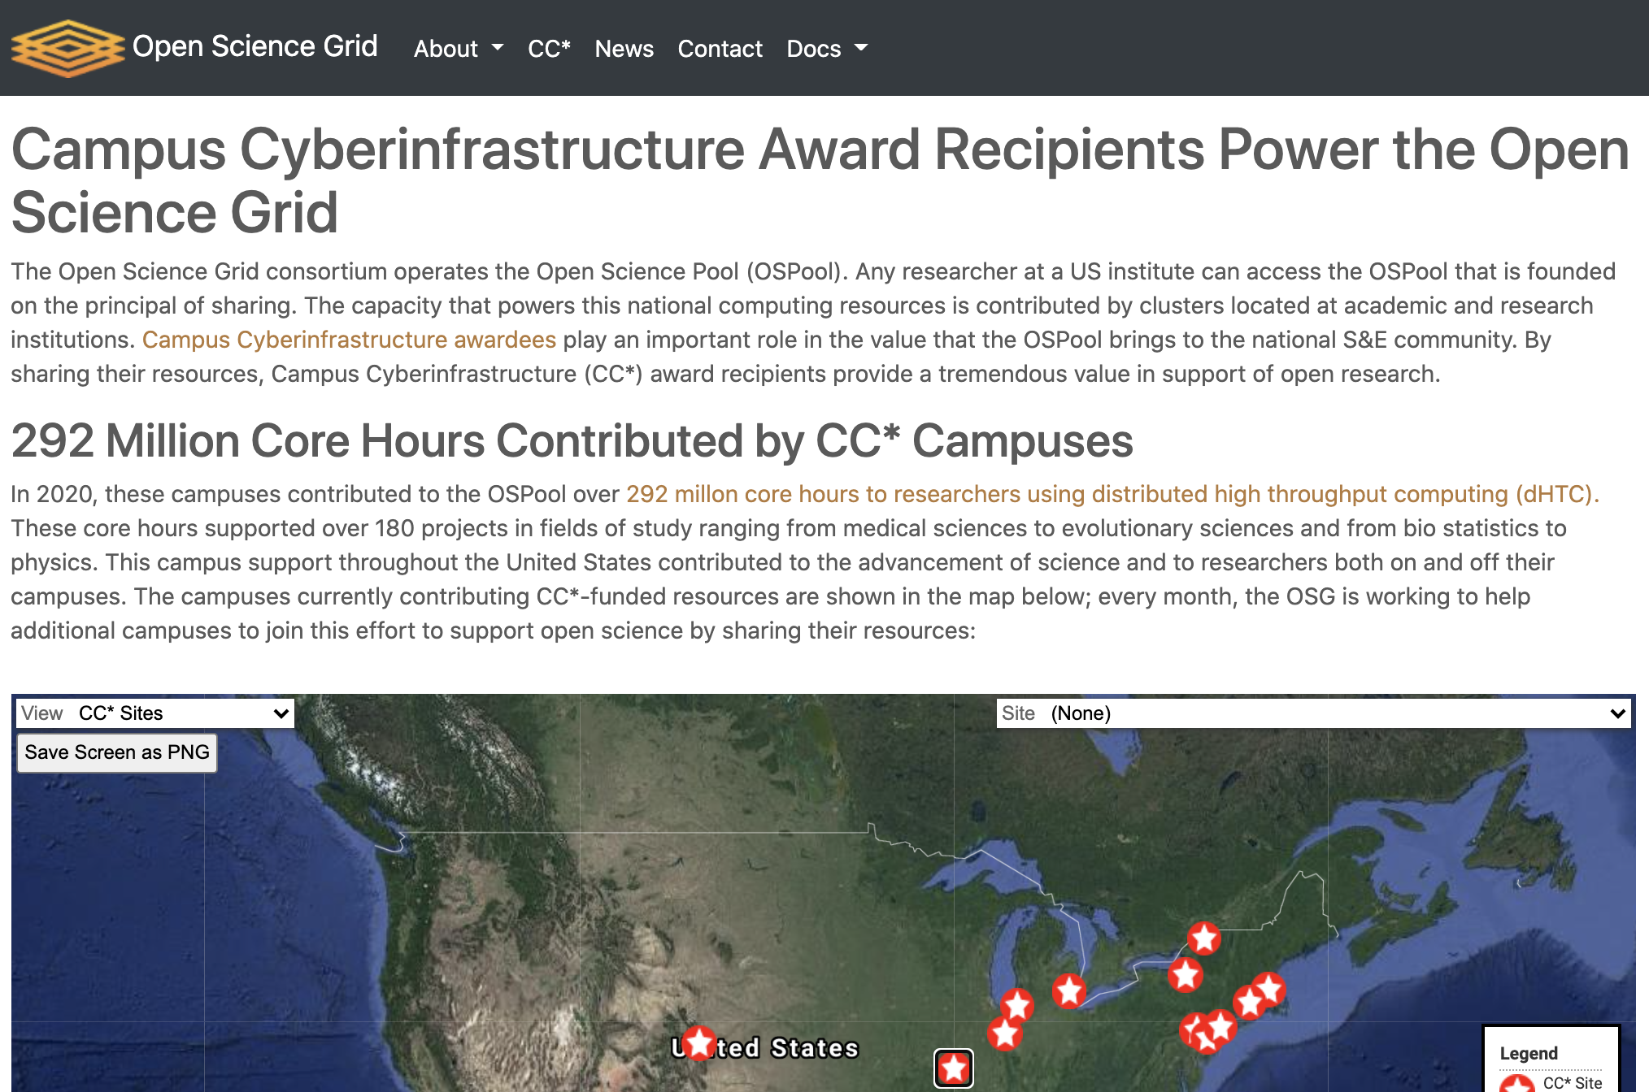
https://opensciencegrid.org/campus-cyberinfrastructure
Notes:
List of campuses contributing is at the bottom of this page. Slides not naming committed campuses who are not yet sharing (some delayed by pandemic-related staffing or infrastructure issues, so as not to draw negative attention in ‘public’ slides, but we’ve been in touch with them.

Slide 7
https://opensciencegrid.org/campus-cyberinfrastructure
Notes:
List of campuses contributing is at the bottom of this page. Slides not naming committed campuses who are not yet sharing (some delayed by pandemic-related staffing or infrastructure issues, so as not to draw negative attention in ‘public’ slides, but we’ve been in touch with them.

Slide 8
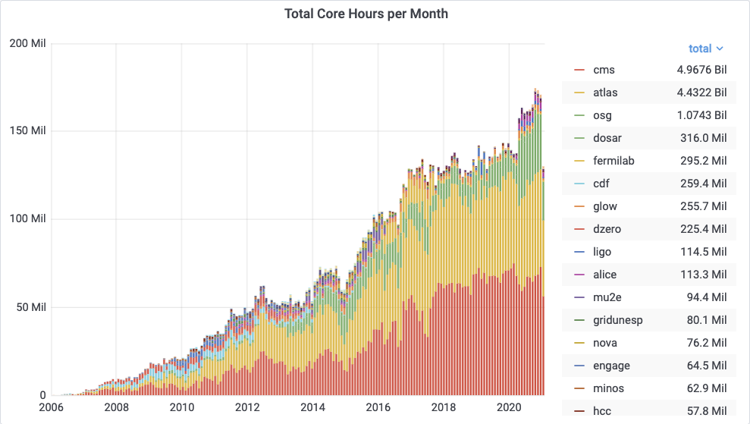
“Open Science Pool”
single researchers/groups (OSG Connect), smaller multi-institution collaborations, & campus access points
gracc.opensciencegrid.org
Notes:
Reminder of OSPool within OSG portfolio

Slide 9
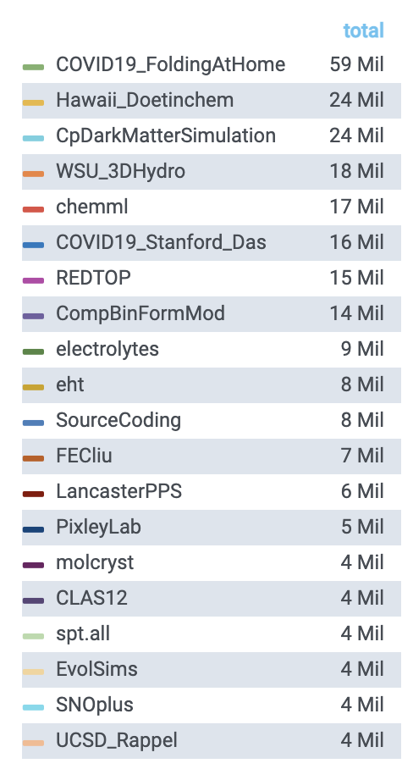
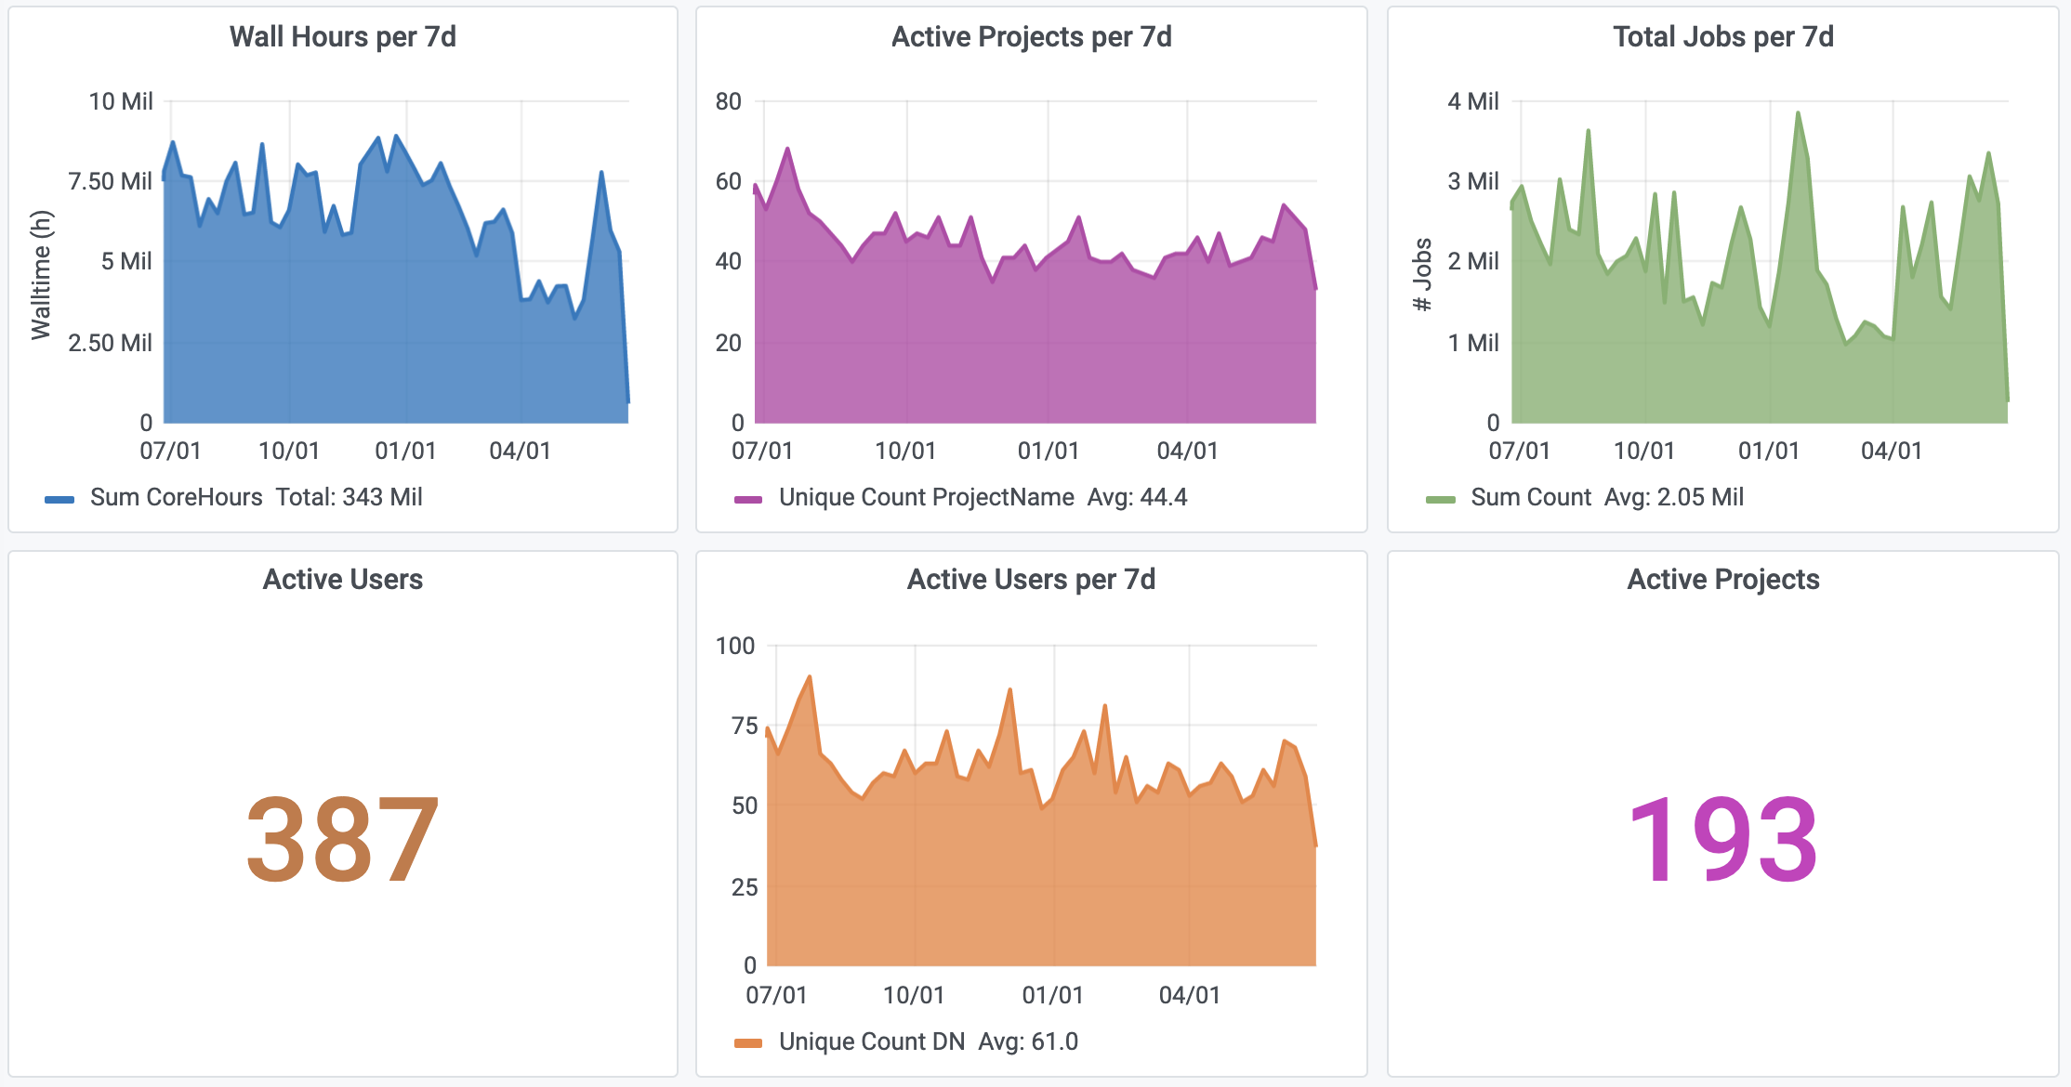
Open Science Pool in the last year
https://gracc.opensciencegrid.org/d/000000077/open-science-pool-all-usage
https://gracc.opensciencegrid.org/d/000000037/payload-jobs-summary
Notes:
10 new projects since AHM

Slide 10
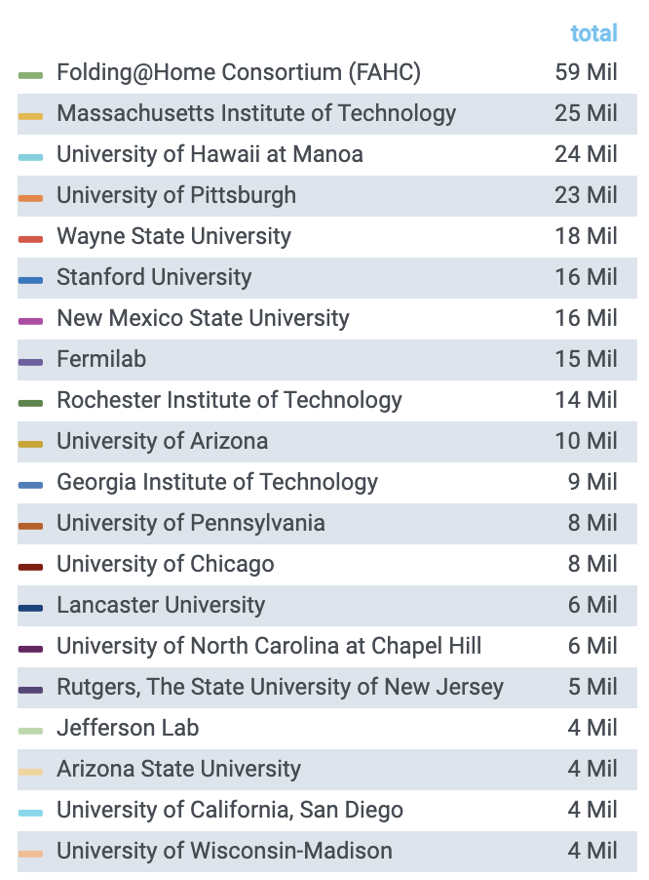
Institutions with Projects using the Open Science Pool in the Last Year!
193 projects from >95 campuses
(top 20 at right)
25+ from campuses with recent CC* awards in collaboration with OSG
35+ projects from non-R1
https://gracc.opensciencegrid.org/d/000000077/open-science-pool-all-usage?orgId=1

Slide 11
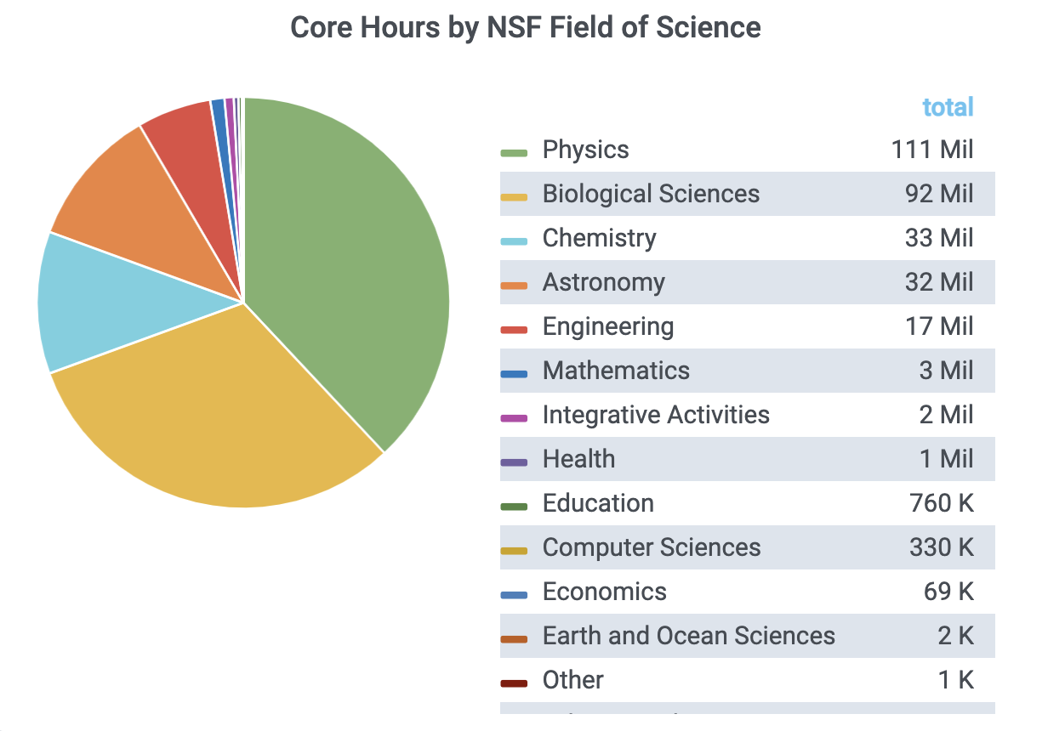
OSPool Impact
https://gracc.opensciencegrid.org/d/000000077/open-science-pool-all-usage?orgId=1
Notes:
As COVID-19 work has wound down, Biological Sciences usage has gone down.

Slide 12
Organizations with Access Points into the Open Science Pool
Organizations (top in 2020) | Core Hours
Massachusetts Institute of Technology | 33.8M
South Pole Telescope | 4.01M
XENON | 2.33M
University of Chicago | 2.12M
Duke University | 1.66M
American Museum of Natural History | 1.28M
University of Southern California (ISI) | 435K
Snowmass | 207K

Slide 13
Questions
Lauren Michael, lmichael@wisc.edu
Research Computing Facilitator, UW-Madison
Research Facilitation Lead (campuses and researchers), OSG
PATh co-PI
This work was partially supported by the NSF grants OAC-2030508, OAC-1841530, OAC-1836650, and MPS-1148698

