Slide 1
Gas Argon TPC R&D for CEvNS
Zhenzhong (Jack) Xing
Supervisor: Jacob Zettlemoyer
5 mins 5 slides
15 June 2021

Slide 2
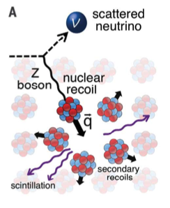
Coherent elastic neutrino-nucleus scattering (CEvNS)
Characteristics
Low energy neutrino (usually below MeV)
Cross section ∝ number of neutrons in the nucleus
Cross section large enable, more event, small size detectors
Limits
Low energy nuclear recoil hard to detect due to low neutrino energy and heavy target nucleus
Akimov, D., et al. “Observation of Coherent Elastic Neutrino-Nucleus Scattering.” Science, vol. 357, no. 6356, Sept. 2017, pp. 1123–26, doi:10.1126/science.aao0990.

Slide 3
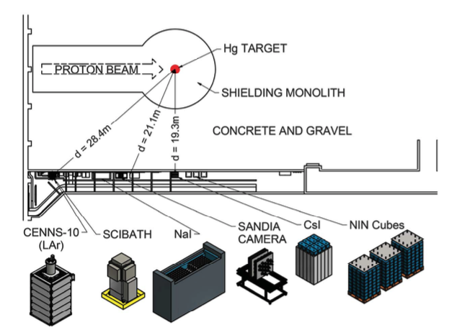
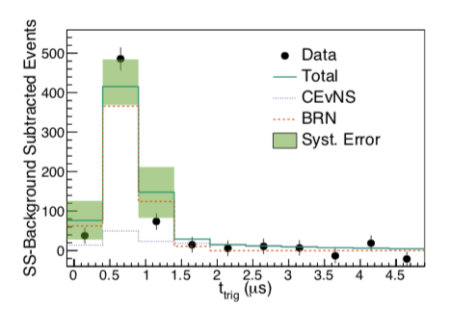
COHERENT detectors
CsI detector First observation of CEvNS
Akimov, D., et al. “Observation of Coherent Elastic Neutrino-Nucleus Scattering.” Science, vol. 357, no. 6356, Sept. 2017, pp. 1123–26, doi:10.1126/science.aao0990.
CENNS-10 (LAr) detector
COHERENT Collaboration, et al. “First Measurement of Coherent Elastic Neutrino-Nucleus Scattering on Argon.” Physical Review Letters, vol. 126, no. 1, Jan. 2021, p. 012002, doi:10.1103/PhysRevLett.126.012002.

Slide 4
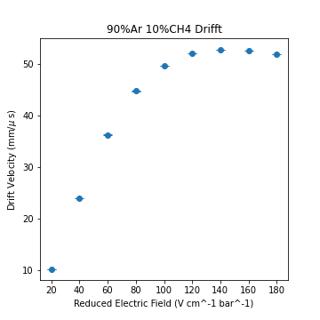
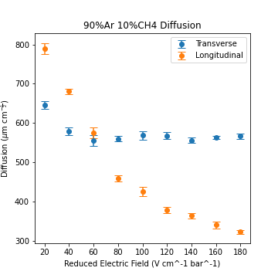
My Project (Track the Recoil)
Improve the lower energy threshold and spatial resolution
Investigate the electron transportation and minimize diffusion in high-pressure noble gas
PyBoltz (cython-based Monte Carlo Simulation Code)

Slide 5
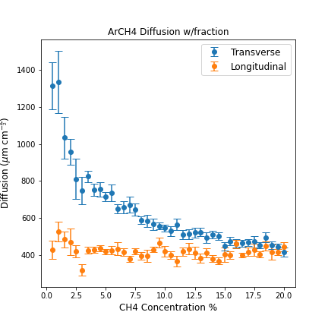
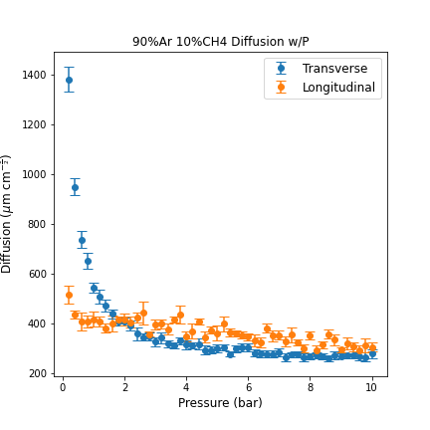
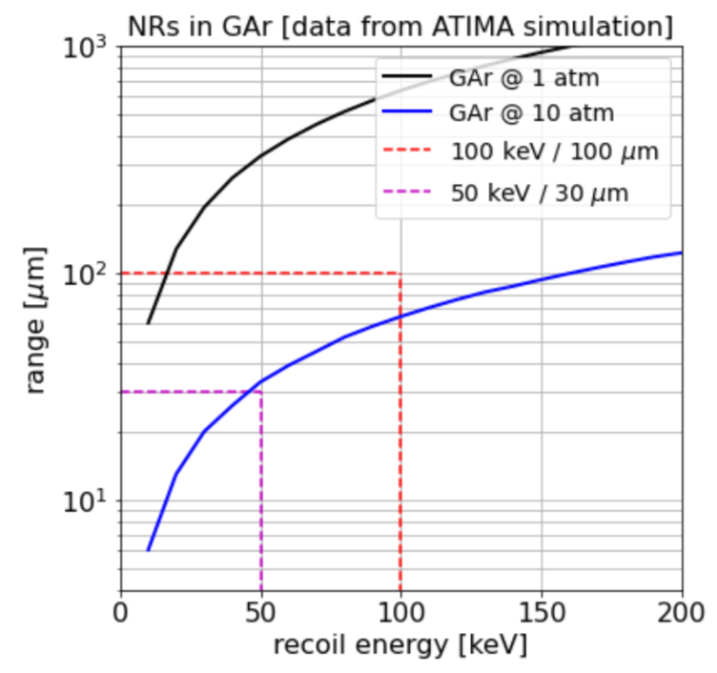
Some Challenges
Concentration vs. Electron Attachment
Pressure vs. Recoil Range

Slide 6
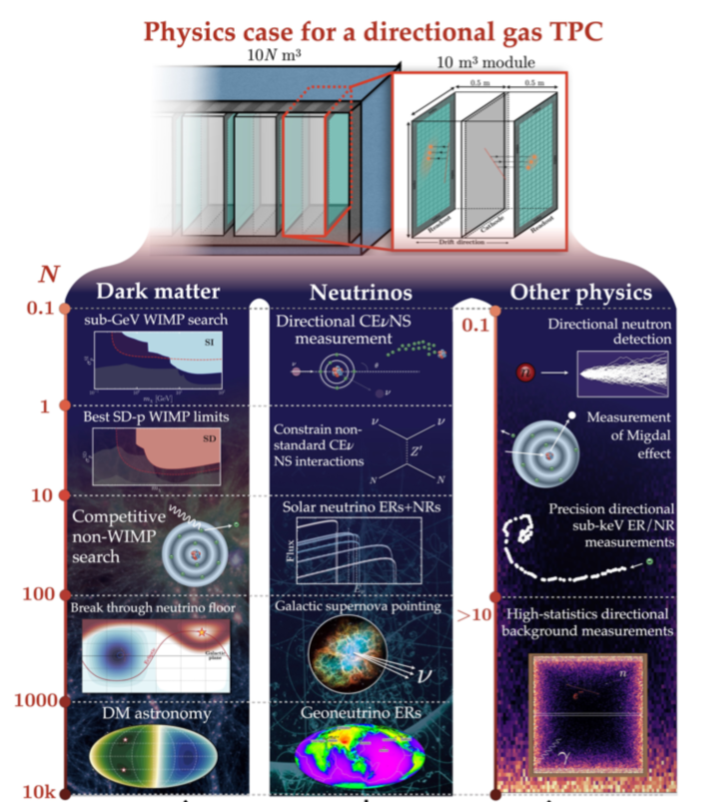
Potential Application
Vahsen, S., et al. Directional Recoil Detection. 2021, https://www.semanticscholar.org/paper/Directional-recoil-detection-Vahsen-O%27Hare/569586658ab403dd6b187201614799706f103e58.

