Slide 1
MicroBooNE Radon Doping and Precision Energy Measurements
Elise Chavez
Supervisors: Joseph Zennamo and Fernanda Psihas
GEM – University of Wisconsin-Madison
06/3/2021

Slide 2
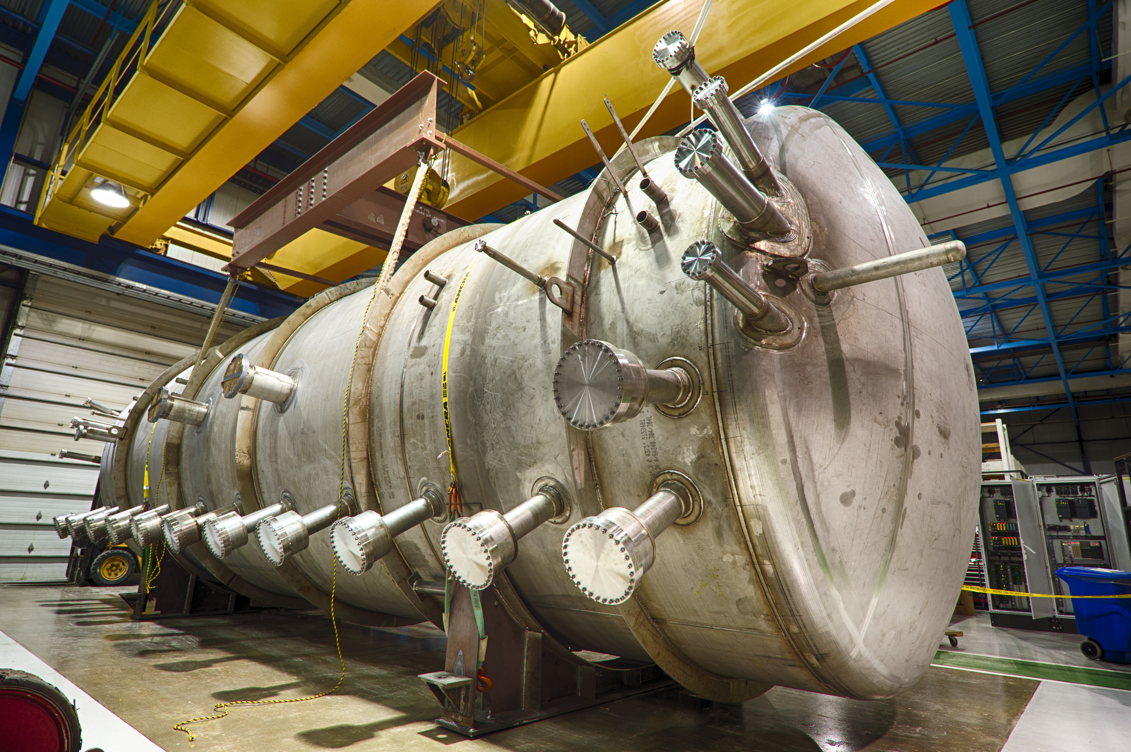
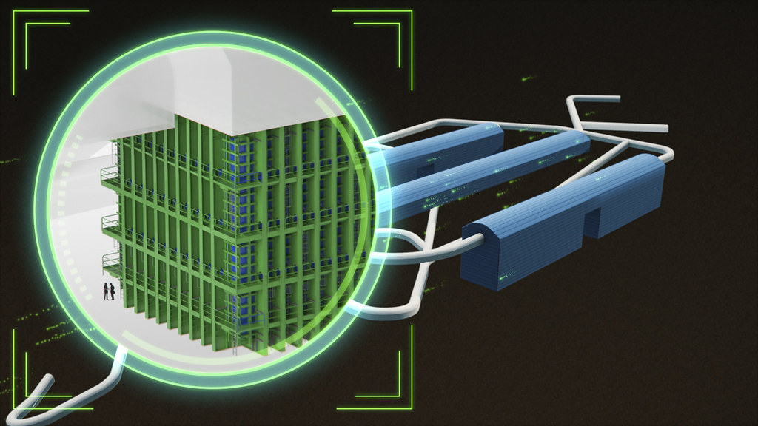
MicroBooNE and DUNE
MicroBooNE
40 feet long, 170-ton Liquid-Argon Time Projection Chamber (LArTPC) located on the booster neutrino beamline
Well understood and very precise MeV scale detector
Taking data 2015-2020
DUNE
Deep Underground Neutrino Experiment
Two detectors: one at Fermilab located at the long baseline neutrino facility (LBNF) along the world’s most intense neutrino beam and one at Sanford Lab
Sanford will have four LArTPC detector modules, totalling 70,000 tons of liquid argon, the near detector will also be made of LArTPCs
An image of the MicroBooNE LArTPC detector.
A rendering of the planned underground detectors at Sanford Lab.

Slide 3
MicroBooNE and DUNE
MicroBooNE
40 feet long, 170-ton Liquid-Argon Time Projection Chamber (LArTPC) located on the booster neutrino beamline
Well understood and very precise MeV scale detector
Taking data 2015-2020
DUNE
Deep Underground Neutrino Experiment
Two detectors: one at Fermilab located at the long baseline neutrino facility (LBNF) along the world’s most intense neutrino beam and one at Sanford Lab
Sanford will have four LArTPC detector modules, totalling 70,000 tons of liquid argon, the near detector will also be made of LArTPCs
An image of the MicroBooNE LArTPC detector.
A rendering of the planned underground detectors at Sanford Lab.

Slide 4
MicroBooNE and DUNE
MicroBooNE
40 feet long, 170-ton Liquid-Argon Time Projection Chamber (LArTPC) located on the booster neutrino beamline
Well understood and very precise MeV scale detector
Taking data 2015-2020
DUNE
Deep Underground Neutrino Experiment
Two detectors: one at Fermilab located at the long baseline neutrino facility (LBNF) along the world’s most intense neutrino beam and one at Sanford Lab
Sanford will have four LArTPC detector modules, totalling 70,000 tons of liquid argon, the near detector will also be made of LArTPCs
We can use MicroBooNE for R&D of DUNE. Can DUNE be the next MeV scale detector?
An image of the MicroBooNE LArTPC detector.
A rendering of the planned underground detectors at Sanford Lab.

Slide 5
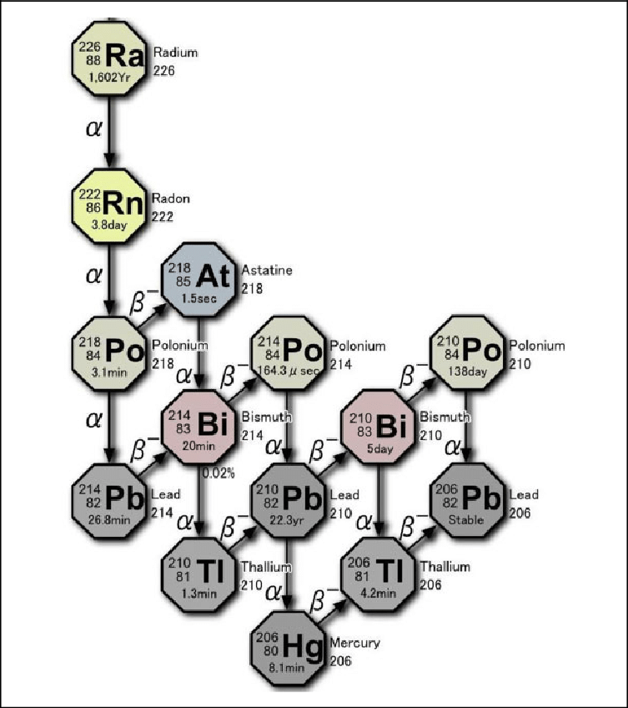
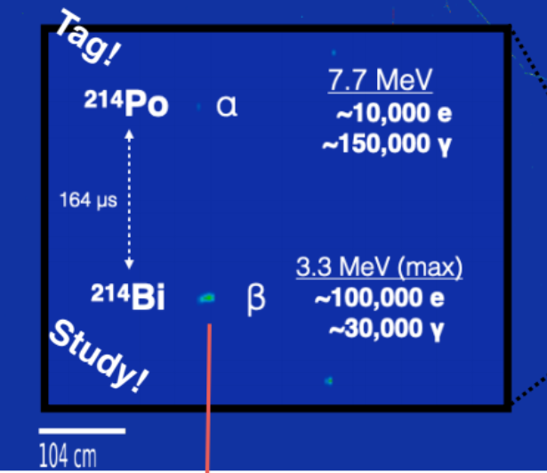
Radon Doping and Precision
What do we want to test?
How precisely we can measure energies in a LArTPC
Radon-222 doping allows us to examine the detector’s MeV scale response
We are interested in the Bi-214 and Po-214 which produce a taggable signal due to the Po-214 half-life
Known energies, will be used as a “standard candle”
Here is the desired signature we wish to observe and study.
The decay chain for radium 226, which includes the radon 222 decay.

Slide 6
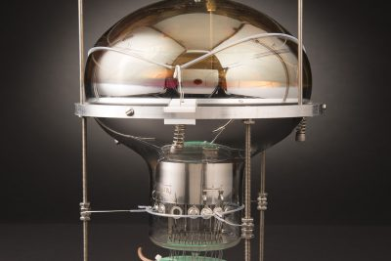
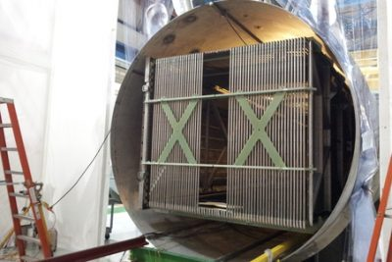
My Project – Data Taking
Aid in the data taking that will start in a week or so
I will be the first to look at the data
Joseph Zennamo’s Project
We are expecting about 550 events per second
Goals for this part of the project
Learn more about MicroBooNE, understand the details of how it works and how it collects/records data
Produce the energy spectrum we hope to compare to simulations, how precise is it
Learn more in general about data acquisition
And the coding techniques that go along with it
One of the photo-multiplier tubes (PMTs) installed in the LArTPC meant to detect light.
A picture of the time projection chamber.

Slide 7
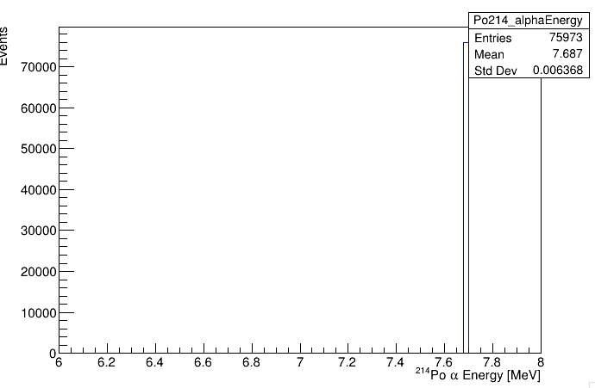
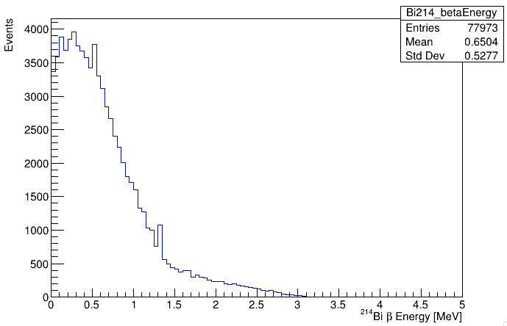
My Project – Analysis and Precision Energy
During or before data taking, I will work on simulations of what we expect to see from MicroBooNE
Precision
Expectations
Truth Spectrum
After the data taking, I will aid in analyzing the data we get from the doping
What does the $β$ spectrum look like?
What do we get for the $α$ energy?
What is the detector’s precision?
Goals
Learn more about fitting
Get back into coding/analysis
Events
Po-214 Alpha Energy (MeV)
Alpha Energy spike.
Events
Bi-214 Beta Energy (MeV)
Beta energy spectrum.

Slide 8
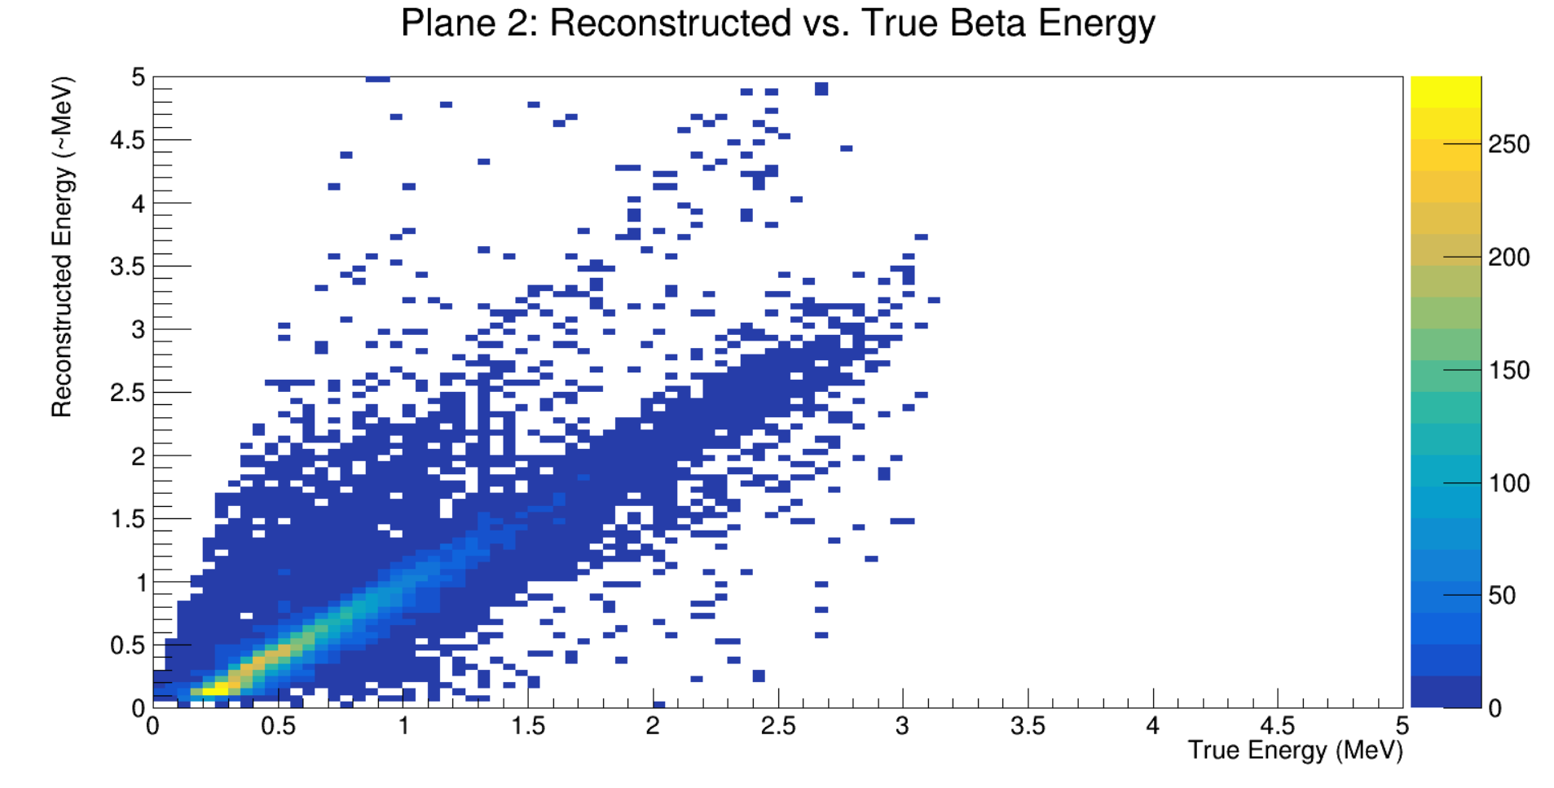
Where am I now and what is next?
For now
Got started on the computers and helped our new intern
Fit the $β$ spectrum
Started looking at MicroBooNE simulation
What is Next?
Look at the comparison of True vs Reconstructed energy
Develop cuts with Joseph and Fernanda
Try to look at our regions of best precision
The first comparison plot of Reconstructed vs. True

Slide 9
Thank You!

