Slide 1
Anomalous Quench in Superconducting Coils
A Machine Learning Perspective
Ashlae Blume
Fermilab June 2021
Scientific Computing Division

Slide 2
The Physics
Fermilab uses high-energy superconductors for particle physics experiments.
These are built using coils of magnetic material that are about 1/2" in diameter. The coils carry current that becomes supercharged at levels up to 14.5 TeV
As the current is varied from i=0, physical imperfections arise in the coil
These imperfections lead to an energetic saturation called a quench. This is the same phenomenon as in seismic activity, where a rift, break, or imperfection occurs in a material.
The quench is audible, and can be detected using acoustic sensors placed at the beam site
As such, superconducting magnets must be trained by gradually raising the current to approach full capacity

Slide 3
The Problem
Quench is not a well understood problem
nonlinear system
industrial environmental noise
Anomalies in machine operating sounds occur before the magnet saturates and are audible. The goal is to predict the quench before it happens to avoid a total shutdown of the experiment. This can be costly at best, and dangerous at worst due to the sudden buildup of energy in the beam.
The goal of my project is to determine when the magnet is going to quench by comparing anomalous and normal audio data from the magnet under normal operating conditions.

Slide 4
Methods
The DCASE Challenge is a tutorial for anomaly detection in industrial applications
We explore a variety of methods used to determine anomaly scores for the data
Keras model is run to train and test anomaly score for the data
Execute various low-level MIR tasks to the audio data for analysis
Statistical analysis and an isolation forest let us compare anomaly regions

Slide 5
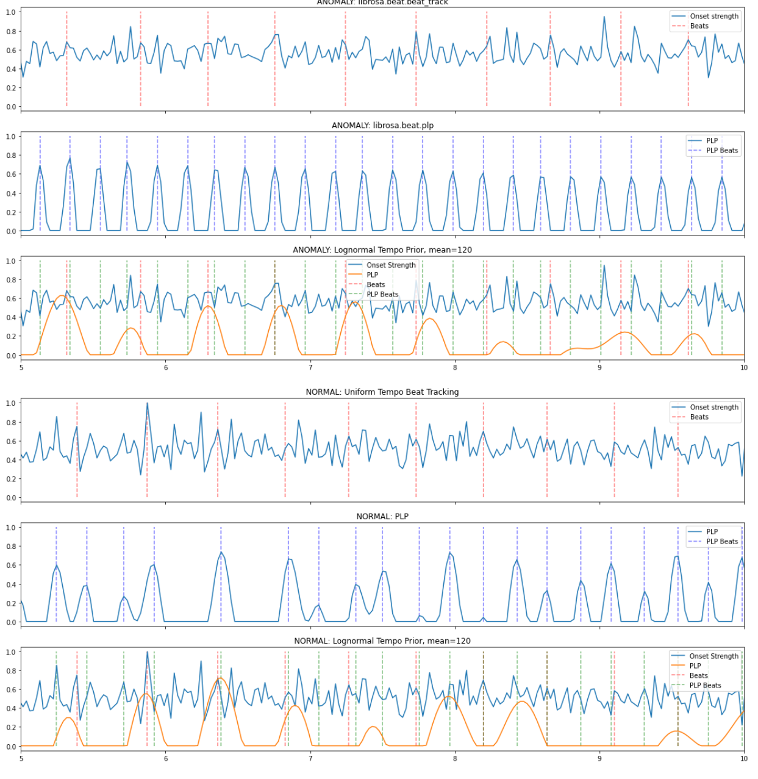
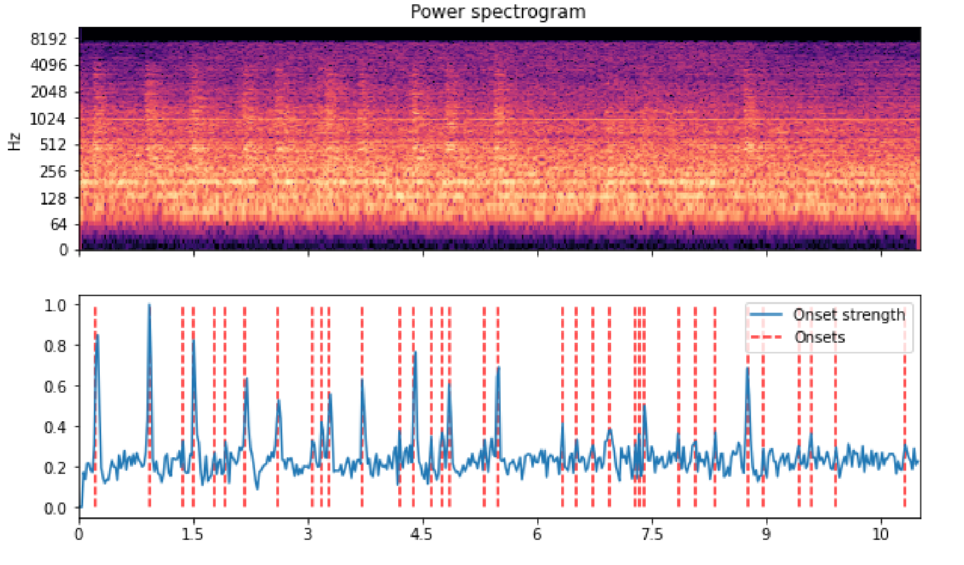
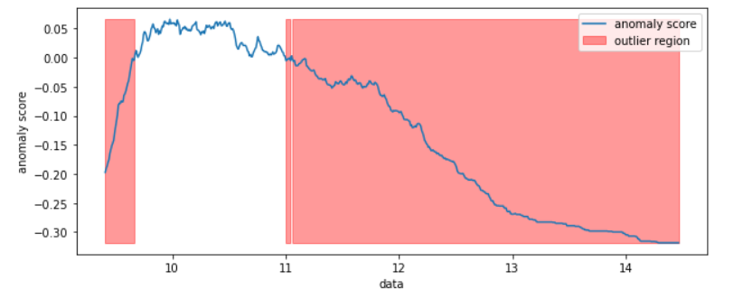
Results

Slide 6
The Future
The eventual goal is to use the info from anomaly detection to set an audio pattern at the beam site that will give ample notice of the anomalous sounds in the machine.
This will be deployed using low power applications of machine learning: tinyML

