Slide 1
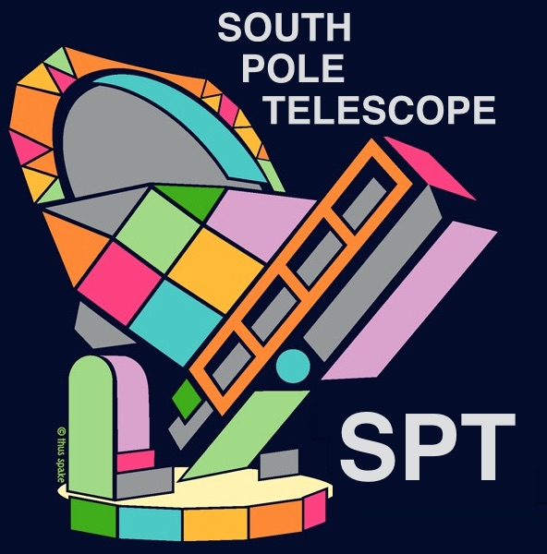
Search for Cosmic Strings using SPT Data
Ebtihal M. Abdelaziz
Supervisor: Adam Anderson
SIST 5 minutes, 5 slides
6/16/2021

Slide 2
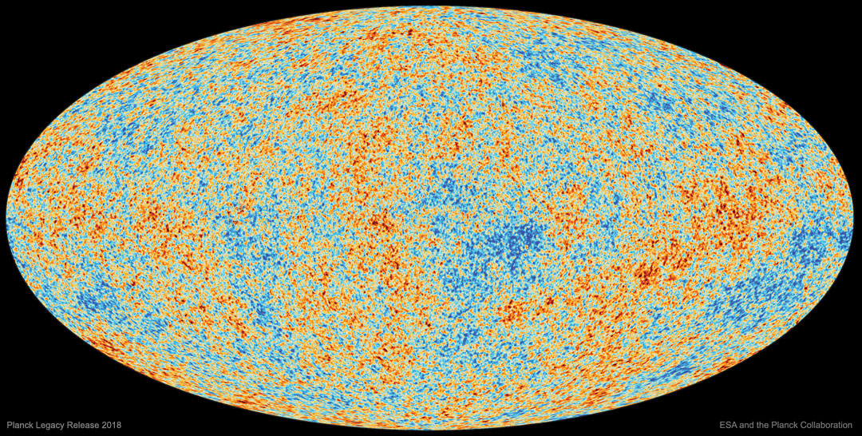
Cosmic Microwave Background
Formed about 380,000 years after the Big Bang
Helped us measure cosmic parameters to a great agreement with theory
CMB maps show fluctuations in temperature or polarization
It is measured by microwave telescopes such as the South Pole Telescope (SPT)
Cosmic Strings have been constrained to be less than 10% of the total CMB anisotropy

Slide 3
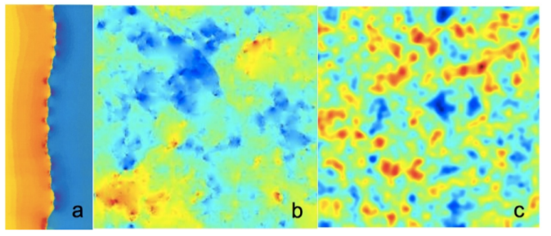
Cosmic Strings
Strings are linear topological defects
Allowed by the standard model of physics
Have not been detected before
Possible detection methods include finding their power spectrum and edge detection algorithms
a) a line-discontinuity in CMB temperature caused by a single string on a uniform background (image provided by Proty Wu and Paul Shellard, (J.H.P.Wu PhD thesis, U. of Cambridge, 2000)). b) anisotropy caused by a network of strings alone (0708.1162). c) anisotropy caused by a network of strings with CMB anisotropy (1004.2885) .

Slide 4
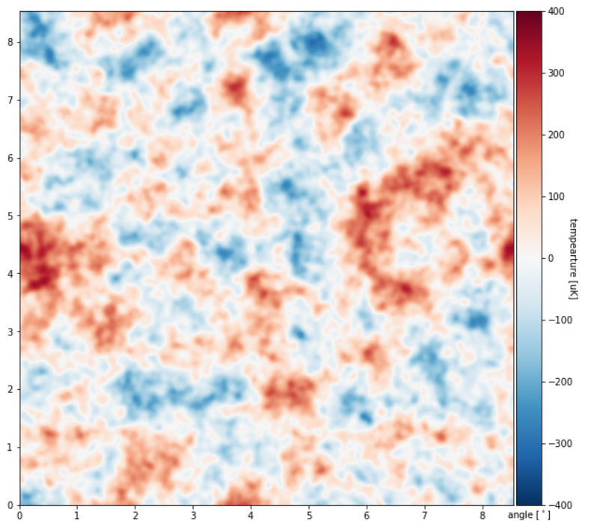
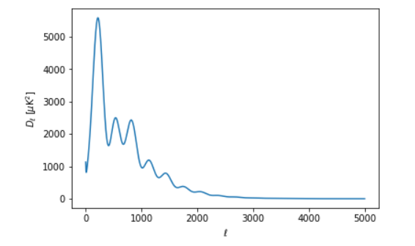
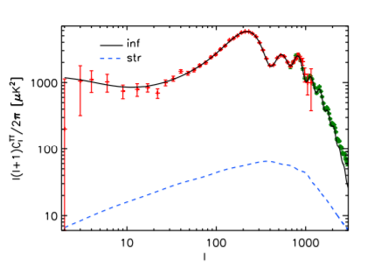
Power Spectrum
(Pictures from CAMB)
Amplitude squared of anisotropies
Fourier
Transform
(Picture from Dvorkin et al.)
Angular scale

Slide 5
Fisher Forecast
Tells us about the maximum uncertainties in the values we are trying to measure
(Picture from Dvorkin et al.)
References
Physics Today 68, 3, 28 (2015); doi: 10.1063/PT.3.2718
M. Landriau and E. Shellard, Phys.Rev. D83, 043516 (2011), 1004.2885.
A. A. Fraisse, C. Ringeval, D. N. Spergel, and F. R. Bouchet, Phys.Rev. D78, 043535 (2008), 0708.1162.
Dvorkin C, Wyman M, and Hu W. 2011. “Cosmic String Constraints from Wmap and the South Pole Telescope Data.” Physical Review D - Particles, Fields, Gravitation and Cosmology 84 (12). https://doi.org/10.1103/PhysRevD.84.123519.

