Slide 1
Teaching Machines to “See” Diffuse Galaxies
Name: Caleb Levy
Advisor: Alex Drlica-Wagner
5 minutes, 5 slides
Notes:
Hello everybody! My name is Caleb Levy and today I will be talking about my project this summer which is on detecting low surface brightness galaxies using machine vision algorithms

Slide 2
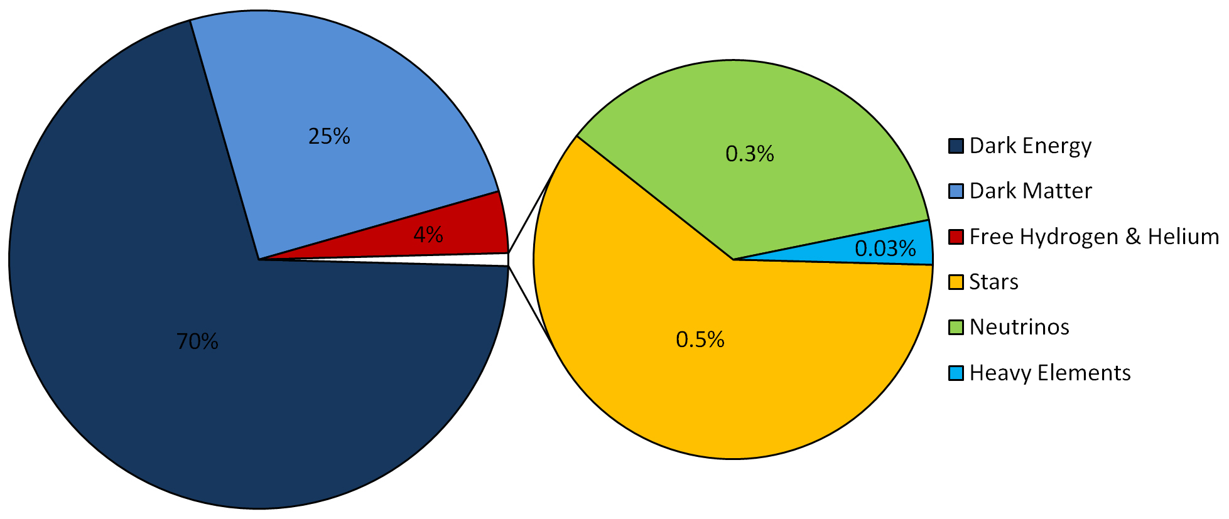
Background
Dark Matter makes up most of the matter in the universe.
But we know almost nothing about it!
How can we get a better picture of Dark Matter’s role in the universe?
Notes:
I’d like to start with some brief background and the overarching motivation for this project, which is to better understand dark matter.
As you can see in this pie chart depicting the composition of the universe, all of our everyday matter is completely overshadowed by the looming content of dark energy and dark matter.
While most physicists are relatively comfortable with this big picture of the universe, the details are a bit unnerving for most, considering we actually have no idea what form Dark Matter takes. The goal of my project this summer is to work towards a better understanding of Dark Matter by devising efficient ways to detect the most diffuse and dark matter dominated galaxies in the universe

Slide 3
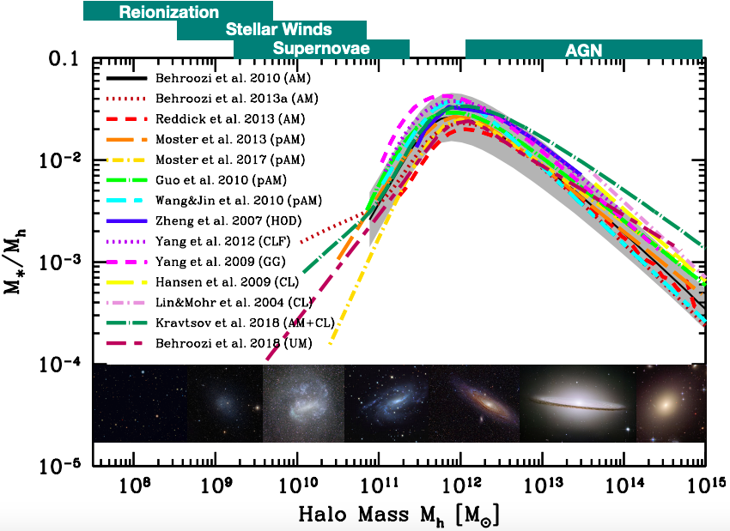
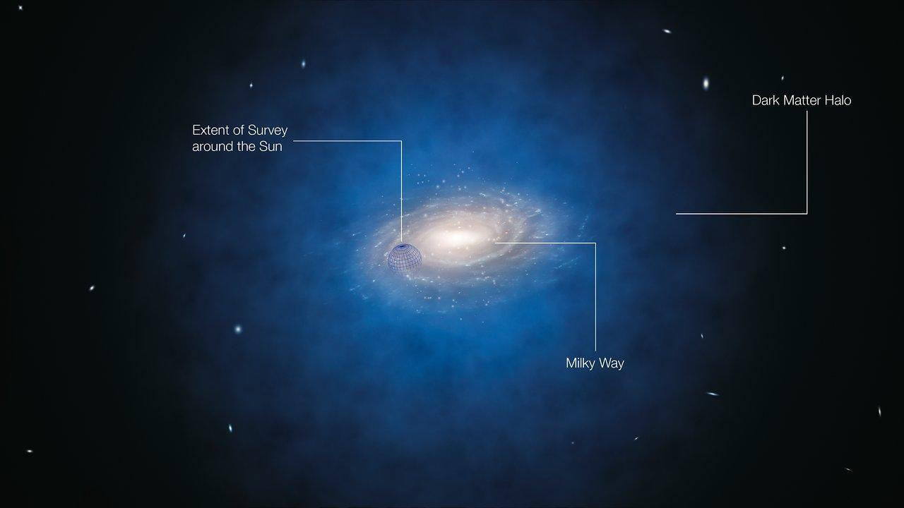
Galaxy-Halo Connection
Notes:
The connection we are drawing upon for understanding dark matter from galaxy observations is nicely described by this diagram.
On the x axis is the total mass of the dark matter halo that is hosting a galaxy, while the y axis is the fraction of that halo mass that is made of stars.
As one would expect, the majority of observations have been able to constrain this curve towards the higher halo masses, and especially when the stellar content is high as these galaxies appear very brightly
The galaxies we are interested in detecting are towards the lower end of this curve, where observational support is sparse.
These galaxies have low halo masses and are dominated by dark matter, making them very dim and generally difficult to detect

Slide 4
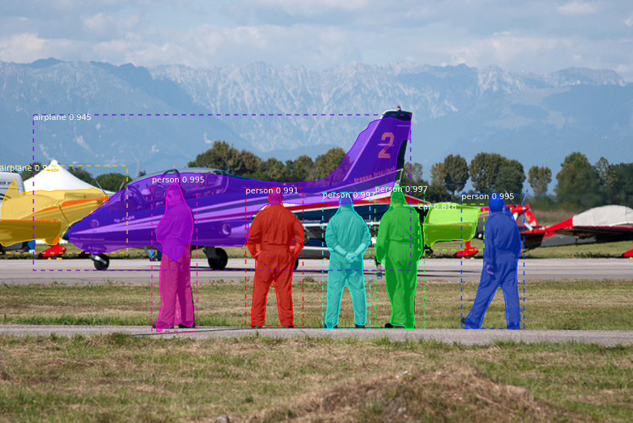
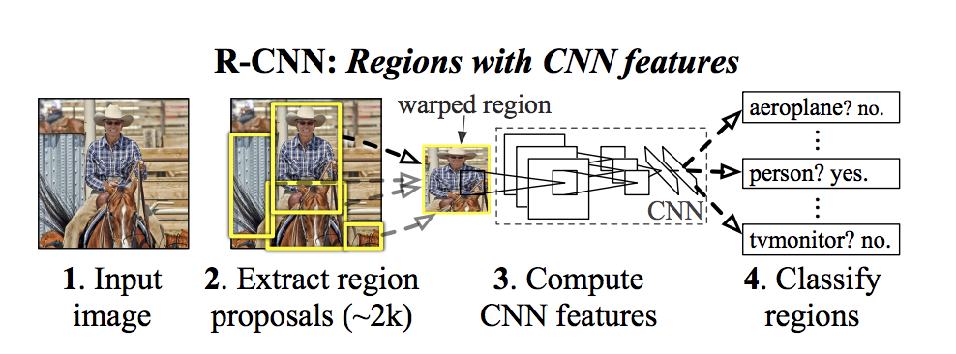
Computer Vision: Mask R-CNN
CNN: Convolutional Neural Network → Extracts Local Features
R-CNN: Region-based CNN → Puts boxes around objects
Mask R-CNN → Places mask around objects
Notes:
Our proposal is to use the machine learning algorithm mask R-CNN, which is a computer vision neural network useful for detecting objects in images and masking them. Our hope is that this algorithm can perform better than the standard algorithms, like the source extractor algorithm, in detecting diffuse galaxies.
Previous work in my advisor’s group has shown the tremendous potential of this algorithm in detecting faint objects and artifacts in Dark energy survery data

Slide 5
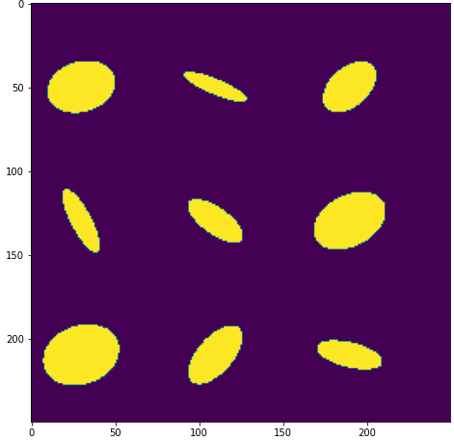
Project for Summer
Create model trained on simulated LSBGs
Compare detection sensitivity to standard algorithms
Use model to detect new LSBGs in DES data!
DES Image
Position of Simulated LSBGs

