Slide 1
“IT” Tasks to support the future program
Overview and Energy Frontier
Victoria White, Associate Lab Director for Computing and CIO
IT Professionals Meeting with Directorate
October 12, 2011

Slide 2
All scientific programs at the lab
Depend heavily (at all stages from inception to publication and beyond) on Computing:
  Facilities (power, cooling, space)
  Data storage and distribution
  Compute servers
  Grid services
  Databases
  High performance networks
  Software frameworks for simulation, processing, analysis
  Tools such as GEANT, ROOT, Pythia, GENIE
  General tools to support collaboration, documentation, code management, etc.
  DAQ & Trigger
  Controls

Slide 3
Tevatron RunII (CDF and D0)
Computing has been key to the enormous scientific output from these experiments and has grown in importance during the 25 years of the Tevatron and will continue throughout the LHC era.
  The availability of computing resources (dedicated and shared) has allowed quick and timely processing of the data and Monte Carlo simulations and supported 100’s of Tevatron users to complete their complex analyses.
CDF and D0 physics analysis will continue well past the end of Tevatron operations.
  We have committed to maintain analysis capabilities for 5+ years
  We have committed to maintain the Tevatron data for 10+ years

Slide 4
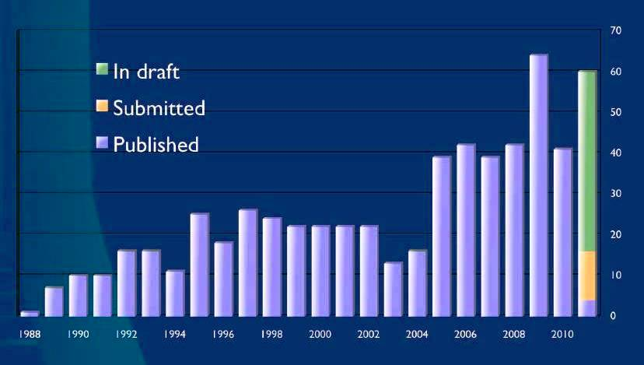
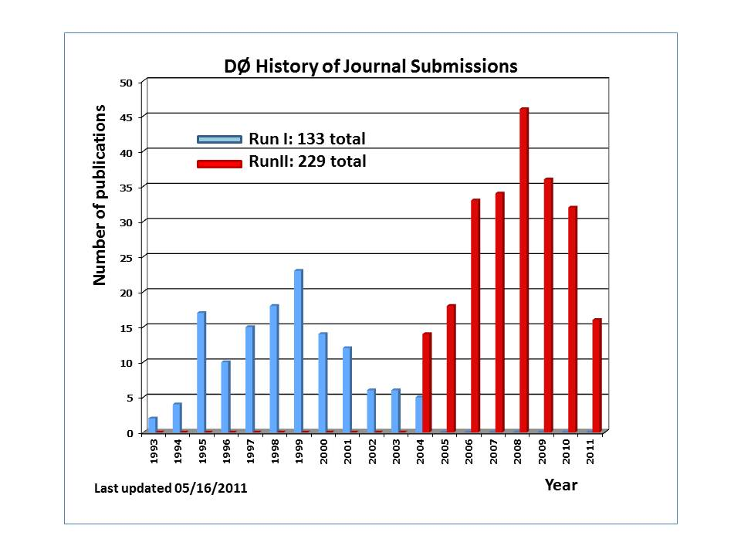
Tevatron – publications
CDF and D0 both have incredible publication rates – will be stable at least through 2012.
Analysis activity:
  Expect > 100 (students+ postdocs) actively doing analysis in each experiment through 2012.
  Expect this number to be much smaller in 2015 though data analysis will still be on-going.
CDF Publications each year
D0 Publications each year

Slide 5
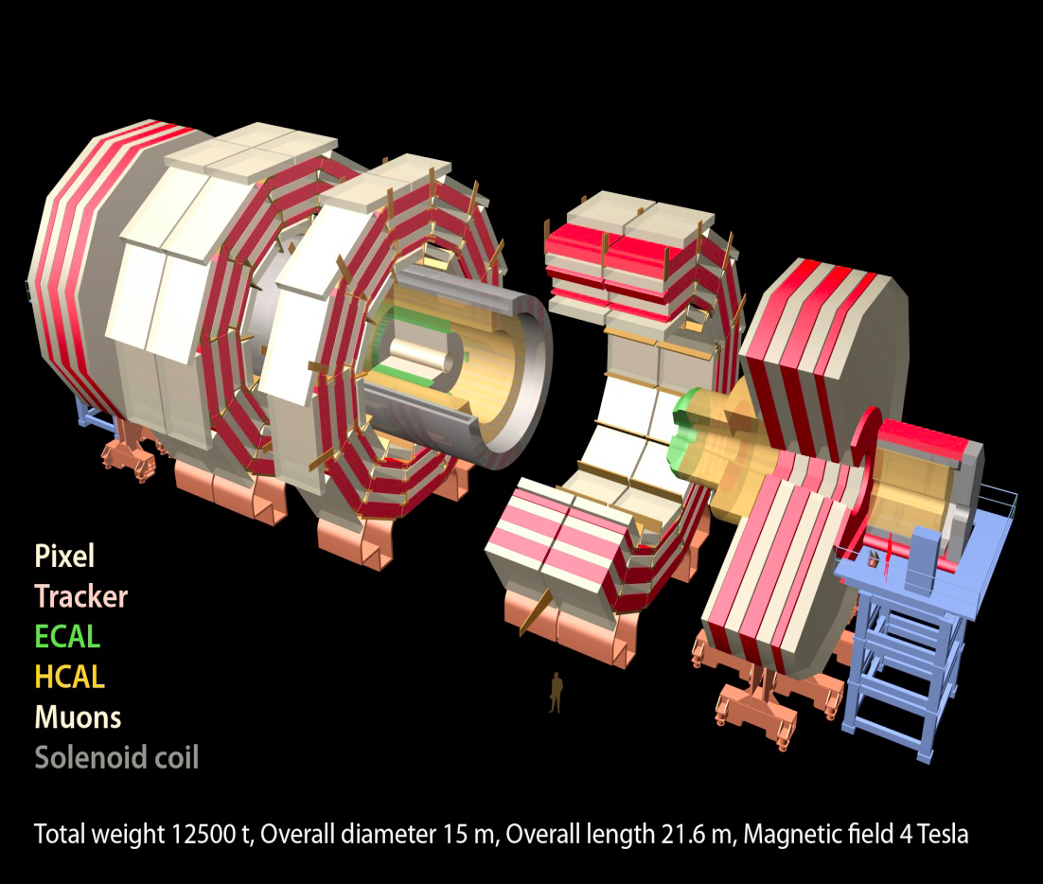
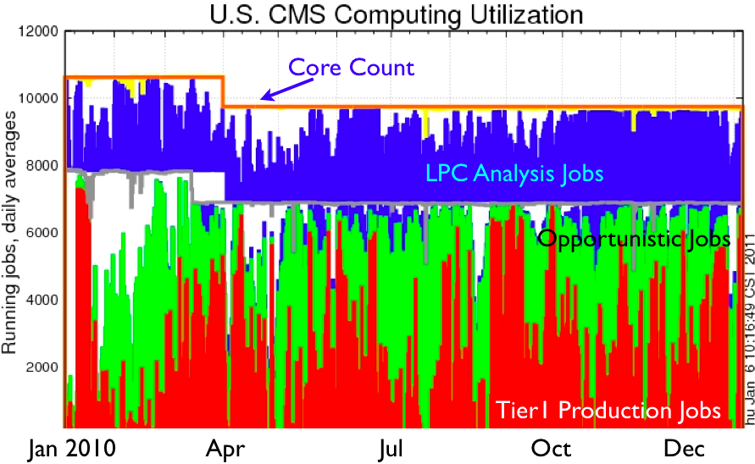
CMS Tier 1 at Fermilab
The CMS Tier-1 facility at Fermilab and the experienced team who operate it enable CMS to reprocess data quickly and to distribute the data reliably to the user community around the world.
Fermilab also operates:
LHC Physics Center (LPC)
Remote Operations Center
U.S. CMS Analysis Facility
Notes:
2010 Data Taking was successful. Scientific Results published within weeks of data being acquired.
Computing system has had flexibility to handle
trigger rates at 300 Hz and much higher in peaks, T0 kept up
more reprocessing passes than expected (19)
full 2010 pp dataset reprocessed in 10 days plus one week debugging/postmorterm
large transfer rates, full-mesh transfer topology
5 PB from T0 and other T1’s to T1
Most T2’s can get data from any T1 or T2
3.1 billion events simulated
with underlying experimental conditions changing throughout!
Workflows were performed at expected locations from Day 1
2011 will have quick startup, with peak luminosity for the year reached as soon as May -- 16 interactions/event!
RECO/AOD event sizes double from 2010 values to 0.8/0.2 MB/event

Slide 6
Computing Strategy for CMS
Continue to evolve the CMS Tier 1 center at Fermilab - to meet US obligations to CMS and provide the highest level of availability and functionality for the $
Continue to ensure that the LHC Physics Center and the US CMS physics community is well supported by the Tier 3 (LPC CAF) at Fermilab
Plan for evolution of the computing, software and data access models as the experiment matures – requires R&D and development
  Ever higher bandwidth networks
  Data on demand
  Frameworks for multi-core

Slide 7
Preparing for the future
Energy Frontier
LHC
Tevatron
LHC Upgrades
Lepton
Collider
MC and Data production and Analysis
Detector simulations and core software
Accelerator modeling, physics studies, framework
NuMI: 300kW @120 GeV
Booster
NuMI 700kW@ 120 GeV
Booster
Project X 2MW@120 GeV, 3 MW@3GeV, 200 kW@8 GeV
Neutrino
Factory
Intensity Frontier
120 GeV Neutrino Program
8 GeV Neutrino Program
 |  | Muon to electron conversion
 | Muon (g-2)
 |  |  | Rare Processes
 |  |  | Nuclear EDM
Time
….

Slide 8
Lattice Gauge Theory at Fermilab
Fermilab is a leading participant in the US lattice gauge theory computational program funded by 3 offices of the Office of Science
This program is overseen by the USQCD Collaboration, which consists of almost all the lattice gauge theorists in the US.
  USQCD’s PI is Paul Mackenzie of Fermilab.
The program’s purpose is to develop software and hardware infrastructure in the US for lattice gauge theory calculations.
  Software grant through the SciDAC program of ~ $2.3 M/year.
  Hardware and operations funded by the LQCD Computing Project of ~$3.6M/year.
  LQCD contractor project manager is Bill Boroski of Fermilab.
http://www.usqcd.org/

Slide 9
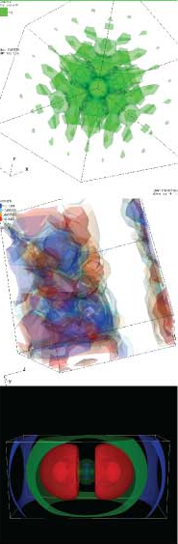
Physics drivers for future lattice gauge theory
Accomplishments have been enormous in the last decade, but much more will be required in the coming one:
In CKM phenomenology, already existing meson mixing experiments demand 0.5% precision from lattice QCD!
  Almost an order of magnitude better than we have done so far.
At the LHC, new results such as the search for BSM effects in B->μ−μ+ will demand new lattice calculations.
The LHC is likely to discover new sectors of physics, some of which are likely to be strongly interacting. New kinds of lattice calculations will be required to investigate them.
  1,000s of possibilities at present.

Slide 10
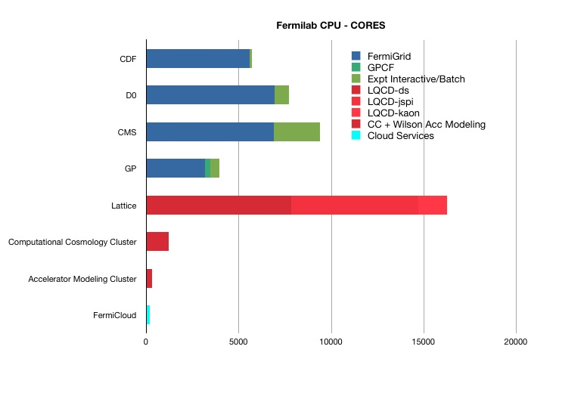
FNAL CPU – core count for science

Slide 11
Data Storage at Fermilab - Tape

Slide 12

Sharing via the Grid – FermiGrid
User Login
& Job
Submission
Open Science
Grid
TeraGrid WLCG NDGF
FermiGrid
Authentication/Authorization
Services
FermiGrid
Site
Gateway
FermiGrid
Infrastructure
Services
FermiGrid
Monitoring/Accounting
Services
GRIDFarm
3284 slots
D0
6916 slots
CDF
5600 slots
CMS
7485 slots

Slide 13
Core Computing – a strong base for science
Scientific Computing relies on Core Computing services and Computing Facility infrastructure
  Core Networking and network services
  Computer rooms, power and cooling
  Email, videoconferencing, web servers
  Document databases, Indico, calendering
  Service desk
  Monitoring and alerts
  Logistics
  Desktop support (Windows and Mac)
  Printer support
  Computer Security
  ….. and more
All of the above is provided through overheads

Slide 14
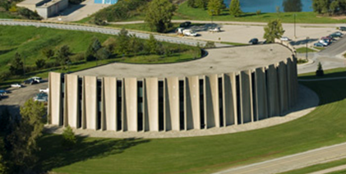
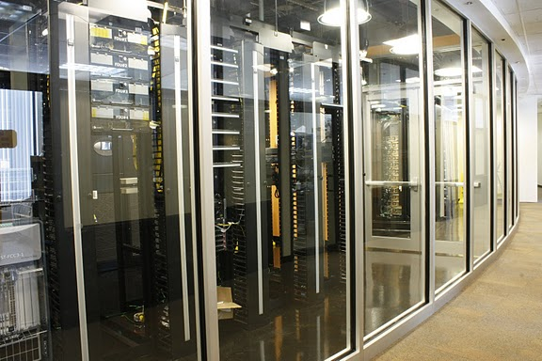
Fermilab Computing Facilities
Feynman Computing Center (FCC)
  High availability services – e.g. core network, email, etc.
  Tape Robotic Storage (3 10000 slot libraries)
  UPS & Standby Power Generation
  ARRA project: upgrade cooling and add HA computing room - completed
Grid Computing Center (GCC)
  High Density Computational Computing
  CMS, RUNII, Grid Farm batch worker nodes
  Lattice HPC nodes
  Tape Robotic Storage (4 10000 slot libraries)
  UPS & taps for portable generators
EPA Energy Star award 2010
Lattice Computing Center (LCC)
  High Performance Computing (HPC)
  Accelerator Simulation, Cosmology nodes
  No UPS

Slide 15
Reliable high speed networking is key for science

Slide 16
Core Computing Division Goals
Provide reliable and efficient computing centers for scientific programs and the lab
Provide the network infrastructure and services for scientific programs and the lab
Sustain and improve core IT services (used by scientific computing and the lab)
Modernize the lab’s information systems and services and work to improve business processes

Slide 17
Goal 3: Sustain and improve core IT services
“HelpDesk to Service Desk” PM Contract
ITIL/ISO20k Initiative Announced
HelpDesk Assessment
ISO20k Maturity Assessment
ITIL/ISO20k Roadmap Begins
FY2008
CD/PPD IT Consolidation
Begins
CD/MIS IT Consolidation Begins
“HELPDESK To Service Desk” “Go Live”
Server & Storage Virtualization
Strategy
ITIL Change, Configuration Processes
ITIL Incident, Problem Processes
Service Desk Staffing Contract
FY2009
CD/TD IT Consolidation
Begins
1st ITIL Problem Management Root Cause
TD Server Consolidations Begin
ITIL Capacity, Availability Processes
Service Management Organization
1st ITIL Change Management CAB
ID Management Kickoff
ITIL Service Continuity Process
FY2010
Email Modernization Kickoff
TD Server Consolidations Complete
Service Now Business Case
Service Now POC & RFP
Managed Services Initiative
ID Management POC’s
~100 Servers Virtualized
FY2011
Email Modernization “Go Live”
Service Now “Go Live”
Managed Services “Go Live”
ID Management Phase 1
ISO20k Certification
~130 Servers Virtualized
FY2012

Slide 18
Conclusion
IT professionals at the lab should be proud of the tremendous successes of the Tevatron, LHC, Lattice QCD and other programs – could not have done it without you.
The Energy Frontier has continuing demands on computing and IT professional help
Efficient, cost-effective, well focused IT services and Information Systems will really help the lab to carry out it’s work and better support the future scientific programs
  We need your help to get there!

