Slide 1
Bridging the Gap Between Simulations and Survey Data:
Domain Adaptation for Merging Galaxy Classification
Kathryn Downey
A. Ćiprijanović, D. Kafkes, S. Jenkins, G. N. Perdue, S. Madireddy, T. Johnston, G. F. Snyder, and B. Nord

Slide 2
Talk Outline
Galaxy Mergers
Why are they important?
How do we identify them?
Domain Adaptation Neural Networks
What are they?
Why are they better than the standard classification methods?
How does it bridge the gap between simulated and real data?
Our Network
Input datasets
Performance

Slide 3
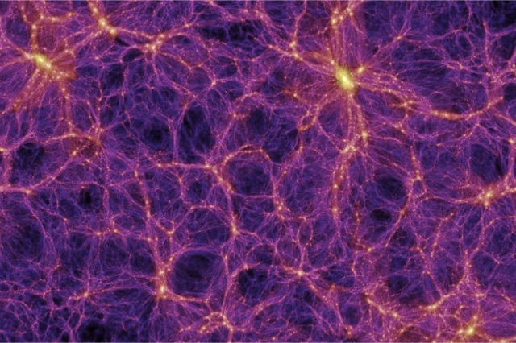
Importance of Merging Galaxies
Galaxy Evolution
Large Scale Structure Formation
Time
Springel & others / Virgo Consortium

Slide 4
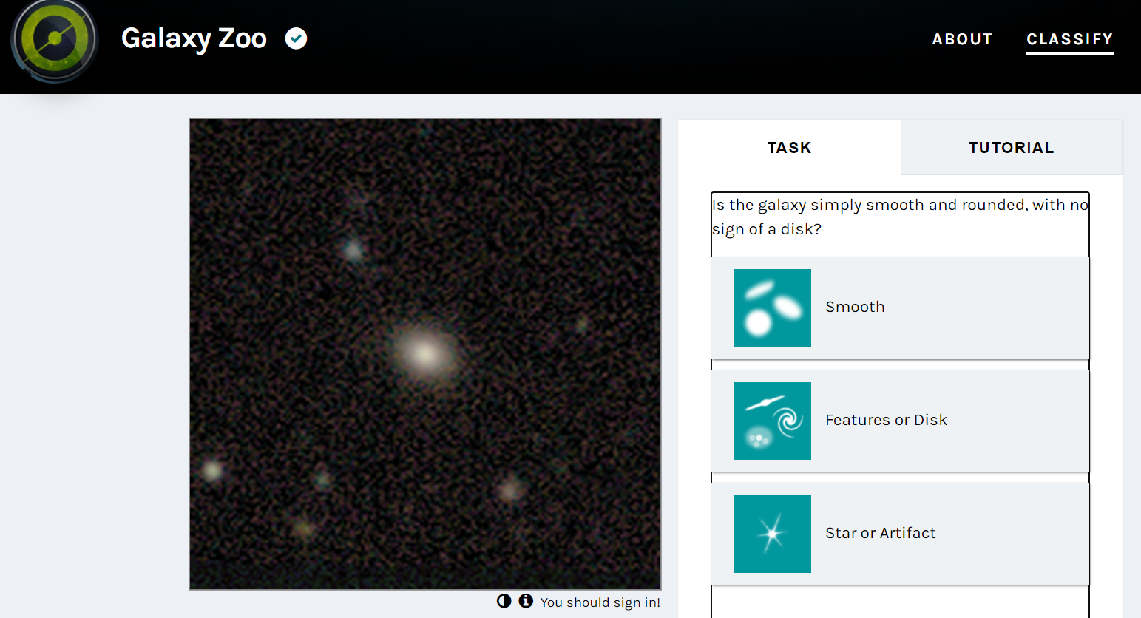
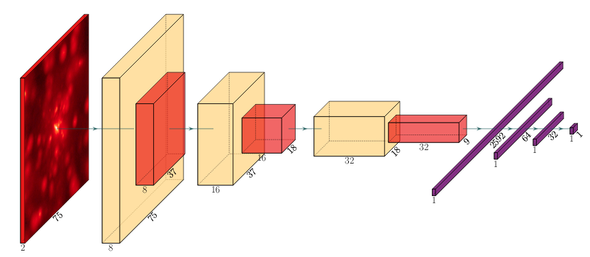
Visual Classification
Neural Networks
Require knowledge about the morphology
Prone to human error
Time consuming
Fast and Consistent
Need large quantities of training data
Train on simulated data but classify real, survey data
Ćiprijanović et al. (2020)

Slide 5
The Gap Between Simulated and Survey Data
Simulations are lacking
physics missing
computational resources
Mimicking ‘error’ in real images
adding noise
PSF
Telescope imperfections
Unique characteristics of the telescope
Need to find domain invariant features that can distinguish mergers from non-mergers in both the simulated and real domains
Simulated
Real

Slide 6
Standard Training
Identify Distinguishing Features
CLASSIFY
+ Labels
Predicted Labels
Simulated Images
TESTING
CLASSIFY
Simulated and Real Images
Predicted Labels

Slide 7
Domain Adaptation Training
+ Labels
Identify Distinguishing Features
CLASSIFY
Predicted Labels
(No labels)
Identify Domain Invariant Features
Simulated and Real Images
TESTING
CLASSIFY
Real and Simulated Images
Predicted Labels

Slide 8
Datasets
Simulated Dataset:
Illustris
Nearby (z = 0)
Small dataset (44 mergers)
Real Dataset:
SDSS
Nearby (z < .1)
Small Dataset (310 mergers)
Both datasets transformed to increase the dataset sizes to ~6000 images
Simulated
Real
Mergers
Mergers
Non Mergers
Non Mergers
Vogelsberger et al. (2014)
Darg et al. (2010)
Lintott et al. (2008)

Slide 9
Performance
With No Domain adaptation the network had a 50% accuracy
Additional Domain Adaptation Techniques:
Maximum Mean Discrepancy
Fisher Loss
Entropy Minimization
Improved accuracy to 69%
~20% accuracy improvement overall
with DA
No DA

Slide 10
Future Plans - Regression Network
Use a regression network trained on the similar simulated and observed data
Predict characteristics about the galaxies that usually require additional measurements
Star formation rates
Stellar mass

Slide 11
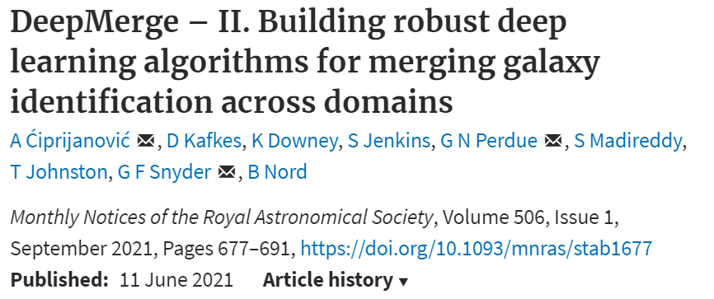
Thank you!

