Slide 1
Quantum Approximate Optimization Algorithm (QAOA) for a Bosonic System
FERMILAB-SLIDES-21-097-QIS
A. Barış Özgüler
FNAL, SQMS
8/19/21
New Perspectives 2021
This material is based upon work supported by the U.S. Department of Energy, Office of Science, National Quantum Information Science Research Centers, Superconducting Quantum Materials and Systems Center (SQMS) under contract number DE-AC02-07CH11359.
With: Davide Venturelli, NASA Ames

Slide 2
Outline
Qubit vs qudits
QAOA for a bosonic system
Method: Quantum optimal control

Slide 3
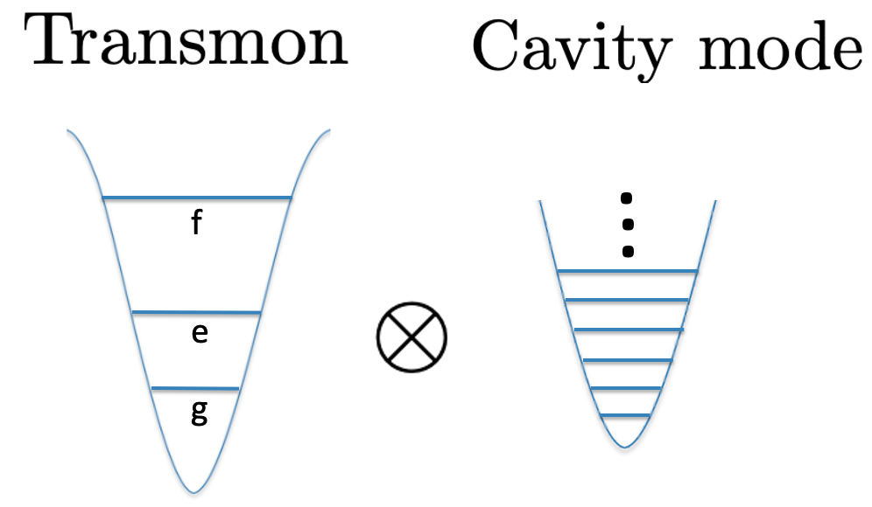







Multiqubit Systems vs. Qudits
Qubits
Qudit
Hilbert space: tensor products of two-level systems
Hilbert space: ladder of Fock (photon number) states
. . .
binary representation
Boson Fock states
Hardware inefficient
Hardware efficient

Slide 4
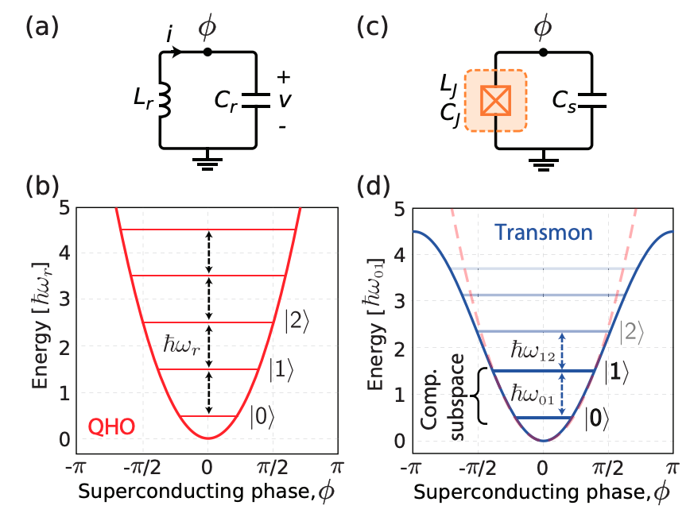
Qubit
linear
nonlinear
Applied Physics Reviews 6, 021318 (2019)

Slide 5
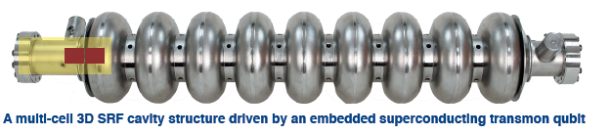
Cavity-Qubit Systems: Different Schemes
Scheme 1:
transmon: qubit
cavity: auxiliary system
Scheme 2:
cavity: qudit
transmon: auxiliary system
providing nonlinearity
cavity
transmon
transmon
J. Majer et al., Nature 449, 443 (2007)

Slide 6
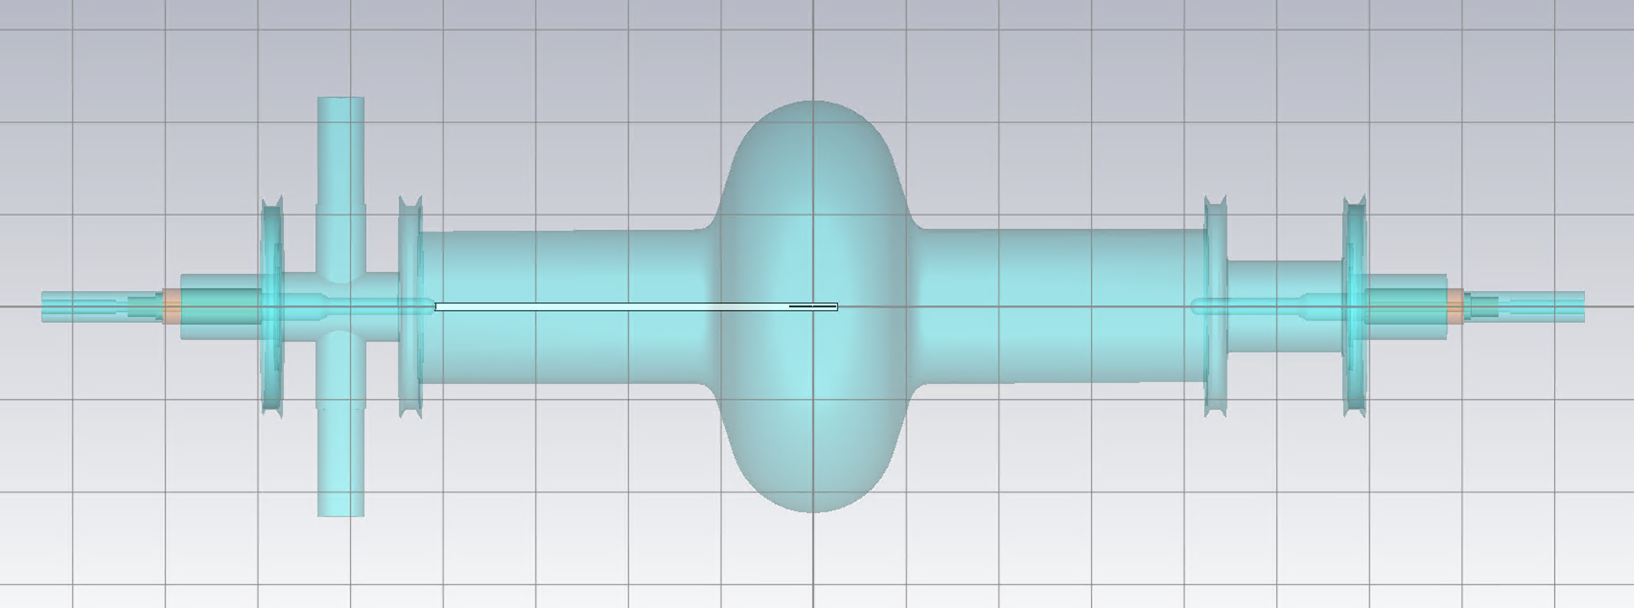
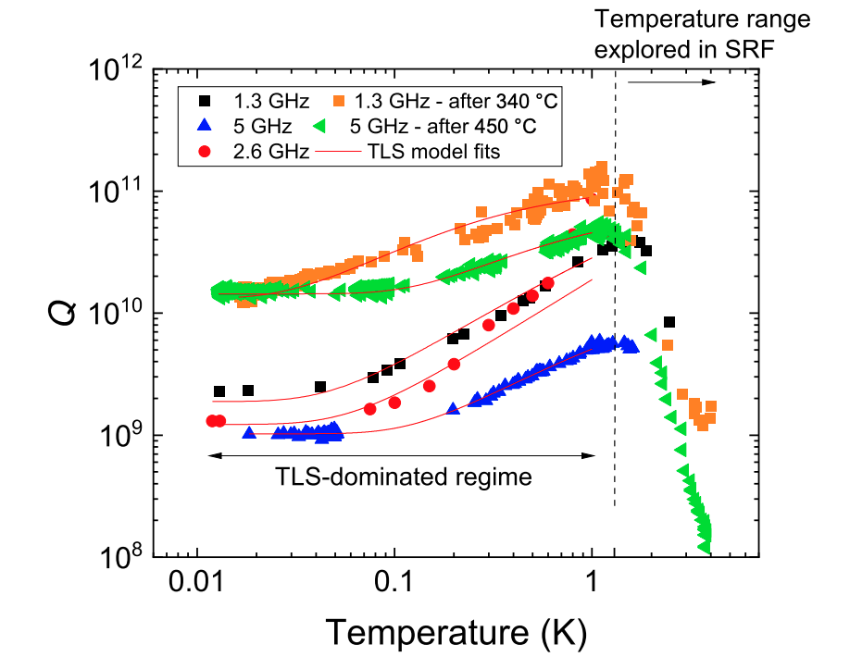

SRF Cavity
high quality factor
long photon lifetime
thousands of energy levels can be stored in each cavity mode
cavity = resonator = harmonic oscillator
surrounded by superconducting walls
Modes: EM field with a certain frequency
State-of-the-art:
Romanenko et al., Phys. Rev. Applied 13, 034032 (2020)
and counting…

Slide 7
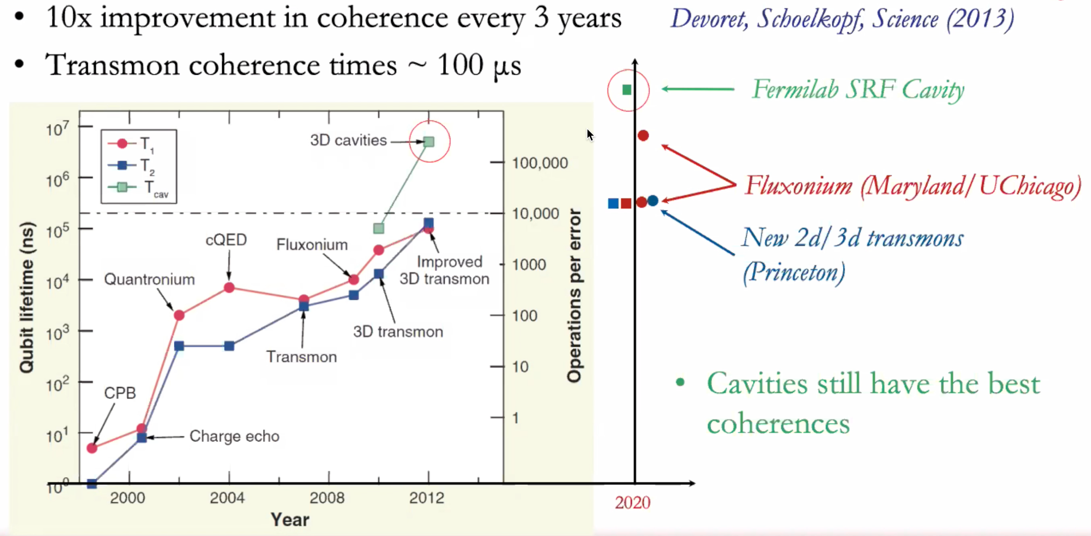
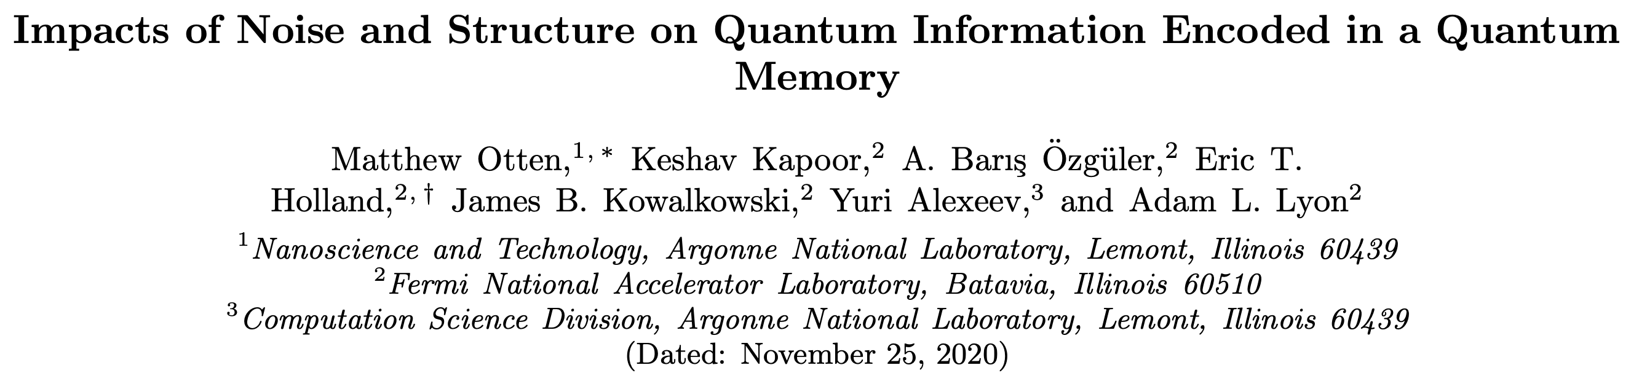
Qubit vs. Qudit Lifetime
Moore’s law for superconducting qubits
From: Srivatsan Chakram’s Talk at SQMS, Fermilab (2/18/21)
What is the achievable number of effective qubits in qudits?

Slide 8
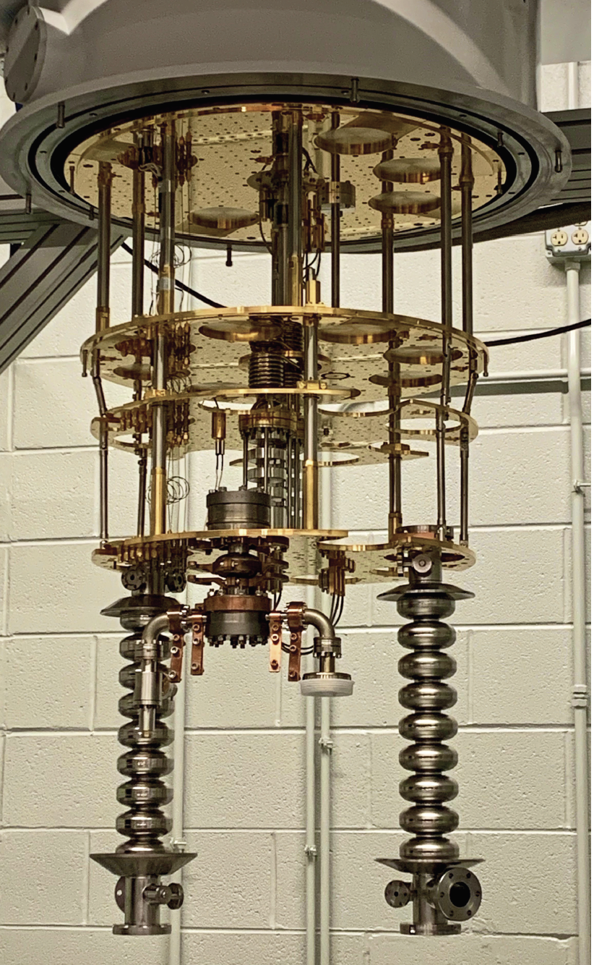
Cavity-qubit system (3D System)
Cavity modes are used as qudits.
A transmon (nonlinear system) is used to control and manipulate the cavity states.
a
b
dispersive regime:
Cavity & qubit states can be resolved

Slide 9
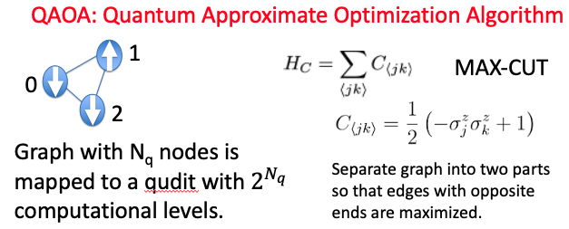

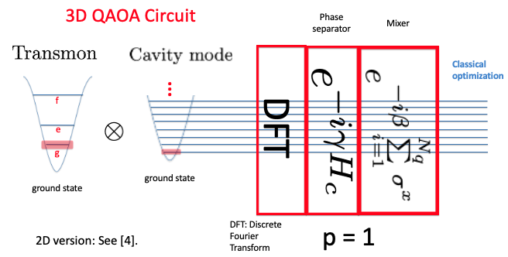


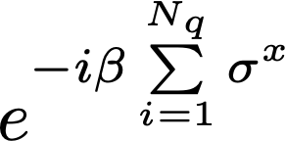

3D QAOA Circuit
INIT =
INIT
PS =
Mixer =
Phase separator is divided into U_{ij}, where i and j represent qubits (nodes) in the graph.

Slide 10
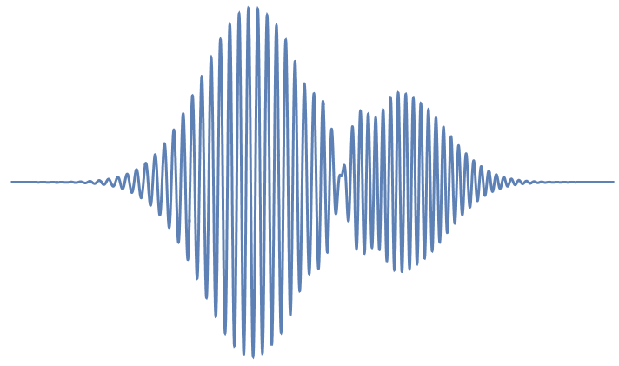
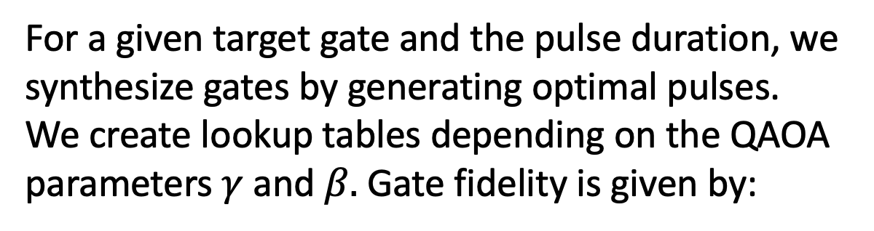
Quantum Optimal Control
For a given target gate and the pulse duration, we synthesize gates by generating optimal pulses. We create lookup tables depending on the QAOA parameters $γ$ and $β.$ Gate fidelity is given by:

Slide 11
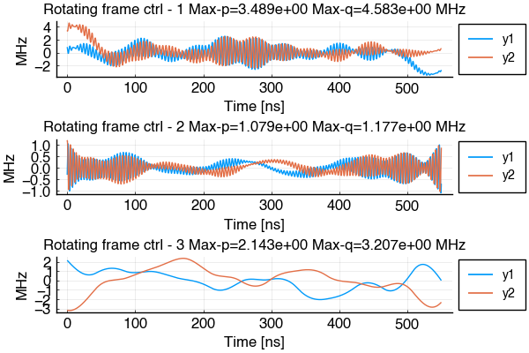
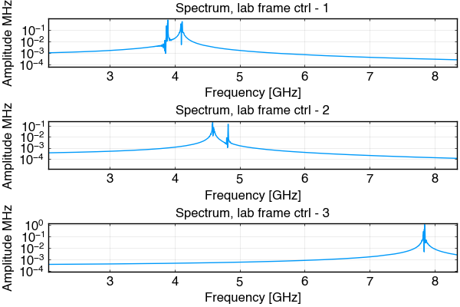
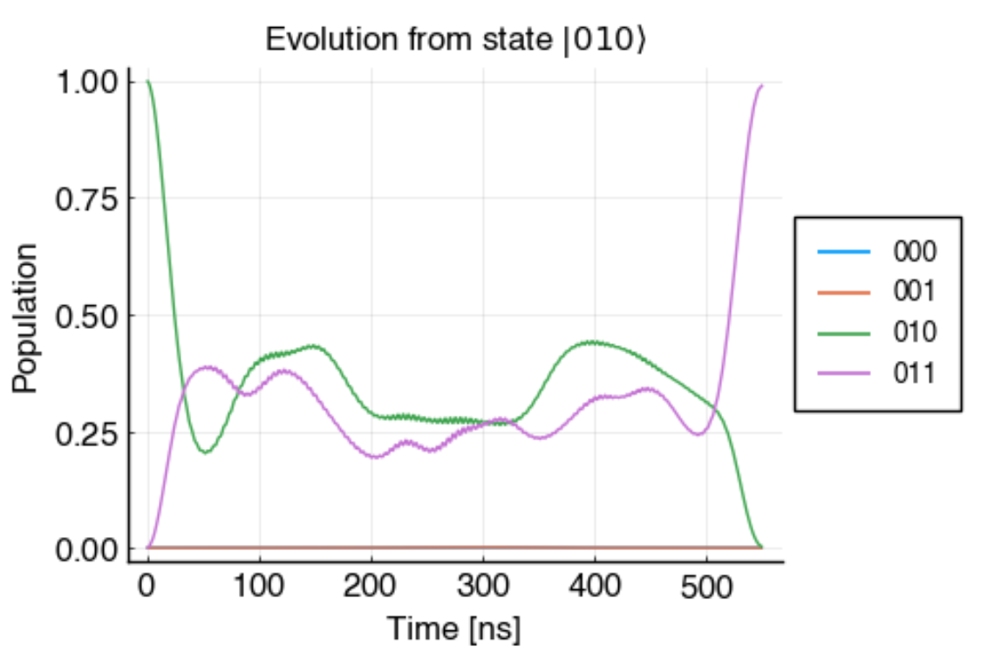
Numerical Method
We study QAOA formulated via qudits (inspired by 3D SQMS device architecture)
Gate synthesis is the bottleneck = Optimal qudit control problem in disguise
Advances in efficient parametrization of the control functions and test and evaluation of recent numerical techniques (GRAPE, GOAT, Discrete Adjoint…)
How to control (multiple) coupled bosonic modes via pulses?
Pulse quadratures in rotating frame for bosonic mode 1
Pulse quadratures in rotating frame for bosonic mode 2
(i) Numerical analysis for gate synthesis for qubits and qutrits (one and two bosonic modes): Hadamard, Single SU(2) and SO(3) rotations, CPHASE gates.
(ii) Discussion of performance expectations for QAOA-like algorithms based on the numerical performance.
Pulse quadratures in rotating frame for control qudit
(illustrated example of synthesis of a two-qubit gate using methods of Juqbox. See arXiv:2001.01013, 2106.14310)
Target Gate
I(1) ⊗ CNOT(2,3)
2,3 = Computational qudits (e.g. cavity modes)
1= Control qudit
(e.g. transmon)

Slide 12


Single-mode cavity coupled to transmon
transmon
self-Kerr
cavity self-Kerr
n_{T} = 2
n_{C} = 8 (equivalence of 3 qubits)
n_{T}, n_{C} number of computational levels
cross-Kerr
System Hamiltonian
H =
Diagonalize to find resonant frequencies for transitions between the states!

Slide 13
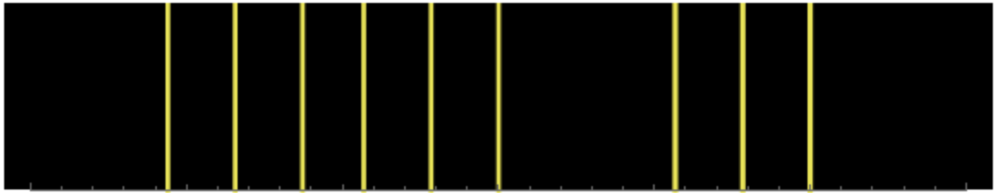
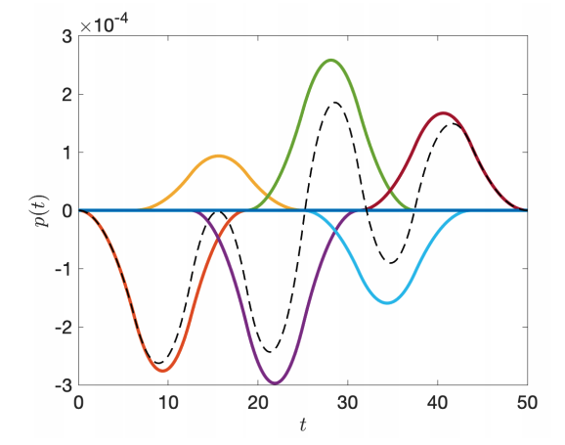
Resonant Frequencies
Δ_{Τ}
Δ_{Τ}−ξ_{T}−2ξ_{X}
Δ_{Τ}−ξ_{T}
Δ_{Τ}−2ξ_{X}
Δ_{Τ}−ξ_{X}
Δ₁−2ξ_{X}
Δ₁−ξ₁−2ξ_{X}
Δ₁
Δ₁−ξ₁
Δ_{Τ}−ξ_{T}−ξ_{X}
Δ₁−ξ_{X}
Δ₁−ξ₁−ξ_{X}
Example spectrum for n_{T} = n_{C} = 3
Carrier wave frequencies:
Envelope and phase is determined by B-splines
transmon
cavity mode
D₁ = 6
arXiv: 2001.01013

Slide 14
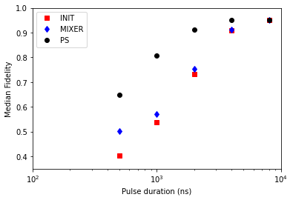
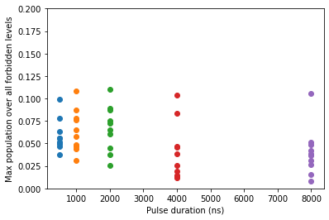
Fidelity vs. Pulse duration
INIT =
PS =
INIT
Mixer =

Slide 15
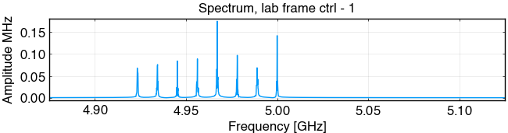
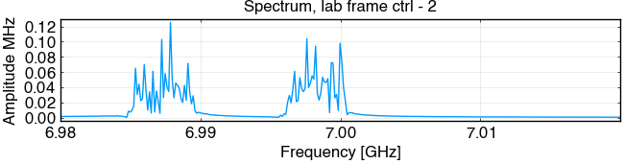
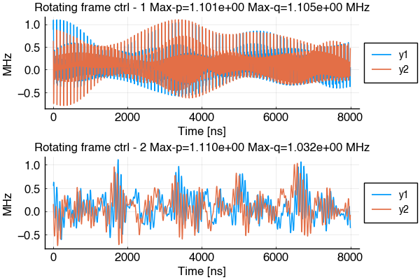
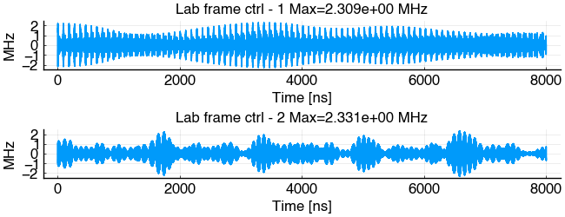
Example pulse that gives high fidelity
…
transmon
cavity
mode

Slide 16
Towards a 3D Compiler
The goal is to develop a compiler that has access to pre-designed optimized pulses for each parameter of the gates.
We are generalizing the idea to multiple bosonic modes encoding qudits controlled by a transmon.
. . .
Natural mapping from
MAX-k-CUT to
k-level
k-level

Slide 17
Thanks for listening!

