Slide 1
Thermal Runaway Studies for the CMS TFPX Phase-II Upgrade
8/16/2021
Kevin Souhrada

Slide 2
Outline:
What is CMS/TFPX?
What is Thermal Runaway and how do we prevent it?
How do we simulate runaway in the lab?
Notes:
outline

Slide 3
What is CMS/TFPX?

Slide 4
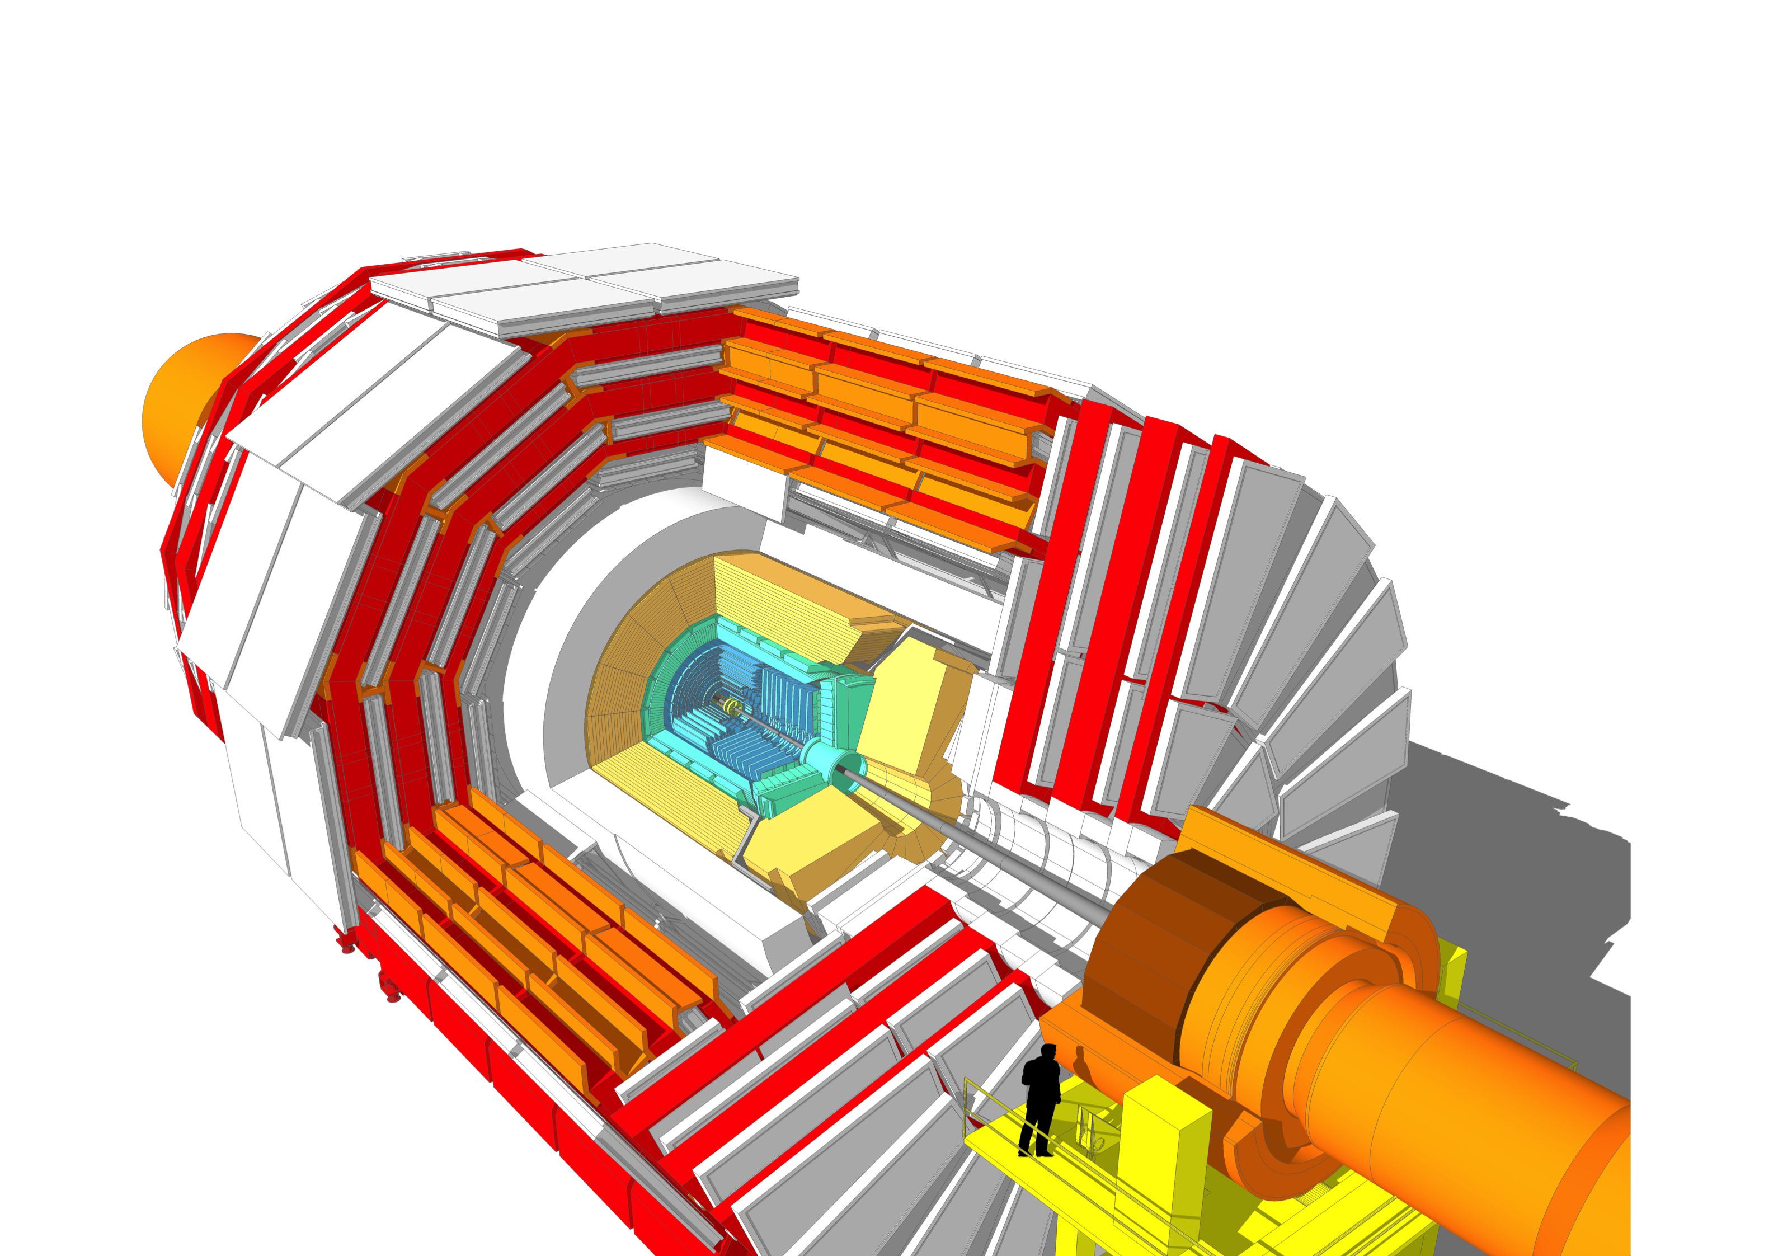
Compact Muon Solenoid (CMS)
Muon Detector
Hadron Calorimeter (HCAL)
Tracker
Electromagnetic Calorimeter (ECAL)
Notes:
Innermost, radiation damage, less on CMS

Slide 5
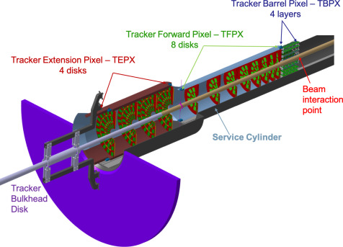
CMS / Tracker

Slide 6
Tracker / TFPX

Slide 7
Tracker / TFPX
Innermost subdetector
Closest to collision point
Highest radiation dose
*Structure needs to be radiation hardy!

Slide 8
What is Thermal Runaway?

Slide 9
What is Thermal Runaway? (Chemistry)
Exothermic Reaction
Heat
Increase in Reaction Rate
Notes:
Combine 11 + 12

Slide 10
What is Thermal Runaway? (TFPX)
Collisions happen very fast (every ~25ns)
Huge amounts of data must be transferred at high speeds
Electronics generate heat
Dark current across the semiconductor of the silicon sensor
With increased radiation damage, the silicon crystal is damaged allowing greater dark current to bridge the bandgap of the semiconductor
Dark current generates ohmic heating, which in turn increases dark current, etc.
Ohmic heating
Dark current
Heat from normal operation
Radiation damage
Notes:
Combine 11 + 12

Slide 11
How do we prevent runaway?

Slide 12
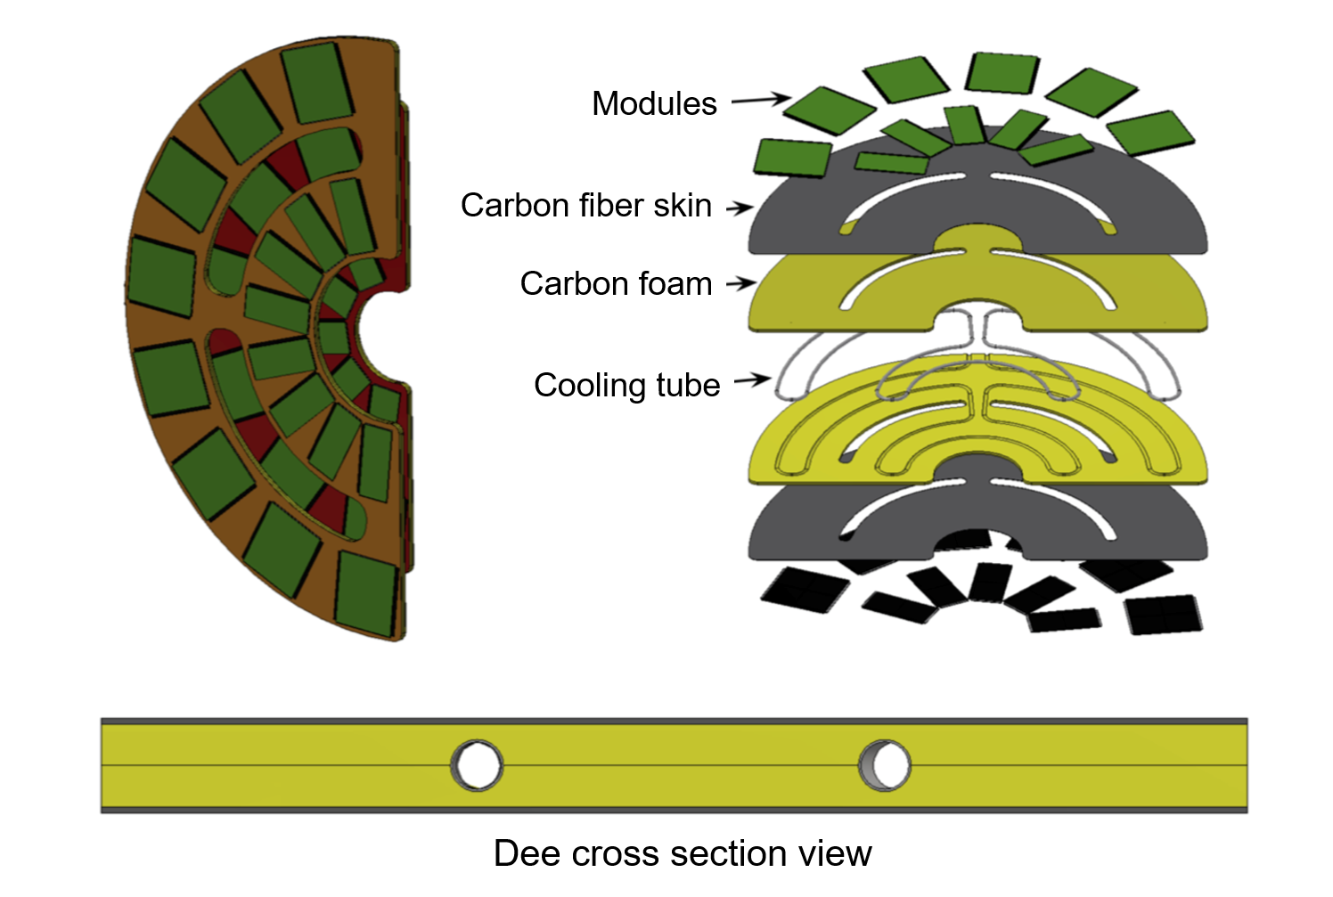
Tracker / TFPX

Slide 13
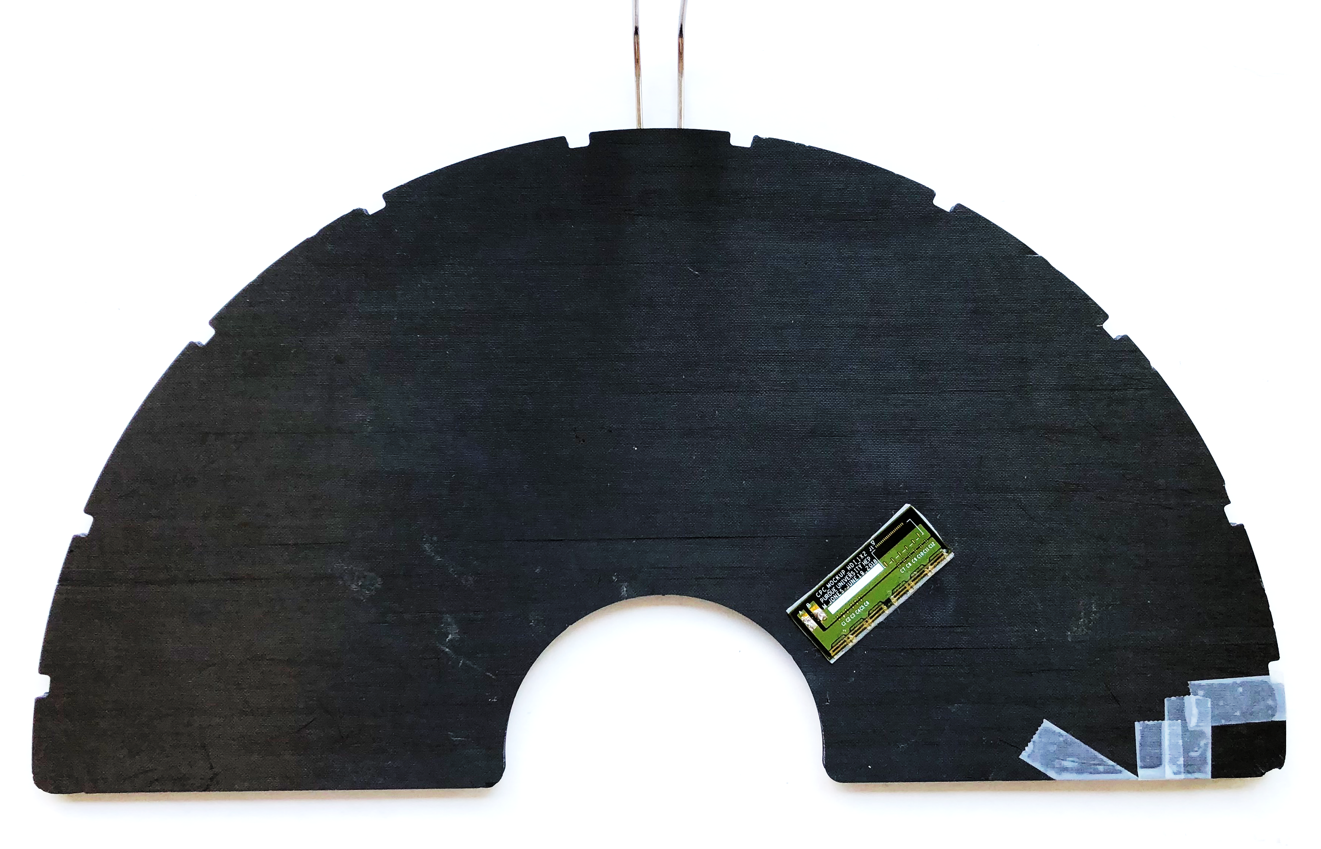
TFPX “Dee”
Notes:
3D model NO N, 2 phase CO2, transition to TRA

Slide 14
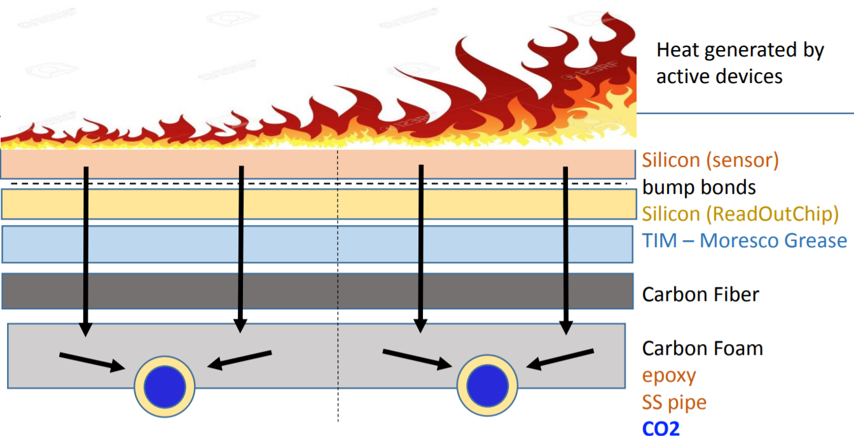
How do we prevent Thermal Runaway?
Need to remove generated heat through the CO₂ cooling
The thermal impedance of the structure must be managed alongside several other design requirements (minimizing total mass, module interchangeability, radiation hardiness, etc.)
One component of the structure that we can change:
Thermal Interface Material (TIM)
Notes:
Focus more on TIM, thermal properties, flame pic

Slide 15
How do we simulate runaway?

Slide 16
How do we simulate Thermal Runaway?
Ceramic heater
TIM
Carbon Foam
Carbon Fiber
Cooling tubes
Notes:
Sam fig, combine 15 + 16 , insert eqn

Slide 17
How do we simulate Thermal Runaway?
Apply power to heater
Allow temperature to stabilize
Read temperature
Calculate new power to apply*
Check for runaway
Power calculated by the equation*:
$$Q\left(T\right)=const. × {\left(\frac{T}{T_{ref}}\right)}^{2}e^{−T_{A}\left(\frac{1}{T}−\frac{1}{T_{ref}}\right)}$$
*Equation from “Analytic model of thermal runaway in silicon detectors,” Beck & Viehhauser, 2010

Slide 18
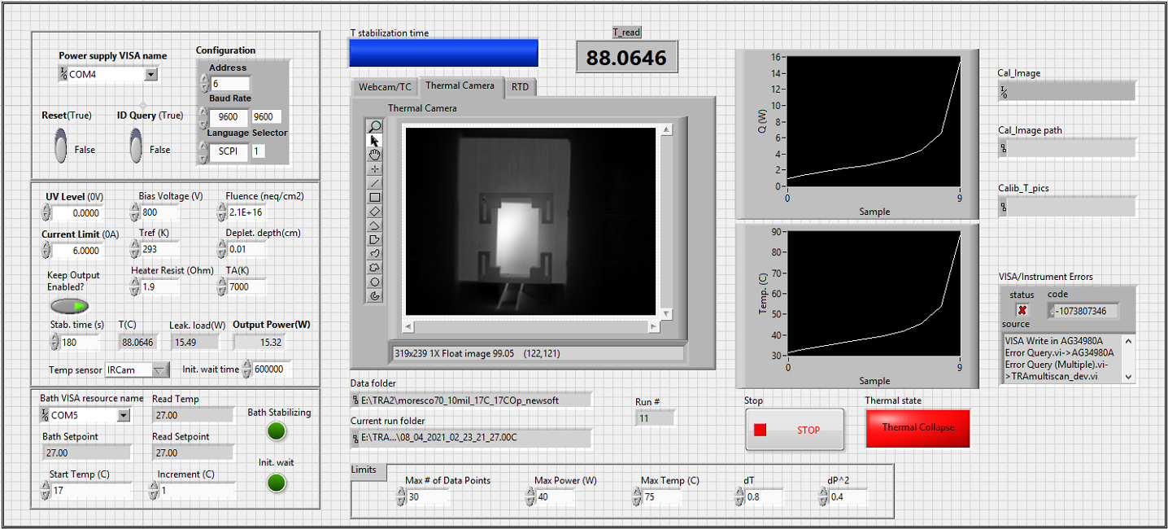
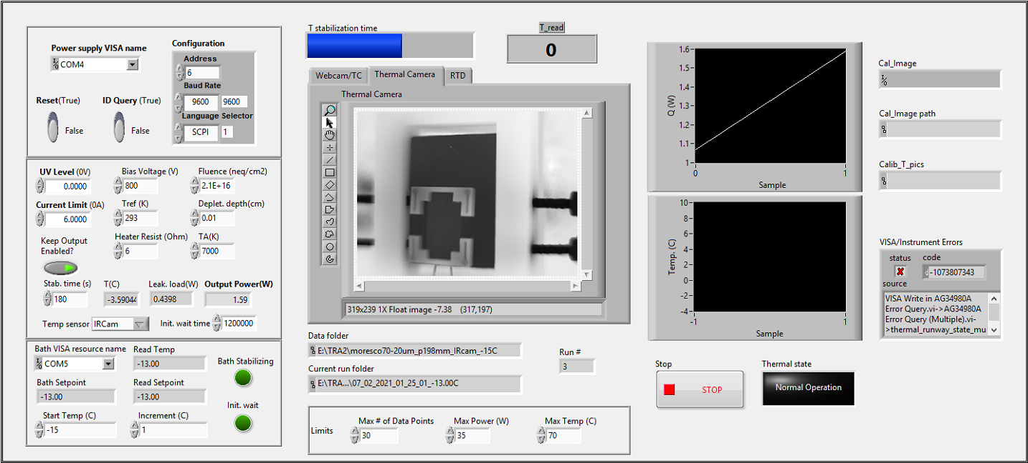
Current runaway LabVIEW program
Notes:
Explain graph, Ircam shows temp of cooling, structure, etc.

Slide 19
Conclusions
Achieved a reproducible and systematic method for generating thermal runaway
Simulating runaway allows us to determine the stable operating range for our final detector
Our decisions on the final parameters of the mechanical structure of TFPX will be based on their thermal performance as determined through runaway testing
Long term goals:
Runaway testing on full-sized Dees with asymmetrically heated replica modules to fully model the detector environment

Slide 20
Thank you!
Comments / questions?

