Slide 1
Measuring the Energy Resolution of MicroBooNE at the MeV-Scale
Elise Chavez
GEM – University of Wisconsin-Madison
New Perspectives
08 August, 2021

Slide 2
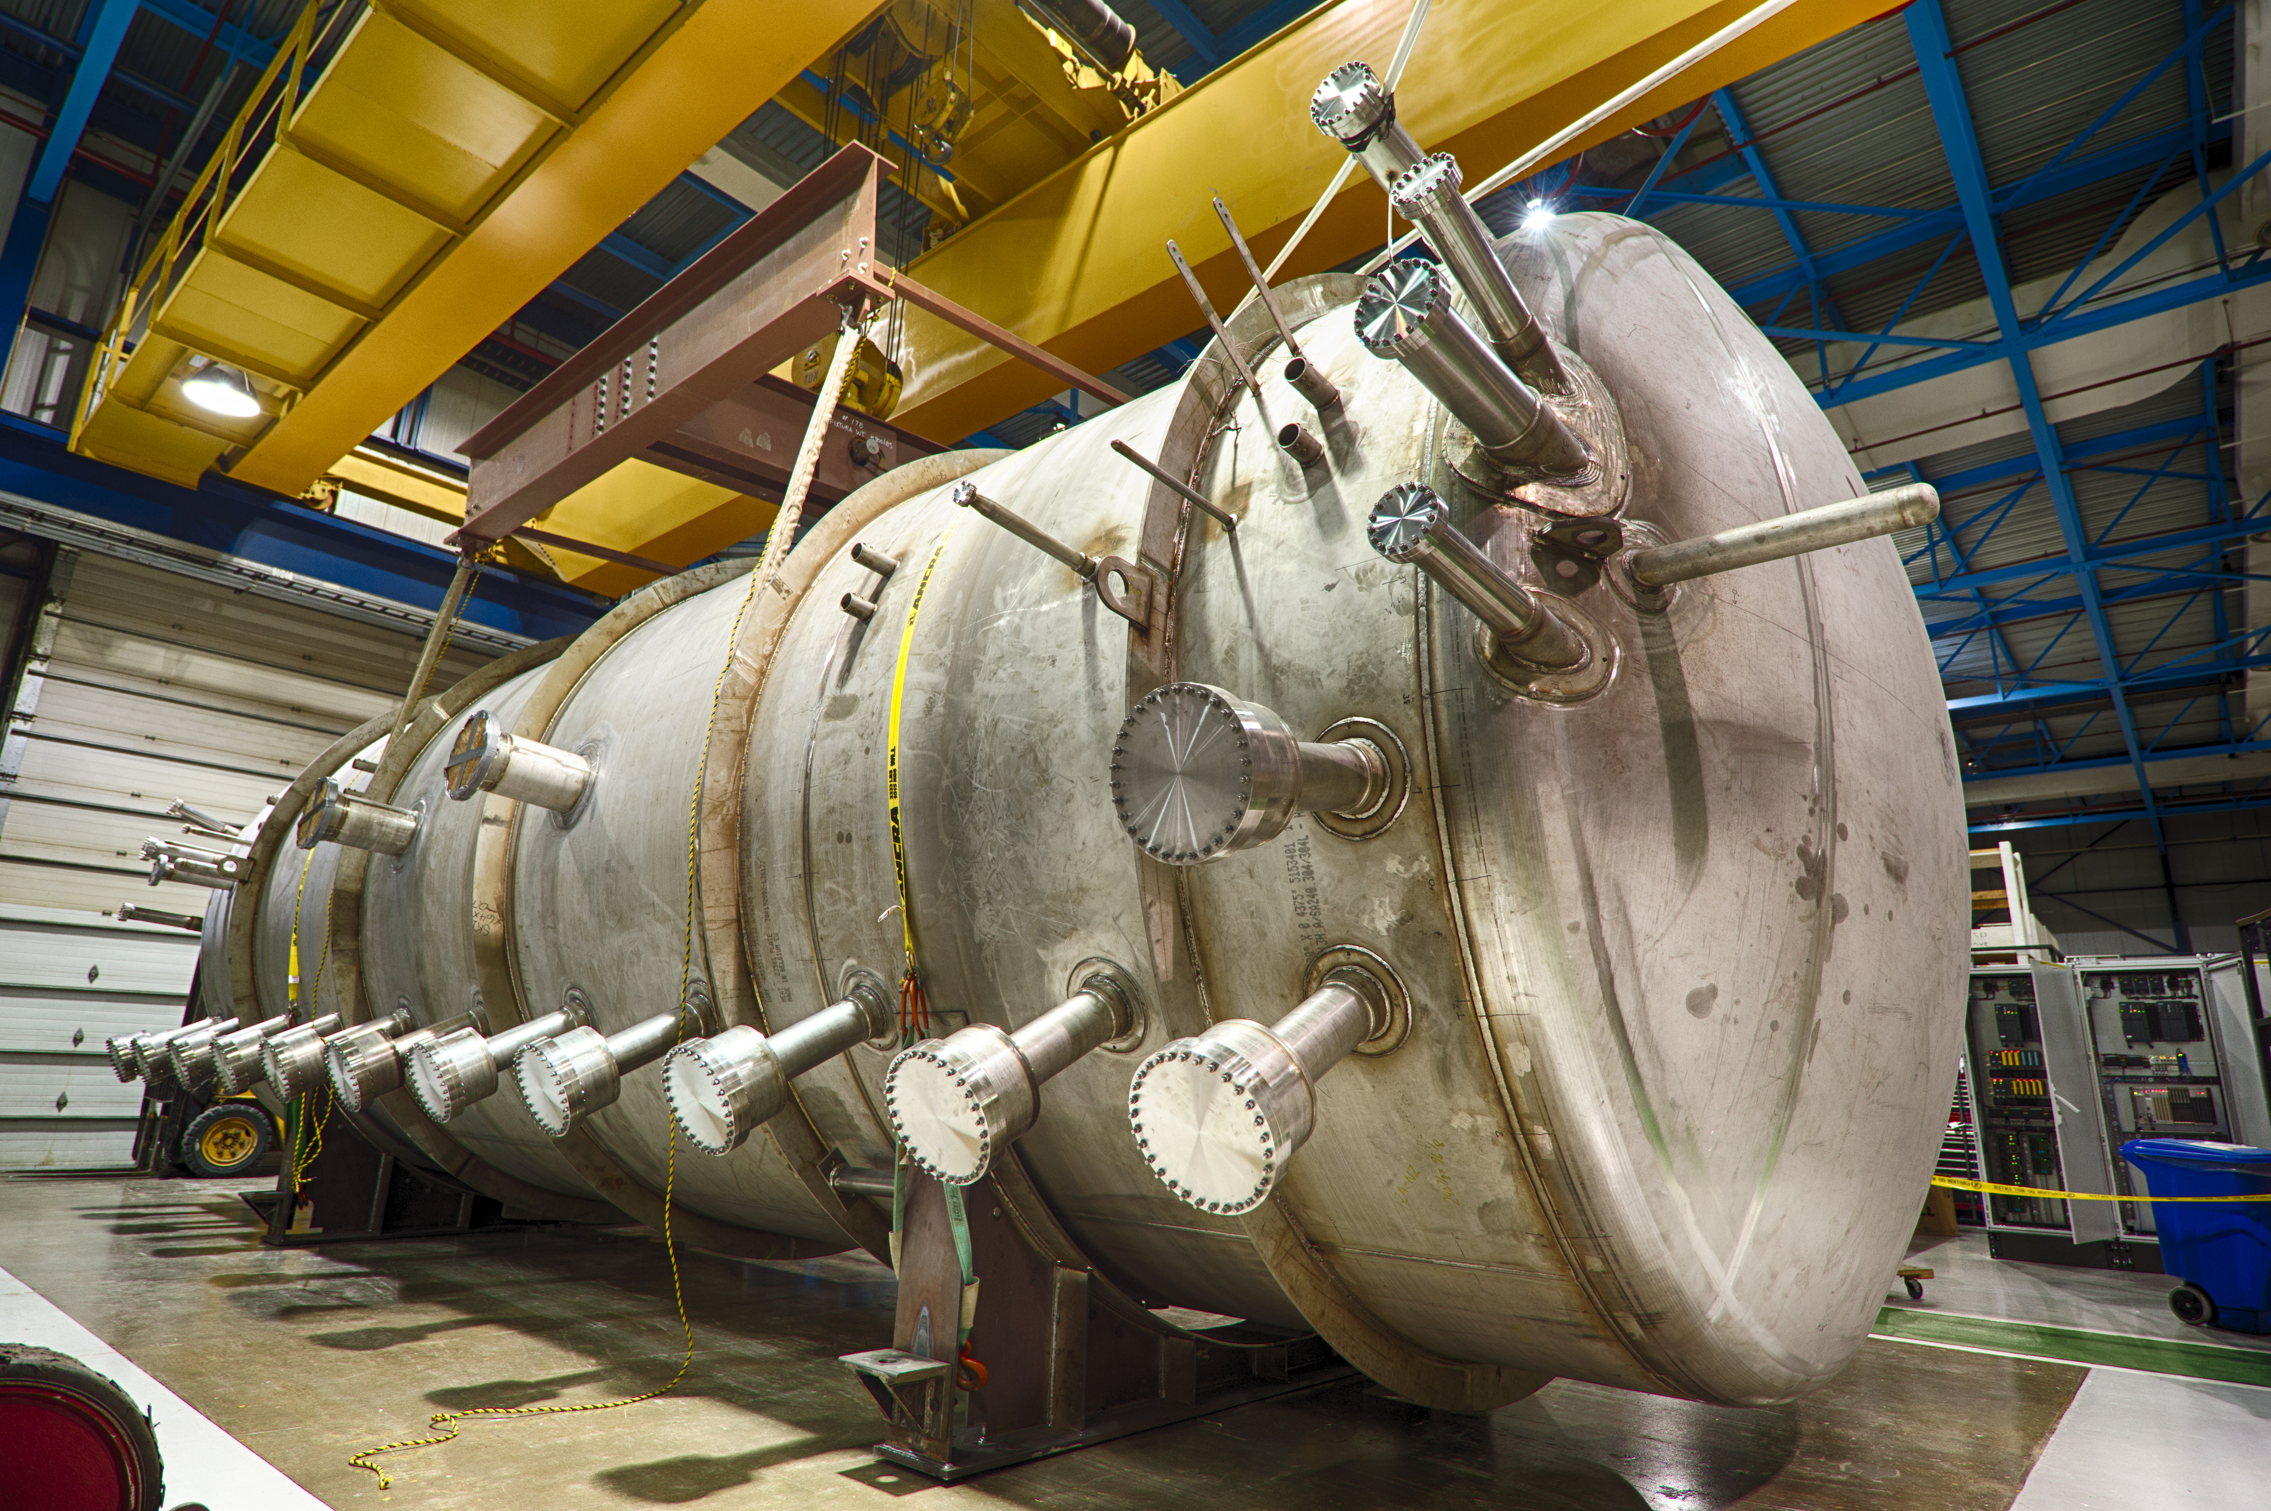
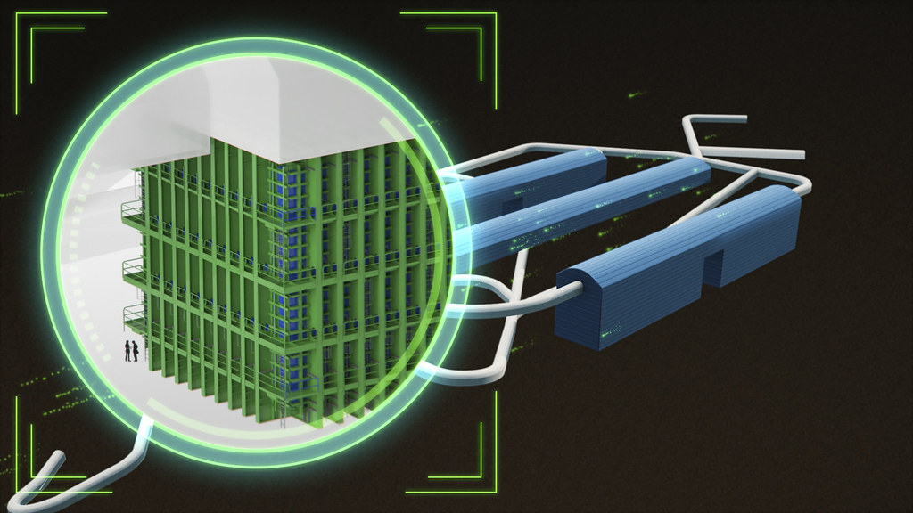
MicroBooNE and DUNE
MicroBooNE
40 feet long, 85-ton Liquid-Argon Time Projection Chamber (LArTPC) located on the booster neutrino beamline
Well understood and very precise MeV scale detector
Taking data 2015-2020
DUNE
Deep Underground Neutrino Experiment
Two detectors: one at Fermilab located at the long baseline neutrino facility (LBNF) along the world’s most intense neutrino beam and one at Sanford Lab
Sanford will have four LArTPC detector modules, totalling 70,000 tons of liquid argon, the near detector will also be made of LArTPCs
An image of the MicroBooNE LArTPC detector.
A rendering of the planned underground detectors at Sanford Lab.

Slide 3
MicroBooNE and DUNE
MicroBooNE
40 feet long, 85-ton Liquid-Argon Time Projection Chamber (LArTPC) located on the booster neutrino beamline
Well understood and very precise MeV scale detector
Taking data 2015-2020
DUNE
Deep Underground Neutrino Experiment
Two detectors: one at Fermilab located at the long baseline neutrino facility (LBNF) along the world’s most intense neutrino beam and one at Sanford Lab
Sanford will have four LArTPC detector modules, totalling 70,000 tons of liquid argon, the near detector will also be made of LArTPCs
An image of the MicroBooNE LArTPC detector.
A rendering of the planned underground detectors at Sanford Lab.

Slide 4
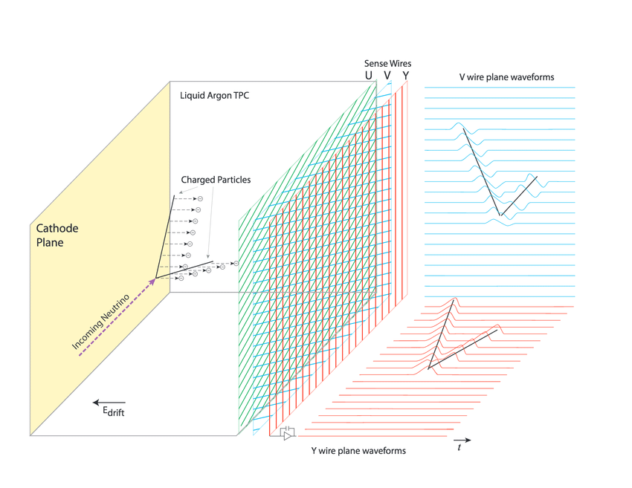
MicroBooNE and DUNE
MicroBooNE
40 feet long, 85-ton Liquid-Argon Time Projection Chamber (LArTPC) located on the booster neutrino beamline
Well understood and very precise MeV scale detector
Taking data 2015-2020
DUNE
Deep Underground Neutrino Experiment
Two detectors: one at Fermilab located at the long baseline neutrino facility (LBNF) along the world’s most intense neutrino beam and one at Sanford Lab
Sanford will have four LArTPC detector modules, totalling 70,000 tons of liquid argon, the near detector will also be made of LArTPCs
An image of the MicroBooNE LArTPC detector.
A rendering of the planned underground detectors at Sanford Lab.

Slide 5
MicroBooNE and DUNE
MicroBooNE
40 feet long, 85-ton Liquid-Argon Time Projection Chamber (LArTPC) located on the booster neutrino beamline
Well understood and very precise MeV scale detector
Taking data 2015-2020
DUNE
Deep Underground Neutrino Experiment
Two detectors: one at Fermilab located at the long baseline neutrino facility (LBNF) along the world’s most intense neutrino beam and one at Sanford Lab
Sanford will have four LArTPC detector modules, totalling 70,000 tons of liquid argon, the near detector will also be made of LArTPCs
We can use MicroBooNE for R&D of DUNE. Can DUNE be the next MeV scale detector?
An image of the MicroBooNE LArTPC detector.
A rendering of the planned underground detectors at Sanford Lab.

Slide 6
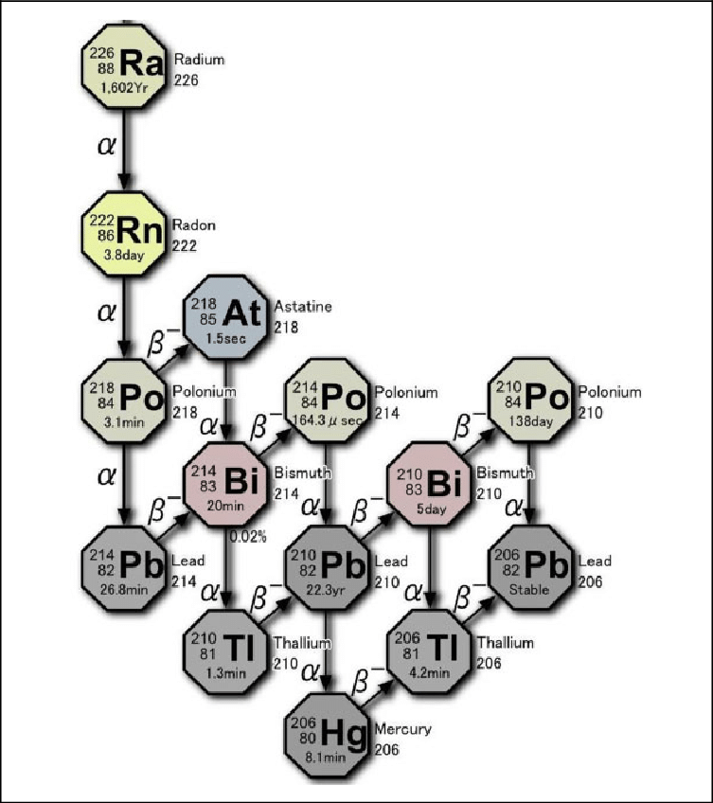
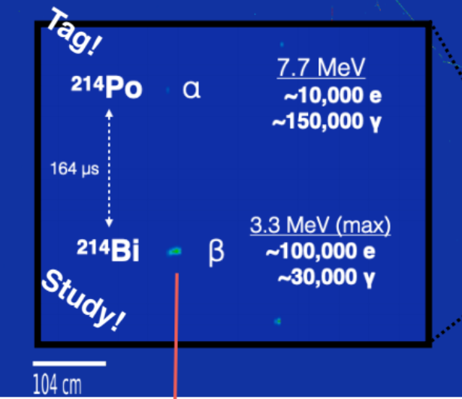
Radon Doping and Precision
What do we want to test?
How precisely we can measure energies in a LArTPC
Radon-222 doping allows us to examine the detector’s MeV scale response
We are interested in the Bi-214 and Po-214 which produce a taggable signal due to the Po-214 half-life
Here is the desired signature we wish to observe and study.
The decay chain for radium 226, which includes the radon 222 decay.

Slide 7
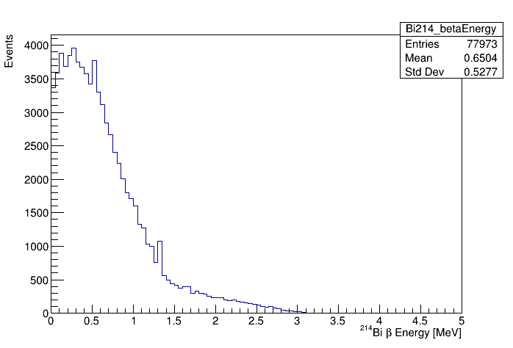
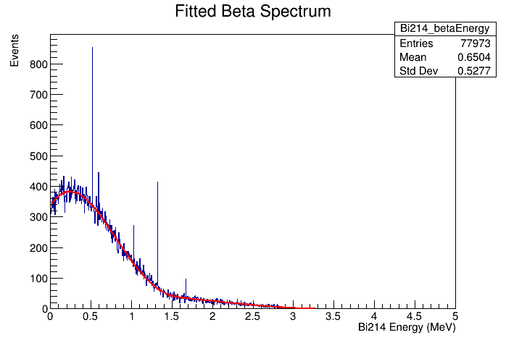
Big Picture
$β$ – spectrum
Use the energy resolution plot to smear what we expect from the beta spectrum
With energy resolution, we can look at the fit parameters and understand how it bends
Measure the energy resolution from real data by comparing
Beta Energy Spectrum
In Progress
In Progress
The fitted $β$ spectrum of the bismuth-214 decay. This fit comes from Betashape on the International Atomic Energy Agency (IEAE) Nuclear Data Services (NDS) Live Nuclide Chart. (https://nds.iaea.org/relnsd/vcharthtml/VChartHTML.html)
The $β$ spectrum of the bismuth-214 decay.

Slide 8
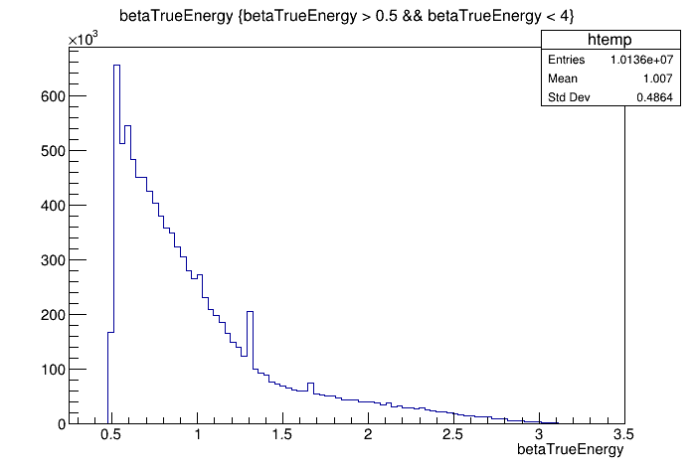
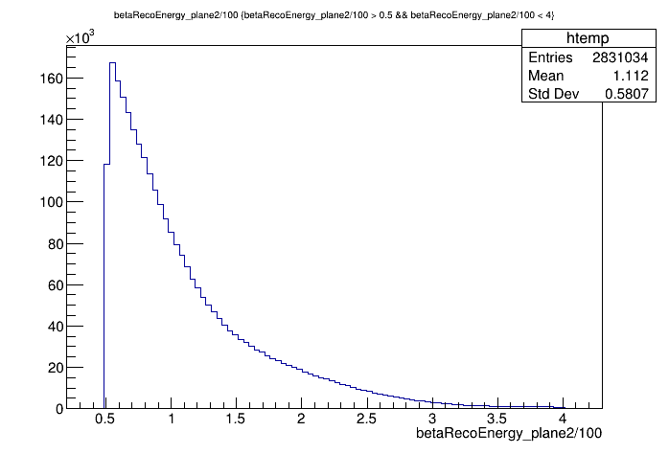
Simulation and Methods
Monte carlo simulation in MicroBooNE
Bi214-Po214 coincidence decay overlayed onto real data
Gave information about the decay $β$
True Energy: Energy the simulation gave the decay $β$
Reconstructed Energy: Sum of the hits on the desired plane, adjusted to ~MeV
Creation vertex
Arb.
In Progress
Arb.
In Progress
True energy plot within a selected region.
Reconstructed energy plot within a selected region.

Slide 9
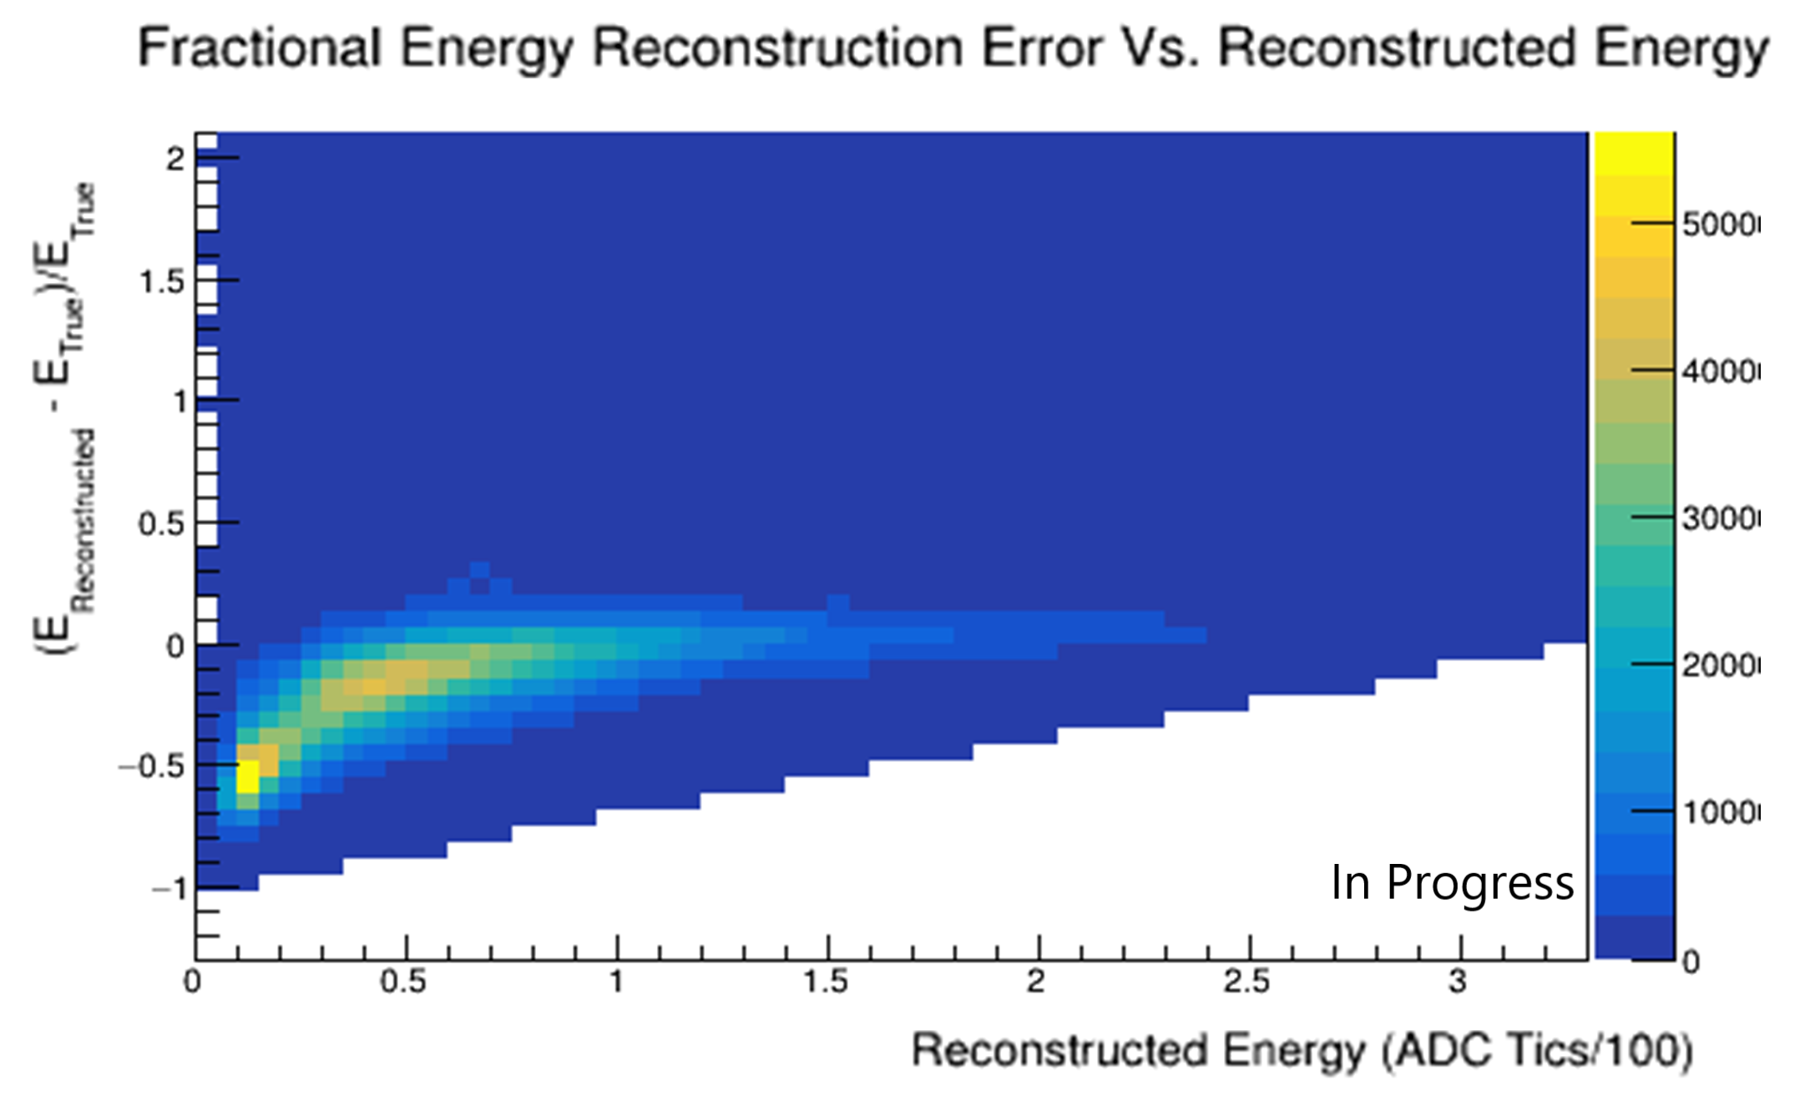
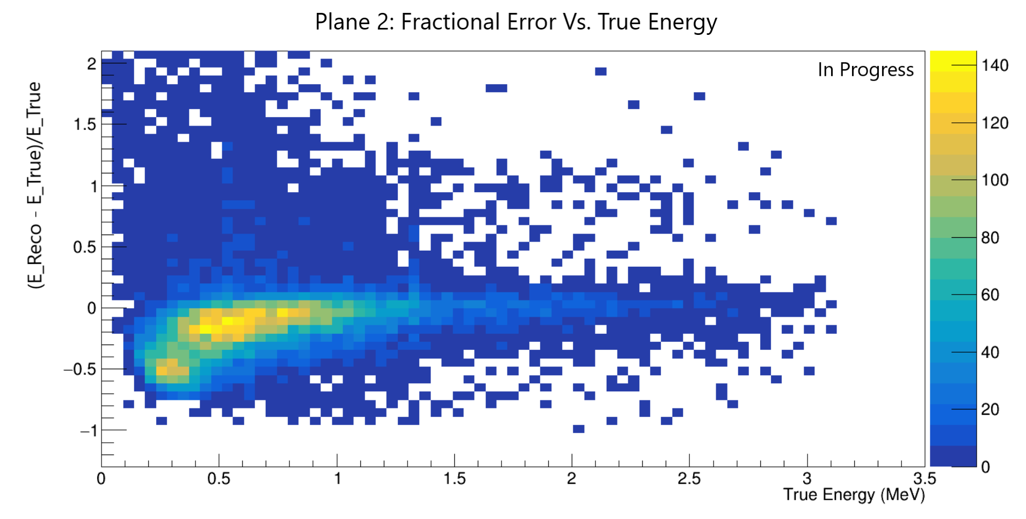
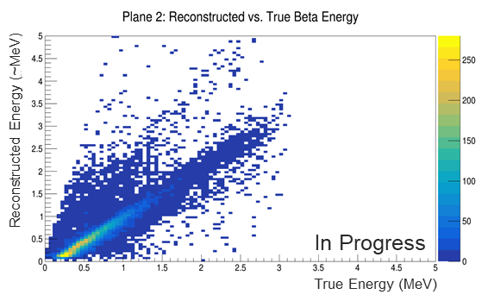
Simulation and Methods
Energy Resolution vs Reconstructed Energy 2D histogram.
Radon-222 -> bismuth-214 -> polonium -214 + $β$
5 variables
Reconstructed Energy
True Energy
Vertex X
Vertex Creation Y
Vertex Z
Fractional Error :
Note the cut-off at 0.5 MeV
Poor Reconstruction
Energy Resolution vs True Energy 2D histogram.
$$\frac{Reconstructed Energy −True Energy}{True Energy}$$
Reconstructed Energy vs True Energy 2D histogram.

Slide 10
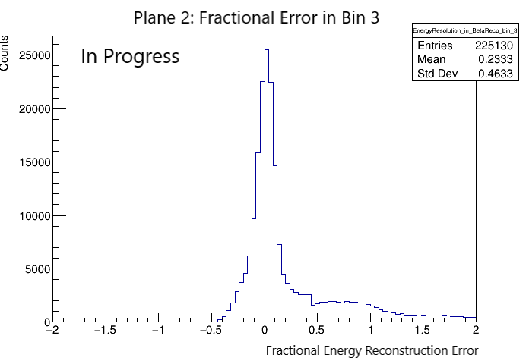
Simulation and Methods
Plane 2 – The Collection Plane
Radon-222 -> bismuth-214 -> polonium -214 + $β$
5 variables
Reconstructed Energy
True Energy
Creation X
Creation Y
Creation Z
Fractional Error :
$$\frac{Reconstructed Energy −True Energy}{True Energy}$$
The precision in one bin of reconstructed energy.

Slide 11
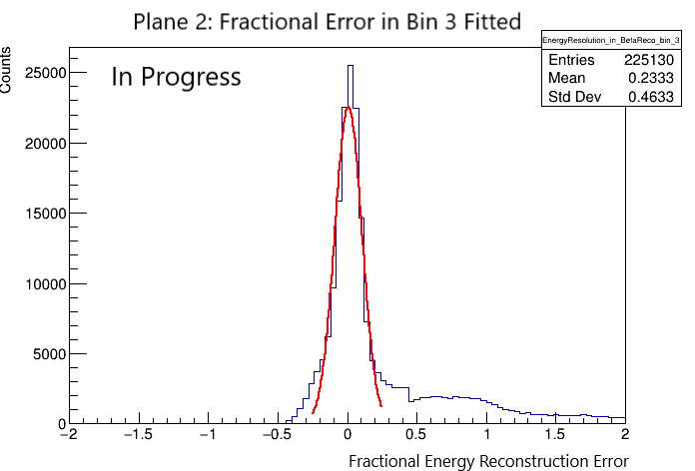
Simulation and Methods
Plane 2 – The Collection Plane
Radon-222 -> bismuth-214 -> polonium -214 + $β$
5 variables
Reconstructed Energy
True Energy
Creation X
Creation Y
Creation Z
Fractional Error :
$$\frac{Reconstructed Energy −True Energy}{True Energy}$$
The fitted precision in one bin of reconstructed energy.

Slide 12
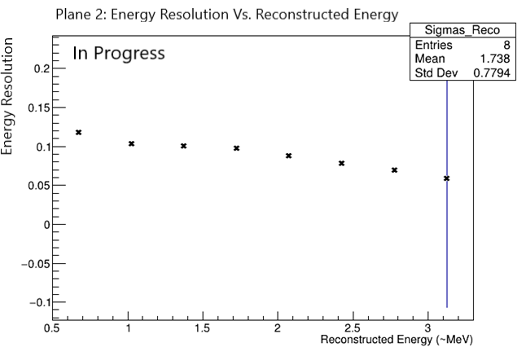
What did we see?
Most significant parameter -> Width
Small errors, until we reach higher energy

Slide 13
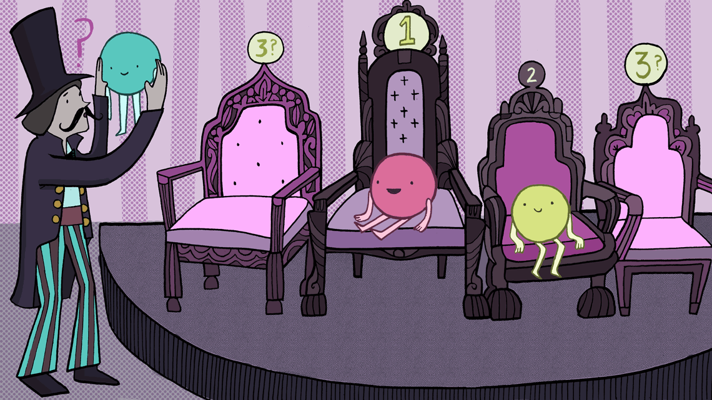
What does it Mean and What is Next?
Knowing and understanding the energy resolution of MicroBooNE is very cool and can give us a better understanding of LArTPCs at low energies
Modify and inform all future studies in this low energy regime
Can give us an idea of whether extending DUNE’s program to low energies would be feasible
Opens up the possibilities (like solar neutrino studies and, possibly, 0$νββ$ decay)
Fit those width plots and begin to make a functional form to fit data
Artwork by Sandbox Studio, Chicago with Corinne Mucha, from Symmetry Magazine (https://www.symmetrymagazine.org/article/how-heavy-is-a-neutrino)

Slide 15
Backup Slides

Slide 16
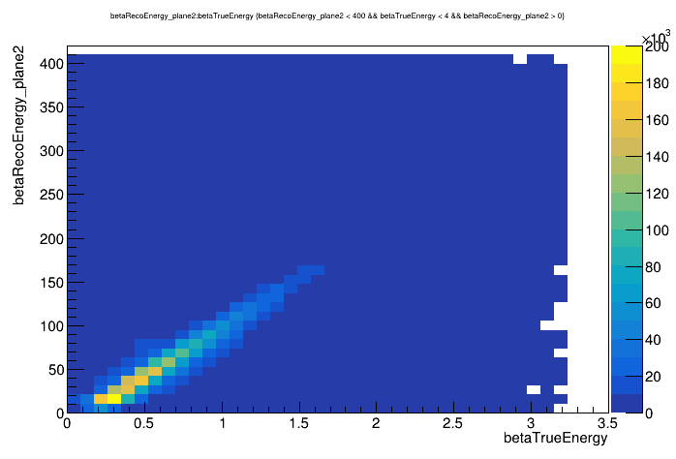
Backup Slides
In Progress

Slide 17
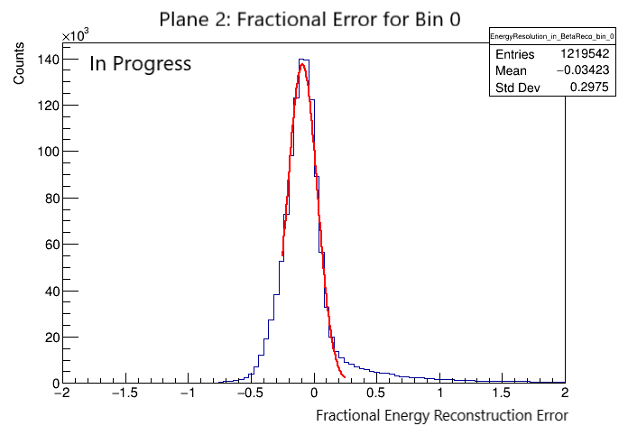
Backup Slides
In Progress

Slide 18
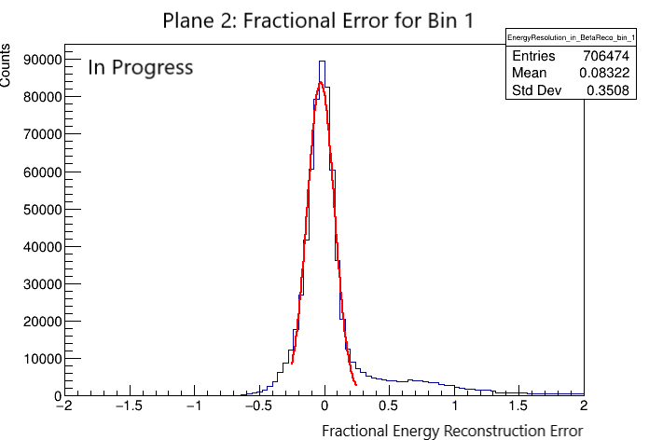
Backup Slides

Slide 19
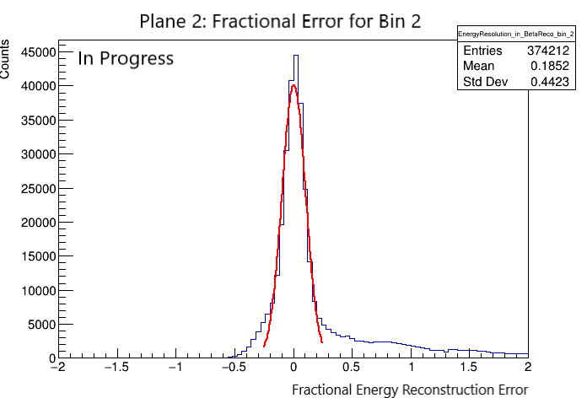
Backup Slides

Slide 20
Backup Slides

Slide 21
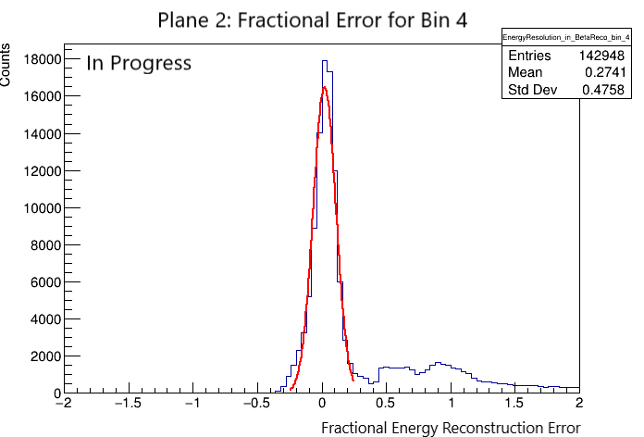
Backup Slides

Slide 22
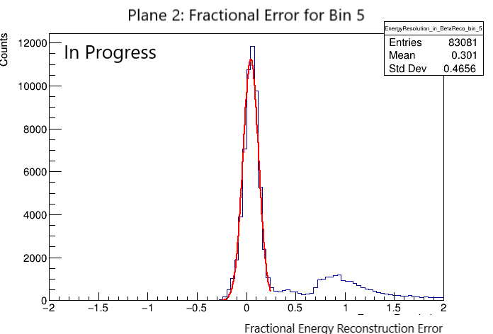
Backup Slides

Slide 23
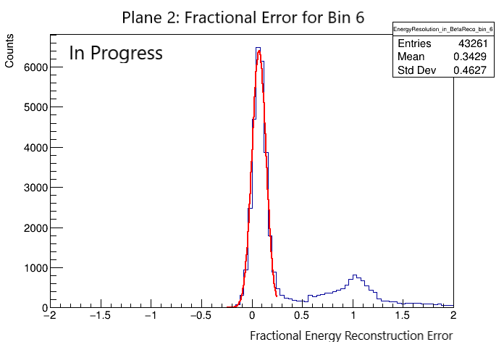
Backup Slides

Slide 24
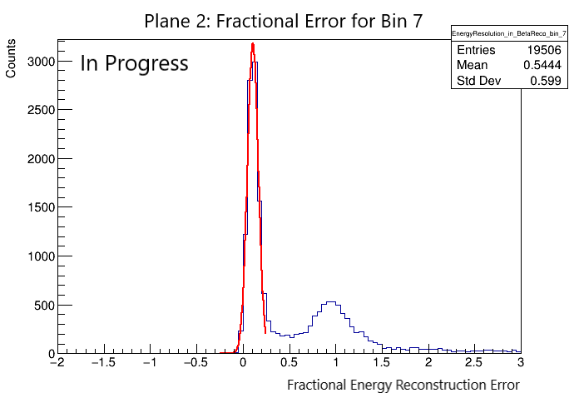
Backup Slides

Slide 25
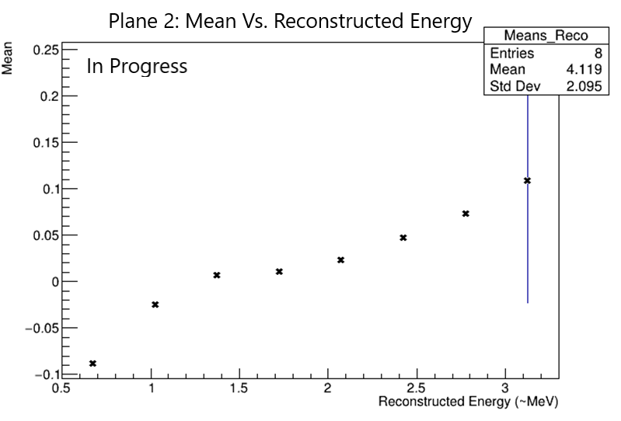
Backup Slides
In Progress

Slide 26
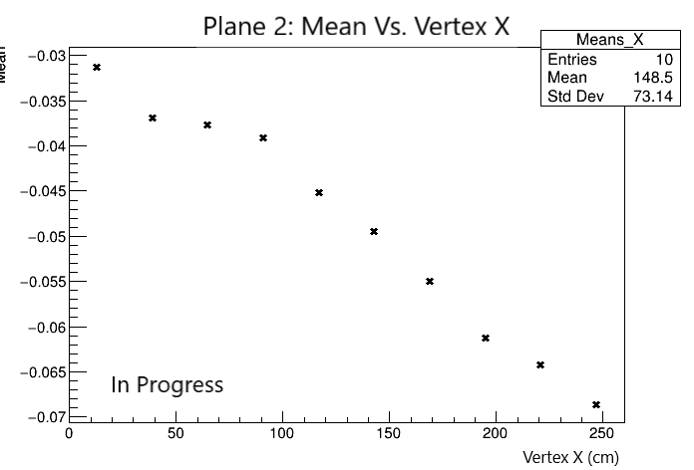
Backup Slides

Slide 27
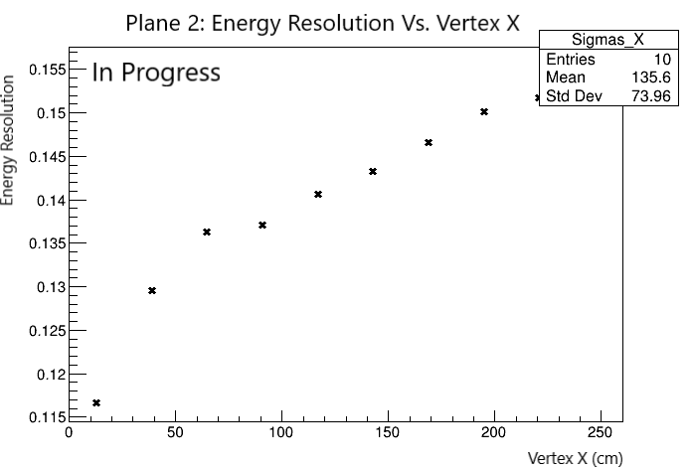
Backup Slides

Slide 28
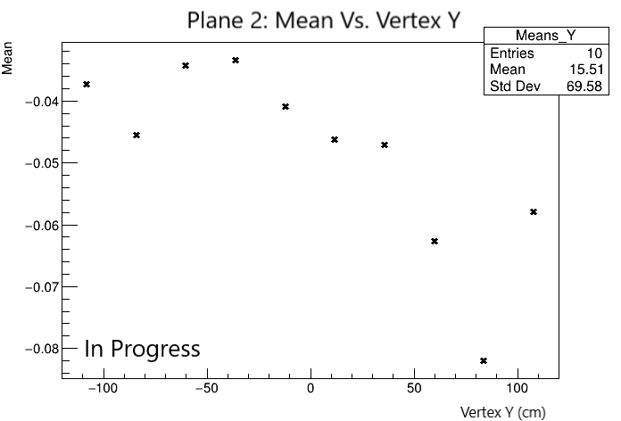
Backup Slides

Slide 29
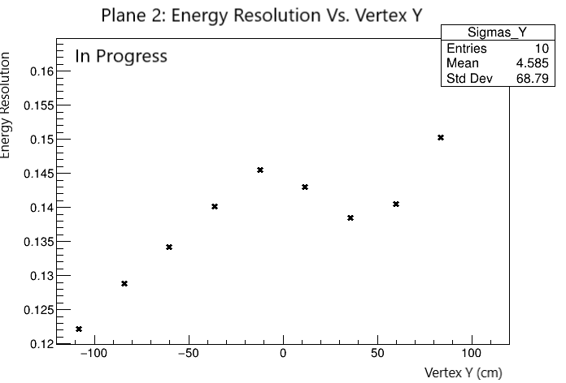
Backup Slides

Slide 30
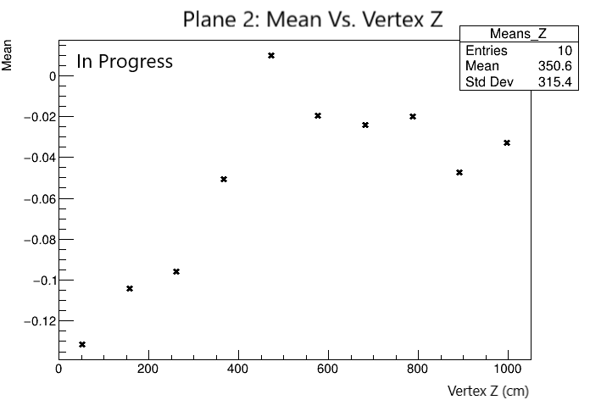
Backup Slides

Slide 31
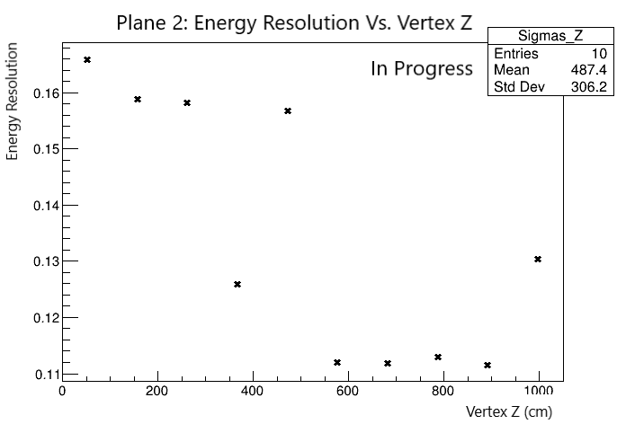
Backup Slides

Slide 32
Backup Slides

Slide 33
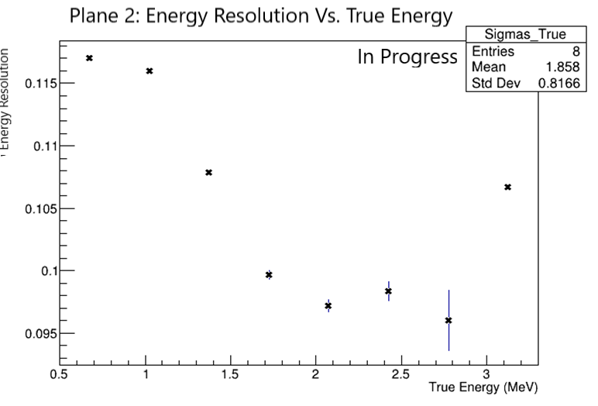
Backup Slides

