Slide 1
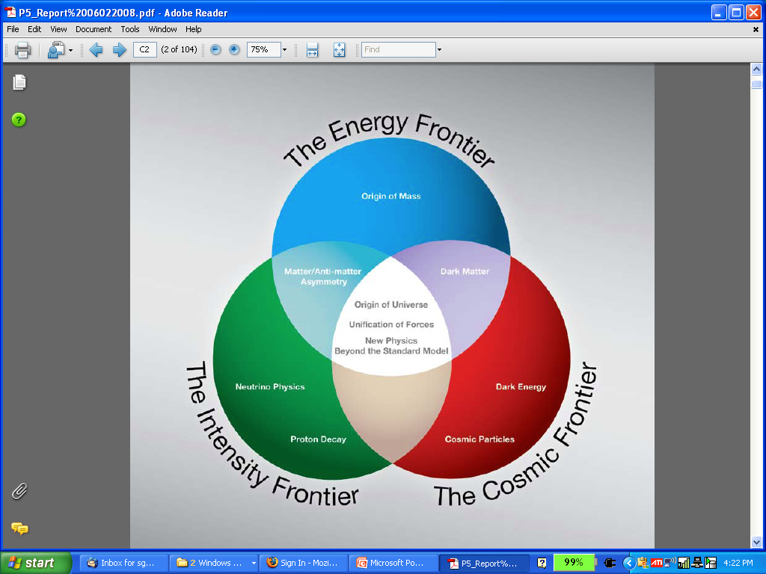
MAP
PLANNING FOR FY12
Steve Geer
Accelerator Physics Center
Fermi National Accelerator Laboratory
L1 + L2 Management Meeting
FNAL, October 20, 2011
μ⁺
μ⁻
ν

Slide 2
MEETING PURPOSE
COMMUNICATION of the present budget guidance, and the strategy (developed together with the L1 managers) for the distribution.
PRESENTATION of the L2 manager FY12 plans for their sub-activity, given the budget guidance for that sub-activity, and what would happen with a bit less (if we get squeezed) or a bit more.
DISCUSSION that will help inform the planning process, and help us reach a common understanding of priorities and choices.

Slide 3
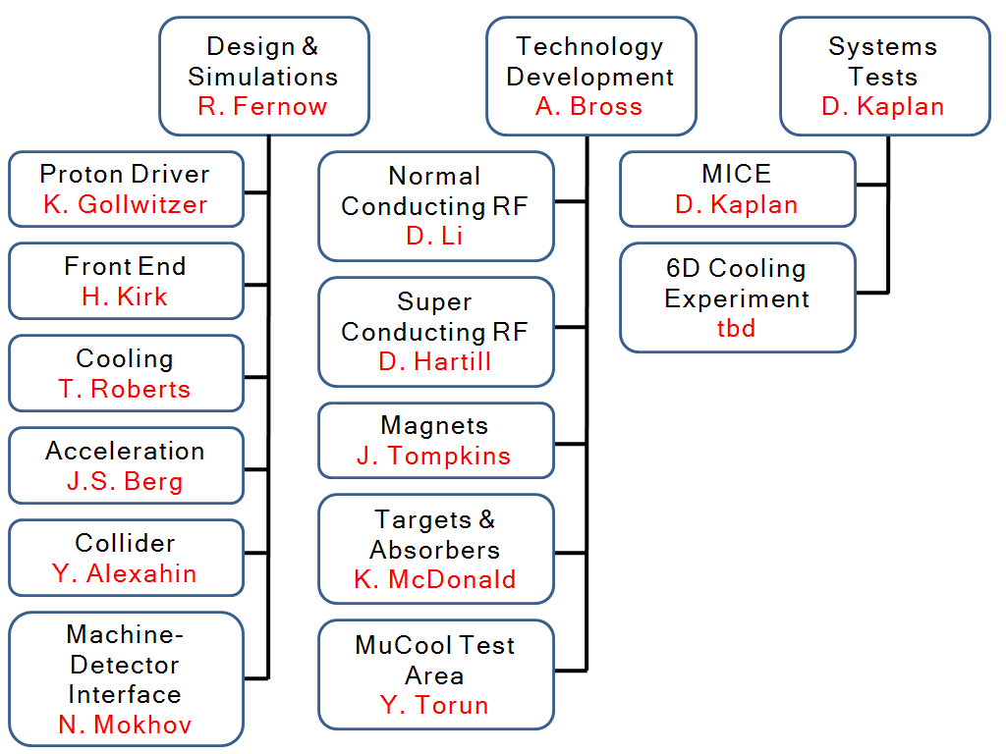
MAP L1 + L2 TEAM
“Level 1”

Slide 4
THE PLAN
BLUEPRINT. In broad-brush, we are following the proposed MAP plan that was reviewed a year ago, at a pace determined by the funding level.
EVOLUTION. The plan is not rigid. It must respond to revised funding expectations, unforeseen problems, what we learn as we proceed, and recommendations from reviews along the way.
UPDATES. The L1 managers maintain the plan for their sub-activity (with L2 managers input, and MAP Directors guidance). Week-by-week issues are discussed in the MAP management council (SG, AB, RF, DK, RP)

Slide 5
TEAM DYNAMICS
MAP
DIRECTOR
GUIDANCE
L1
L1
L1
INPUT
L2 s
L2 s
L2 s

Slide 6
TEAM DYNAMICS
MAP
DIRECTOR
MANAGEMENT
COUNCIL
PERSON
X
L1
L1
L1
INPUT
L2 s
L2 s
L2 s

Slide 7
PLANNING PROCESS
Started mid-August with budget guidance from DOE, and priorities set by the MAP Director.
August / September: L1 input → MAP Director → draft distribution (by sub-activity & institution/division).
FNAL piece negotiated with FNAL Directorate & division heads for division head presentations (Sept. 8th).
L1+L2 meeting (now). Follow-up will be to draft SOWs for each institution – may be some plan updates arising from dialogue with institutions.
Once budget guidance becomes budget reality: revise plan as needed & finalize institutional SOWs.

Slide 8
PAST-PRESENT-FUTURE
First
~10 yrs
FY07 –
FY09
FY10
FY11
FY12
≥FY13
NFMCC
+
MCTF
NFMCC
Interim
MAP
MAP
MAP
MAP
12 M$
(guideline)
~15 M$ (requested)
~4 M$
~9 M$
10 M$
10.5 M$

Slide 9
FY12 GUIDANCE & STRATEGY
GUIDANCE. 12M$
HIGHEST PRIORITIES:
  - MICE SS
  - MICE First CC test & complete MICE RFCC plan
  - RF in magnetic field R&D
  Maintain viable design & simulation effort
    (includes IDS-NF & MAP-PX task force)
NEXT-HIGHEST PRIORITIES.
  - Advance MICE RFCC (substantial uncertainties until magnet plan finalized), & other MICE priorities.
  - Prepare for future potential “highest priority” activities
  (HTS, rapid cycling magnets)
  - Set aside some modest support for new initiatives (some sort of review process with “external validation” will be needed)

Slide 10
DISTRIBUTION STRATEGY
The MICE magnets are the “lion in the den”. We must fully fund completing the two SS, and also fund with high priority (but without completely wrecking the rest of the program) progress towards completing the RFCC modules.
Since the RFCC FY12 needs have substantial uncertainties, will disperse funds in two distributions. This preserves some flexibility to deal with unforeseen emergencies.
Within the 2nd distribution, there is still about 1.1 M$ uncommitted in the draft plan. This is to cover additional RFCC support as the RFCC plan firms-up, and also some funding (hopefully few x 100K$) for new initiatives.

Slide 11
DRAFT FY12 DISTRIBUTION
Institution | RF | Key Design Simulation | MICE Non Magnet | MICE Magnet | Target | Non-MICE Magnet | SUMS | Percent
ANL | 185 | 0 | 0 | 0 | 0 | 0 | 185 | 1.70%
BNL | 0 | 1378 | 0 | 0 | 461 | 0 | 1839 | 16.86%
FNAL | 2291 | 1038 | 1119 | 1488 | 15 | 974 | 6925 | 63.50%
LBNL | 0 | 0 | 665 | 500 | 0 | 0 | 1165 | 10.68%
ORNL | 0 | 0 | 0 | 0 | 0 | 0 | 0 | 0.00%
SLAC | 150 | 0 | 0 | 0 | 0 | 0 | 150 | 1.38%
Jlab | 0 | 10 | 0 | 0 | 0 | 0 | 10 | 0.09%
UC-Berkeley | 3 | 0 | 0 | 0 | 0 | 0 | 3 | 0.03%
UCLA | 0 | 50 | 0 | 0 | 0 | 0 | 50 | 0.46%
UC-Riverside | 0 | 0 | 10 | 0 | 0 | 0 | 10 | 0.09%
IIT | 216 | 0 | 42 | 0 | 0 | 0 | 258 | 2.37%
U. Mississippi | 0 | 0 | 0 | 0 | 0 | 230 | 230 | 2.11%
Princeton | 0 | 0 | 0 | 0 | 10 | 0 | 10 | 0.09%
Muons, Inc. | 0 | 58 | 0 | 0 | 0 | 0 | 58 | 0.53%
Pass Thr. OH | 4.38 | 2.16 | 1.04 | 0 | 0.2 | 4.6 | 12.38 | 0.11%
SUMS | 2849.38 | 2536.16 | 1837.04 | 1988 | 486.2 | 1208.6 | 10905.38
% of Allocated | 26.13% | 23.26% | 16.85% | 18.23% | 4.46% | 11.08% | 100.00%
Unallocated |  |  |  |  |  |  | 1094.62
FY12 TOTAL |  |  |  |  |  |  | 12000
FULLY
LOADED
(M&S + SWF)
To cover RFCC
progress + new
initiatives

Slide 12
INTERPRETTING THE NUMBERS
The L1s should be able to interpret the numbers for you in terms of effort and M&S.
Note that, except for MICE magnet related funding, and a couple of activities that have completed in FY11, most other things are roughly flat wrt FY11 funding. So comparing with the numbers/FTEs in the FY11 SOWs will help you interpret the guidance.
This means that the growth in MAP funding in FY12 is largely accounted for by MICE magnet needs, with hopefully a little bit left over to support new initiatives.

Slide 13
FINAL REMARKS
MAP planning is an ongoing process with L2-L1-MAP Director dialogue throughout the year, and opportunities for broader discussions at bi-annual (?) MAP meetings.
September/October is the time when the Director(with L1-L2 input) has to translate the plan into funding and effort levels for the coming FY.
Input from this meeting will help fine-tune the FY12 plan, but is also valuable input for the ongoing planning process (“the planning process is more valuable than the plan”)

