Slide 1
FY12 RF Plans
MAP L1+L2 Management Meeting
Derun Li
Center for Beam Physics
General Accelerator Development Review
October 20, 2011
Fermi National Accelerator Laboratory

Slide 2
FY12 Budget Guidance

Slide 3
RF Plans: NCRF for Muon Cooling
Two major areas
Normal conducting RF cavities R&D for muon ionization cooling (in the presence of magnetic field)
805 MHz program
201 MHz program
Responsibilities in MICE
RF and Coupling Coil (RFCC) Module
201-MHz RF cavities
Coupling Coil Magnets
Spectrometer solenoids
Down-selection of RF cavity

Slide 4
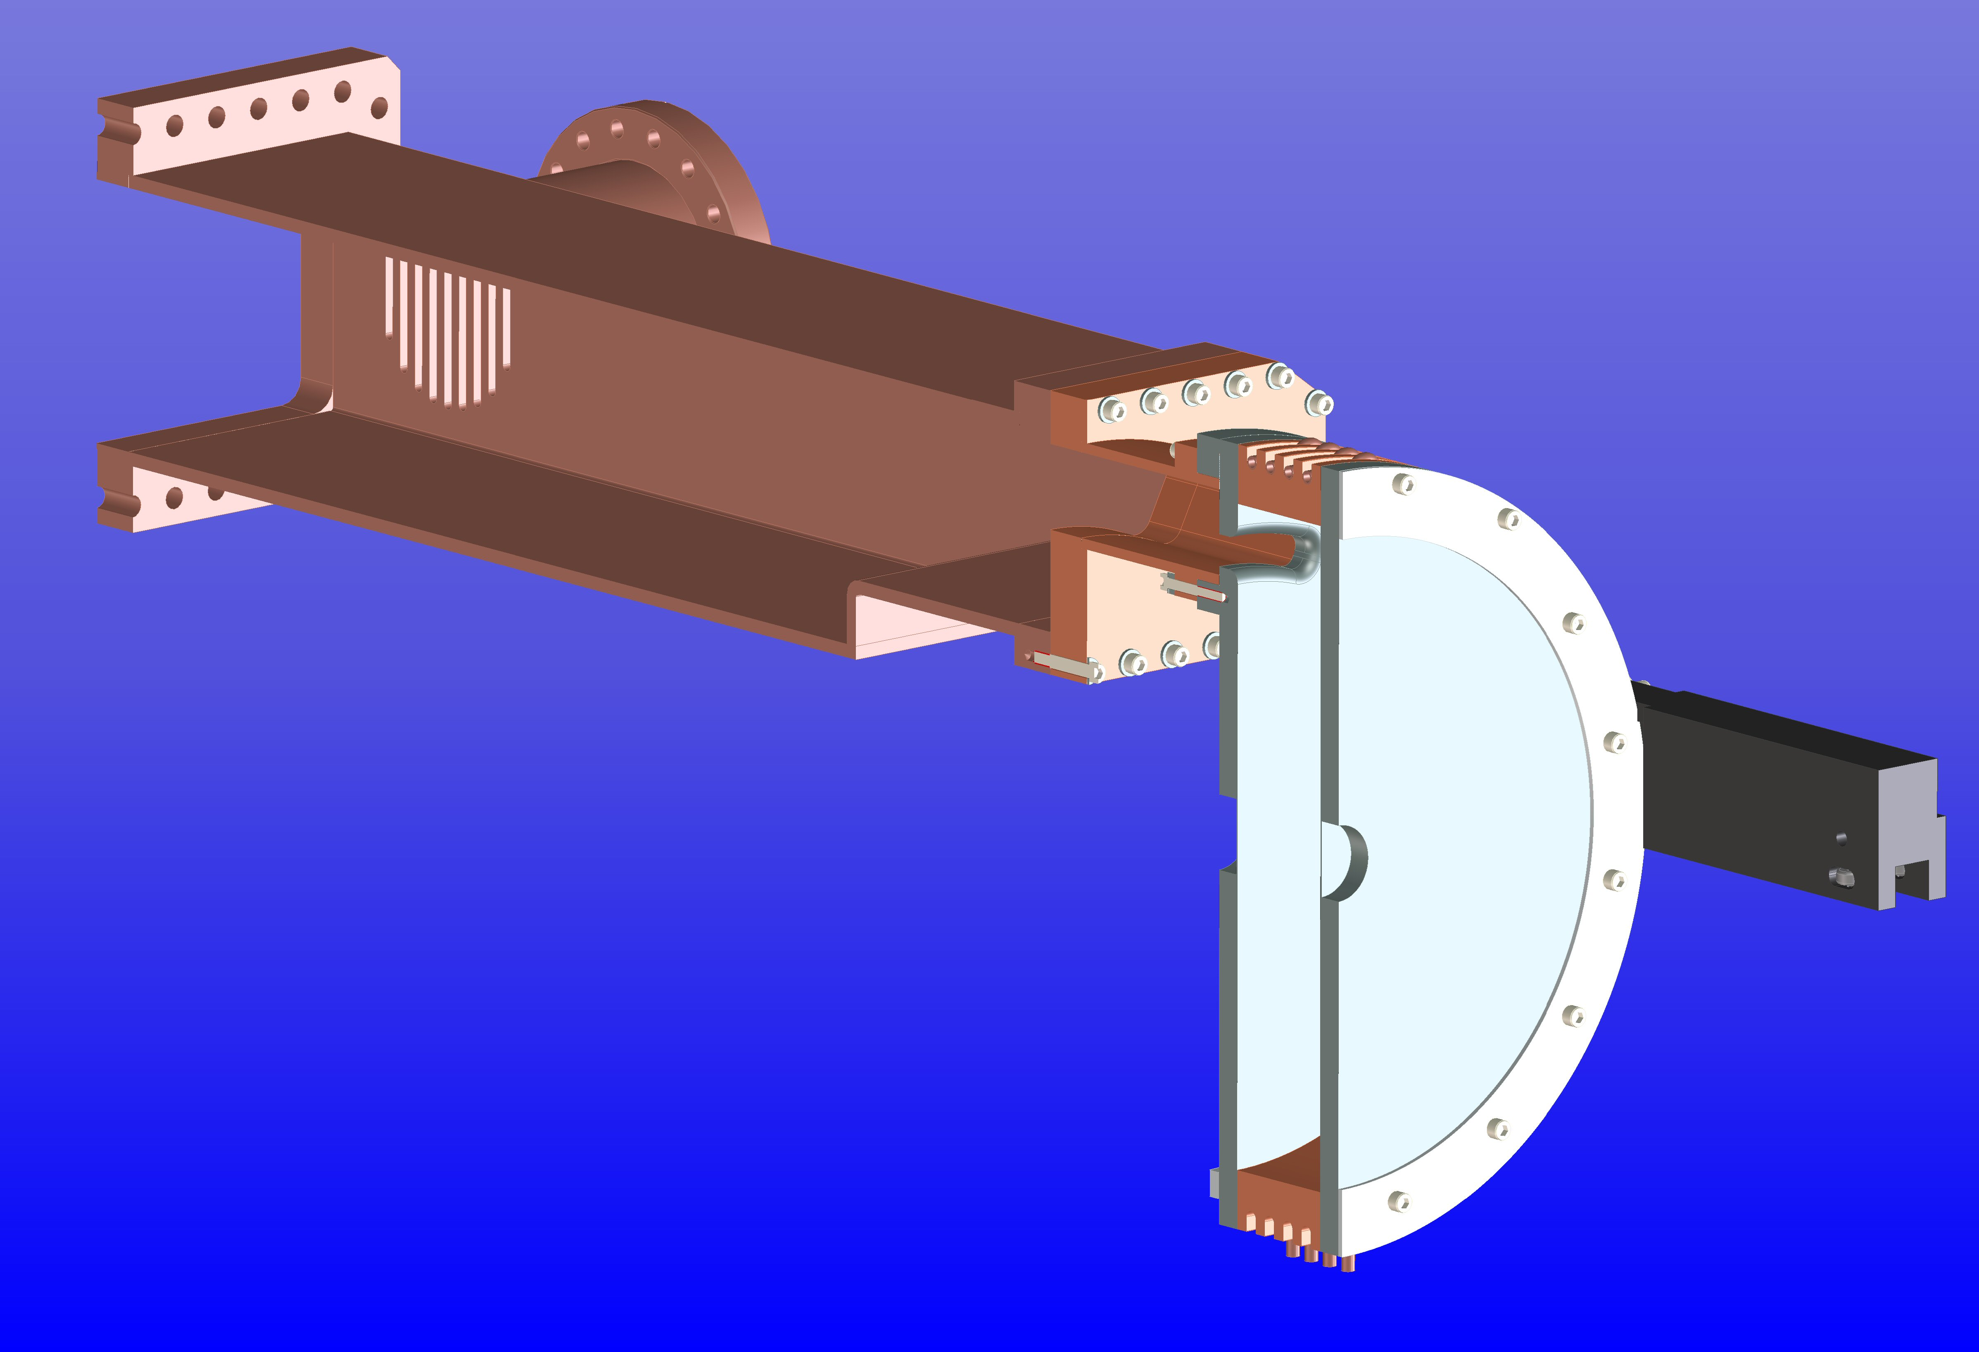
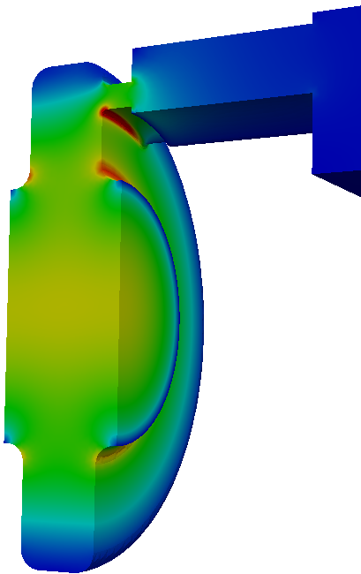
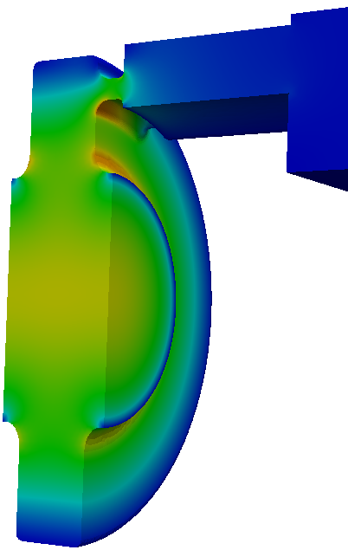
805 MHz Programs in FY12
Experimental program at the MTA (Y. Torun)
Pillbox cavity + button testing
Box cavity testing (ExB effects)
ALD cavity at ANL
Refurbishment of the pillbox cavity
New cavity design and construction
Beryllium-wall cavity (LBNL)
New pillbox cavity (SLAC)
Best practice of normal conducting RF design and fabrication techniques developed at SLAC
Design and Fabrication Readiness review
January 2012
Extra klystron at 805-MHz? Possible test at SLAC?
New coupler + new waveguide + RF window
LLNL (B. Rusnak) expressed interest in MAP RF
Simulations using CST MWS
Be-wall cavity
design

Slide 5
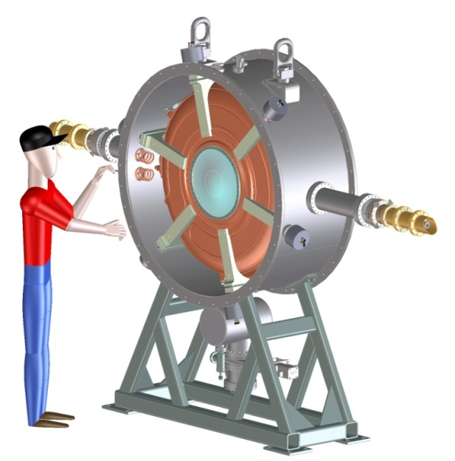
201 MHz Programs in FY12
Experimental program at the MTA
Two new couplers for the prototype cavity
Modification of RF loop and fabrication of other parts in progress
Single cavity vessel design and fabrication
Fabrication in progress and will be ready ∼ December 2012
Plan to use MICE cavities for testing at the MTA
Electro-polishing of MICE cavities
Tuner arms (six per cavity)
Actuators (six per cavity)
Cavity support in the vessel
Testing of 201-MHz cavities using the vessel
Programs will be defined and developed

Slide 6
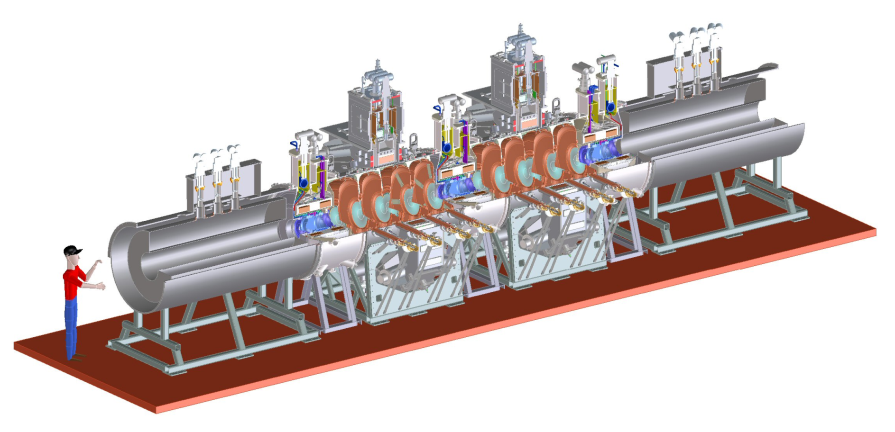
Responsibilities in MICE
International MICE experiment at RAL
Demonstration of muon ionization cooling

Slide 7
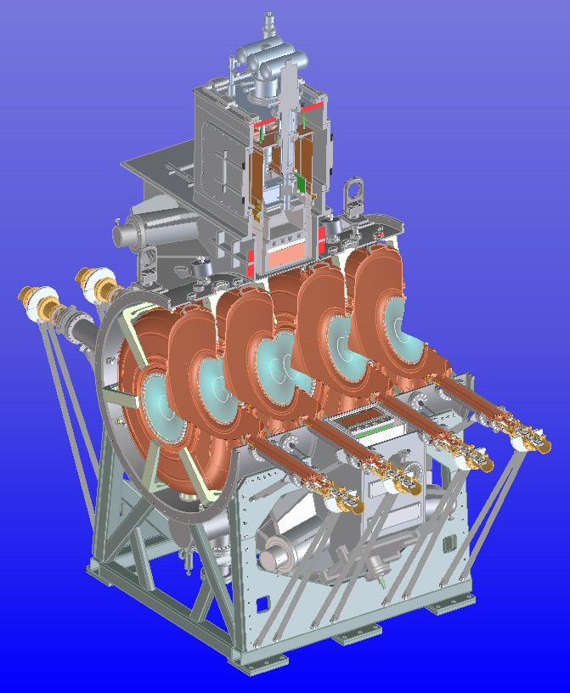
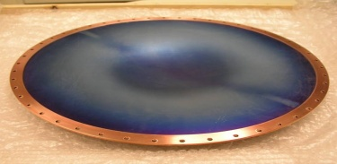
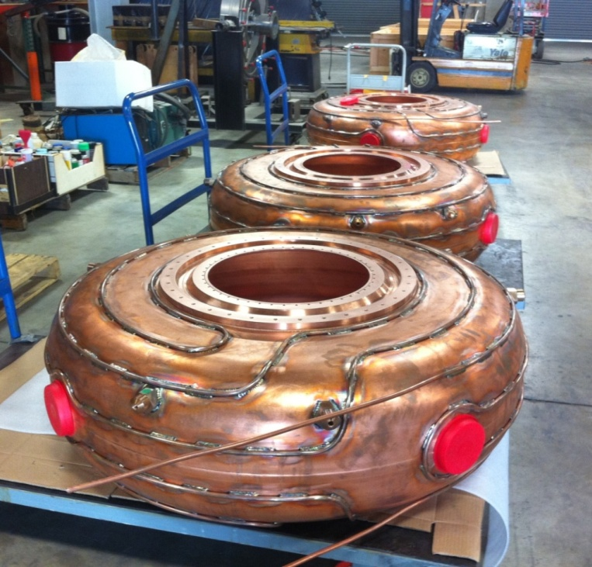
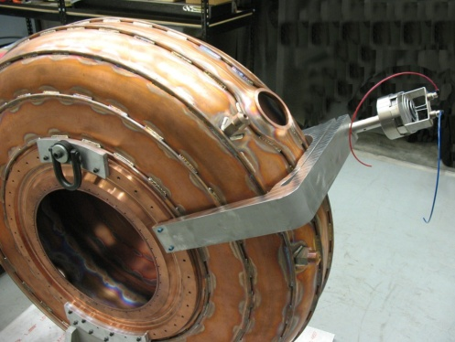
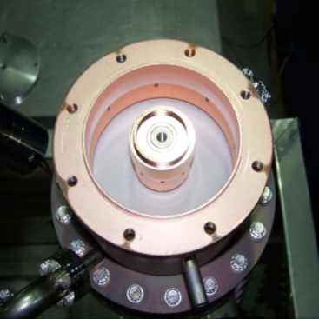
RFCC Module: 201 MHz Cavity
Beryllium window
Sectional view
of RFCC module
Cavity fabrication
Coupler
tuner
RF window

Slide 8
Status of MICE Cavities at LBNL
Ten cavities with brazed water cooling pipes (two spares) complete in December 2010
Five cavities measured
Received nine beryllium windows
Ten ceramic RF windows purchased, six at LBNL now
1st set of six prototype tuner arms in fabrication, and actuators to be fabricated in FY12
Design of RF power (loop) coupler complete, modification design in progress
Design of cavity support and vacuum vessel complete
Electro-polishing work started and will be completed in FY12:
ES&H review approval in process
Chemicals ordered
Fixture design in progress

Slide 9
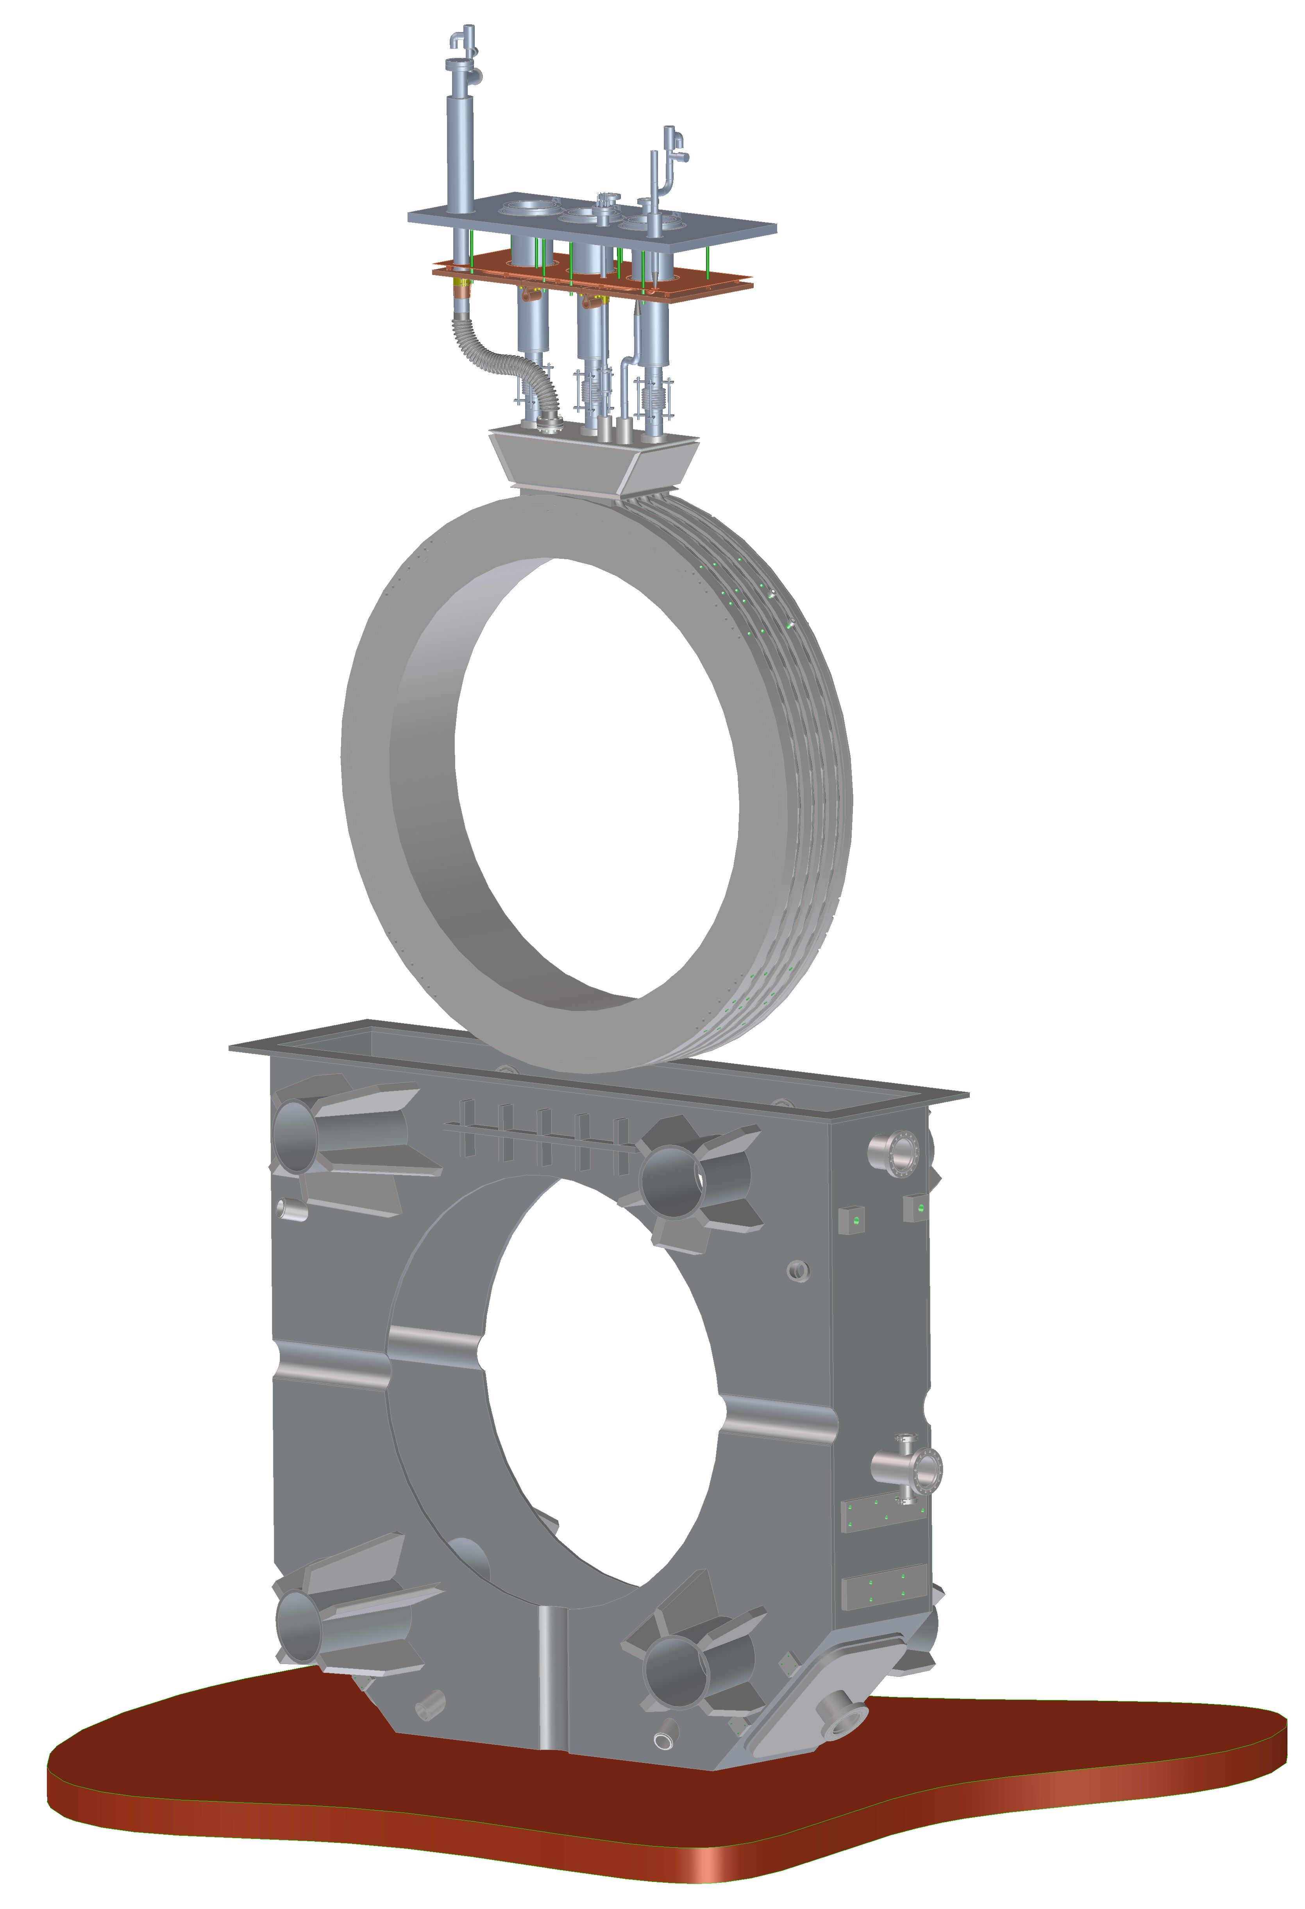
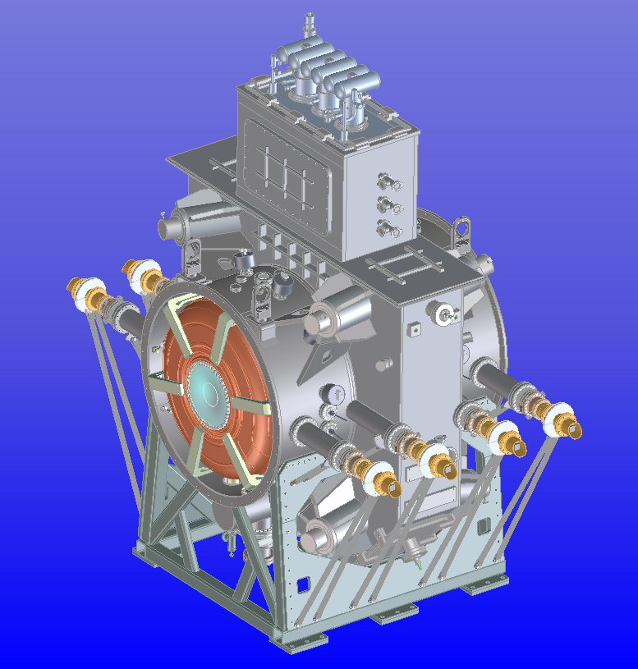
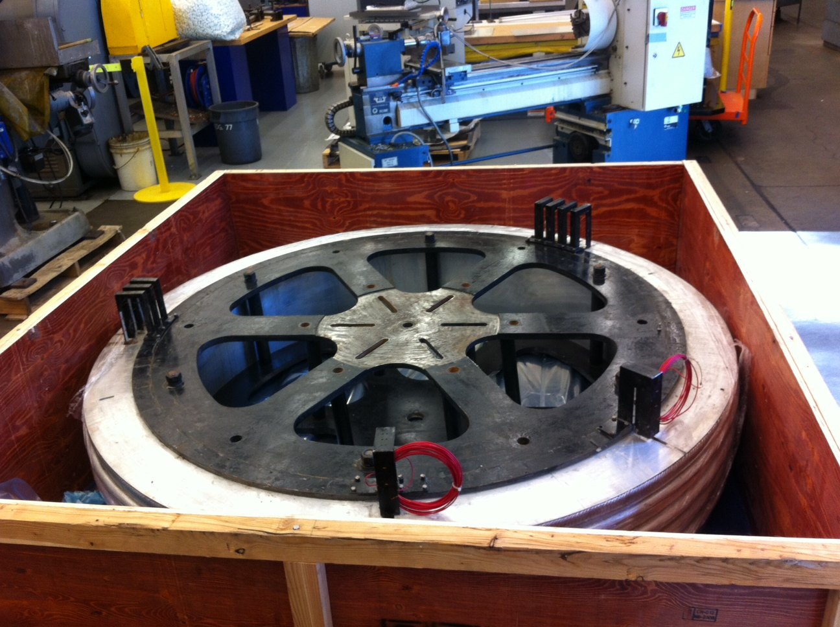
RFCC Module: Coupling Coil (Virostek)
Cold mass testing at Fermilab
Cryostat fabrication readiness review ∼ January 2012
Quench protection
Cryostating
Testing
Cryostat
Cold-mass

Slide 10
Funding Increase/Decrease Scenario
20% Increase Scenario
New coupler, waveguide and RF windows for 805 MHz cavity and testing
Complete all hardware needed for single cavity vessel and cavity testing at MTA
New RF postdoc at FNAL helping with RF testing and data analysis
Post-processing of MICE cavities: measurements, tuning and other accessory components
Refurbishment of the 805 MHz pillbox cavity
LLNL proposal
20% Decrease Scenario
Readjust/postpone (according to MICE schedule) some of MICE RF cavity work

