Slide 1
Advanced Accelerator R&D at
A0 Photoinjector and High Brightness Electron Source Lab.
Yine Sun
Accelerator Advisory Committee Meeting
Nov. 7 - 9, 2011

Slide 2
Outline
Introduction;
Experiments at the A0 Photoinjector (A0PI) and Recent Achievements;
From A0PI to HBESL (High Brightness Electron Source Lab.);
HBESL: Goals, Possible Experiments and Outlook.

Slide 3
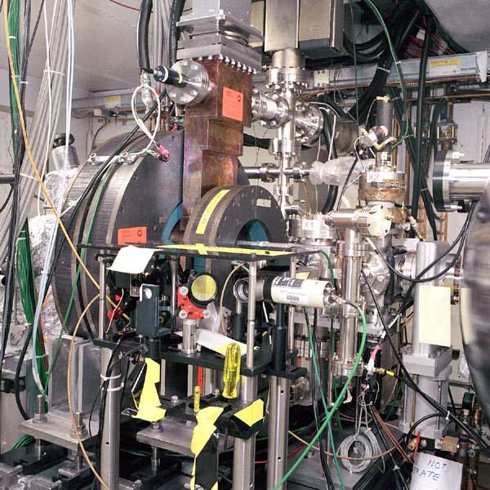
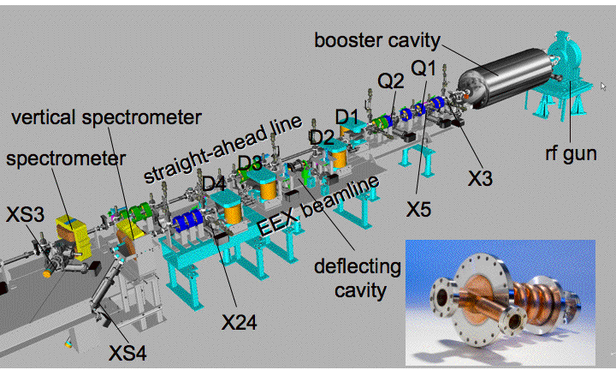
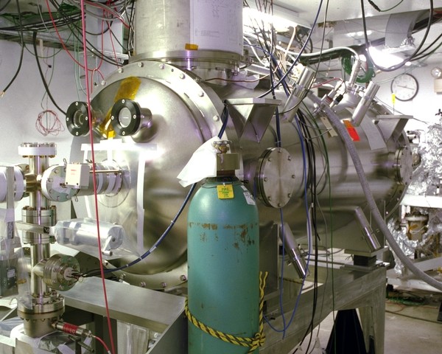
A0: Introduction
Electron photoinjector with normal conducting RF gun and TESLA SC RF 9-cell cavity;
Two beamlines:
  Straight-ahead beamline (round-to-flat beam transformation);
  Double-dogleg beamline (emittance exchange (x,x’) ↔(z,δ)).

Slide 4
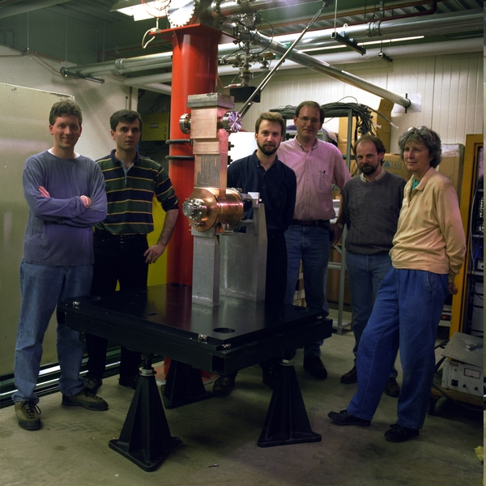
A0: History and Accomplishments
Fermilab designed and built the photoinjector for the TESLA Test Facility (TTF) at DESY; A0 photoinjector is identical to the one delivered to TTF.
The first beam of A0 photoinjector was produced on March 3, 1999.
  12 students graduated from A0’s design and experiments:
  Eric Colby, PhD, UCLA, 1997 (J. Rosenzweig)
  Alan Fry, PhD, U. of Rochester, 1998 (A. Melissinos)
  Michael Fitch, PhD, U. of Rochester, 2000 (A. Melissinos)
  Sven Fritzler, PhD, Darmstadt U, 2000 (A. Zilges)
  Jean-Paul Carneiro, PhD, U. Paris XI, France, 2001 (J. Le Duff)
  Dan Bollinger, MS, Northern Illinois U., 2005 (C. Bohn)
  Yin-e Sun, PhD, U. of Chicago, 2005 (K.-J. Kim)
  Rodion Tikhoplav, PhD, U. of Rochester, 2006 (A. Melissinos)
  Matt Thompson, PhD, UCLA, 2007 (J. Rosenzweig)
  Arthur Paytan, MS, Yerevan State U., Armenia, 2008 (E. Laziev)
  Timothy Koeth, PhD, Rutgers U., 2009 (S. Schnetzer)
  Timothy Maxwell, PhD, Northern Illinois U., 2011 (P. Piot)

Slide 5
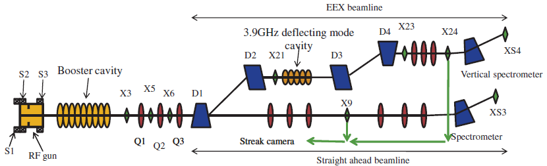
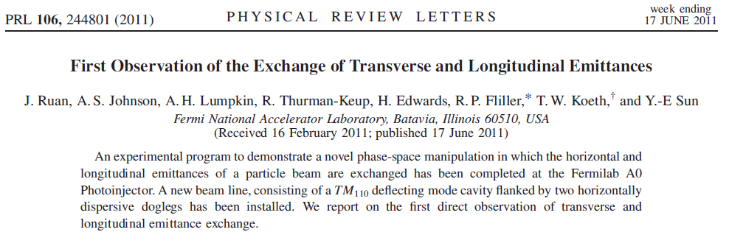
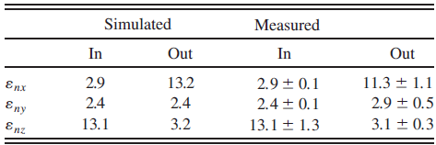
A0 FY11 Experiments (I) -- EEX
Transverse-Longitudinal Emittance Exchange (Ruan et al.)

Slide 6
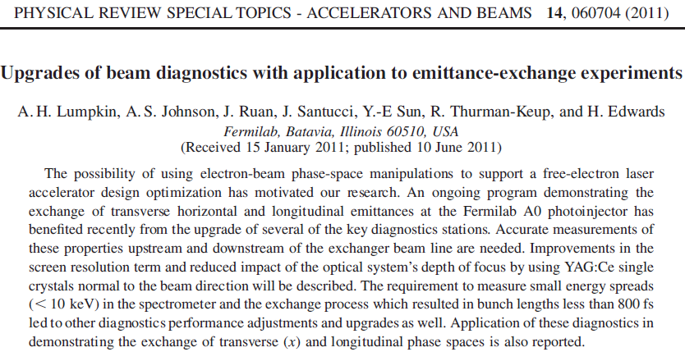
A0 FY11 Experiments (II) – Beam Diagnostics
Beam Diagnostics Upgrades for EEX (Lumpkin et al.)

Slide 7
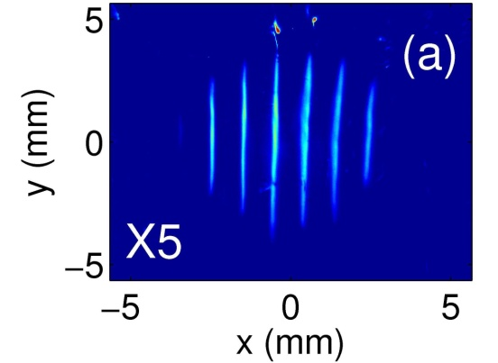
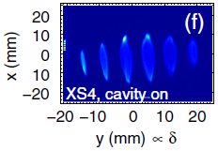
A0 FY11 Experiments (III) – Subps Bunch Trains
Longitudinal Beam Profile Shaping Using EEX (Sun et al.)
initial horizontal beam intensity modulation → final beam current/energy modulation
For A0 photoinjector:
α=22.5 °
L=803 mm
S=764 mm

Slide 8
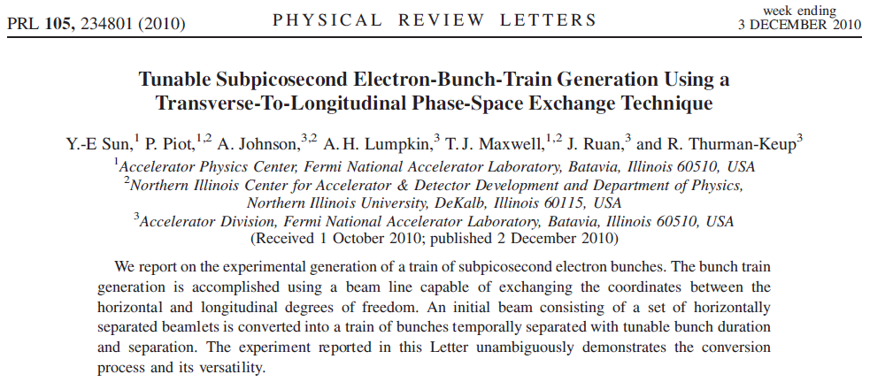
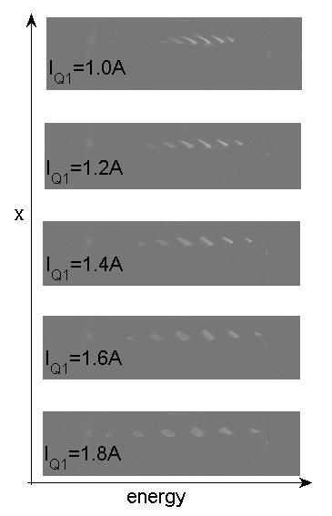
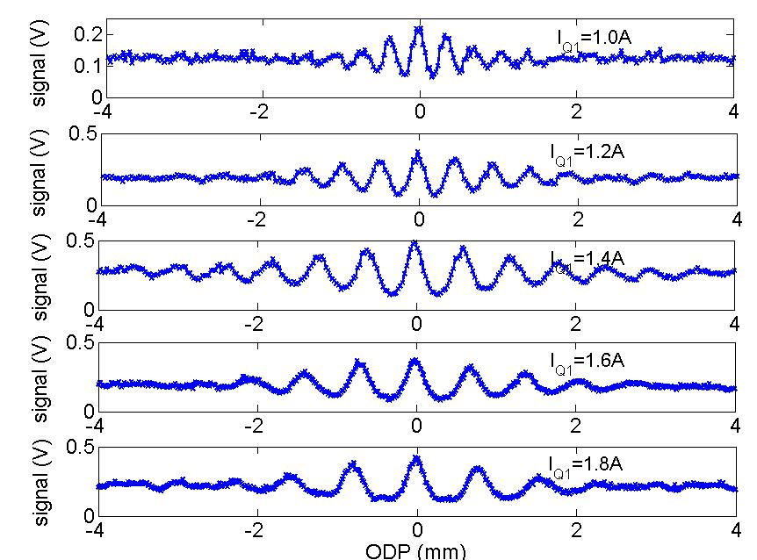
A0 FY11 Experiments (III) – Subps Bunch Trains
Longitudinal Beam Profile Shaping Using EEX (Sun et al.)
energy
time: autocorrelation function

Slide 9
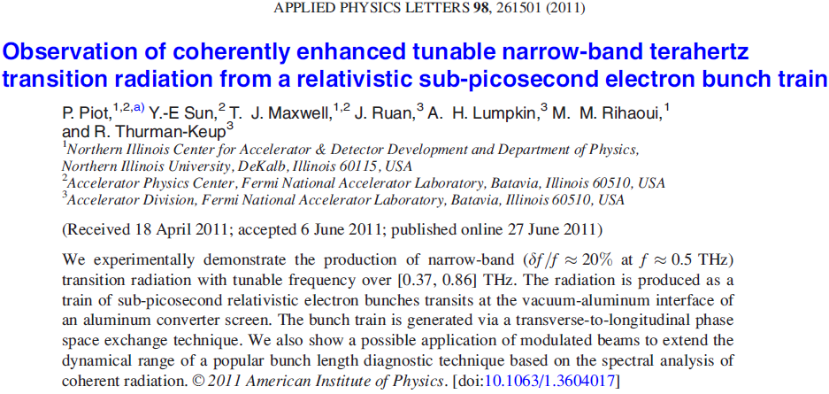
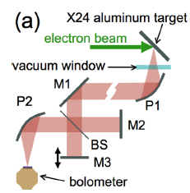
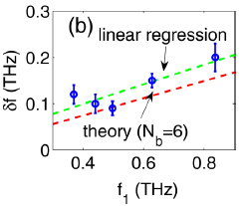
A0 FY11 Experiments (IV) – Subps Bunch Trains Applications
Narrow-Band THz Radiation Generation (Piot. et al.)

Slide 10
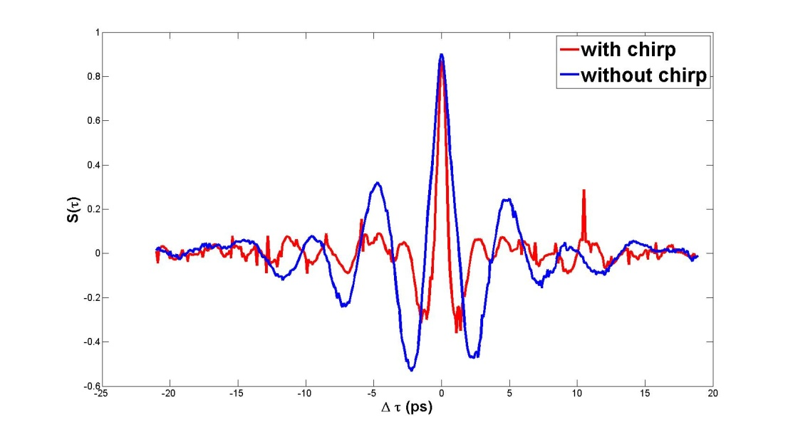
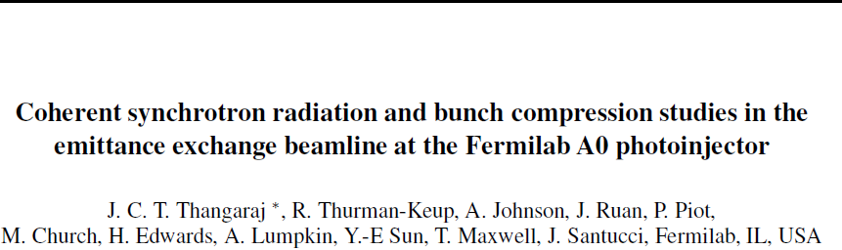

A0 FY11 Experiments (V) – CSR
Coherent Synchrotron Radiation Studies (Thangaraj et al.)
CSR has been measured at A0 for different charges
Power, polarization and angular distribution of CSR have been measured.
‘Chirp mode’ with EEX shows pulse compression.
CSR can be used as a diagnostics tool for bunch length measurements.
In preparation for submission to PRSTAB

Slide 11
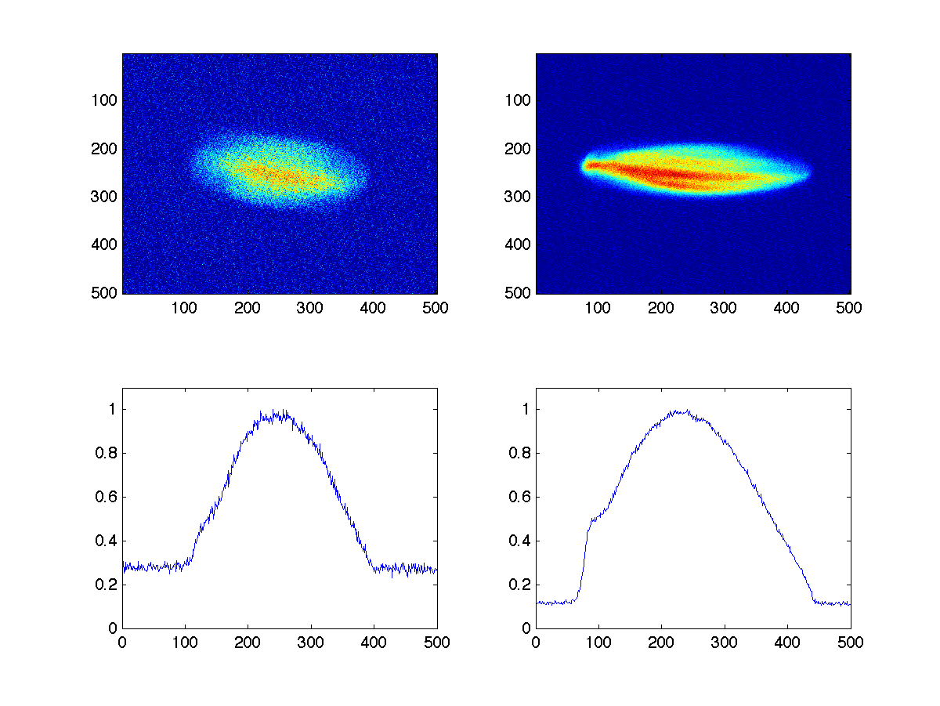
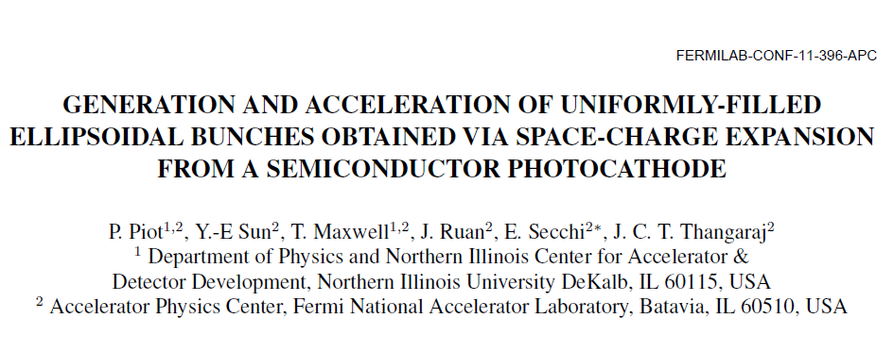
A0 FY11 Experiments (VI) – Ellipsoidal Beam
3D Ellipsoidal Bunch From Cs₂Te Photocathode (Piot et al.)
  Preliminary experiment completed,
  final data taking in 06/2011 with
  improved diagnostics.
y
bunch
100 pC 600 pC
N
cathode
time
laser
In preparation for submission to PRSTAB

Slide 12
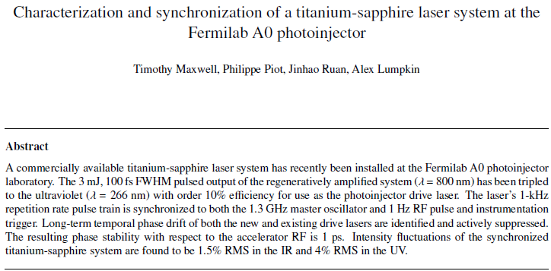
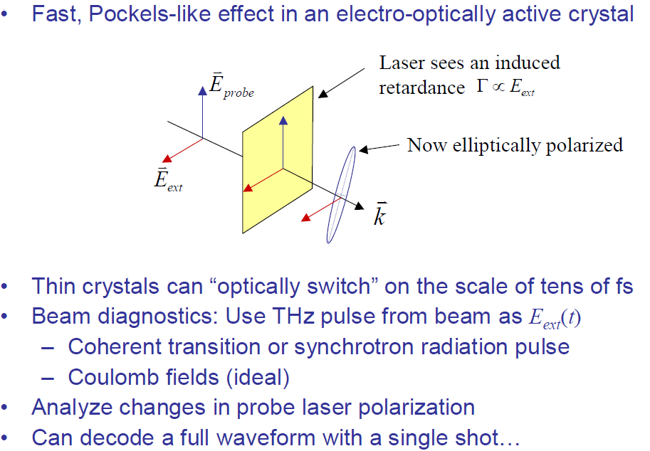
A0 FY11 Experiments (VII) – Electro-optical Sampling
Electron-optica Sampling for Ultra-fast Diagnostics, Ph. D. Disseration (Maxwell, Northern Illinois Univ.)
In preparation for submission to NIM

Slide 13
A0 Publications in FY11:
  Referred Journal :
Y.-E Sun et al., Phys. Rev. Lett. 105, 234801 (2010).
P. Piot et al., Phys. Rev. ST Accel. Beams 14, 022801 (2011).
A. H. Lumpkin et al., Phys. Rev. ST Accel. Beams 14, 060704 (2011).
J. Ruan et al., Phys. Rev. Lett. 106, 244801 (2011).
P. Piot et al., Appl. Phys. Lett. 98, 261501 (2011).
  Conference & Workshop Proceedings
A. Lumpkin, et al., “Investigation of OTR Polarization in Beam-profile Monitors”, FEL11 (2011).
P. Piot, et al., “Generation and Acceleration of Uniformly-filled Ellipsoidal Bunches Obtrained via Space-charge-driven Expansion from a Semiconductor Photocathode”, FEL11 (2011).
J . Ruan, et al., “Demonstration of Tranverse-to-Longitudinal Emittance Exchange at A0 Photoinjector”, FEL11 (2011).
J . Ruan, et al., “Commissioning of a Stream Camera for Laser Characterization at A0PI”, FEL11 (2011).
Y. Sun et al., “Experiment and Simulations of Sub-ps Electron Bunch Train Generation at Fermilab Photinjectors”, FEL11 (2011)
J. Thangaraj, et al., “Coherent Synchrotron Radiation Studies and Bunch Compression in the Emittance Exchange Line at the A0 Photoinjector”, FEL11 (2011).
A. S. Johnson, et al., “Near-ideal Emittance Exchange at the Fermilab Photoinjector”, PAC11(2011).
T. Maxwell, et al., “Synchronization and Jitter Studies of a Titanium-sapphire Laser at the A0 Photoinjector”, PAC11 (2011).
Y. Sun et al., “Subpicosecond Electron Bunch Train Production Using a Phase-Space Exchange Technique”, PAC11 (2011).
R. Thurman-Keup et al, “Transverse Emittance and Phase Space Program Developed for Use at the Fermilab A0 Photoinjector”, PAC 11 (2011).
J. Thangaraj, “Experimental Studies on Coherent Synchrotron Radiation in the Emittance Exchange Line at the Fermilab A0 Photoinjector”, PAC11 (2011).
A. Lumpkin, et al., “Initial Beam-Profiling Tests with the NML Prototype Station at the Fermilab A0 Photoinjector”, PAC11 (2011).
P. Piot et al., “Transverse-to-longitudinal phase space exchange: a versatile tool for shaping the current and energy profile of relativistic electron bunches”, Proc. AAC10 (2010).
J. Thangaraj, et al., “Experimental study of coherent synchrotron radiation in the emittance-exchange line of the A0 photoinjector”, Proc. AAC10 (2010).
Y.-E Sun, et al., “Experimental Generation of Longitudinally-modulated Electron Beams using an Emittance-exchange Technique”, Proc. IPAC10, 4313 (2010).
M. Thompson, et al., “Observations of low-aberration plasma lens focusing of relativistic electron beams at the under-dense threshold”, Phys. Plasmas 17, 073105 (2010).
A. Johnson, et al., “Demonstration of Transverse-to-longitudinal Emittance Exchange at the Fermilab Photoinjector”, Proc. IPAC10, 4614 (2010).
Y.-E Sun, et al., “Conversion of a transverse density modulation into a longitudinal modulation using a emittance exchange technique”, Proc, HBEB09, ArXiV:1003.3126 (2010).
A. Lumpkin, et al., “OTR polarization effects in beam-profile monitor at the A0 photoinjector”, Proc. BIW10 (2010).

Slide 14
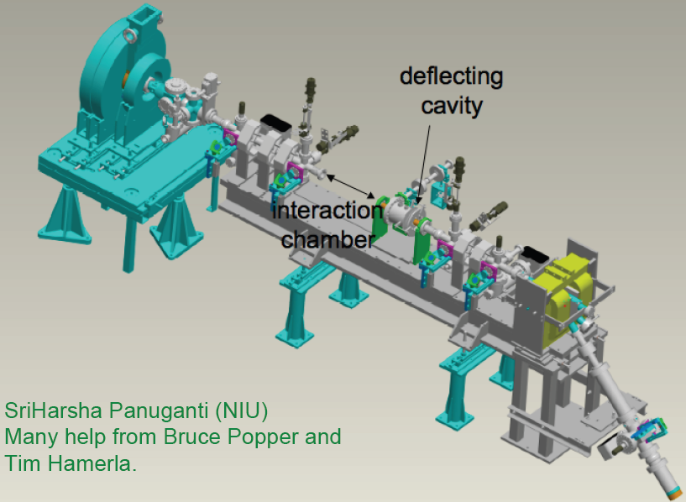
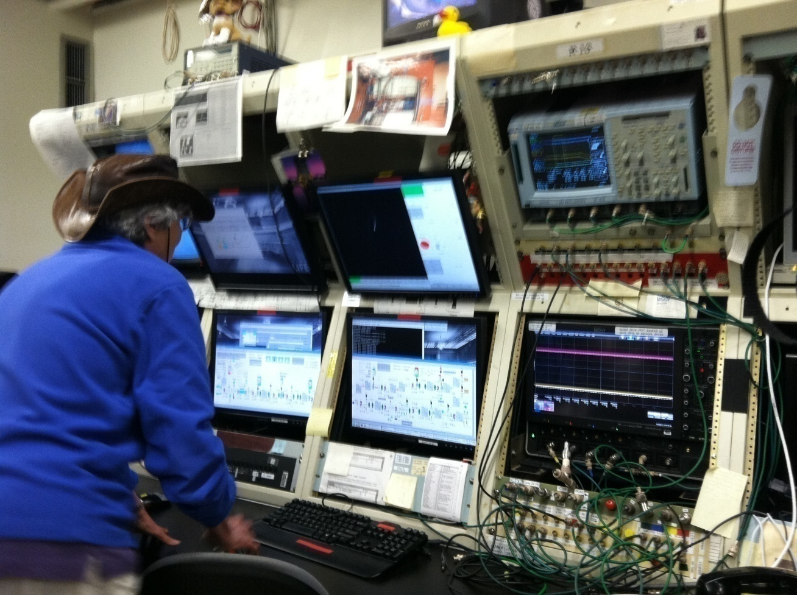
From A0 to HBESL
A0 ceases the16 MeV e⁻beam operation with the Tevatron shutdown in Oct. 2011 (NC gun 4 MeV + SC cavity 12 MeV).
A0 is to be converted into High-Brightness Electron Source Lab. (NC gun only due to the lack of cryo, 4 MeV) (P. Piot).

Slide 15
HBESL: Motivations
Electron sources development is important for high-energy accelerators, critical for high-average current accelerators such as energy recovery linacs and accelerator-based light sources;
Lots of new ideas are being developed in the areas of cathodes and guns, as well as advanced beam shaping right at the birth of electron beams;
A facility that is dedicated to electron sources R&D is desired-- if we don’t build it, some one will. It can’t be part of a larger accelerator such as ASTA to avoid interference with other programs.
The existing infrastructure at A0 photoinjector is just right for a source development lab. – spend minimal funding yet gain an important asset for Fermilab.

Slide 16
HBESL 10-Year Goal
Be on the forefront of electron source development for HEP, light-sources and other related communities:
  cathode fabrication and testing;
  electron gun design and testing;
  high-brightness/high average current electron beam studies.
Build strong ties with universities and provide the infrastructure for graduate students to work on their theses, thus foster the education of accelerator scientists and engineers;
Serve as the electron source test facility for ASTA;
Provide beams for the testing of novel diagnostics instruments, accelerating structures etc..

Slide 17
HBESL FY12 Goal
Reconfigure the Beamline:
  Removal of the superconducting cavity;
  Removal of the beamline elements needed by ASTA etc.;
  Reconfiguration of the beamline for HBSEL:
    Relocate sections of the beamline for electron beam transportation;
    Relocate the dipole magnet and beam dump;
    Relocate the beam diagnostics (beamline hardware, electronics and software control systems);
    Get permission for beam operation from radiation safety etc.
Reconfigure the Laser Room:
  real-estate reconfiguration to allow space for new lasers;
  installation of the new fs high-power photocathode drive-laser.
Resumption of Beam Operations:
  test of multi-photon emission of electrons...

Slide 18
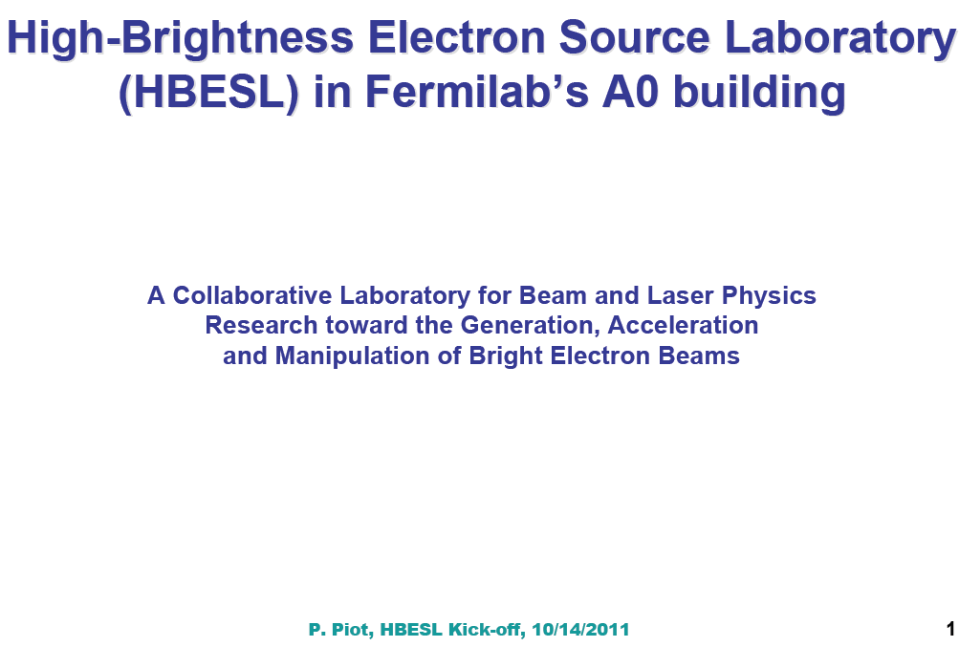
Possible Experiments for HBESL (Piot)

Slide 19
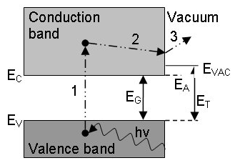
Possible Experiments for HBESL (I)
Three-photon Photo-emission from CsTe Cathode:
  – Presently 266 nm UV laser is used to match peak in photoemission (hv = 4.5 eV);
  – A high-peak-power 800-nm laser can be used to photo-emit from CsTe;
  – Advantages: simple and
  more efficient laser system.
Measurement of the CsTe Cathode Response Time:
  – Never measured before;
  – CsTe expected to be slow emitters with emission time below 1 ps;
  – A deflecting cavity directly downstream of the gun could enable this measurement.
CsTe Cathode Fabrication and Testing (in collaborations with INFN, Italy and Argonne)

Slide 20
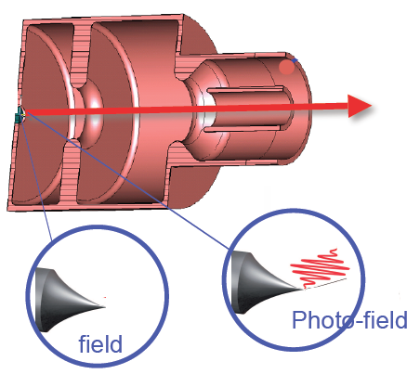
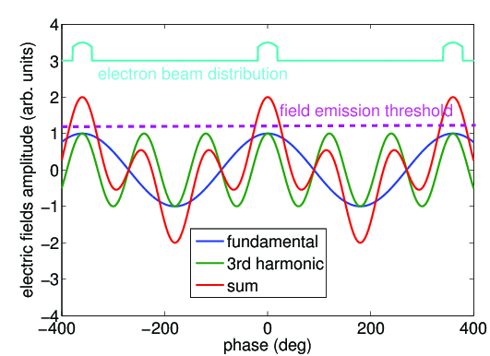
Possible Experiments for HBESL (II)
Emission from needle cathodes (with Vanderbilt University):
– Unprecedented brightness at the quantum-degenerate limit.
– How the brightness is maintained
after acceleration in an rf gun
Photo-field emission:
– Use a 6-fs laser to enable emission from needle;
– Attosecond bunches from laser “buckets”.
Gated field emission:
– two-frequency rf gun (funded SBIR with RadiaBeam) a 1.3-3.9-GHz rf gun will be delivered during FY13;
– two-frequency coaxial line with a the cathode at one of its extremity → new cathode holder being designed with VU.

Slide 21
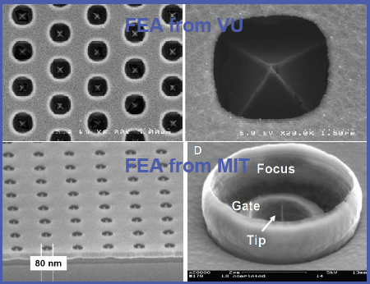
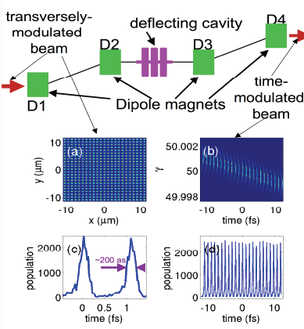
Possible Experiments for HBESL (III)
Field Emission Needle Testing
(1st Time in a RF Gun)
– Diamond c anathode (VU)
– Carbon nanotube (RB)
Field Emission Array:
– Many (104-106) needles on the
substrate (VU/MIT)
– Initially motivation increase current
– New directions:
– pre-bunch at the attosec. level
[Graves, Kartner, Moncton, Piot (2011)]
– Improve brightness”.

Slide 22
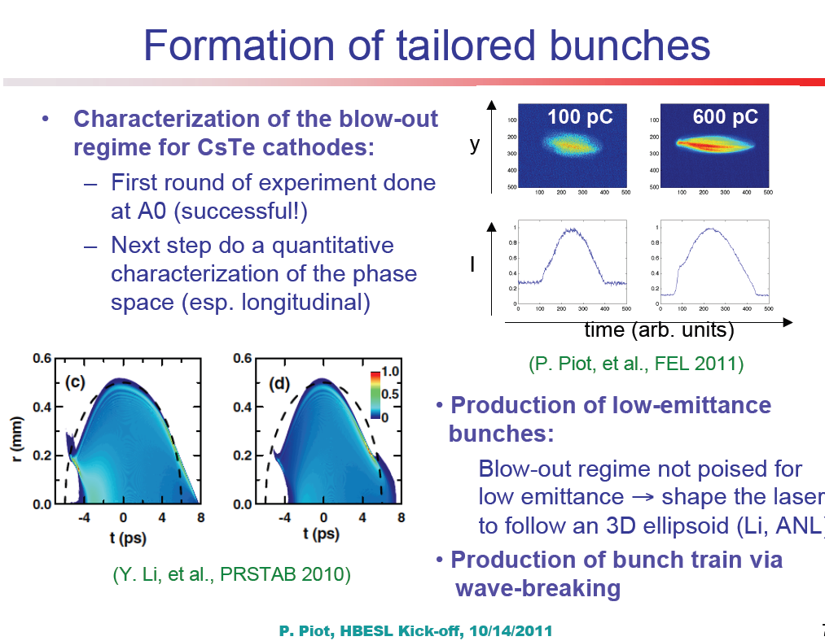
Possible Experiments for HBESL (IV)

Slide 23
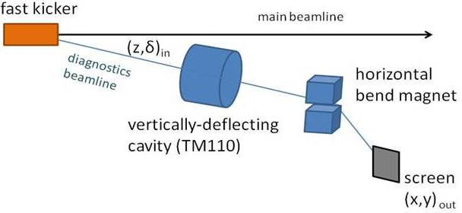
Possible Experiments for HBESL (V)
Beam Diagnostics Testing (Colorado State Univ.)
Low energy measurements (up to 5 MeV) with a deflecting cavity and beam profile screens to benchmark/validate longitudinal phase space diagnostics design.

Slide 24
Summary of Possible Experiments for HBESL
Three-photon Photo-emission from CsTe Cathode;
Response Time of CsTe Cathode;
Blow-out regime operation of CsTe Cathode and Beam Longitudinal Phase-Space Studies;
Drive-Laser Shaping to Produce Ellipsoidal Beam;
Direct Laser Acceleration (MIT);
Beam Diagnostics Development and Testing;
Field-Emitted High-Brightness Beam Generation:
  From a needle cathode (daimond from Vanderbilt Univ.; carbon nanotube from RadiaBeam);
  Photo-enabled need cathode (to generate pulsed beam);
  Gated field emission (two-frequency rf gun, funded SBIR with RadiaBeam);
  Field emission arrays.

Slide 25
HBESL Outlook
By the virtue of being a R&D facility, the HBESL welcomes multi-disciplinary researches that are of high-risk high-payoff nature;
Proof-of-principle/proof-of-feasibility experiments are well-suited for PhD dissertations; HBESL should be proud to serve as such a facility to carry out its goal in educating accelerator scientists;
Universities will bring students and grants for the R&D experiments for HBESL;
The success of HBESL depends on the operational support from Fermilab (LCW, vacuum, RF, control software and expertise from instrumentation group etc.).

