Slide 1
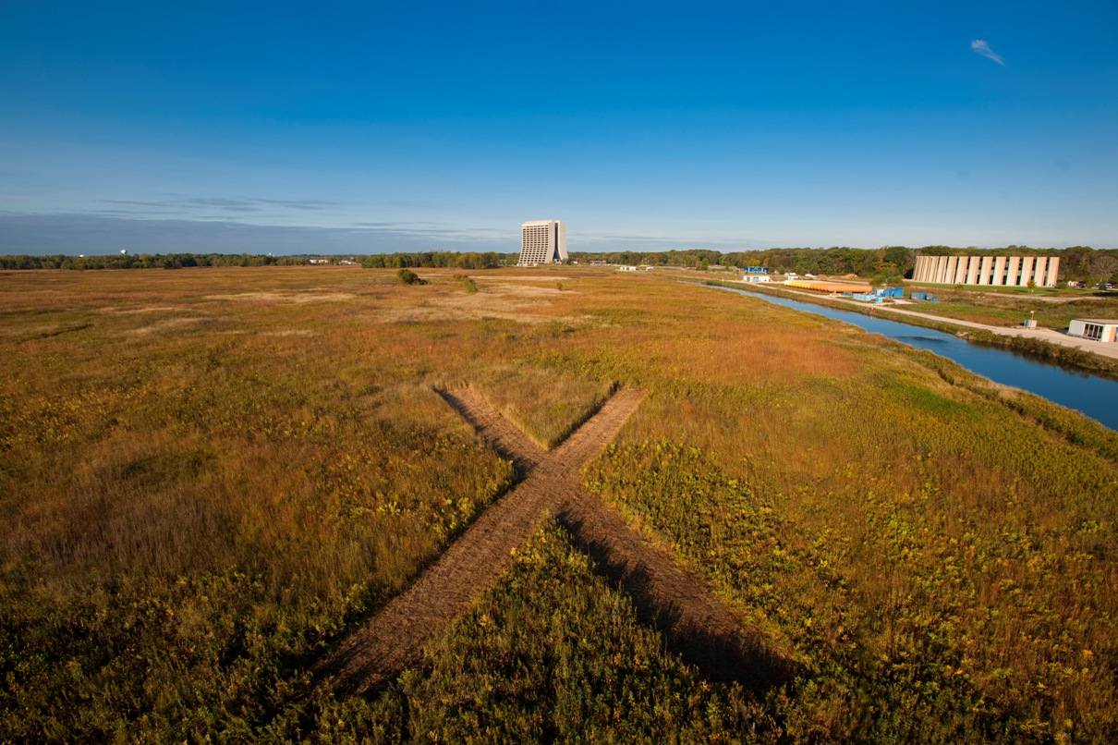
Project X Reference Design and
R&D Plan
Sergei Nagaitsev
Fermilab Accelerator Advisory Committee
November 7-9, 2011

Slide 2
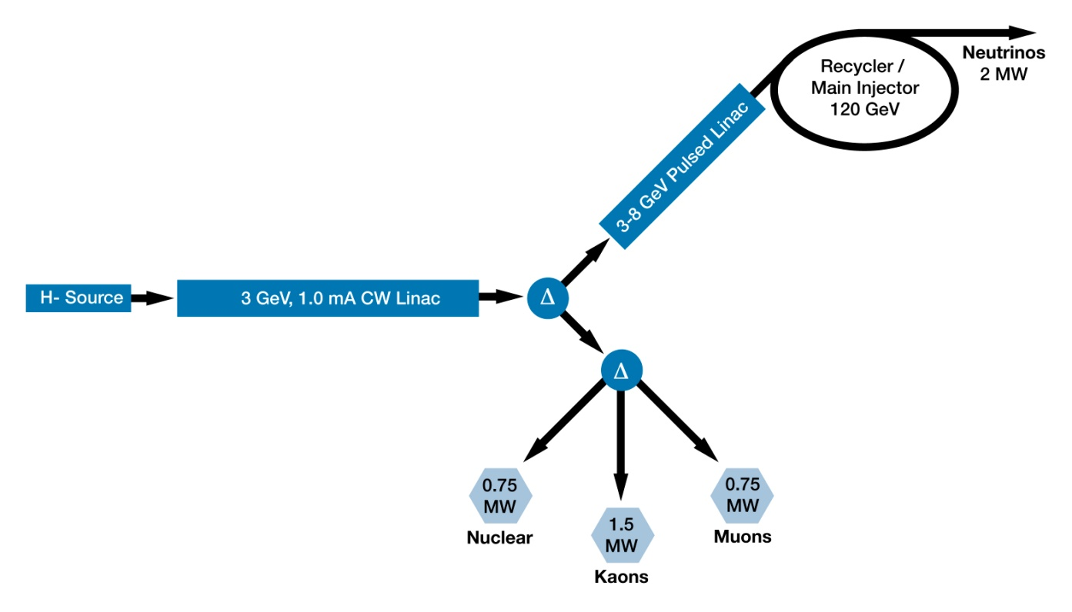
Reference Design
Reference Design continues as our baseline concept
  Modified configuration of initial 10 MeV acceleration (RFQ and HWR)
  Functional Requirements Specification (FRS) updated to reflect changes
    Project X Document # 658
3 MW @ 3 GeV
200 kW @ 8 GeV
2 MW @ 120 GeV
1-GeV extraction
section

Slide 3
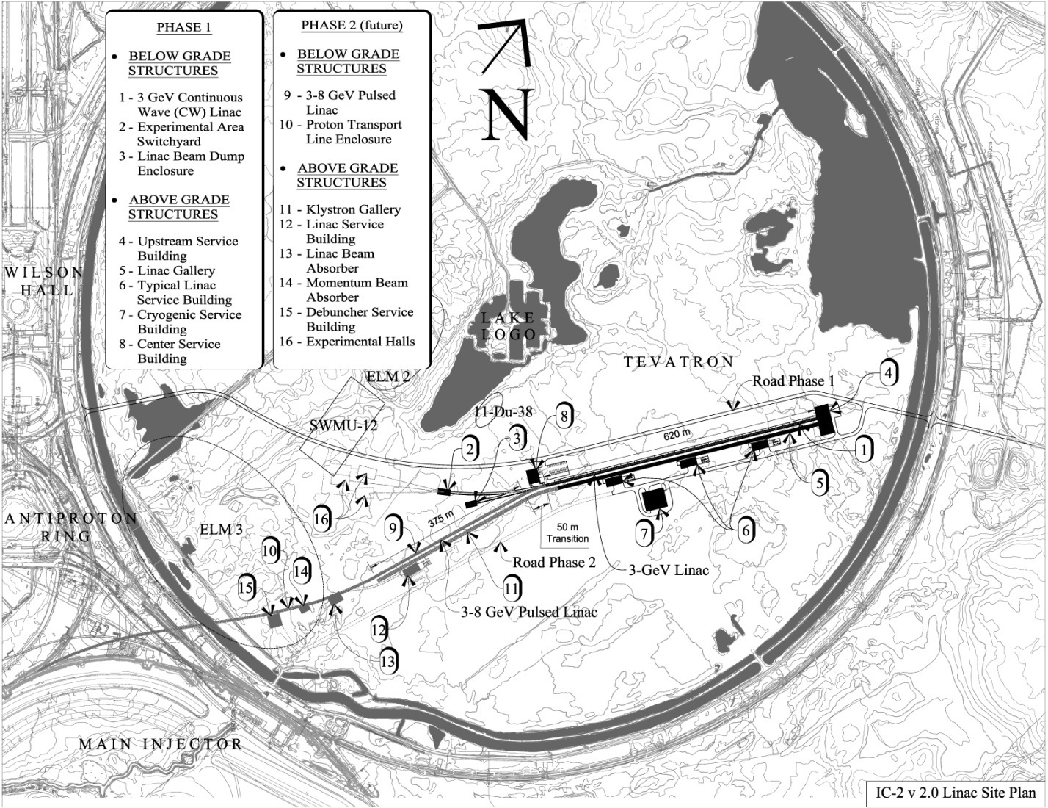
Reference Design
Provisional Siting
CW Linac
Pulsed 3-8 GeV Linac based on ILC / XFEL technology
Pulsed Linac

Slide 4

Reference design: accelerator scope
Warm cw front end 162.5 MHz, 5 mA (H- ion source, RFQ, MEBT, chopper)
3-GeV cw SCRF linac (162.5, 325, 650 MHz), 1-mA ave. beam current
Transverse beam splitter for 3-GeV experiments
3-8 GeV: pulsed linac (5% duty cycle), 1.3 GHz
Recycler and MI upgrades
1-GeV extraction section (new)
Various beam transport lines,
including targets (new)
5% duty cycle
Pulsed dipole
1-GeV
extraction

Slide 5
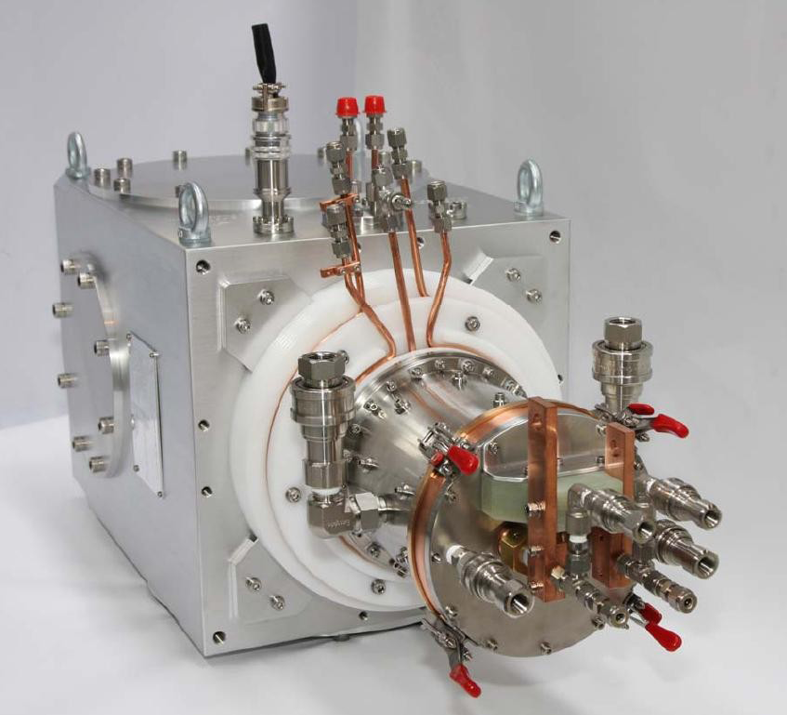
Ion Source
The Linac beam starts from an H- ion source operating at a constant current, set for a given timeline:
  If MI/Recycler is running, the minimum ion source current is 1.7 mA
  If MI/Recycler is NOT running, the minimum ion source current is 1 mA
  The nominal ion source beam current used in optics design is 5 mA
  The ion source is capable of 15 mA, RFQ and MEBT are designed to 10 mA
Regardless of the ion source current, the linac beam current is 1 mA
  this is achieved by a LEBT and MEBT choppers

Slide 6
Linac beam current:
1 mA averaged over ~us
Linac beam current has a periodic time structure (at 10 Hz) with two major components.
Beam to Recycler

Slide 7
Chopping for injection
RF frequency at injection into the Recycler : ~53 MHz
Chopper needs to provide a kicker gap (~200 ns per 11 µs) and needs to remove bunches that fall into “wrong” phase of ring rf voltage.
162 MHz bunches to be removed
Recycler RF

Slide 8
Chopping for injection
Kicker gap requires chopping out ~ 6% of beam
Chopping for longitud. painting: ~ 33%
Thus, the minimum ion source current for injection is 1.65 mA
If the cw program (3 GeV) requires e.g. 5 mA, 80% of bunches need to be chopped

Slide 9
Chopping and splitting for 3-GeV experiments
1 μsec period at 3 GeV
Muon pulses (16e7) 81.25 MHz, 100 nsec at 1 MHz 700 kW
Kaon pulses (16e7) 20.3 MHz 1540 kW
Nuclear pulses (16e7) 10.15 MHz 770 kW
Ion source and RFQ operate at 4.2 mA
~75% of bunches are chopped at 2.5 MeV after RFQ
Separation scheme
Transverse rf splitter

Slide 10
Beam after splitter
1 MHz pulses
10 MHz bunches
20 MHz bunches

Slide 11
SRF Linac Technology Map
β=0.1
β=0.22
β=0.4
β=0.61
β=0.9
β=1.0
CW
Pulsed
162.5MHz
2.1-10 MeV
325 MHz
10-160 MeV
650 MHz
0.16-3 GeV
1.3 GHz
3-8 GeV
Section | Freq | Energy (MeV) | Cav/mag/CM | Type
HWR (β_{G}=0.1) | 162.5 | 2.1-10 | 9 /6/1 | HWR, solenoid
SSR1 (β_{G}=0.22) | 325 | 10-42 | 16/8/ 2 | SSR, solenoid
SSR2 (β_{G}=0.47) | 325 | 42-160 | 36/20/4 | SSR, solenoid
LB 650 (β_{G}=0.61) | 650 | 160-460 | 42 /14/7 | 5-cell elliptical, doublet
HB 650 (β_{G}=0.9) | 650 | 460-3000 | 152/19/19 | 5-cell elliptical, doublet
ILC 1.3 (β_{G}=1.0) | 1300 | 3000-8000 | 224 /28 /28 | 9-cell elliptical, quad

Slide 12
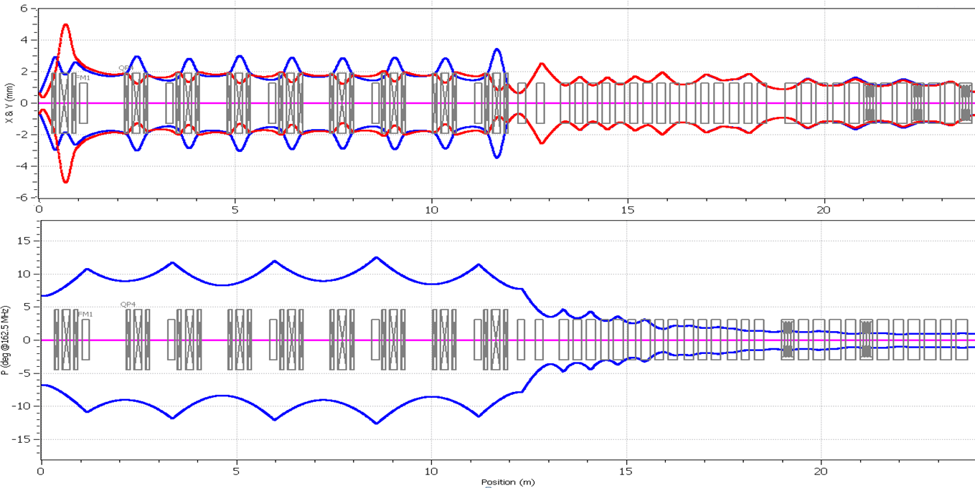
RFQ-MEBT-HWR-SSR1
Emittances: 0.14, 0.14, 0.217 π∙mm∙mrad;
Current 5 mA@162.5 MHz; Energy: 2.1 MeV – 10.8 MeV – 22.1 MeV
Chopper
HWR
SSR1-1
MEBT: Match(triplet+Cavity)-Chopper-Match (cavity+solenoid)
Chopper: QWR 162.5 MHz RT cavities; Triplets, 4 (2) wide-band kickers

Slide 13
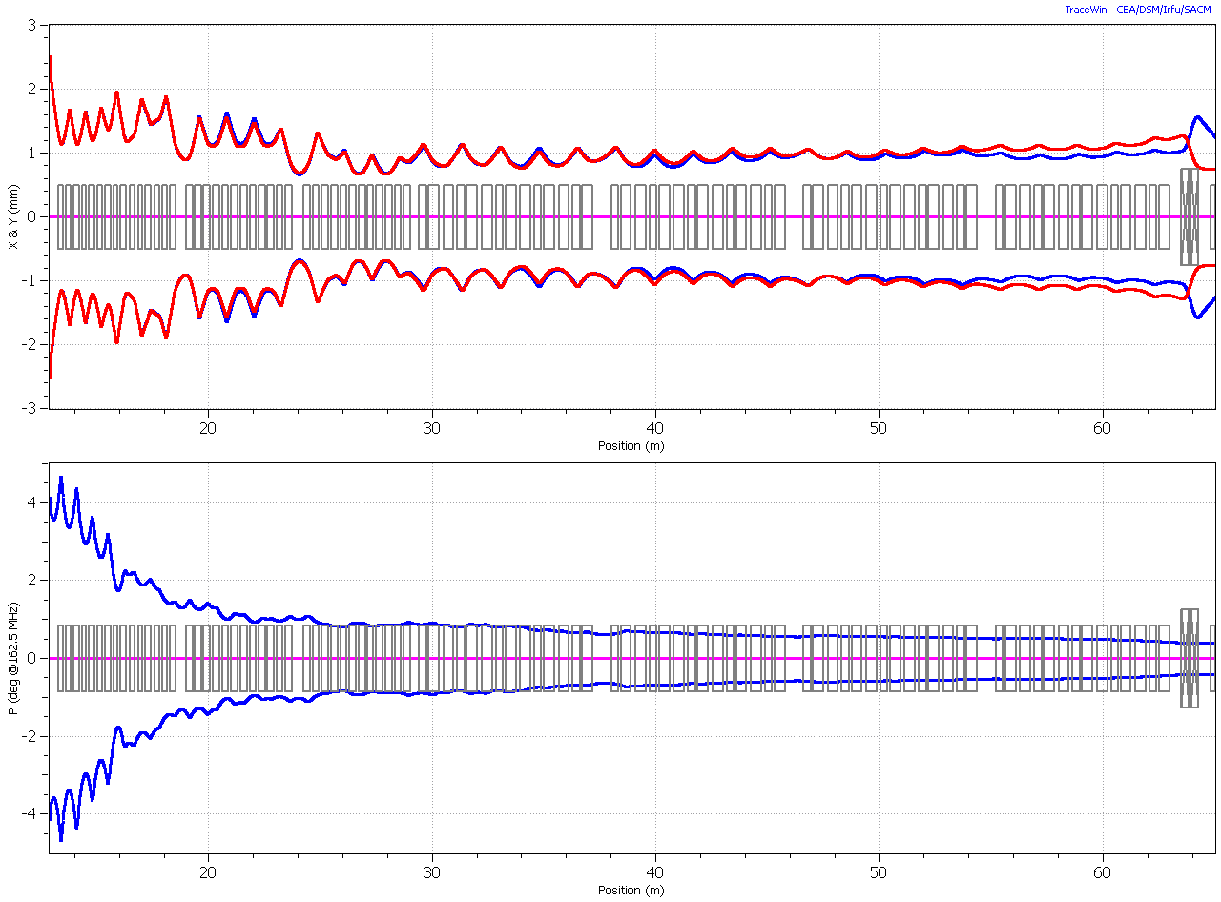
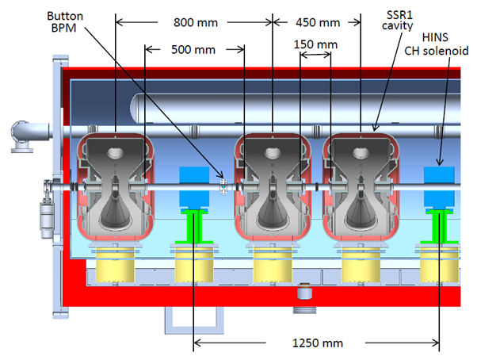
Front End (HWR+SSR1+SSR2)
Envelope of transverse RMS beam size
Envelope of longitudinal RMS beam size (in degrees at 162.5 MHz)
All CM’s are separated by short (0.2÷0.5m)
warm sections
Solenoid has X or Y corrector and attached BPM.
Collimators are placed in warm interconnects
Similar CM’s for SSR1 (~5m) and SSR2 (~8m)

Slide 14
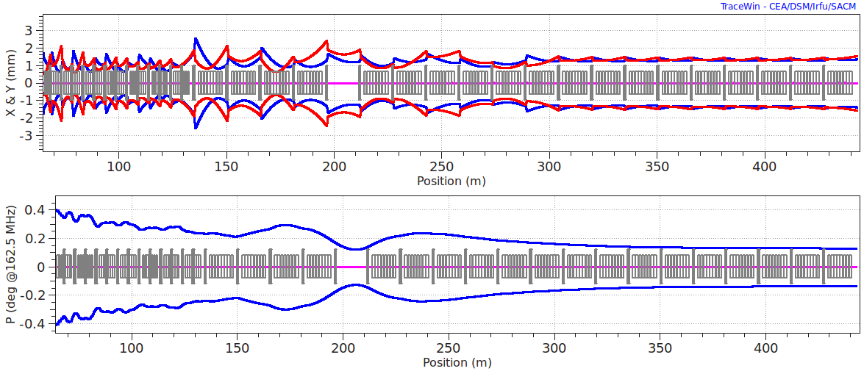
650 MHz LB (β=0.61) and HB (β=0.9) Sections
Envelope of longitudinal RMS beam size (in degrees at 162.5 MHz)
All CM’s are separated by ~2÷3 m warm section with warm doublet, X/Y correctors and BPMs. Extra space for skew correction, collimation and beam diagnostics.
Beta=0.6 CM has 6 cavities and 1 SC doublet in the middle with cold BPM
Beta = 0.9 CM contains 8 SC cavities only
A 15 m free region to accommodate 1 GeV beam extraction is shown.

Slide 15
LE 650 Cryomodules
8878.49
3000
HE 650 Cryomodules
11325.12
3000

Slide 16
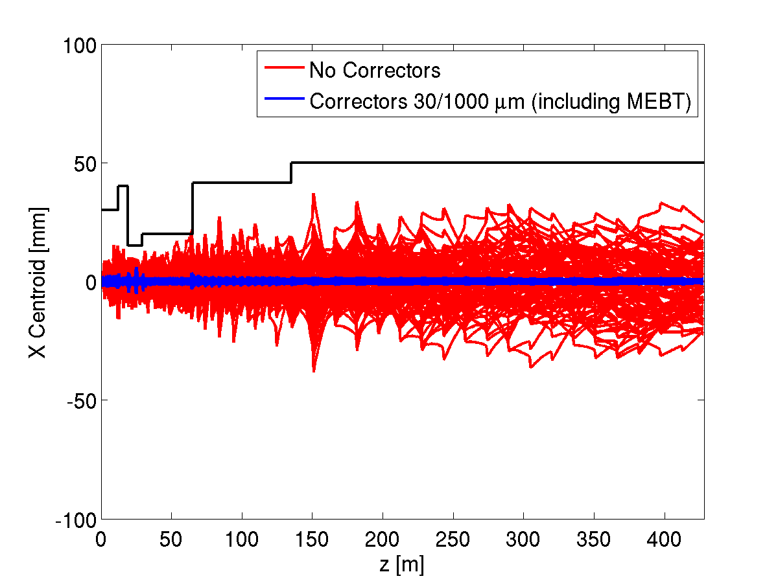
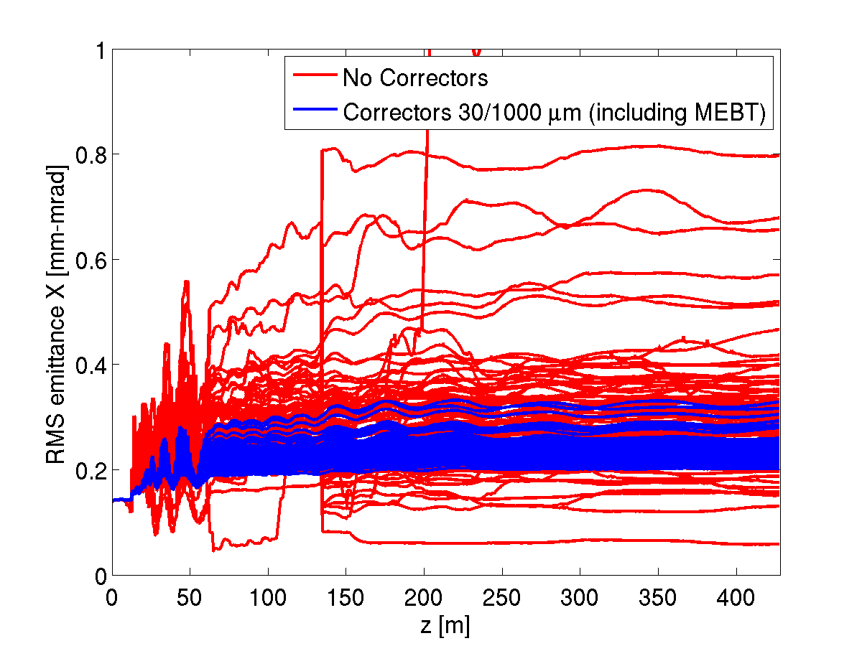
Steering Errors Correction
(for a representative lattice)
Misalignments ±0.5 mm for all elements
RF jitter of 1.0 ° x 1.0 % in all the cavities
100 seeds and 1 million macro-particles per seed.
1 corrector, 1 BPM per solenoid/douplet/quad; BPM resolution=30 μm
Beam centroid is corrected to ±1mm;
The uncorrected seeds predict losses above 100 W/m;
corrected – no losses
Beam Centroid off-set
Beam Transverse Emittance
The red curves: 100 seeds without correction; blue curves : 100 seeds with correction

Slide 17
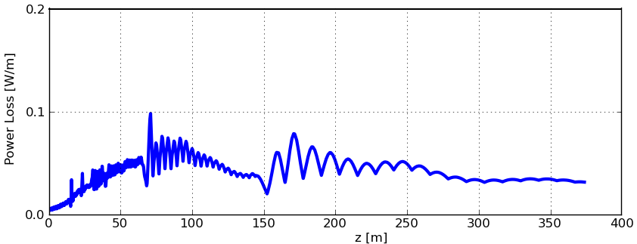
H⁻ stripping Summary
Stripping on residual gas is < 0.1 W/m if pressure is better than 10⁻⁸ Torr
at 300 °K (10⁻¹⁰ at 3°K)
  (Assuming gas contains 50% H2, 25% O2, 25% N2/CO)
Magnetic stripping is well below 0.1 W/m, even for unrealistic 5 mm beam offset.
Stripping due to blackbody radiation is not an issue for SC linac.
Intra-beam stripping is ~0.1 W/m for the baseline design.
  Experimental confirmation: 90% of SNS linac losses are from stripping
In the pulsed 3-8 GeV linac, losses due to H⁻ stripping are well below 0.1 W/m

Slide 18
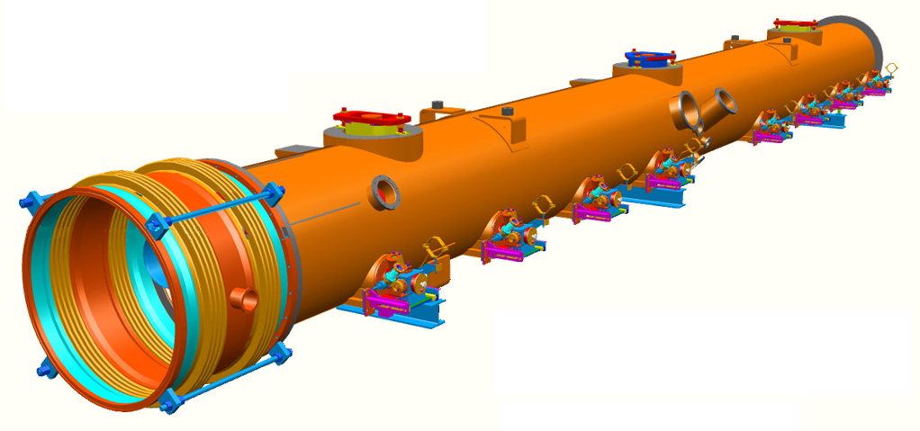

3 – 8 GeV acceleration
Pulsed linac based on the ILC technology
  1.3 GHz, 25 MV/m gradient, ≤5% duty cycle
  considering 8-30 ms pulse length
  ~250 cavities (28 ILC-type cryomodules) needed.
  Simple FODO lattice
  1 Klystron per 2 CM’s

Slide 19
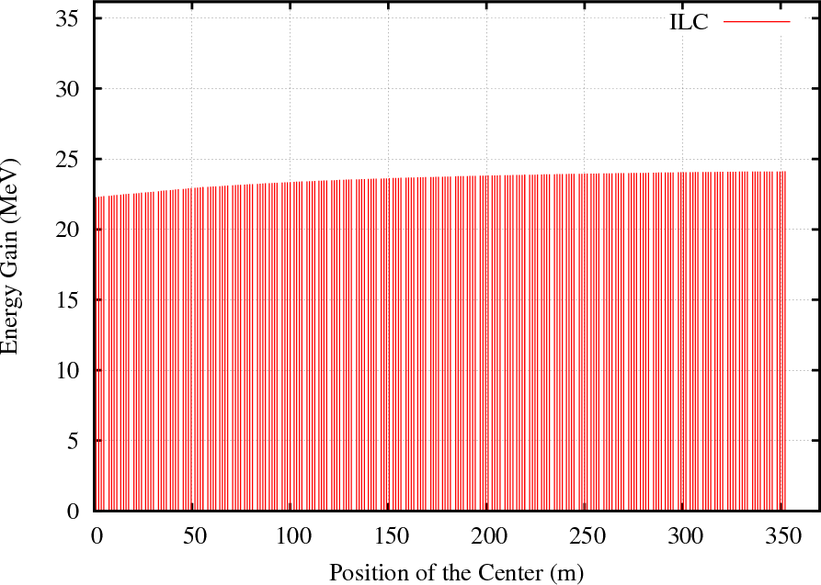
Cavity Energy Gain
Eacc = 25 MV/m: L=1.038m

Slide 20
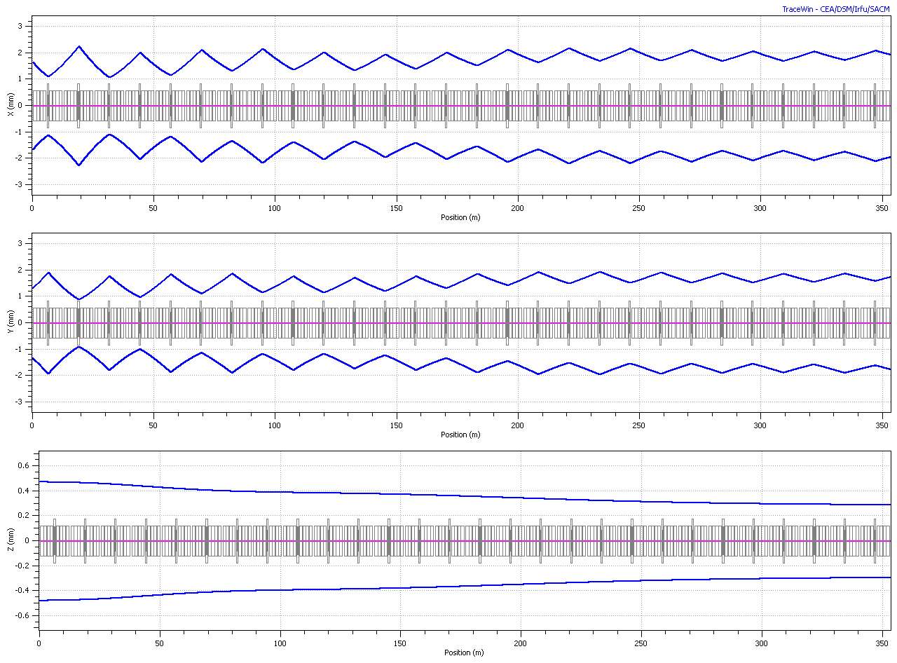
Envelopes (sigma)

Slide 21
Pulsed Linac rf power parameters
Cost estimate assumes: 1 Klystron per 2 CM’s

Slide 22
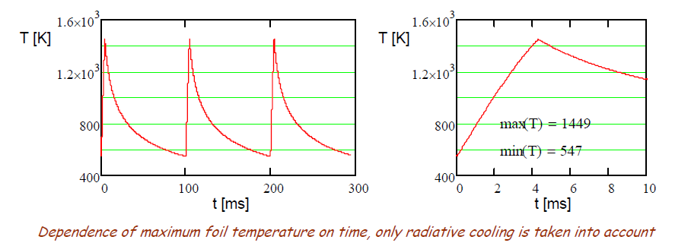
Injection
Need to accumulate 26 mA-ms protons in the MI/Recycler
For a stationary foil, a single 26-ms pulse would destroy the foil.
6 pulses at 10 Hz give enough time for radiative cooling between pulses

Slide 23
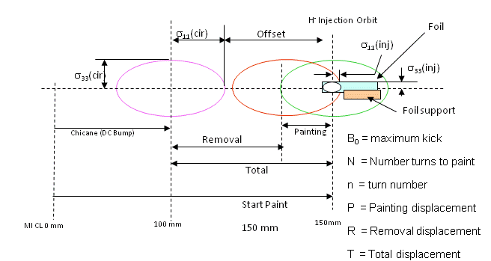
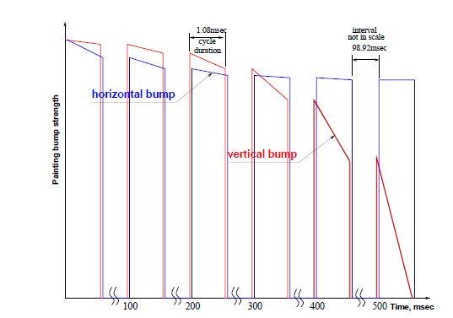


Recycler Injection
Stripping foil
H⁰
Thick foil H⁰->H⁺
HBC1
H⁻
HBC2
HBC3
HBC4
H⁺ to inj. absorber
75 to 100 mm
Circulating protons
8.941 m
0.606 m
1.068 m
+3.5669 kG
-0.4656 kG
-11 kG
11 kG
KEK (anti-correlated) H paint V steer
Foil orientation (corner foil used in present simulation)
Hor. Strip foil (matched to size of beam)
18mm
6-8mm
14mm
12mm

Slide 24
Alternative injection scheme
A possibility to inject in a single 26-ms pulse is highly desirable.
  Eliminates the need for Recycler (as an accumulator)
  Potentially allows for a lower linac energy (6-7 GeV)
  Requires long-pulse linac operation

Slide 25
Recycler modifications
New rf systems:
  53 MHz and 106 MHz (fixed frequency)
New injection system
Possibly TiN vacuum pipe coating to mitigate electron cloud

Slide 26
MI modifications
New RF systems
  53 MHz and 106 MHz (with freq. sweep for acceleration)
  2.7 MV/turn at 36-degree synch phase
γ_{t} jump system
Possibly TiN vacuum pipe coating to mitigate electron cloud

Slide 27
R&D overview
Goal: Mitigate risk associated with technical, cost, and schedule uncertainties
CW linac
  The first ~20 MeV is key to the Reference Design concept.
  Front-end, chopper, low-β acceleration, beam loss mitigation
Pulsed linac
  Pulsed linac has diverged from ILC requirements due to low current
  Long-pulse beam operation, β=1 accelerating structures/modules
MI/Recycler
  H- injection; factor of three increase in beam intensity (relative to NOvA)
  Injection, instabilities, rf systems
Design development
  Facility configuration including upgrade paths
  Beam and e-m modeling; reliability analysis; MC and mu2e Task Forces

Slide 28
Front-End Test Facility
We are preparing to build a prototype of the first ~30 MeV of Project X.
  Validate the concept for the Project X front end, thereby eliminating the primary technical risk element within the Reference Design.
  Wideband chopper; low-β acceleration
  Operate at full design parameters
Integrated systems test goals:
  1 mA average current with 80% chopping of beam delivered from RFQ
  Efficient acceleration with minimal emittance dilution through ~30 MeV
Potential utilization in Project X facility following successful demonstration
Collaboration between Fermilab, ANL, LBNL, SLAC; India & China?
Oct 2016: Beam through β=0.1 , 0.2 CM at ~30 MeV with nearly final parameters (1 mA cw, 5 mA peak, arbitrary bunch chopping)

Slide 29
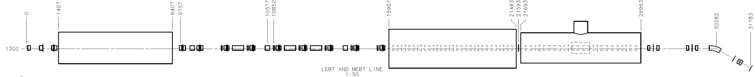
Project X Injector Experiment: PXIE
RFQ
MEBT
HWR
SSR1
LEBT
LBNL FNAL, SLAC FNAL ANL
Dump
CW H- source delivering 5 mA at 30 keV
LEBT with beam pre-chopping
CW RFQ operating at 162.5 MHz and delivering 5 mA at 2.1 MeV
MEBT with integrated wide band chopper and beam absorbers capable of generating arbitrary bunch patterns at 162.5 MHz, and disposing of 4 mA average beam current
Low beta superconducting cryomodules: 1 mA to 30 MeV
Beam dump capable of accommodating 1 mA at 30 MeV (30 kW) for extended periods.
Associated beam diagnostics, utilities and shielding

Slide 30
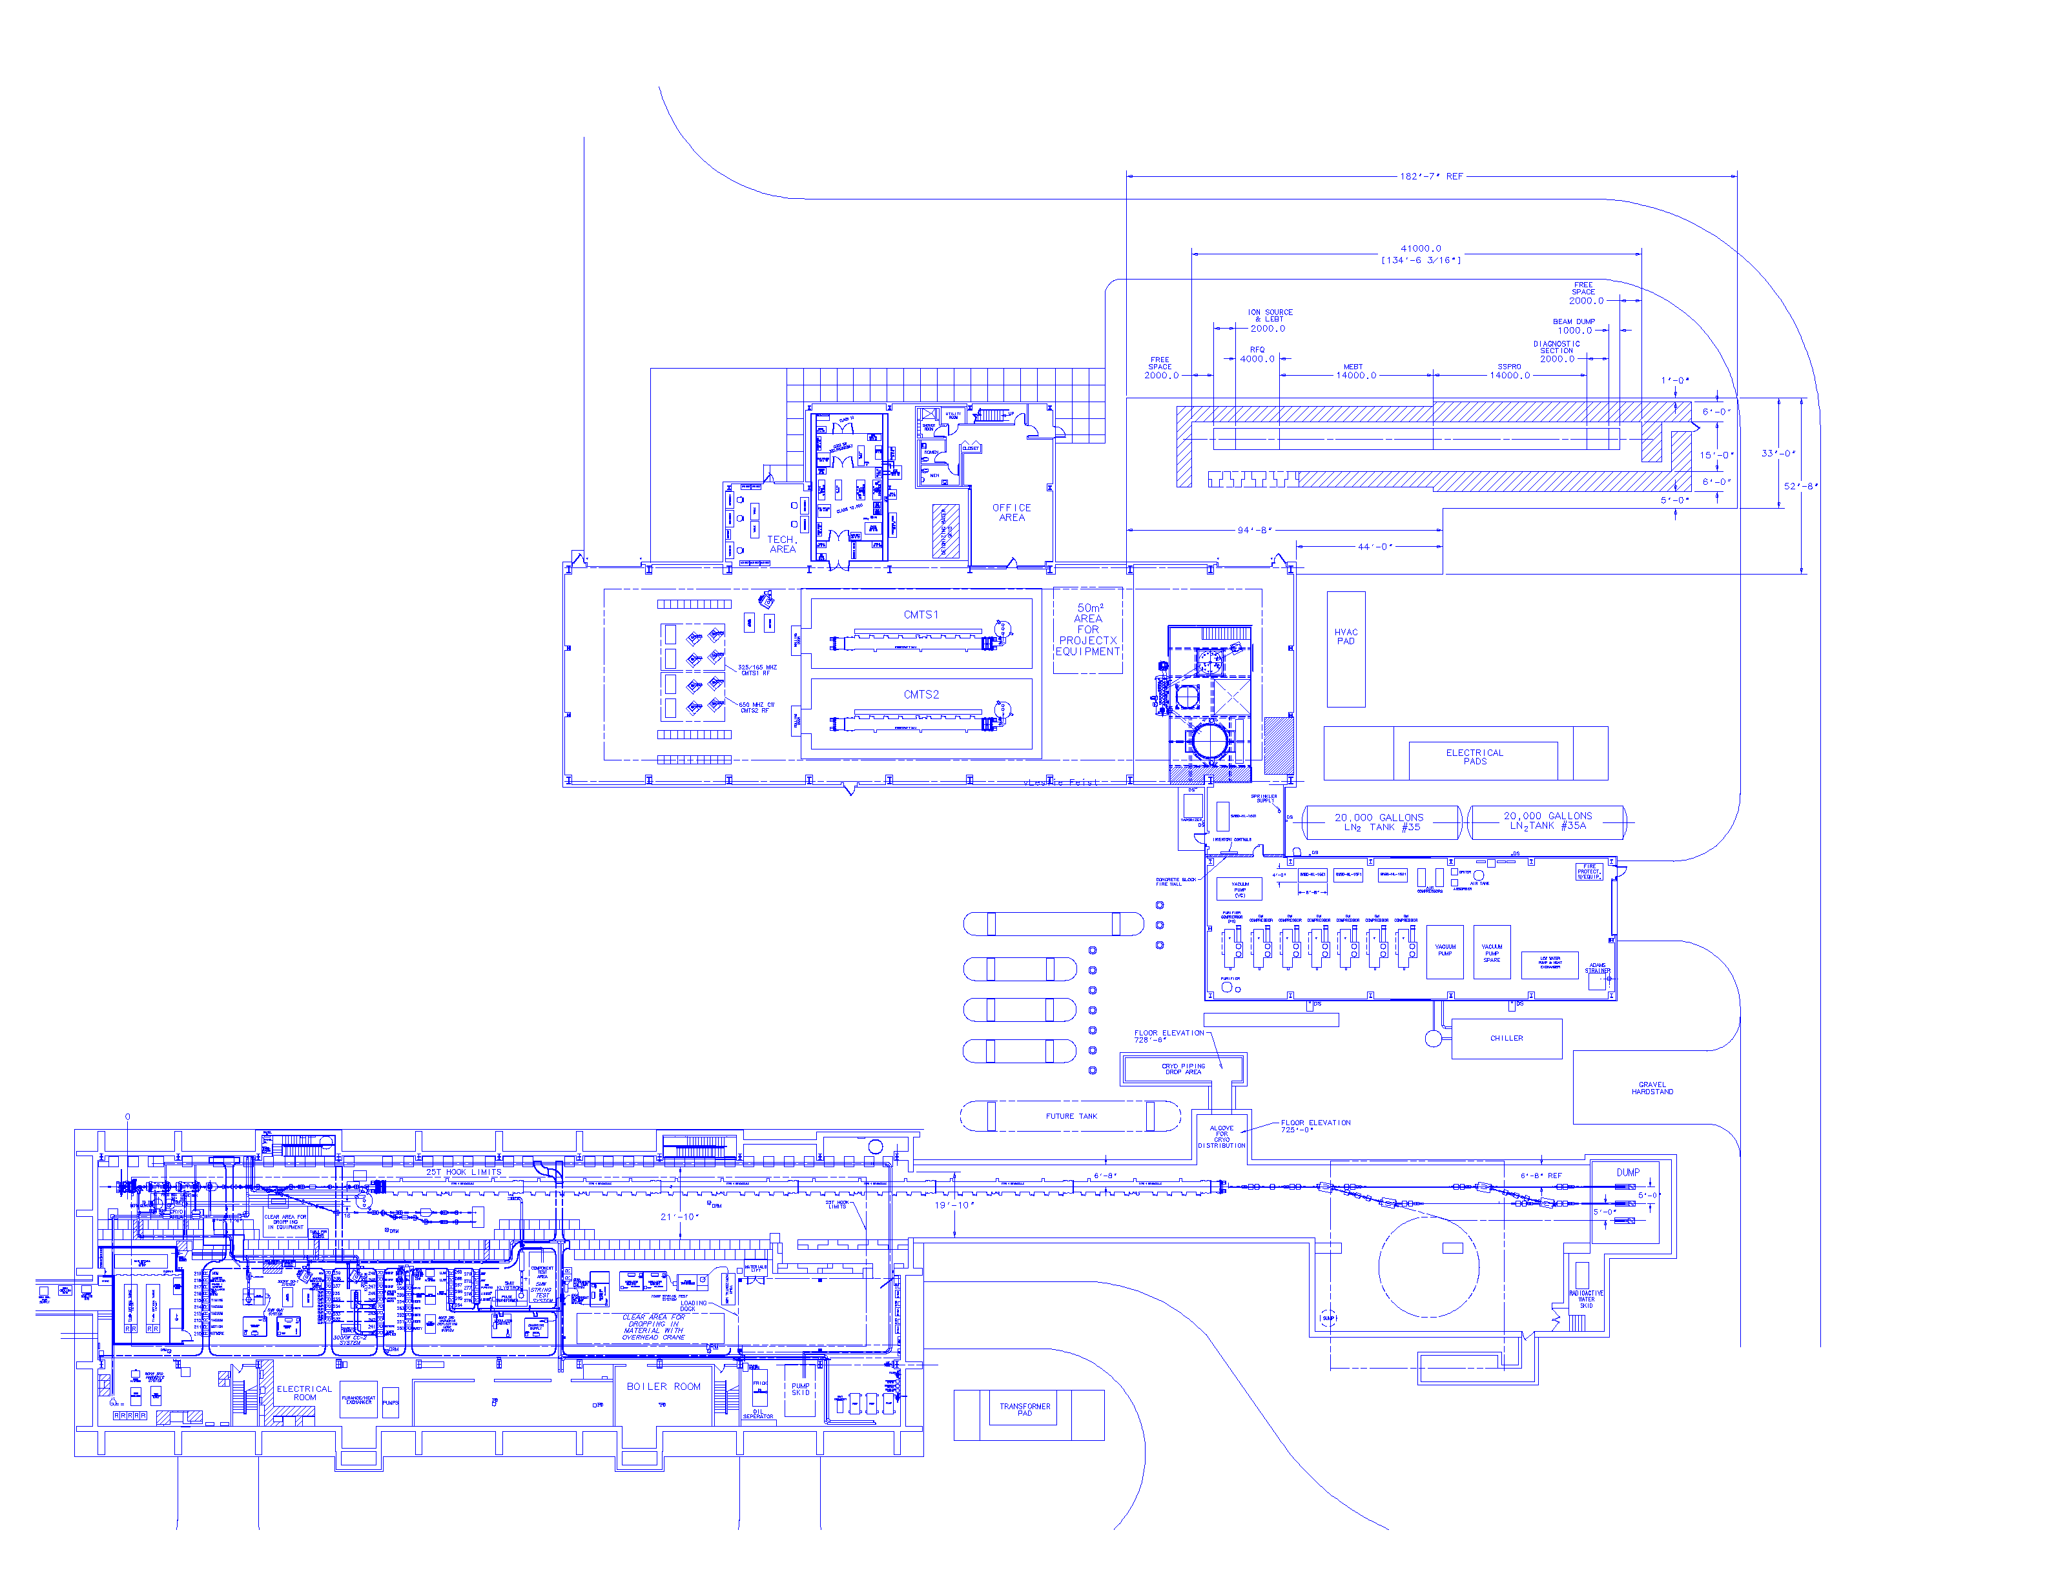
PXIE Location
PXIE
CMTF
New Muon Lab

Slide 31
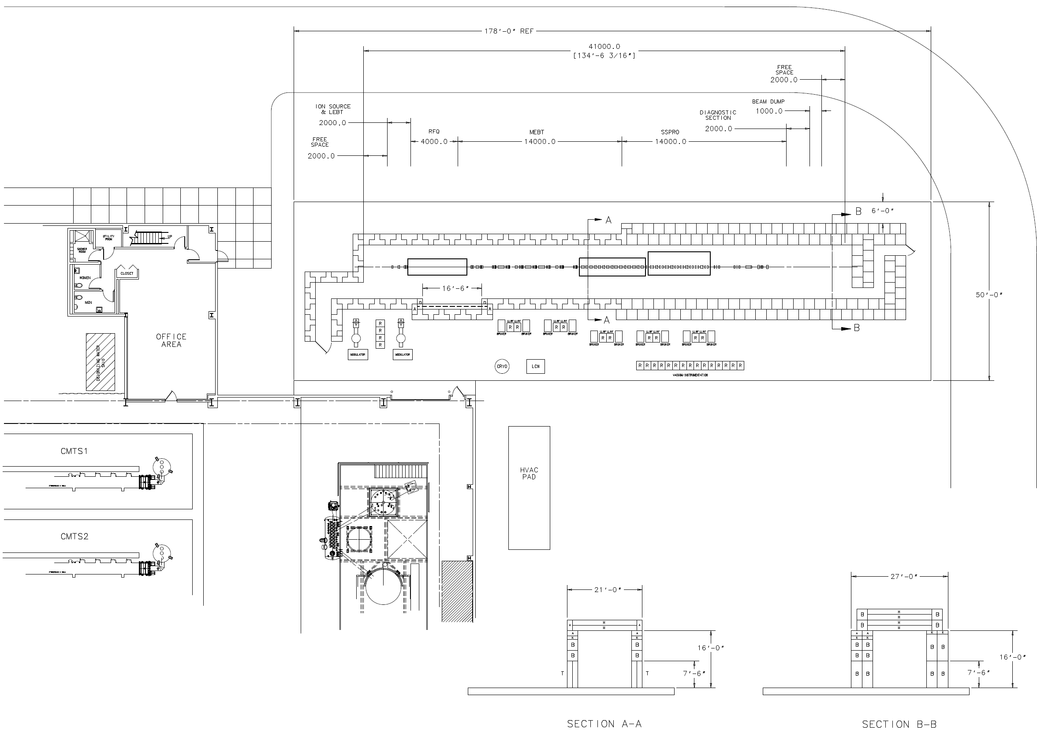
PXIE Layout

Slide 32
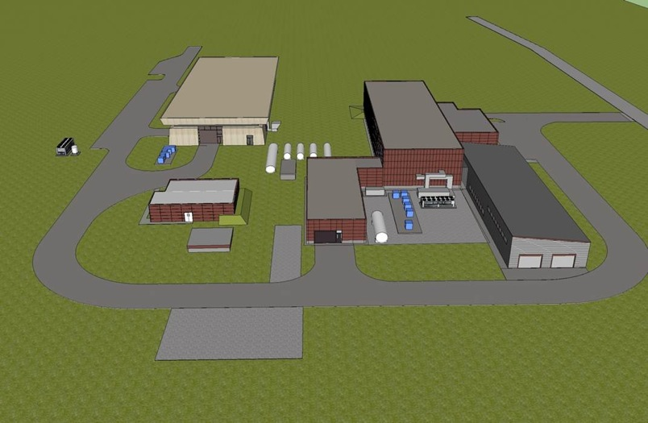
Possible building layout
PXIE

Slide 33
Goals for FY2012
CW Linac/PXIE
  Conventional facilities
    Complete shielded enclosure – ready for equipment installation.
  LEBT
    Complete design and all parts ordered
    Ion source commissioning (at LBNL)
  RFQ
    Complete design, ready for procurement (LBNL/FNAL)
    Specifications complete, ready for procurement: rf & water systems
  MEBT
    Vacuum prototype chopper kicker tested (bandwidth and average power)
    12 kW prototype beam absorber designed, fabricated and tested (e-beam)
    MEBT design 50% complete
  HWR Cryomodule (ANL)
    Cavity design complete, fabrication started
    Cryomodule design complete

Slide 34
Goals for FY2012
CW Linac/design & development
  Complete lattice design for CW linac (including front end)
    Preliminary specifications on all linac components: cavities, CM, magnets, correctors, diagnostics
  Beam dynamics studies
    Preliminary tolerances: alignment, stability, optical mismatch
    Failure analysis: effect of failed components on performance and correction schemes
  RF sources (w/ SLAC, India)
    325 MHz test stand operational at MDB (couplers)
    Complete coupler designs; prototype
    Solid statedevelopment (w/SLAC)
  Cryogenics
    Heat load estimates, pre-conceptual design, segmentation
  Design of an SSR1 test cryomodule

Slide 35
Goals for FY2012
Pulsed Linac
  Complete lattice design
    Specifications for alignment and RF tolerances
    Failure analysis
  Design of the transport lines to/from pulsed linac
  Conceptual design of the HLRF system
    Systems specifications
    Survey of alternatives (klystron, IOT, magnetron)
  LLRF performance study for long pulse operation.
  Complete conceptual and EM design of splittable SC (focusing) magnet
  Conceptual design of the cryogenic systems and specifications
  Specifications for beam diagnostics in Linac and transport lines

Slide 36
Goals for FY2012
Main Injector/Recycler
  RF systems
    Complete design of the second harmonic (106 MHz) cavity (w/SLAC)
    Fabricate 53 MHz cavity mockup for low level measurements
  Instabilities
    e-cloud
      In-situ measurements of different material samples.
      Evaluate beam conditioning effect on SEY (in MI).
      Set-up coating facility (sputtering) in E4R.
    Space Charge
      Continue simulations with SYNERGIA and IMPACT/MLI
  H- Stripping injection
    Simulate rotating foil with tracking.
    Order parts for Laser stripping R&D.
      Collaboration with SNS

Slide 37
Goals for FY2012
Experimental Facilities
  Prepare for DOE workshop
  Preliminary concepts for experimental facilities
Conventional Facilities
  Master planning as related to PX siting and utility needs
    Consolidation of new project (LBNE, MU2E, PX, g-2) infrastructure
  Preliminary design of critical infrastructure needs:
    Electrical single lines and load tables
    Cooling schematics with input from pond studies; cost analysis of various cooling options (cooling towers, new pond(s), ICW, etc.)
    Update siting scenarios against latest wetland studies,
    Discipline reviews of CD-0 cost estimate Review and revise RLS to support a CD-0 review
  General support of alternate configurations, value engineering and phasing options

Slide 38
Summary
Project X Reference Design concept has remained stable for 18 months, subject to technical adjustments
  Adopt 162.5 MHz front end through 10 MeV (ANL proposal)
R&D program underway with very significant investment in srf
  PXIE identified as centerpiece of the program – planning underway
    Main technical uncertainties with (1) chopper kicker, (2) chopper driver and (3) beam absorber
    Integration test of RFQ, MEBT, HWR, SSR1
  R&D on alternative injection schemes remains high priority
Acknowledgements: many colleagues have contributed to this talk. Thank you!

Slide 39
Backup slides

Slide 40
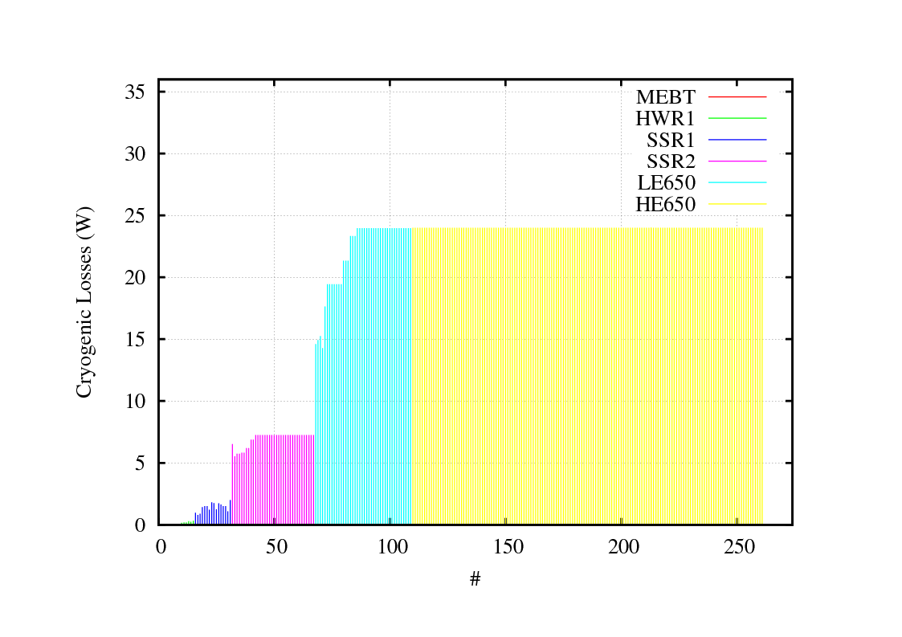
Cryogenic losses

Slide 41
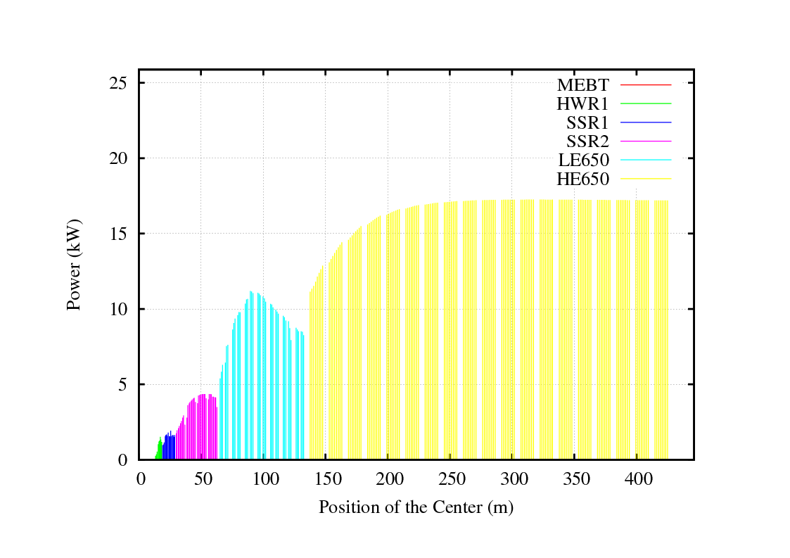
RF Power (without overhead)
MEBT is excluded
Single cavity per rf source

Slide 42
Misalignments, Focusing Errors
and RF Jitter
Benchmark errors/losses TRACK and ASTRA - good agreement in term of losses
Study in TRACKv39, 50k particles, 400 machines on the FermiGrid.
Summary of error thresholds at which losses become observable for a representative CW lattice
Errors Type | Limit
Solenoid X&Y | 150 μm
Solenoid θ_{x} | 1 mrad
Quad X&Y | 150 μm
Quad θ_{x} | >10 mrad
Cavity X&Y | > 1 mm
Cavity θ_{x} | 10 mrad
RF phase jitter | 1 deg
RF field jitter | 1 %
RF phase + field | 1deg + 1%
* No correction was applied

Slide 43
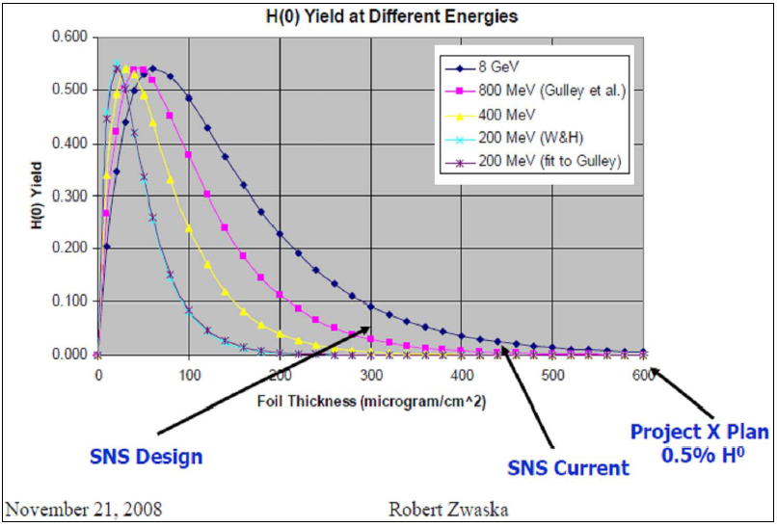
Foil efficiency

