Slide 1
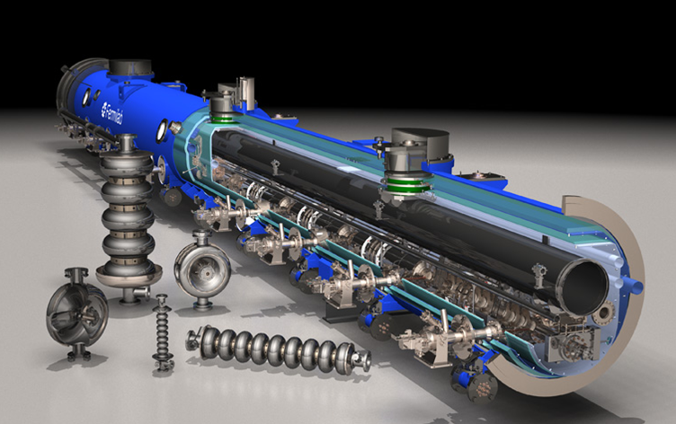
FNAL Superconducting RF Program
Bob Kephart

Slide 2
Goals of the Fermilab SRF Program
Support the strategic goals of the U.S. HEP program
  Energy frontier: International Linear Collider (& Muon Collider)
  Intensity frontier: Project X
Develop low-beta SRF cavities and cryomodules for the acceleration of high intensity Proton beams
  Subharmonics of 1.3 GHz
  SRF starting from very low beam energy of 2.1 MeV (New!)
Develop β=1 SRF cavities and cryomodules for ILC and/or the Project X pulsed linac (3-8 GeV)
Develop related SRF infrastructure and technology that can be applied to future Office of Science projects
  Infrastructure and expertise at Fermilab and U.S. partners
  U.S. Industrialization to permit fabrication of SRF projects

Slide 3
Context of SRF Activity at Fermilab
The FNAL SRF effort started small for several years as part of the TESLA collaboration but ramped up substantially in 2006 in support of ILC R&D (thru at least FY12)
Because of past emphasis on ILC R&D ➔There is substantial ongoing activity on 1.3 GHz technology
  R&D on gradient, quality factor, and manufacturing yield
  Development of US cavity vendors (ARRA procurements)
  Cavity inspection, processing, and test infrastructure
  Construction of cryomodules for RF Unit test at New Muon Lab
We received one-time ARRA SRF funds of ~$53 M in FY09 which has helped enormously with building FNAL infrastructure and with U.S. industrialization

Slide 4
Context of SRF Activity at Fermilab
SRF R&D for Project X began with the HINS program
  Development of 325 MHz SSR1 spoke resonator
Adoption of a 3 GeV CW linac followed by a 3-8 GeV pulsed linac for Project X has added great capability to the Project, but presents new challenges
  Need six different families of cavities optimized for changing velocity ( β ) of Protons
  Four different frequencies (162.5, 325, 650, 1300 MHz)
  Five of these cavities are completely new for Project X (vs 2 for SNS)
The development of these cavities is a major new effort
Fermilab SRF activities are managed as an integrated program to avoid duplications and insure efficiency

Slide 5
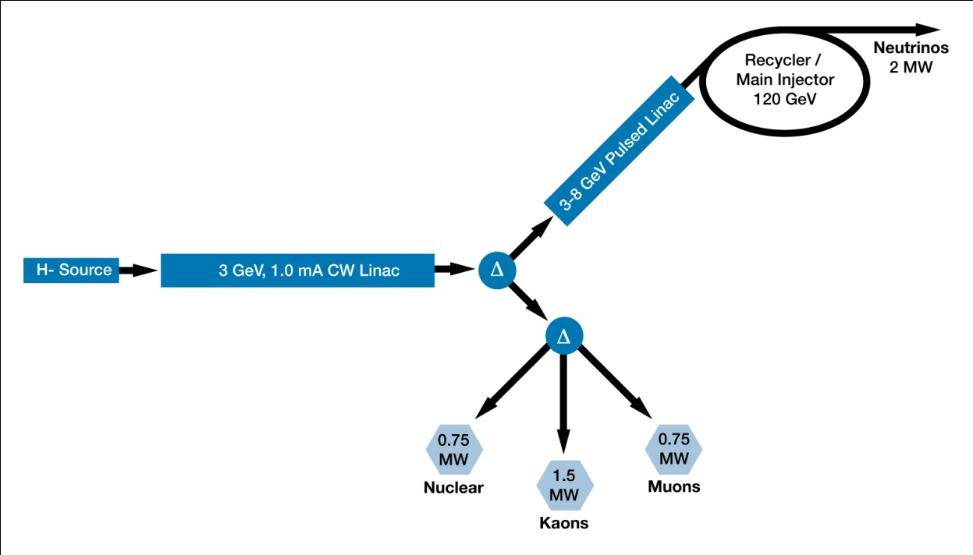
Reference design configuration
3 MW @ 3 GeV
200 kW @ 8 GeV
2.2 MW @ 120 GeV
3-GeV, 1-mA CW linac provides beam for rare processes program
  ~3 MW; flexible provision for beam formats supporting multiple users
  <5% of beam is sent to the MI
3-8 GeV acceleration: pulsed linac
  Linac would be 1300 MHz with <5% duty cycle
  Up to 200 kW beam power available at 8 GeV

Slide 6
PX SRF Linac Technology Map
ILC
β=0.11
β=0.22
β=0.4
β=0.61
β=0.9
β=1.0
CW
Pulsed
162.5 MHz
2.1-10 MeV
325 MHz
10-160 MeV
650 MHz
0.16-3 GeV
1.3 GHz
3-8 GeV
Section | Freq | Energy (MeV) | Cav/mag/CM | Type
HWR (β_{G}=0.11) | 162.5 | 2.1-10 | 9 /6/1 | Half Wave, solenoid
SSR1 (β_{G}=0.22) | 325 | 10-42 | 16/8/ 2 | Single Spoke, solenoid
SSR2 (β_{G}=0.47) | 325 | 42-160 | 36/20/4 | Single Spoke, solenoid
LB 650 (β_{G}=0.61) | 650 | 160-460 | 42 /14/7 | 5-cell elliptical, doublet
HB 650 (β_{G}=0.9) | 650 | 460-3000 | 152/19/19 | 5-cell elliptical, doublet
ILC 1.3 (β_{G}=1.0) | 1300 | 3000-8000 | 224 /28 /28 | 9-cell elliptical, quad

Slide 7
Current Activities
  Project X:
    162.5 Cavity and Cryomodule Development (ANL)
    325 MHz Cavity & Cryomodule Development
    650 MHz Cavity & Cryomodule Development
  ILC and Project X
    1300 MHz: Cavity gradient improvement, CM development, and industrialization
    1300 MHz: SRF Infrastructure Operations
  Additional SRF Infrastructure Construction
  RF unit test facility at New Muon lab
  CryoModule Test Facility (CMTF)
  Design, Construction of Project X Injector Experiment (PXIE)

Slide 8
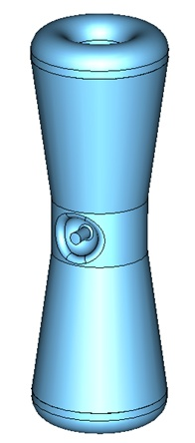
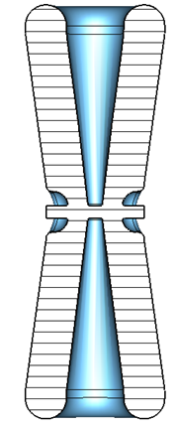
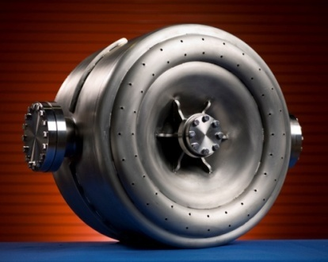
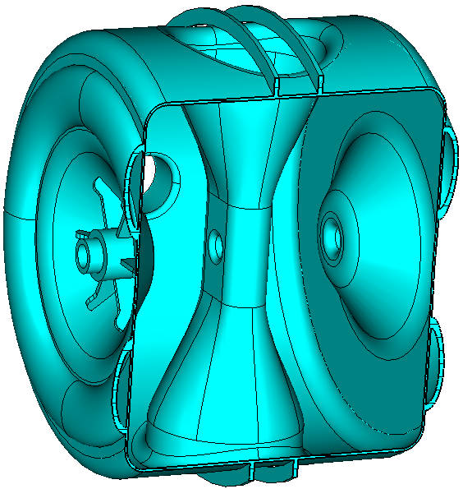
162.5 and 325 MHz Cavities
Three designs cover the beta range 0.07 → 0.52
HWR ( β = 0.11 ) Half Wave Resonator
  EM and Mechanical Design starting at ANL
  Very similar to cavities & CM already manufactured by ANL
  Optimize to achieve tight packing in PX front end
SSR1 ( β = 0.22 ) Single Spoke Resonator
  Started under HINS program and is therefore more advanced
  Two prototypes have been fabricated by industry, processed in collaboration with ANL, and tested at Fermilab
  Two cavities in fabrication at IUAC-Delhi ( Fall 2011 )
  Ten cavities in fabrication by US industry (4 have arrived)
  One cavity dressed with He vessel, coupler tuner
  Tests in progress (next slides)
SSR2( β = 0.47 )
  EM design complete
  Awaiting Mechanical Design
  Prototype in FY12-FY13

Slide 9
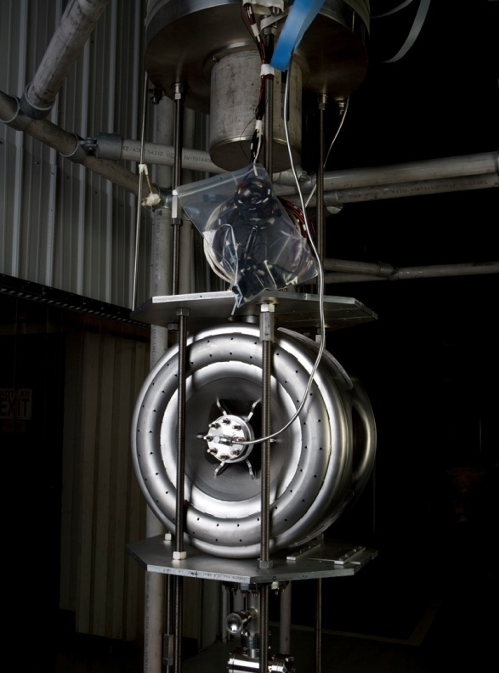
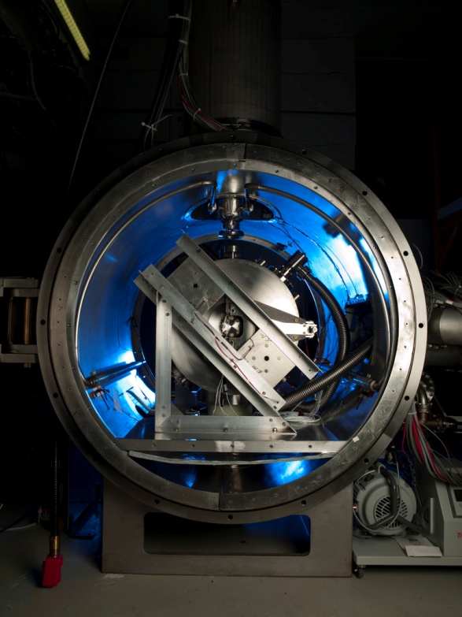
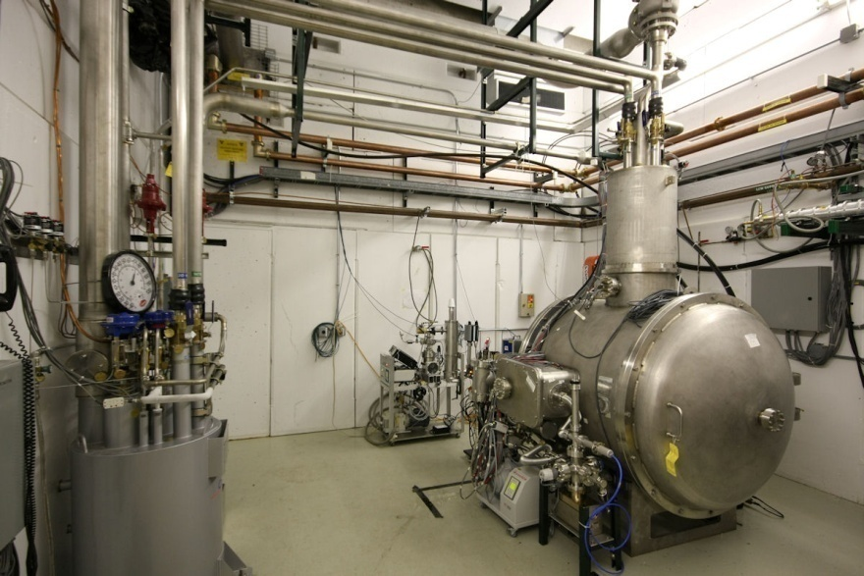
New 325 MHz Test Capabilities Developed
Bare
Dressed
SSR-1 prototypes were tested in the VTS-1 vertical dewar (normally used for 1.3 GHz cavity testing ) with the addition of new electronics and tooling.
Spoke Cavity Test Cryostat completed and commissioned.
Enables 4 K testing of “dressed” 325 MHz single-spoke resonators.
Upgrades for 1.8 K operation in process
Dressed SSR-1 prototype prepared for testing.
Includes RF couplers, tuners, and magnetic shielding

Slide 10
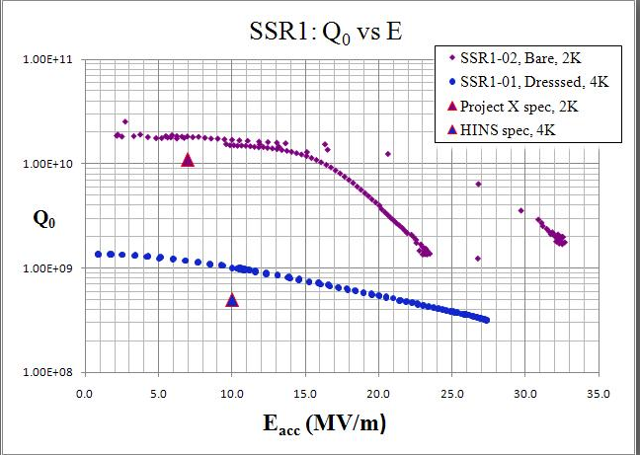
SSR1 Prototypes Exceeded Performance Specs.
Bare cavity at 2 K
PX
Dressed cavity at 4.8K
Also tested one dressed cavity at 4.8 K. Exceeded the HINS specification
Modifications to allow CW tests of dressed spoke resonators at 2 K for Project X are in progress
Tested two SSR1 spoke resonators both performed very well in bare cavity tests
Performance at 2 K is above requirements for Project X in both Q₀ and gradient

Slide 11
  650 MHz Electromagnetic Cavity Design β = 0.6 & 0.9 Five-Cell Cavities is Complete

Slide 12
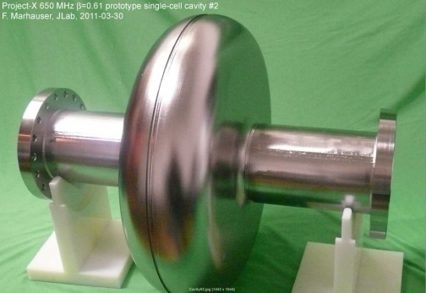
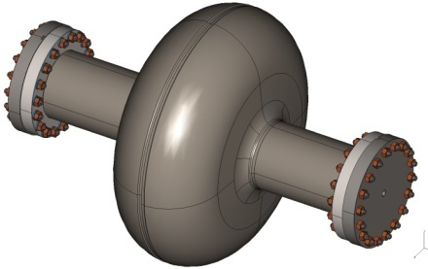
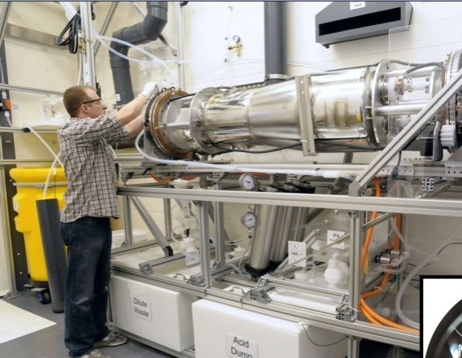
650 MHz Cavity Prototypes and Readiness for Processing & Testing
Single-cell designs complete: for β = 0.6 & 0.9 cavities
Prototypes fabricated:
  Single-cell β = 0.6: 2 prototypes@JLab, 6 ordered industry
  Single-cell β = 0.9: 5 cavities ordered from industry; due Nov 11
  Prototypes at both β are also being fabricated in India
  Two 5-cell β = 0.9 cavities ordered from industry
Infrastructure modifications: for 650 MHz in process
    FNAL: Vertical Test Stand: Electronics, amplifier, tooling
    FNAL: Cavity handling & HPR tooling, etc.
    FNAL: Optical inspection system modifications
    ANL: New electro-polishing tool
    Industry: EP/BCP capability in US industry

Slide 13
Excellent Results from JLAB single cell tests

Slide 14
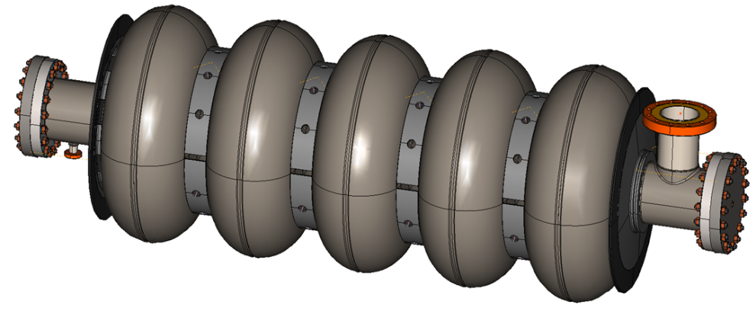
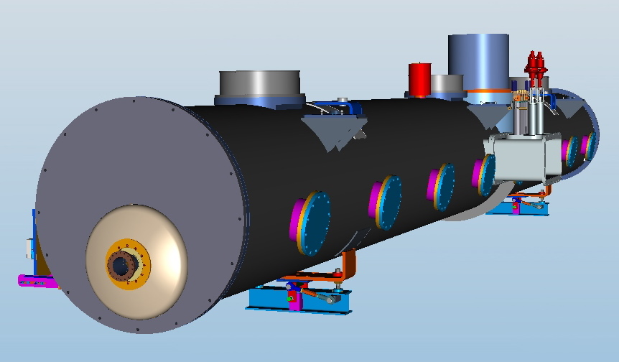
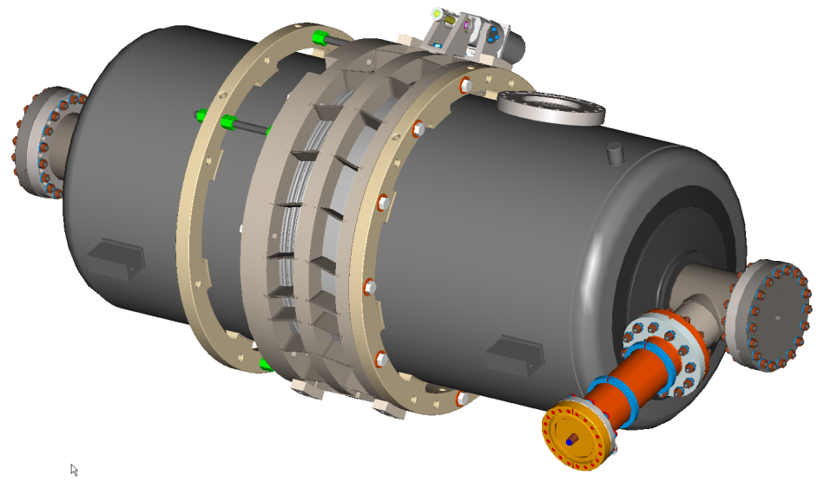
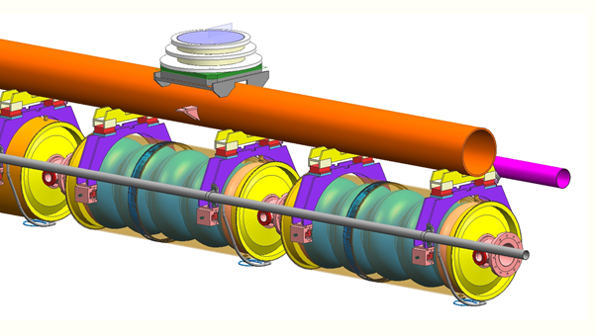
650 MHz Five-Cell Cavity and CW CM Design Status
Cavity drawing package and specification done
CW CM conceptual design advanced
  stand-alone 8-cavity cryomodule
  Overall length: ~12 m, 48 “ O.D.
5-cell β= 0.9
Stiffening rings located to minimize dF/dP while maintaining tunability
Collab with India
Concept utilizing blade tuner

Slide 15
1300 MHz Development for ILC and PX
Goals: ILC SRF goals remain
    S0 >35 MV/m bare cavities
    S1 31.5 MV/m dressed cavities in a ILC Cryomodule
    S2 Beam test of full ILC RF unit (CM, klystron, modulator)
    Build and test ~ 1 CM/yr
  All of this will benefit the 3-8 GeV pulsed linac for Project X
Accomplishments:
  Excellent progress on gradient improvement
  ANL/FNAL EP facility: world class throughput & yield
  18 Dressed cavities, HTS tests in progress for CM2
  Parts for 4 more 1.3 GHz cryomodules ( ARRA funds)
  Cost reduction (e.g. tumbling vs. EP, & cavity repair.)
Excellent progress on all of these
  CM1 cold and under test at NML ( All 8 cavities powered)

Slide 16
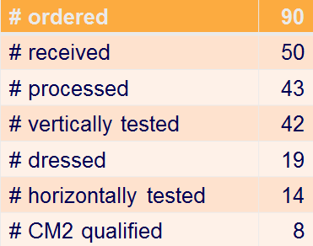
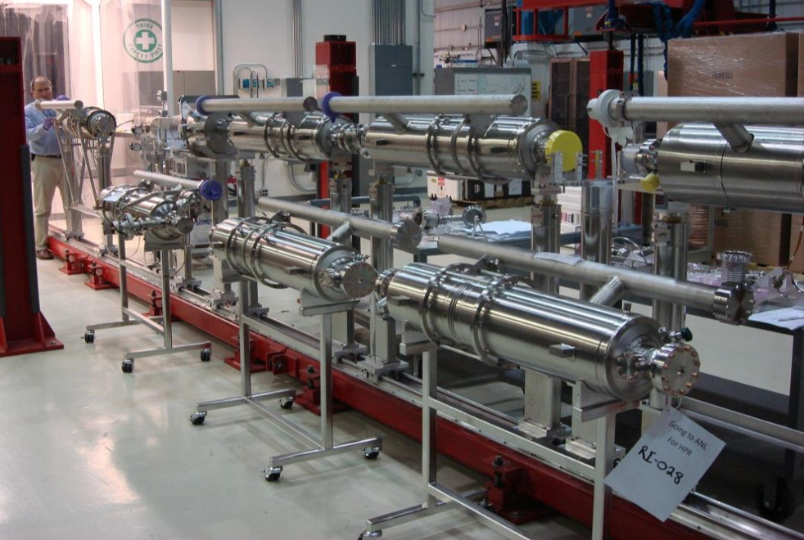
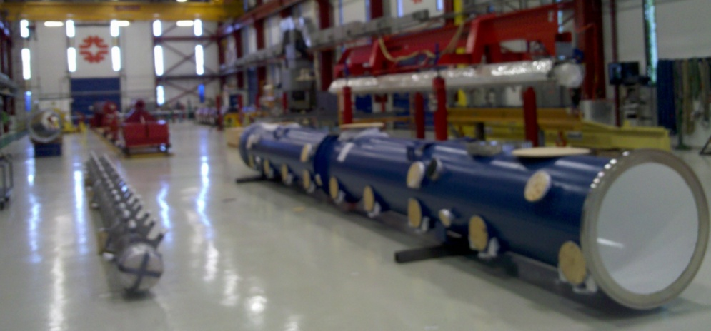
Current 1300 MHz cavity status
Full suite of facilities in use
New vendors being developed
Dressed cavities in CAF
Cryomodule 2: cold mass parts from Europe in hand, 8 dressed cavities tested >35 MV/M, string assembly
U.S. built ILC/PX Cryomodule Parts
CM 3, 4, 5, 6 for NML arriving,
funded by ARRA

Slide 17
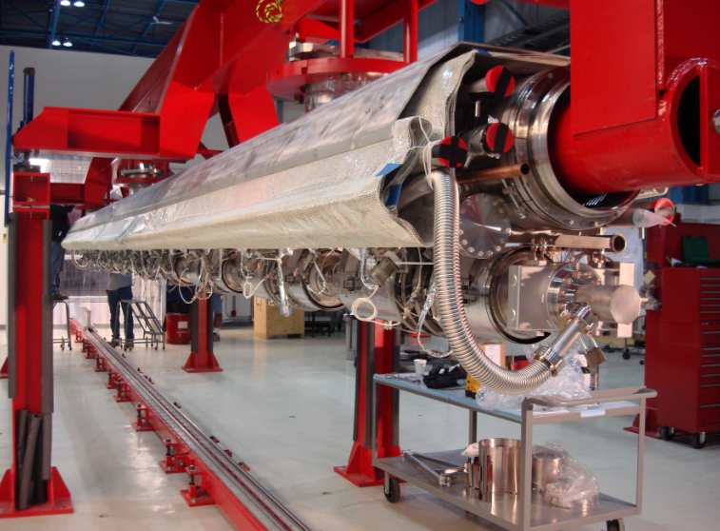
CM-2 String complete (>31.5 MV/M ave)
CM-2 Assembly complete Dec 11
RDK, AAC, Nov 2011
17

Slide 18
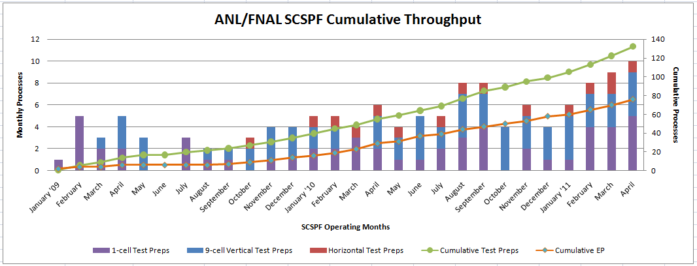
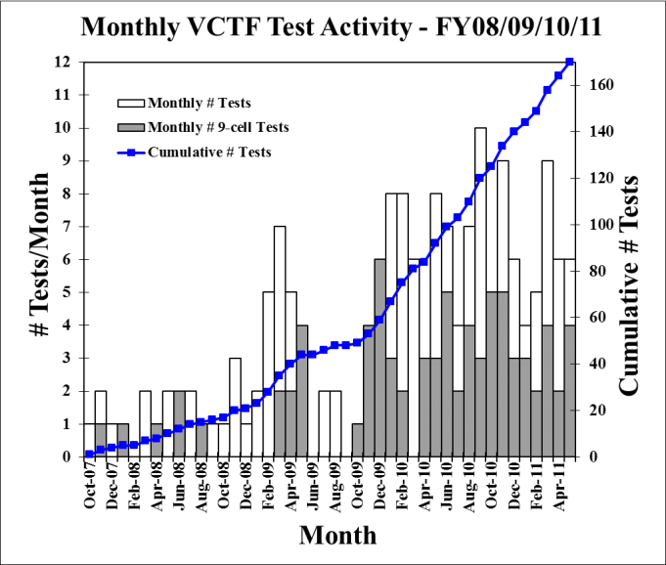
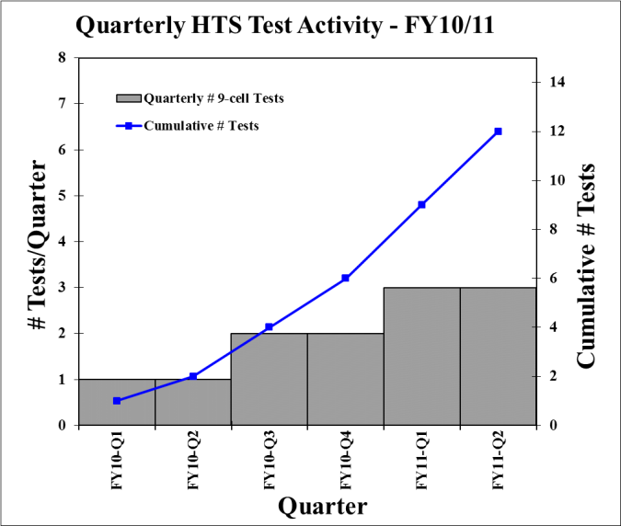
Facility Throughput
ANL/FNAL EP Processing
VTS
HTS
Steady and improving throughput from ANL/FNAL processing, VTS, and HTS

Slide 19
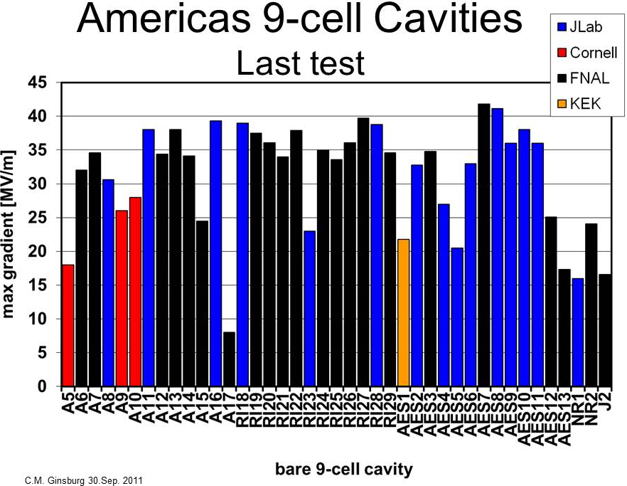
AES replaced damaged end group on A12. CBP then EP
A15 Repaired by CBP 20→34
AES002 repaired by dressed EP→ 33
AES003 repaired at KEK by grinding→34
AES006 repaired by CBP to 35
AES005 repaired tumbling@Cornell to 31
ILC
PX
JLAB & ANL/FNAL facility contributing heavily to ILC gradient program
Pits in EB weld HAZ
New vendor

Slide 20
FNAL SRF Infrastructure
Goals:
Build generic SRF infrastructure at FNAL
  Particularly large cryogenic & RF systems, cavity & cryomodule assembly and test facilities, etc. that are hard for industry to provide
Develop SRF capability in U.S. Industry
Accomplishments:
Vertical test stands (VTS1) fully operational, VTS 2/3 dewars delivered, VTS 2/3 civil work complete, installation in progress
  VTS2 and Cryo upgrades operational in FY12 ?
Horizontal Test Stand (HTS1): fully operational
  Testing dressed cavities for CM2, tuner studies, LLRF, etc
  HTS-2: Design in collab with India ( 2 dressed 650/1300 CW cavities)
Two new vacuum oven installed & operational (ARRA)
Excellent progress on NML and CMTF (slides)

Slide 21
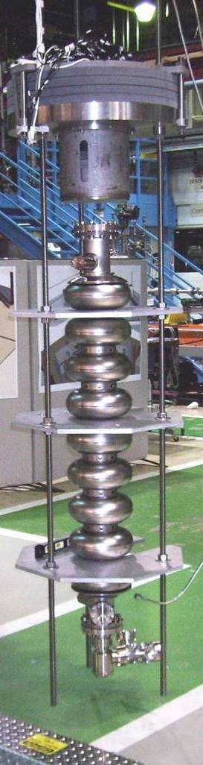
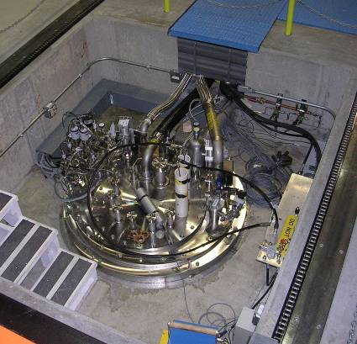
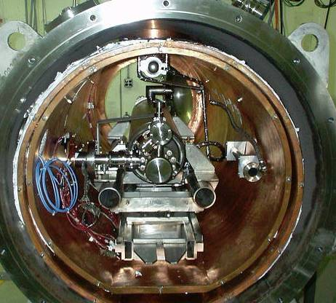
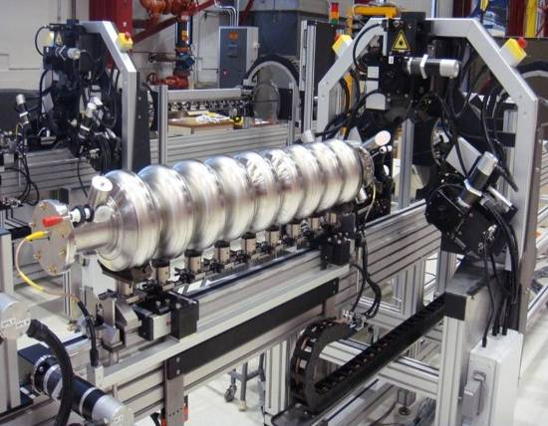
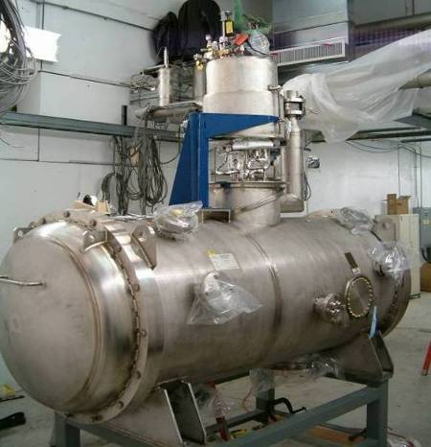
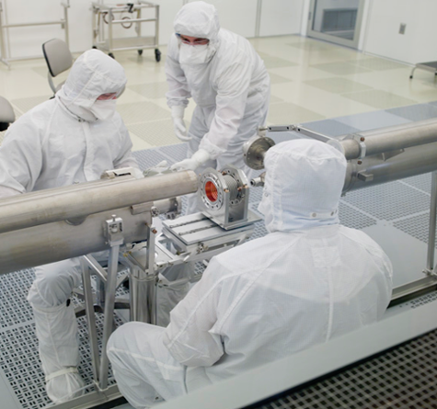
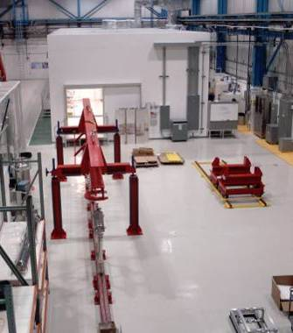
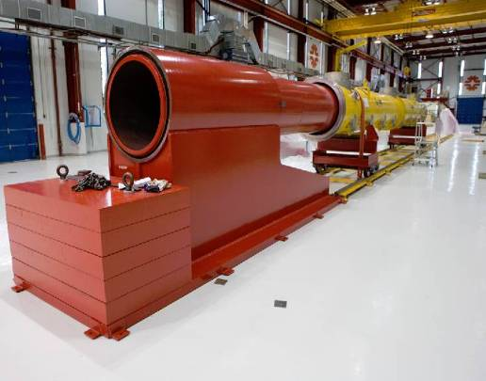
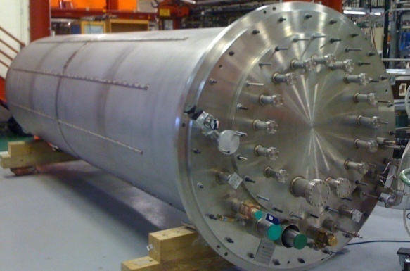
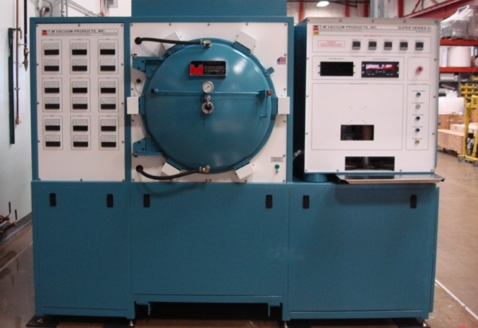
New Vacuum Oven for 1300 MHz
New FNAL SRF infrastructure
Cavity tuning machine
VTS
HTS
VTS
String Assembly
MP9 Clean Room
VTS2 Dewar
Final Assembly

Slide 22
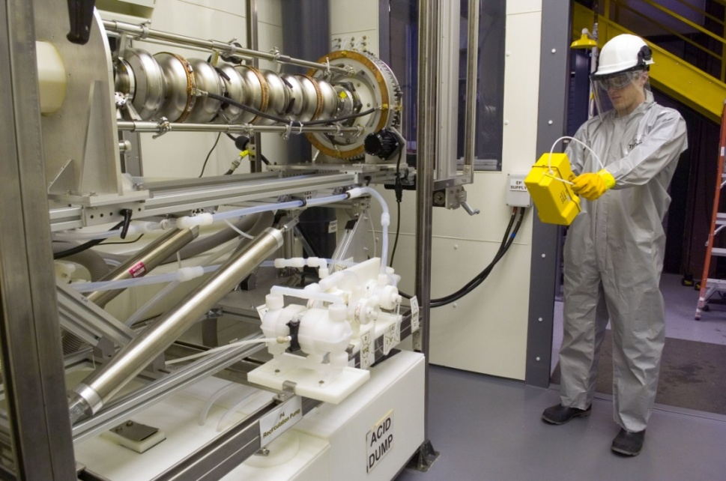
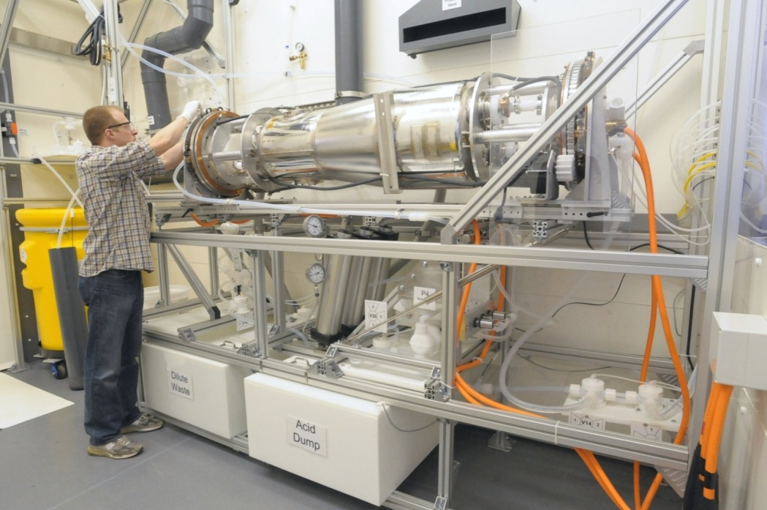
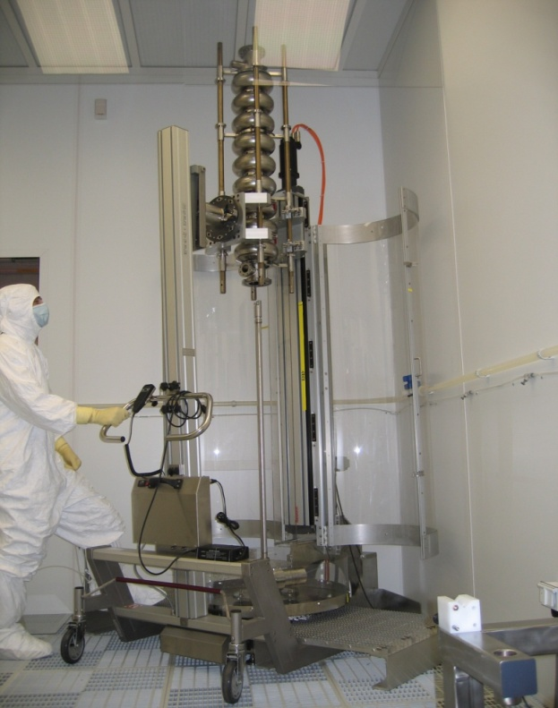
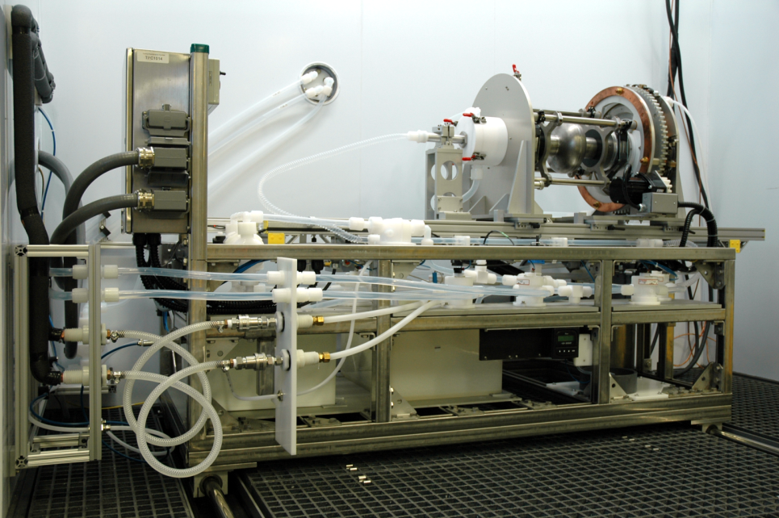
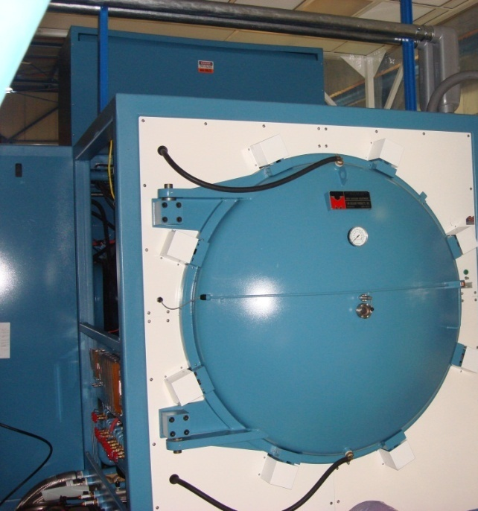
ANL/ FNAL cavity processing infrastructure
New EP tool for ¼ wave and 650 MHz cavities at ANL
EP tool for 1300 MHz at ANL
New EP tool at FNAL
HPR and clean Rooms
New Vacuum Oven
for 650 MHz + SSR

Slide 23
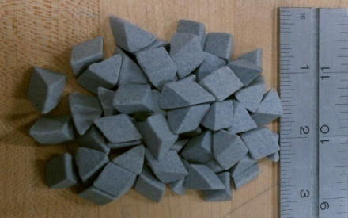
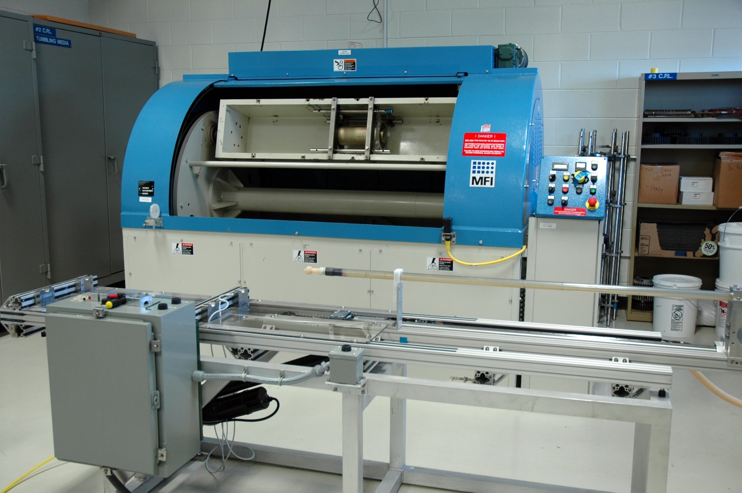
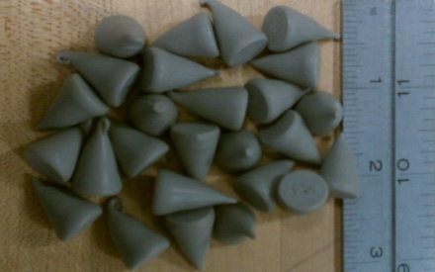
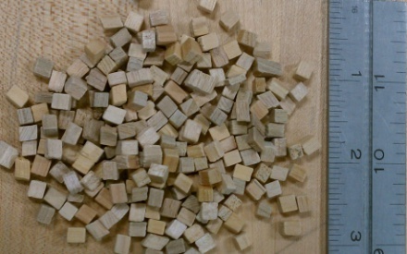
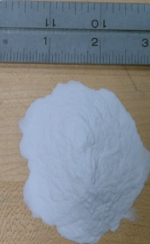
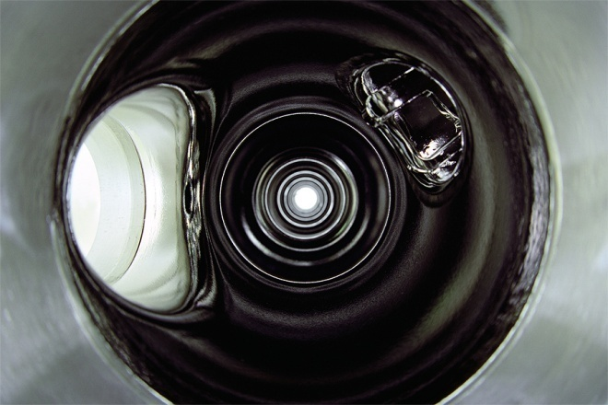
FNAL CBP Machine
C. Cooper Recipe Media
Tumbles 2 cavities/run, 2 complete cycles/week

Slide 24
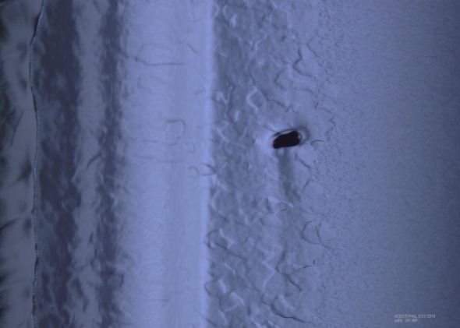

9-Cell Cavity Results – CBP Repairs
Previously limited here
ACC015 Before CBP
Break through !
Demonstrated cavity gradients > 35 MV/M
Drastic reductions in acid use.
Demonstrated as a cavity repair method.
After CBP and 40 microns EP – Pit completely removed

Slide 25
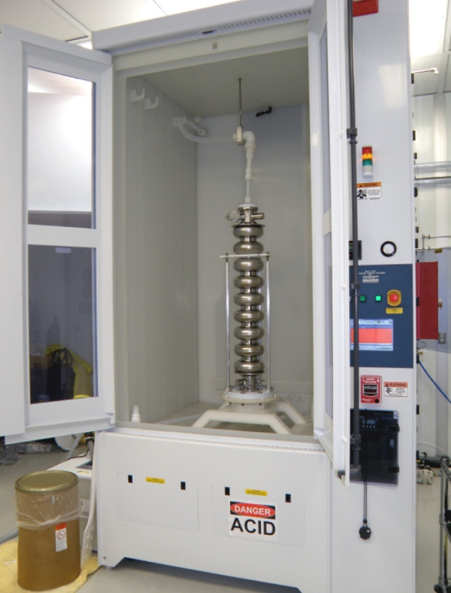
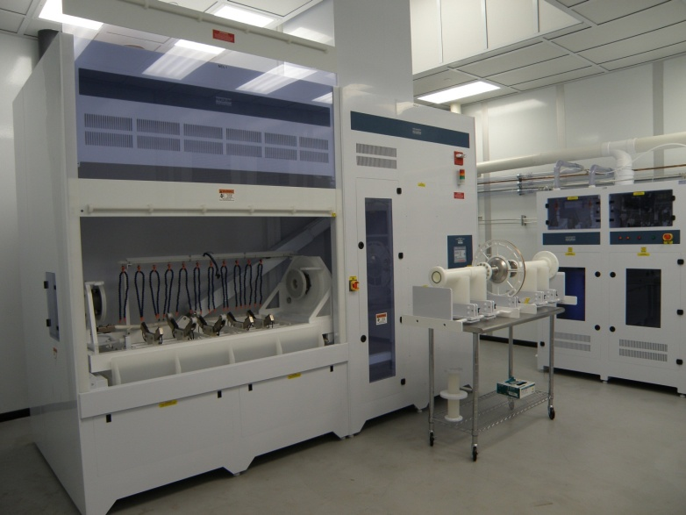
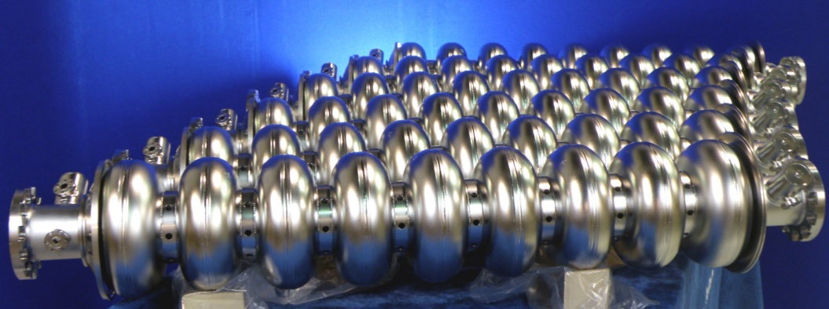
Industrial Capabilities--AES
BCP and EP Tools for 1300 MHz 9-cell or 650 MHz 5-cell. (commissioning)
HPR up to 1000 lb structures. (commissioned)
BCP up to 1000 lb. structures. (commissioned)
Clean Room Area is planned in the future
Also developing capability at Roark-Niowave, PAVAC

Slide 26


NML: RF Unit Test Facility
1st Cryomodule Cold and under test

Slide 27

Cryomodule 1 Testing in Progress
-7 cavities are powered
simultaneously from
5 MW klystron using
SLAC RF dist system
-Tuner motor failure
so powered 8 by itself
Preliminary

Slide 28

NML Status and Expansion
Capture Cavity II operational
CM1: cold and operational
New Underground Tunnel Expansion
(Space for up to 6 Cryomodules (2 RF Units), AARD Test Beam Lines)
Civil construction complete (doubles tunnel length to 160 M)
Phase 1 NML Building

Slide 29
Project X Injector Experiment (PXIE)
Front End test facility for Project X
Goal: Build a prototype of the first ~15-30 MeV of Project X.
  Validate the Project X front end to mitigate the primary technical risk
  Beam through β=0.1 , 0.2 CM at ~15 MeV with nearly final parameters (1 mA CW, 5 mA peak, arbitrary bunch chopping
CW H- source delivering 5 mA at 30 keV & LEBT with beam pre-chopping
CW RFQ operating at 162.5 MHz and delivering 5 mA at 2.1 MeV
MEBT with integrated wide band chopper and beam absorbers capable of generating arbitrary bunch patterns at 162.5 MHz, and disposing of 4 mA average beam current
Low beta superconducting cryomodules capable of accelerating 1 mA to ~15 MeV
Beam dump capable of accommodating 1 mA at 15 MeV (15 kW) for extended periods.
Associated beam diagnostics, utilities and shielding

Slide 30


New NML Buildings (ARRA funded )
New Electronics building above tunnel extension
PXIE
New Cryomodule Test Facility
New 600 W 1.8 K refrigerator
(under fabrication in industry)
will be located in CMTF bldg
Compressor building

Slide 31
R&D Plans: FY12 Priorities
ILC priorities
  Process and test 1300 MHz cavities to demonstrate required yield at 35 MV/M for ILC (~ same pace at FY11)
    Note: CBP may become the new standard for processing
  Cryomodule construction and test
    CM2 assembly
    Dress and HTS test cavities for CM3
    CM1 post mortem and rebuild ← Lower Priority
    S1 global cavity post mortem and rework ← Lower Priority
  Install CM2 at NML (1st high gradient CM) and test
  Cost reduction R&D ( hydroform, ALD, etc) ← funding!
  SRF surface and materials R&D; with deliberate focus on gradients and yields ← funding!
ILC R&D also benefits the Project X pulsed linac

Slide 32
R&D Plans: FY12 Priorities
SRF B&R Priorities:
  Complete ARRA tasks:
    VTS 2/3 milestones, RF equipment orders
    ARRA buildings (NML tunnel ext, CMTF, etc)
    Work with vendor to monitor progress on Superfluid plant
    Order cryo distribution box for CMTF
    Prepare for arrival of super-fluid refrigerator at CMTF
    Obligate all remaining ARRA funds in FY12
  Move Photo-injector parts and rebuild CCI with new cavity ( also for long pulse 30 ms PX studies)
  Work to provide 1st beam at NML by end of FY12← funding!
  Work with India on HTS-2 and CM test stands
  Continue tech transfer effort to U.S. Industry ← funding!
SRF operations:
  Operate the facilities we have built ( VTS, HTS, STF, NML) at about FY11 pace and install 120 C ovens

Slide 33
R&D Plans: FY12 Priorities
GAD Priorities: Cavity/CM development for Project X.
  Project X Injector Experiment (PXIE): work out the design details, costs, and begin construction
  Build low beta cavity infrastructure as required (e.g. STF upgrade, 650 MHz cavity fixtures, etc)
  Prototype 162.5 MHz HWR in collaboration with ANL
  Inspect, process, and test bare SSR1 cavities (10 arriving)
  Dress and test SSR1 cavities (examine tuner options)
  Design SSR1 cryomodule and order parts← funding!
  Process and test 650 MHz single cells, 1st 5 cell 650 MHz
  Complete mechanical design of beta=0.6 five cell 650 MHz cavity with JLAB
  325 and 650 MHz Coupler test stand
  Complete ICPA and operate it. ← funding!
  Order more 650 MHz cavities incl Nb ← funding!
  SSR2 design and prototype incl Nb ← people/funding!

Slide 34

Integrated SRF Schedule - Cryomodules

Slide 35

Integrated SRF Schedule - Infrastructure
Shows only remaining items, many completed items are now not shown (VTS-1, HTS, STF, CAF)

Slide 36
Concerns in FY12 and beyond
Available funding and reduced workforce (10% down vs FY11) will limit our progress
Outlook for overall funding is FY12-15 below our Feb 2010 plan
AND we have added new scope PXIE (~ $ 40 M ) ➔ another $ 8-10 M per year is needed between GAD and Project X
Our plan to revise our RLS as we understand outyear funding and PXIE costs

Slide 37
Summary
SRF program at FNAL supports both ILC & Project X strategic goals
  Demonstrated world class performance of 1300 MHz cavities
  Developing additional 162.5, 325, & 650 MHz cavity and cryomodule designs in support of Project X
Application of SRF to the low energy extreme of 2.1 MeV is a new and significant development in high intensity hadron linacs
  Project X Injector Experiment (PXIE) is a major new thrust
Program leverages existing FNAL infrastructure (bldgs, cryo, etc)
  Augmented with SRF and ARRA infrastructure funds
  Lots of infrastructure is now in operation and is being used effectively
Leveraging existing SRF collaborations and building new ones
Significant effort to transfer SRF technology to U.S. Industry but this may stall in projected funding scenarios
Excellent team in place with growing SRF expertise
Available resources will limit our technical progress.

Slide 38
Collaborations (~20 MOU’s)
ANL: EP development and cavity processing
Cornell: Cavity processing & test, materials R&D
DESY: 3.9 GHz, cryomodule kit, FLASH
Dubna: cavity development, bimetallic joints
KEK: Cavity R&D, ATF II
MSU: Cavity cost reduction, hydro-form, TIG
TJNL: EP cavity processing and test, PX cavities
INFN: tuners, HTS, NML gun cathodes
TRIUMF: Vendor development (PAVAC)
SLAC: RF power, klystrons, couplers
CERN, DESY, KEK, INFN, etc: Type IV CM design
BARC, RRCAT, IUAC, VECC (India) CM design, cavities, infrastructure
China: Peking U, IHEP, cavity development ( developing)
UC,NW,NHMFL, UN Reno, Cornell, DESY, KEK…: Materials R&D
Notes:
38

