Slide 1
NSF Report: Division of Physics Particle Physics
Jim Shank, Keith Dienes
National Science Foundation
Division of Physics
FNAL Users Meeting
August 2,2021

Slide 2
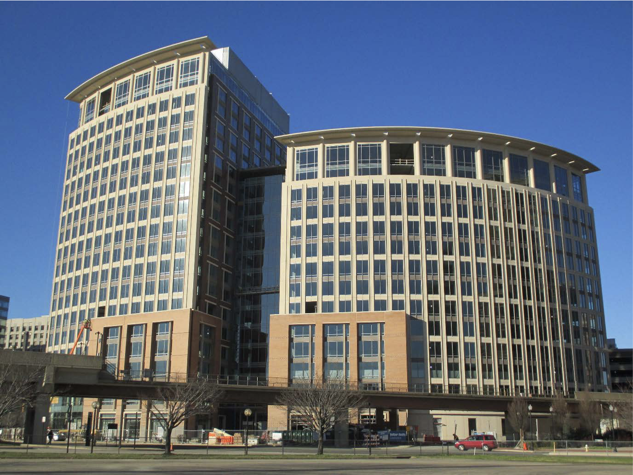
NSF Particle Physics Programs
Transitions in Physics Division (PHY)
Status of EPP Exp and THY Programs

Slide 3
Division of Physics – Individual Investigator Programs
Atomic, Molecular, & Optical Physics
Experiment: John Gillaspy, Kevin Jones, Tony Calamai
Theory: Robert Forrey
Gravitational Physics + LIGO research
Pedro Marronetti
Notable transitions:
Edmundo Garcia-Solis has left NSF
Saul Gonzales has left the PHY division
Jim Whitmore has retired
Plasma Physics
Slava Lukin, Jose Lopez
Nuclear Physics
Experiment: Allena Opper; Jim Thomas
Theory: Bogdan Mihaila
Elementary Particle Physics
Experiment: Jim Shank
Theory: Keith Dienes
Physics of Living Systems
Krastan Blagoev
Particle Astrophysics
Experiment: Darren Grant
Theory (+cosmology): Keith Dienes
Quantum Information Science
(Alex Cronin); Julio Gea-Banacloche
Physics Frontiers Centers
Jim Shank
Physics at the Information Frontier
Bogdan Mihaila
Integrative Activities in Physics
(REU Sites, MRI, CAREER, BP) Kathy McCloud (soon)

Slide 4
FY2022 President’s Request

Slide 5
Major Research Equipment Account
FY2022 President’s budget request
MREFC Account Funding, by Project
(Dollars in Millions)
 | FY 2020 Actual | FY 2021 Estimate¹ | FY 2022 Request | FY 2023 Estimate | FY 2024 Estimate | FY 2025 Estimate | FY 2026 Estimate | FY 2027 Estimate
Antarctic Infrastructure Recapitalization | $48.78 | $90.00 | $90.00 | $60.00 | $60.00 | TBD | TBD | TBD
DKIST | - | - | - | - | - | - | - | -
HL-LHC Upgrade | 33.00 | 33.00 | 36.00 | 33.00 | 18.00 | - | - | -
Mid-scale Research Infrastructure² | - | 76.25 | 76.25 | 76.25 | 76.25 | 76.25 | 76.25 | 76.25
NEON | 0.74 | - | - | - | - | - | - | -
RCRV | 25.00 | - | 5.00 | 15.00 | - | - | - | -
Vera C. Rubin Observatory | 46.35 | 40.75 | 40.75 | 15.00 | - | - | - | -
Dedicated Construction Oversight | 0.97 | 1.00 | 1.00 | 1.00 | 1.00 | 1.00 | 1.00 | 1.00
Total | $154.84 | $241.00 | $249.00 | $200.25 | $155.25 | $77.25 | $77.25 | $77.25

Slide 6
FY2022 President’s budget request
PHY Funding
(Dollars in Millions)
 | FY 2020 Actual | FY 2021 Estimate | FY 2022 Request | Change over FY 2021 Estimate
 |  |  |  | Amount | Percent
Total | $304.39 | $303.90 | $316.59 | $12.69 | 4.2%
Research | 175.08 | 187.32 | 203.22 | 15.90 | 8.5%
CAREER | 10.24 | 7.30 | 7.30 | - | -
Centers Funding (total) | 7.45 | 7.70 | 11.00 | 3.30 | 42.9%
Artificial Intelligence Research Institutes | 2.79 | 2.70 | 6.00 | 3.30 | 122.2%
STC: Center for Bright Beams (PHY) | 4.66 | 5.00 | 5.00 | - | -
Education | 5.76 | 4.92 | 4.92 | - | -
Infrastructure | 105.86 | 96.66 | 90.15 | -6.51 | -6.7%
IceCube | 3.50 | 3.50 | 3.65 | 0.15 | 4.3%
LHC | 20.00 | 20.00 | 20.50 | 0.50 | 2.5%
LIGO | 45.00 | 45.00 | 45.00 | - | -
Midscale Research Infrastructure | 15.36 | 12.66 | 18.50 | 5.84 | 46.1%
NSCL | 22.00 | 15.50 | 2.50 | -13.00 | -83.9%
Research Resources | - | 1.00 | 2.50 | 1.50 | 150.0%

Slide 7
Physics Funding at NSF
Directorate of Mathematical and Physical Sciences
PHY FY21 Request is 9.6% below FY19 Actual
Particle physics funding is ~1/3 of Physics budget
Increasing importance of NSF multidisciplinary “Big Ideas”
Overall, FY20 enacted is ~3% above FY19 Actual for NSF
Actual
Multidisciplinary
Physics
Mathematical Sciences
Materials Research
Chemistry
Astronomy

Slide 8
Particle Physics Research Programs

Slide 9
Experimental EPP Program
Elementary Particle Physics (EPP) Program, which primarily supports particle physics at accelerators and advances in detector development.
Range of program coverage:
  High Energy Physics (ATLAS, CMS,…)
  Precision Experiments (Neutrinos, LHCb, Rare-K, EDMs, …), LHCb M&O
  Tools for Particle Physics (Artificial Intelligence, Instrumentation,…)
Program Directors: S. Gonzalez, J. Shank
EPP Program | FY 2015 | FY 2016 | FY 2017 | FY 2018 | FY 2019 | FY 2020
Funding (in $k) | $19,913 | $19,183 | $19,133 | $20,522 | $17,325 | $21,090
Awards issued | 19 | 12 | 7 | 18 | 15 | 15
CAREER awards | 1 | 2 | 1 | 1 | 0 | 3

Slide 10
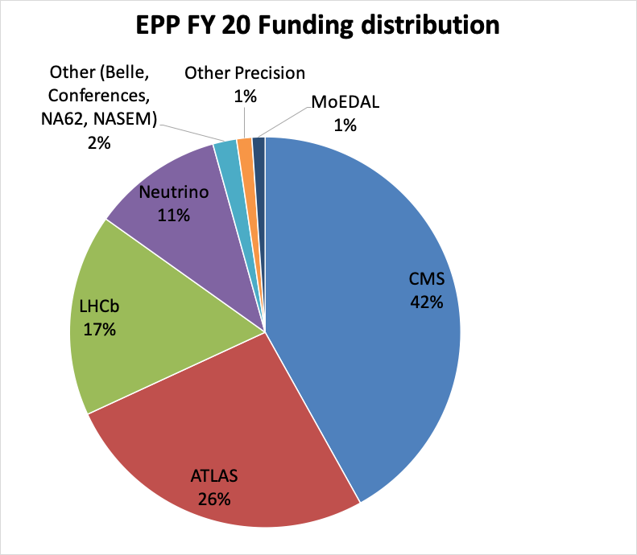
The awards from 2020 proposals.
Notes:
MoEDal = Monopole search at p[t. 8 LHC

Slide 11
Full EPP program at the end of 2020
All awards by fraction of FY20 budget.

Slide 12
Theory Program for Particle Physics
Particle Theory is essential to the success of the entire Particle Physics mission. We support cutting-edge investigator-driven research in two programs:
  Theoretical High-Energy Physics
  Theoretical Particle Astrophysics and Cosmology
Regular interactions with EPP, PA, Gravity Theory, Nuclear Theory, Astronomy, Materials Research, Mathematical Sciences, etc.
Supporting individuals, RUI's, and special facilities or initiatives (Aspen Center for Physics, TASI summer school, LHC Theory Initiative, etc.)
Trend: Dramatic increase in number of proposals—factor of two in last 5 years, +20% last year
Program Director: K. Dienes
Theory Programs | FY 2015 | FY 2016 | FY 2017 | FY 2018 | FY 2019 | FY 2020
Funding (in $k) | $13,751 | $13,232 | $13,388 | $13,427 | $12,029 | $13,559
Awards issued | 28 | 30 | 26 | 32 | 23 | 32
CAREER awards | 2 | 1 | 2 | 1 | 1 | 1

Slide 13
Primary NSF Physics Funding Opportunities
(relevant for high-energy physics, particle astrophysics, and cosmology)
https://www.nsf.gov/pubs/2021/nsf21593/nsf21593.htm: Our general, all-purpose Solicitation for our regular base grants. Use this as your default. Deadlines in Fall 2021, depending on specific program.
https://www.nsf.gov/pubs/2014/nsf14579/nsf14579.htm. (“RUI”) Same as above, but for applicants from primarily undergraduate institutions. Check eligibility with your SRO.
https://www.nsf.gov/pubs/2020/nsf20525/nsf20525.htm: (“CAREER”) An alternative funding track for those junior (untenured) faculty who, at this point in their careers, wish to undertake a significant education/outreach activity in addition to their research. Not simply a research-excellence prize, and not intended as a default for junior faculty unless you plan a major mix of research and education/outreach. Next deadline: July 26, 2021.
https://www.nsf.gov/pubs/2021/nsf21570/nsf21570.htm: (“LEAPS-MPS”) Grants designed to “launch the careers of pre-tenure faculty… at minority-serving institutions (MSIs), predominantly undergraduate institutions (PUIs), and Carnegie Research 2 (R2) universities … with the goal of achieving excellence through diversity.” Launch = you have no prior or current NSF grants (see special exceptions). Deadline for FY22 not yet determined.
Supplements to existing NSF grants to fund a new graduate student. Emphasis placed on “increasing the involvement by members of underrepresented groups”. Apply anytime, fall preferred.
  https://www.nsf.gov/pubs/2020/nsf20083/nsf20083.jsp: “MPS AGEP-GRS” (only for allowed institutions).
  https://www.nsf.gov/pubs/2021/nsf21065/nsf21065.jsp: “PHY-GRS” (similar, but for remaining institutions).
https://www.nsf.gov/pubs/2021/nsf21573/nsf21573.htm: (“MPS-Ascend”) Fellowships to “support postdoctoral Fellows who will broaden the participation of under-represented groups”. Postdocs or graduating PhDs apply on their own after identifying a potential postdoctoral mentor. Deadline for FY22 not yet determined
Other Divisions, such as Division of Astronomy. Contact relevant Program Directors in both Divisions.
Proposal & Award Policies & Procedures Guide:
New PAPPG in effect Oct. 4!
https://www.nsf.gov/pubs/policydocs/ pappg22_1/ index.jsp
Jim Shank (jshank@nsf.gov) -- HEP Experiment
Keith Dienes (kdienes@nsf.gov) -- HEP Theory & Particle Astro/Cosmo Theory
Darren Grant (dgrant@nsf.gov) -- Particle Astro Experiment
Kathy McCloud (kmccloud@nsf.gov) -- for LEAPS-MPS and MPS-Ascend
PHY Contacts:

Slide 14
Research Infrastructure

Slide 15
Mid-Scale Research Infrastructure
Webinar from Nov. 2020: weblink
Mid-Scale RI-1 Solicitation: 21-505
Preliminary Proposal Deadline Date: January 7, 2021
Full Proposal Deadline Date: April 23, 2021 (By Invitation Only)
Mid-Scale RI-1 Implementation projects Total cost: $6M - $20M
Mid-Scale RI-1 Design projects Total cost: $600k - $20M
Mid-Scale RI-2 Solicitation: 21-537
Letter of Intent Deadline Date: Feb.3, 2021 , Prelim proposal: Mar. 5, Full: Sept. 20, 2021
Mid-Scale RI-2 Projects Total cost: $20M - $100M
Consult the Major Facilities Guide NSF 19-068

