Slide 1
HR Business Partners
Deanne Randich
WDRS
Users meeting 2021

Slide 2
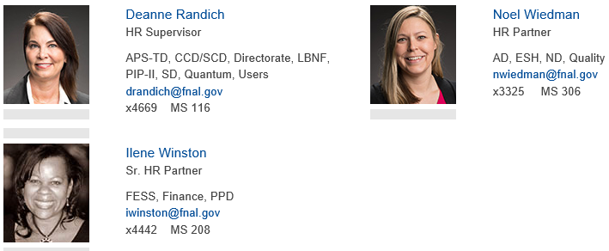
Who We Are

Slide 3
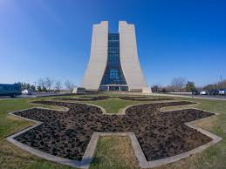
What We Do – An Overview
Provide strategic HR guidance to managers and employees that aligns with the mission and vision of Fermilab.
Fermilab’s Vision and Mission
Our vision is to solve the mysteries of matter, energy, space and time for the benefit of all. We strive to:
lead the world in neutrino science with particle accelerators
lead the nation in the development of particle colliders and their use for scientific discovery
advance particle physics through measurements of the cosmos
Our mission is to drive discovery by:
building and operating world-leading accelerator and detector facilities
performing pioneering research with national and global partners
developing new technologies for science that support U.S. industrial competitiveness
How do we do this?

Slide 4
What We Do – An Overview
Function cross-departmentally and cross-divisionally to ensure a consistent approach to HR policy and procedure – minimizing risk
Lead investigations and recommend actions/outcomes
Drive Performance Review Process
Conduct exit and stay interviews – striving for meaningful metrics!
Coach managers and employees (policy interpretation, conflict resolution strategies, engagement opportunities)
Responsible for Employee Relations across the laboratory, supporting ≈1800 employees and 1800 users.

Slide 5
New Employee/Users Assistance Program
Effective July 1, 2021
ComPsych is available 24 hours a day, 7 days a week:
1-866-586-1375 guidancesresources.com
ComPsych is the world’s largest provider of employee assistance programs to support and encourage well-being and healthy outcomes for our employees and users.
Guidance Resources services on:
Relationships, work, school, children, wellness, legal, financial and free time
Search for qualified child and elder care, attorneys and financial planners
Ask questions, take self-assessments and more.
Create an account to access the online portal (instructions here)

Slide 6
Reporting Channels
There are numerous reporting channels available to you to report harassment, waste, and abuse. The DOE Hotline and Integrity Counts portal provide an opportunity for anonymous reporting.
Managers, supervisors, division and/or section leadership
The Office of the General Counsel
DOE/OIG Office of the Inspector General
HR Business Partners
Integrity Counts
FRA policy prohibits retaliation or punishment of individuals who make a report through any of these channels.

Slide 7
Integrity Counts – Launched Summer 2020

Slide 8
What’s New
Recent Updates from the HR Partner Offices:
Mother’s Rooms updates and new locations in Wilson Hall and AD cross gallery

