Slide 1
PreCam: A Step Towards the Photometric Calibration of the DES
Sahar S. Allam & Douglas L. Tucker
for the PreCam team 17 April 2012
1-Overview
2-Photometric Quality
3-What next?

Slide 2
PreCam Observers: Commissioning & Operations
Sahar Allam
Jim Annis
Eduardo Balbinot
Joe Bernstein
Tomasz Biesiadzinski
David Burke
Melissa Butner
Julio Camargo
Darren DePoy +TAMU group
Brian Gerke
Rick Kessler
Kyler Kuehn
Steve Kuhlmann
Wolfgang Lorenzon
Marcio Maia
Leandro Martelli
Brian Nord
Eric Neilsen
Ricardo Ogando
John Peoples
Dominik Rastawicki
Joerg Retzlaff
Michael Schubnell
J. Allyn Smith
Adam Sypniewski
Greg Tarle
Douglas Tucker
Will Wester
Students:
D. Park
H. Head
T. Bailey
L. Maki
And special thanks to:
Oscar Saa and CTIO TelOps
Tim Abbott, Chris Smith, Alistair Walker
Pat Seitzer (PI of Curtis-Schmidt NASA program)

Slide 3
PreCam
Is a shallow bright survey. It’s goals to deliver 1-2% (1%) photometry over full the DES footprint.
Originally, 500 sqr deg for 10 times in each 5 filter.
Or simply 25,000 sqr deg, using C-S in 100 nights.
Total raw data including from engineering & commissioning (Sep & Jan Runs) is ~>0.5TB gzipped.
For each data deduced, we used ~1TB (gzipped).
Total # of observation from 20101117UT – 20110120UT (51 nights) ~23,443 frames:-
Including bias, flats, darks, focus, SL test std & sci
~460 frame/night
47% of the data was Sci and Std.

Slide 4
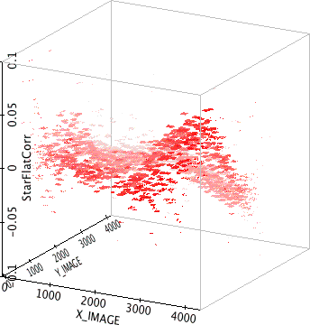
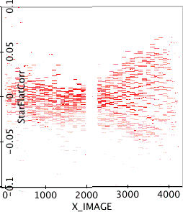
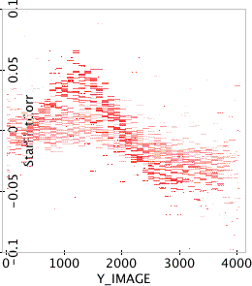
PreCam V3-Photometric Quality
For PreCam V3 data reduction set: we discovered a systematic flat-fielding error and used SDSS Stripe 82 Marriner Catalog to create a “star flat” (to correct later processing)
Δmag
Δmag
Δmag

Slide 5
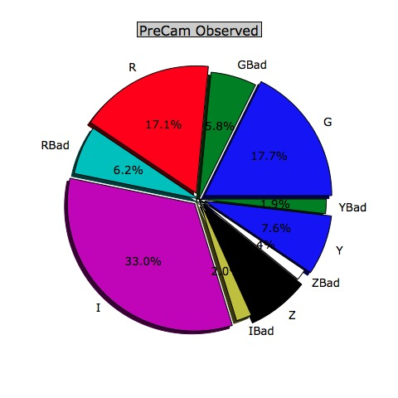
Total imaging data
(as of V4-Reduction)
F. Observed
#11020
G 2588
R 2568
I 3852
Z 969
Y 1043
V4-Good #9028
G #1946 ~3810.8☐deg
R #1882 ~3685.5☐deg
I #3635 ~6707.1☐deg
Z #939 ~1838.8☐deg
Y #836 ~1637.1☐deg
V4-Bad #1989
& imaging area
~3894.9☐deg
PreCam collecting an imaging area of
~17,679☐deg [+/- 5%] > SDSS DR8(14,055☐deg)

Slide 6
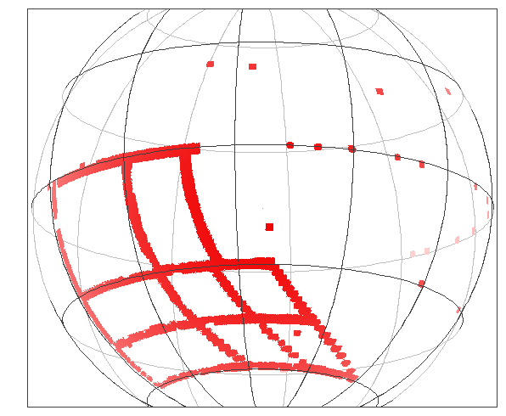
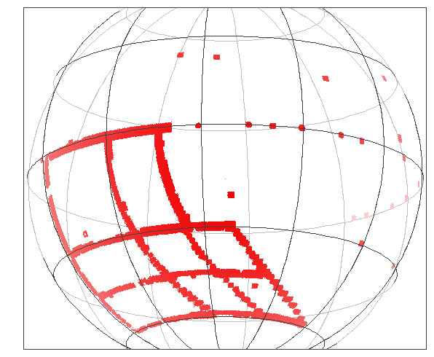
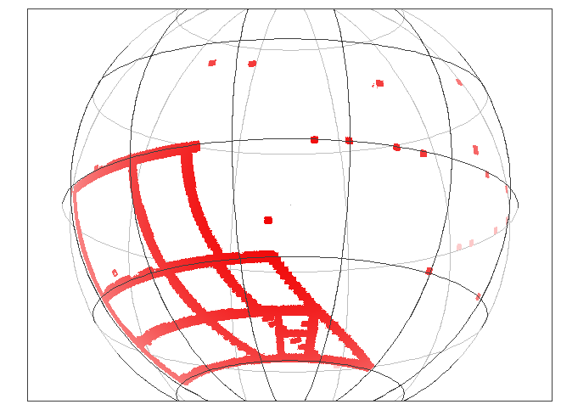
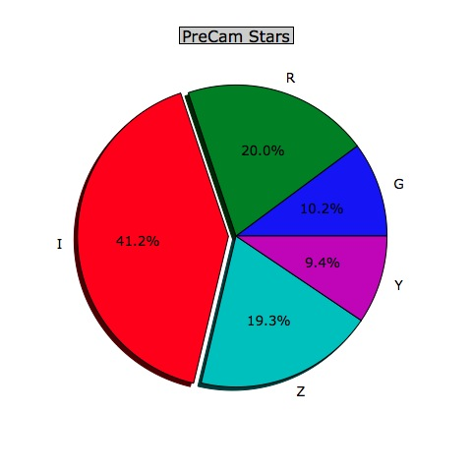
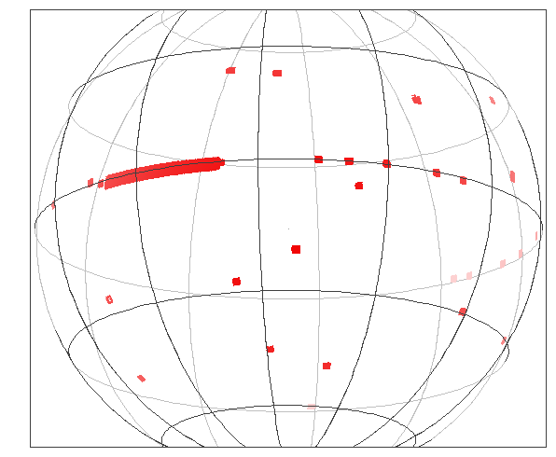
PreCam sky covered
as V4-Reduction
g-band
r-band
i-band
z-band
y-band

Slide 7
Photometric Quality
Systematic (comparison with
Marriner-S82)
V4 processing,
and calibration using nightly solution alone
(NO OVERALL GLOBAL RELATIVE CALIBRATION
HAS YET BEEN APPLIED)

Slide 8
Total Throughput SDSS vs DES
transmission
Wavelength

Slide 9
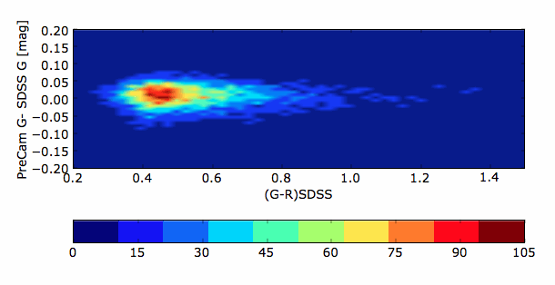
Nightly Solutions PreCam-g
(PreCam-g – SDSS-g) vs SDSS-g
0.2
-0.2
g-Nightly Solutions
(mean)
4.30 + 0.152*X
-.073*((g-r)-0.53)
(PreCam-g – SDSS-g)
vs SDSS(g-r)

Slide 10
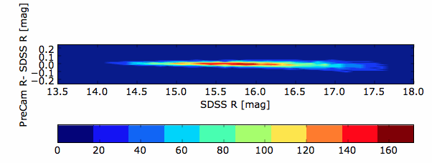
Nightly Solutions PreCam-r
(PreCam-r – SDSS-r) vs SDSS-r
0.2
-0.2
r-Nightly Solutions
(mean)
4.271 + 0.08*X
-.079*((g-r)-0.53)
(PreCam-r – SDSS-r)
vs SDSS(g-r)

Slide 11
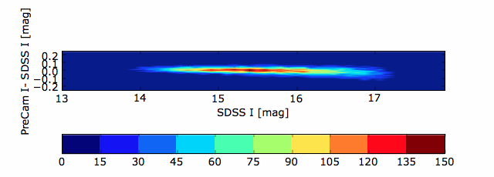
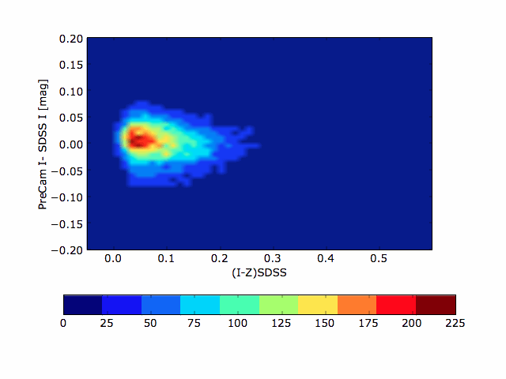
Nightly Solutions PreCam-i
(PreCam-i - SDSS-i) vs SDSS-i
0.2
-0.2
i-Nightly Solutions (mean)
4.432+ 0.077*X
-0.253*((i-z)-0.09)
(PreCam-i – SDSS-i)
vs SDSS(i-z)

Slide 12
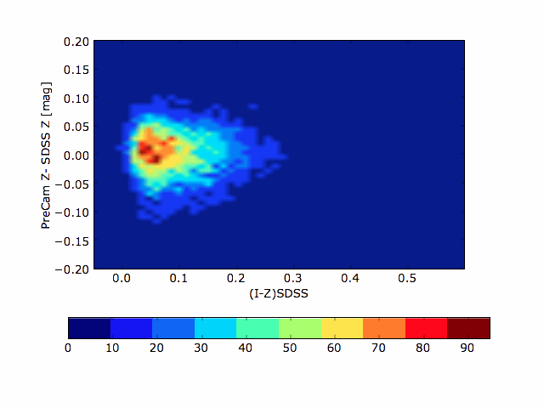
Nightly Solutions PreCam-z
(PreCam-z – SDSS-z) vs SDSS-z
0.2
-0.2
Z-Nightly Solutions
mean
4.7076+ 0.0333*X
-0.1056*((i-z)-0.09)
(PreCam-z – SDSS-z)
vs SDSS(i-z)

Slide 13
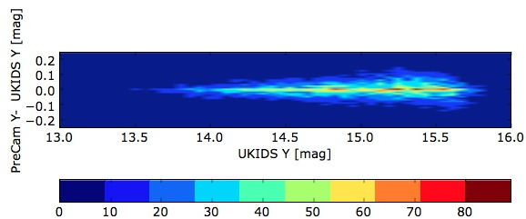
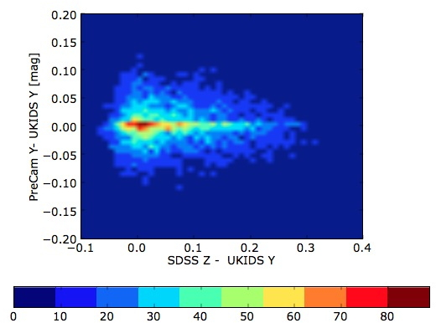
Nightly Solutions PreCam-Y
0.2
-0.2
(PreCam-Y – UKIDSS-Y) vs UKIDSS-Y
Y-Nightly Solutions
5.748 + 0.03*X
+.463*((z-Y)-0.05)
(PreCam-Y – UKIDSS-Y)
vs SDSSz-UKIDSS-Y

Slide 14
How to improve
Photometric Quality
Systematic:
Using the
# of Repeated star
observation
(√N) will improve
our results for each filter

Slide 15
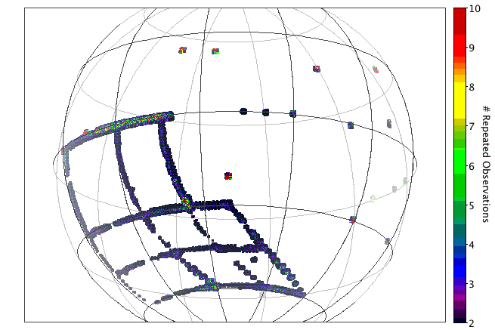
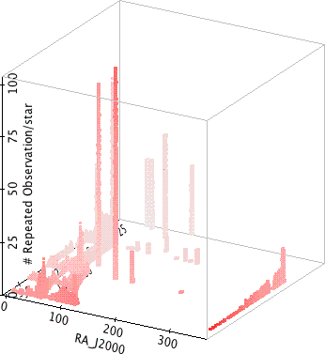
r-band
(# of Repeat Star Observations)
(√N) will improve
our results
2-10
100

Slide 16
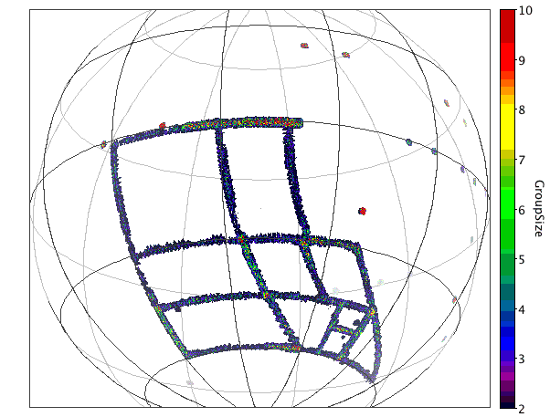
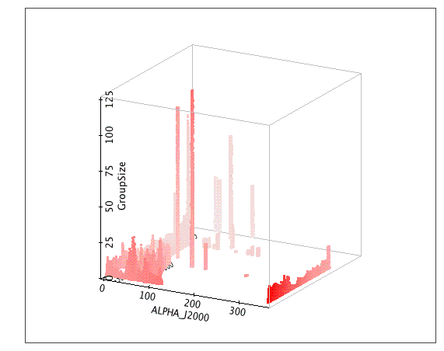
i-band Groups
(# of Repeat Star Observations)
(√N) will improve
our results
2-10
125

Slide 17
To do list
Apply overall global relative calibration,
Improve the Systematic: by using the # of
repeated star observation (√N)
Plan for the future PreCam (1.5++)

Slide 18
Extra Slides

Slide 19
Extra “Shutter++” problem ~400 frames have “Dark” recoverable frames
Before
After

Slide 20
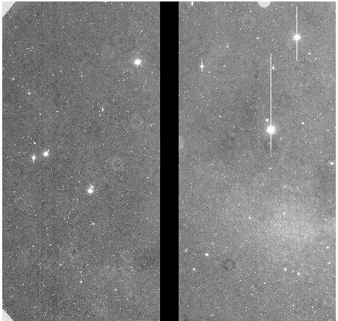
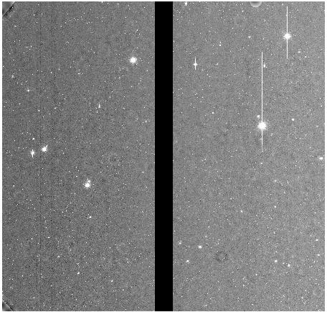
Extra “Shutter++” problem ~300 frames have “bright” recoverable frames
Before
After

