Slide 1
Climate Change:
The King, The Emperor, and The Holy Grail
B. A. Wielicki and the CLARREO Science Team
Calibration and Standardization of Large Surveys and Missions in Astronomy and Astrophysics
April 16, 2012
Fermilab

Slide 2
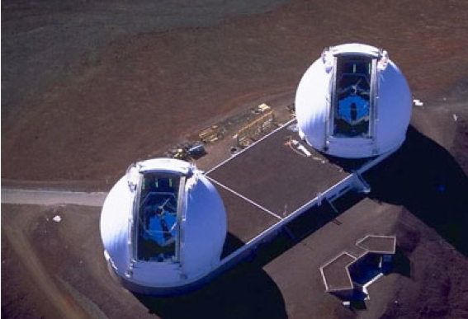
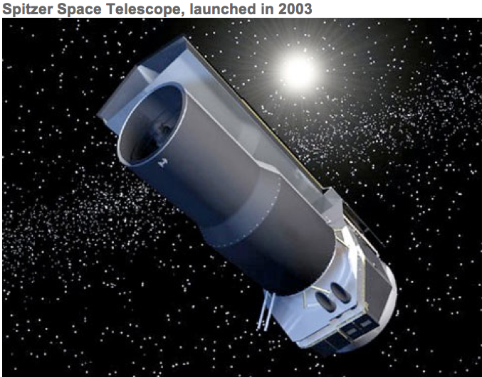
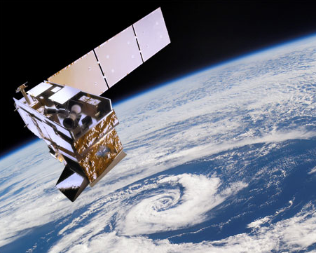
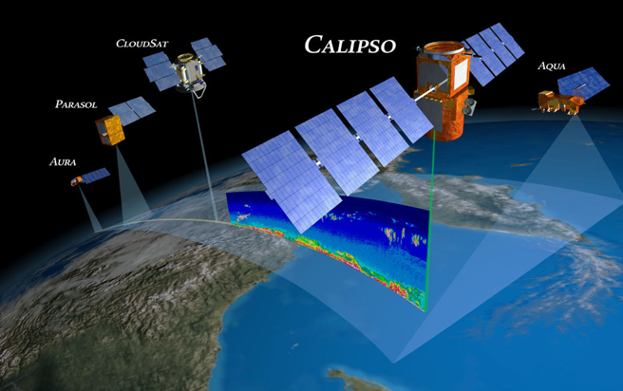
Two Sides of Remote Sensing
Out toward
the heavens...
Keck
Spitzer
NPP Soumi
A-train
In toward
humanity...

Slide 3

The Difference, by Scott Page
Increased diversity of:
perspectives,
experiences,
tools.
Improves the ability
to solve complex problems
Caveat:
Diversity of values
decreases that ability

Slide 4
Who am I? What's my perspective?
Climate scientist at NASA Langley Research Center
PhD from Scripps Institution of Oceanography in 1980
Research: remote sensing of clouds, Earth's radiation balance, climate, testing climate models with observations
Co-Investigator on 4 previous satellite missions (ERBE, Landsat, CALIPSO, Cloudsat)
Principal Investigator for the CERES mission (Clouds and the Earths Radiant Energy System)
Science Team Lead for the CLARREO Decadal Survey mission currently in pre-phase A development. (Climate Absolute Radiance and Refractivity Observatory
Give public lectures on climate change
Addicted to golf
My wife Barb is in human resources for a large company
Complex challenges: what is climate sensitivity? how do we design a climate observing system? how do we narrow uncertainty in climate predictions?

Slide 5
Accuracy is King
The Emperor has No Clothes
The Holy Grail is in Sight

Slide 6
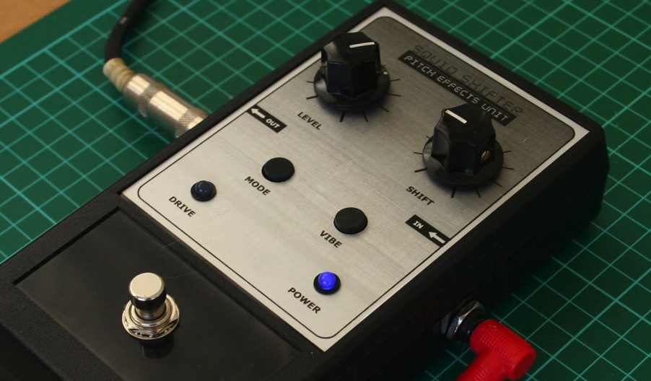
The Idealist View of Climate Models
Climate
Response: Global Surface Temperature
Climate
Sensitivity
Abrupt
Climate
Change
Climate Forcing: Anthropogenic CO₂
Hypothesis test: Measure Forcing, Compare Response to Prediction

Slide 7
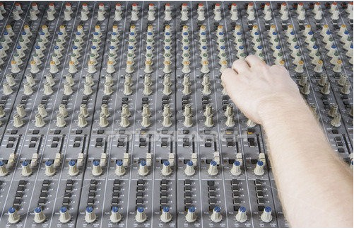
The Realist View of Climate Models
Carbon Cycle
Aerosol Forcing
Land Use Forcing
Natural Forcing
Cloud Feedback
Lapse Rate Fdback
W. Vapor Fdback
Snow/Ice Fdback
Glacier Response
Sea Ice Response
Deep Ocean Mixing
Flood Response
Drought Response
Sea Level Change
.....
.....
.....
Climate Modeler
Hypothesis Test: What climate variables? Where? When? How Accurate?

Slide 8
Testing Climate Model Predictions
All models will always be invalid: but by how much?
Can we get from the Dark Ages to the Age of Reason?
How do we design climate model hypothesis tests for decadal change, and use this to determine observational uncertainty requirements?

Slide 9
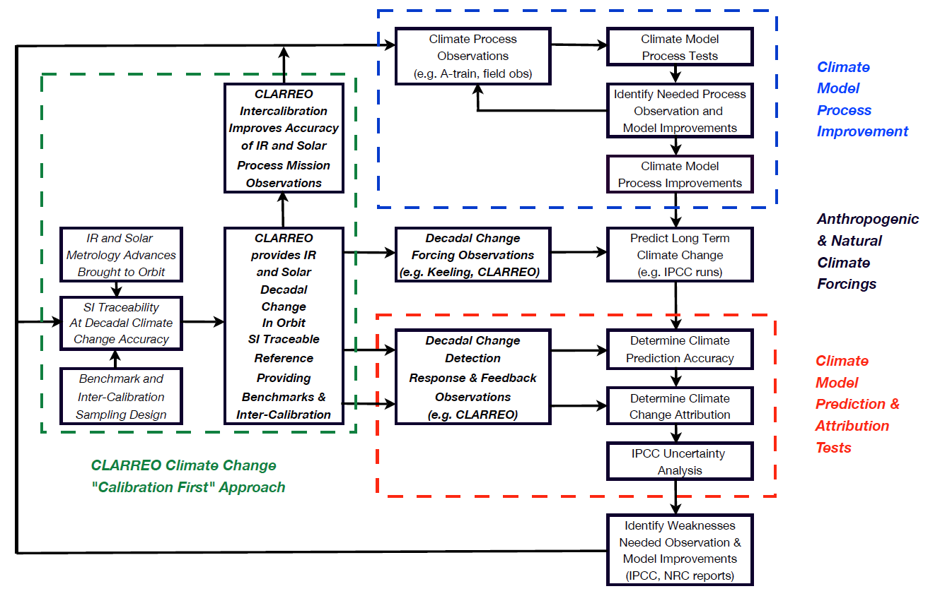
Climate Science and Observations
Process Inter-calibration
CLARREO
Climate Change
Calibration 1st
Approach
Climate Benchmarks
IPCC Uses 5yr running mean climate data
2 - 9

Slide 10
Outline
Climate model tests: base state vs decadal change
Decadal change accuracy (uncertainty) requirements
Climate Observing System Simulation Experiments (OSSEs)
Uncertainty budgets for decadal change
Detecting feedback decadal signals vs climate noise
Conclusions

Slide 11
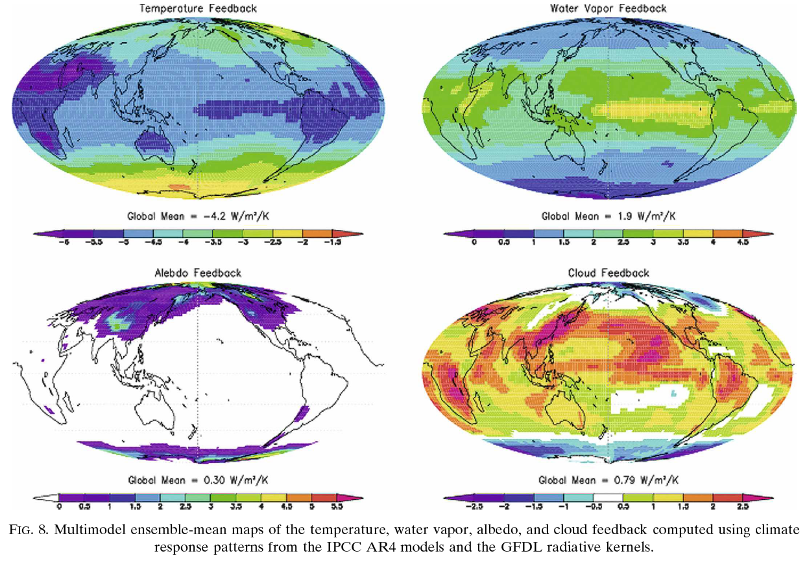
Climate Feedbacks are Large Scale
Temperature Feedback
Water Vapor Feedback
Global Mean = -4.2 W/m²/K
Global Mean = 1.9 W/m²/K
Albedo Feedback
Cloud Feedback
Global Mean = 0.30 W/m²/K
Global Mean = 0.79 W/m²/K
Soden et al.
2008

Slide 12
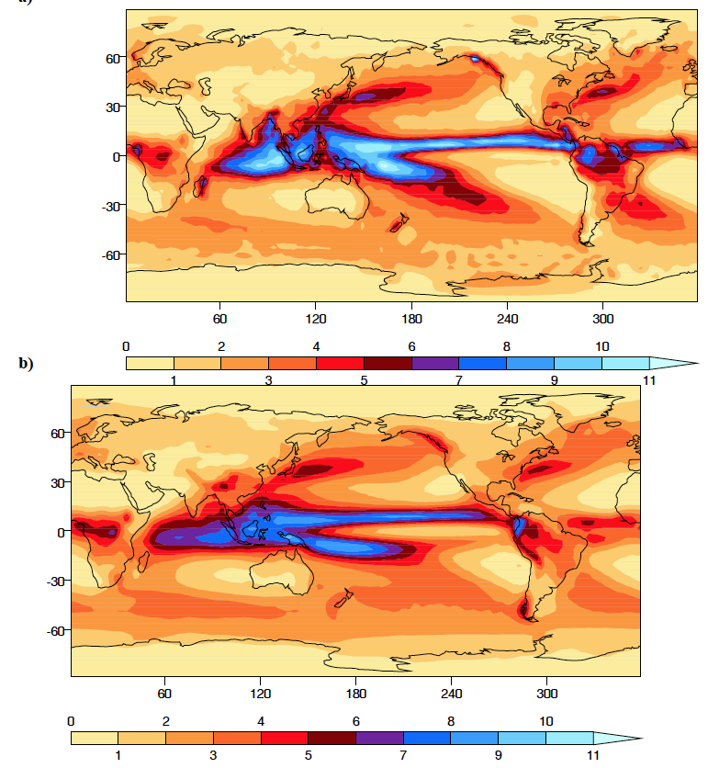
Annual Mean Precipitation Rate (mm/day)
Satellite Observed
Climate Model
Ensemble Mean
IPCC, 2007

Slide 13
Climate Model Testing
The most common method of testing climate model accuracy is to compare a global gridded map for the mean climatology of a single climate variable: e.g. surface air temp, precipitation
Mean climatology testing is useful but is not a direct test of decadal climate change prediction accuracy
  Consider the analogy of weather prediction: would mean climatology tests be a good predictor of weather prediction accuracy?
  Attempts to use EOFs of disagreement in mean climate fields for climate model Perturbed Physics Ensembles failed to narrow the uncertainty in climate sensitivity to better than current IPCC range of ~ 2 to 6C global temperature change for doubled CO₂.

Slide 14
Climate Model Testing
Wielicki and Hu used 2500 of the climateprediction.net simulations of normal and doubled CO2 to examine the ability to use observed minus climate model mean state as a predictor of differences in climate sensitivity.
  Model J vs Model I is analogous to Model J vs Earth Observations
  Use of base state climatology metrics were very nonlinear and were not robust: failed when applied to IPCC models
  Use of climate change metrics was more accurate, very linear, and worked for IPCC models as well.
Radiative Kernel approach (e.g. Soden et al., 2008) demonstrates that climate sensitivity can be understood as a linear combination of feedbacks if decadal change is used.

Slide 15
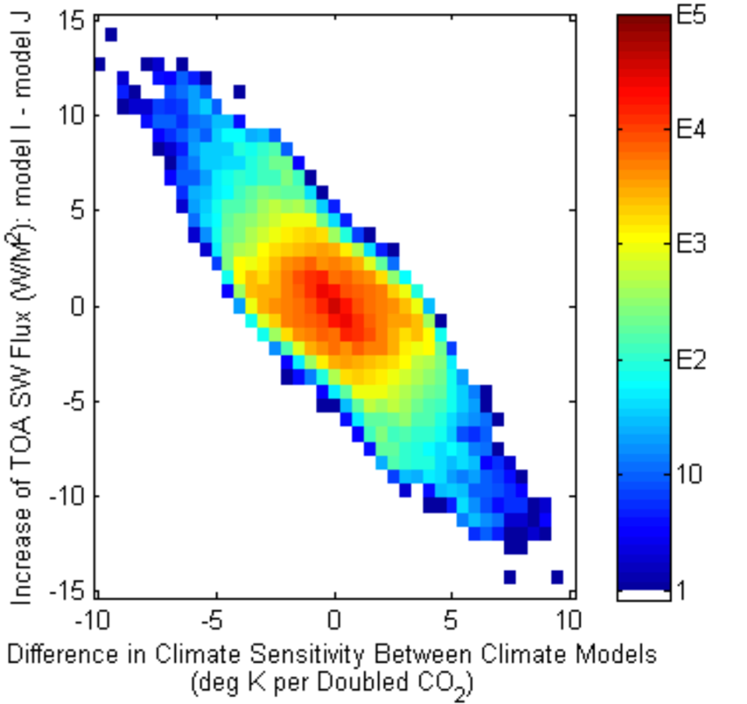
Decadal Change of Reflected Solar Radiation and Climate Sensitivity
Yongxiang Hu
NASA Langley
Change in global reflected solar radiation as a measure of cloud feedback

Slide 16
Climate Model Testing
The most powerful tests of climate model prediction accuracy will be decadal change observations.
How long a record is needed?
What variables are key?
What accuracy in the observations is required?

Slide 17
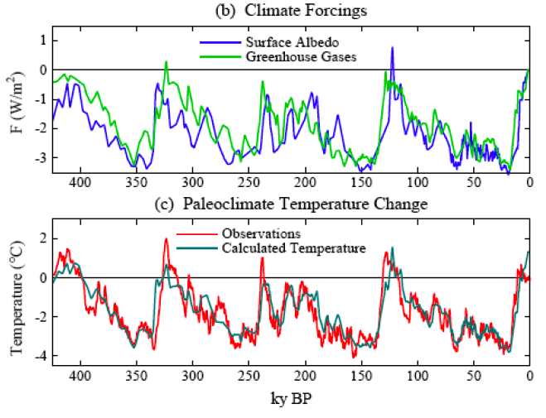
How Long a Record?
Hansen, 2007
400,000 Year Ice Sheet Records of CO₂, Glacier Coverage, Temperature

Slide 18
Paleo Vs Modern Observations
Paleontological data will play an increasingly large role in estimating at least the average sensitivity of the Earth's climate system.
  Uncertainties remain in relating local temperature changes (e.g. ice cores) to global temperatures
  Uncertainties remain in separating multiple effects on isotope analyses (e.g. ocean sediment cores that go back to 100 million years), but improvements are underway
  Largest issue is the limited number of climate variables that can be tested: sea level, temperature, CO₂/methane, ice sheet extent.
  Limited ability to observe precipitation/drought, vegetation
  Almost no ability to observe clouds, radiation, water vapor
Modern data can provide much more complete observational tests, but over much more limited record length: a few decades.
Both methods will continue to be effective independent tests and both will be needed to obtain high confidence in climate predictions.

Slide 19
Determining the Accuracy of Decadal Change Trends and Time to Detect Trends
A perfect climate observing system is limited in trend accuracy only by climate system natural variability (e.g. ENSO) (Leroy et al, 2008).
Degradation of accuracy of an actual climate observing system relative to a perfect one (fractional error F_{a} in accuracy) is given by:
F_{a} = (1 + Σf ²_{i})^{1/2} - 1 , where f ²_{i} = σ ²_{i} τ_{i} / σ ²_{var} τ_{var}
for linear trends where σ is standard deviation, τ is autocorrelation time, σ_{var} is natural variability, and σ_{i} is one of the CLARREO error sources.
Degradation of the time to detect climate trends relative to a perfect observing system (fractional error in detection time F_{t}) is similarly given by:
F_{t} = (1 + Σf ²_{i})^{1/3} – 1
Degradation in time to detect trends is only 2/3 of degradation in accuracy.
Provides an integrated error budget across all decadal change error sources

Slide 20
Decadal Change Trends
The accuracy of decadal change observations is required only at large time and space scales such as zonal annual, not at instantaneous field of view. Therefore all errors in the error budgets are determined over many 1000s of observations: never 1, or even a few.
Climate change requirements are very different than a typical NASA Earth Science process mission interested in retrievals at instantaneous fields of view at high space/time resolution.
So what accuracy relative to a perfect observing system is needed?

Slide 21
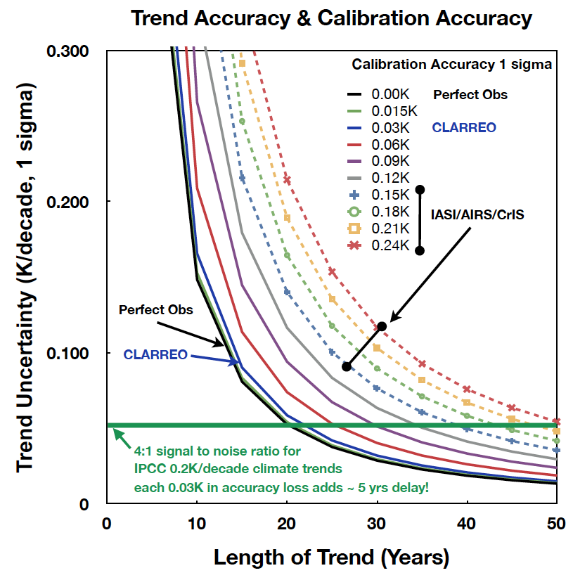
Requirement is to be within 20% accuracy of an ideal climate observing system: IR
Example for Global
Temperature Trends
CLARREO accuracy goals
are optimal cost/value
High confidence critical
for policy decisions
CLARREO accuracy
designed to provide
that confidence.
Climate Change Accuracy is Critical to Making Difficult Policy Decisions

Slide 22
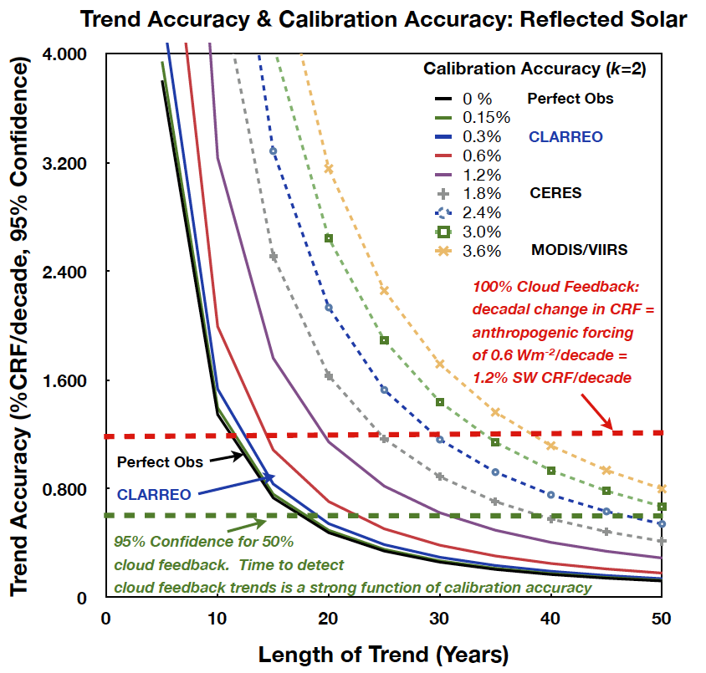
Requirement is to be within 20% accuracy of an ideal climate observing system: RS
Example for Decadal
Change in SW Cloud
Radiative Forcing (global)
All major error sources
included:
absolute accuracy
assumes gaps occur
orbit sampling (90 deg)
instrument noise
reference intercalibration
uncertainty (CERES).
Climate Change Accuracy is Critical to Making Difficult Policy Decisions

Slide 23
CLARREO Accuracy Requirements
CLARREO instrument absolute accuracy requirements are derived consistent with the goal of achieving accuracy within 20% of a perfect climate observing system, and time to detect trends within 15% of a perfect observing system.
0.1K (k=3) for the IR spectra absolute accuracy required. Driven by natural variability of IR spectra.
0.3% (k=2) for the RS spectra (nadir reflectance) is required. Driven by natural variability of cloud radiative forcing, cloud fraction, cloud optical depth, particle size.
0.03% (k=2) refractivity, consistent with an accuracy of 0.1K (k=3) for temperature profile. Accuracy is for 5km to 20km altitudes.
Achieving SI traceable observations with absolute accuracy at these decadal change levels enables the CLARREO mission to uniquely survive even short gaps in the climate record. Overlap becomes very important for a continuous climate record, but a gap does not break the climate record and cause a "restart".
Instrument Absolute Accuracy set for < 20% Trend Accuracy Degradation

Slide 24
Climate Change OSSEs-
Observing System Simulation Experiments
CLARREO mission requirements have been determined using climate model OSSEs
  GFDL, Canadian, and NCAR climate models
CLARREO mission requirements have been determined using simulations based on existing data sets + radiative transfer theory
  CERES-MODIS, SCHIAMACY-PARASOL, AIRS-IASI, MODIS-CALIPSO-Cloudsat)
A few examples of the modeling OSSE studies follow….

Slide 25
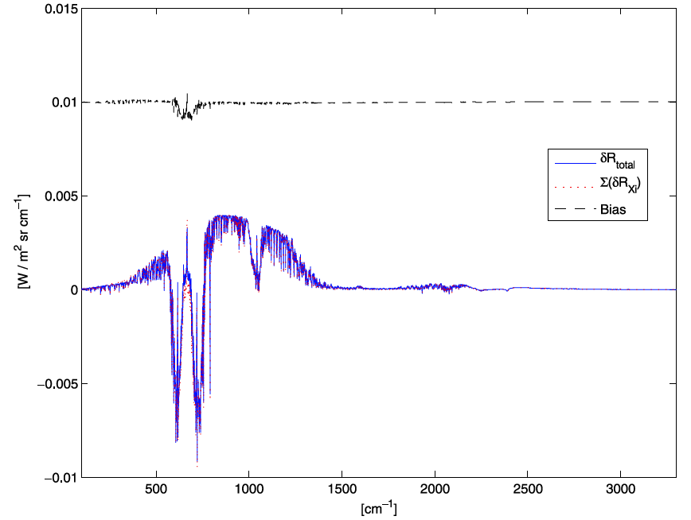
Spectral Decadal Change is Linear
Nonlinear portion of decadal change
Is a few percent of total (offset by 0.01)
Huang et al.
2010
Blue = total of all changes
Red = linear sum of individual
Component changes
Spectral Radiance Change
Doubled CO2 change of all-sky
Global spectral radiance from
T(z), q(z), CO₂, clouds, for the
CFMIP CCCMA coupled climate model
similar linearity
found for
decadal change
of reflected
solar spectra
Jin et al., 2010
20 μm
10 μm
5 μm
Instantaneous changes are nonlinear: decadal change is highly linear

Slide 26
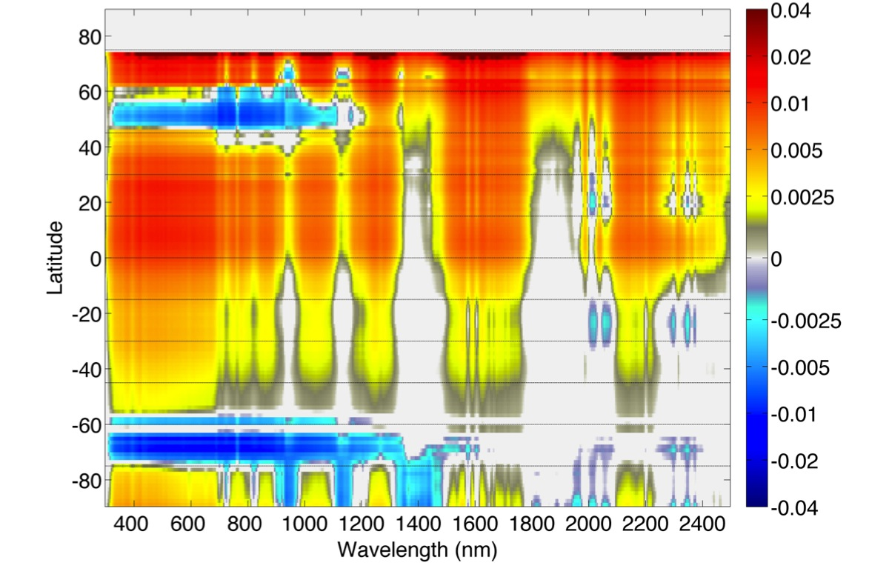
DJF Clear Sky Nadir Refectance Change: 2030s vs 2000s
Natural
Variability
Feldman and Collins, 2011

Slide 27
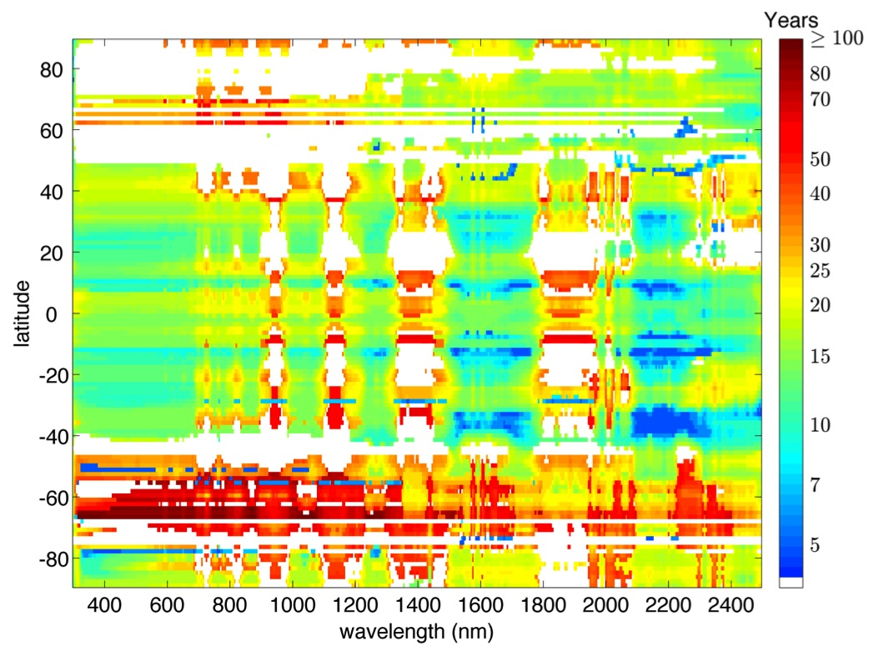
All Sky Time to Detect 95% Confidence Climate Trends
Spectral Nadir Reflectance
Feldman and Collins, 2011

Slide 28
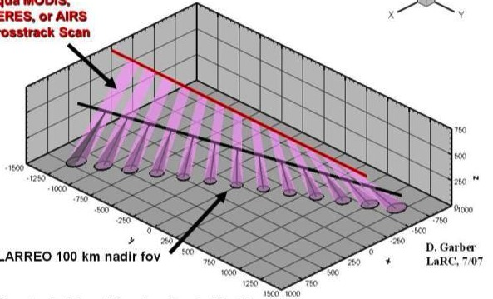
CLARREO as an In Orbit Reference Radiometer
NIST Traceable to 0.1K (k=3) infrared, 0.3% (k=2) solar
Simulations of CLARREO Reference Intercalibration
using orbit crossings show the ability to meet the
climate change accuracy requirements for both
reflected solar (e.g. VIIRS/CERES) and infrared
(e.g. CrIS/IASI)
JPSS VIIRS,
CrIS, or CERES
CLARREO field of view
CLARREO 90 degree orbit enables reference interalibration in all climate regimes

Slide 29
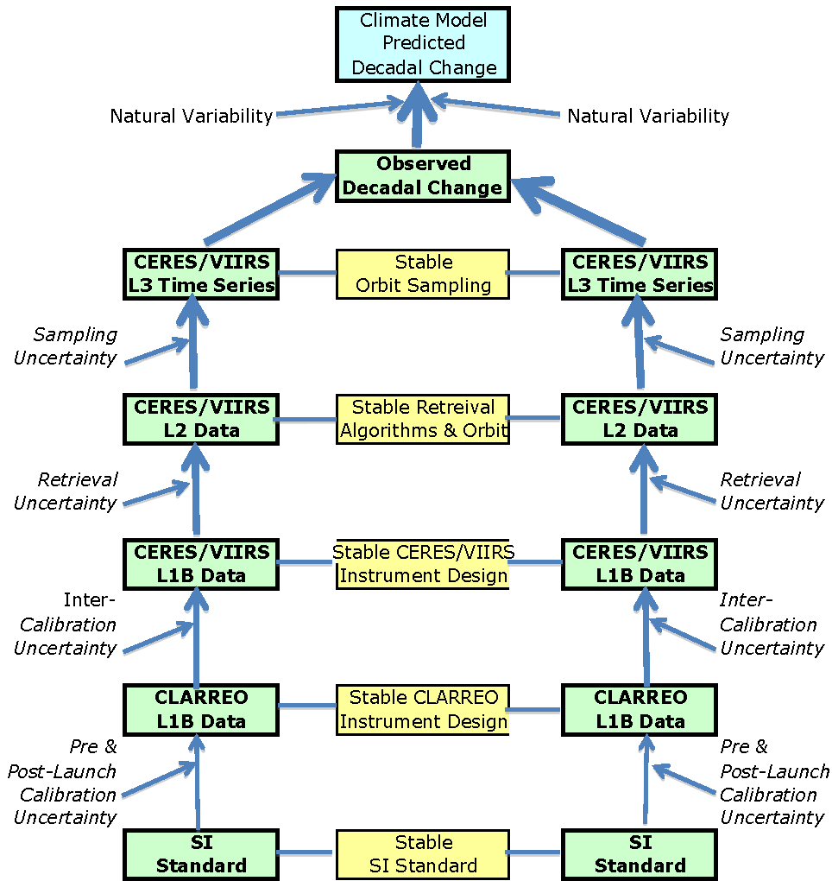
Decadal Change Reference Intercalibration Benchmarks: Tracing Mission Requirements
Climate OSSEs
Data, models
Orbit Sampling
Simulations
Retrieval Bias
Simulations
Intercalibration
Simulations
Instrument
Design Studies
IIPs, NIST
DECADE 1
DECADE 2

Slide 30
Regional vs Zonal vs Global Change
Anthropogenic climate change signals must be detected against the noise background of natural variability (e.g. ENSO).
To first order for climate trends: noise drops as (ΔT)^{3/2} where the linear drop is from anthropogenic signal increase, and the square root drop is from reduced noise from natural variability.
While climate signals can be larger at zonal or regional scales: so is climate noise. For example from CERES data:
  0.3 Wm⁻² global annual SW flux (1σ)
  0.8 Wm⁻² zonal annual SW flux (1σ)
  2.2 Wm⁻² regional (10 lat by 30 lon) regional SW flux (1σ)
What matters for climate change detection/attribution is the ratio of climate signal to climate noise.
Recent example for cloud feedback from Dessler, Dec 10, 2010 Science: ENSO variations dominated feedback uncertainty for 10 year record. Short term cloud feedback was not equal to long term cloud feedback (decadal)

Slide 31
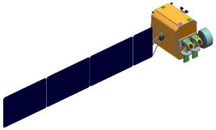
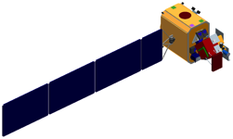
CLARREO Mission Status
Infrared/RO Observatory
Reflected Solar Observatory
Small instruments and observatories (< 1/4th of Terra or Aqua)
Focused on high absolute accuracy SI traceability for decadal change:
overlap not required
Full infrared spectrum (5 to 50 μm, 0.5 cm⁻¹ unapodized spectral resolution)
Full reflected solar spectrum (320 – 2300nm, 8nm resolution)
GNSS Radio Occultation
Provide climate change spectral fingerprints for model testing
Provide reference radiometer in orbit to calibrate operational
instruments such as CrIS, IASI, VIIRS, AVHRR, CERES, geo.
90 degree orbit precesses through full diurnal cycle in 6 months
Climate OSSEs, Reference Intercalibration simulations, and orbit
sampling show entire system can meet climate change accuracy goals
Currently in Extended Pre-phase A science/engineering studies

Slide 32
Accuracy is King:
Critical for decadal change observations
The Emperor has No Clothes:
We have no decadal change climate observing system: need to design/implement one
The Holy Grail is in Sight:
Climate OSSEs for observing system design, leading to diverse, independent, high accuracy tests of climate predictions

Slide 33
Looking under the Lamp Post
Measurement has too often been the leitmotif of many investigations rather than the experimental examination of hypotheses. Mounds of data are collected, which are statistically decorous and methodologically unimpeachable, but conclusions are often trivial and rarely useful in decision making. This results from an overly rigorous control of an insignificant variable and a widespread deficiency in the framing of pertinent questions. Investigators seem to have settled for what is measurable instead of measuring what they would really like to know.
- Edmund D. Pellegrino. 'Patient Care—Mystical Research or Researchable Mystique/', Clinical Research (1964), 12, no. 4, 422.

Slide 34
The perspective is not new….
The scientist is not a person who gives the right answers, he's one who asks the right questions.
- Claude Lévi-Strauss, Le Cru et le cuit, 1964
An experiment is a question which science poses to Nature, and a measurement is the recording of Nature's answer.
- Max Planck, Scientific Autobiography and Other Papers, 1949
Scientific principles and laws do not lie on the surface of nature. They are hidden, and must be wrested from nature by an active and elaborate technique of inquiry.
- John Dewey, Reconstruction in Philosophy, 1920

Slide 35
Goals for Calibration and Science
Learn to ask the right questions,
Design observations to clearly hear Nature’s answer,
Enable discovery of Nature’s laws and principles.
The goal is to predict climate change with the high level of confidence and accuracy we need to
improve, inform, and enable societal decisions.

Slide 36
Backup Slides

Slide 37
Societal Benefit | Science Objective | Level 1 Science Requirements | Level 2 Measurement Requirements | Level 2 Mission Requirements
Enable knowledgeable policy decisions based on internationally acknowledged climate measurements and models through: - Observation of high accuracy long-term climate change trends - Use the long term climate change observations to test and improve climate forecasts. | Highly accurate and SI-traceable decadal change observations sensitive to climate radiative forcings, responses, and feedbacks: | CL.PRJ.REQ.1000 - 1005 Verifiable on-orbit accuracy Traceable to SI standards Decadal trends < 20% of perfect observing system 5 yr record, likely overlap 1 yr | CL.SYS.REQ.2000 Accuracy traceable to the relevant standard and maintained throughout the sensors lifecycle. CL.SYS.REQ.2007 and 2008 Calibrated and validated on-orbit with an SI-traceable system | CL.SYS.REQ.2010 Measurements from platforms in polar orbits: Orbit Period: 5812.4 ± 0.25 seconds (609 km ± 200 m) Inclination: 90± 0.1° Eccentricity: ≤0.001 Ground Track Repeat Cycle: 60.83 days (903 distinct paths) Ground Track Error: ±20.0 km cross track at ascending node from target ground track established by the 60.83 day ground track repeat cycle. NOTE Orbit Definition considers science sampling requirements and reference intercalibration requirement
 | Infrared spectra temperature and water vapor feedbacks cloud feedbacks decadal change of: Temperature profiles Water vapor profiles Clouds, radiative fluxes GHG radiative effects | CL.PRJ.REQ.1006 Infrared radiance spectra of the Earth and its atmosphere with: Spectral coverage 200 – 2000 cm⁻¹ Spectral resolution 0.5 cm⁻¹ unapodized Systematic error that corresponds to ≤ 0.1 K radiance calibration uncertainty (k=3) | CL.SYS.REQ.2001 and 2005 Measure the Infrared Spectra: Spectral range 200 – 2000 cm⁻¹ Spectral resolution 0.5 cm⁻¹ unapodized GIFOV no less than 25 km Ground sampling interval no greater than 200 Systematic error ≤ 0.100 Kelvin (k=3)
 | Solar reflected spectra cloud feedbacks snow/ice albedo feedbacks decadal change of: Clouds Radiative fluxes Snow cover, sea ice, land use | CL.PRJ.REQ.1007 Solar spectral reflectance of the Earth and its atmosphere relative to the solar irradiance spectrum with: Spectral coverage 320 to 2300 nm Spectral resolution (8 nm) Absolute uncertainty ≤ 0.3% relative to global mean reflected solar energy (k=2) | CL.SYS.REQ.2002 and 2006 Measure the Solar Reflected Spectra: Spectral range 320 – 2300 nm Spectral sampling 4 nm, resolution 8 nm GIFOV ≤0.5 km by 0.5 km in nadir view SNR > 33 for 380 to 900 nm, >20 elsewhere, for 0.3 reflectance, solar zenith angle 75° Swath width ≥ 100 km Polariz. sens.<0.5% (k=2) <1000nm, else <0.75% (k=2) >1000nm, Radiometric calibration uncertainty ≤0.3% of albedo and within individual bands Angle variation <25%, knowledge <10% IFOV Geolocation knowledge <1 km on ground Match RI sensors’ view <5 min and <1 deg
 |  |  |  | CL.SYS.REQ.2100 Observations made from Earth orbiting observatories
 | GNSS-RO decadal change of temperature profiles | CL.PRJ.REQ.1008 Atmospheric refractivity with: Annual means in 10º latitude zones Uncertainty of 0.03% (k=1) for 5-20 km altitude in these zones | CL.SYS.REQ.2003 Measure the phase delay rate of GNSS transmitted signal occulted by the atmosphere: Altitudes 5-20 km Uncertainty ≤0.5 mm/sec CL.SYS.REQ.2004 Measure averaged microwave refractivity: Over 1 year 10° latitudinal zones, over all longitudes, Altitudes 5–20 km Uncertainty ≤0.03% in these zones
 |  |  |  | CL.SYS.REQ.2103 Consumables for 5 years
 | Reference inter-calibration Broadband CERES Operational sounders (e.g. CrIS, IASI) Operational imagers (e.g. VIIRS, AVHRR, Landsat) | CL.PRJ.1.REQ.1009 Provide data to climate relevant operational sensors that will be used to improve the accuracy of their measurements.

Slide 38
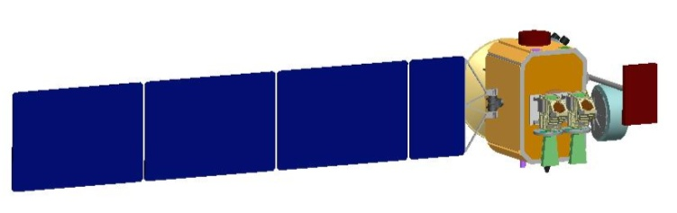
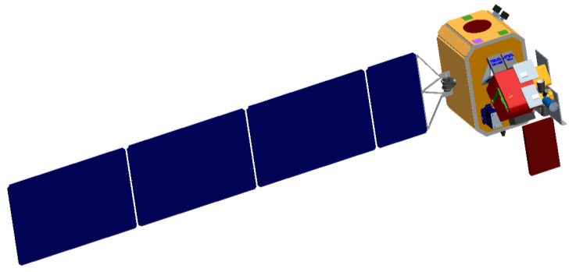
Mission Architecture
  CLARREO Observatories:
    Four small observatories (~ 370 kg each)
      Two Infrared Observatories with GNSS-RO
      Two Reflected Solar Observatories with GNSS-RO
    Observatories will be configured around a small, common spacecraft bus to reduce cost
    Observatories are compatible with Falcon 1e, Athena, Taurus XL, and Minotaur IV
  Launch Schedule
    2017: Infrared Observatory
    2019: Reflected Solar Observatory
    2020: Both observatories dual-manifested
    Mission concept assumes a Minotaur IV launch vehicle for all launches
  Orbit Parameters:
    Altitude: 609 km
    Inclination: 90° (polar)
Reflected Solar Observatory
Infrared Observatory

Slide 39




Orbit Selection
Orbit Parameters:
Mean Altitude = 609 km (61-day ground track repeat cycle)
Period = 5812.4 ± 0.25 secs (orbit maintenance requirement)
Inclination = 90°
RAAN = 0° or 180° (for reference inter-calibration)
Optimal Observatory Spacing TBD in Phase A
IR and RS Observatories are Paired for Overlapping Measurements
RS
RS
IR
IR

Slide 40
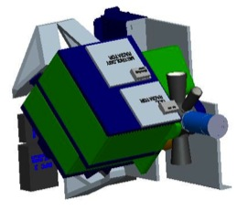
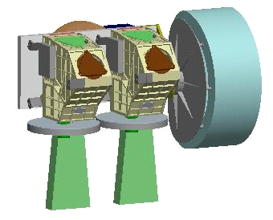
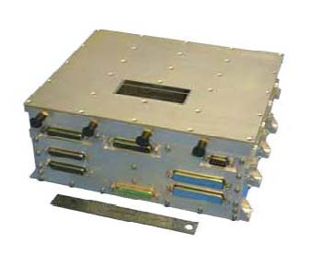
Science Instruments: L2 Requirements
GNSS
Radio Occultation
Receiver
Infrared (IR) Instrument Suite
Reflected Solar (RS)
Instrument Suite
Fourier Transform Spectrometer
Systematic error less than 0.1K (k=3)
200 – 2000 cm⁻¹ contiguous spectral coverage
0.5 cm⁻¹ unapodized spectral resolution
Nadir pointing, systematic within 0.2°
GIFOV: 25 km – 100 km
Consecutive earth view orbit samples ≤ 200 km
NeDT < 10 K (1 σ)
Two Grating Spectrometers with Gimbal-mounted (1-axis)
Systematic error less than 0.3% (k=2) of earth mean reflectance
320 – 2300 nm contiguous spectral coverage
4 nm sampling, 8 nm resolution
GlFOV < 0.5 km by 0.5 km
Swath width ≥ 100km @600 km
Nadir viewing > 90% of the time
S/N ratio > 33 for λ < 900 nm,
S/N ratio > 25 for λ > 900 nm
Polarization sensitivity < 0.5% (k=2) for λ < 1000 nm, < 0.75% (k=2) for λ > 1000 nm
GNSS Receiver, POD Antenna, RO Antennae
Refractivity uncertainty 0.03% (k=1) for 5 to 20 km altitude range
Sampling for annual mean 10 degree latitude zones (1000 occultations/day)

Slide 41
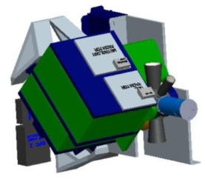
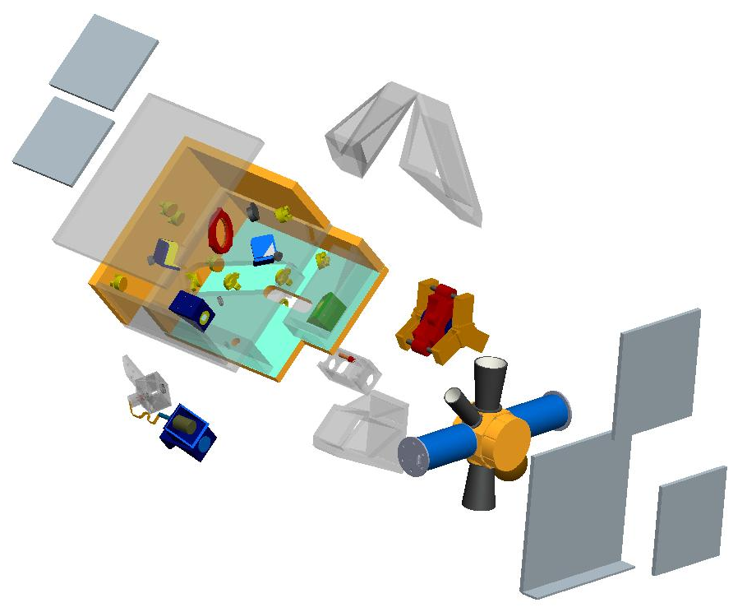
Infrared Interferometer
Instrument Description:
  Fourier Transform Spectrometer
  Calibration obtained through a sequence of on-orbit verification tests for deep well blackbody temperature (phase change cells), emissivity (QCL laser, heated halo), polarization sensitivity, instrument line shape (QCL), tested over 190K to 320K temperature range.
  0.1K (k=3) accuracy is a factor of 3 to 5 improvement over weather spectrometers (e.g. AIRS, IASI, CrIS)
Characteristics:
  Spectral Range: 200 to 2000 cm⁻¹
  Spectral Resolution: 0.5 cm⁻¹ unapodized
  Nadir IFOV: 25km
  Calibration: 0.1K (k=3) for full range of Earth scene temperatures (190 to 320K)
Baseline Instrument Package:
  Fourier Transform Spectrometer
  CBE Mass: 76 kg
  CBE OA Power: 124W
  Dimension (total): 88 x 59 x 59 cm
  Data Rate: ~ 225 kbps, 3 Gbytes/day
  Nadir pointing with internal scene selection
  FOV: 25km

Slide 42
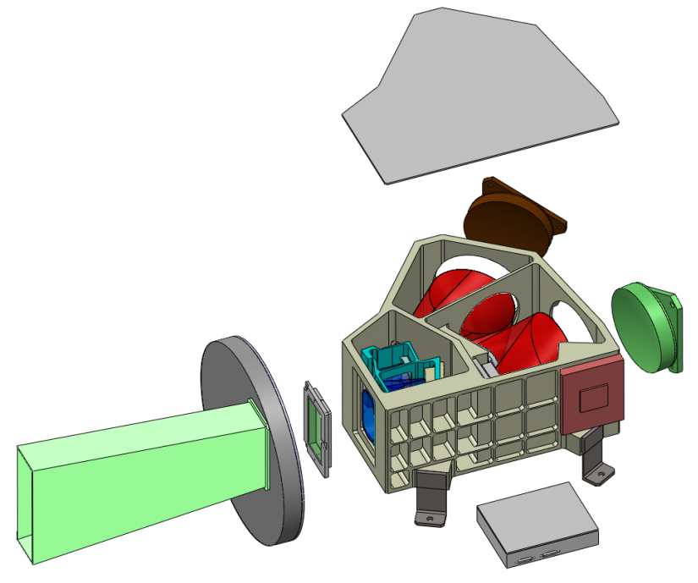
Reflected Solar Spectrometer
Instrument Description:
  Pushbroom grating spectrometers
  Calibration obtained through precision apertures and neutral density filters rotated via filter wheels using monthly lunar and solar views, venus/stars for stray light, as well as NIST SIRCUS characterization
  Field of regard (FOR) needed for Solar-Lunar Calibrations, Inter-calibrations, and Benchmarking achieved with single axis gimbal, spacecraft yaw maneuvers
  Factor of 3 to 6 improvement in calibration over CERES/MODIS/VIIRS
Characteristics:
  Spectral Range: 320 to 2300 nm
  Spectral Sampling/Res: 4 nm/8nm
  Polarization Sensitivity: < 0.25% (k=2)
  IFOV: 0.5km, Swath width 100km
  Pointing Stability: ~ 34 arc sec
  Calibration: 0.3% (k=2) relative for Earth spectral reflectance.
Baseline Instrument Package:
  Two Spectrometers, 67 kg, 96 W total
  Dimension (total): 93 x 40 x 70 cm
  Data Rate:
    Benchmarking: ~ 13 Gbytes/day
    Intercalibration: ~17 Gbytes/day
    Solar-Lunar Calibration: ~ 70 Gbytes/month

Slide 43
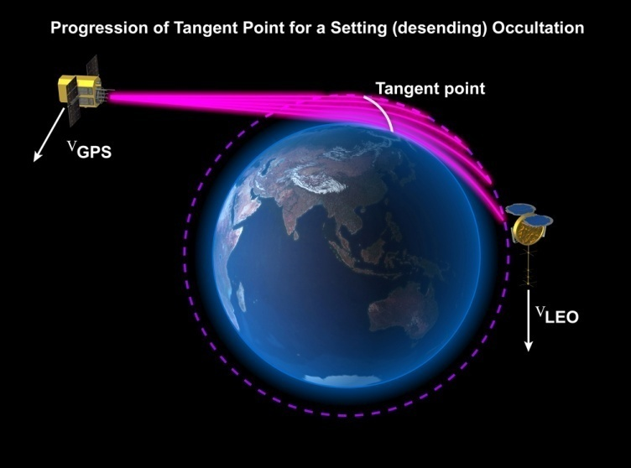
GNSS Radio Occultation Measurements
  Radio occultation of GNSS signals used to derive atmospheric refractivity
  Accuracy is attained through a direct link to the SI standard of time
  Provides critical information on temperature, pressure, and humidity profiles to address temperature lapse rate feedbacks, temperature response, and remove ambiguities in IR all-sky spectra optimal fingerprinting
  natural variability drives the 0.03% (k=1) refractivity requirement.
  0.03% (k=1) refractivity drives the +/- 0.5 mm/sec (k=1) phase delay rate uncertainty
  1000 profiles/day
SI Traceable Accuracy in Refractivity Equivalent to 0.1K (3σ)

Slide 44
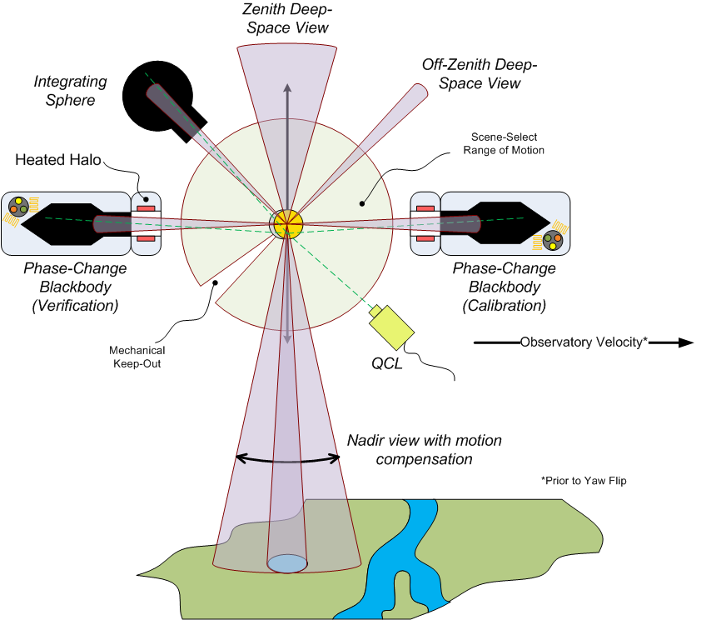
IR On-orbit Verification
Instrument Line
Shape (ILS)
(perpendicular to Beam-splitter polarization axis)
“Ambient” BB
SI Traceable Accuracy 0.1K (k=3) all Earth Scene Temps (190 to 320K)

Slide 45
RS Operating Modes
Nadir spectral reflectance benchmarking, calibration and inter-calibration requirements lead to three basic operating modes
  Solar Calibration (varying modes, overall 1/month)
  Lunar Calibration (constant lunar phase angle, 1/month)
  Benchmarking Nadir Data Collection (95%)
  Inter-calibration of LEO/GEO assets (avg. 1 per orbit, 3 to 5% of instrument operations)

Slide 46
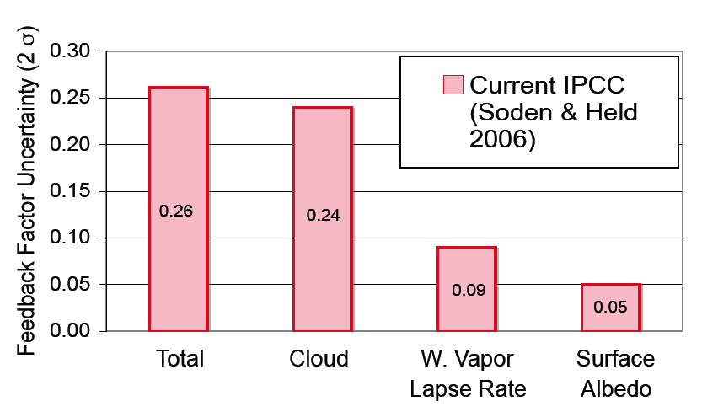
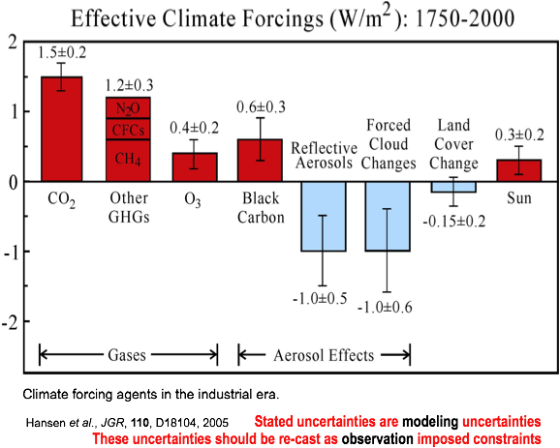
Science Impact
Climate Sensitivity uncertainty is
driven by uncertain Feedbacks:
Factor of 3 uncertainty in response to doubled CO2
Relative uncertainty known
Climate Change Response:
Temperature Profile,
Water Vapor Profile,
Cloud Properties,
Surface albedo (snow, sea-ice, land cover)
Radiative Forcings:
Verify greenhouse gas infrared radiation effects
Aerosols advances by GLORY APS and NRC ACE missions.
0.26
0.24
0.09
0.05
Effective Climate Forcings (W/m²): 1750-2000

Slide 47
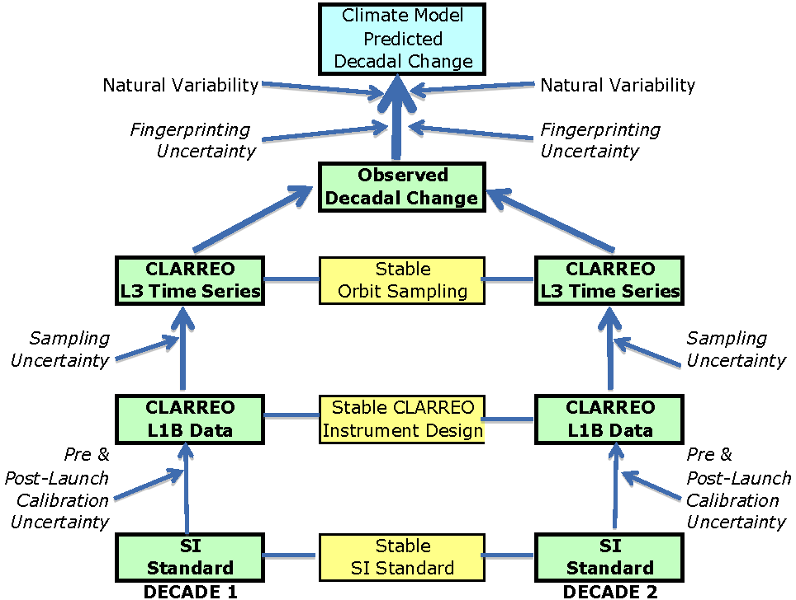
Decadal Change Spectral Fingerprinting Benchmarks: Tracing Mission Requirements
Data, models
Climate OSSEs;
A-train observation +
RTM simulations
Orbit Sampling
Simulations
Instrument
Design Studies
IIPs, NIST

Slide 48
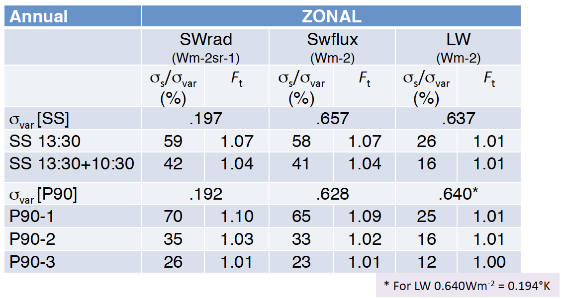
Orbit Sampling Uncertainty
Simulate 74, 83, 90 degree and sunsynch orbits, 1, 2, or 3 of each
Truth data is 6 years of CERES hourly 1 degree grid global data for reflected SW flux and nadir reflectance, infrared window, and LW flux. Subsample with orbits.
Results: sampling errors increase at smaller time/space scales, but so does natural variability, so that accuracy in trends can be met at our large time/space scales
Given CLARREO trend accuracy/time to detect trend goals: one satellite is sufficient. Example below is for Annual zonal: but global, regional, seasonal similar
Table Definitions:
σ_{var} = natural variability
σ_{s} = orbit sampling error
F_{t} = ratio of time to detect climate trends to a perfect observing system limited only by natural variability
P90 = 90 deg inclined orbit
SS = sun-synchronous orbit
SW = shortwave reflected solar radiation (SWrad = nadir radiance, SWflux = angle integrated flux)
LW = longwave emitted infrared radiation
Doelling, Fall AGU, 2009
Single 90 degree orbit meets annual global/zonal/regional diurnal sampling

Slide 49
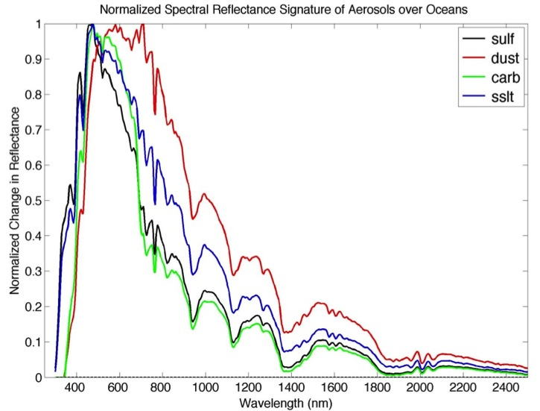
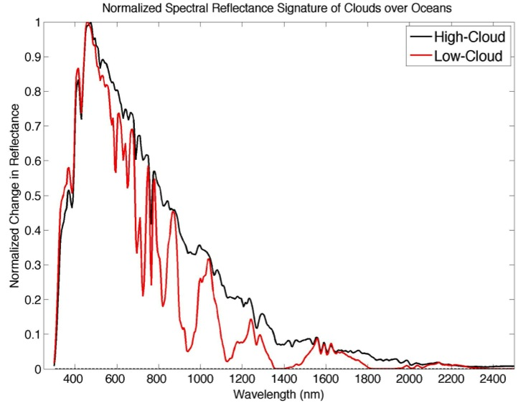
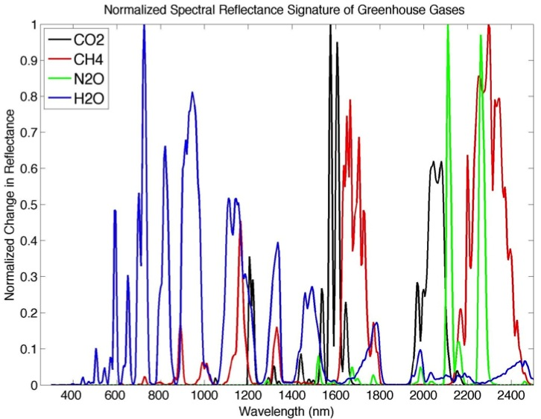
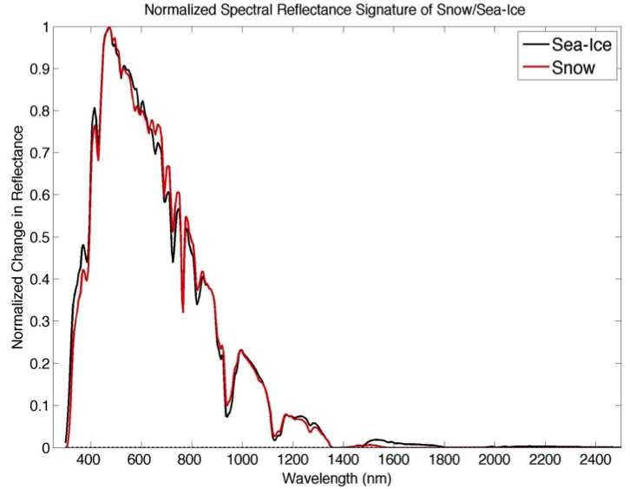
Spectral Signatures of Forcings & Feedbacks
GHG’s: small signals but have sharp and separable signature features.
Aerosols: broadband signatures with some separability by Angstrom exponent.
Clouds: broadband signatures with H₂O lines indicative of cloud height.

Slide 50
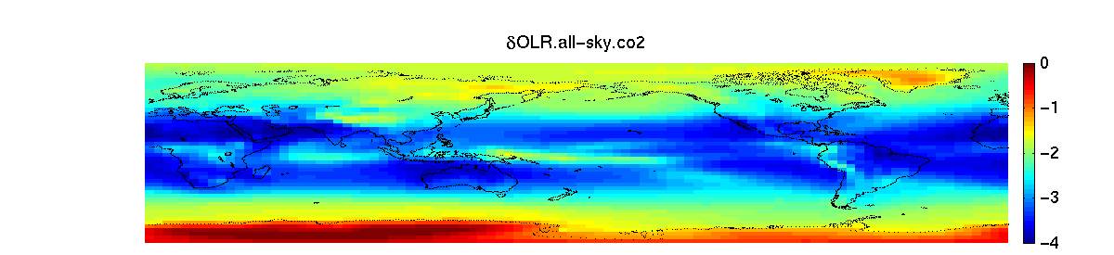
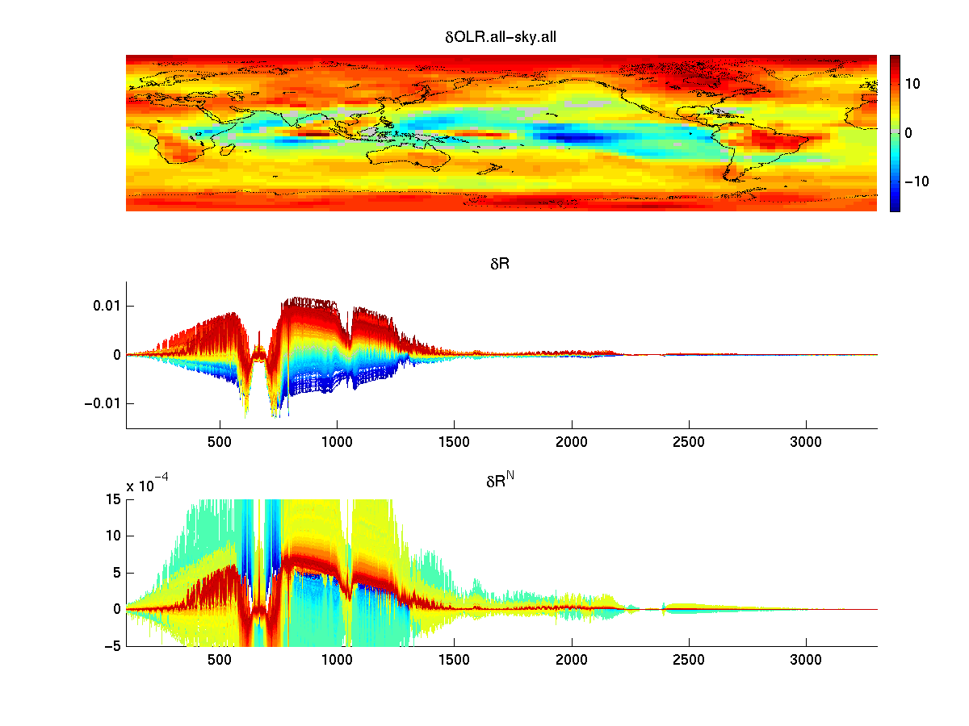
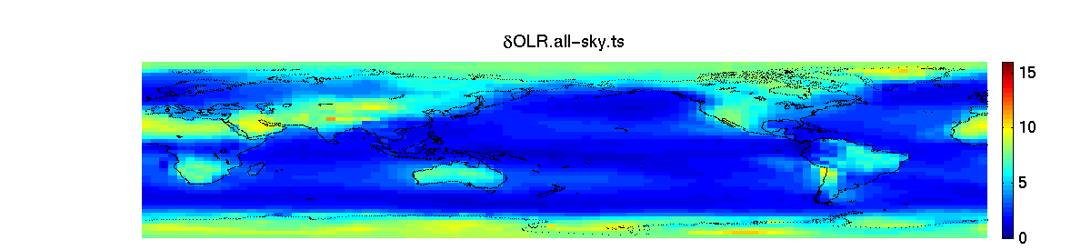
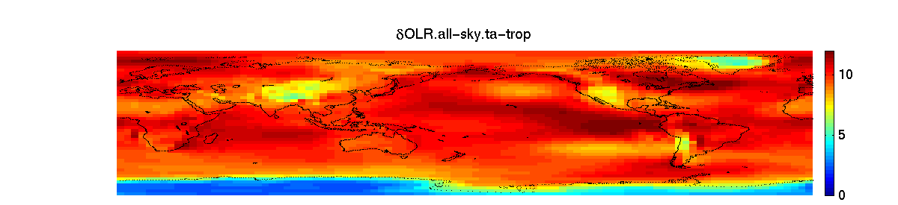
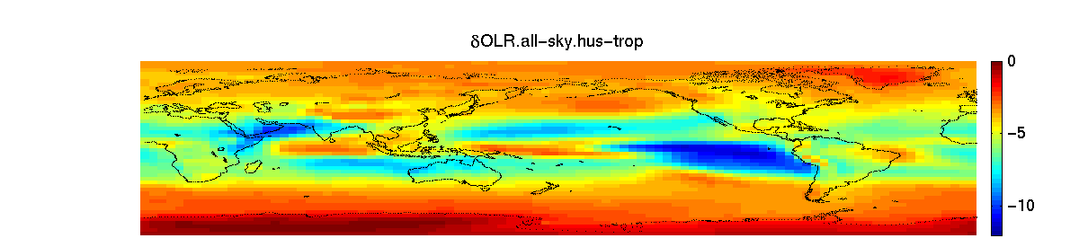
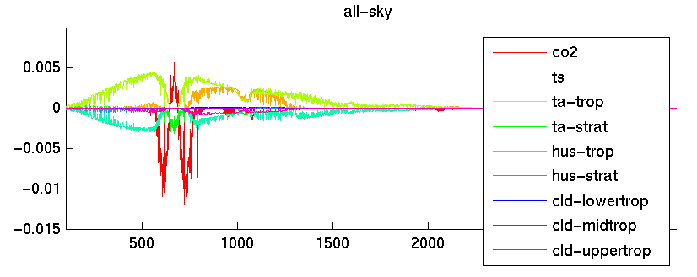
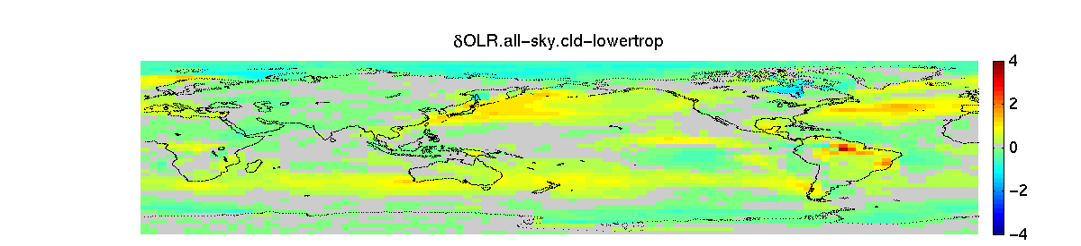
Observable: OLR_{total}, δR_{total} – total change in flux or radiances
Wanted: δOLR_{Xi}, δR_{Xi} – individual contributions
CO2
Surf. Temp.
Atmos. Temp
Water vapor
Linear Regression
Cloud
Huang et al. 2009

Slide 51
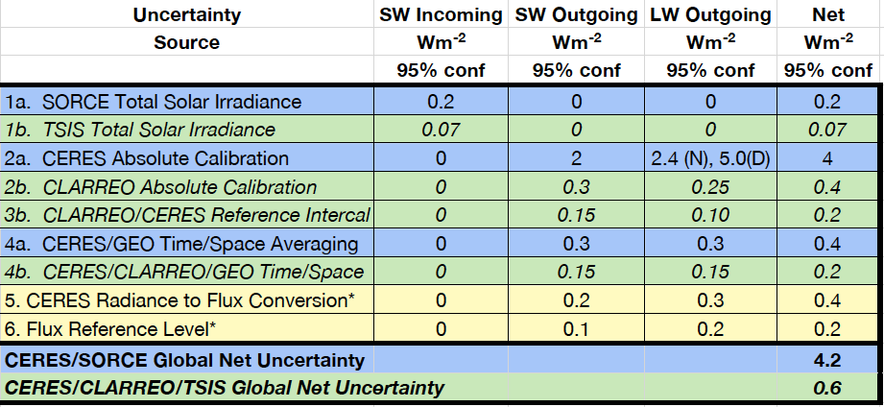
CLARREO & Global Net Flux
Accuracy improvement in absolute global net flux from CLARREO + CERES?
Extend the analysis of Loeb et al. 2008 for global net flux (blue is CERES/SORCE current, green is CERES/CLARREO/TSIS future, yellow is both).
Interannual anomaly uncertainties improve from 0.4 to 0.15
Natural Variability of global annual net flux 0.2 Wm⁻² (95% conf)
factor of 7 improvement in absolute accuracy, factor of 3 for interannual anomaly

