Slide 1
Monitoring atmospheric water vapour at ESO’s Paranal observatory
Florian Kerber (ESO)
Calibration and Standardization of Large Surveys and Missions in Astronomy and Astrophysics
Apr 16-19th, 2012
Fermilab

Slide 2
VISIR upgrade: PWV Monitor
Water vapour monitor installed and commissioned on Paranal (Oct/Nov 2011)
Performance validated: Instrument fully compliant with SoW and Technical specifications
Data will be part of VISIR science header information
Precipitable water vapour (PWV) as user-provided constraint for service mode observing
Tool for characterizing atmospheric properties

Slide 3
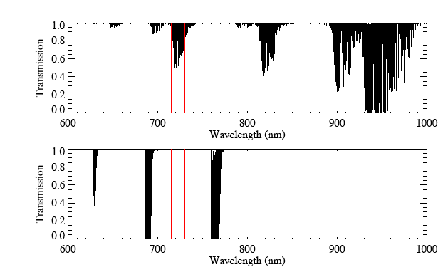
Atmospheric Model: PWV (Univ. Lethbridge)
H₂O only,
PWV = 1 mm
All other
constituents:
CO₂, O₂

Slide 4
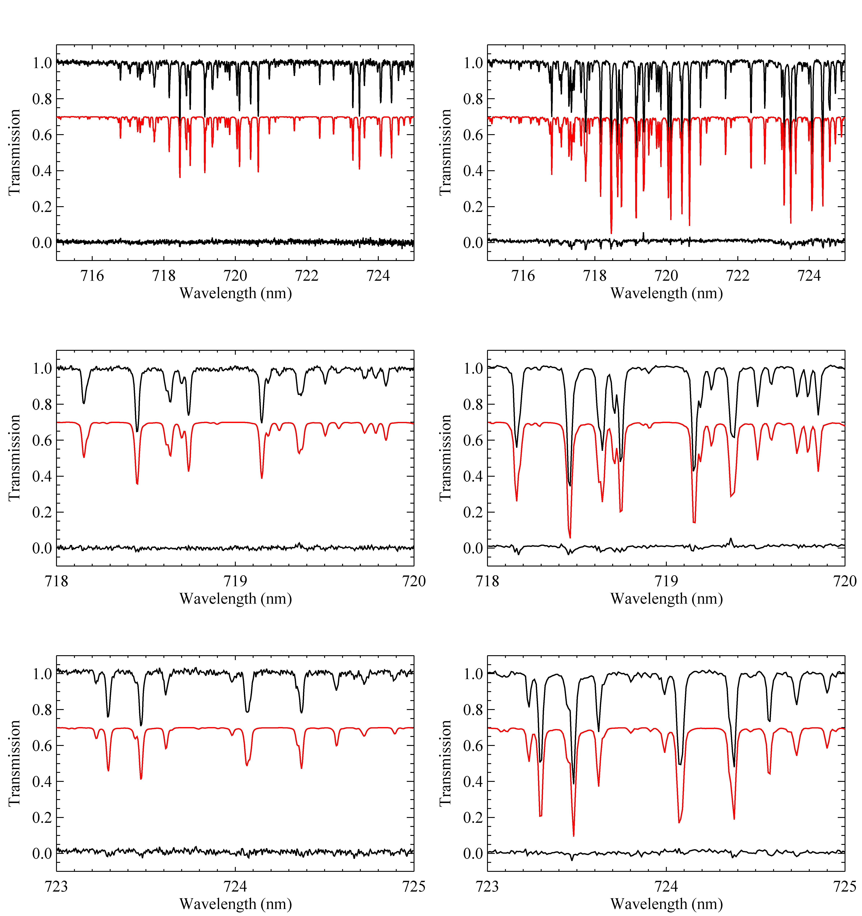
UVES: high resolution echelle optical spectra
Querel et al. 2011

Slide 5
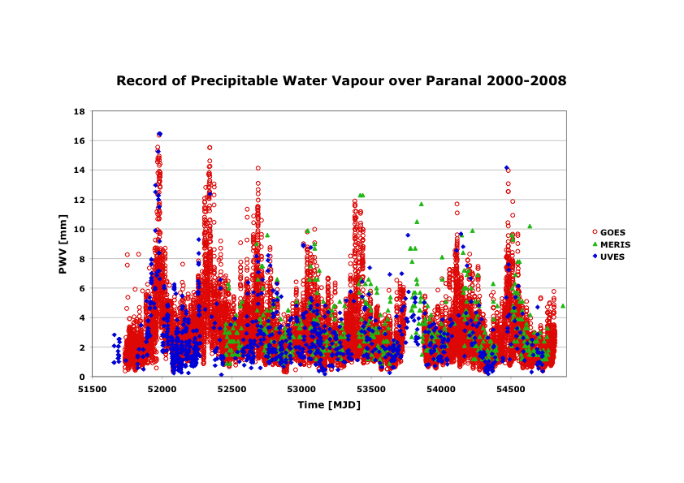
E-ELT site characterisation (2009)

Slide 6
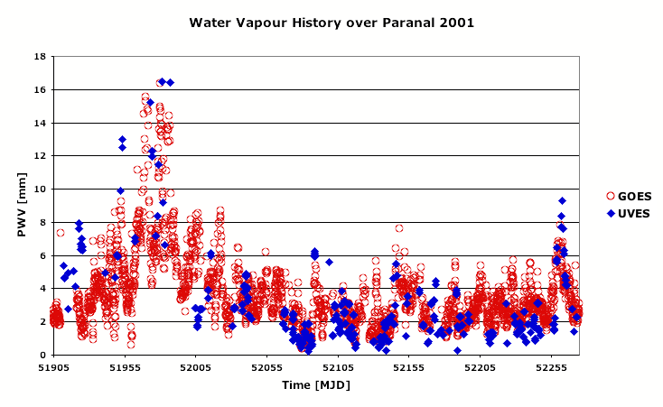
E-ELT site characterisation

Slide 7
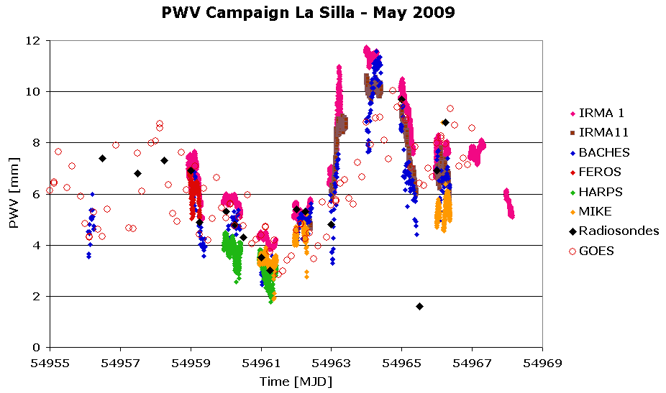
E-ELT site characterisation

Slide 8
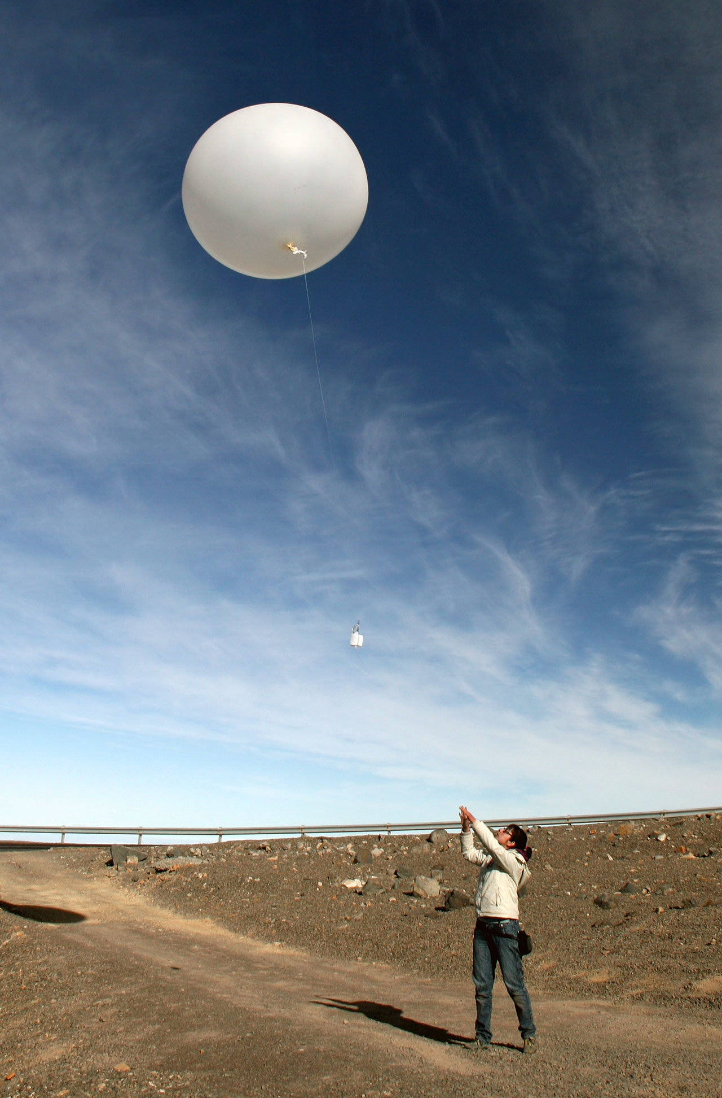
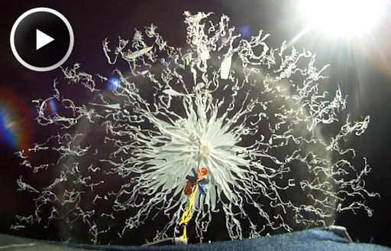
Radiosondes
In-situ measurements:
T, p, relative humidity
2 sec time resolution
trajectory follows wind
duration 1.5 h
up to 25 km

Slide 9
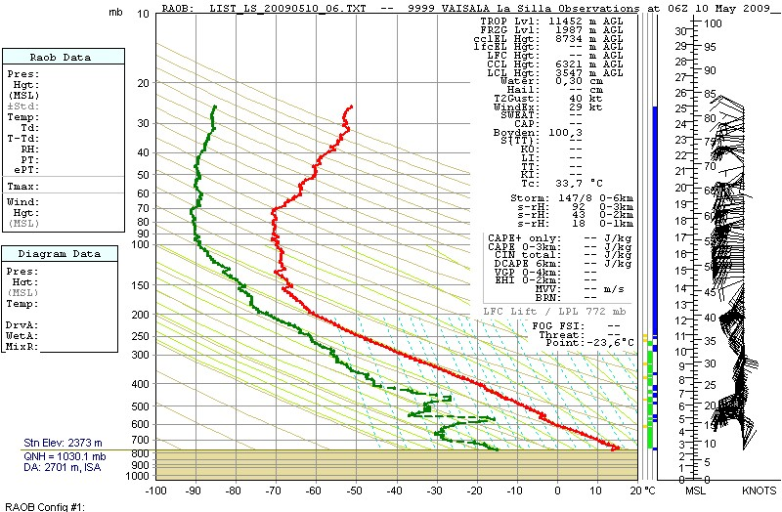
2009-05-10T06:00:00

Slide 10
Comparison with other instruments
IRMA
CRIRES
UVES
VISIR
Kerber et al. 2010 & in preparation

Slide 11
Comparison with other instruments
Satellite Data: fine for site testing,
but not adequate for observatory science operations

Slide 12
Lessons learned
E-ELT site characterisation: La Silla, Paranal, Armazones (in collaboration with TMT)
  Spectroscopy plus atmospheric model works
  10 year history of Paranal reconstructed from archival data
  Remote sensing data only for statistical purposes
Dedicated PWV campaigns
  Validation of methods with respect to radiosondes (standard in atmospheric research)
  Visible/IR instruments: precision 15-20%
  Radiometer: precision 5%

Slide 13
PWV Monitor: requirements
VISIR upgrade
  mid-IR instrument, N (10 μm) and Q (20 μm) band
  Optimise use of periods with low PWV
  Real-time support of science operations
PWV Monitor
  High precision,
  real-time,
  High time-resolution,
  low maintenance,
  absolute calibration,
  stand-alone instrument

Slide 14
PWV Monitor: options
Remote sensing
  Lack of precision, time resolution
  Spatial resolution
Radiosondes
  Expensive, operational load prohibitive
  Cadence
VLT instruments
  Precision, Time resolution and coverage, expensive use of 8 m telescope
GPS
  Precision, real-time

Slide 15
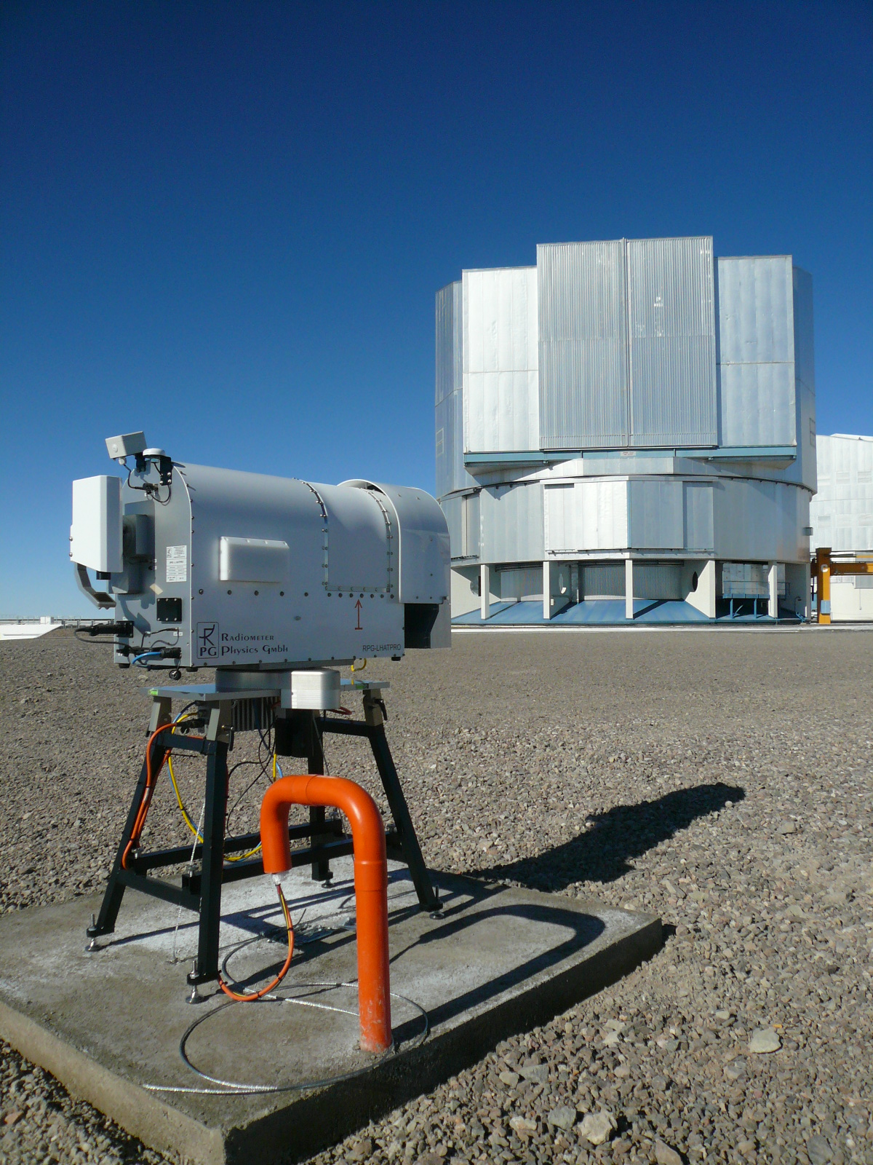
PWV Monitor: options
Radiometers:
  IRMA 20 μm
  22 GHz: range > 3 mm PWV
  183 GHz: range 0-5 mm PWV
  Paranal median: 2.5 mm
Selected: 183 GHz profiling
radiometer (LHATPRO) built by
Radiometer Physics GmbH
(RPG)

Slide 16

LHATPRO
Instrument (commercial product):
  183 GHz, 6 channels (H₂O line, humidity profile)
  58 GHz, 7 channels (O₂ line, temperature profile)
  IR camera 10 μm (sky brightness, cloud detection)
  All-sky pointing capability
  Boundary layer scan
Observing strategy
  Zenith, staring mode
  2-D sky map every 6 h (ELEV 90-30 degrees)
  Cone (Hovmoeller) scan (ELEV 30 degrees)

Slide 17
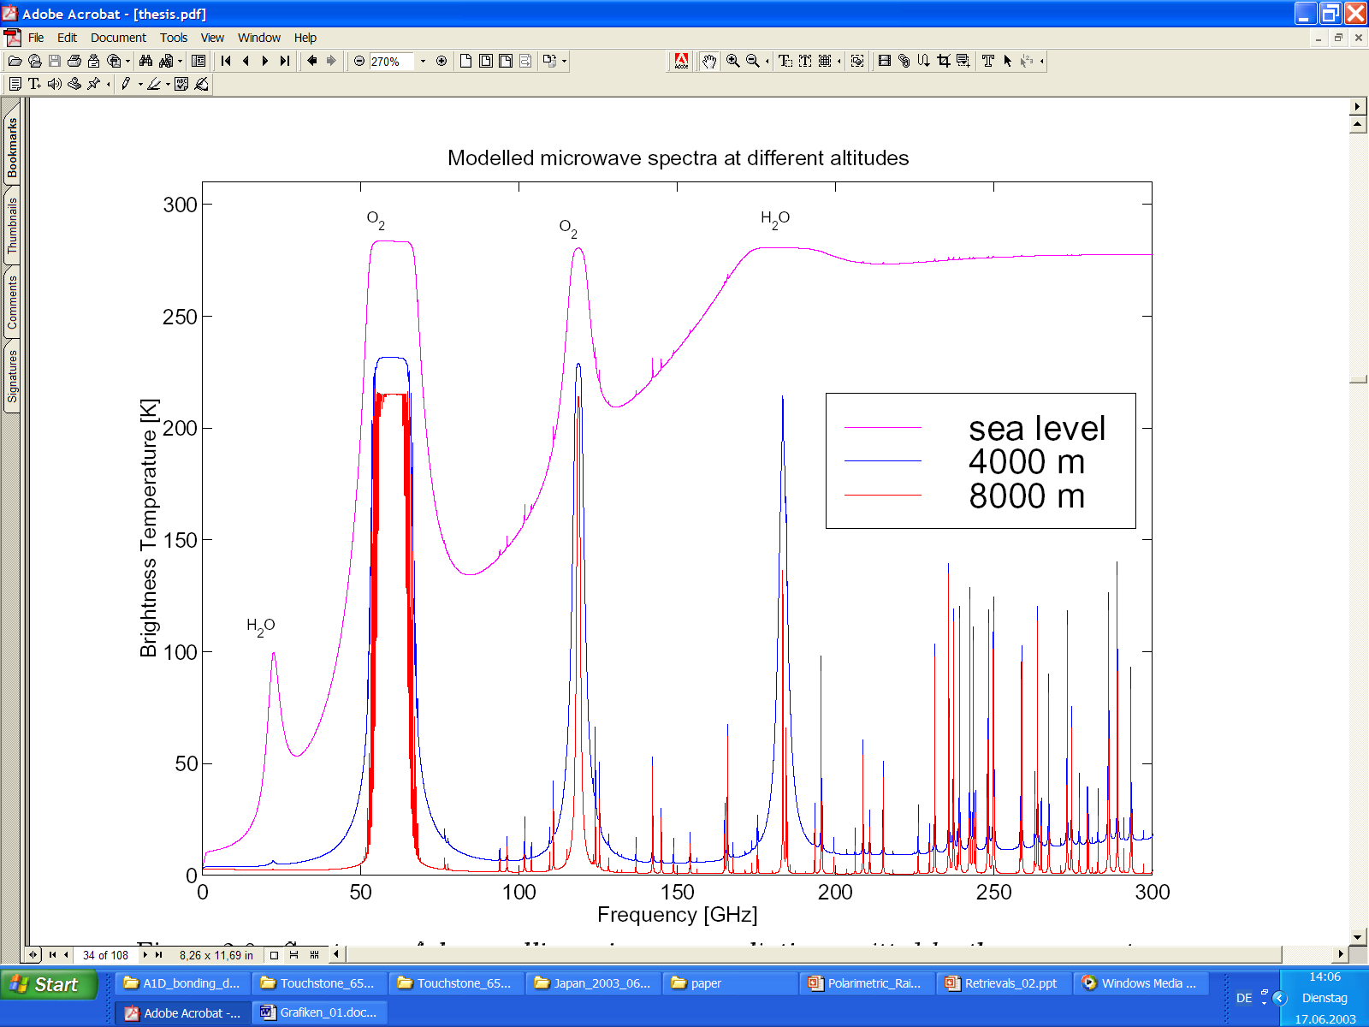
Atmospheric Spectra at Different Altitudes
LHATPRO
IWV = 70 kg / m^2
WVL disappears
Modelled atmospheric attenuation up to 300 GHz for various altitudes (courtesy of Feist, Univ. of Bern).
Courtesy: RPG

Slide 18
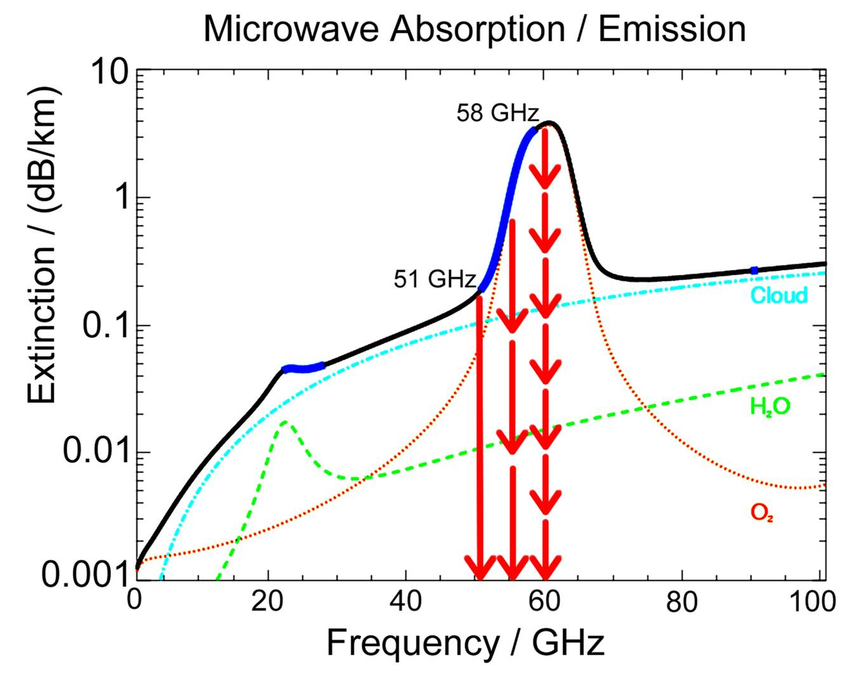
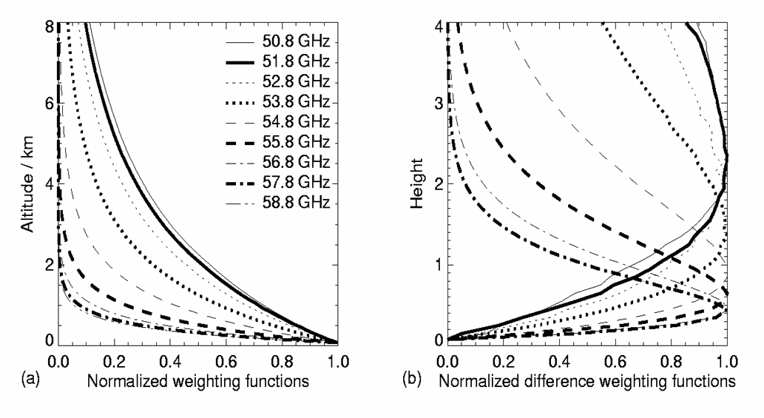
How does the Profiling work?
Freq. Channels:
Humidity Profiling:
183.3 -191.8 GHz
(6 channels)
RPG-HATPRO
Temp. Profiling:
50-59 GHz Band (7 channels)
31.4 GHz
Courtesy: RPG

Slide 19
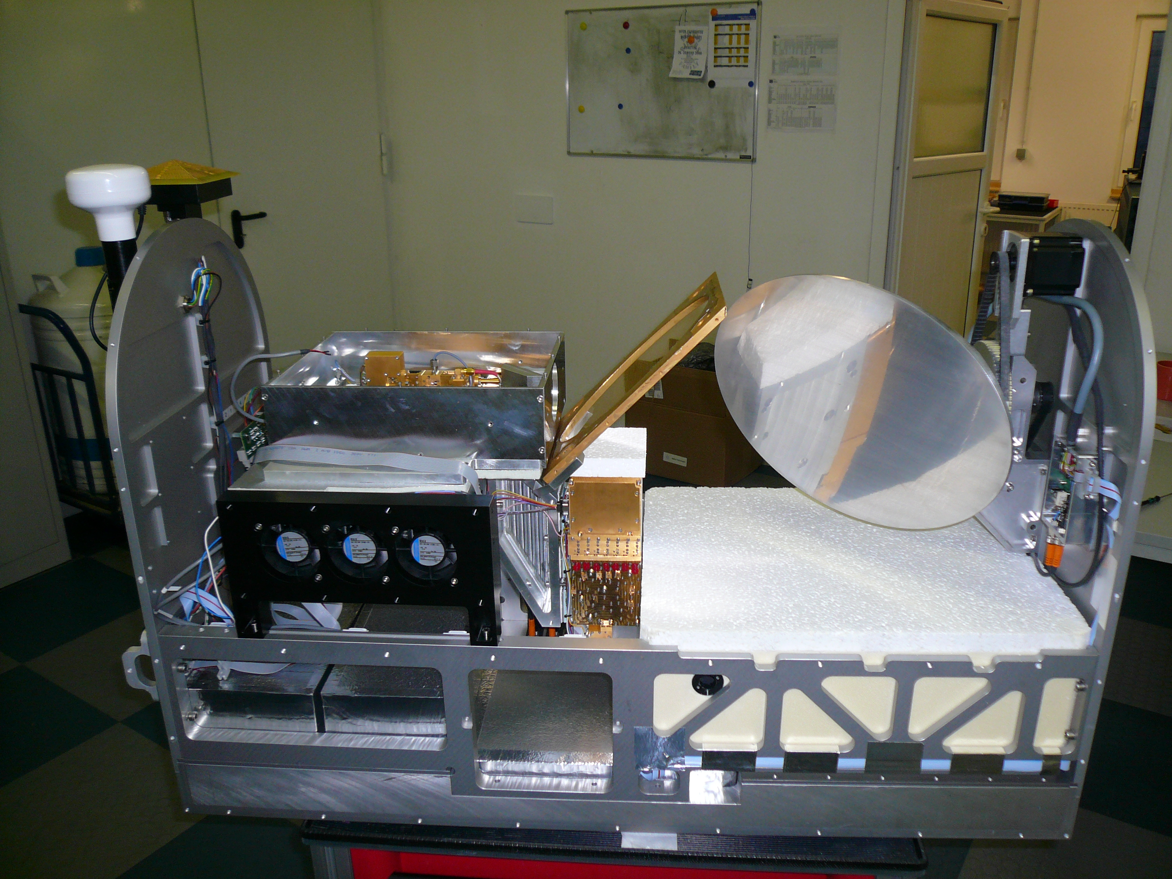
LHATPRO Instrument Configuration
Beam combiner
Scanning parabola mirror
6 channel 183 GHz
WV Radiometer
50-60 GHz temp. profiler
Ambient temp. target
Courtesy: RPG

Slide 20
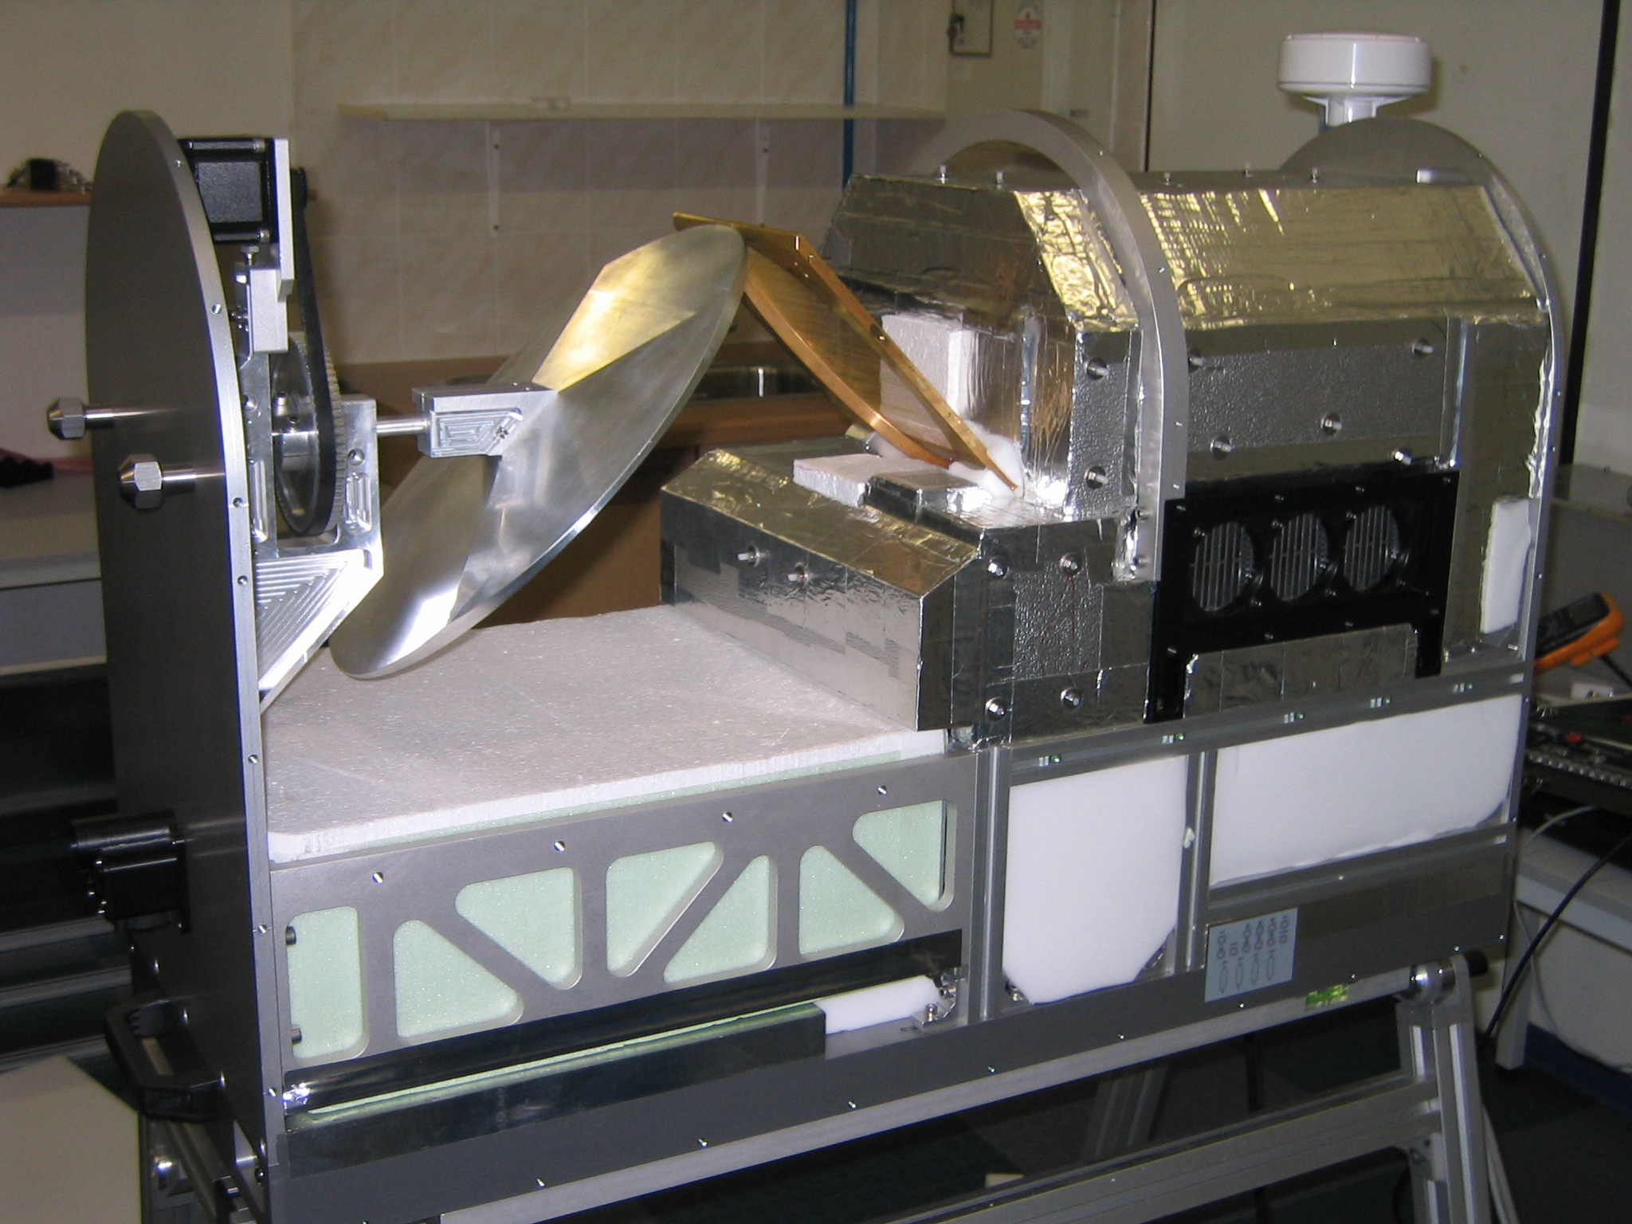
Thermal Receiver Stabilisation
Two stage thermal stabilisation system:
Receiver stabilisation:
<30 mK over full operating temperature range (-50°C to + 45°C)
Courtesy: RPG

Slide 21
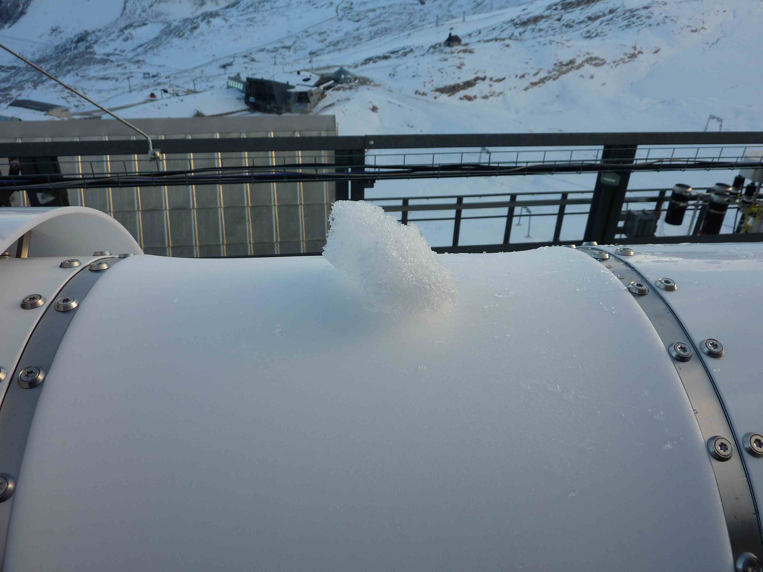
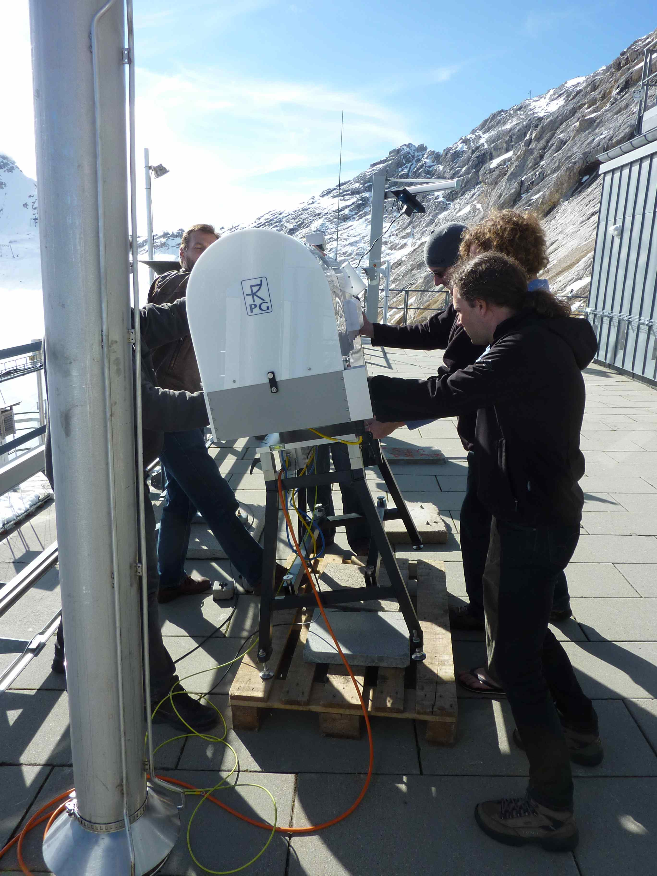
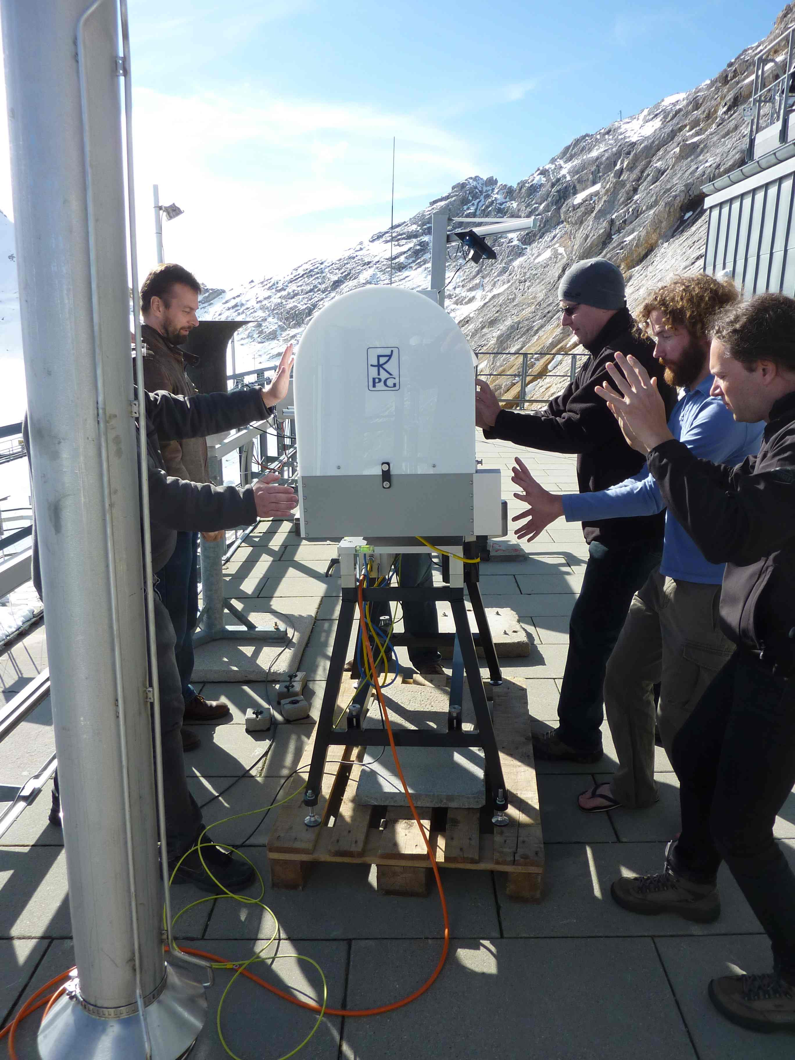
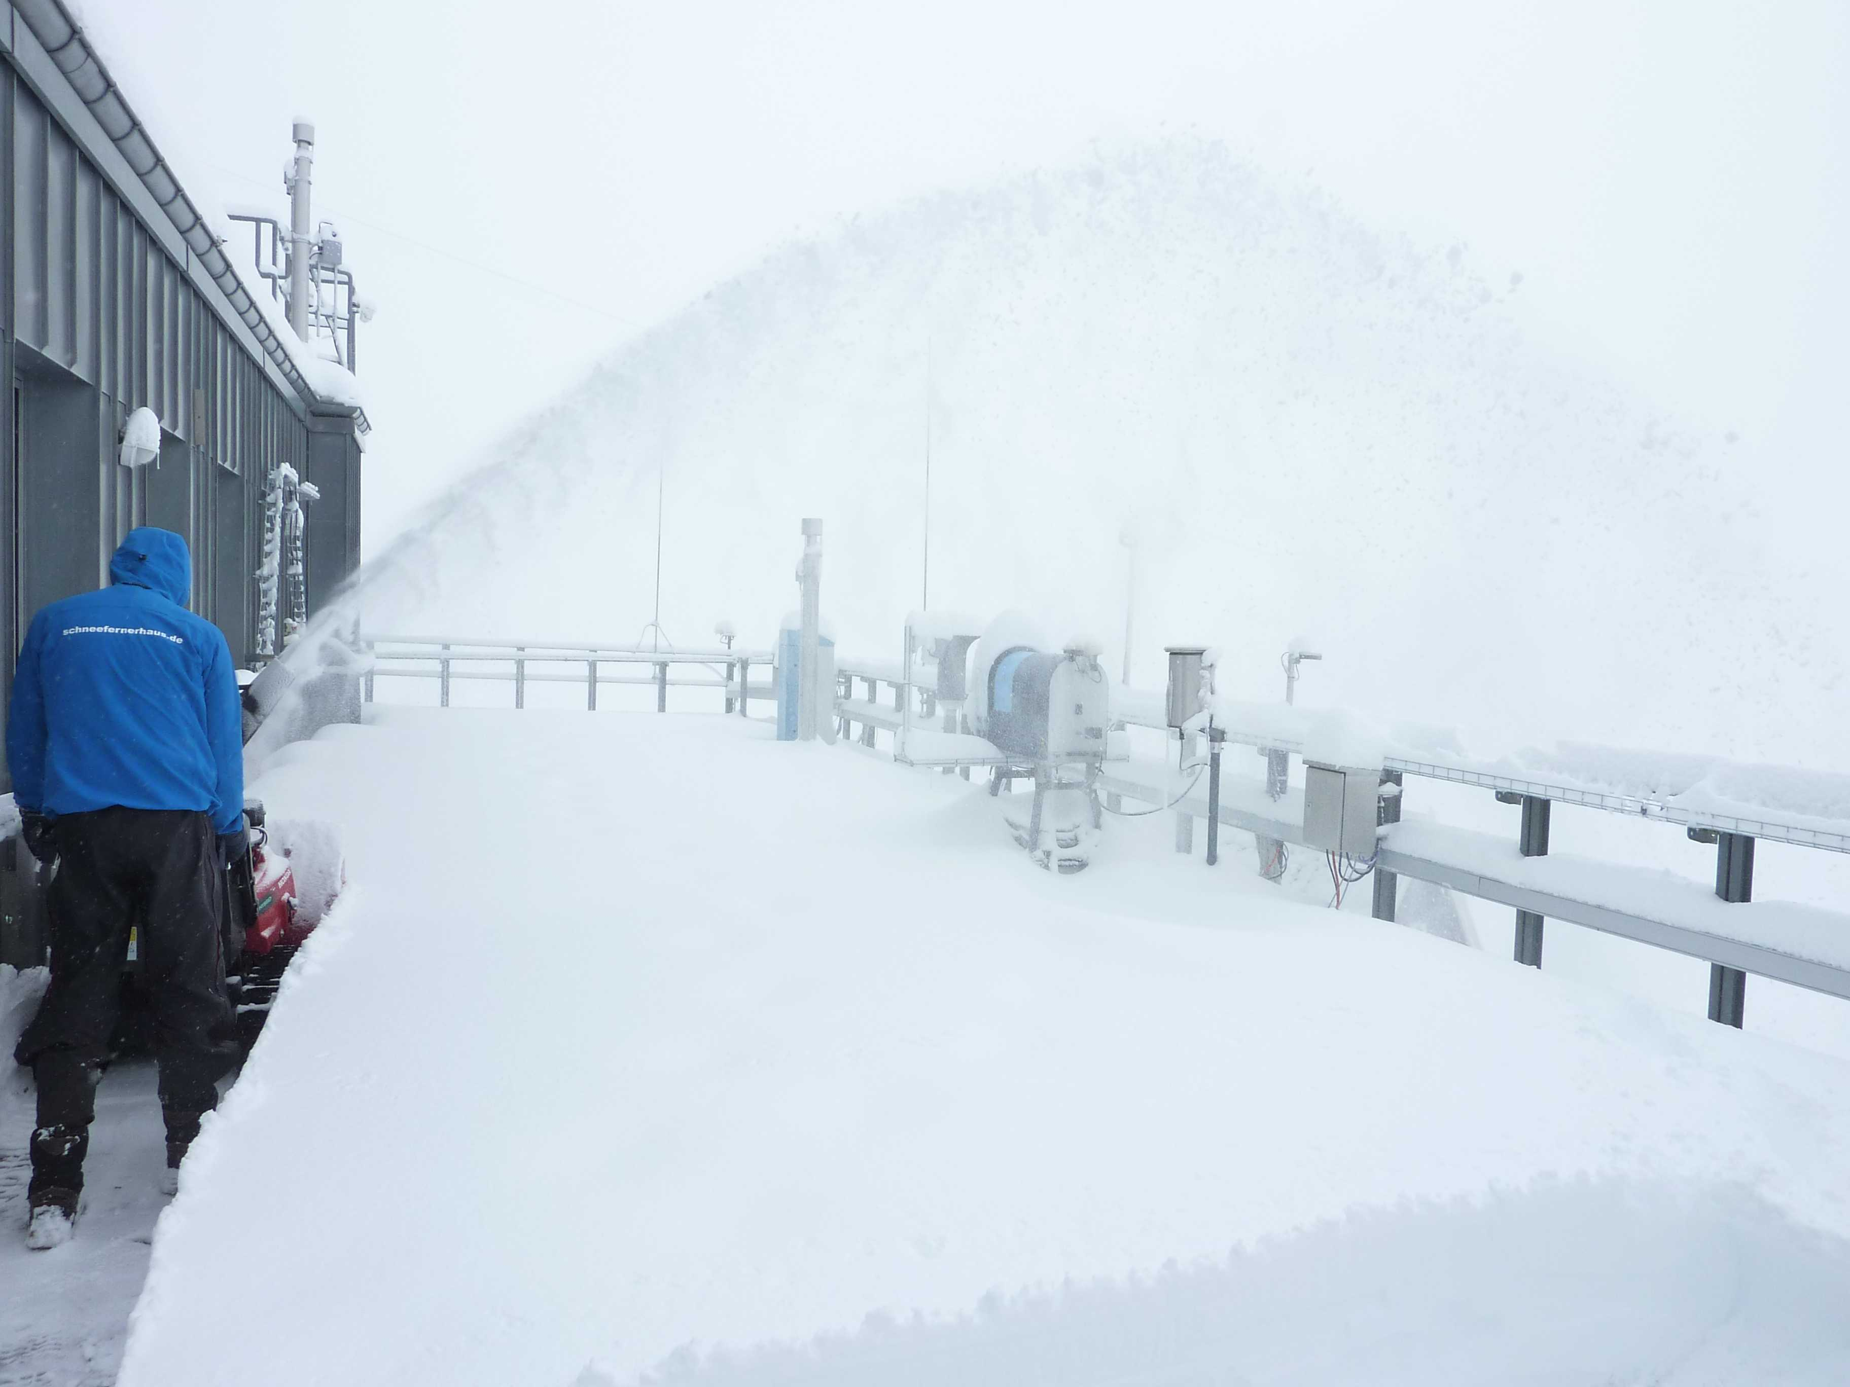
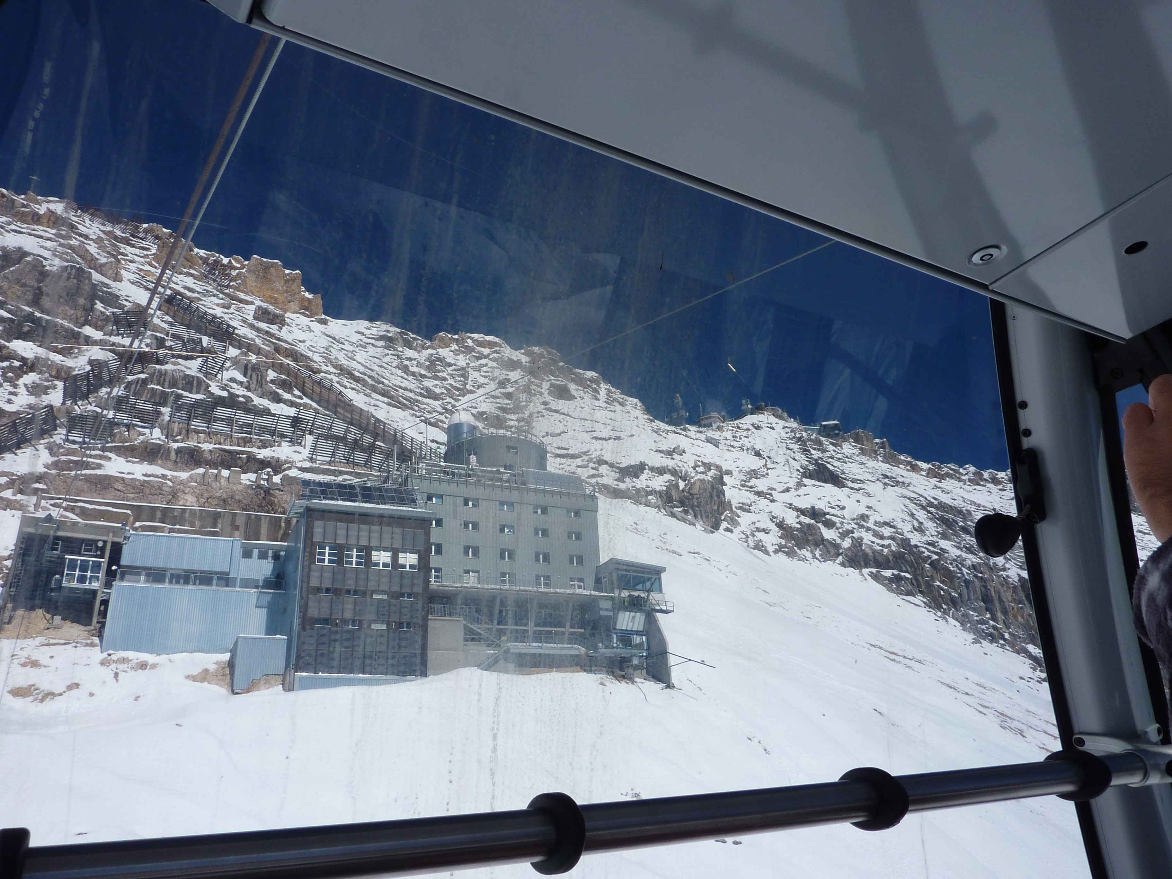
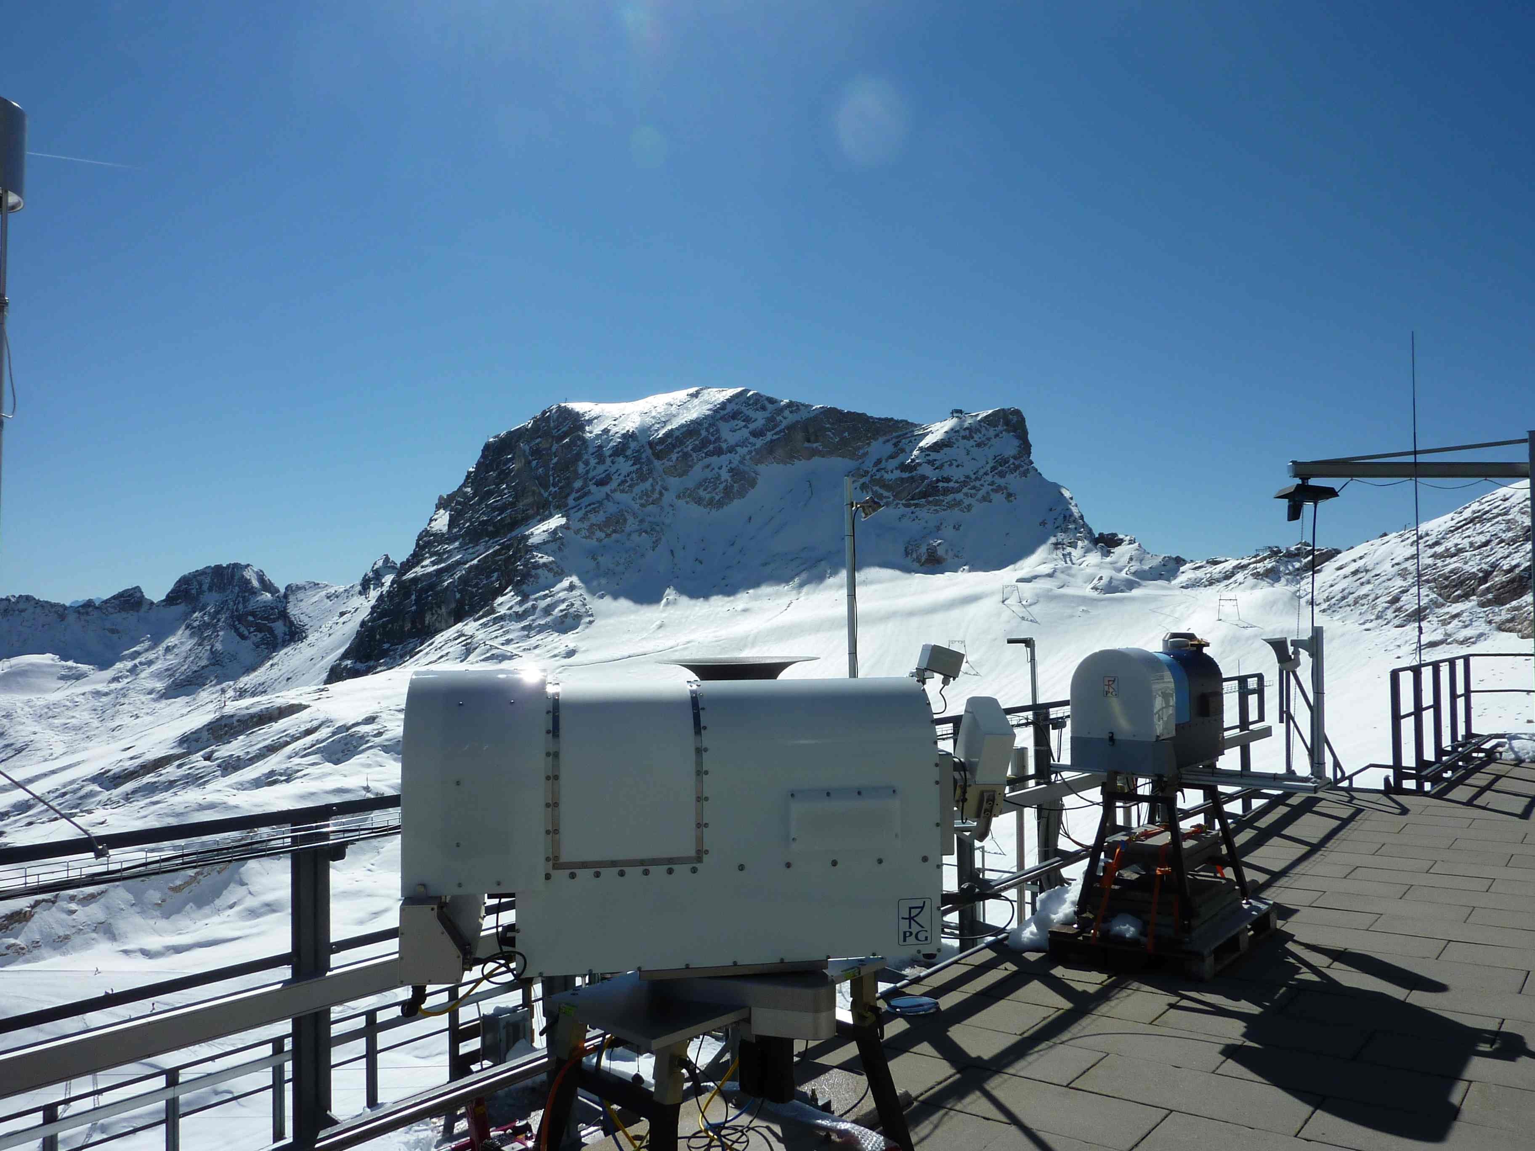
Test at UF Schneefernerhaus
Very valuable test period under variable conditions (2650 m); Sep 2011

Slide 22
Commissioning on Paranal
2-week period in Oct/Nov, 2011, 2635 m
Location: NE part of telescope platform
Th. Rose (RPG) on site for set-up and tests
Dedicated campaign with radiosonde balloons (U. Valparaiso) – 22 balloons launched
IR radiometer (Lethbridge, loan from GMT)
VLT instruments (CRIRES, UVES, VISIR, XSH)

Slide 23
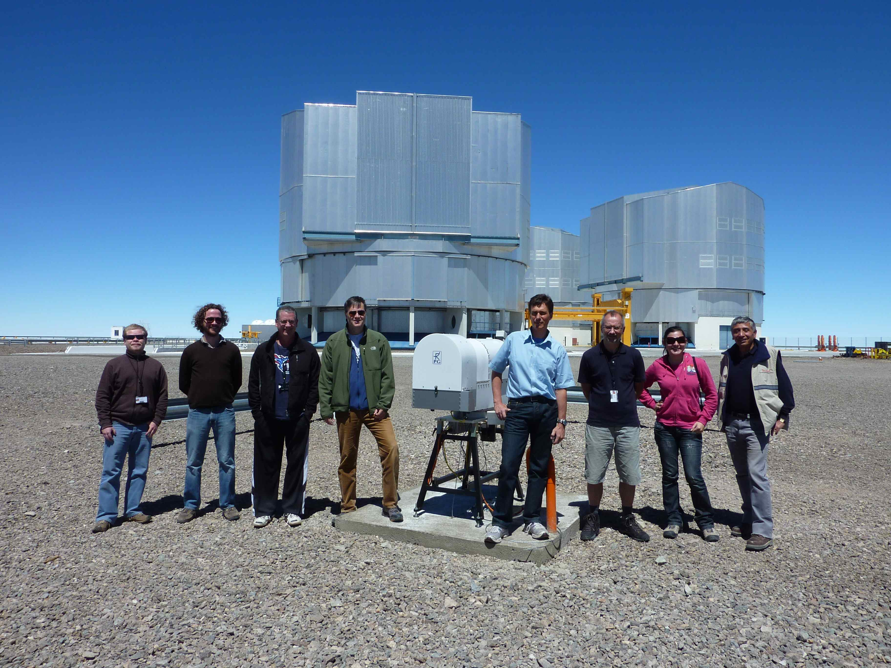
Commissioning on Paranal
Excellent support from Paranal staff

Slide 24
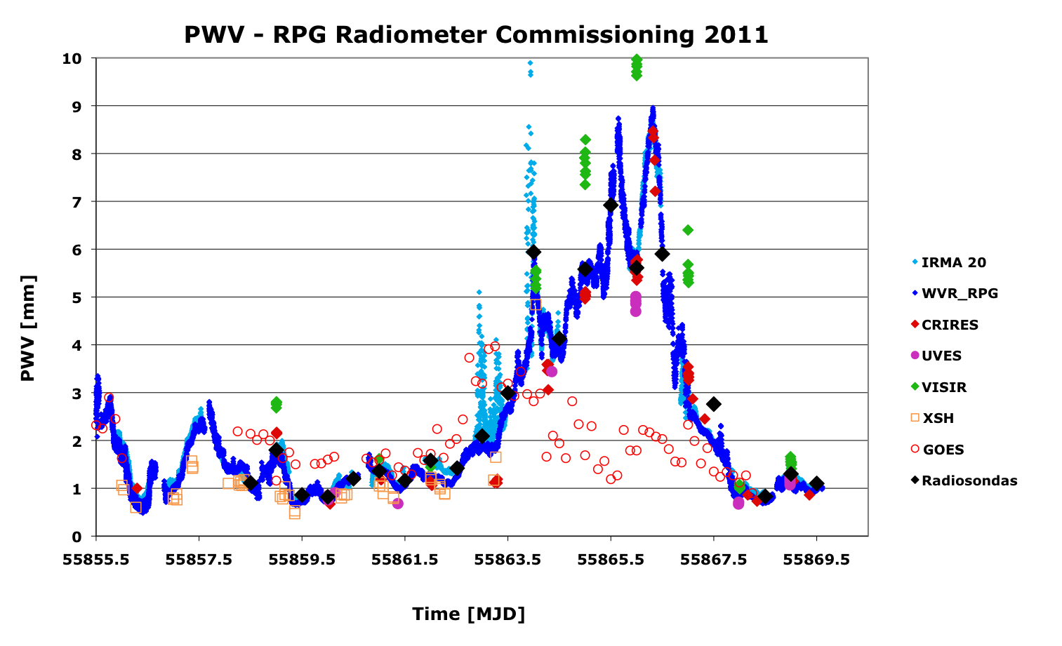
Commissioning on Paranal

Slide 25
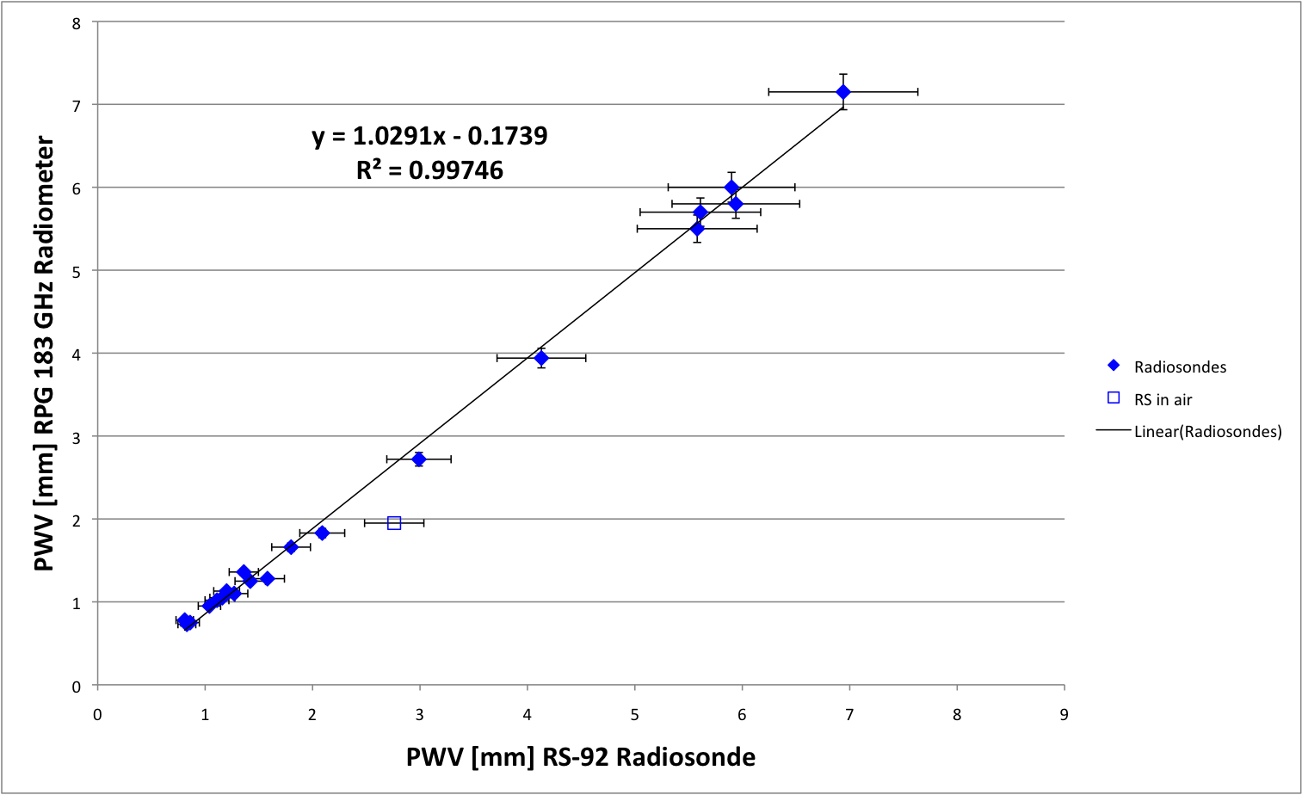
Commissioning on Paranal

Slide 26
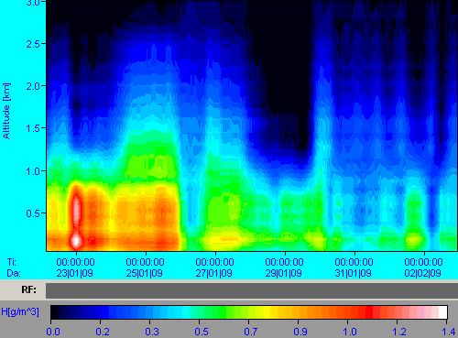
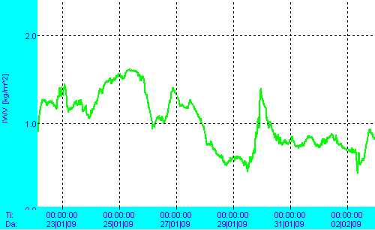
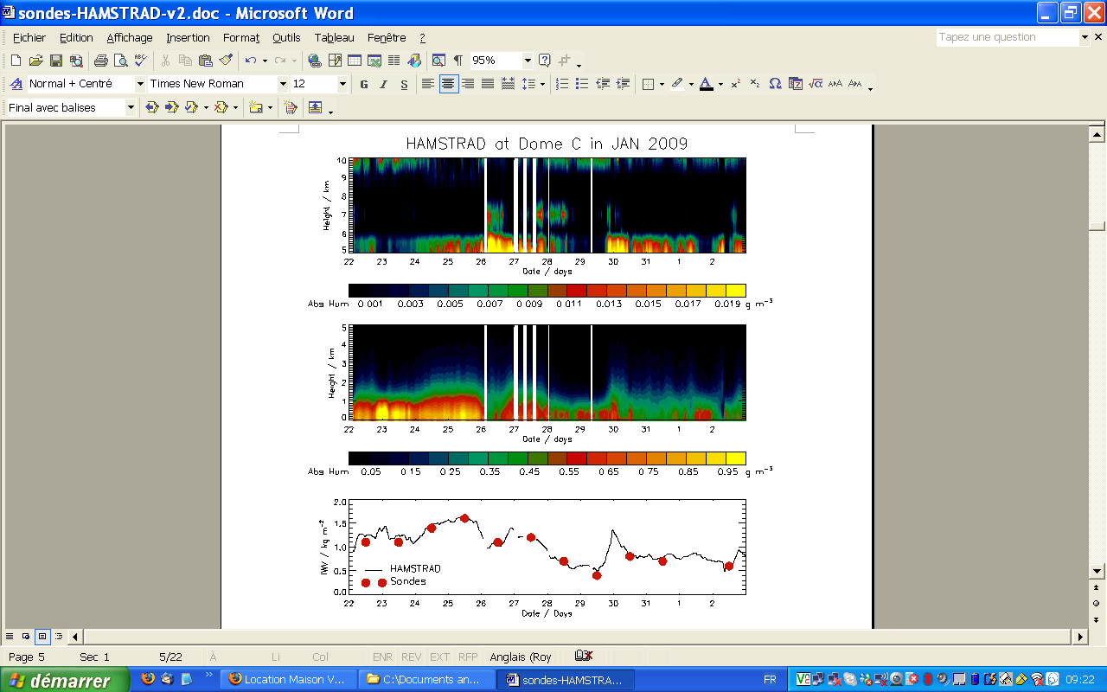
Atmospheric Data from Dome C
IWV variation (summer): 0.5 – 1.5 mm
Absolute humidity
profile map
Humidity profile time series and IWV for the period 22.1.2009 to 3.2.2009
(courtesy of P.Ricaud, Laboratoire d'Aerologie, Observatoire Midi-Pyrenees).
Courtesy: RPG

Slide 27
First Atmospheric Data from ESO Paranal Observatory
IWV Temporal Variability
IWV Spatial Variability
IRT Temporal Variability

Slide 28
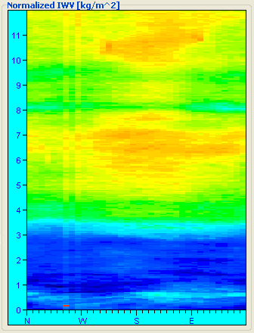
Example of Cirrus Detection (Measured at RPG)
IWV Temporal Variability
IWV Spatial Variability
IRT Temporal Variability

Slide 29
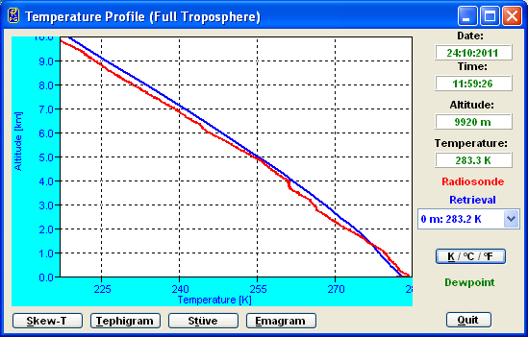
First Atmospheric Data from ESO Paranal Observatory
Blue: Radiometer
Red: Radio Sonde
Temperature Profile Comparison with Paranal Radio Sounding (24.10.2011, 12:00 UTC)

Slide 30
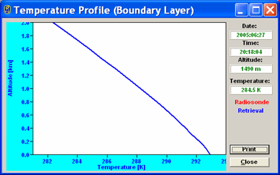
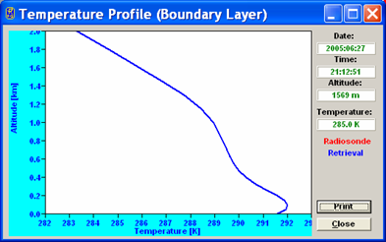
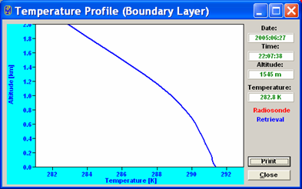
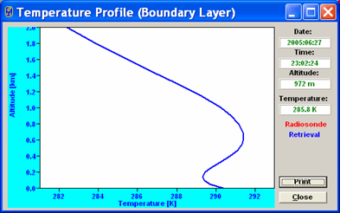
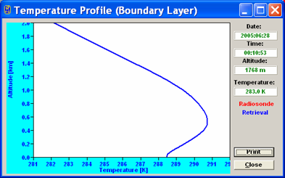
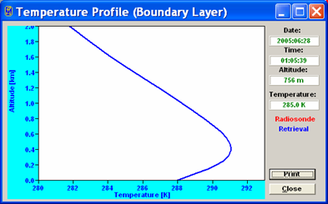
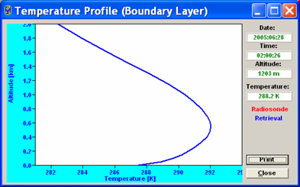
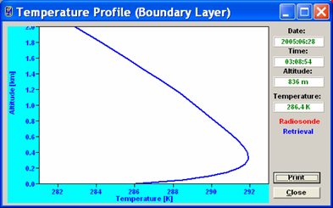
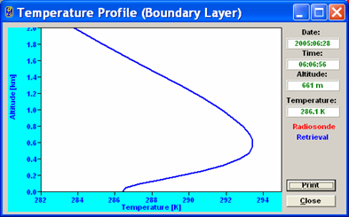
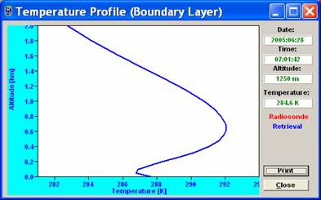
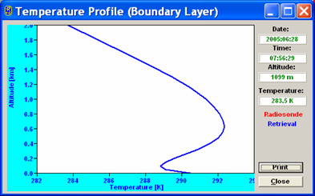
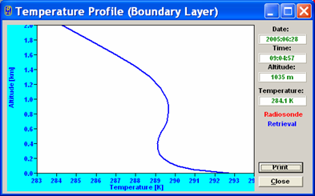
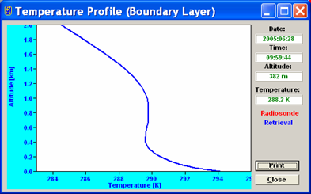
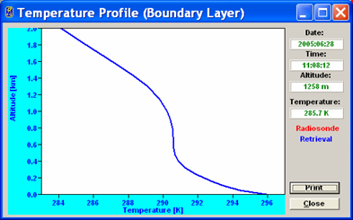
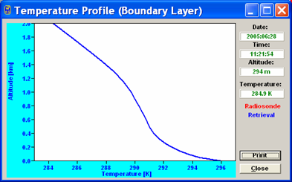
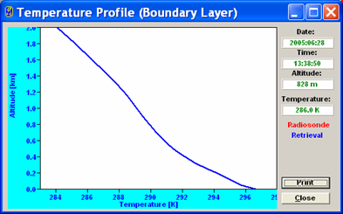
Potential of Temperatur Profiling: Inversion Development and Decay

Slide 31
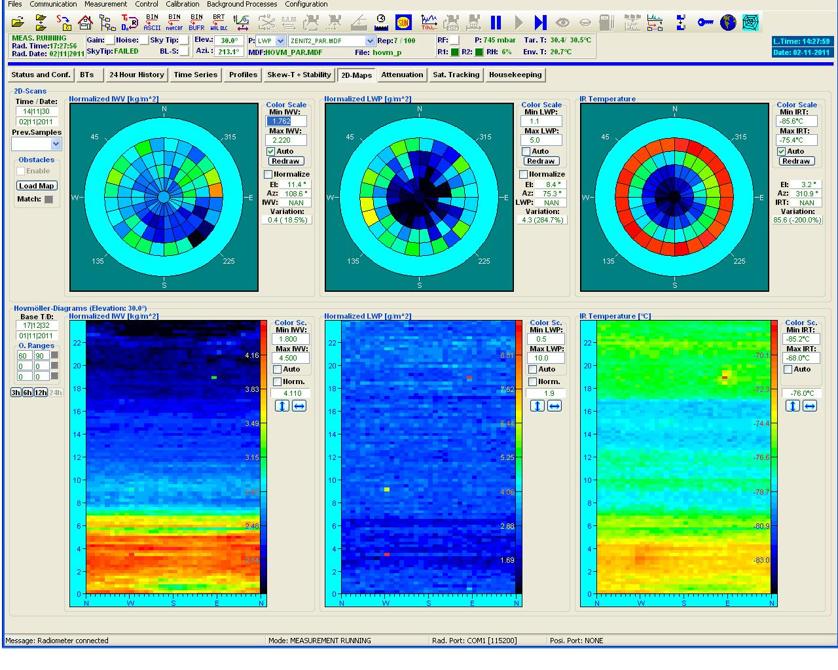
Tool on Paranal

Slide 32
Commissioning: Results
WVR meets all specifications
  PWV range 0.5-9 mm validated
  PWV precision: ca 30 μm
  PWV accuracy: ca 0.1 mm
  All sky pointing, 2-D scanning capability
  High time-resolution (sec)
  Autonomous operation
  Remote data access and control option
  Absolute calibration (LN2)
  Integrated into Paranal meteo-information
  New header keywords (VISIR)

Slide 33
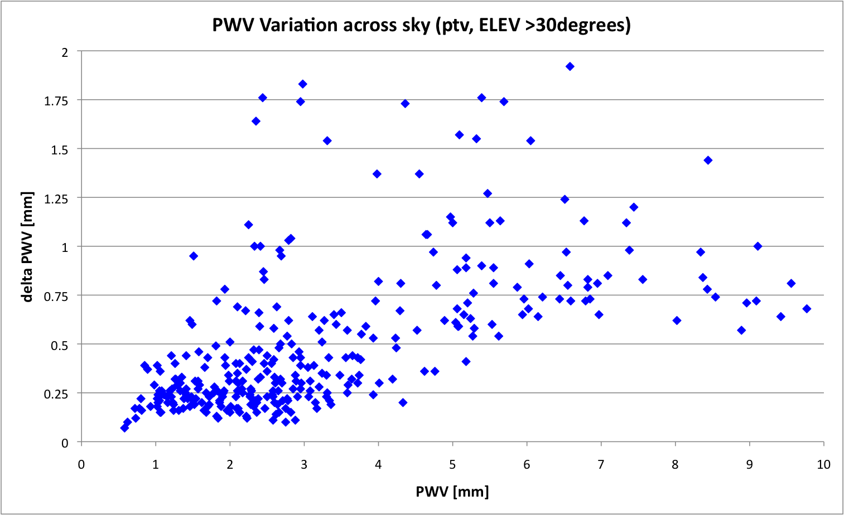
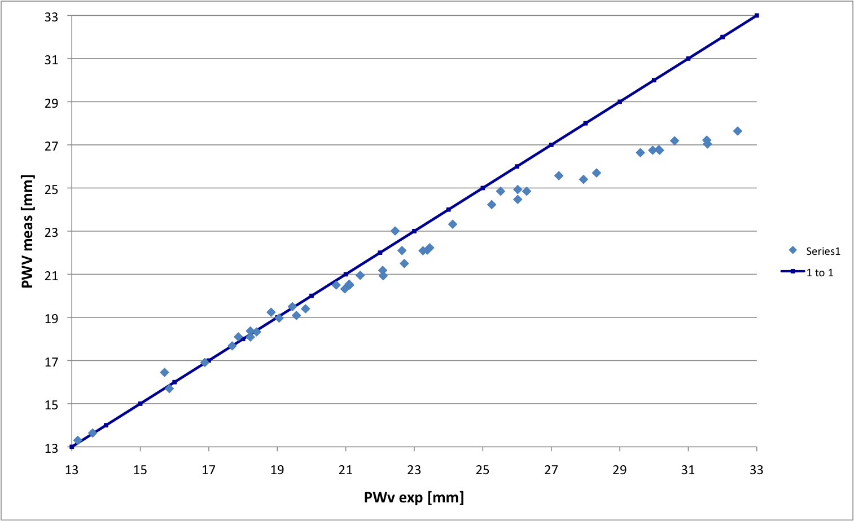
Early operations: Results
WVR reliable
  About 3% downtime
Learning how to best use it
PWV homogeneity 5-20%
Saturation limit: ca 20 mm
IR channel: powerful tool for cloud detection
  need to characterise quantitatively
Ready to support science operations for VISIR
Other VLT instruments will also use it

Slide 34
PWV as an Observing Constraint
Implemented in observation preparation software p2pp
Scheduled for full release for Phase 2 P90 (period starting Oct 1, 2012
Simultaneous release of new VISIR ETC with PWV as user-defined constraint
Update user manual with new observing strategy

Slide 35
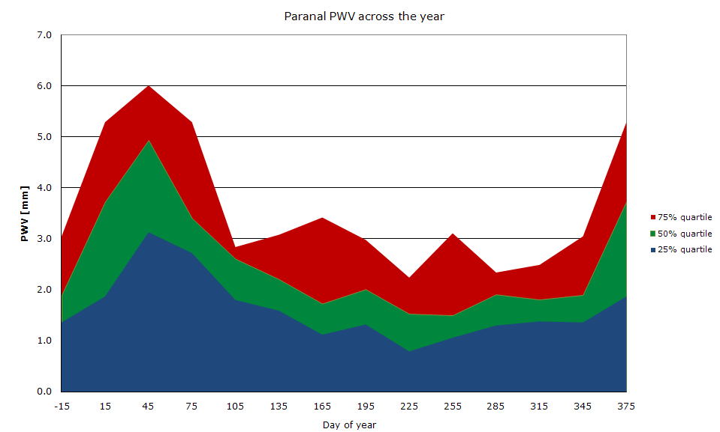
Paranal PWV Statistics
Paranal median PWV: 2.4 mm (vs 1.5 mm for Mauna Kea)

Slide 36
PWV in Fits headers
TEL AMBI START/END (being implemented)
  Type: double
  Value Format: %.2f
  Content Field: integrated water vapour (WVR)
  Description: integrated water vapour at zenith in mm at Start/End of exposure
PWV variation over 2-min interval

Slide 37
VISIR upgrade: PWV Monitor
Water vapour monitor (profiling radiometer) operational on Paranal
Performance validated:
  Range: 0-9 mm (saturation limit: 20 mm),
  Precision: 30 μm, accuracy ca 0.1 mm
PWV as user-provided constraint for service mode observing
PWV for real-time decisions at telescope
PWV in FITS headers

Slide 38
PWV profiling radiometer
Humidity profiles
Temperature profiles
Atmospheric modeling – telluric standard stars
Quality control tool for survey work
Meso-scale models for forecasting ?
Routine characterisation of atmosphere
Combination with other techniques of atmospheric sensing …

Slide 39
Summary
PWV radiometer on Paranal
Tool for real-time support of science operations
Commercial product (standardisation)
Absolute calibration (LN2)
Characterisation of impact of atmospheric properties on science
  Optimisation of science time
  Data quality of survey

