Slide 1
Addressing the Photometric Calibration Challenge: Explicit Determination of the Instrumental Response and Atmospheric Transmission Functions
Christopher Stubbs
Department of Physics
Department of Astronomy
Harvard University
stubbs@physics.harvard.edu

Slide 2
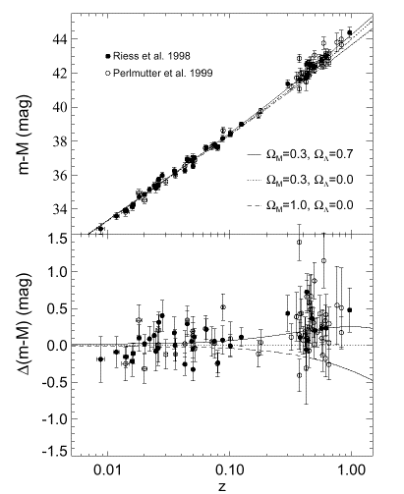
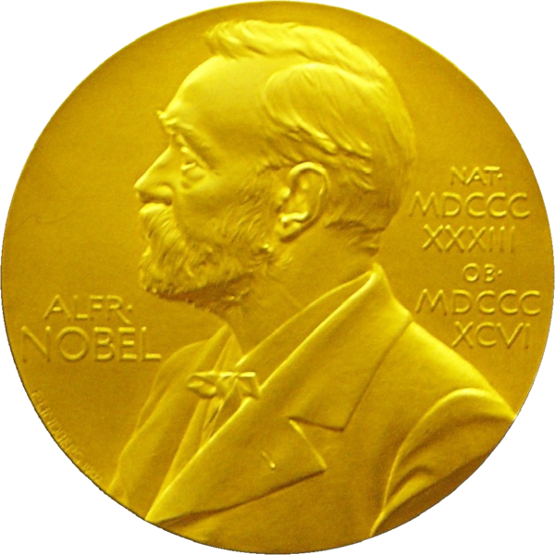
Flux Measurements Discovered the Dark Energy
Initial discovery of accelerating expansion came from type Ia supernovae at redshift z~0.6 being ~20% fainter than expected
(Perlmutter et al, 1999, Riess et al 1998).
Measurements of SN luminosity distances and redshifts are a direct measurement of the history of cosmic expansion.
For the future, supernovae will remain a valuable probe for characterizing of the nature of dark energy

Slide 3
Our ability to determine cosmological parameters with D_{L}(z) is completely degenerate with our ability to perform precise photometric calibration.
This is currently the main systematic limitation to SN cosmology.
By far.
This afflicts both optical and infrared data.

Slide 4
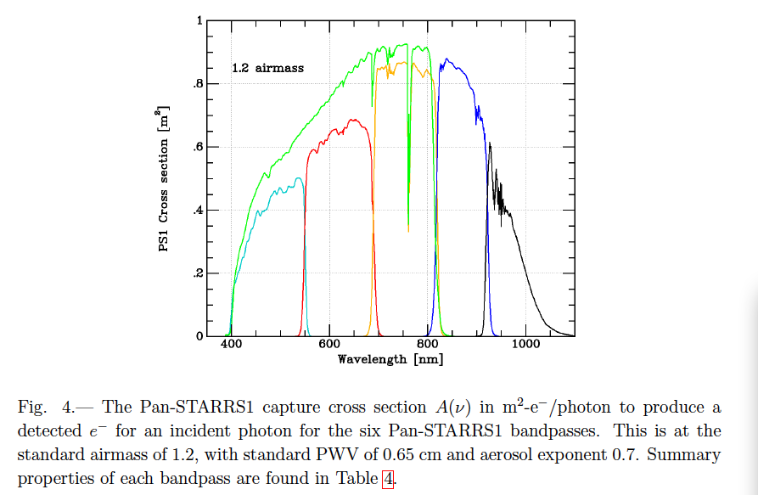
Passbands and System Sensitivity

Slide 5
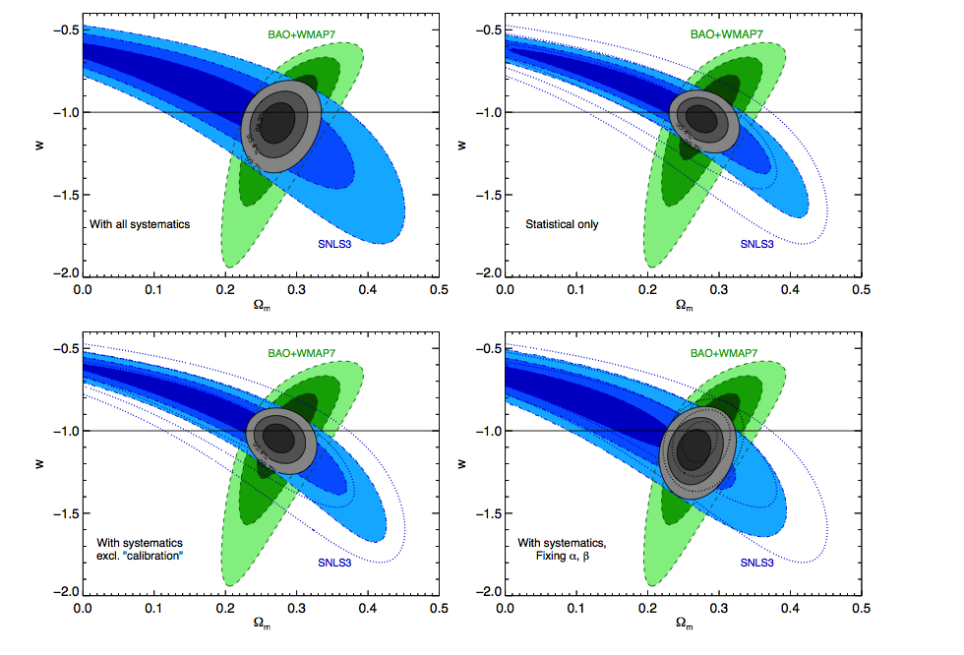
Current State of SN Cosmology
SNLS
Notes:
5

Slide 6
Current State of SN Cosmology
SNLS
Notes:
6

Slide 7
Current State of SN Cosmology
SNLS
Notes:
7

Slide 8
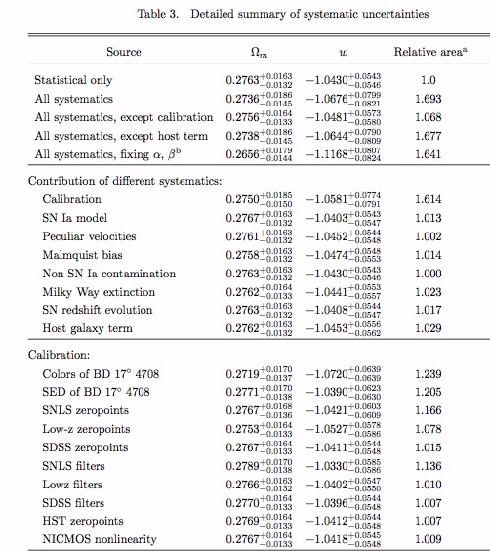
Current State of SN Systematics
Photometric
Calibration Uncertainties Dominate!
From Sullivan et al. 2011
Notes:
8

Slide 9
Next Steps on Dark Energy:
Bigger and Better Imaging Surveys
Discovery data 1998 | 20 distant SNe | 10% precision
ESSENCE, SNLS … 2009 | 200 distant SNe | 3 % precision
PanStarrs, DES 2011-2015 | 2000 SNe | 1% precision (?)
LSST 2018 | 20,000 SNe | < 1% goal

Slide 10
Broadband photometry:
“Metrology and Meteorology”
Extinction above the atmosphere
Source Atmosphere Instrumental transmission
Four aspects to the photometry calibration challenge:
Relative instrumental throughput calibration
Absolute instrumental calibration (I claim this this is far less important)
Determination of atmospheric transmission
Determination of line of sight extinction
Historical approach has been to use spectrophotometric sources (known S(λ)) to deduce the instrumental and atmospheric transmission, but this (on its own) is problematic: integral constraints are inadequate, plus we don’t know the source spectra to the requisite precision.

Slide 11
Potential Color calibration approaches
Terrestrial black-body sources, using triple point of metals, and Vega as the transfer standard
Theoretical models of stellar spectra
DA white dwarf stars, with 20,000K < T <80,000K.
Theoretical models depend only on log (g) and T
Model of Vega plays a role as well
But beware of extinction effects
3. Statistical assemblage of stars, en masse. Color-color diagrams, ubercalibration tie to another photometric system.
4. Shift the calibration approach entirely, and base it on well-characterized detectors.
Not mutually exclusive

Slide 12
How we’ve been addressing this
Explicit measurement of atmospheric transmission.
    See also talks later today by Fagin and Albert
Explicit measurement of instrumental response function.
    We use a tunable laser in conjunction with NIST photodiode standard
    Initial results from CTIO (2005, 2006)
    PanSTARRS (2010)
Explicit determination of atmospheric transmission
    multi-narrowband imager at CTIO (2007)
    dispersed imager at PanSTARRS (2011)
    balloon-borne sources (2012)
Try to shift away from celestial calibrators entirely.
Re-assess Galactic extinction.
    Schlafly & Finkbeiner (2011) used SDSS to revise SFD dust map, correction factor of 0.78 at 1 micron!
This work done in partnership with: NIST, Univ. of Hawaii,
Dartmouth, Univ. of Victoria, Univ. of NM, LSST, and STSCI.

Slide 14
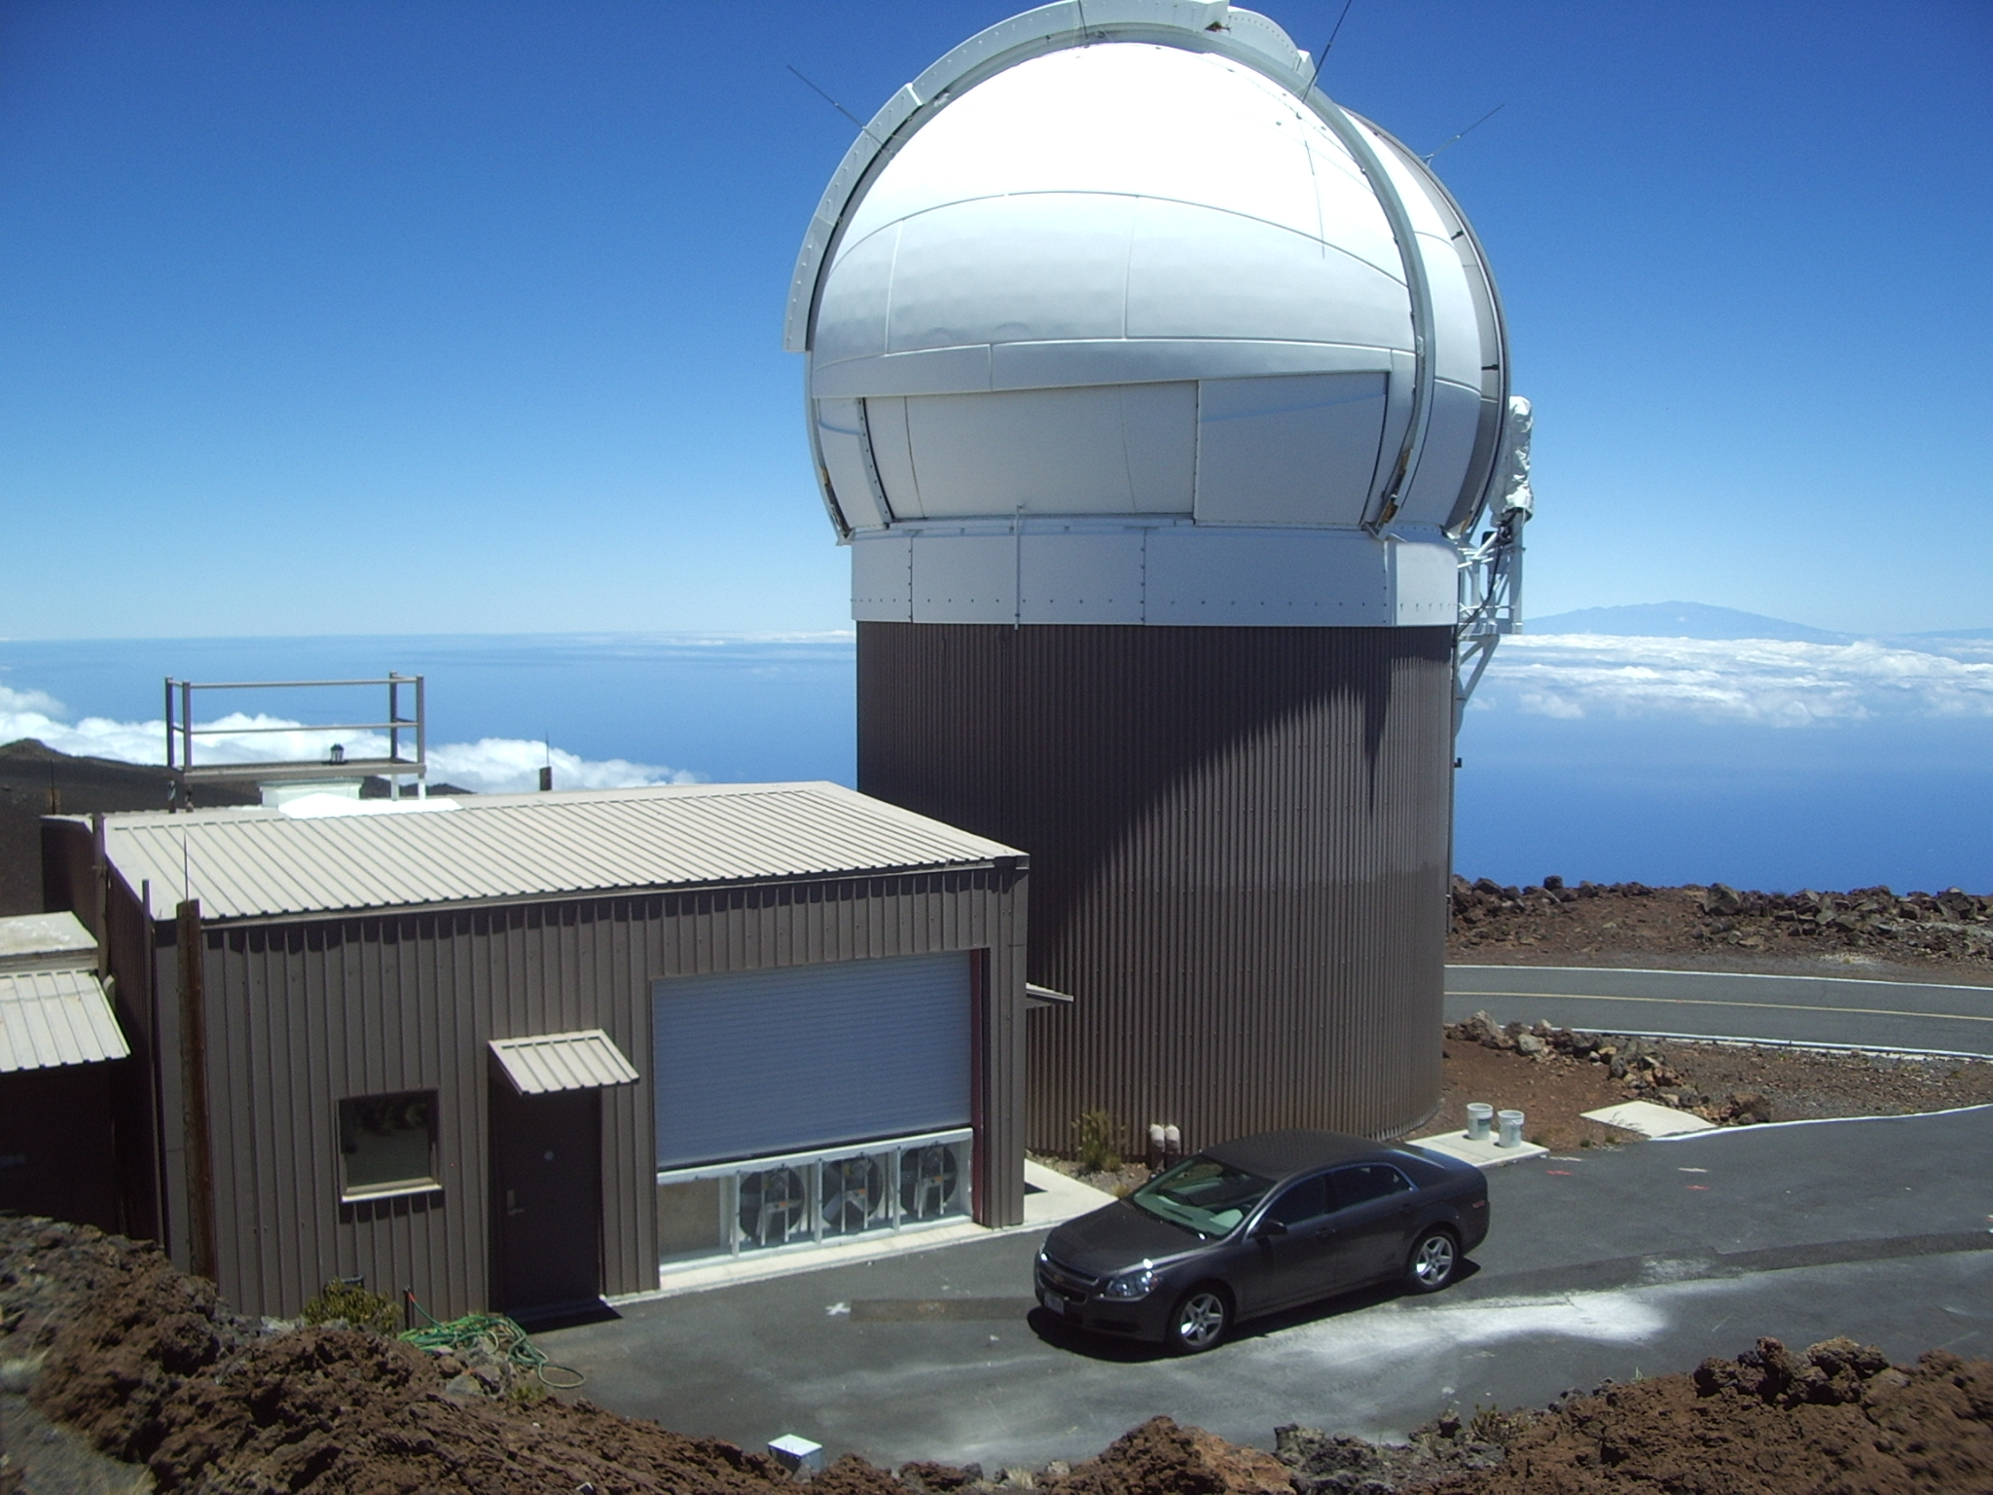
The PanSTARRS Survey
1.4 Gpix camera
3.3 degree FOV
1.8 meter telescope

Slide 15
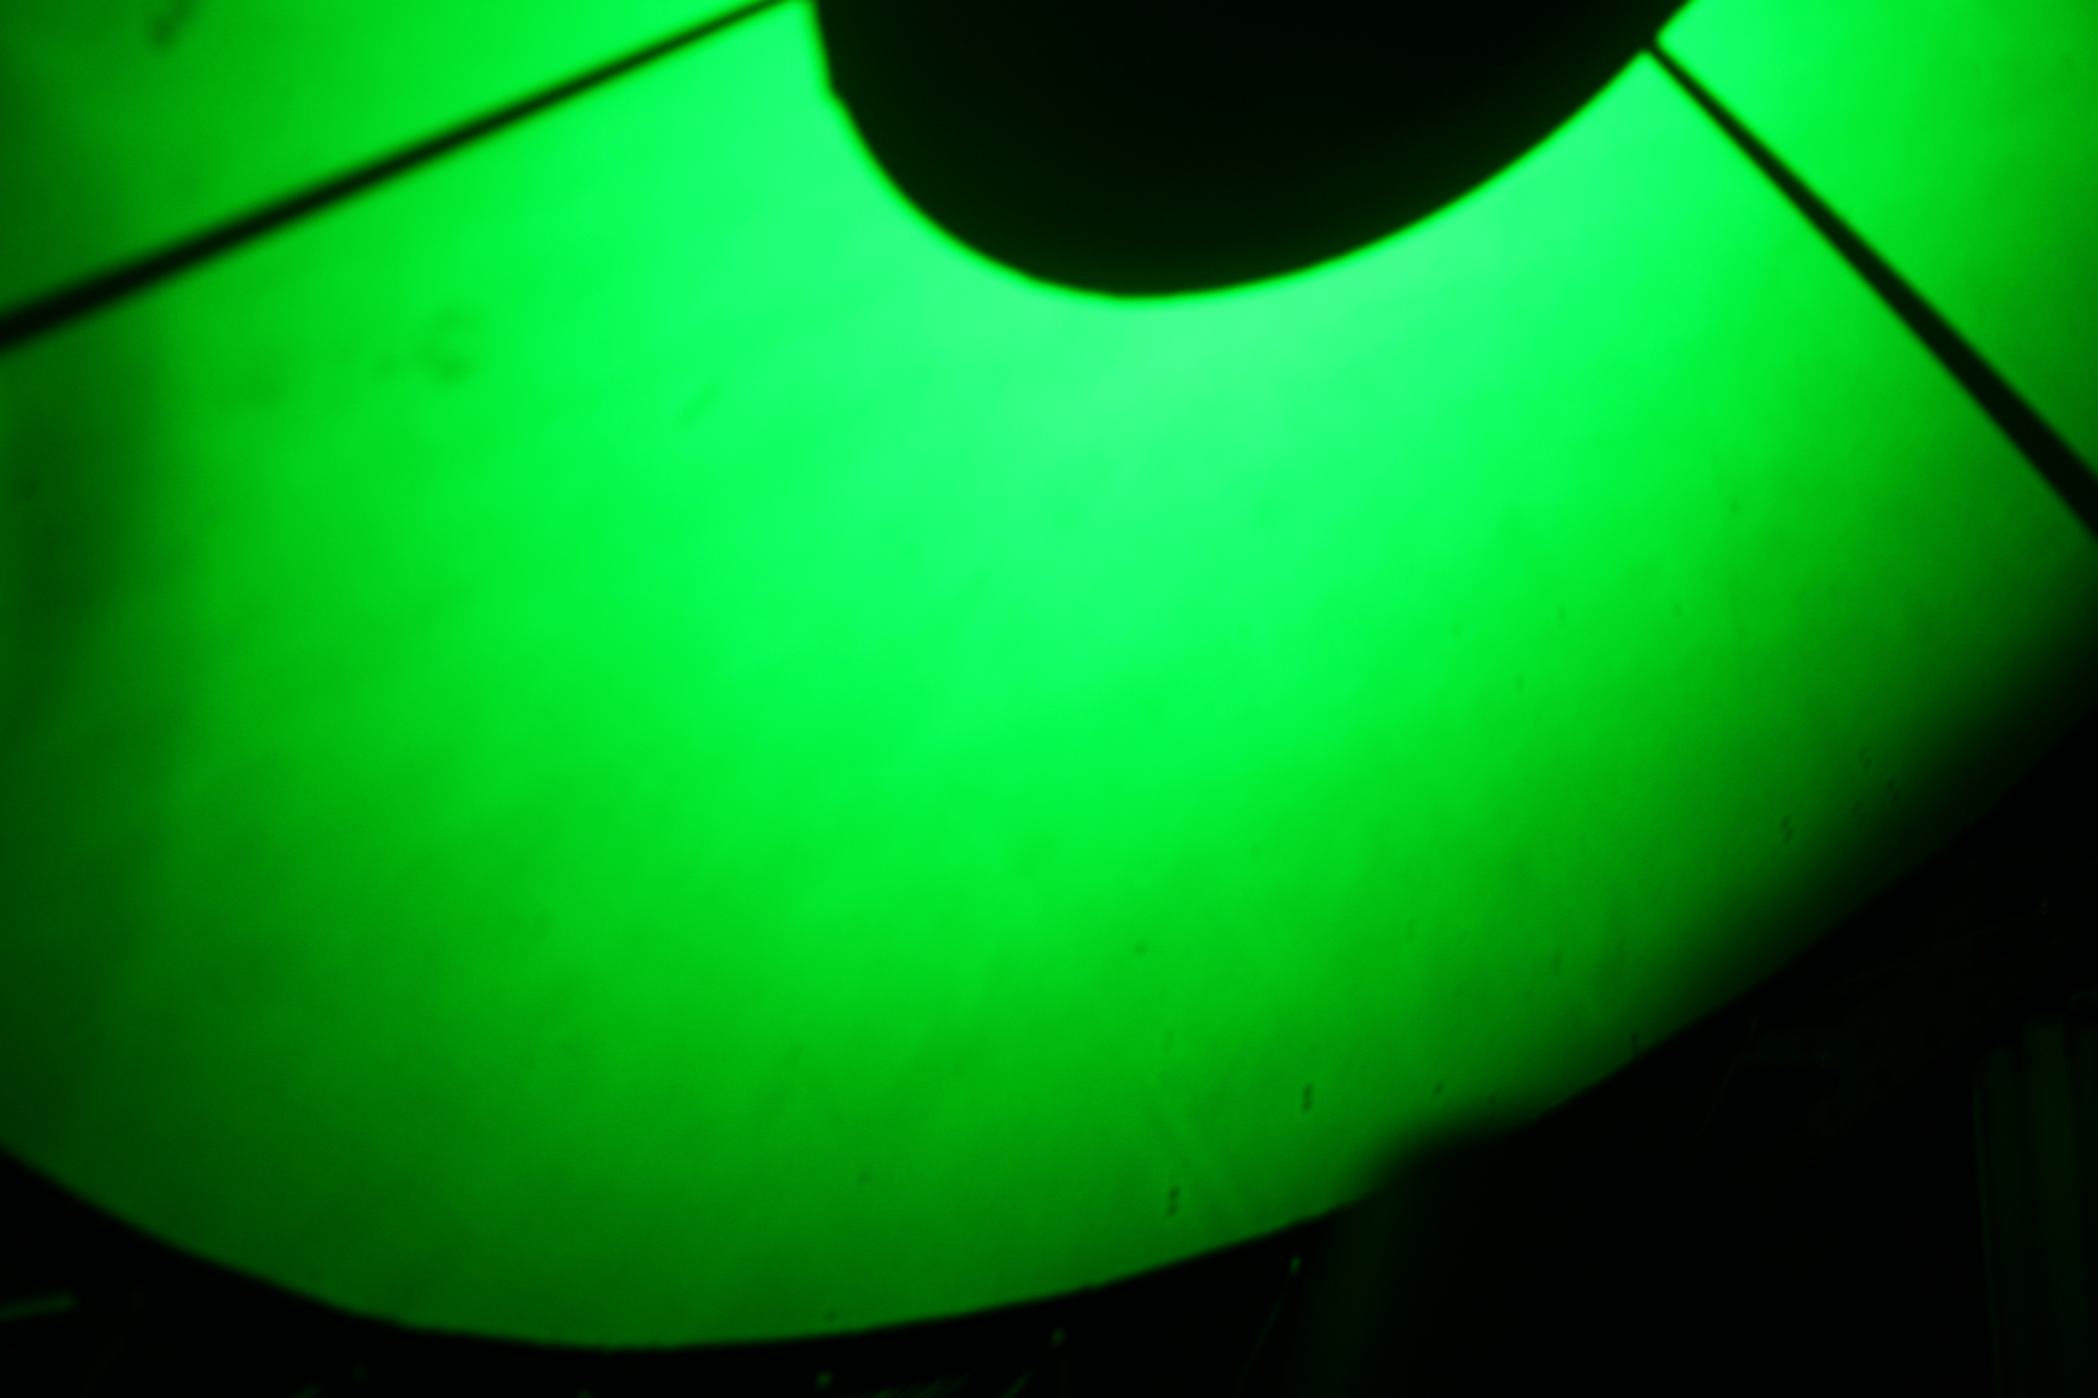
Monochromatic Source Full-system
Throughput Determination

Slide 16
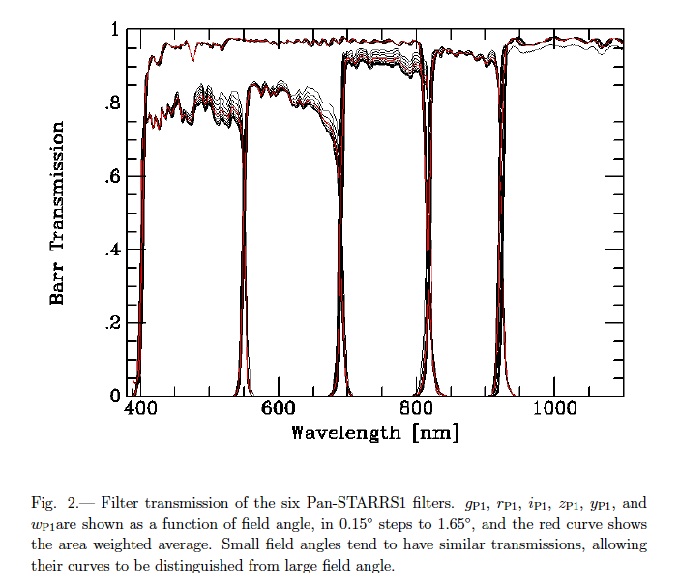
Precise Filter Determination
But this is not
the main objective!

Slide 17
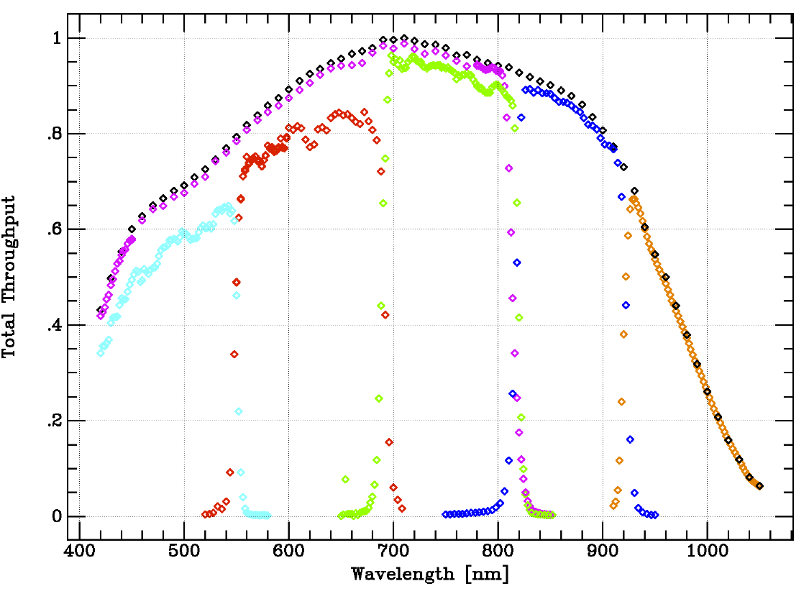

Stubbs et al, Ap J , arXiv:1003.3465S

Slide 18
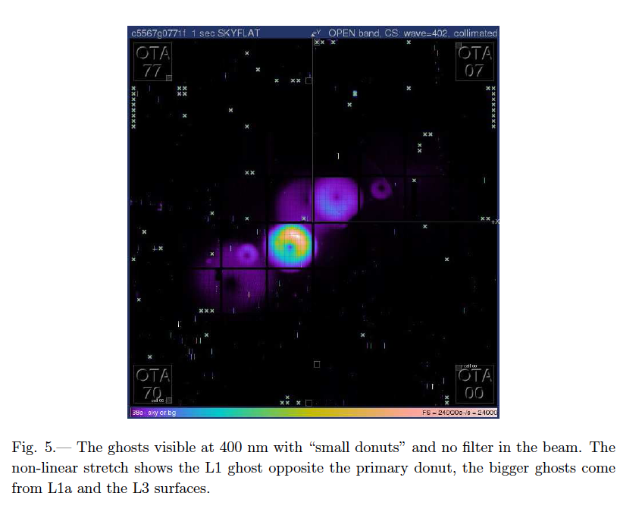
Collimated Source Measurements

Slide 19
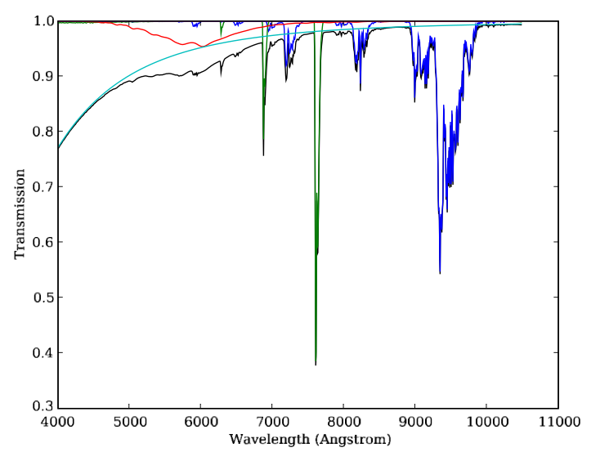
Atmospheric Transmission
Burke et al, ApJ 720, 811B (2010)

Slide 20
The Variable Aspects of Atmosphere
Ozone satellite data
Water Vapor EW of water lines
                dual-band GPS
                differential narrowband
Aerosols stellar monitor
        balloon-borne lasers
Clouds local zeropoint adj.

Slide 21
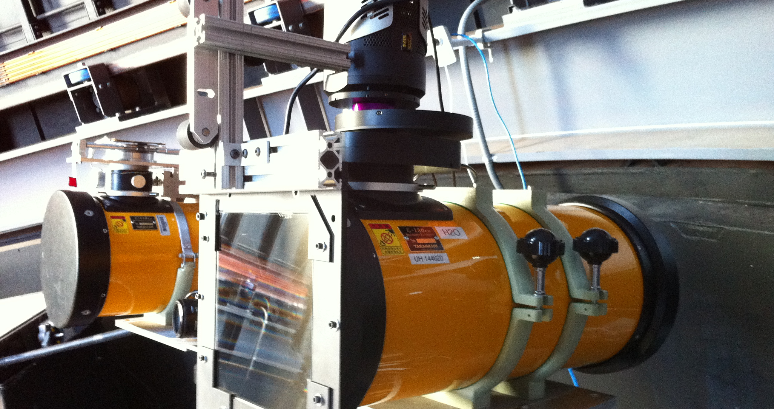
Objective grating atmospheric monitor

Slide 22
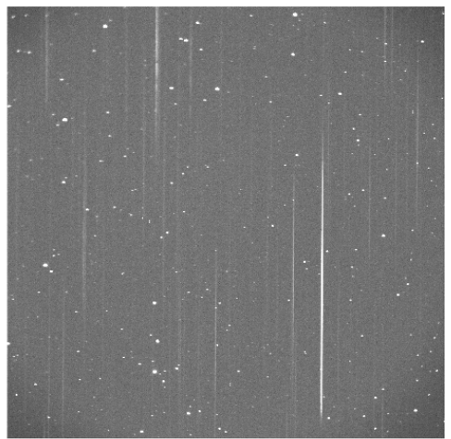

Slide 23
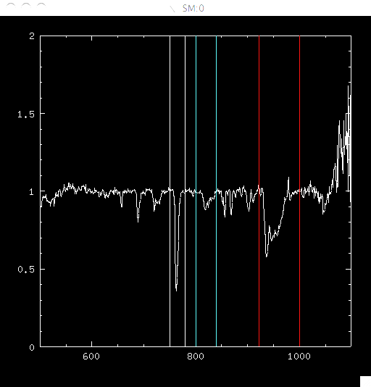

Slide 24
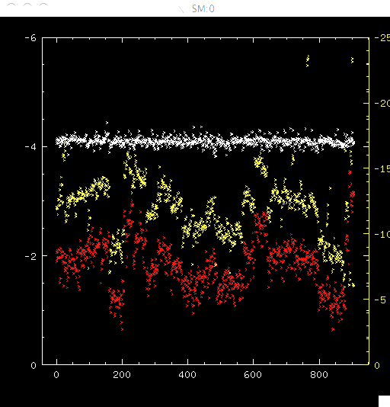
PWV evolution over 1 month
O₂ 780 nm
H₂0 950 nm
H₂0 820 nm

Slide 25
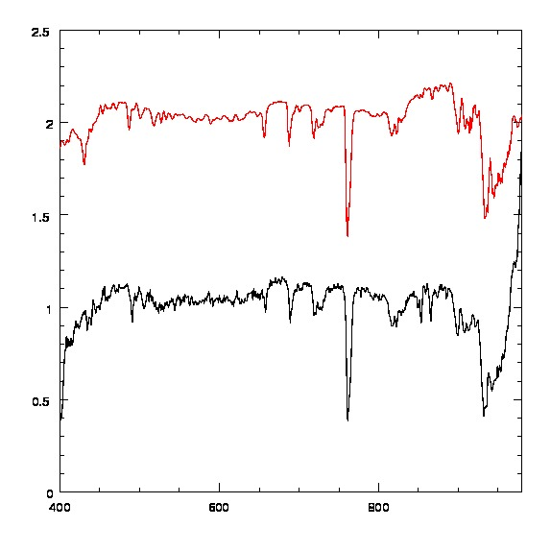
MODTRAN model
Polaris Spectrum

Slide 26
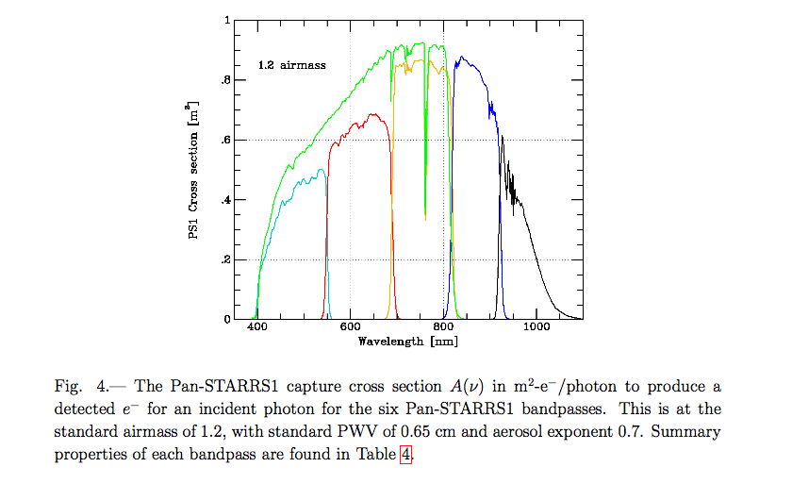
PanSTARRS-1 throughput
Tonry et al
arXiv:1203.0297

Slide 27
Closing the loop
Instri
Instri
Instri
Instrumental
Sensitivity
Atmospheric Transmission
Spectrophotometric Standards
Instri
PanSTARRS
photometry
With this initial effort, we come within 5% rms of matching ab initio calculations with observations (Tonry et al, arXiv:1203.0297, 2012)

Slide 28
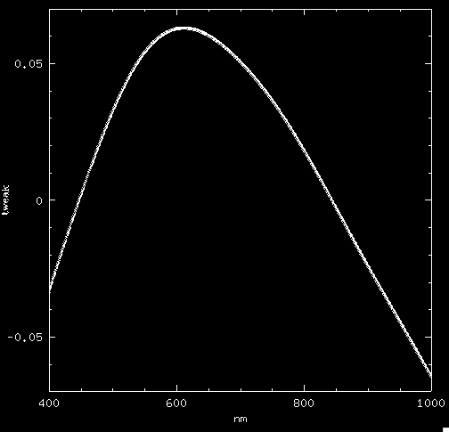
Tweaks to throughput and atmosphere
Applied a nightly adjustment to aerosol wavelength dependence (to MODTRAN desert extinction Spring-Summer).
Applied low-order
correction to system
throughput function.

Slide 29
Our Planned Next Steps
Precise determination of aerosol attenuation
  We favor using a set of laser diodes on a balloon to establish a set of empirical stellar SED’s.
Continuing efforts to push below 1% in tying together the instrument, the atmosphere, Galactic extinction, and the source spectrum.
Ongoing atmospheric and instrumental characterization for PanSTARRS. Understand the origin of the mismatch.
Exploit nightly multiband images of celestial pole with PS1.
Continue development of collimated flat-field for LSST.
Assess angular and temporal correlation of atmos atten.

Slide 30
Summary
SN cosmology is stalled until we improve calibration
  Determination of luminosity distance vs. z is completely degenerate with our ability to calibrate photons(λ).
We need to determine 3 things:
  instrumental sensitivity function
  atmospheric transmission
  extinction along the line of sight
A relative determination suffices. Don’t need absolute flux scale (zeropoint), since this is degenerate with M _{SN.}
I am dubious about any celestial spectrophotometric standard below the 1% level.
We are making (slow) progress towards implementing a relative calibration based on laboratory standards.

Slide 31


Thanks to these collaborators:
Justin Albert, U Vic
Ralph Bohlin, STSCI
Steve Brown, NIST
Yorke Brown*, Dartmouth
David Burke, SLAC
Ken Chambers, UH
Claire Cramer*, NIST
Susana Deustua, STSCI
Peter Doherty*, Harvard
Maxwell Fagin, Dartmouth
Will High*, Univ. Chicago
Keith Lykke, NIST
John McGraw, UNM
Gautham Narayan*, Harvard
Abe Saha, NOAO
Isaac Shivvers*, Berkeley
Chris Smith, CTIO
John Tonry, UH
John Woodward, NIST
Peter Zimmer, UNM
(*past or current group member)

Slide 32
References
Initial demonstration of tunable laser calibration
  Stubbs et al BAAS 37, 1460 (2005)
  arXiv astro-ph/0609260
Specific suggestion for explicit, independent, high-precision measurement of both atmosphere and instrument, NIST-based.
  Stubbs & Tonry ApJ 646, 1436 (2006)
Atmospheric transmission overview
  Stubbs et al, PASP 119, 860 (2007)
Stellar locus regression
  High et al, AJ 138, 110 (2009)
Joint photometry & spectroscopic observations
  Burke et al, ApJ 720, 811 (2010)
Precise PanSTARRS throughput determination (2010)
  Stubbs et al, ApJSupp 191, 736
First attempt to “close the photometric loop” with PanSTARRS (2012):
  PanSTARRS Photometric System, Tonry et al, ApJ in press, arXiv: 1203.0297

