Slide 1
Organizing large projects across boundaries P. Oddone, AACR Translation of the Cancer Genome Conference, October 16th , 2011

Slide 2
Nothing to disclose

Slide 3
Abstract: Organizing large projects across boundaries
The sun never sets on today’s large particle physics collaborations. Major experiments at the Large Hadron Collider at CERN each involve more than 2000 physicists from more than 100 institutions and forty countries. The detectors built by these collaborations are massive, billion-dollar enterprises of great complexity and myriad components. Collaborating physicists carry out the analysis of the data that is acquired by these detectors and relayed electronically across the globe to data centers tied together through GRID computing. The collaborations publish papers based on petabytes of data just months after the data are taken.
How can this possibly work?
I will describe how particle physics has evolved to be able to organize these projects across boundaries, from setting the physics goals, establishing governance, making the hard technology choices and the actual construction and commissioning of the detectors to the analyses and production of physics discoveries.
Is there anything to learn here that is applicable to biological research?
When asked to give this talk I was intrigued by the inquiry into whether the nature of international particle physics collaborations reveals possible applications to major biological projects. I will describe my conclusions and the many questions that this inquiry raised.

Slide 4
Outline
Today’s large physics collaborations
Differences between detector and accelerator collaborations
Scale of modern detector collaborations
The detector model: The stages in the life of a large collaboration
An analysis of Governance
Coordination across agencies and countries
How the improbable became real
The importance of evolution
The role of theory in developing consensus
The role of the host accelerator laboratory
The absence of hang-ups on intellectual property
Are any lessons applicable to large biological projects?

Slide 5
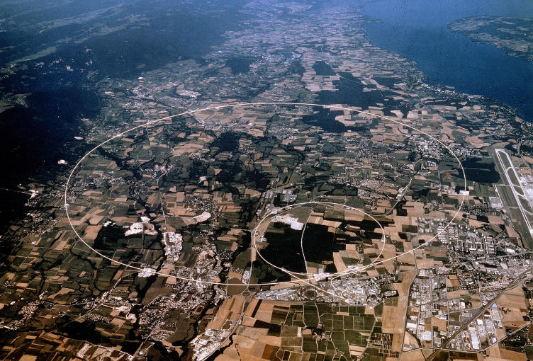
Accelerators are built centrally

Slide 6
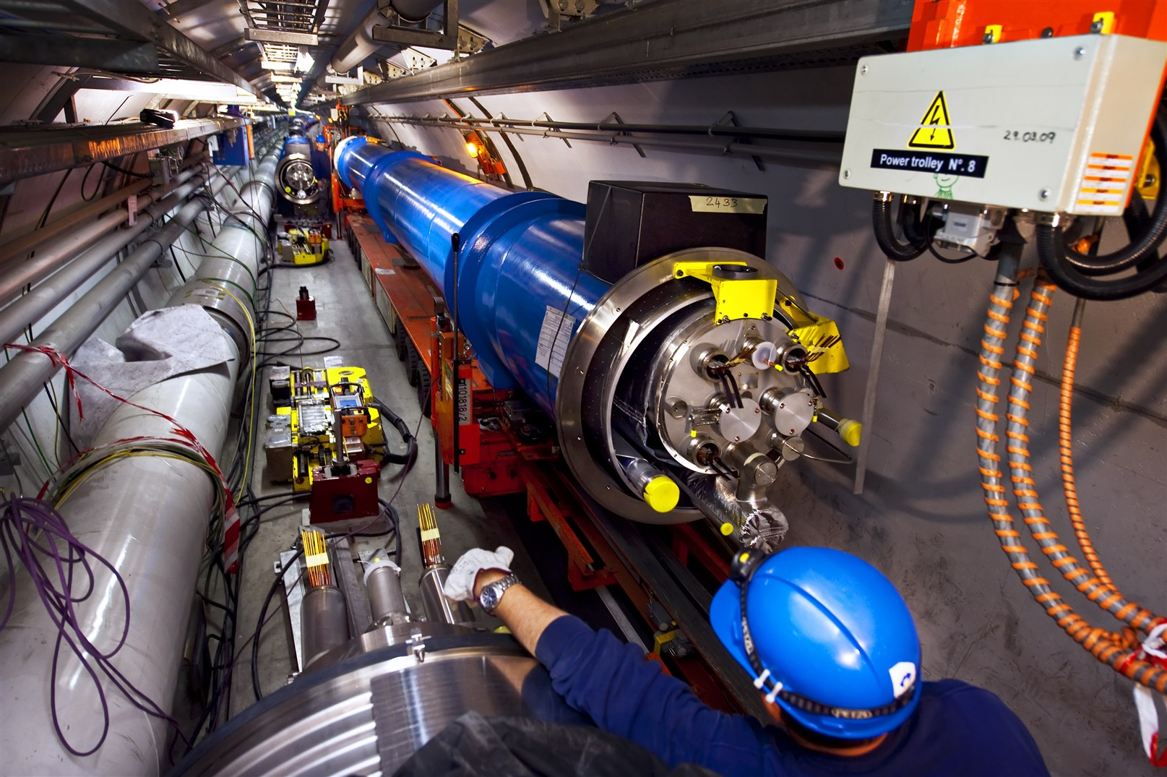
Accelerators are built centrally

Slide 7
Detector collaborations are different
Common wisdom would consider a high degree of centralization preferable for large projects
In detector collaborations large number of groups across the world contribute to all phases of the experiment
Despite the complexity and cost of the enterprise and the many interfaces, the collaborations integrate successfully
Leadership is with the physicists themselves who agree to work under a clear governance model
This model has been successful and is now being adapted to future major accelerator projects

Slide 8
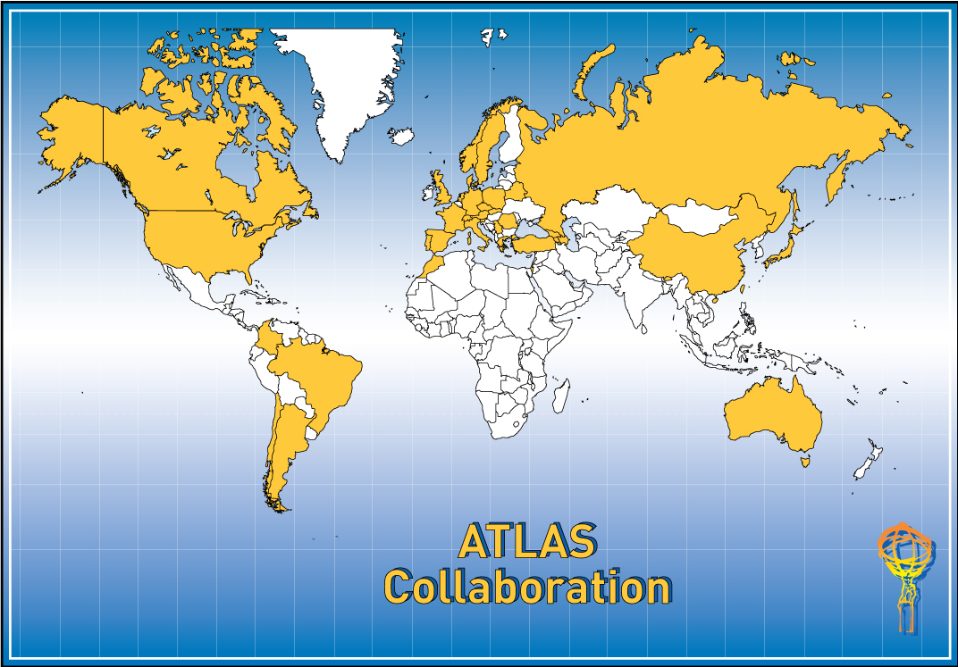
The scale: The Sun never sets …..
~2800 physicists (800 PhD students) from 169 Institutions/Universities,
37 countries, 5 continents

Slide 9
How do we detect events?
Vertex detector
electron
charged
hadron
Tracking
gamma
neutron
EM calorimeter
muon
neutrino
Hadron calorimeter

Slide 10
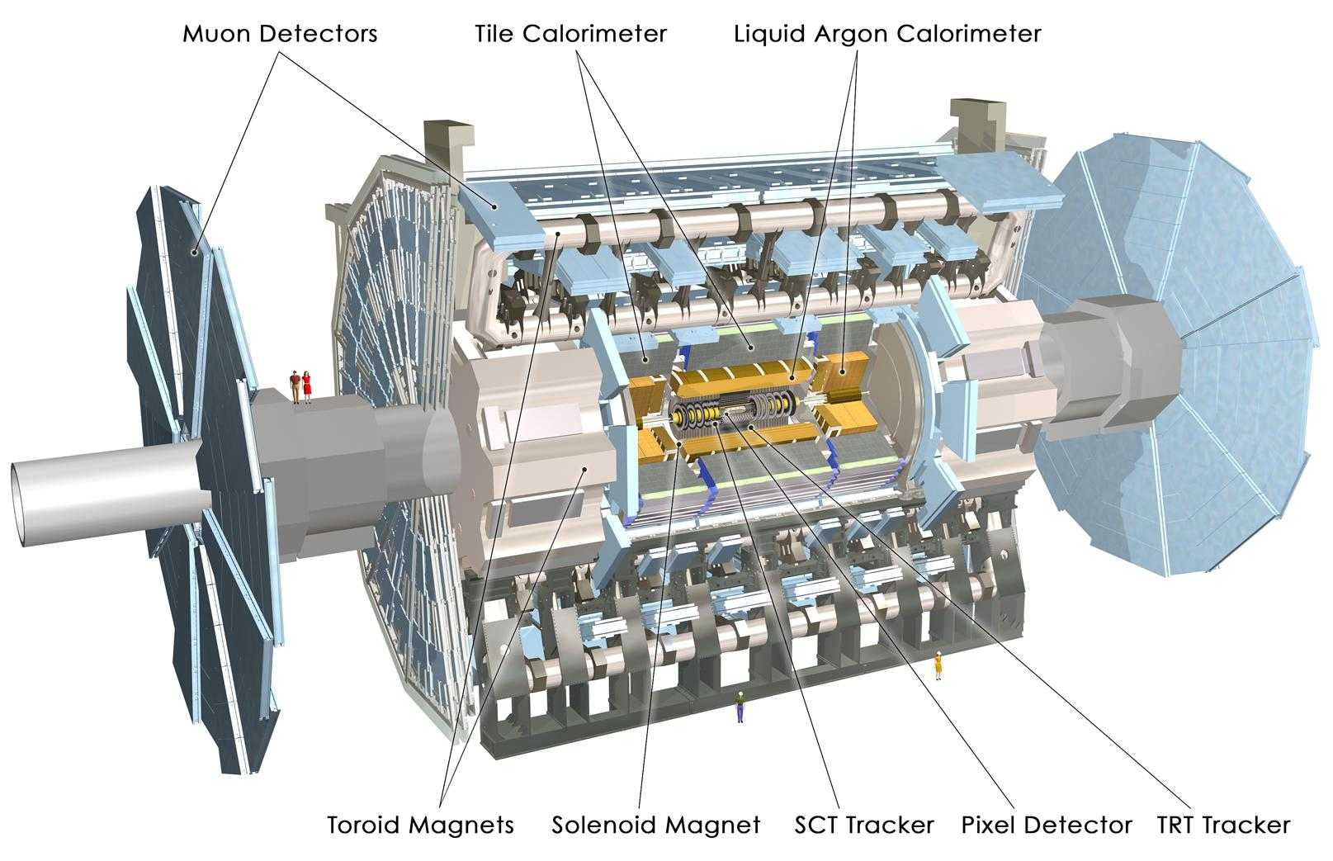
ATLAS detector

Slide 11
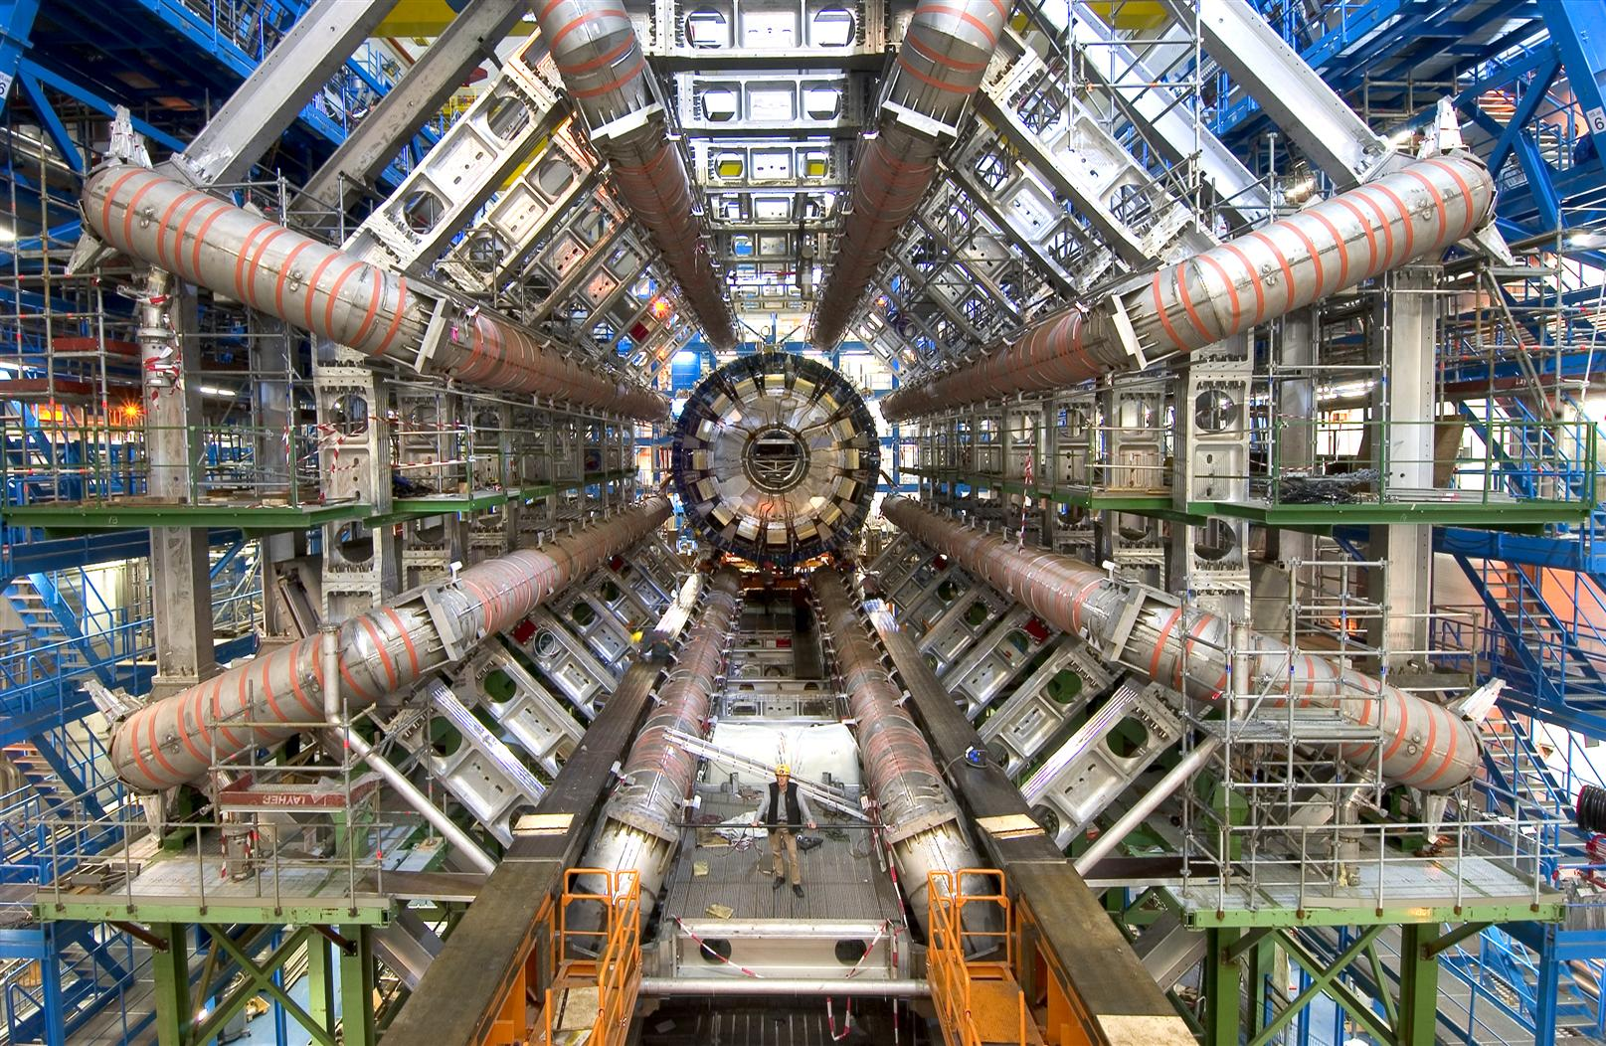
ATLAS detector toroid

Slide 12
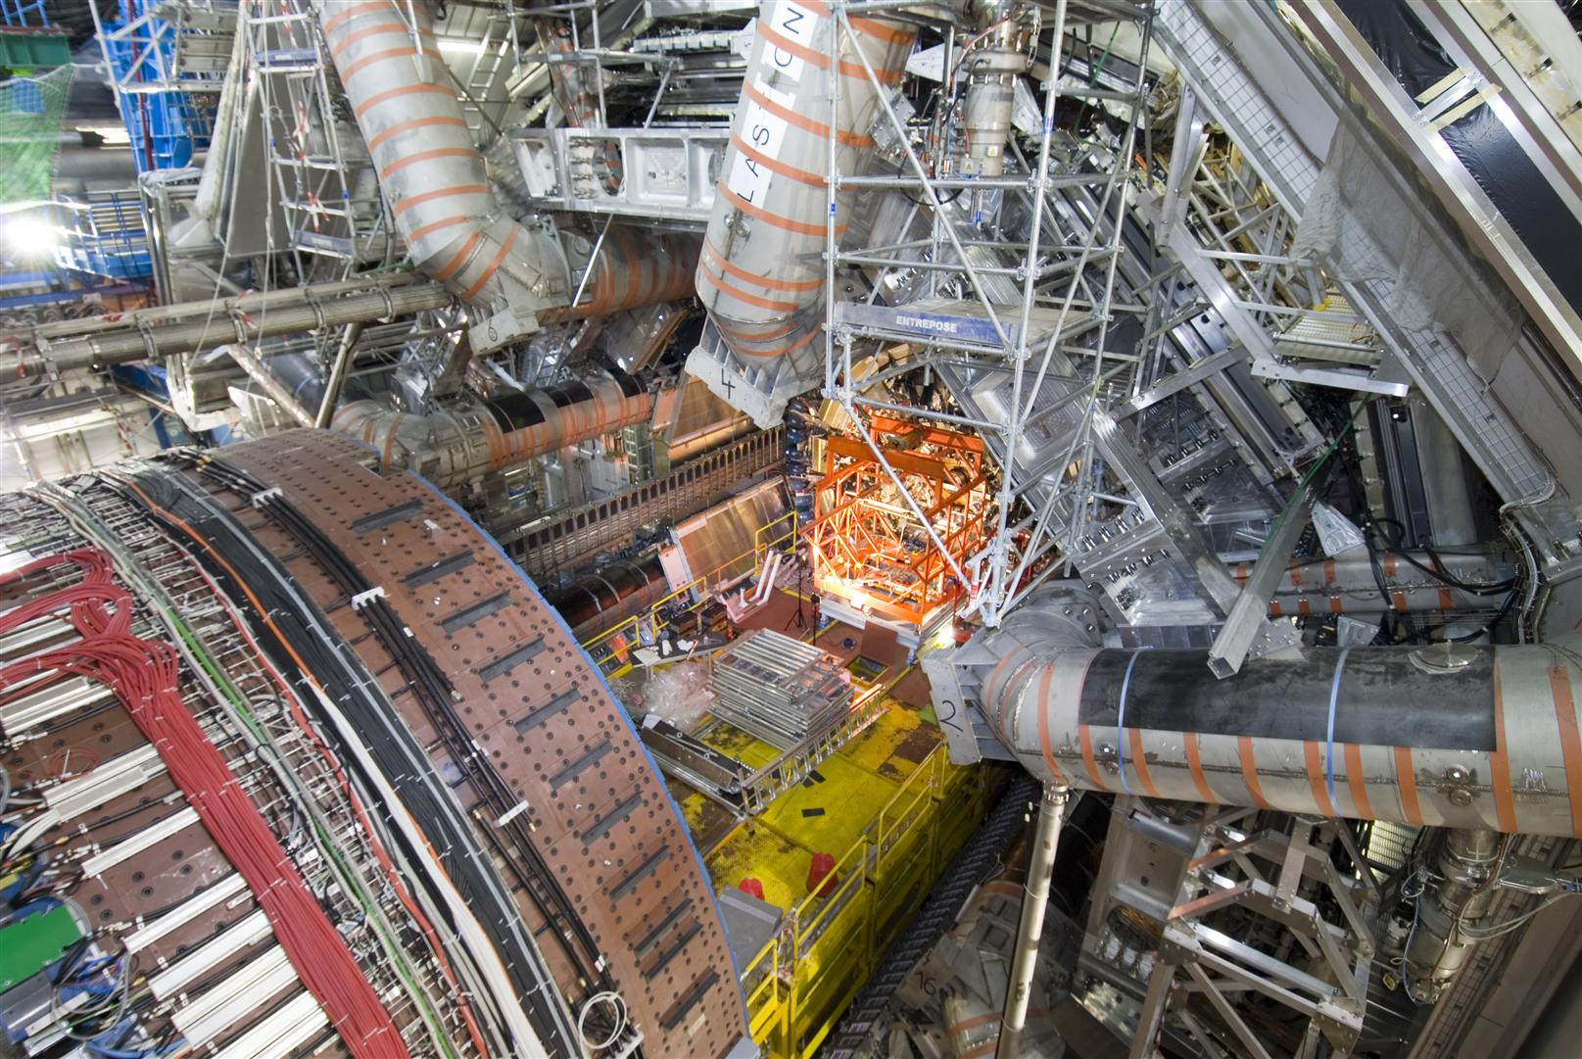
ATLAS assembly

Slide 13
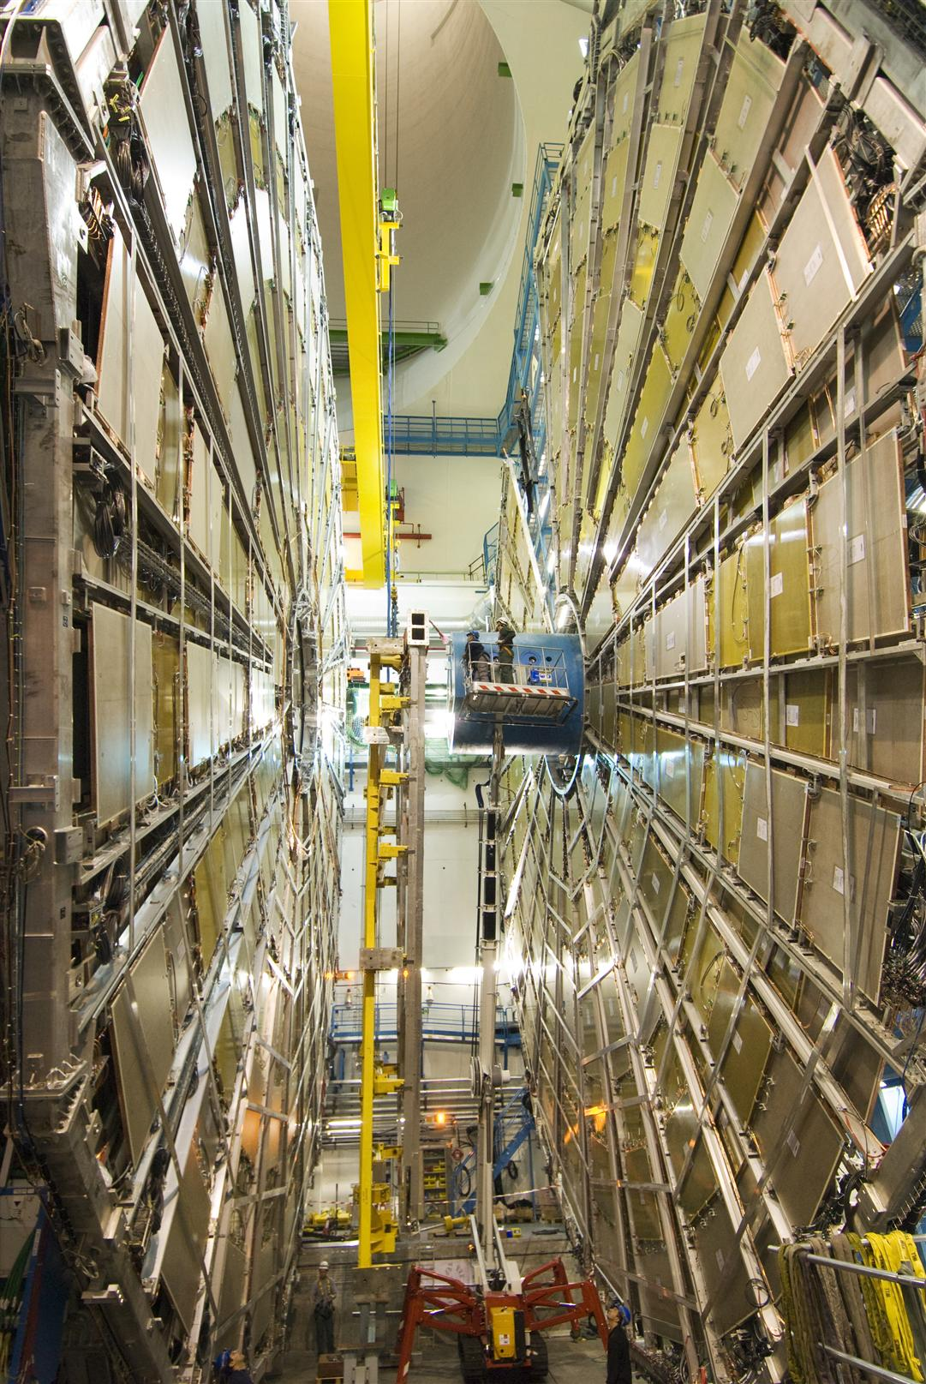
ALTLAS muon detectors

Slide 14
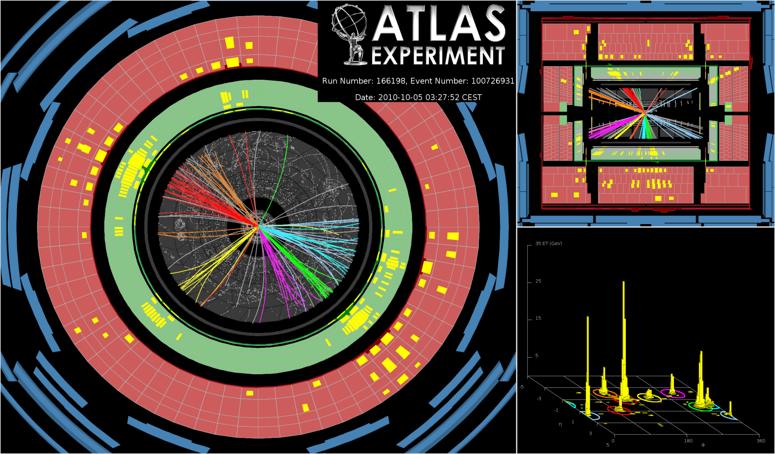
A real event

Slide 15
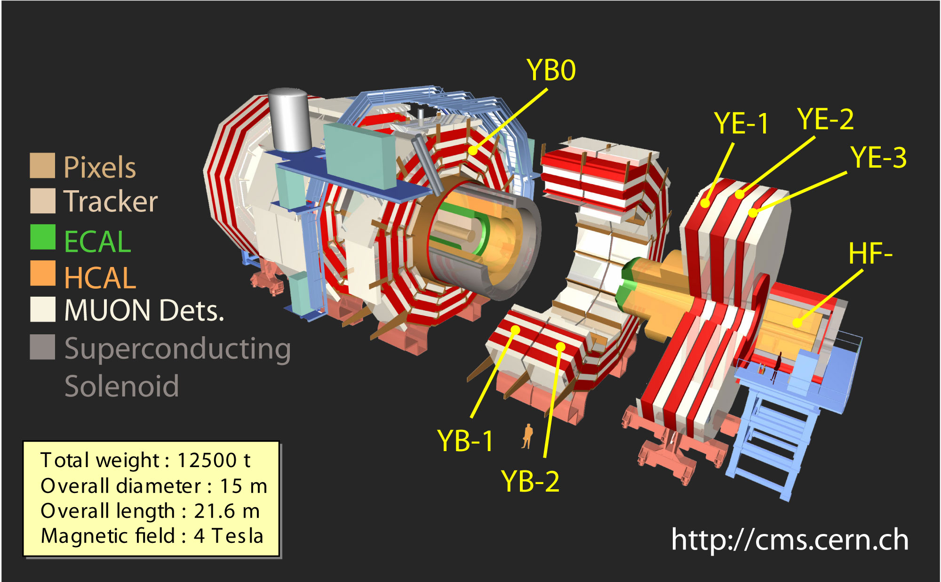
The CMS Detector
>2500 scientists/engineers from 38 countries

Slide 16
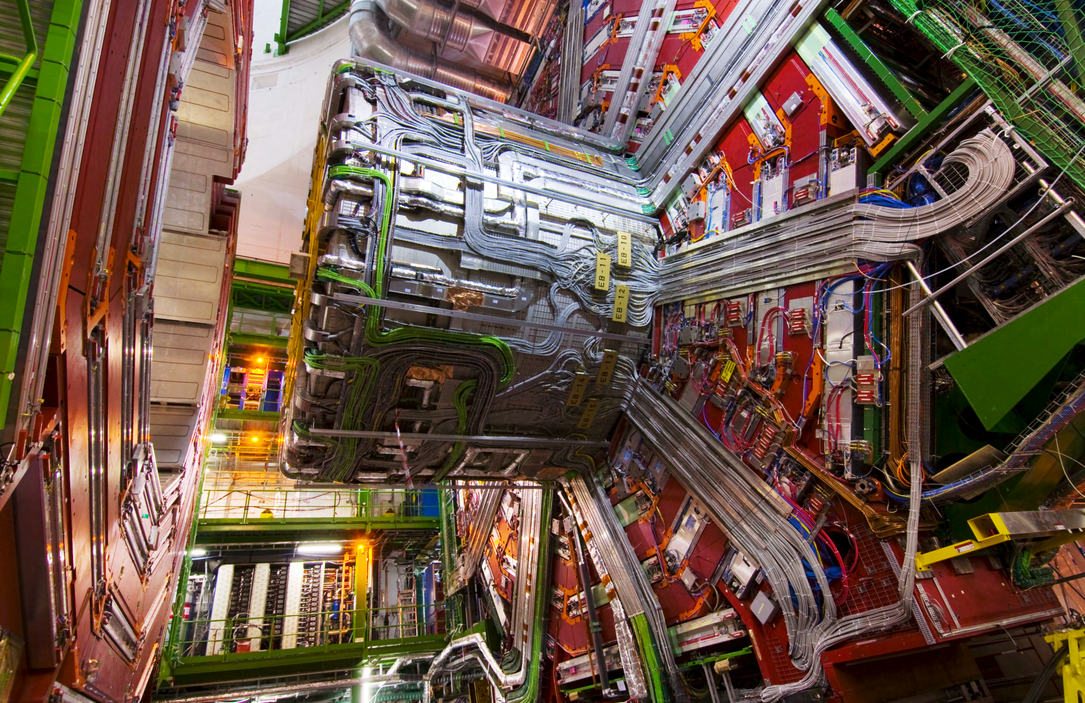
The CMS Detector
YB0 Services: Nov’07

Slide 17
Stages: Initiation and selection
Groups from previous experiments usually nucleate new collaborations aiming at a future accelerator
These proto-collaborations develop physics aims and concept detectors
When the accelerator is approved for construction, the host laboratory through its advisory committees down-selects the actual detectors to be built
Collaborations typically re-configure at this point and accept groups from the “losing” detector proposals

Slide 18
Stages: Design and construction
The collaboration organizes to develop a coherent design, define the components and interfaces, and distribute responsibilities: hardware and software
The collaboration develops a work breakdown structure to 10 levels, cost and schedule
Work packages themselves are tackled by collaborations of several institutes
The roles of individual institutions are defined through successive approximation with input from the funding agencies in the various countries
Many reviews along the way: host laboratory, individual institutions and funding agencies

Slide 19
Stages: Commissioning and operations
There is strong continuity between the groups that build a system and the commissioning and operation of individual systems
Usually cosmic ray runs precede the actual data taking to bring detectors into operation
Accelerators improve the “luminosity” (number of interactions per crossing) as a function of time. “Trigger” studies are critical to insure proper selection
Running 24 hrs/day: six to ten individuals per shifts to monitor the data taking, experts on call. Remote shifts are possible

Slide 20
Stages: Computing and analysis
Real time triggering (selection) system
200x10⁶ collisions/sec
On-line system (monitoring and QA)
1000 collisions/sec
“Tier 0” off-line reconstruction and analysis system

Slide 21
Stages: computing and analysis

Slide 22
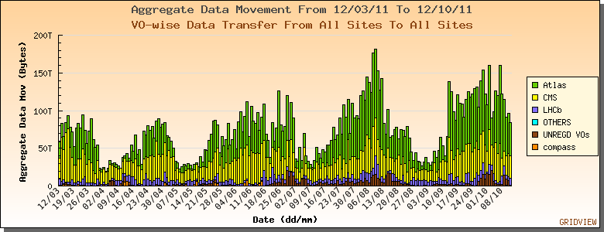
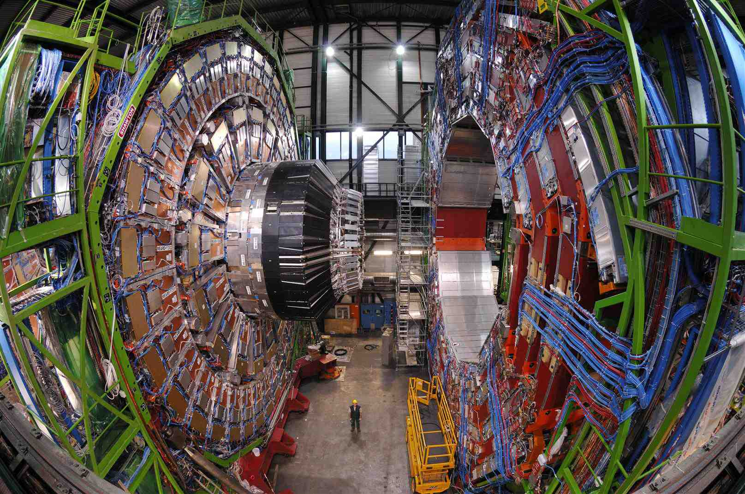
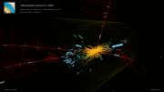
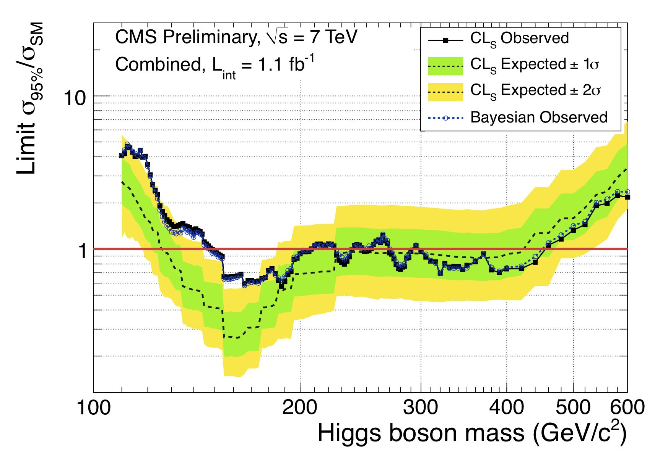
Computing and analysis: CMS GRID Sites
3000 CMS Collaborators
Tier 0 at CERN in Geneva
7 Tier-1 and 53 Tier 2 sites
60 Tier 3 sites for analysis

Slide 23
Computing and analysis: Software
More than 2 Million Lines of Code in the software for the CMS experiment at the LHC.
Most people developing software consider themselves to be scientists not “software developers”
Experienced software professionals (PhD level)many manage the effort
Continually support both development and production applications
Validation and testing very important
Operations team distributes tested releases to sites
Lines of Code vs time

Slide 24
Computing and analysis: resources
Global resources
Some 100,000 CPU Cores
40,000 Terabytes of disk storage
65,000 Terabytes of tape storage
Possible to run 70,000 jobs simultaneously across 60 GRID sites
Managed through the experiment, GRID organization(s) and local institutes
National and international networks are essential for success and to move data around

Slide 25
Computing and analysis: Physics
Analysis of the data is organized by physics topics: measurements and searches for new phenomena
For instance, the search for the Higgs: organized along multiple subtopics according to the different decay modes of the Higgs (depend on the Higgs mass)
In the largest collaborations there will be parallel analysis: redundancy provides cross-checks and is essential before announcing any new discovery
Internal reviews (editorial boards) before the collaboration publishes results – reviews can call for new independent analysis. Generally the author list has every scientist working in the collaboration

Slide 26
Governance and demographics
Detailed “Constitutions” describing all critical elements of the collaboration’s life:
Organization
Elections
Analysis/review of results
Membership and authorship
Talks at conferences
DØ Governance Document

Slide 27
Governance and demographics

Slide 28
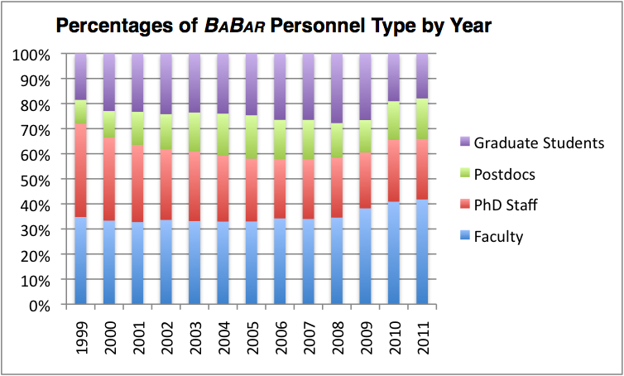
BaBar collaboration ( about 500 )

Slide 29
ATLAS collaboration (2700)
All 2690 (< 35 y 47.2%)
Male 81.8% (< 35 y 44.0%)
Female 18.2% (< 35 y 61.3%)
(Status 1.1.2010)

Slide 30
Governance and demographics
One very difficult issue is the association of credit for discoveries with individuals: this is necessary for academic careers. It has worked in the DZero and CDF detectors at the 500 collaborators level and is an experiment at the LHC with 3000 collaborators.
Rules for authorship are clearly established: require “service work” in addition to analyzing data. Generally everyone that has contributed to the result from hardware builders to algorithm developers lands on the author list
For an academic department, internal documentation and references within the collaboration must be weighed to establish contribution

Slide 31
Coordination among agencies
Individual detector collaborations have “international finance committees” that agree on funding, including operational costs (usually through a capitation charge)
There exists an international group, the “Funding Agencies for Large Colliders” (FALC), that brings together managers from the funding agencies and three directors, one each from Europe, Asia and the Americas. Most important for establishing relations among science managers in the different regions.
The US participation on the large LHC detectors, ATLAS and CMS, are overseen by a “Joint Oversight Group (JOG)” formed by the DOE and NSF

Slide 32
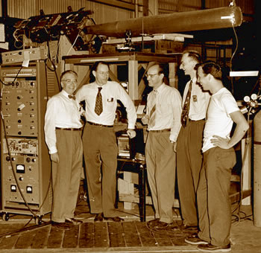
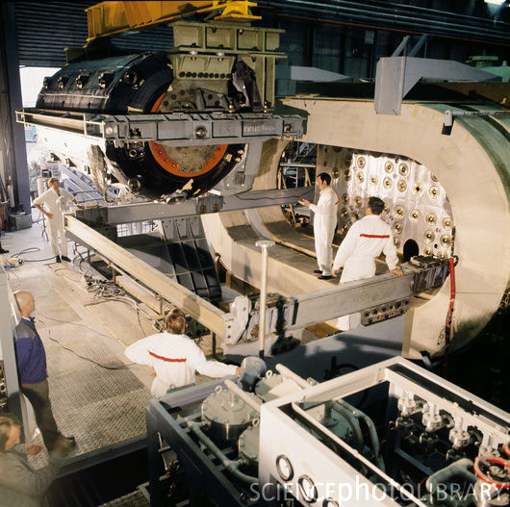
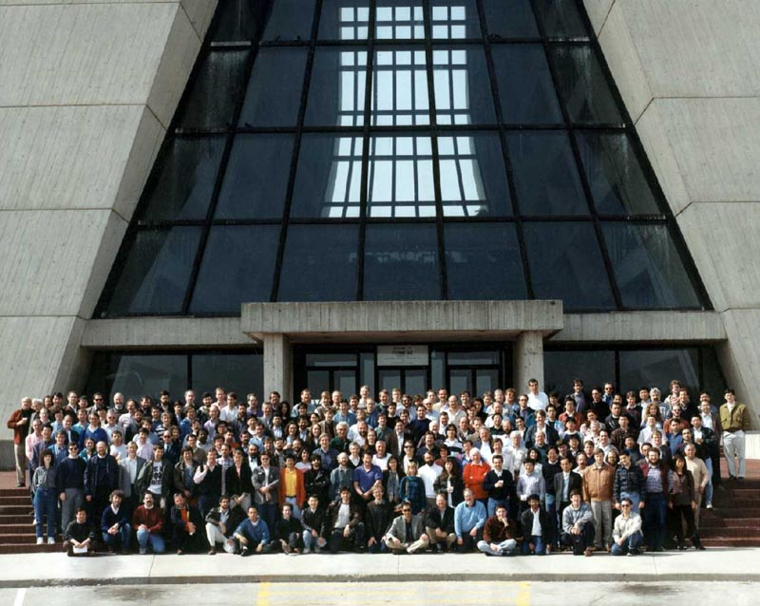
Improbable → real: Evolution
The field has had the time to evolve to scalable models of collaboration
Antiproton (Bevatron)
5 collaborators (1956)
Weak neutral currents (PS)
50 collaborators (1973)
Top quark (Fermilab)
500 collaborators (1995)
Higgs ? (LHC)
3000 collaborators 2012?

Slide 33
Improbable → real: Evolution
Collaboration | Start Year | Number of scientists | Countries
CDF (Tevatron) | 1979 | ~500 | ~ 15
DØ (Tevatron) | 1983 | ~500 | ~ 20
BaBar (B-factory) | 1993 | ~400 | ~ 12
Belle (B-factory) | 1993 | ~400 | ~ 15
LHCb (LHC) | 1998 | ~600 | ~ 12
ATLAS (LHC) | 1992 | ~3000 | ~ 40
CMS (LHC) | 1992 | ~3000 | ~ 40
Time between start of the collaboration and data taking
~6 years for B factories
~8 years for the Tevatron
~15 years for the LHC

Slide 34
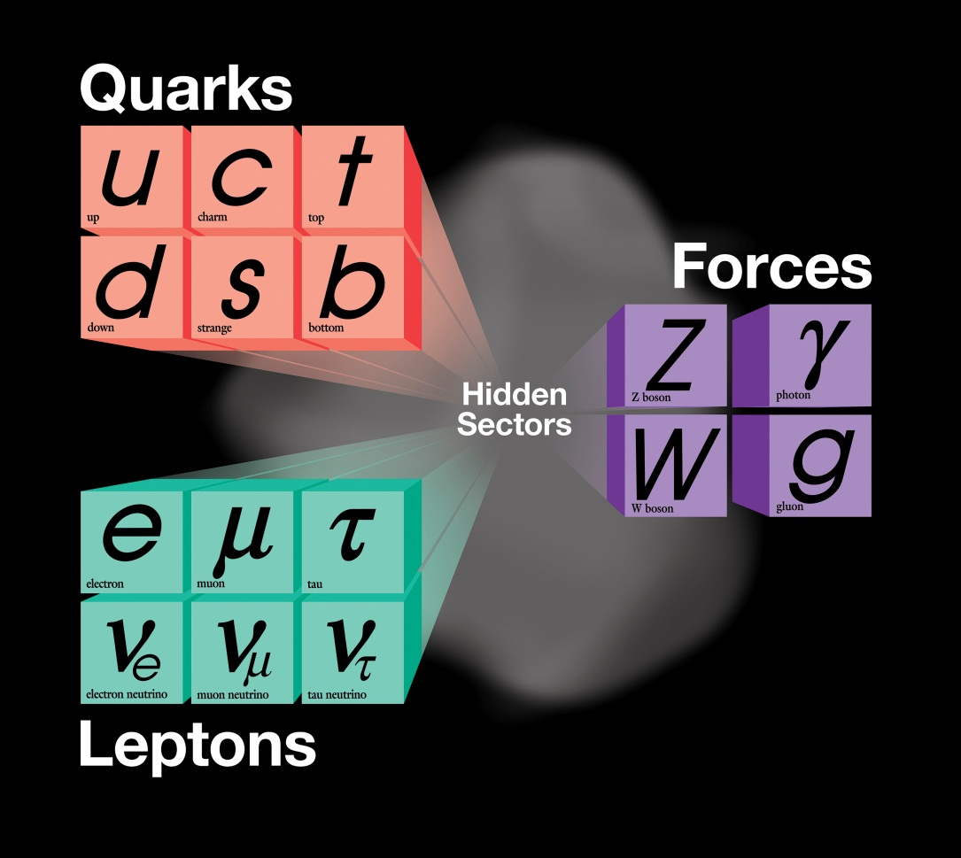
Improbable → real: The role of theory
The present theory is a remarkable intellectual construction
Every particle experiment ever done fits in the framework
But it is not complete; as our knowledge increased
So did the mysteries

Slide 35
Improbable → real: The role of theory
The theory sharply defines the important questions
Where does mass come from?
Are there extra dimensions of space?
Why only three families of quarks and lepton?
Why is matter dominant?
What are the neutrino masses and what do they say?
Where are the heavy neutrino partners?
Does nature use supersymmetry?
Do the forces unify?
What is dark matter?
What is dark energy?

Slide 36
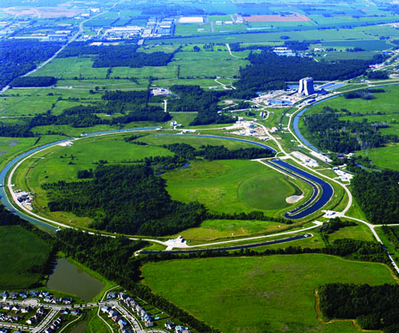
Improbable→ real: Role of the host lab
Oversight of detector projects
Physical space, Utilities, infrastructure
Safety and engineering standards
Integration
Tier 0 Computing

Slide 37
Improbable→ real: no hang-ups on IP
While the R&D on detector components generates IP, this is relatively easy to handle. Generally done by one institution or a consortium that is providing the component.
The output of the science itself: understanding the current deep mysteries (dark energy, dark matter, generation of mass, neutrinos…..) are not perceived to lead to any short term economic impacts. Therefore we do not have to negotiate complicated IP issues when putting the collaboration together.

Slide 38
Any lessons for large biology projects?
I describe observations and questions that arose while preparing this talk. I hope they will stimulate discussion

Slide 39
Physics:
1) Strong focus on single place where the collisions occur and data is generated
Biology:
1) Usually a more distributed infrastructure with many equivalent centers
→ A strong convergence at some stage of the project such as amalgamation of data can provide a strong focus

Slide 40
Physics:
2) The Standard Model of particle physics provides a predictive framework and defines the missing pieces
Biology:
2) Theoretical framework is fragmentary, incomplete and not generally predictive
→ Clear goal and a roadmap to achieve it with necessary experiments and subsequent analysis could substitute

Slide 41
Physics:
3) The science itself requires projects of scale; US particle physics budget < 1/30 of the NIH budget so it is not the scale of the overall funding
Biology:
3) Much important science can be done on different subjects, organisms, chemical pathways and largely independently
→ Some projects with far reaching goals may require collaboration among many institutions similar to particle physics projects

Slide 42
Physics:
5) Large projects and time scales accepted by funding agencies. Agency collaboration is the accepted mode
Biology:
5) A smaller fraction are projects of scale: Human Genome Project (international); the Cancer Genome Atlas (NIH) and its subprojects
→ The mode seems to me to be somewhat different: from my limited perspective physics projects have more self governance

Slide 43
Physics:
6) Coordination among funding agencies that support a project: committee of international funding agencies; FALC* group
Biology:
6) I am aware of few examples supported by coordinated action among international funding agencies.
→ NIH represents a large fraction of world’s biomedical research: it can fund large projects singly, at least for now
*FALC = Funding Agencies for Large Colliders

Slide 44
Physics:
7) The output of the science itself does not generate a short term impact on the economy. IP is generated mostly in the development of hardware
Biology:
7) Large projects are aimed at practical and applicable discoveries generating valuable intellectual property
→ More complex negotiations in the disposition of IP generated by the project for all collaborators

Slide 45
Physics:
8) Large concentration of technical resources* at major centers helps integration of the detectors.
Biology:
8) Capabilities are more widely distributed
→ As more projects of scale take place, infrastructure resources will tend to be concentrated more sharply
Fraction of national programs: CERN in Europe (3/4), FNAL in US (1/2), KEK in Japan (2/3)

Slide 46
Physics:
9) Governance includes “term limits” for leadership positions. Leadership elected by the collaboration. We have lost the individual “hero”
Biology:
9) Many strong personalities associated with long term leadership in the field;
→ The need to bring multiple centers and agencies together in large projects will drive the system to shared leadership

Slide 47
Physics:
10) Particle physics has had time to evolve these models, at least five decades, try them and modify them
Biology:
10) The rate of change of what is possible is enormous (sequencing is an example) requiring very rapid scale-up in the size of projects
→ I hope you find the description of particle physics projects and these remarks useful

Slide 48
Questions and discussion

